Slide 1
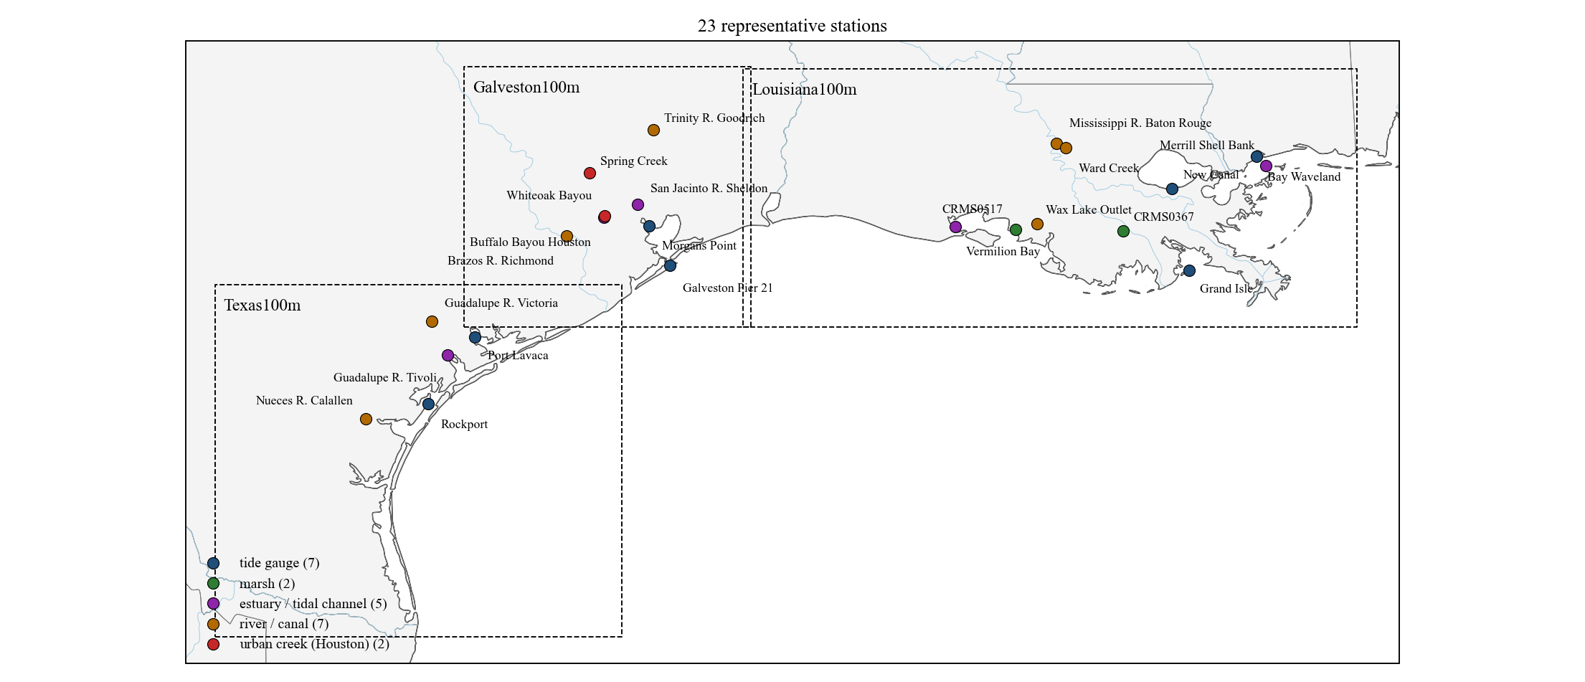
Representative stations: 6 h water-level forecasts of the LSTM (v4: water level + wind + upstream discharge)
Test period 2024-01 to 2025-12. Forecasts issued every hour; the plots show the 1–6 h trajectory issued every 6 h.
Louisiana100m: 3 tide gauge, 2 marsh (CRMS), 2 estuary / tidal channel, 3 river.
Galveston100m: 2 tide gauge, 2 estuary / tidal channel, 2 river, 2 urban creek (Houston).
Texas100m: 2 tide gauge, 1 estuary / tidal channel, 2 river.
1

Slide 2
How to read the station slides
Each station slide has three 4-day windows from the test period:
hurricane — Francine (10–14 Sep 2024) for Louisiana100m, Beryl (7–11 Jul 2024) for Galveston100m and Texas100m;
high water — the 4 days around the highest observed level outside the hurricane;
normal — 4 days whose 6 h error equals the station's whole-year error.
Black: observation. Red: the v4 model's 1–6 h forecast issued every 6 h, drawn from the observation at the issue time.
Blue dashed: the water-level-only model (no wind, no discharge), same issue times.
The RMSE in each window title uses every hourly issue time in the window, not only the drawn ones.
Whole-year RMSE is the test-period RMSE of all hourly forecasts (2024-01 to 2025-12). All errors in cm.
Where no red line is drawn, the past 72 h of observations or wind were too incomplete to issue a forecast.
2

Slide 3
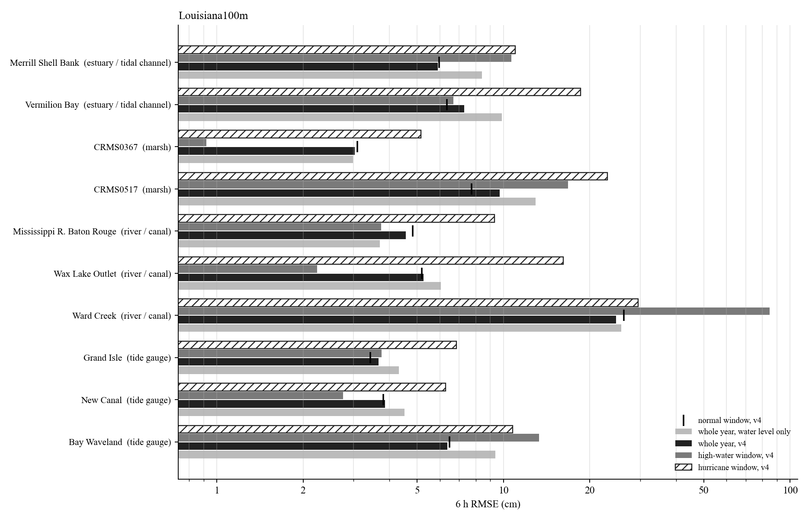
Louisiana100m: 6 h RMSE of the representative stations
Hurricane window: Francine (Sep 2024).
Whole-year 6 h RMSE from 3.0 cm (CRMS0367) to 24.7 cm (Ward Creek).
Tide gauges, marsh and estuaries: hurricane windows 2 to 3 times the whole-year error; the wind input reduces them most.
Rivers and creeks: the high-water or hurricane window is 5 to 10 times the whole-year error; errors sit in the first hours of each rise.
Log scale.
3

Slide 4
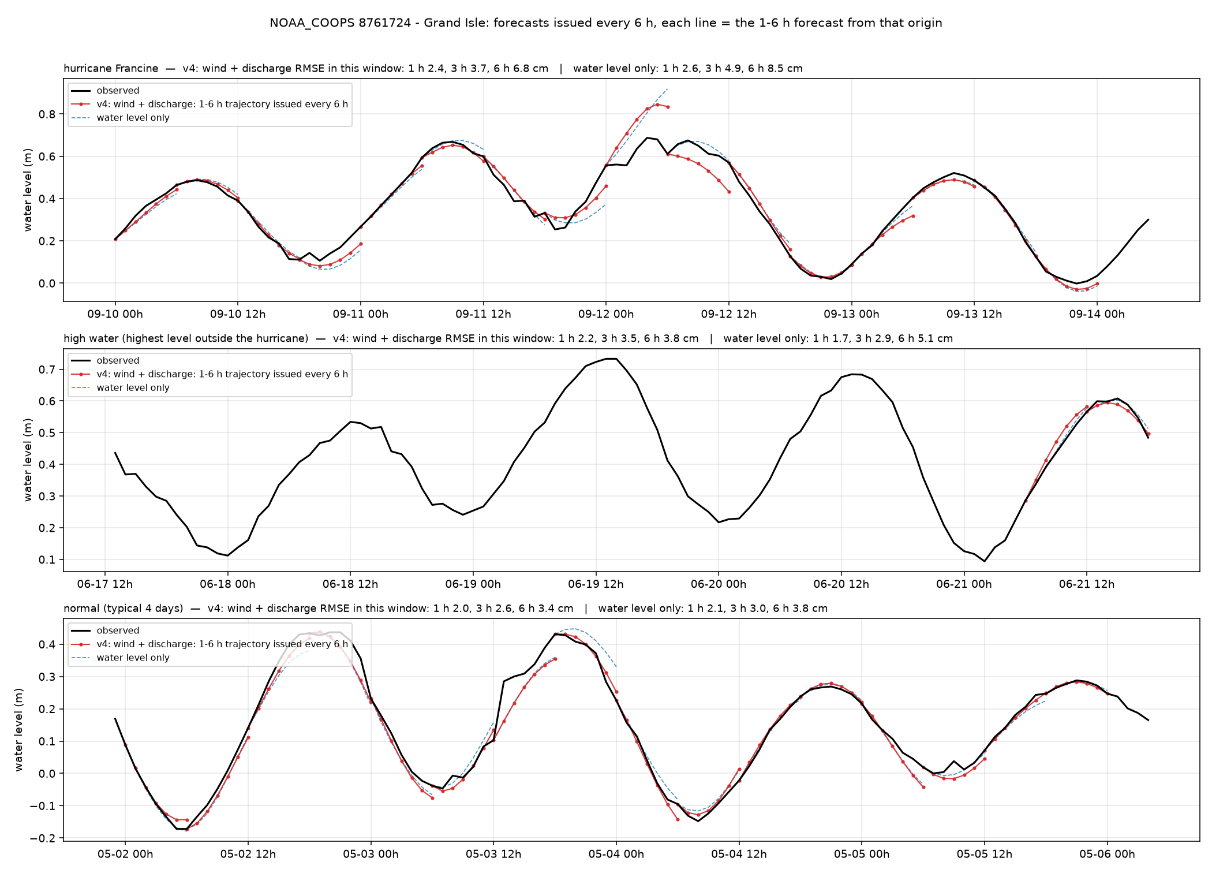
Grand Isle — Grand Isle (NOAA_COOPS 8761724)
Louisiana100m · tide gauge · 29.263°N 89.957°W
6 h RMSE, cm
whole year, v4
3.7
whole year, water level only
4.3
hurricane window (2024-09-10)
6.8
high-water window (2024-06-17)
3.8
normal window (2025-05-01)
3.4
1 / 3 / 6 h, whole year, v4
1.8 / 2.6 / 3.7 cm
Open coast. Tide dominates; both models within 4 cm except the Francine surge hours.
4

Slide 5
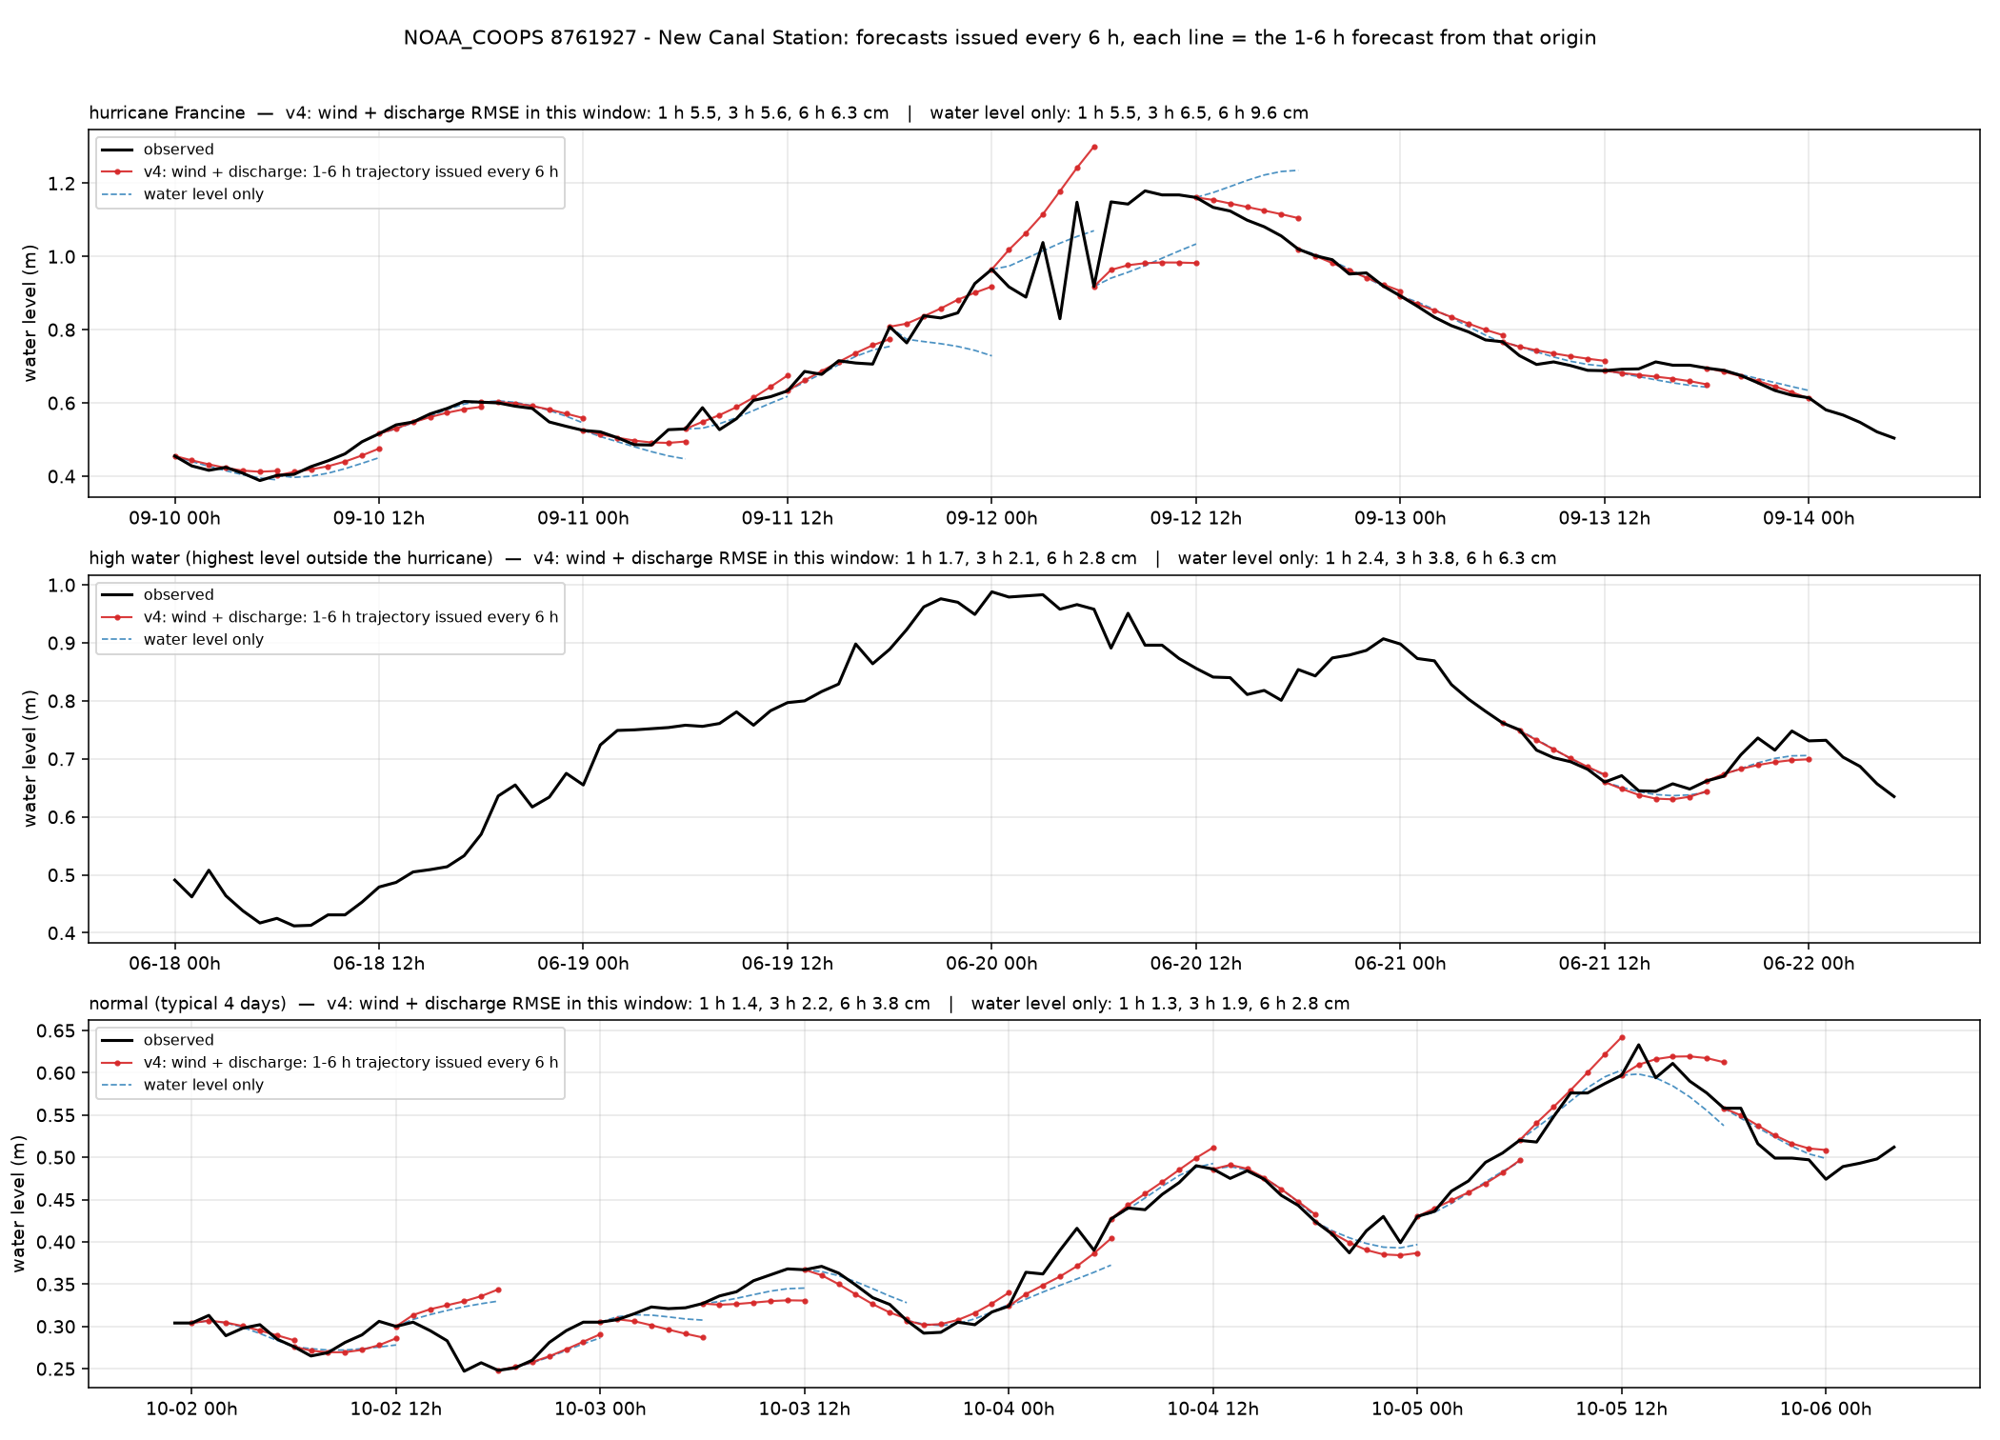
New Canal — New Canal Station (NOAA_COOPS 8761927)
Louisiana100m · tide gauge · 30.027°N 90.113°W
6 h RMSE, cm
whole year, v4
3.9
whole year, water level only
4.5
hurricane window (2024-09-10)
6.3
high-water window (2024-06-18)
2.8
normal window (2024-10-01)
3.8
1 / 3 / 6 h, whole year, v4
2.5 / 2.8 / 3.9 cm
Lake Pontchartrain. Wind set-up is the main signal; wind input halves the error on windy days.
5

Slide 6
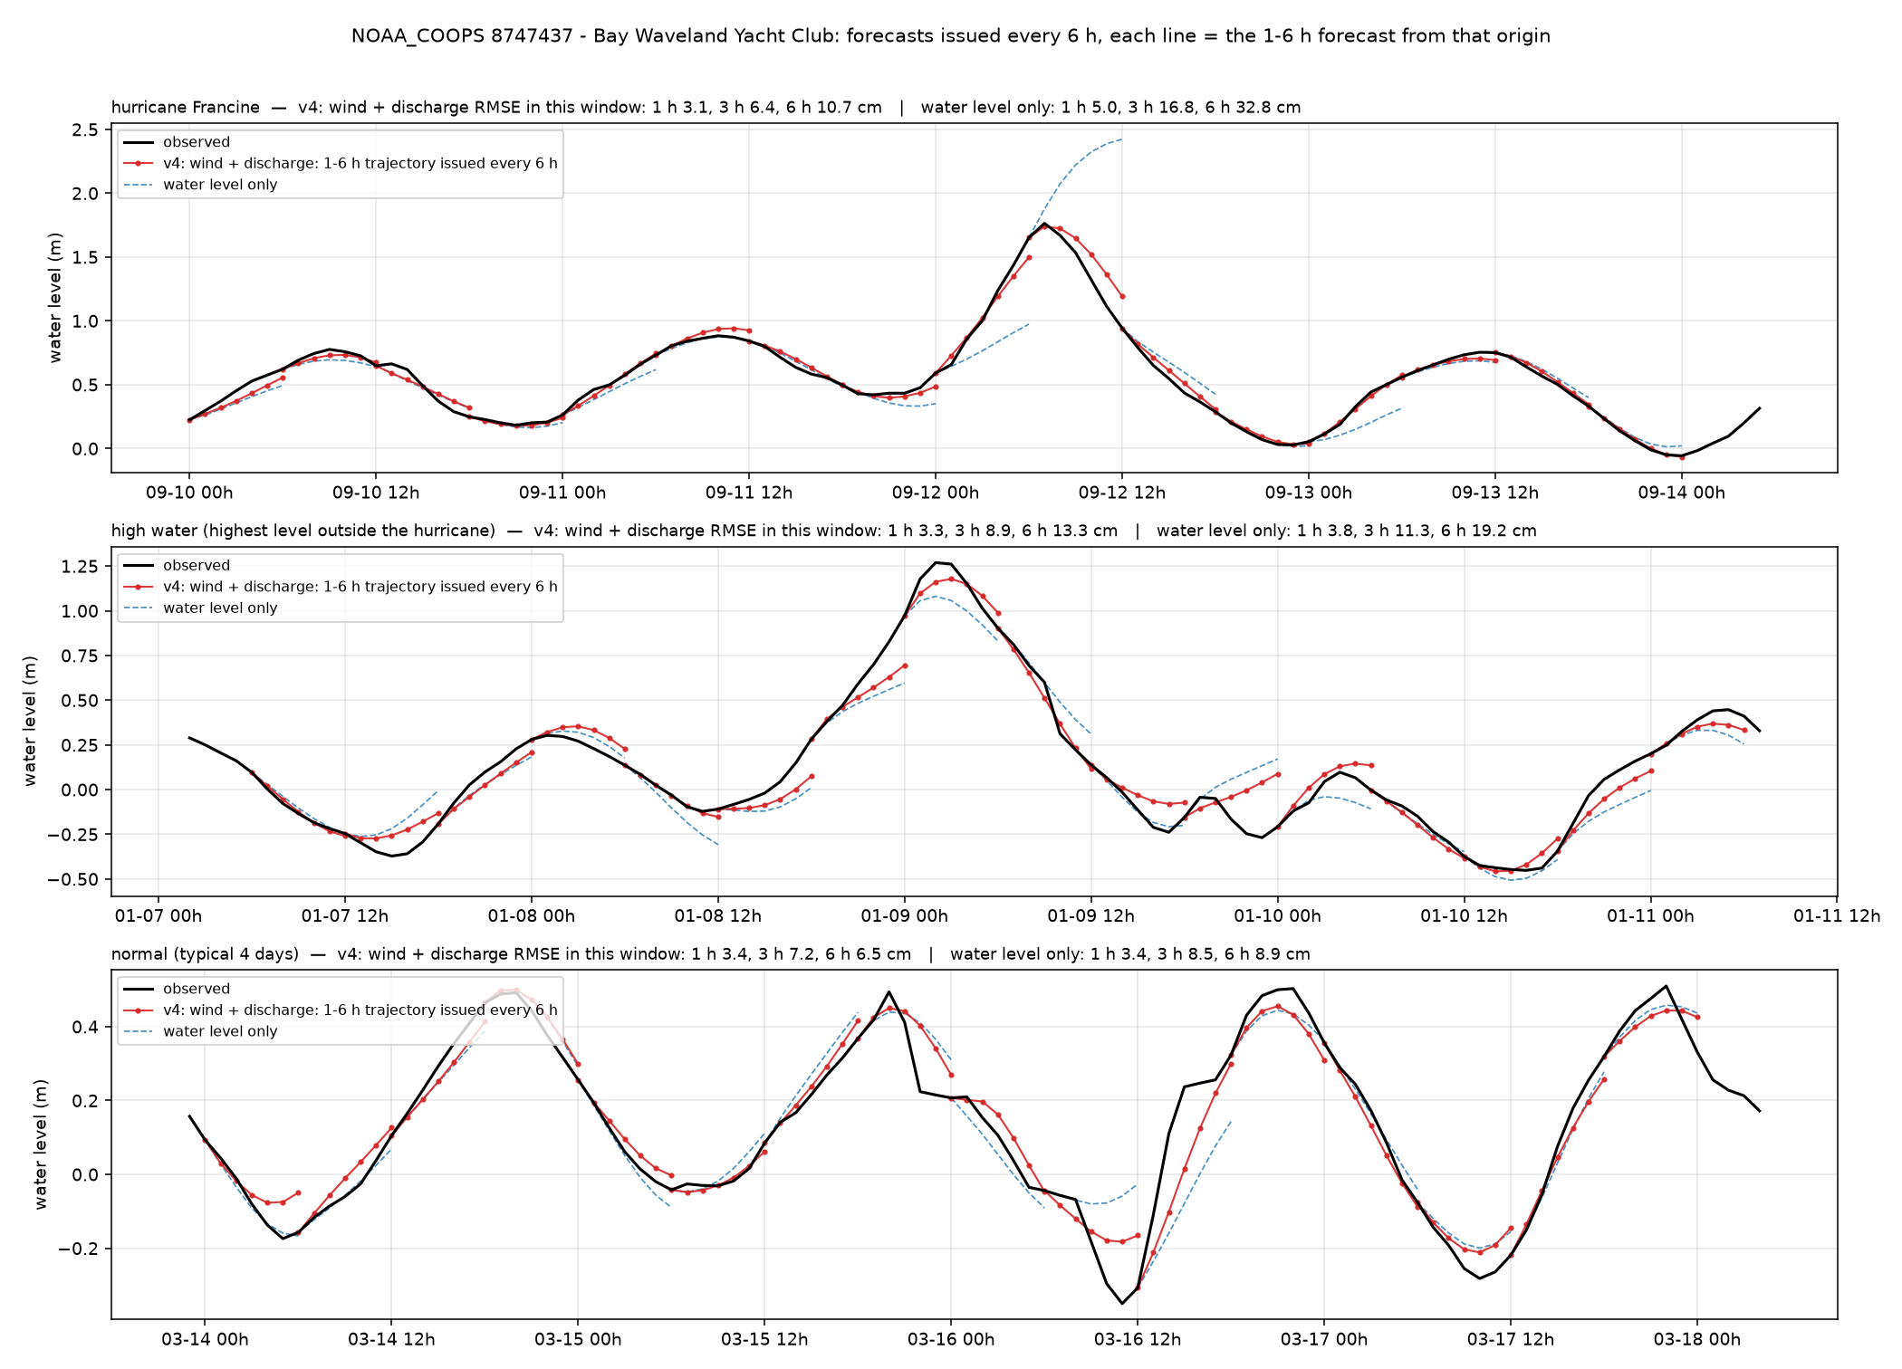
Bay Waveland — Bay Waveland Yacht Club (NOAA_COOPS 8747437)
Louisiana100m · tide gauge · 30.326°N 89.326°W
6 h RMSE, cm
whole year, v4
6.4
whole year, water level only
9.4
hurricane window (2024-09-10)
10.8
high-water window (2024-01-07)
13.3
normal window (2024-03-13)
6.5
1 / 3 / 6 h, whole year, v4
2.2 / 5.1 / 6.4 cm
Mississippi Sound. Francine surge of 1.75 m followed by the wind model; the water-level-only model overshoots to 2.4 m.
6

Slide 7
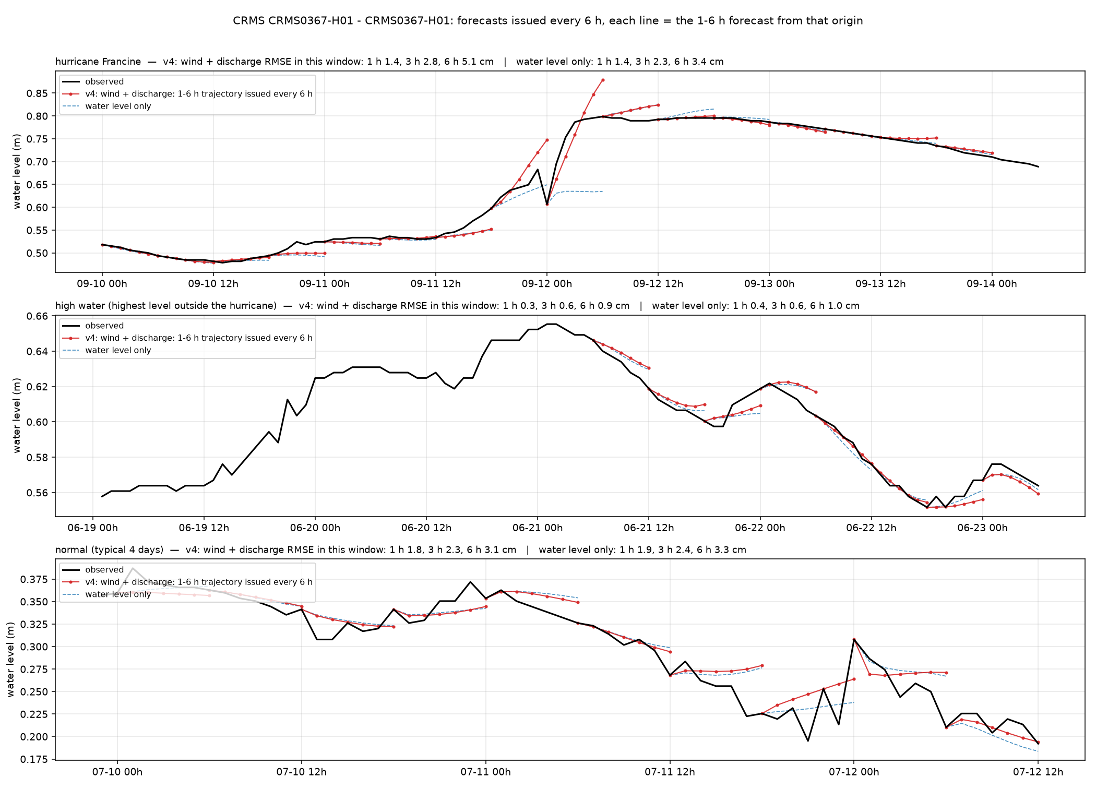
CRMS0367 — CRMS0367-H01 (Terrebonne) (CRMS CRMS0367-H01)
Louisiana100m · marsh (CRMS) · 29.631°N 90.572°W
6 h RMSE, cm
whole year, v4
3.0
whole year, water level only
3.0
hurricane window (2024-09-10)
5.2
high-water window (2024-06-19)
0.9
normal window (2024-07-09)
3.1
1 / 3 / 6 h, whole year, v4
1.3 / 2.3 / 3.0 cm
Terrebonne marsh, slow water. Errors under 1 cm in quiet weeks; Francine window 5 cm.
7

Slide 8
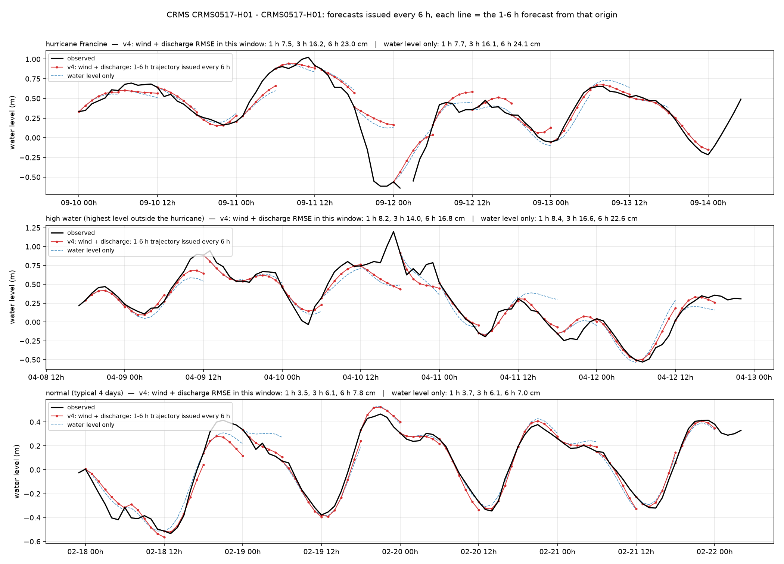
CRMS0517 — CRMS0517-H01 (Teche/Vermilion) (CRMS CRMS0517-H01)
Louisiana100m · marsh (CRMS) · 29.643°N 91.572°W
6 h RMSE, cm
whole year, v4
9.7
whole year, water level only
12.9
hurricane window (2024-09-10)
23.0
high-water window (2024-04-08)
16.8
normal window (2024-02-17)
7.8
1 / 3 / 6 h, whole year, v4
4.9 / 7.8 / 9.7 cm
Teche/Vermilion marsh. One of the largest wind gains among marsh stations (12.9 to 9.7 cm over the year).
8

Slide 9
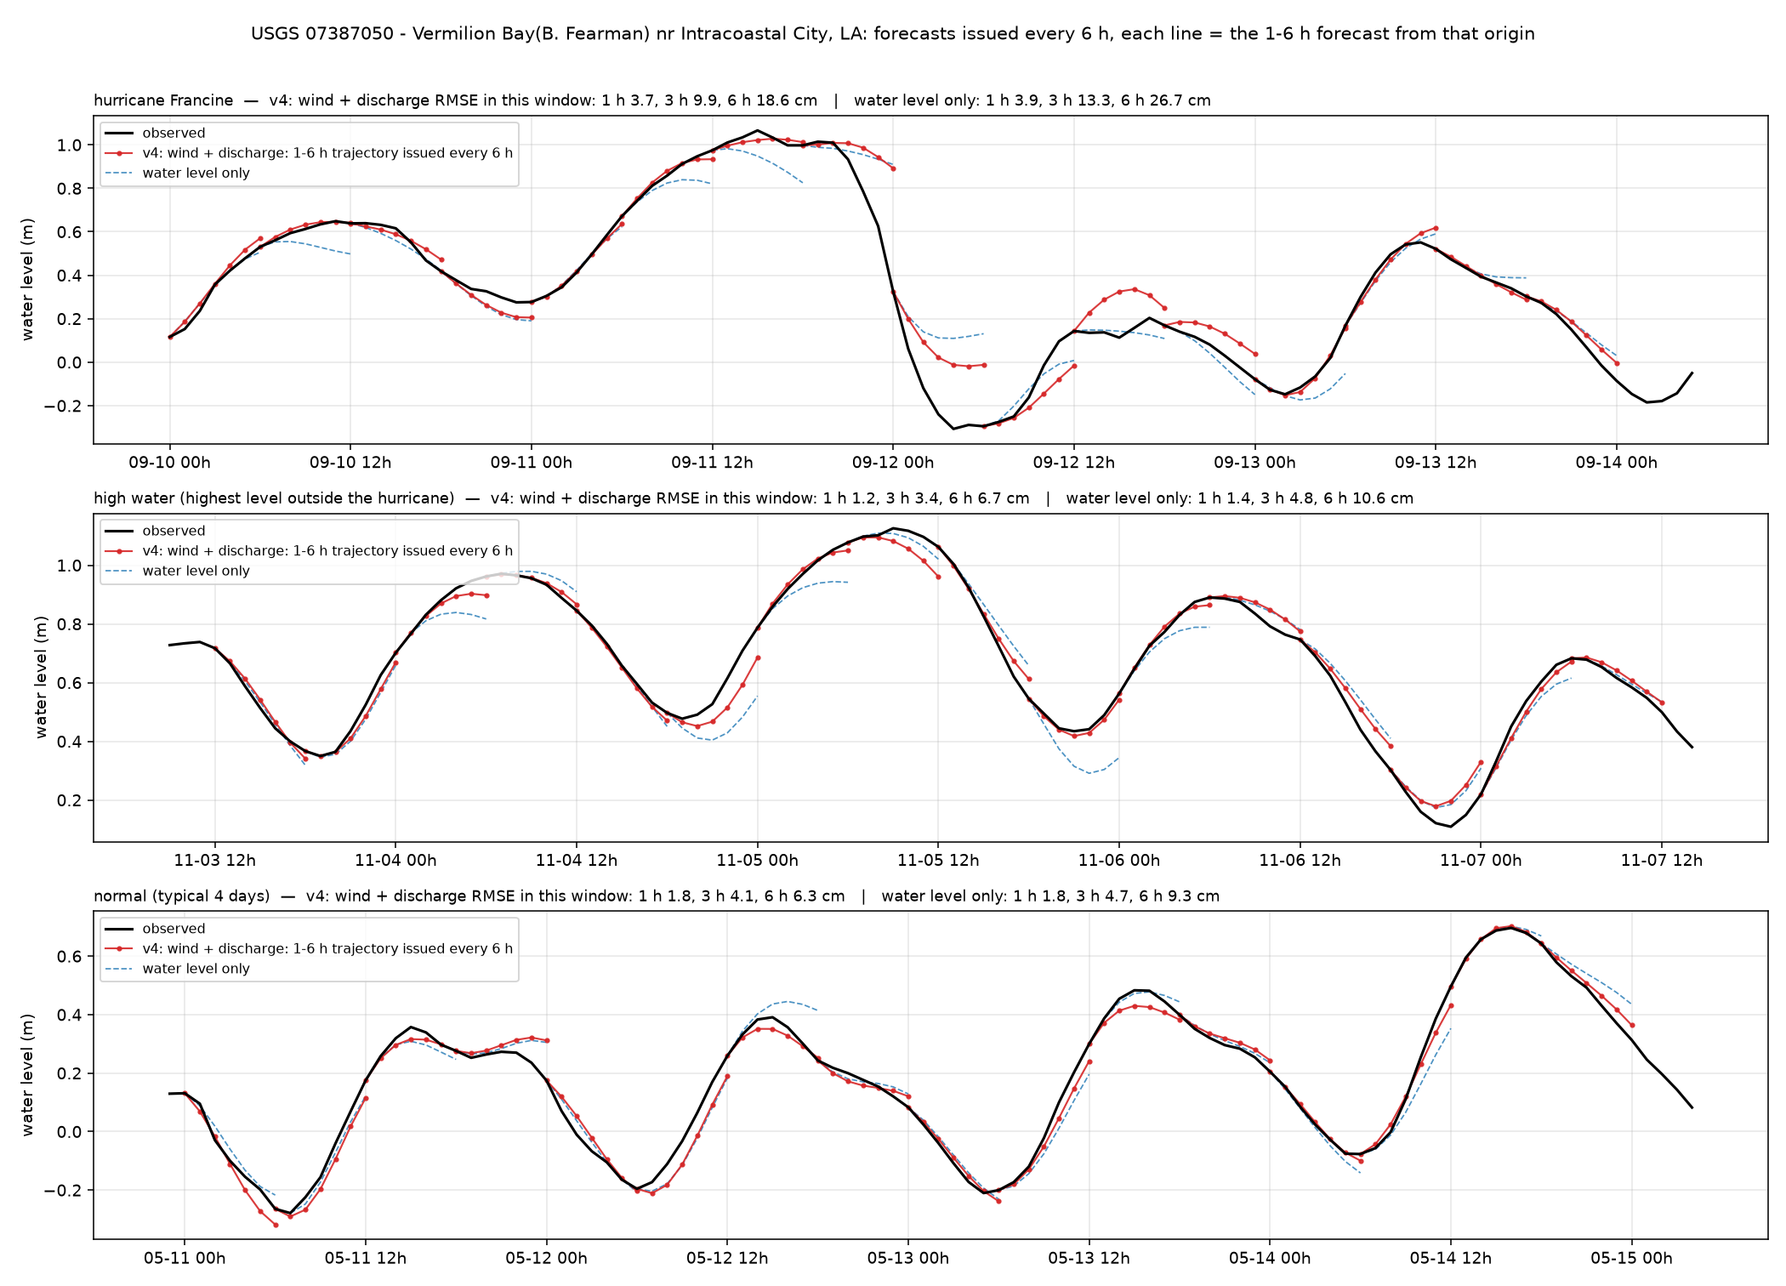
Vermilion Bay — Vermilion Bay(B. Fearman) nr Intracoastal City, LA (USGS 07387050)
Louisiana100m · estuary / tidal channel · 29.674°N 92.136°W
6 h RMSE, cm
whole year, v4
7.3
whole year, water level only
9.9
hurricane window (2024-09-10)
18.6
high-water window (2024-11-03)
6.7
normal window (2025-05-10)
6.3
1 / 3 / 6 h, whole year, v4
2.1 / 4.9 / 7.3 cm
Vermilion Bay. Shallow bay pushed by wind; hurricane window 18.6 cm, normal 6.4 cm.
9

Slide 10
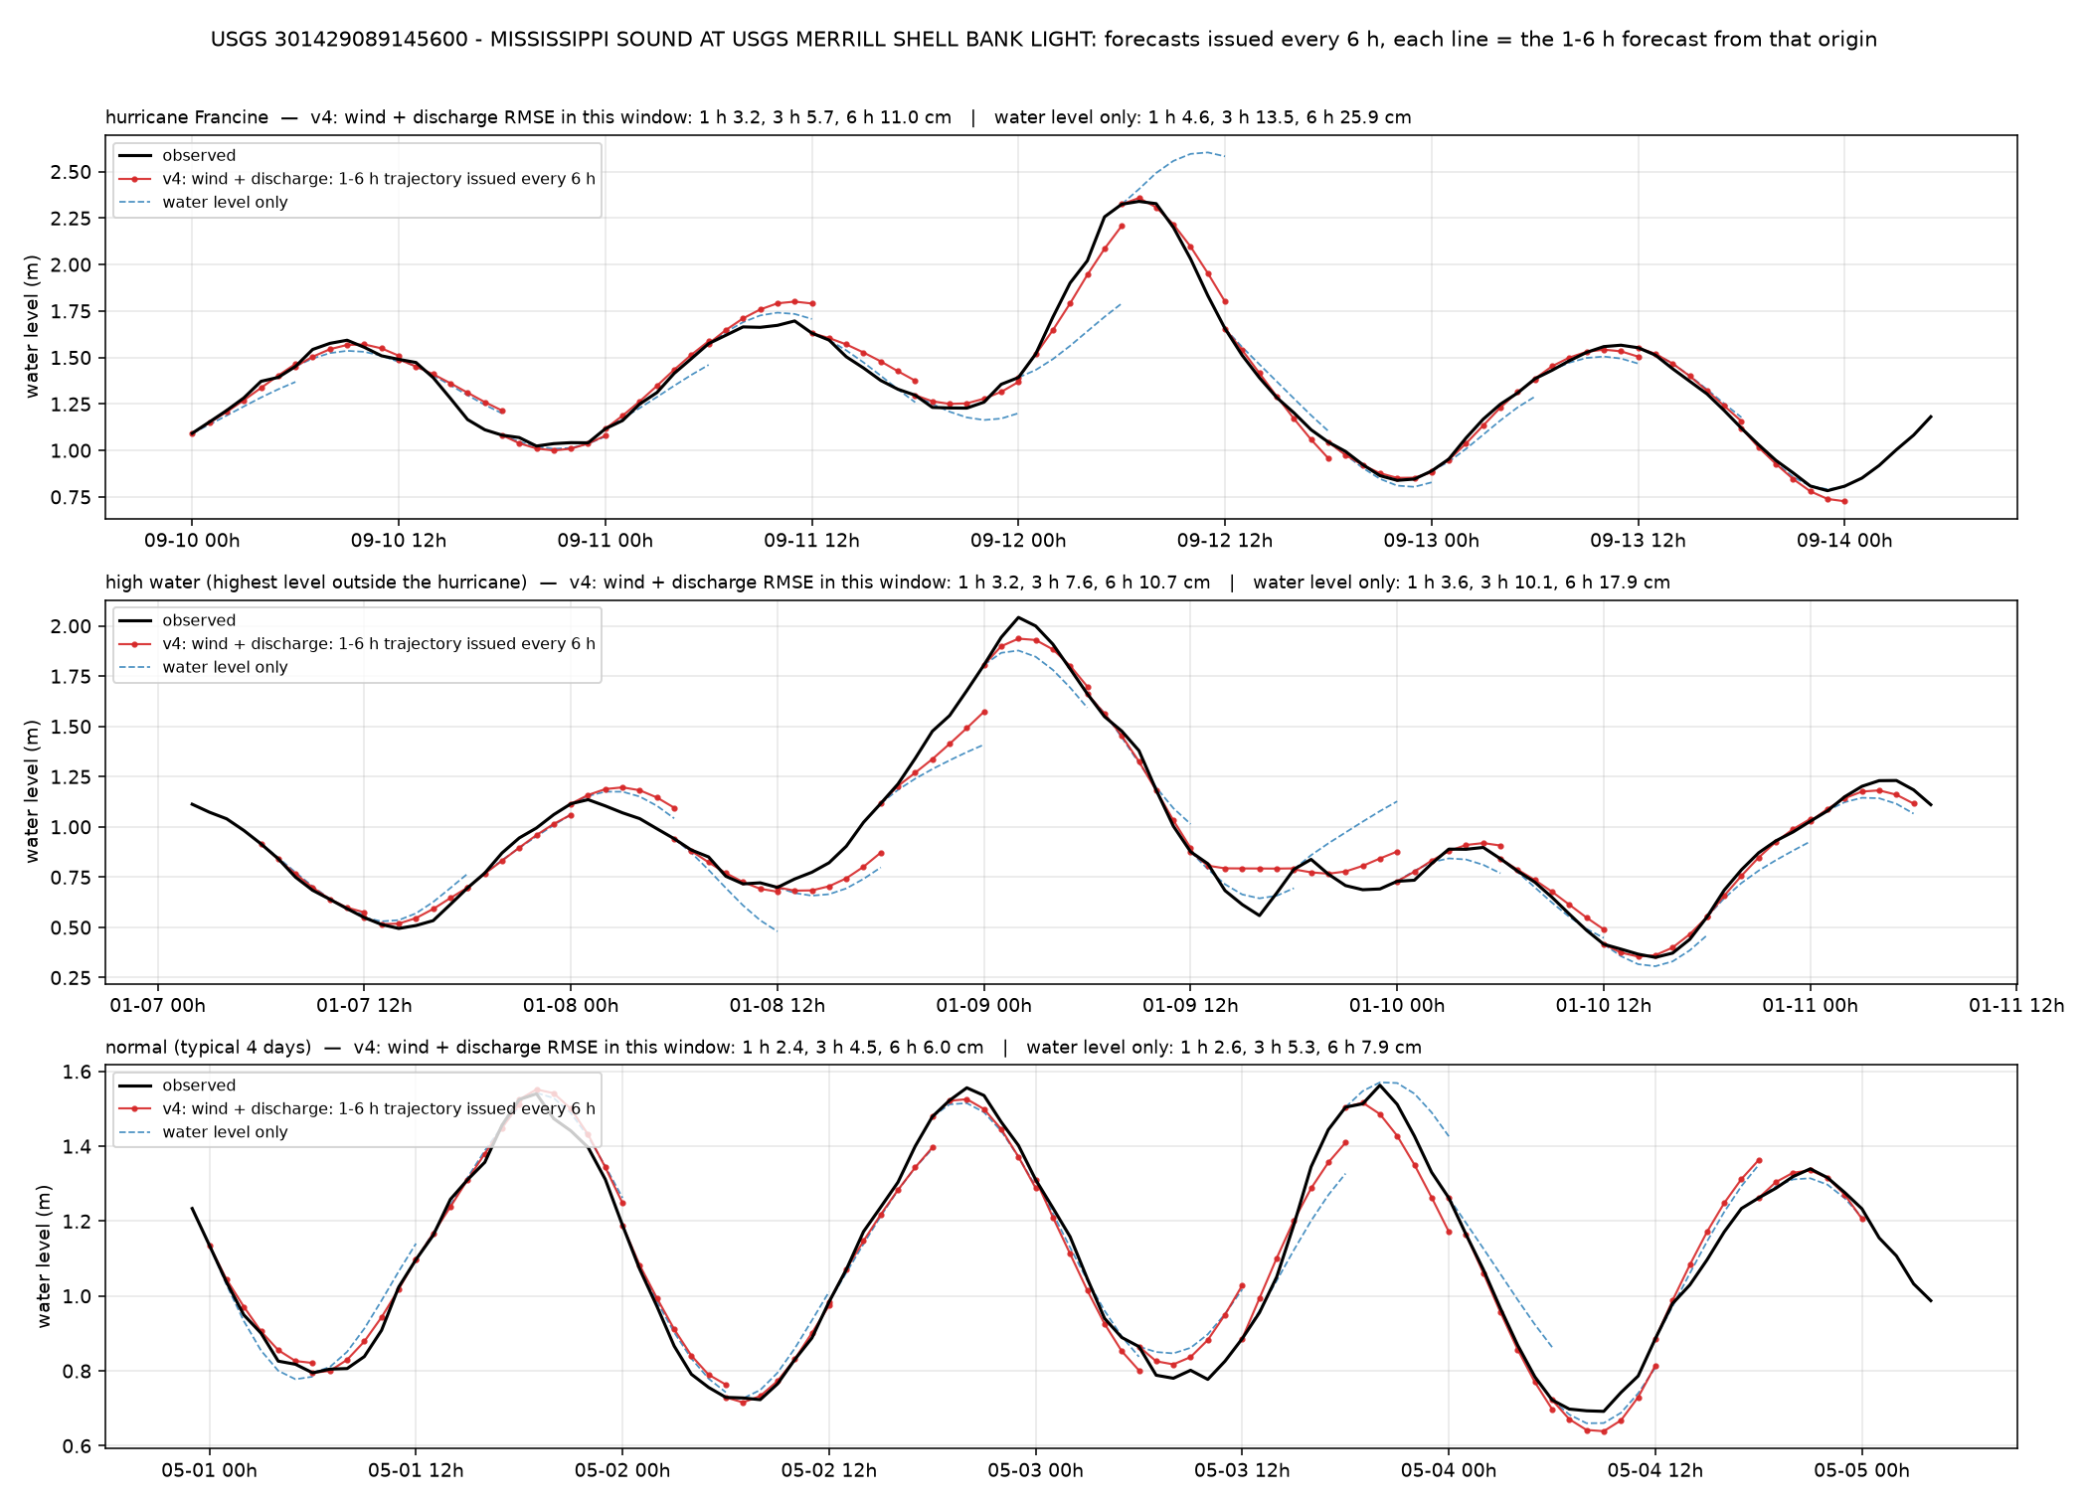
Merrill Shell Bank — MISSISSIPPI SOUND AT USGS MERRILL SHELL BANK LIGHT (USGS 301429089145600)
Louisiana100m · estuary / tidal channel · 30.238°N 89.243°W
6 h RMSE, cm
whole year, v4
5.9
whole year, water level only
8.4
hurricane window (2024-09-10)
11.0
high-water window (2024-01-07)
10.7
normal window (2025-04-30)
6.0
1 / 3 / 6 h, whole year, v4
2.1 / 4.3 / 5.9 cm
Mississippi Sound light. Storm set-up resolved by the wind model.
10

Slide 11
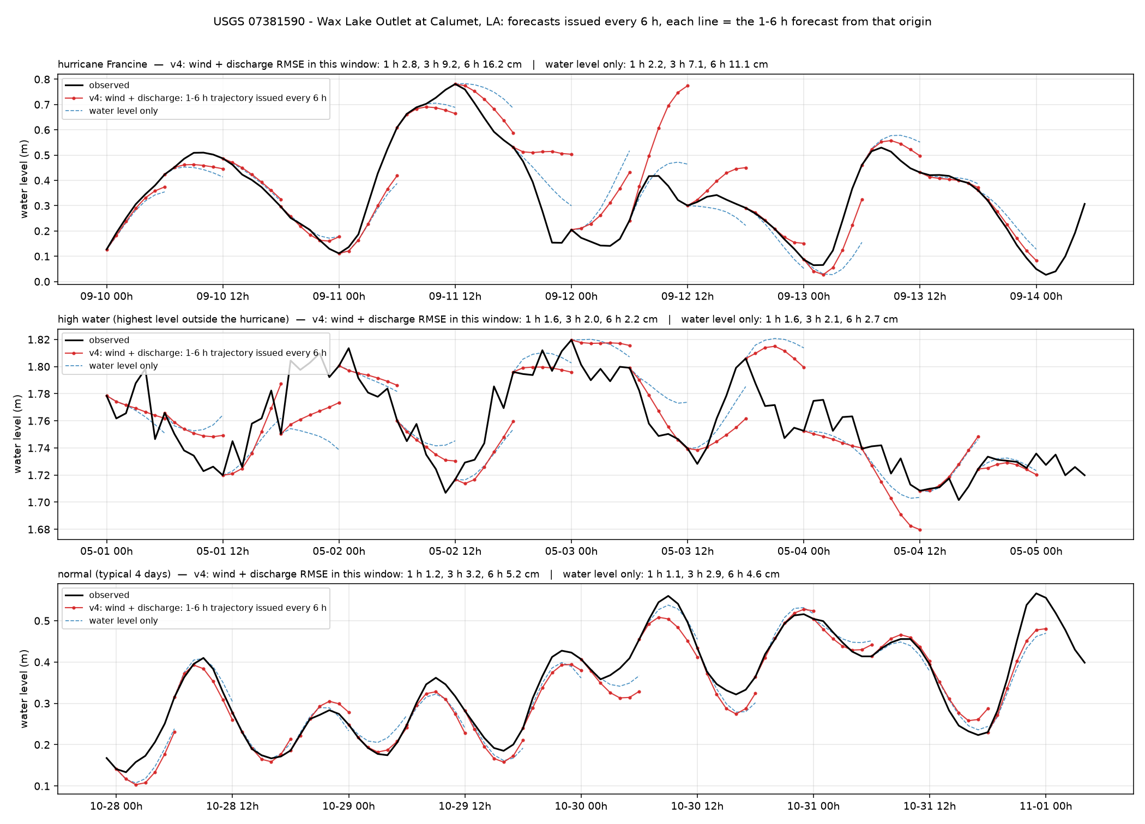
Wax Lake Outlet — Wax Lake Outlet at Calumet, LA (USGS 07381590)
Louisiana100m · river · 29.698°N 91.373°W
6 h RMSE, cm
whole year, v4
5.3
whole year, water level only
6.0
hurricane window (2024-09-10)
16.2
high-water window (2025-05-01)
2.2
normal window (2024-10-27)
5.2
1 / 3 / 6 h, whole year, v4
1.5 / 3.5 / 5.3 cm
Wax Lake Outlet, Atchafalaya distributary. River plus tide; Francine window 16 cm, otherwise 2 to 5 cm.
11

Slide 12
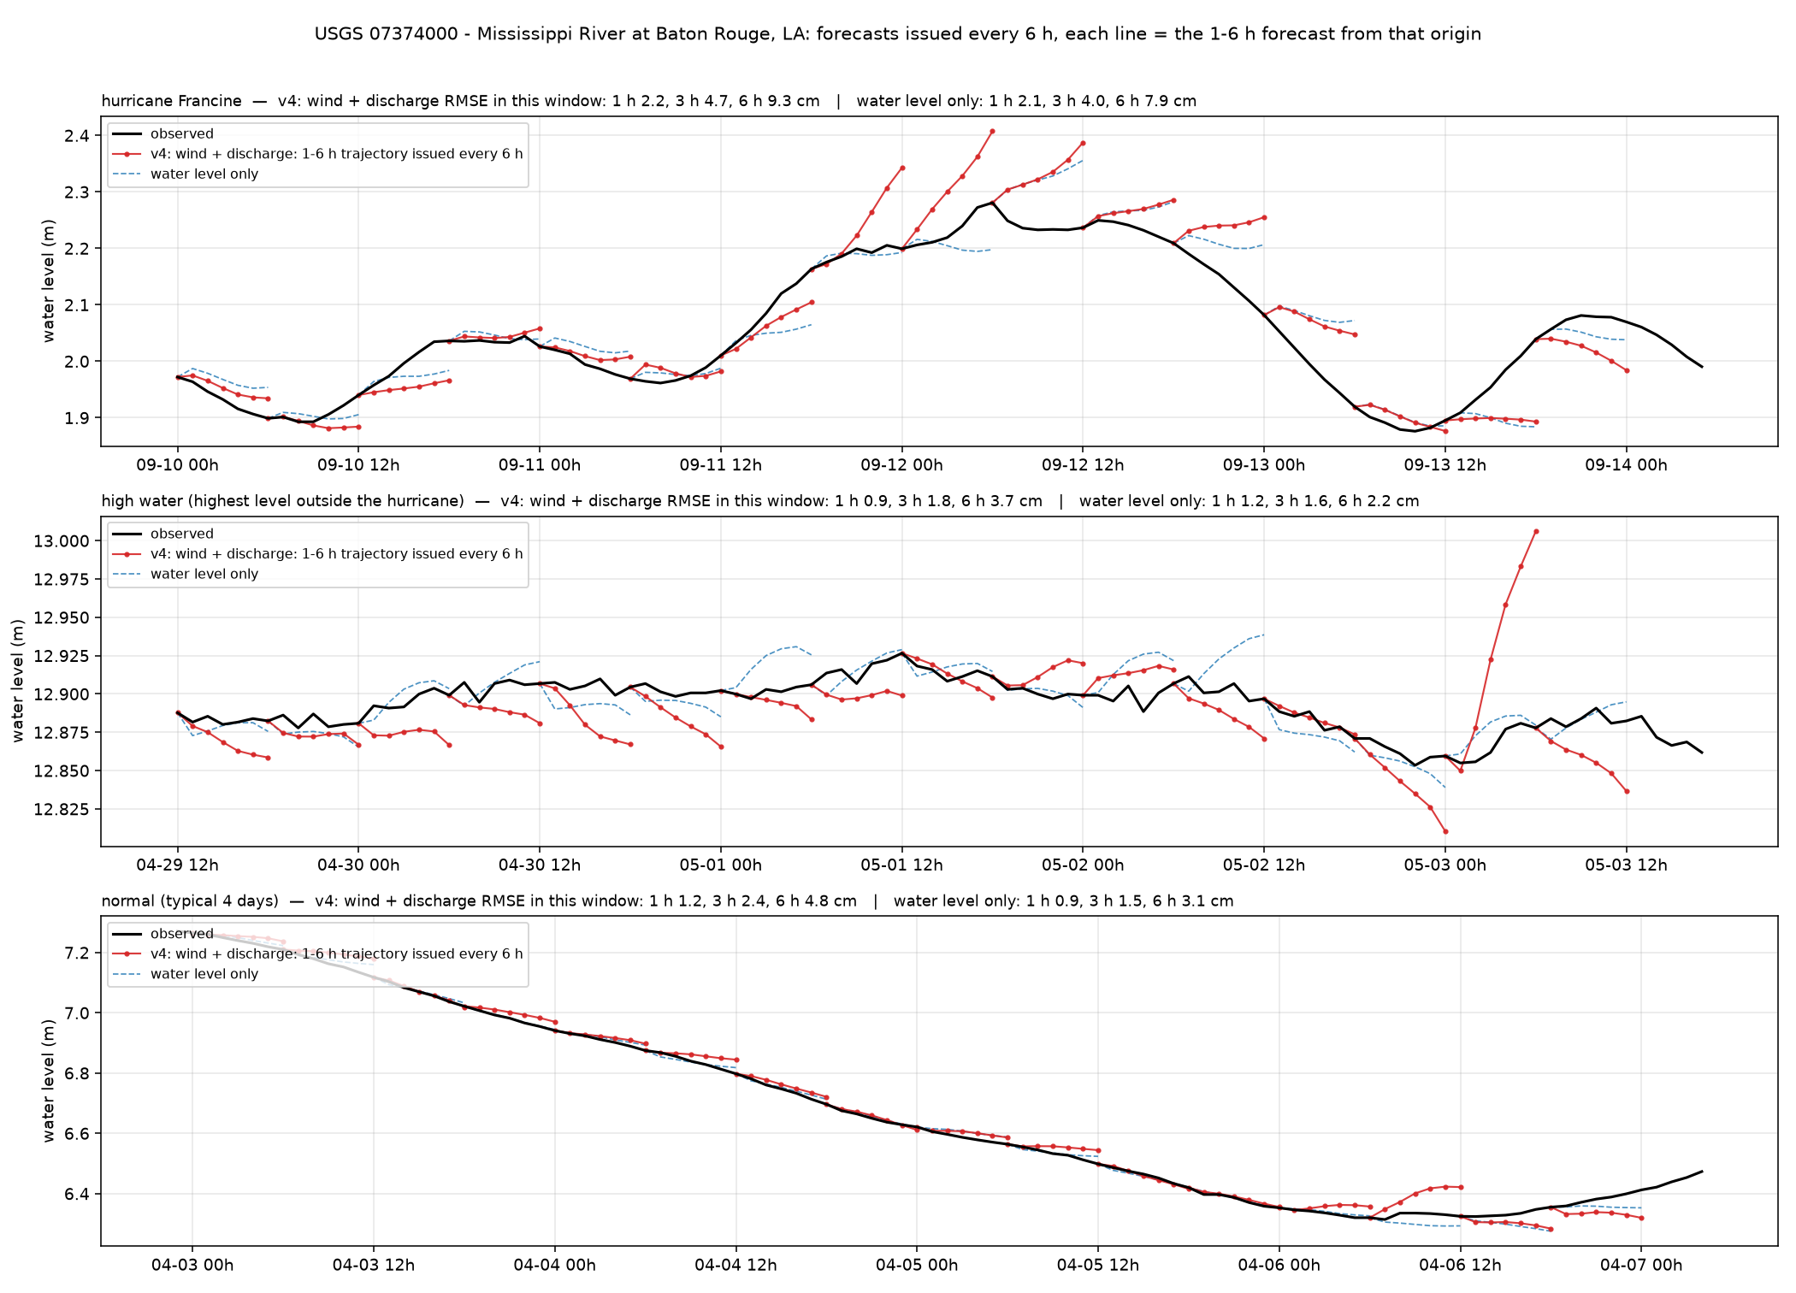
Mississippi R. Baton Rouge — Mississippi River at Baton Rouge, LA (USGS 07374000)
Louisiana100m · river · 30.446°N 91.192°W
6 h RMSE, cm
whole year, v4
4.6
whole year, water level only
3.7
hurricane window (2024-09-10)
9.3
high-water window (2025-04-29)
3.7
normal window (2025-04-02)
4.8
1 / 3 / 6 h, whole year, v4
1.6 / 2.2 / 4.6 cm
Lower Mississippi. Water-level-only model is better here (3.7 vs 4.6 cm): wind is noise for a far-inland river station.
12

Slide 13
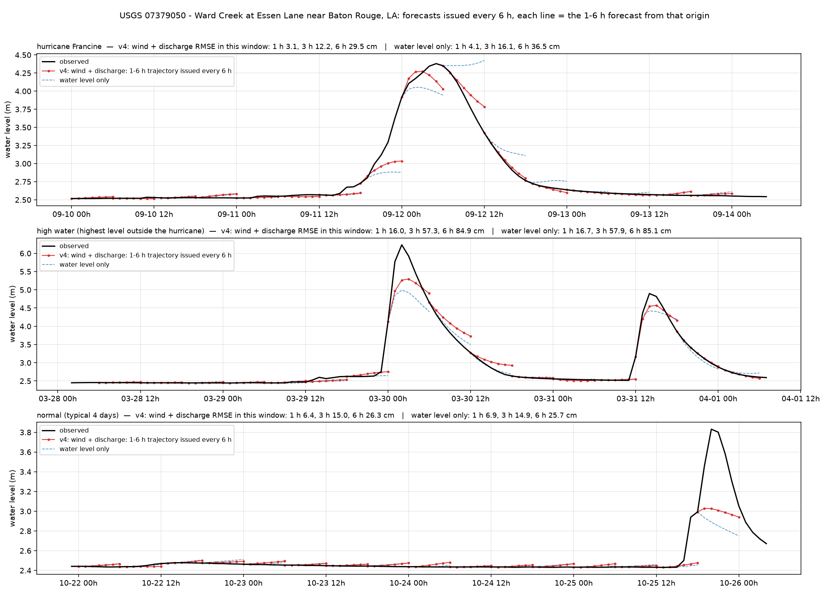
Ward Creek — Ward Creek at Essen Lane near Baton Rouge, LA (USGS 07379050)
Louisiana100m · river · 30.405°N 91.103°W
6 h RMSE, cm
whole year, v4
24.7
whole year, water level only
25.7
hurricane window (2024-09-10)
29.5
high-water window (2025-03-28)
84.9
normal window (2025-10-21)
26.3
1 / 3 / 6 h, whole year, v4
6.2 / 17.3 / 24.7 cm
Baton Rouge urban creek. Flash rises of 3 m in two hours are not forecastable from level, wind or discharge; rain is missing.
13

Slide 14
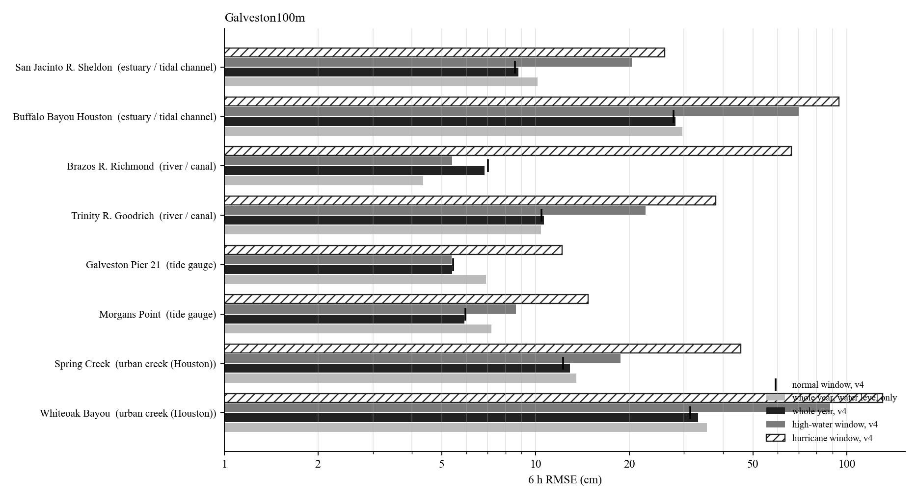
Galveston100m: 6 h RMSE of the representative stations
Hurricane window: Beryl (Jul 2024).
Whole-year 6 h RMSE from 5.4 cm (Galveston Pier 21) to 33.2 cm (Whiteoak Bayou).
Tide gauges, marsh and estuaries: hurricane windows 2 to 3 times the whole-year error; the wind input reduces them most.
Rivers and creeks: the high-water or hurricane window is 5 to 10 times the whole-year error; errors sit in the first hours of each rise.
Log scale.
14

Slide 15
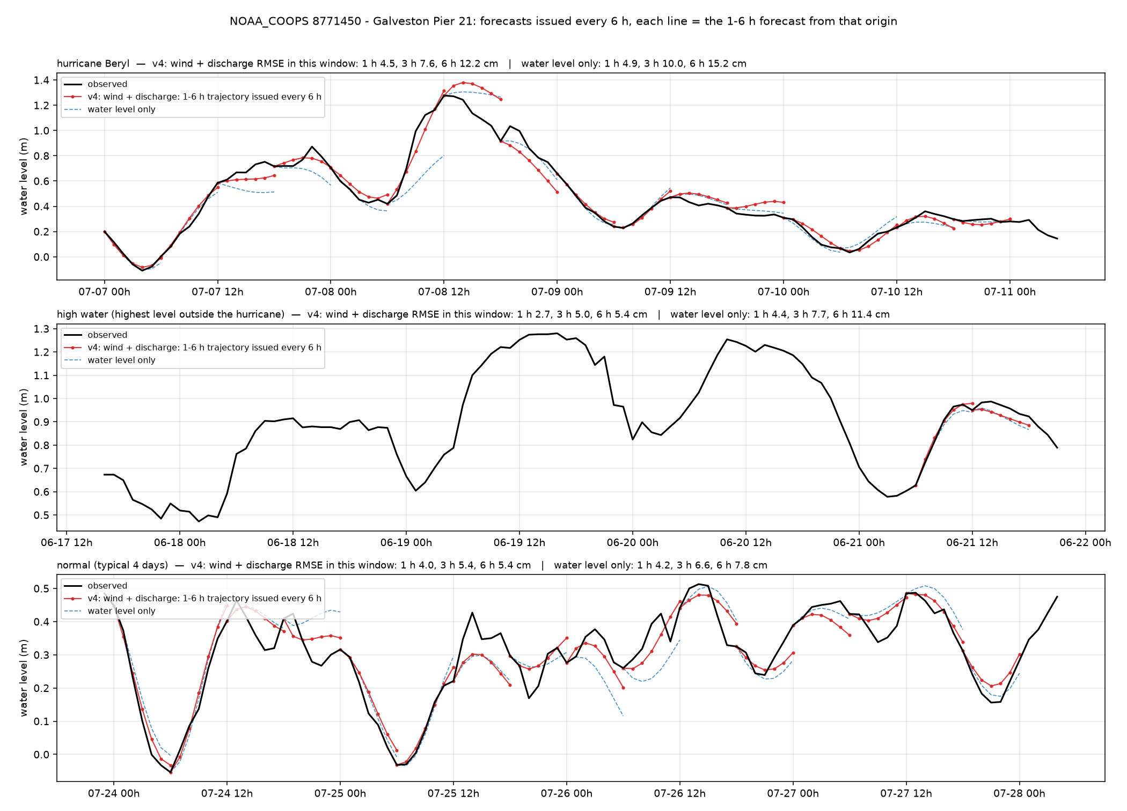
Galveston Pier 21 — Galveston Pier 21 (NOAA_COOPS 8771450)
Galveston100m · tide gauge · 29.310°N 94.793°W
6 h RMSE, cm
whole year, v4
5.4
whole year, water level only
6.9
hurricane window (2024-07-07)
12.2
high-water window (2024-06-17)
5.4
normal window (2024-07-23)
5.4
1 / 3 / 6 h, whole year, v4
2.6 / 4.3 / 5.4 cm
Galveston Pier 21. Beryl window 12 cm (water-level-only 15 cm); normal weeks 5 cm.
15

Slide 16
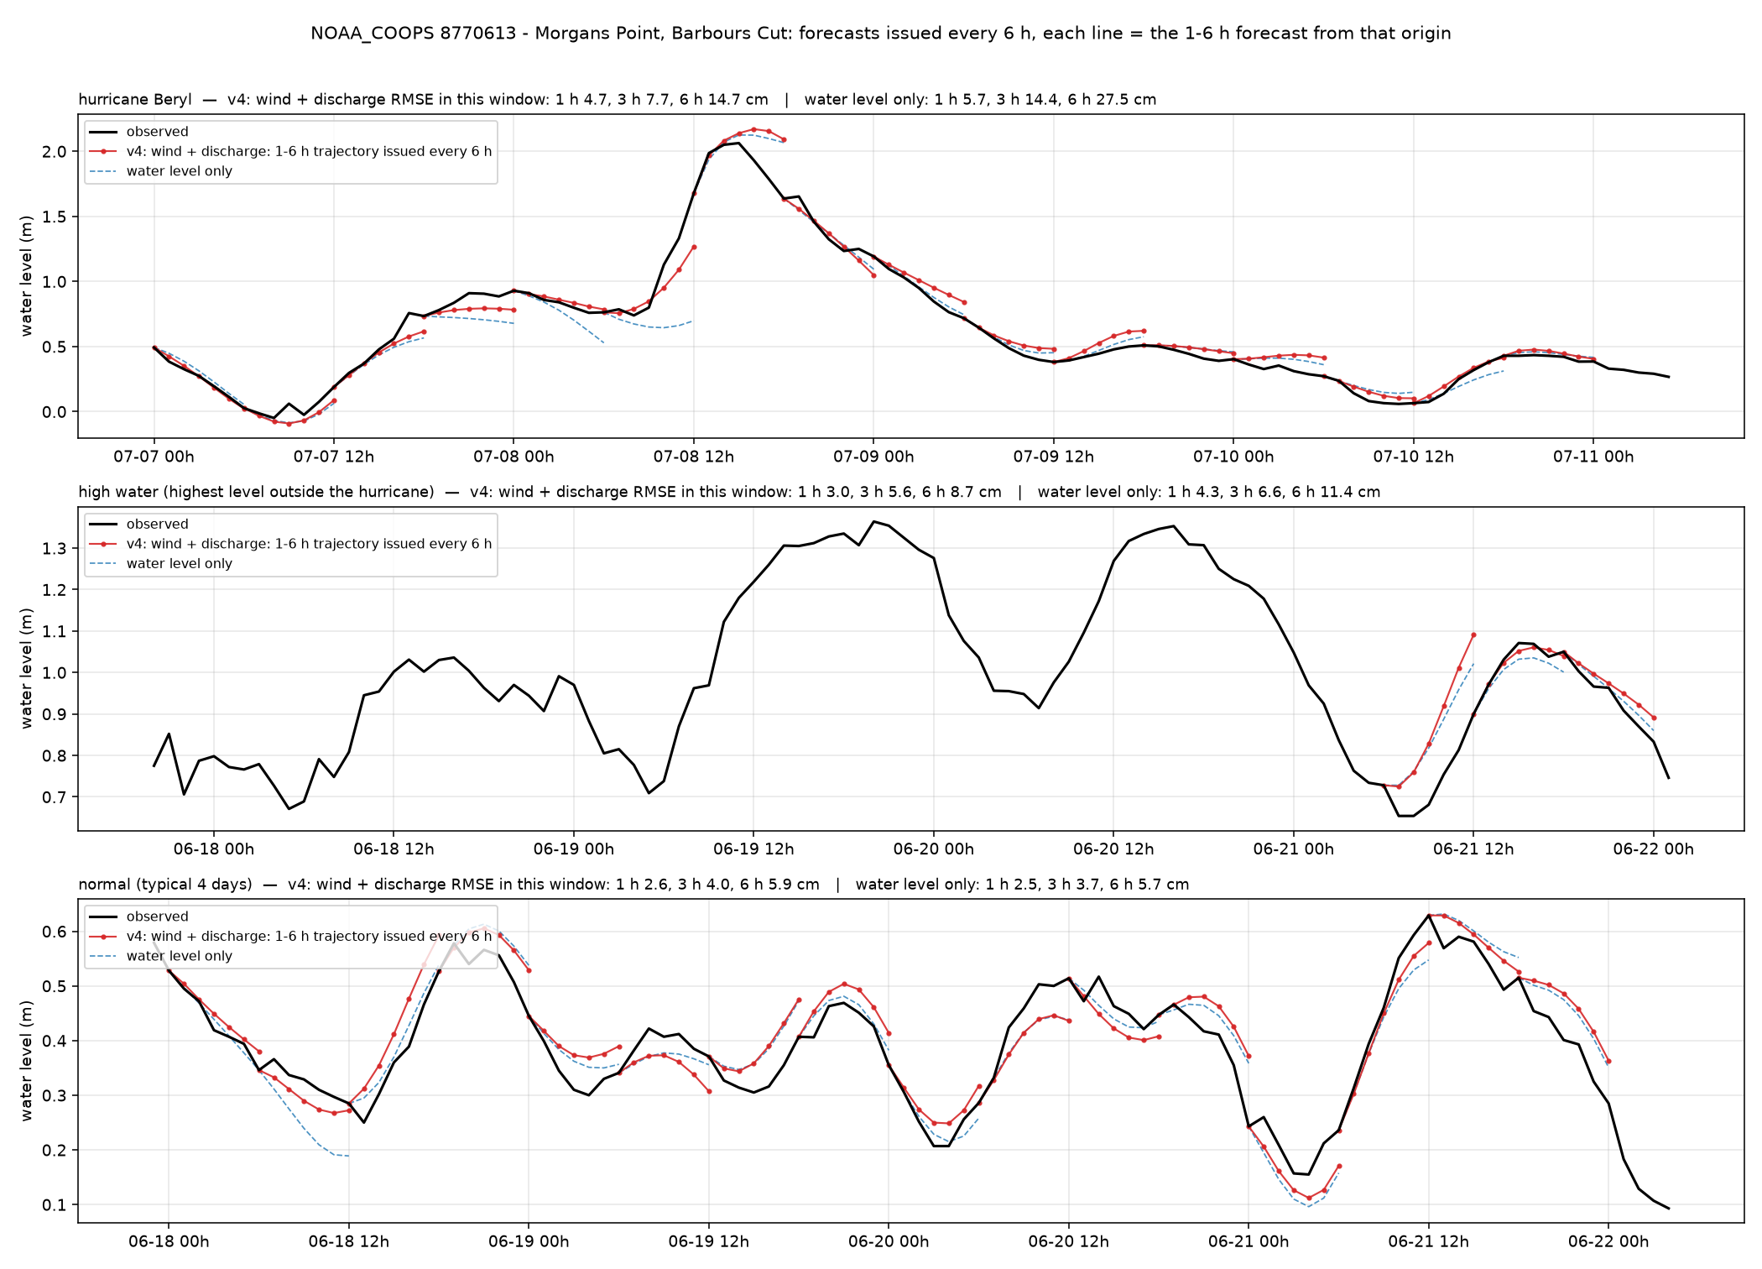
Morgans Point — Morgans Point, Barbours Cut (NOAA_COOPS 8770613)
Galveston100m · tide gauge · 29.682°N 94.985°W
6 h RMSE, cm
whole year, v4
5.9
whole year, water level only
7.2
hurricane window (2024-07-07)
14.7
high-water window (2024-06-17)
8.7
normal window (2025-06-17)
5.9
1 / 3 / 6 h, whole year, v4
2.7 / 3.8 / 5.9 cm
Upper Galveston Bay. Beryl surge of 2.1 m followed by the wind model (14.7 cm vs 27.6 cm water-level-only).
16

Slide 17
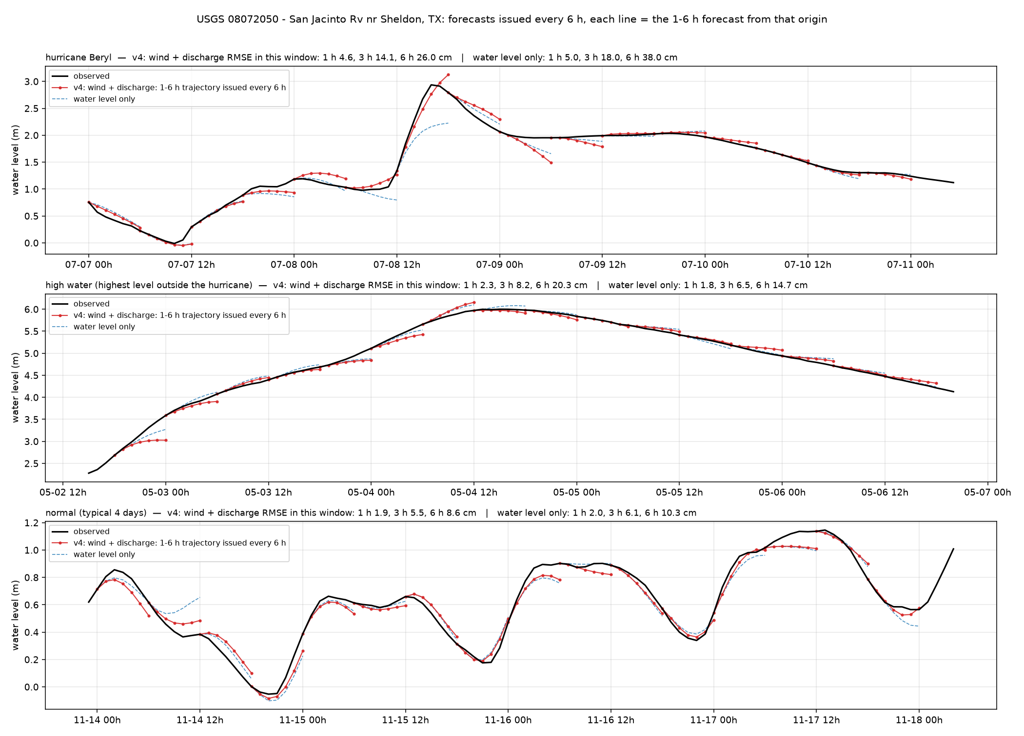
San Jacinto R. Sheldon — San Jacinto Rv nr Sheldon, TX (USGS 08072050)
Galveston100m · estuary / tidal channel · 29.876°N 95.094°W
6 h RMSE, cm
whole year, v4
8.8
whole year, water level only
10.2
hurricane window (2024-07-07)
26.0
high-water window (2024-05-02)
20.4
normal window (2024-11-13)
8.6
1 / 3 / 6 h, whole year, v4
2.2 / 5.8 / 8.8 cm
San Jacinto River above the bay. Tide plus Lake Houston releases; Beryl window 26 cm.
17

Slide 18
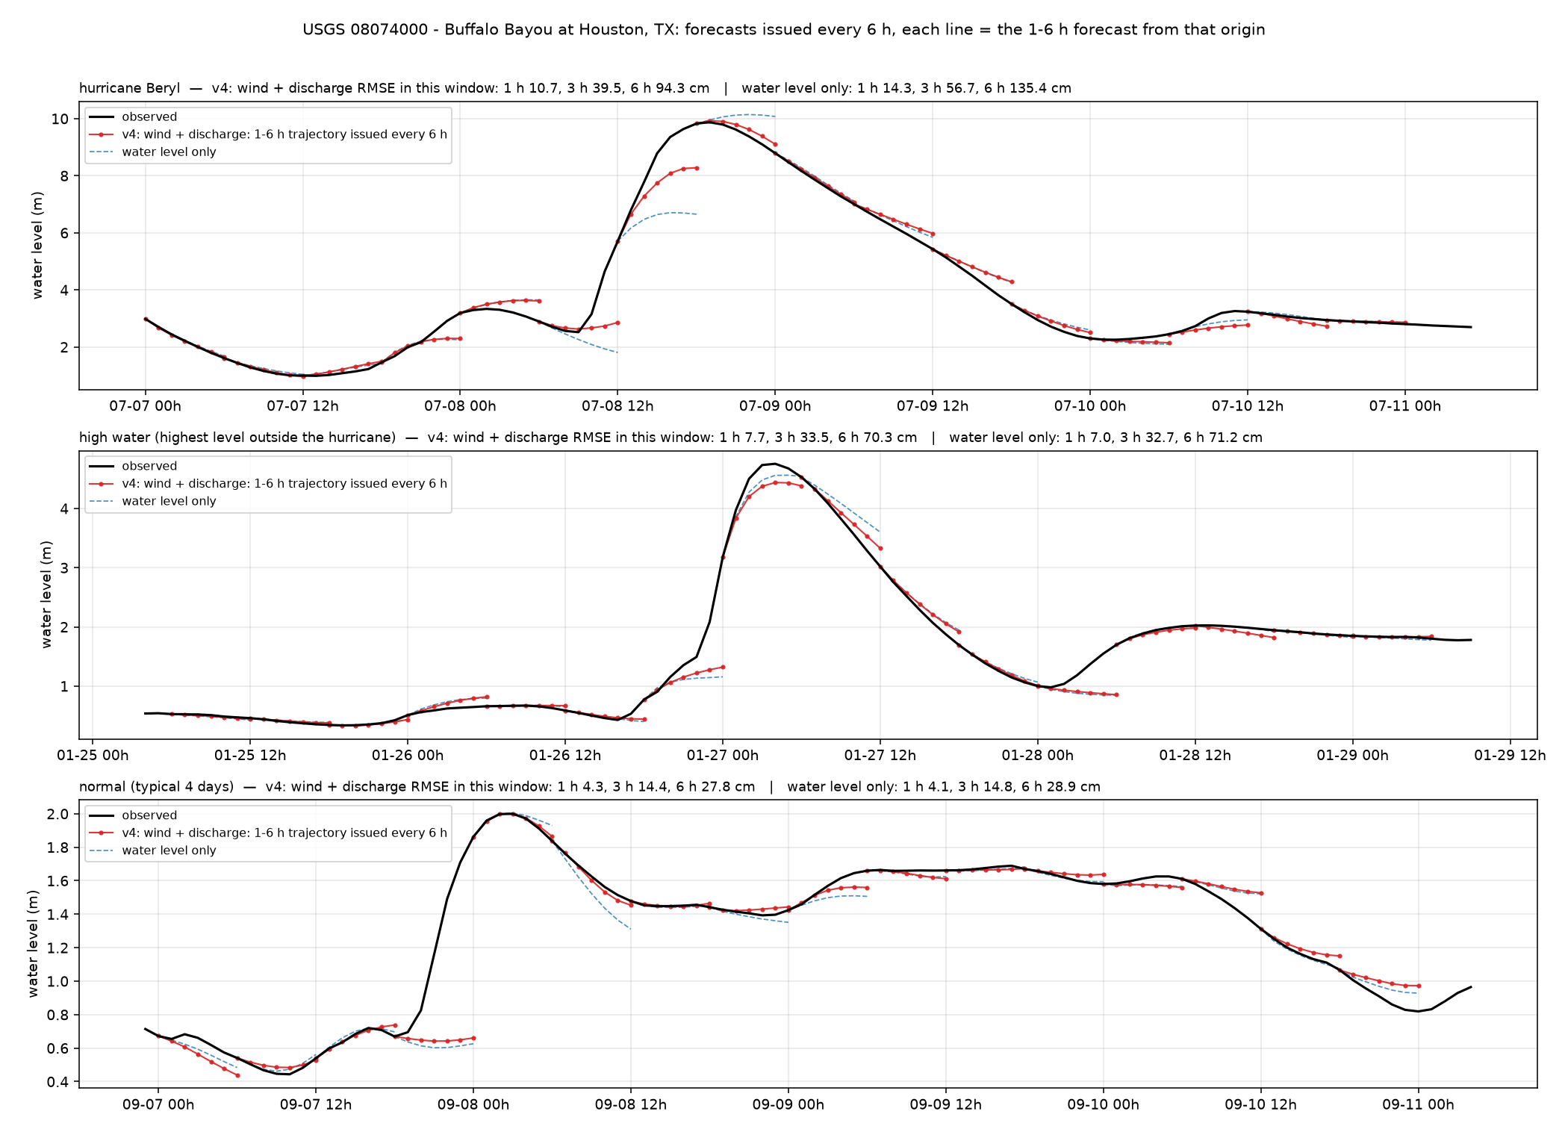
Buffalo Bayou Houston — Buffalo Bayou at Houston, TX (USGS 08074000)
Galveston100m · estuary / tidal channel · 29.760°N 95.409°W
6 h RMSE, cm
whole year, v4
28.2
whole year, water level only
29.6
hurricane window (2024-07-07)
94.3
high-water window (2025-01-25)
70.3
normal window (2025-09-06)
27.8
1 / 3 / 6 h, whole year, v4
4.5 / 15.1 / 28.2 cm
Buffalo Bayou downtown. Beryl rise of 7 m: the 6 h forecast reaches 8.3 m of 9.9 m; recession well captured.
18

Slide 19
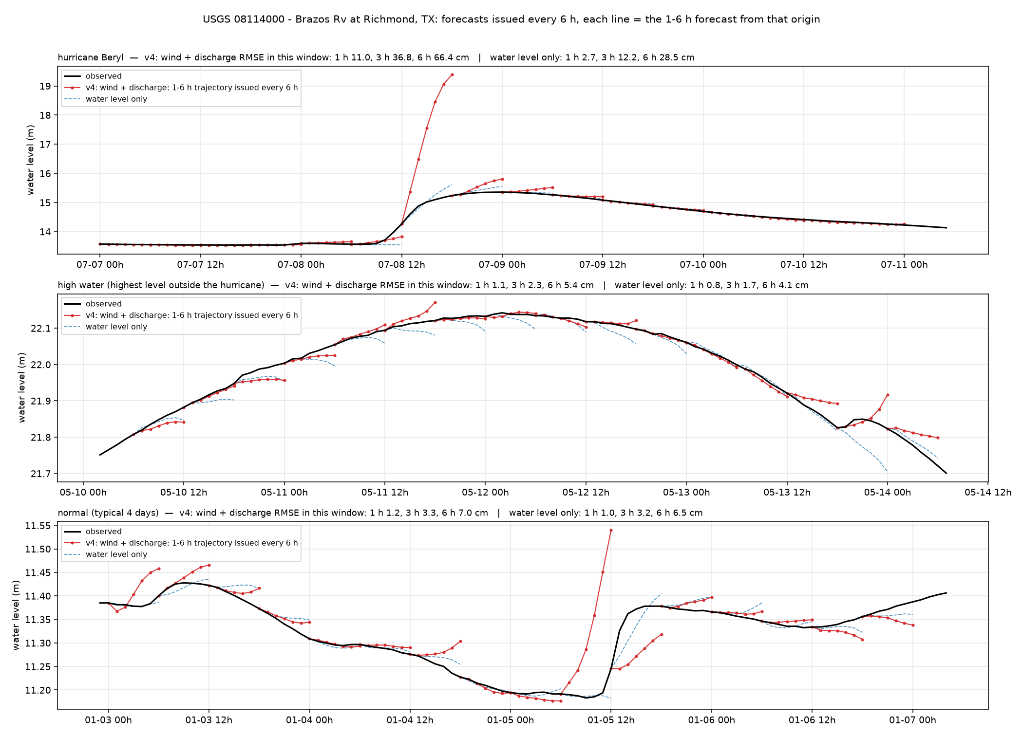
Brazos R. Richmond — Brazos Rv at Richmond, TX (USGS 08114000)
Galveston100m · river · 29.582°N 95.758°W
6 h RMSE, cm
whole year, v4
6.9
whole year, water level only
4.4
hurricane window (2024-07-07)
66.4
high-water window (2024-05-10)
5.4
normal window (2024-01-02)
7.0
1 / 3 / 6 h, whole year, v4
1.2 / 3.4 / 6.9 cm
Brazos River at Richmond. Same-river upstream discharge helps every month; a false 5 m spike during Beryl remains (wind).
19

Slide 20
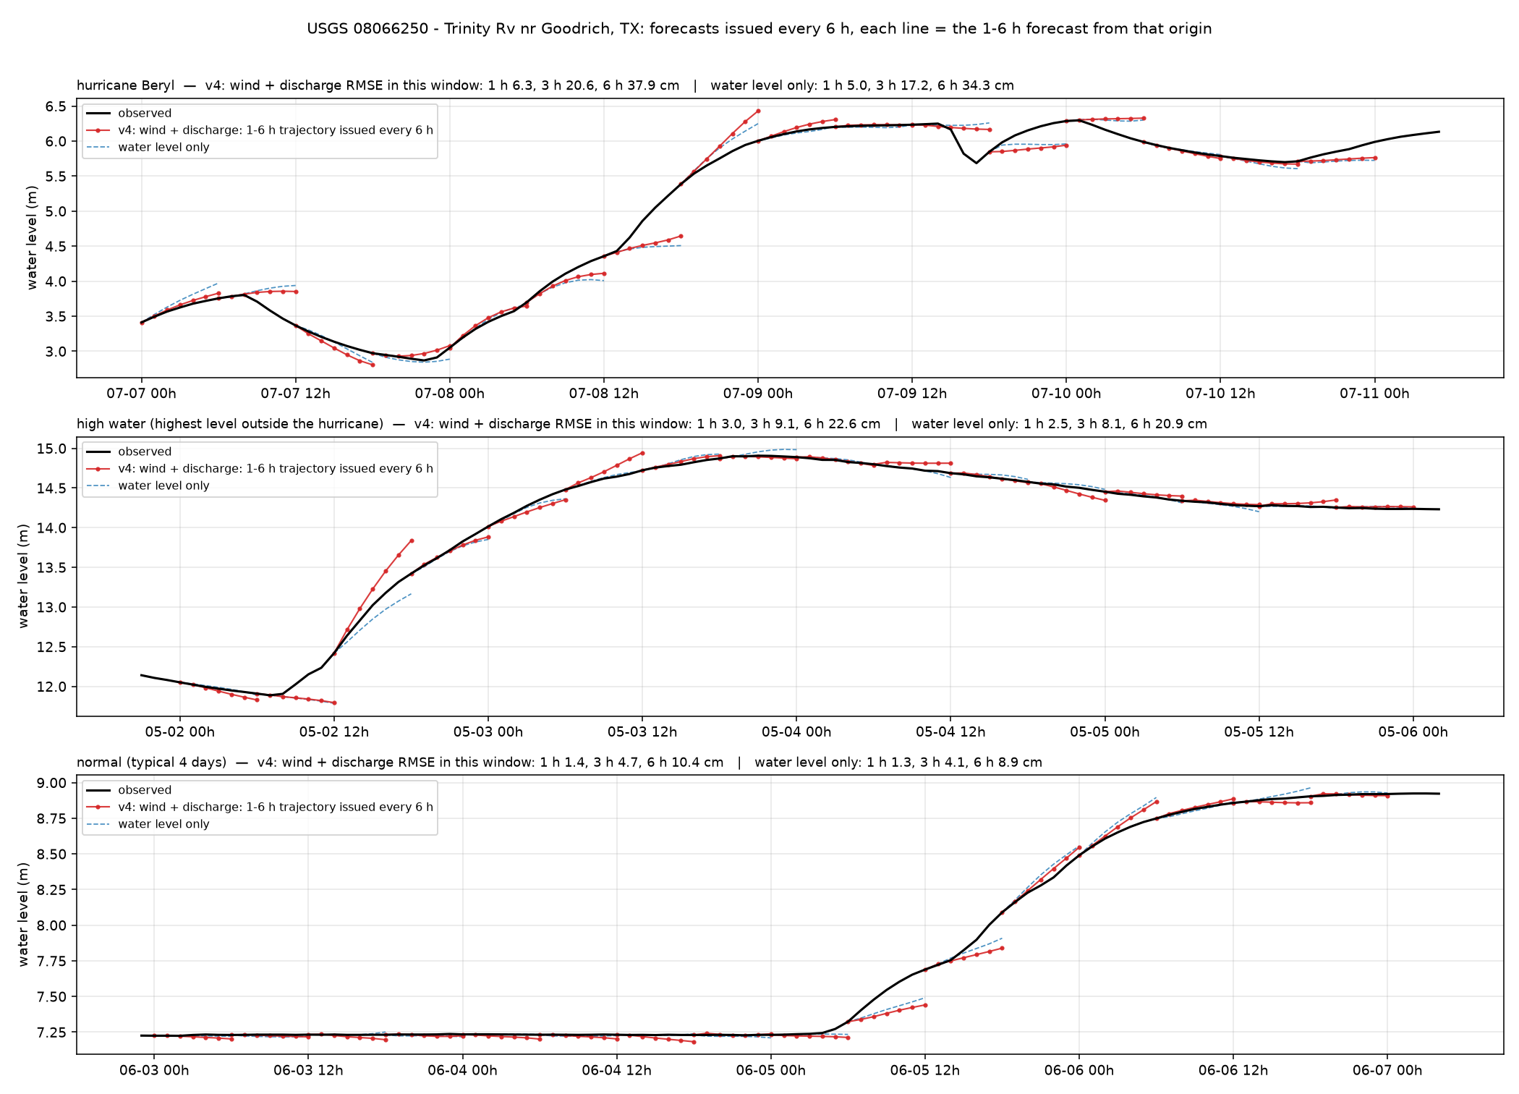
Trinity R. Goodrich — Trinity Rv nr Goodrich, TX (USGS 08066250)
Galveston100m · river · 30.572°N 94.949°W
6 h RMSE, cm
whole year, v4
10.6
whole year, water level only
10.4
hurricane window (2024-07-07)
37.9
high-water window (2024-05-01)
22.6
normal window (2025-06-02)
10.4
1 / 3 / 6 h, whole year, v4
1.5 / 4.9 / 10.6 cm
Trinity River below Lake Livingston dam. Releases are scheduled; no input anticipates them.
20

Slide 21
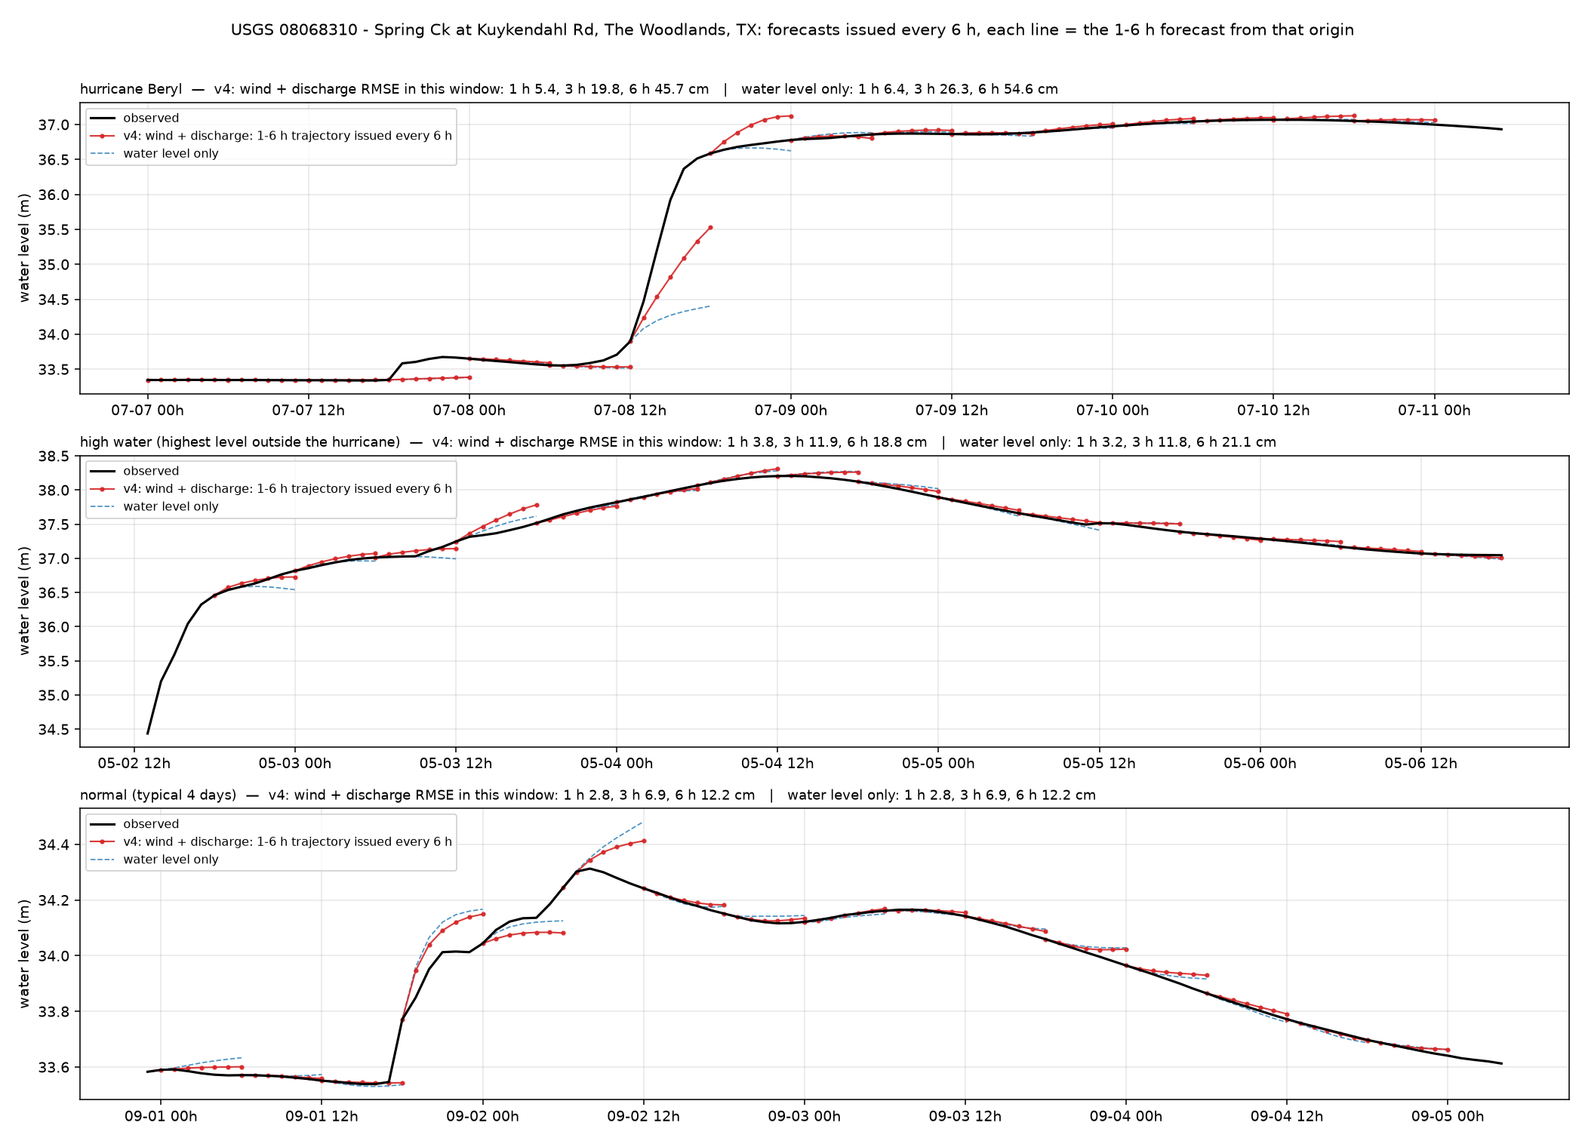
Spring Creek — Spring Ck at Kuykendahl Rd, The Woodlands, TX (USGS 08068310)
Galveston100m · urban creek (Houston) · 30.170°N 95.542°W
6 h RMSE, cm
whole year, v4
12.9
whole year, water level only
13.5
hurricane window (2024-07-07)
45.7
high-water window (2024-05-02)
18.8
normal window (2024-08-31)
12.2
1 / 3 / 6 h, whole year, v4
2.8 / 7.7 / 12.9 cm
Spring Creek, The Woodlands. Typical Houston creek: quiet weeks 12 cm, Beryl 46 cm.
21

Slide 22
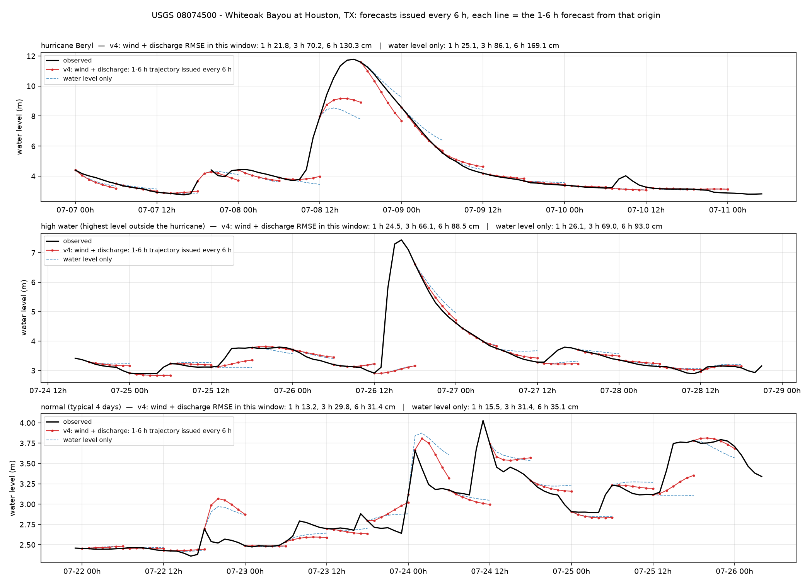
Whiteoak Bayou — Whiteoak Bayou at Houston, TX (USGS 08074500)
Galveston100m · urban creek (Houston) · 29.775°N 95.397°W
6 h RMSE, cm
whole year, v4
33.2
whole year, water level only
35.5
hurricane window (2024-07-07)
130.3
high-water window (2024-07-24)
88.5
normal window (2024-07-21)
31.4
1 / 3 / 6 h, whole year, v4
8.0 / 22.4 / 33.2 cm
Whiteoak Bayou, Houston. Largest errors in the set: 33 cm over the year, 130 cm in the Beryl window.
22

Slide 23
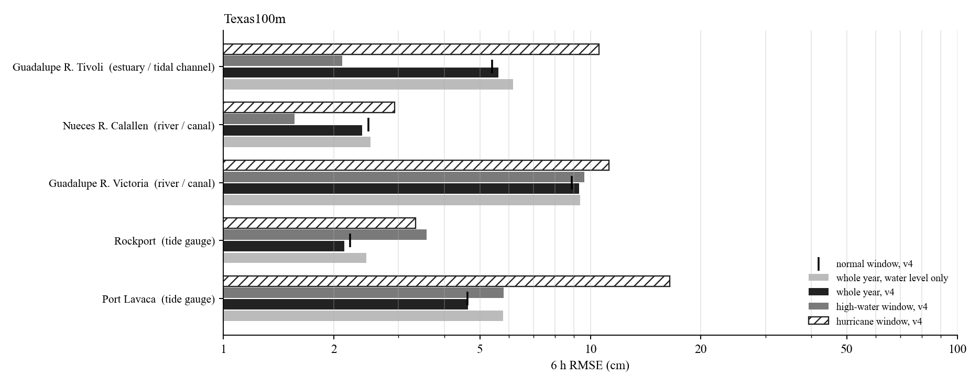
Texas100m: 6 h RMSE of the representative stations
Hurricane window: Beryl (Jul 2024).
Whole-year 6 h RMSE from 2.1 cm (Rockport) to 9.3 cm (Guadalupe R. Victoria).
Tide gauges, marsh and estuaries: hurricane windows 2 to 3 times the whole-year error; the wind input reduces them most.
Rivers and creeks: the high-water or hurricane window is 5 to 10 times the whole-year error; errors sit in the first hours of each rise.
Log scale.
23

Slide 24
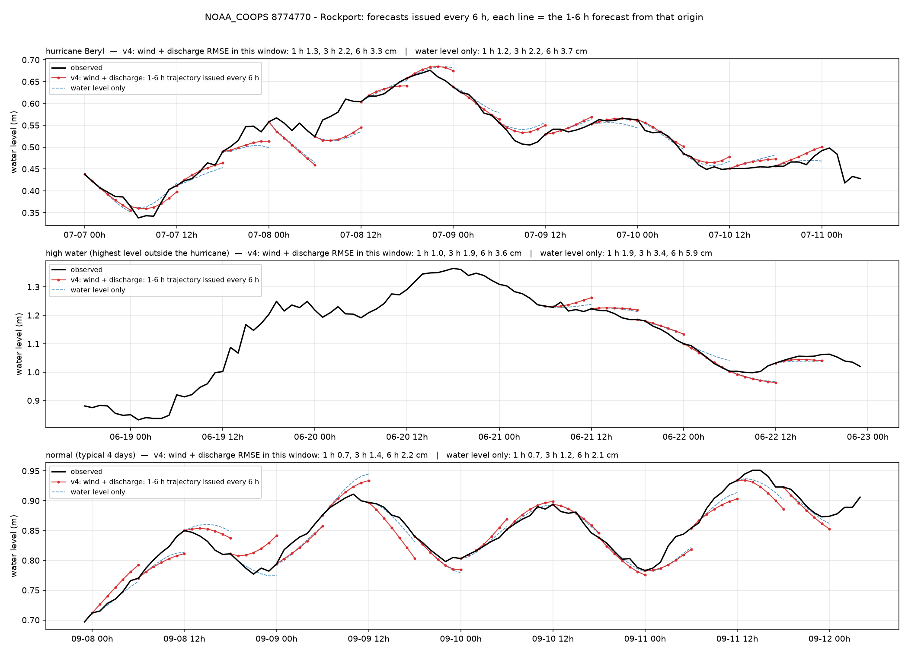
Rockport — Rockport (NOAA_COOPS 8774770)
Texas100m · tide gauge · 28.022°N 97.047°W
6 h RMSE, cm
whole year, v4
2.1
whole year, water level only
2.4
hurricane window (2024-07-07)
3.3
high-water window (2024-06-18)
3.6
normal window (2024-09-07)
2.2
1 / 3 / 6 h, whole year, v4
1.0 / 1.6 / 2.1 cm
Rockport, Aransas Bay. Best station class: 2 cm over the year, 3 cm during Beryl.
24

Slide 25
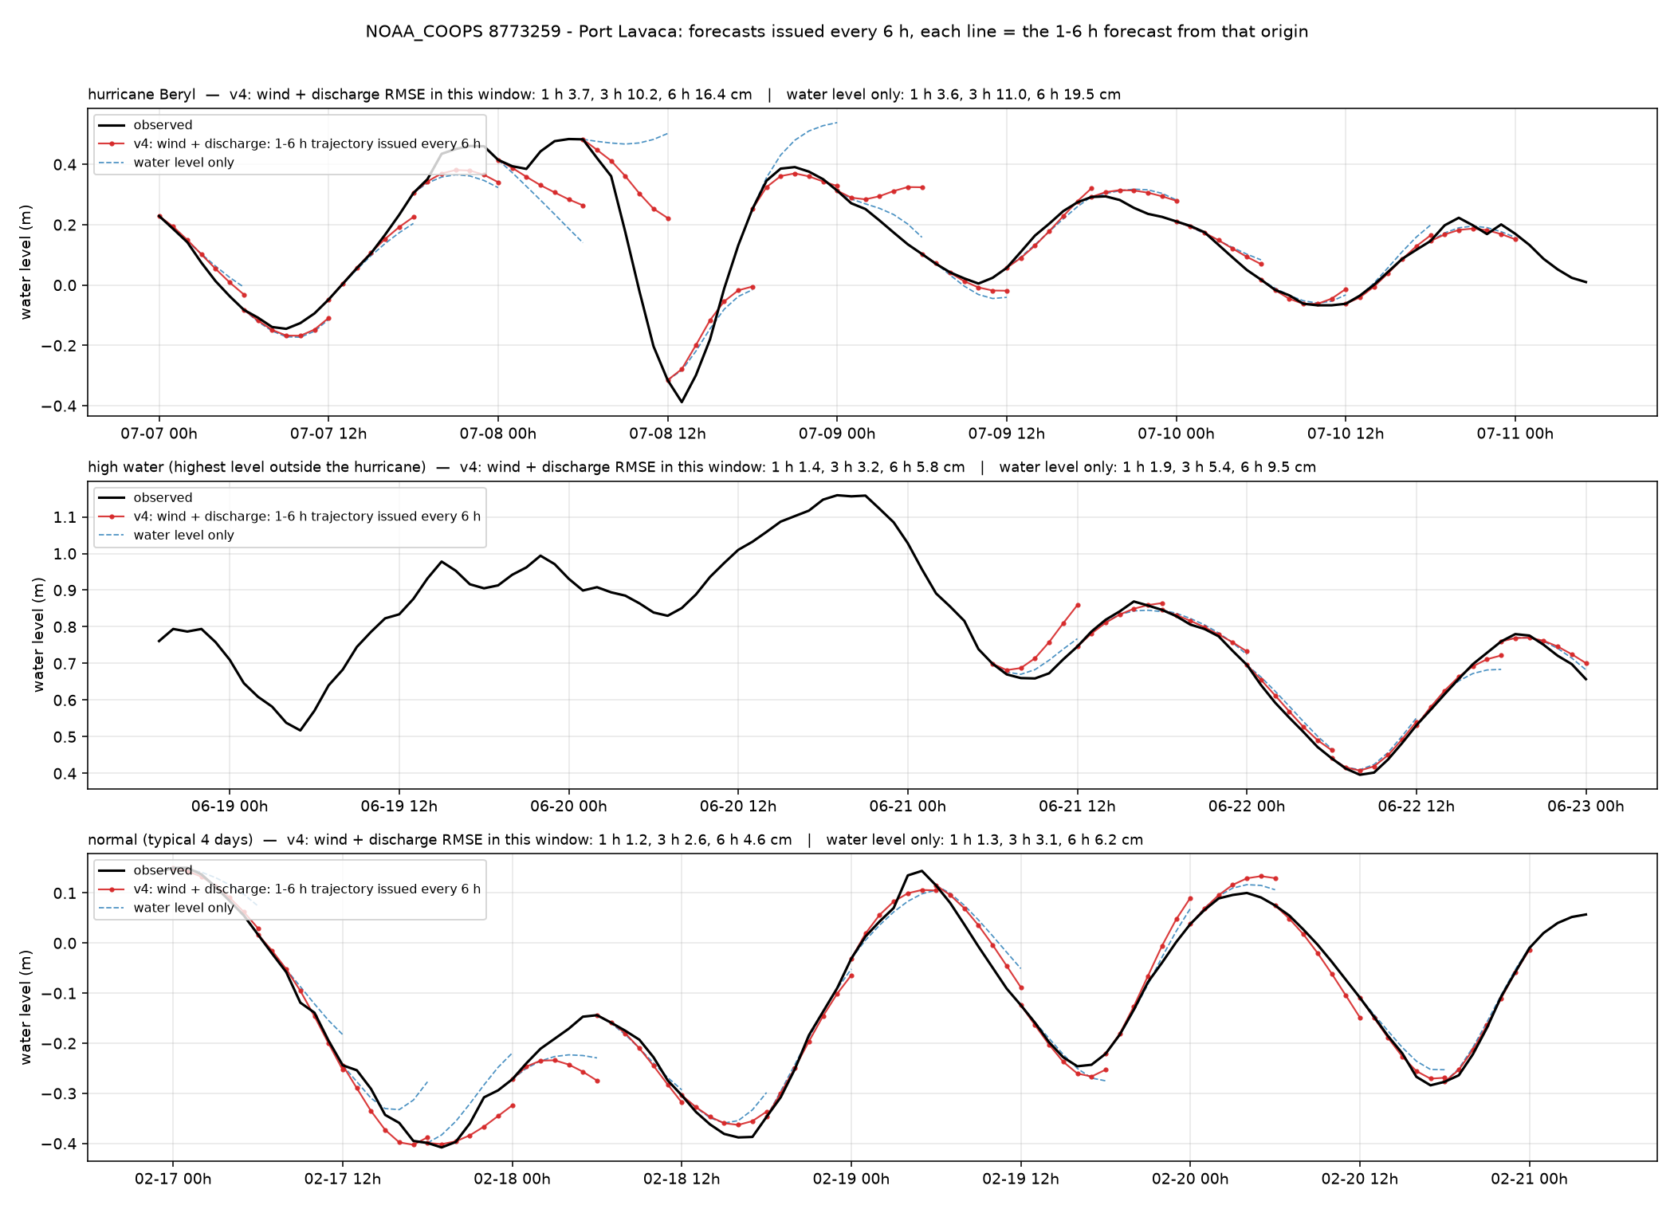
Port Lavaca — Port Lavaca (NOAA_COOPS 8773259)
Texas100m · tide gauge · 28.641°N 96.610°W
6 h RMSE, cm
whole year, v4
4.6
whole year, water level only
5.8
hurricane window (2024-07-07)
16.4
high-water window (2024-06-18)
5.8
normal window (2024-02-16)
4.6
1 / 3 / 6 h, whole year, v4
1.2 / 2.8 / 4.6 cm
Port Lavaca, Matagorda Bay. Beryl window 16 cm, otherwise 5 cm.
25

Slide 26
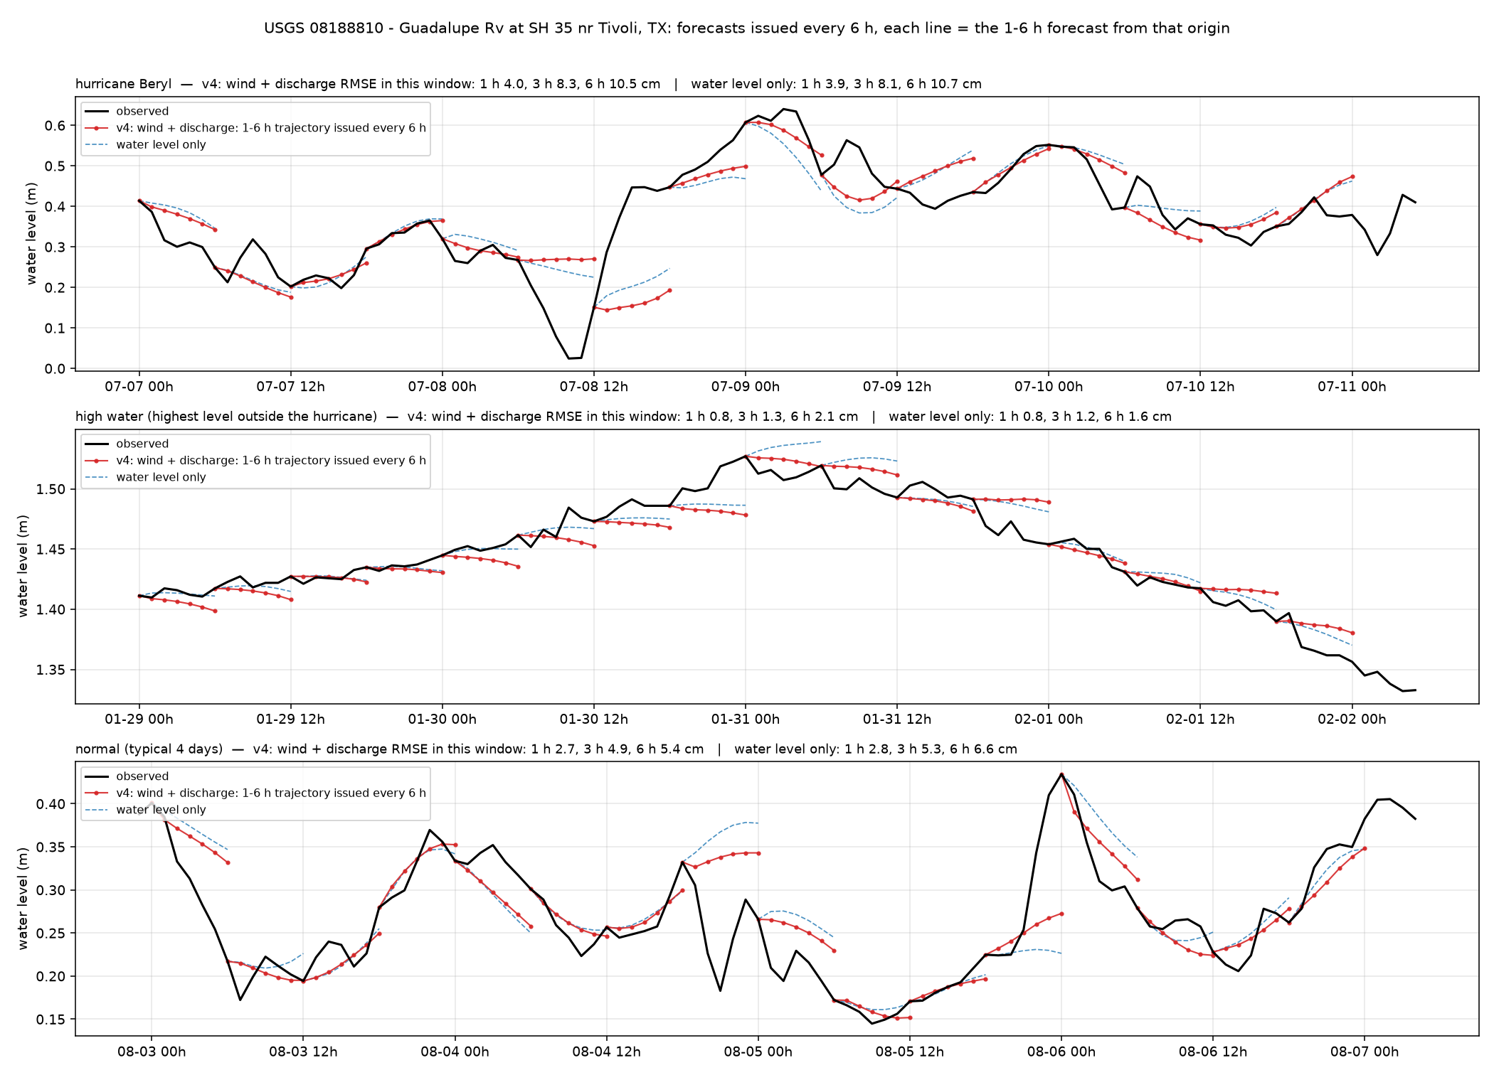
Guadalupe R. Tivoli — Guadalupe Rv at SH 35 nr Tivoli, TX (USGS 08188810)
Texas100m · estuary / tidal channel · 28.478°N 96.863°W
6 h RMSE, cm
whole year, v4
5.6
whole year, water level only
6.2
hurricane window (2024-07-07)
10.5
high-water window (2024-01-29)
2.1
normal window (2025-08-02)
5.4
1 / 3 / 6 h, whole year, v4
2.4 / 4.5 / 5.6 cm
Lower Guadalupe, tidal. Hurricane window 10.5 cm; river rises 2 cm.
26

Slide 27
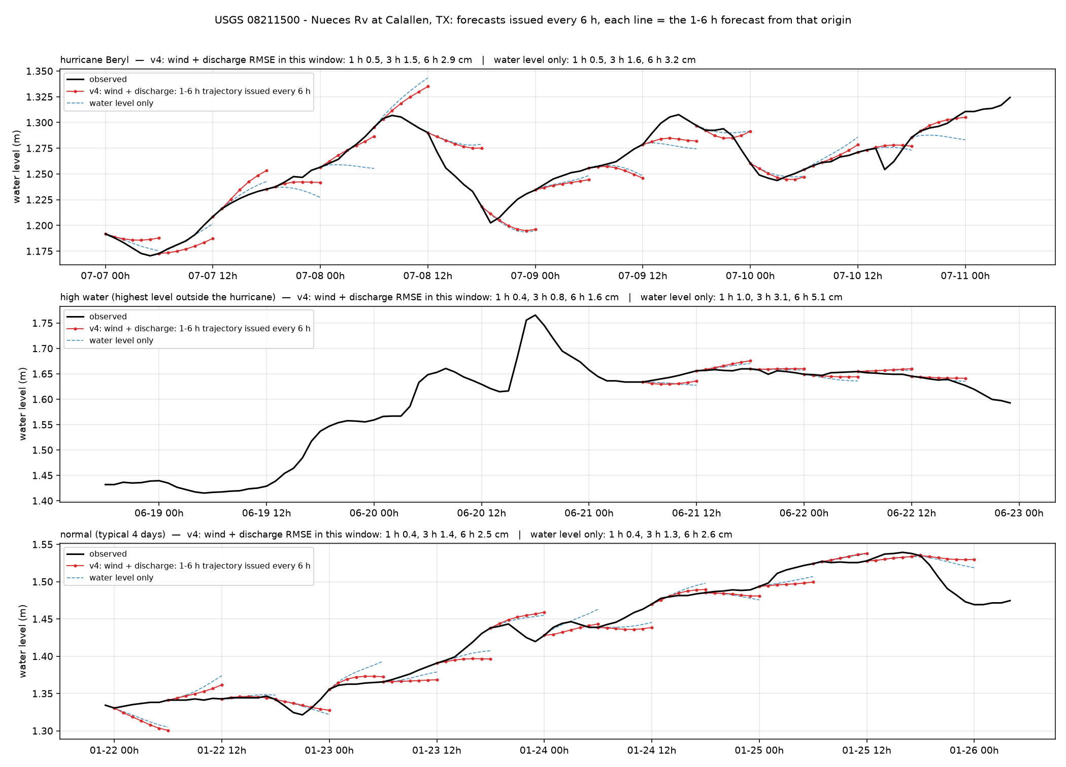
Nueces R. Calallen — Nueces Rv at Calallen, TX (USGS 08211500)
Texas100m · river · 27.883°N 97.625°W
6 h RMSE, cm
whole year, v4
2.4
whole year, water level only
2.5
hurricane window (2024-07-07)
2.9
high-water window (2024-06-18)
1.6
normal window (2025-01-21)
2.5
1 / 3 / 6 h, whole year, v4
0.5 / 1.3 / 2.4 cm
Nueces River at Calallen, below the saltwater dam. Nearly flat; 2.4 cm over the year.
27

Slide 28
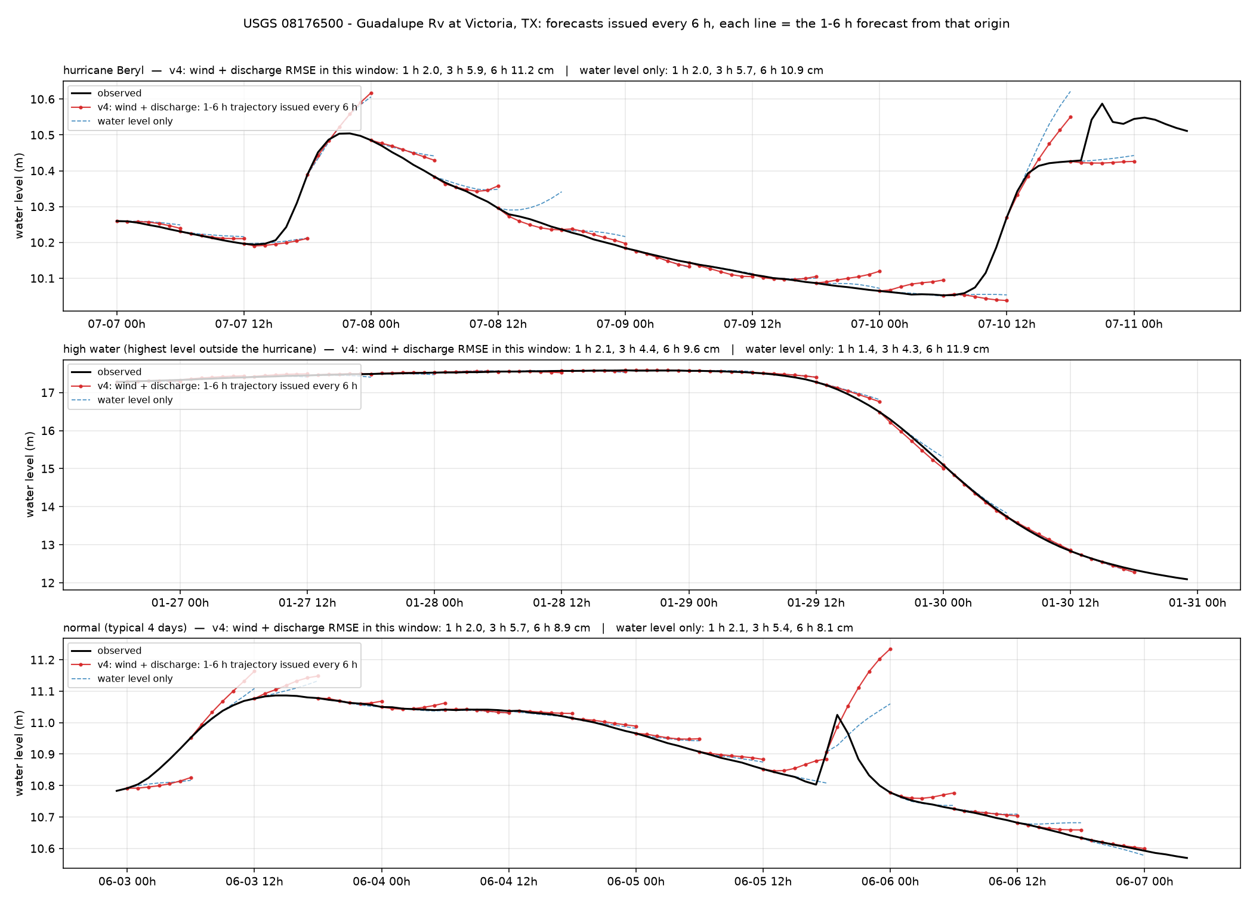
Guadalupe R. Victoria — Guadalupe Rv at Victoria, TX (USGS 08176500)
Texas100m · river · 28.793°N 97.013°W
6 h RMSE, cm
whole year, v4
9.3
whole year, water level only
9.4
hurricane window (2024-07-07)
11.2
high-water window (2024-01-26)
9.6
normal window (2024-06-02)
8.9
1 / 3 / 6 h, whole year, v4
1.2 / 4.5 / 9.3 cm
Guadalupe River at Victoria. Inland river; errors concentrate in the first hours of each rise (June 2025 flood).
28

Slide 29
Louisiana100m: summary (6 h RMSE, cm)
station | type | year v4 | year level-only | hurricane | high water | normal | 1 h | 3 h
Grand Isle | tide gauge | 3.7 | 4.3 | 6.8 | 3.8 | 3.4 | 1.8 | 2.6
New Canal | tide gauge | 3.9 | 4.5 | 6.3 | 2.8 | 3.8 | 2.5 | 2.8
Bay Waveland | tide gauge | 6.4 | 9.4 | 10.8 | 13.3 | 6.5 | 2.2 | 5.1
CRMS0367 | marsh (CRMS) | 3.0 | 3.0 | 5.2 | 0.9 | 3.1 | 1.3 | 2.3
CRMS0517 | marsh (CRMS) | 9.7 | 12.9 | 23.0 | 16.8 | 7.8 | 4.9 | 7.8
Vermilion Bay | estuary / tidal channel | 7.3 | 9.9 | 18.6 | 6.7 | 6.3 | 2.1 | 4.9
Merrill Shell Bank | estuary / tidal channel | 5.9 | 8.4 | 11.0 | 10.7 | 6.0 | 2.1 | 4.3
Wax Lake Outlet | river | 5.3 | 6.0 | 16.2 | 2.2 | 5.2 | 1.5 | 3.5
Mississippi R. Baton Rouge | river | 4.6 | 3.7 | 9.3 | 3.7 | 4.8 | 1.6 | 2.2
Ward Creek | river | 24.7 | 25.7 | 29.5 | 84.9 | 26.3 | 6.2 | 17.3
Hurricane window: Francine (Sep 2024). year = whole test period 2024-01 to 2025-12; windows = 4 days.
29

Slide 30
Galveston100m: summary (6 h RMSE, cm)
station | type | year v4 | year level-only | hurricane | high water | normal | 1 h | 3 h
Galveston Pier 21 | tide gauge | 5.4 | 6.9 | 12.2 | 5.4 | 5.4 | 2.6 | 4.3
Morgans Point | tide gauge | 5.9 | 7.2 | 14.7 | 8.7 | 5.9 | 2.7 | 3.8
San Jacinto R. Sheldon | estuary / tidal channel | 8.8 | 10.2 | 26.0 | 20.4 | 8.6 | 2.2 | 5.8
Buffalo Bayou Houston | estuary / tidal channel | 28.2 | 29.6 | 94.3 | 70.3 | 27.8 | 4.5 | 15.1
Brazos R. Richmond | river | 6.9 | 4.4 | 66.4 | 5.4 | 7.0 | 1.2 | 3.4
Trinity R. Goodrich | river | 10.6 | 10.4 | 37.9 | 22.6 | 10.4 | 1.5 | 4.9
Spring Creek | urban creek (Houston) | 12.9 | 13.5 | 45.7 | 18.8 | 12.2 | 2.8 | 7.7
Whiteoak Bayou | urban creek (Houston) | 33.2 | 35.5 | 130.3 | 88.5 | 31.4 | 8.0 | 22.4
Hurricane window: Beryl (Jul 2024). year = whole test period 2024-01 to 2025-12; windows = 4 days.
30

Slide 31
Texas100m: summary (6 h RMSE, cm)
station | type | year v4 | year level-only | hurricane | high water | normal | 1 h | 3 h
Rockport | tide gauge | 2.1 | 2.4 | 3.3 | 3.6 | 2.2 | 1.0 | 1.6
Port Lavaca | tide gauge | 4.6 | 5.8 | 16.4 | 5.8 | 4.6 | 1.2 | 2.8
Guadalupe R. Tivoli | estuary / tidal channel | 5.6 | 6.2 | 10.5 | 2.1 | 5.4 | 2.4 | 4.5
Nueces R. Calallen | river | 2.4 | 2.5 | 2.9 | 1.6 | 2.5 | 0.5 | 1.3
Guadalupe R. Victoria | river | 9.3 | 9.4 | 11.2 | 9.6 | 8.9 | 1.2 | 4.5
Hurricane window: Beryl (Jul 2024). year = whole test period 2024-01 to 2025-12; windows = 4 days.
31

Slide 32
What the 23 stations show
Tide gauges, marsh, estuaries (14 stations): whole-year 6 h RMSE 2.1–28.2 cm; hurricane windows 3.3–94.3 cm. The wind input gives most of the improvement over the water-level-only model, and it shows in the surge hours (Bay Waveland, Morgans Point).
Rivers (7 stations): whole-year 2–11 cm. Large rivers are quiet most of the year; the first hours of a rise carry the error. Upstream discharge helps mid-river stations (Brazos Richmond); it cannot anticipate dam releases (Trinity Goodrich). For the far-inland Mississippi the wind input only adds noise.
Urban creeks and small creeks (3 stations incl. Ward Creek): whole-year 13–33 cm, hurricane windows 30–130 cm. Flash rises from local rainfall are not visible in any current input.
Normal 4-day windows equal the whole-year RMSE at every station: the whole-year number describes ordinary days; event skill has to be read from the event windows.
32

