Slide 1
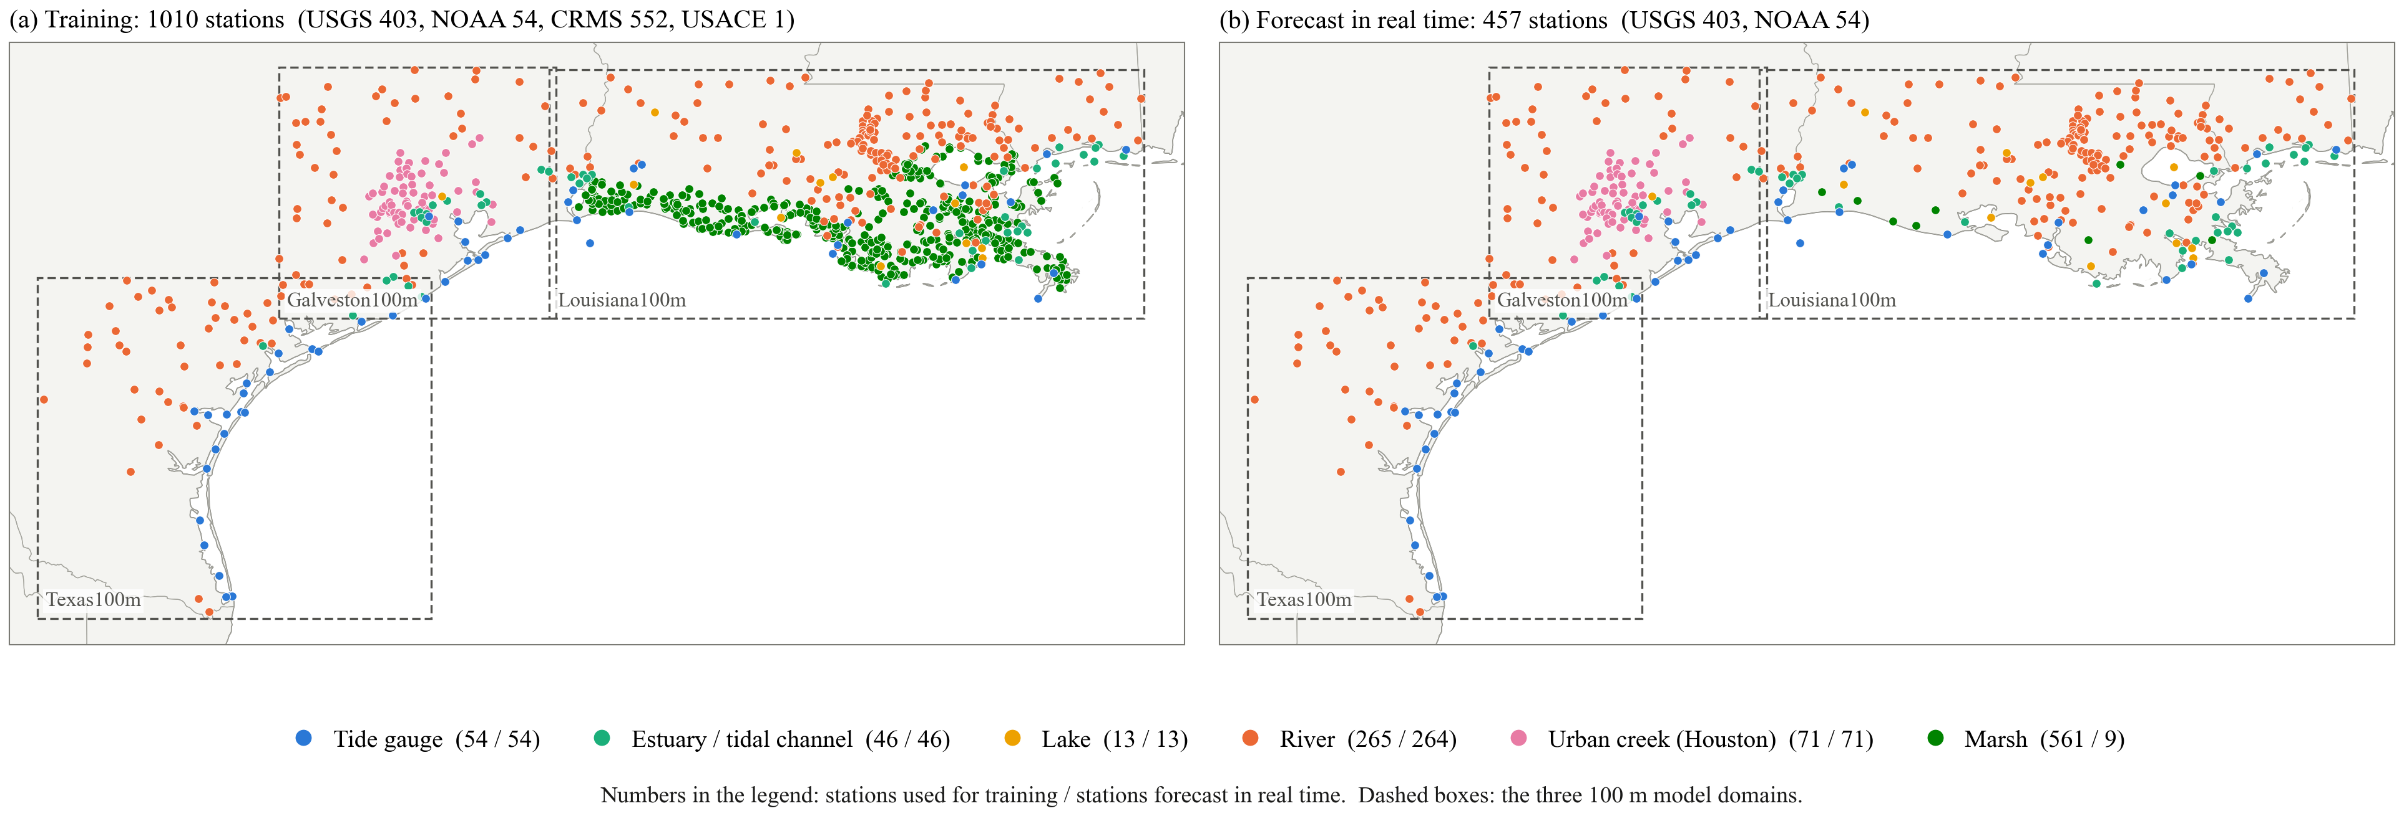
The stations: all of them for training, those with a real-time feed for the forecast
(a) One model is trained on all 1010 stations in the three 100 m domains. The 552 CRMS marsh stations are read out from loggers and published months later, so they add training data but cannot be forecast in real time.
(b) A forecast is issued for the 457 USGS and NOAA stations, which report in real time: tide gauges, estuaries, lakes, rivers and the Houston creeks.
All error numbers on the following slides are for the 443 of these 457 stations that have enough observations in the test period (January 2024 to December 2025). CRMS stations are not in any of the numbers.

Slide 2
Every model version so far; the version that is run is highlighted
6 h RMSE (cm)
Version
What it adds or changes
Available in real time
All stations
Urban creeks
Tide gauges
Water level only
72 h of water level at the station
yes
10.2
13.5
5.0
+ wind, past 72 h
wind at the station, past 72 h
yes (HRRR analysis)
9.9
13.1
4.4
+ wind, next 6 h
wind for the 6 forecast hours
yes (HRRR forecast)
9.8
13.0
4.3
+ upstream discharge
discharge at the nearest upstream USGS gauge
yes (USGS)
9.7
12.9
4.4
refined discharge and wind (no rainfall)
gauge on the same river; no wind at 15 inland rivers
yes
9.7
12.9
4.4
+ rainfall, past 72 h
rainfall, 15 km around the station, past 72 h only
yes (MRMS)
9.5
12.5
4.3
+ rainfall, HRRR forecast
past rainfall + HRRR forecast total of the next 6 h
yes (MRMS, HRRR)
9.0
11.4
4.5
+ rainfall, observed future
past rainfall + observed rainfall of the next 6 h
NO - upper bound
7.2
7.9
4.3
6 h-change scaling + gap filling
error scaled by 6 h change; gaps take the last value
yes - no new data
9.5
12.7
4.3
scaling + gap filling + HRRR rainfall
past rainfall + HRRR forecast total of the next 6 h
yes (MRMS, HRRR)
8.7
11.1
4.4
scaling + gap filling + HRRR rainfall,
trained with missing hours
newest 1-3 h of level removed in 25% of samples
yes (MRMS, HRRR)
8.7
10.9
4.5
scaling + gap filling + observed rainfall
past rainfall + observed rainfall of the next 6 h
NO - upper bound
6.9
7.4
4.4
look-back 720 h instead of 72 h
30 days of history as input; training 9 times as long
yes
8.8
11.1
4.3
+ 7-day and 30-day summaries
mean level and rainfall totals of the last 7 and 30 days
yes
8.7
11.0
4.4
+ gauges up- and downstream
water level at the next gauges on the same river
yes (USGS, NOAA)
8.6
10.7
4.4
Highlighted: the version that is run for the forecast - 6 h-change scaling, gap filling, HRRR rainfall, trained with missing hours. First block: each row keeps everything above it and adds one input, ending with water level + wind + discharge. Second block: rainfall added to that. Third block: water level + wind + discharge and the two rainfall versions again, with the error scaled by the 6 h change and gaps filled with the last observation; in the highlighted row the model is also trained to cope with a gauge that has stopped reporting (see the slide on a gauge that stops reporting). Fourth block: three more additions tried on top of scaling + gap filling + HRRR rainfall; they changed nothing and were dropped.
Every rainfall row has the rainfall of the past 72 h as input; the rows differ in where the rainfall of the next 6 h comes from. In real time the past 72 h come from MRMS radar rainfall.
Test period January 2024 to December 2025, 443 stations with real-time data (USGS and NOAA; CRMS marsh stations are used for training only and are left out). All stations: RMSE over all forecasts. Urban creeks, tide gauges: the median station of that type. Same network in every row unless stated: 2-layer LSTM, hidden size 128, 72 h look-back, one model for all stations.

Slide 3
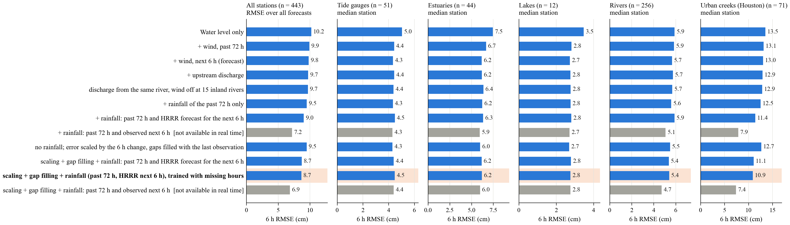
What each version does, by station type
Wind helps the tidal types: tide gauges 5.0 to 4.3 cm, estuaries 7.5 to 6.2 cm, lakes 3.5 to 2.7 cm. Upstream discharge changes the medians by 0.1 cm or less.
The 6 h-change scaling and gap filling help rivers (5.7 to 5.5 cm) and do not cost the tidal types anything.
Rainfall helps urban creeks, and how much depends on where the rainfall of the next 6 h comes from: 12.9 cm without rainfall, 10.9 cm with scaling, gap filling and the HRRR forecast (highlighted), 7.4 cm if the rainfall were known exactly (grey bars, not available in real time).
Without the scaling and gap filling, HRRR rainfall made rivers and tide gauges slightly worse; with them it does not.

Slide 4
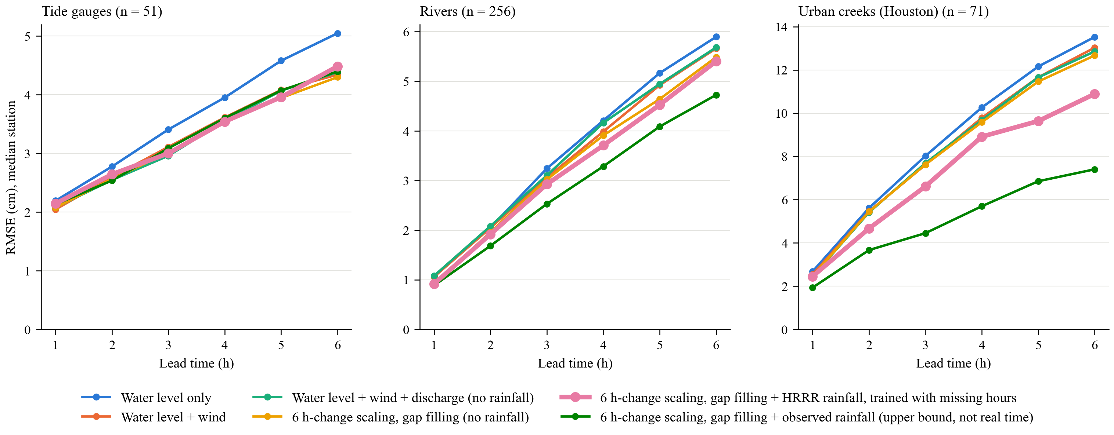
Error against lead time for the six main versions
Tide gauges: all versions with wind lie on one line, 0.7 cm below water level only at 6 h. Neither the scaling and gap filling nor rainfall changes them.
Rivers: the 6 h-change scaling and gap filling lower the error at every lead; rainfall lowers it further.
Urban creeks: the versions separate after 2 h. With scaling, gap filling and HRRR rainfall (thick line) the error is 2.0 cm below water level + wind + discharge at 6 h; with observed rainfall it would be 5.5 cm below.

Slide 5
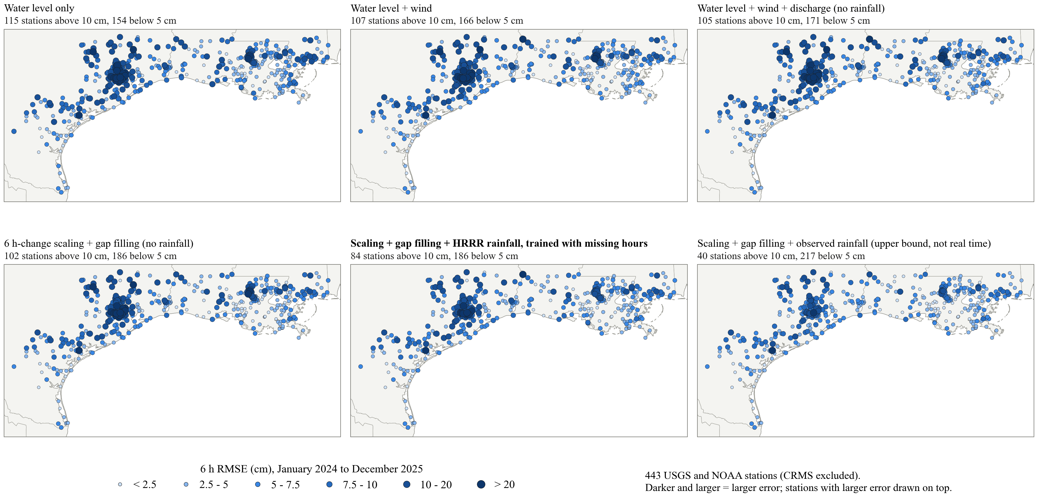
Station by station: 6 h RMSE of the six main versions
Stations above 10 cm: 115 with water level only, 105 with wind and discharge added, 102 with 6 h-change scaling and gap filling, 84 with HRRR rainfall added to that, 40 with observed rainfall. The dark stations sit in the same two places in every map: the Houston creeks and the small rivers north and east of Baton Rouge.

Slide 6
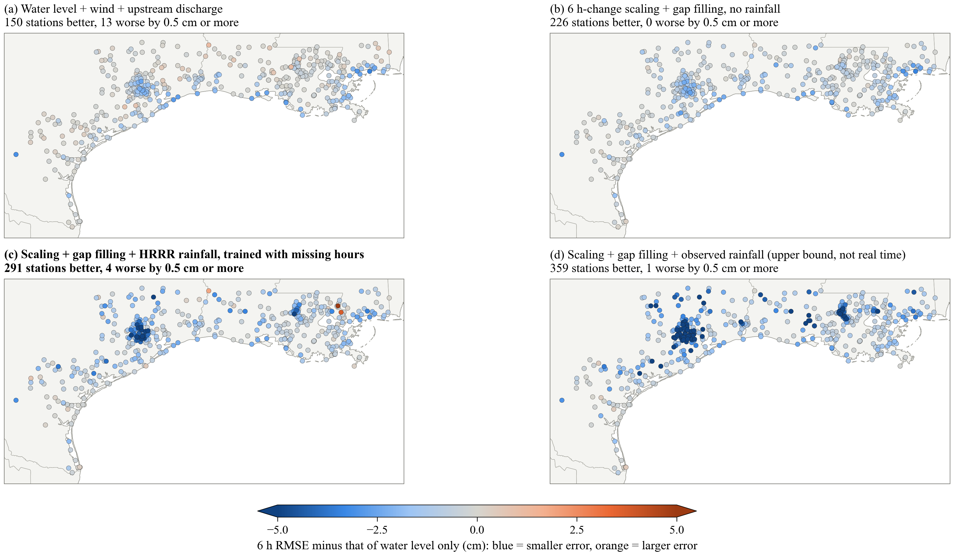
Station by station: each version against water level only
All four maps show the 6 h RMSE minus that of the water-level-only version, so they can be compared with each other.
(a) Water level + wind + discharge: 150 stations better, 13 worse. The gain follows the coast and the bays.
(b) 6 h-change scaling + gap filling, no rainfall: 226 better, 0 worse. Inland rivers are added to the gain; no station is worse than with water level only.
(c) Scaling + gap filling + HRRR rainfall, trained with missing hours: 291 better, 4 worse. Houston and the creeks around Baton Rouge turn blue. The two dark orange stations are Pearl River navigation locks, where gate operation sets the level and rainfall only misleads the model.
(d) Scaling + gap filling + observed rainfall of the next 6 h: 359 better, 1 worse. Same places as (c), several times stronger. The difference between (c) and (d) is the error of the rainfall forecast.
Better / worse: by 0.5 cm or more. Colour scale limited to 5 cm in both directions.

Slide 7
The version that is run: RMSE by station type, in the hurricanes and in the rest of the test period
Hurricanes Beryl and Francine
Rest of 2024 and 2025
RMSE (cm)
stations
1 h ahead
3 h ahead
6 h ahead
1 h ahead
3 h ahead
6 h ahead
Tide gauges
51
4.2
7.8
14.4
2.5
3.8
5.0
Estuaries / tidal channels
44
6.3
19.6
42.1
2.5
5.9
8.8
Lakes
12
2.1
6.2
7.3
1.3
2.6
3.8
Rivers / canals
256
2.0
6.1
13.4
1.5
4.3
7.6
Urban creeks (Houston)
71
9.2
24.5
57.9
3.3
8.7
12.7
Marsh
9
1.0
1.4
4.4
1.0
1.5
2.2
All stations
443
4.7
12.9
29.1
2.2
5.3
8.4
Scaling + gap filling + HRRR rainfall, trained with missing hours. RMSE over all forecasts of the stations of a type (not the median station); stations with real-time data, January 2024 to December 2025.
Hurricane periods: Beryl, 7 to 11 July 2024, at the stations of the Texas and Galveston domains; Francine, 10 to 14 September 2024, at the stations of the Louisiana domain. Rest: every other forecast of the two years; it still contains other floods, such as May 2024.
Over all stations the 6 h error in the hurricanes is 3.5 times that of the rest (29.1 against 8.4 cm). The largest errors are at urban creeks (57.9 cm) and estuaries (42.1 cm); lakes and rivers grow least. At 1 h ahead no type exceeds 9.2 cm, also in the hurricanes.
Marsh: 9 stations and 141 forecasts in the hurricane periods, so those numbers are uncertain.

Slide 8
Also tried: changes that made no measurable difference
Change
6 h RMSE, all stations (cm)
Reference (cm)
Look-back 168 h instead of 72 h
9.76
9.69
Look-back 336 h instead of 72 h
9.77
9.69
3 LSTM layers instead of 2
9.72
9.69
Observed rainfall at the station point instead of the 15 km mean
7.24
7.19
HRRR rainfall as 6 hourly values, 15 km, instead of a 6 h total, 45 km
9.11
9.03
HRRR rainfall as 6 hourly values, 45 km
9.09
9.03
HRRR cycle issued at forecast time instead of 1 h earlier
9.07
9.03
Model trained on observed rainfall, run with HRRR rainfall
9.72
9.70
Error scaled all the way to the 6 h change instead of half-way (tide gauges 0.4 cm worse)
9.45
9.50
Look-back 720 h (30 days) instead of 72 h; 12 training epochs each, training takes 9 times as long
8.96
8.99
Mean level and rainfall total of the last 7 and 30 days as extra inputs
8.72
8.71
Water level at the next gauge downstream (or the nearest tide gauge) as input
9.48
9.50
Reference: water level + wind + discharge for the first three rows and the eighth; the version of the same kind for the others (for the last three rows: the version with 6 h-change scaling and gap filling, with or without HRRR rainfall). Same stations in both columns.
Separate models for tidal stations and for river stations were also trained and were not better than the single model on the same stations.
Network size and the form of the inputs are not what limits the forecast. The limit is information the inputs do not contain: rainfall of the coming hours, and gate and reservoir operation.

Slide 9
How to read the station slides
One station per slide. Six columns: six versions, left to right. Two rows: two 4-day periods from the test years.
Top row: the hurricane — Francine, 10 to 14 September 2024, in Louisiana; Beryl, 7 to 11 July 2024, in Texas.
Bottom row: the highest water level at that station outside the hurricane.
Black: observed water level. Orange lines, pale to vivid: the forecast valid at each hour that was issued 1, 3 and 6 hours earlier. A forecast is issued every hour.
A red-orange line that follows the black line a few hours late means the version only reacts once the rise is already in the observations. Grey band: 24 hours around the observed peak. Numbers inside each panel: RMSE in that period at 1, 3 and 6 hours lead.
Above each column: the 6 h RMSE of that version at the station over the whole two test years.
The fifth column, with its heading in bold, is the version that is run: 6 h-change scaling, gap filling and HRRR rainfall, trained with missing hours. Columns one to four have no rainfall.
The sixth column uses the observed rainfall of the next 6 hours. It cannot be run in real time and shows how far a perfect rainfall forecast would go.
Stations: 18, picked by type, with a complete record. A station is shown only if the observation and the inputs of all six versions have no missing hour in both periods.
No USGS marsh station met that condition, so the marsh type is not shown.

Slide 10
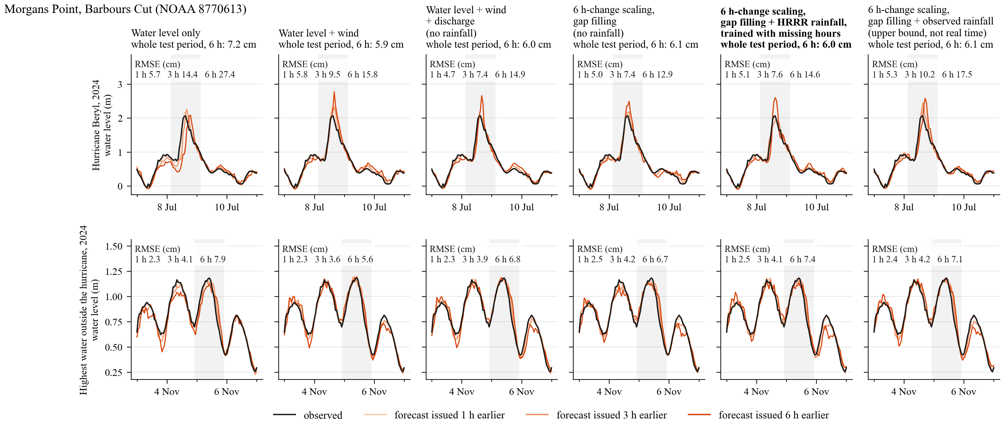
Tide gauge — Morgans Point, Barbours Cut (NOAA 8770613), Galveston100m
Whole test period, step by step: wind -1.3 cm; discharge and wind refinements +0.1 cm; 6 h-change scaling and gap filling +0.1 cm; HRRR rainfall and training with missing hours on top of that -0.1 cm (observed rainfall would give +0.1 cm).

Slide 11
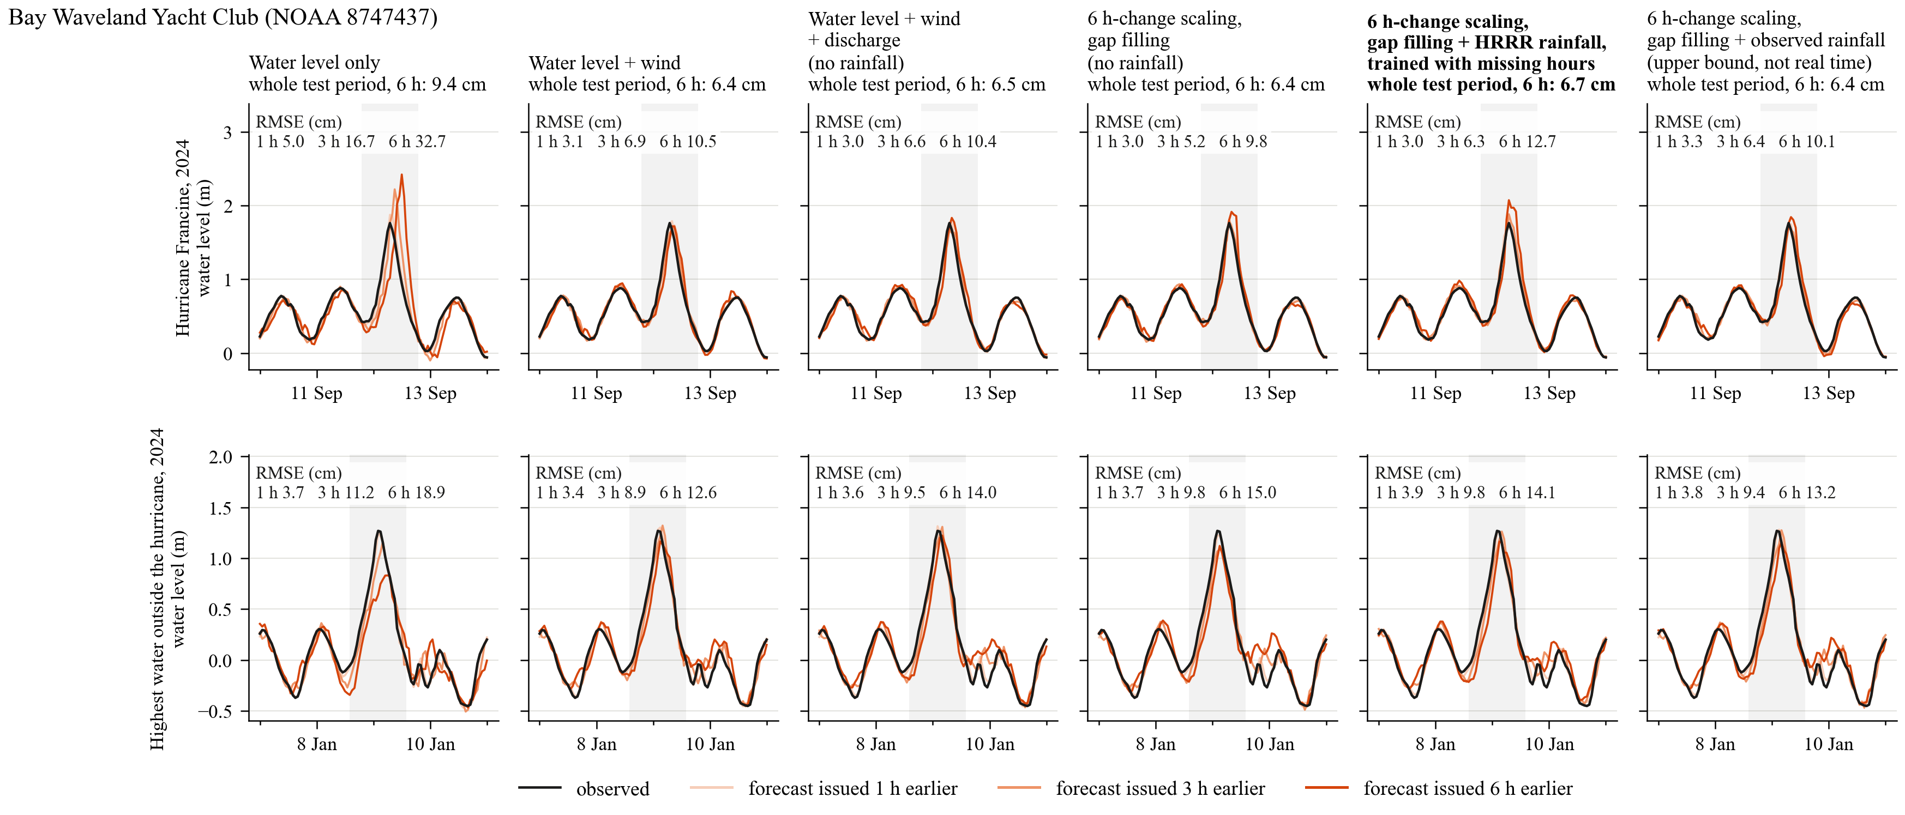
Tide gauge — Bay Waveland Yacht Club (NOAA 8747437), Louisiana100m
Whole test period, step by step: wind -3.0 cm; discharge and wind refinements +0.1 cm; 6 h-change scaling and gap filling -0.1 cm; HRRR rainfall and training with missing hours on top of that +0.3 cm (observed rainfall would give +0.0 cm).

Slide 12
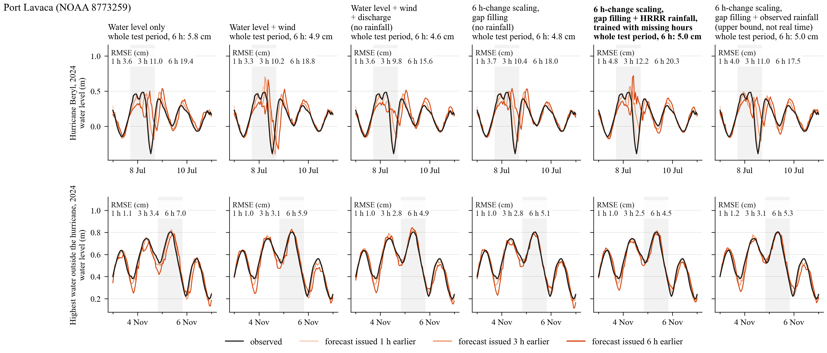
Tide gauge — Port Lavaca (NOAA 8773259), Texas100m
Whole test period, step by step: wind -0.9 cm; discharge and wind refinements -0.2 cm; 6 h-change scaling and gap filling +0.2 cm; HRRR rainfall and training with missing hours on top of that +0.2 cm (observed rainfall would give +0.2 cm).

Slide 13
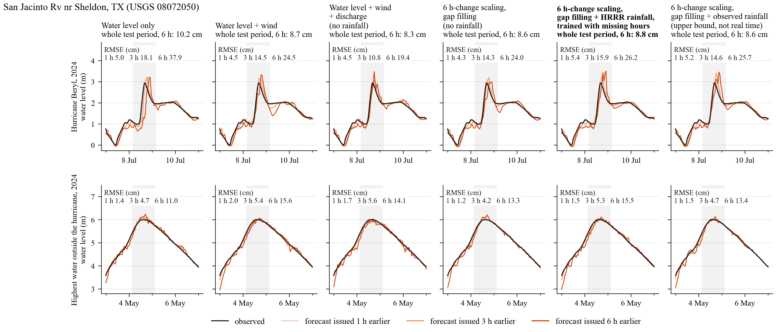
Estuary / tidal channel — San Jacinto Rv nr Sheldon, TX (USGS 08072050), Galveston100m
Whole test period, step by step: wind -1.4 cm; discharge and wind refinements -0.4 cm; 6 h-change scaling and gap filling +0.3 cm; HRRR rainfall and training with missing hours on top of that +0.2 cm (observed rainfall would give -0.0 cm).

Slide 14
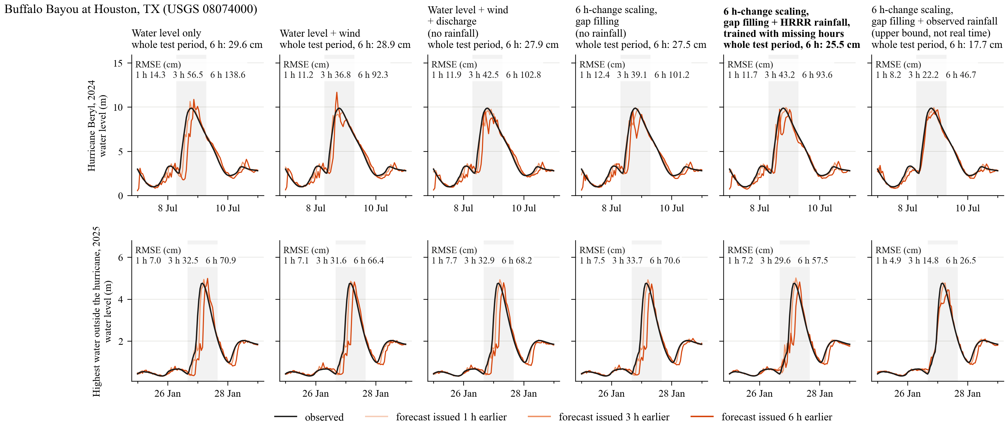
Estuary / tidal channel — Buffalo Bayou at Houston, TX (USGS 08074000), Galveston100m
Whole test period, step by step: wind -0.7 cm; discharge and wind refinements -1.0 cm; 6 h-change scaling and gap filling -0.4 cm; HRRR rainfall and training with missing hours on top of that -2.0 cm (observed rainfall would give -9.8 cm).

Slide 15
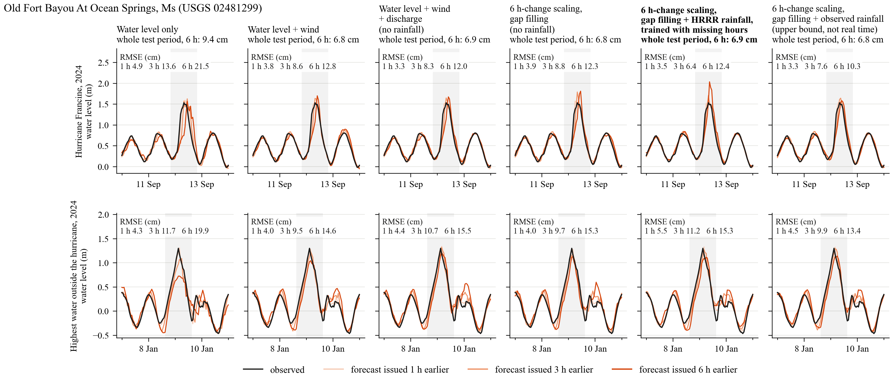
Estuary / tidal channel — Old Fort Bayou At Ocean Springs, Ms (USGS 02481299), Louisiana100m
Whole test period, step by step: wind -2.5 cm; discharge and wind refinements +0.0 cm; 6 h-change scaling and gap filling -0.1 cm; HRRR rainfall and training with missing hours on top of that +0.1 cm (observed rainfall would give -0.0 cm).

Slide 16
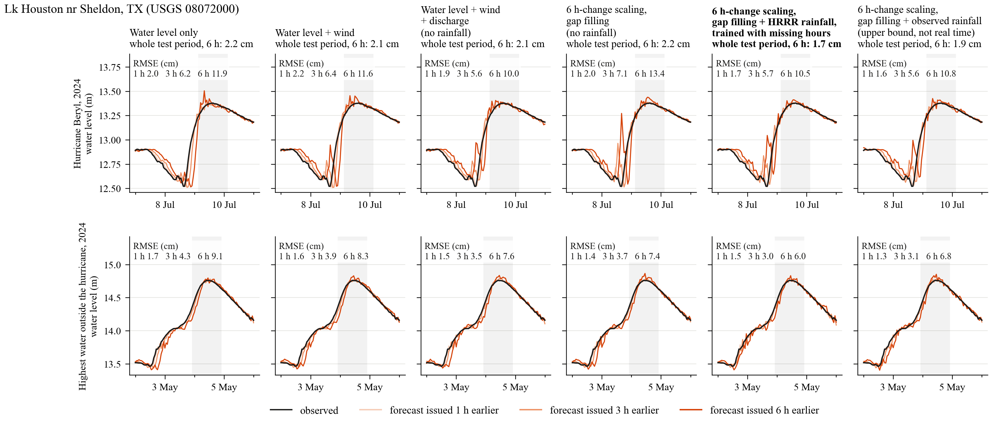
Lake — Lk Houston nr Sheldon, TX (USGS 08072000), Galveston100m
Whole test period, step by step: wind -0.1 cm; discharge and wind refinements +0.0 cm; 6 h-change scaling and gap filling +0.0 cm; HRRR rainfall and training with missing hours on top of that -0.4 cm (observed rainfall would give -0.2 cm).

Slide 17
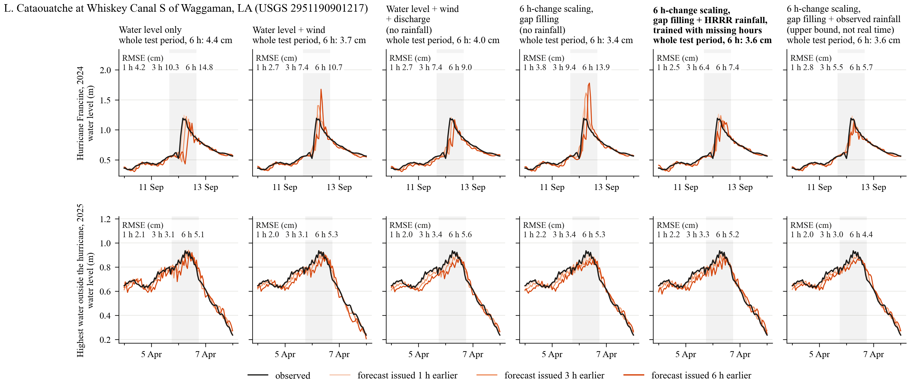
Lake — L. Cataouatche at Whiskey Canal S of Waggaman, LA (USGS 2951190901217), Louisiana100m
Whole test period, step by step: wind -0.7 cm; discharge and wind refinements +0.3 cm; 6 h-change scaling and gap filling -0.6 cm; HRRR rainfall and training with missing hours on top of that +0.2 cm (observed rainfall would give +0.2 cm).

Slide 18
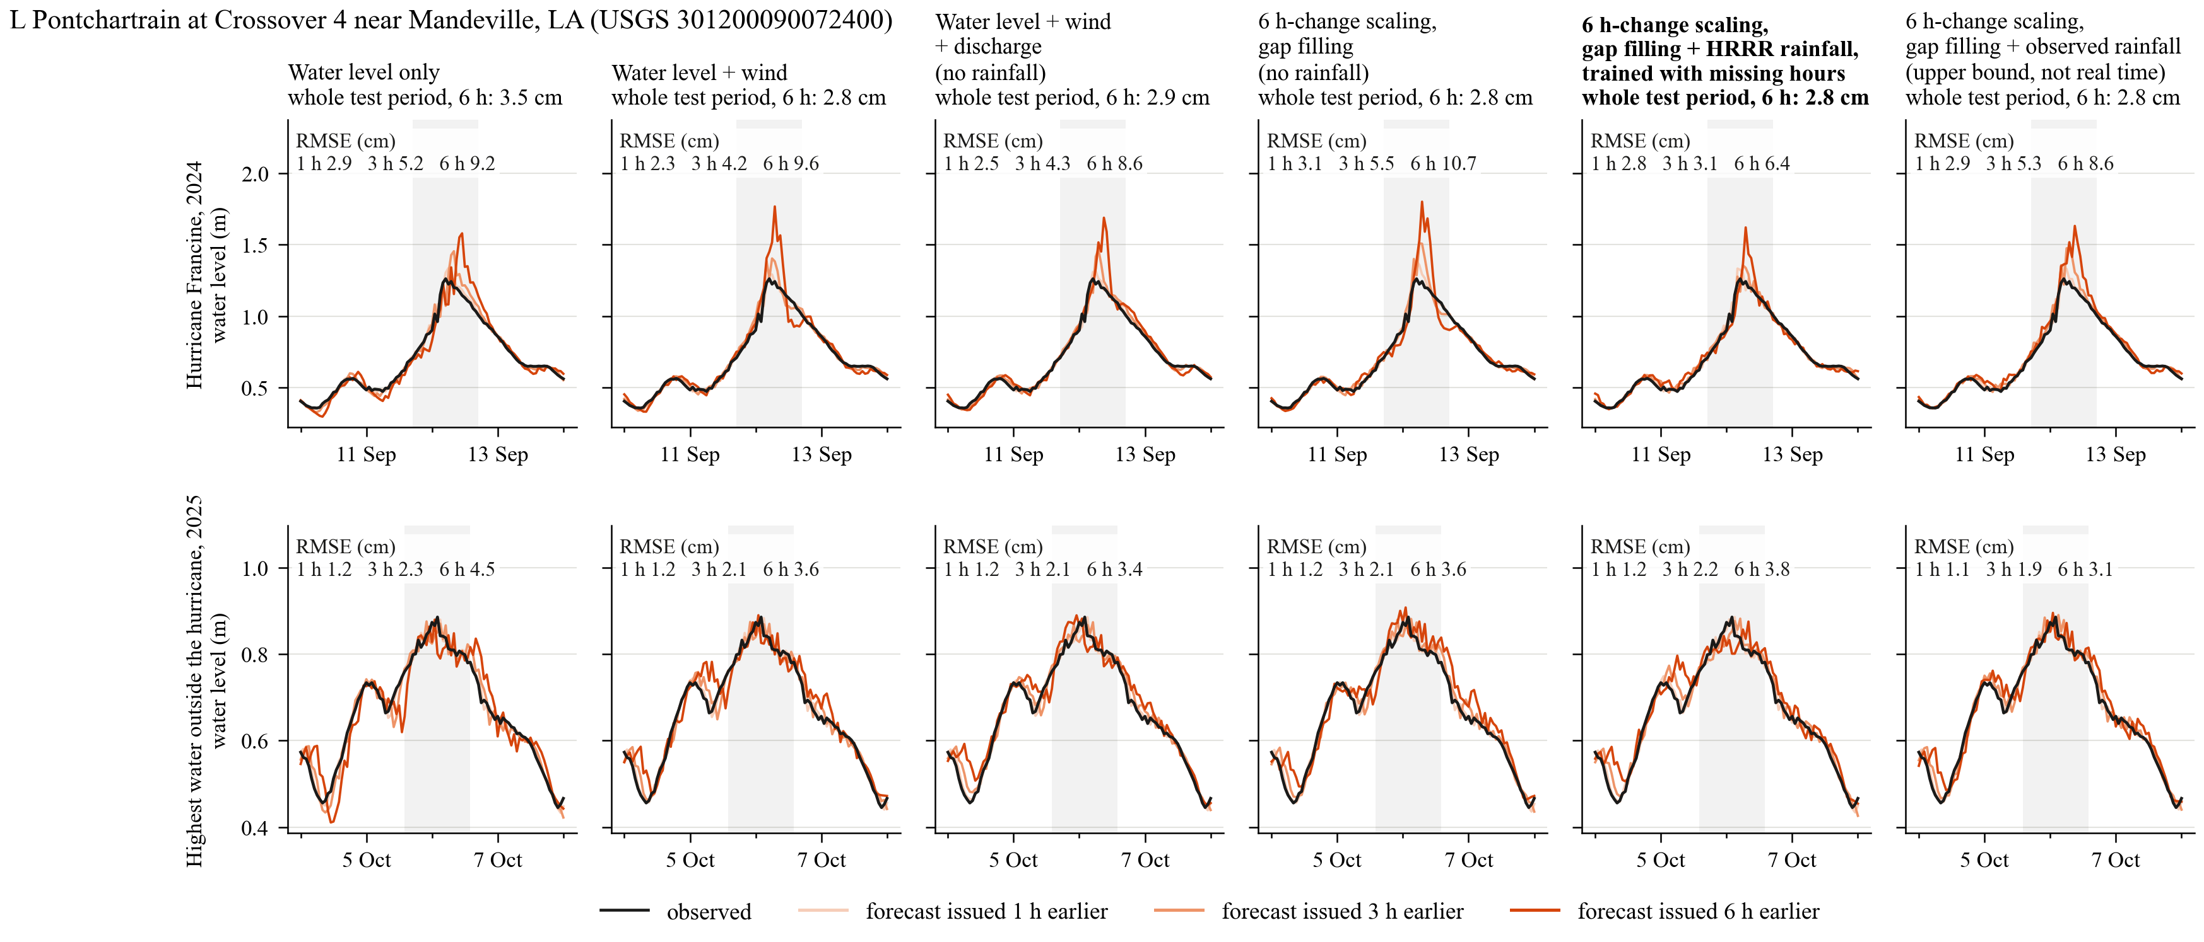
Lake — L Pontchartrain at Crossover 4 near Mandeville, LA (USGS 301200090072400), Louisiana100m
Whole test period, step by step: wind -0.7 cm; discharge and wind refinements +0.0 cm; 6 h-change scaling and gap filling -0.1 cm; HRRR rainfall and training with missing hours on top of that +0.1 cm (observed rainfall would give +0.1 cm).

Slide 19
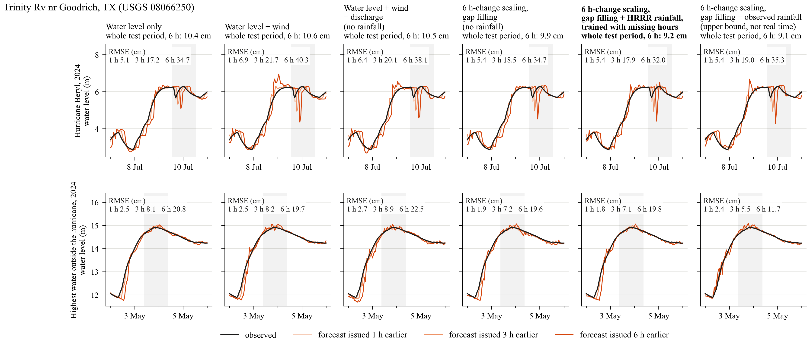
River — Trinity Rv nr Goodrich, TX (USGS 08066250), Galveston100m
Whole test period, step by step: wind +0.2 cm; discharge and wind refinements -0.1 cm; 6 h-change scaling and gap filling -0.6 cm; HRRR rainfall and training with missing hours on top of that -0.7 cm (observed rainfall would give -0.8 cm).

Slide 20
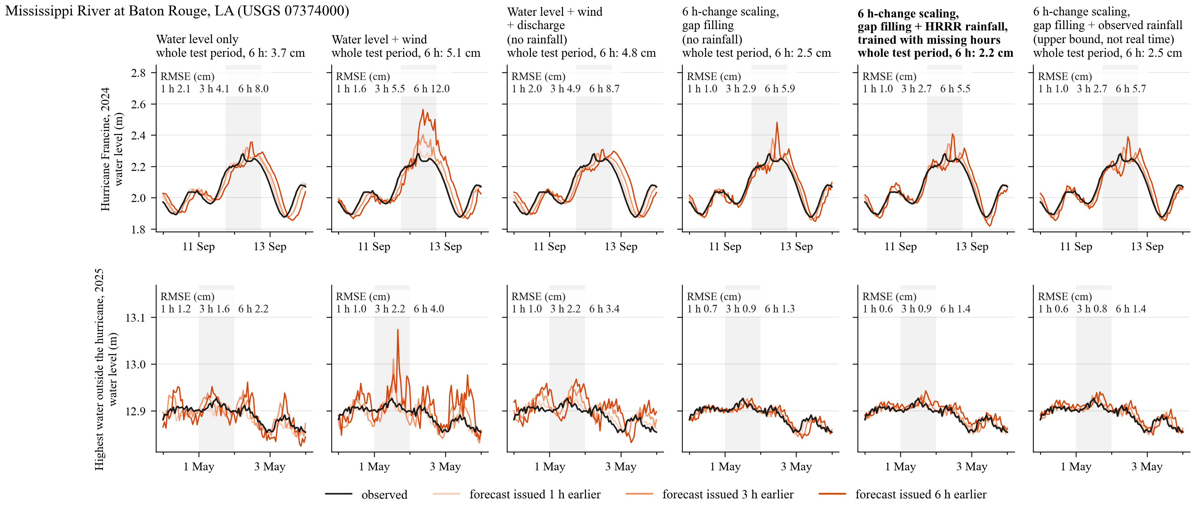
River — Mississippi River at Baton Rouge, LA (USGS 07374000), Louisiana100m
Whole test period, step by step: wind +1.4 cm; discharge and wind refinements -0.3 cm; 6 h-change scaling and gap filling -2.3 cm; HRRR rainfall and training with missing hours on top of that -0.3 cm (observed rainfall would give +0.0 cm).

Slide 21
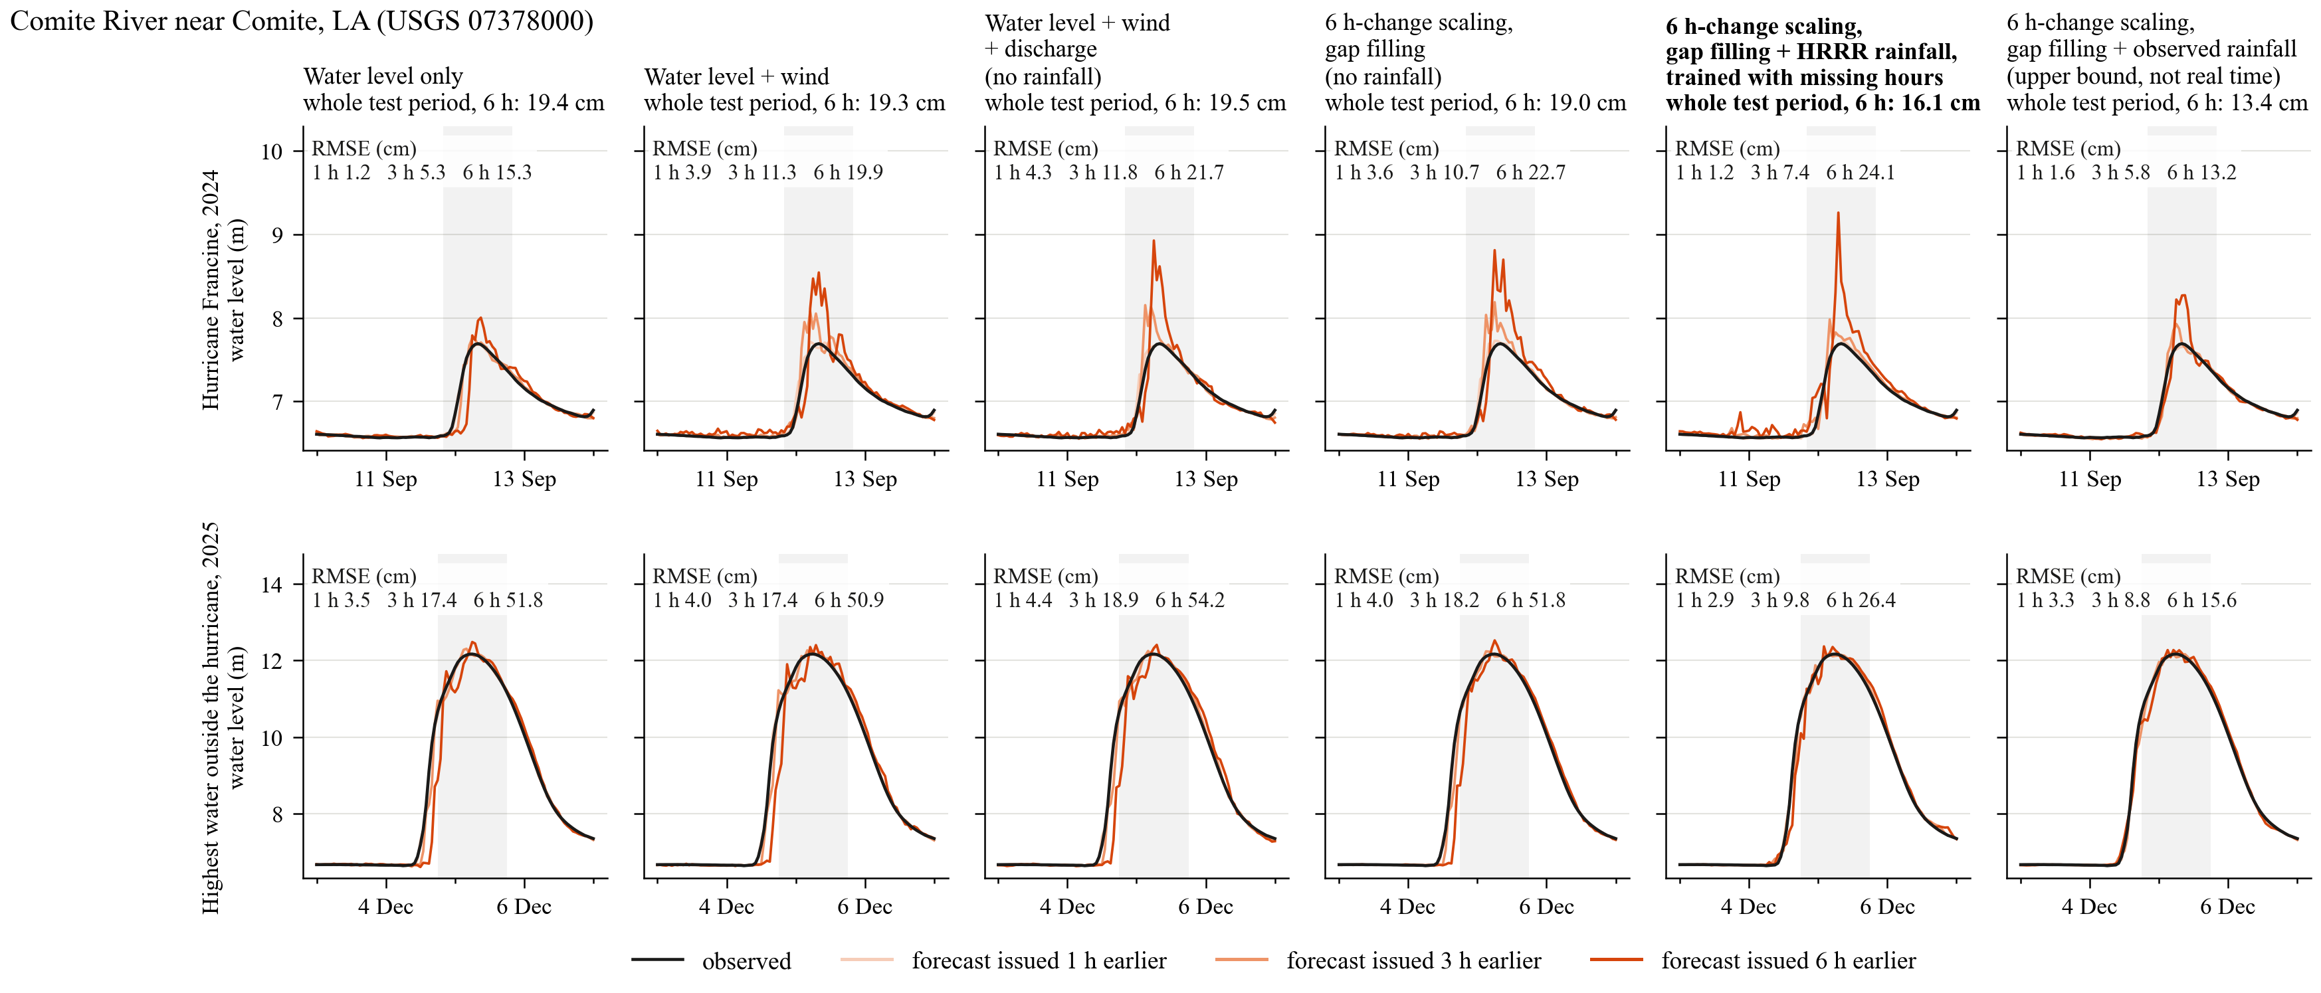
River — Comite River near Comite, LA (USGS 07378000), Louisiana100m
Whole test period, step by step: wind -0.2 cm; discharge and wind refinements +0.2 cm; 6 h-change scaling and gap filling -0.4 cm; HRRR rainfall and training with missing hours on top of that -2.9 cm (observed rainfall would give -5.7 cm).

Slide 22
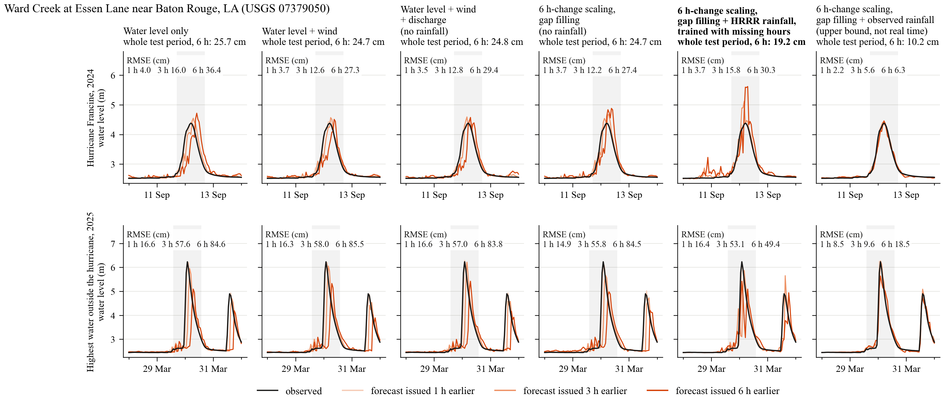
River — Ward Creek at Essen Lane near Baton Rouge, LA (USGS 07379050), Louisiana100m
Whole test period, step by step: wind -1.0 cm; discharge and wind refinements +0.1 cm; 6 h-change scaling and gap filling -0.2 cm; HRRR rainfall and training with missing hours on top of that -5.5 cm (observed rainfall would give -14.5 cm).

Slide 23
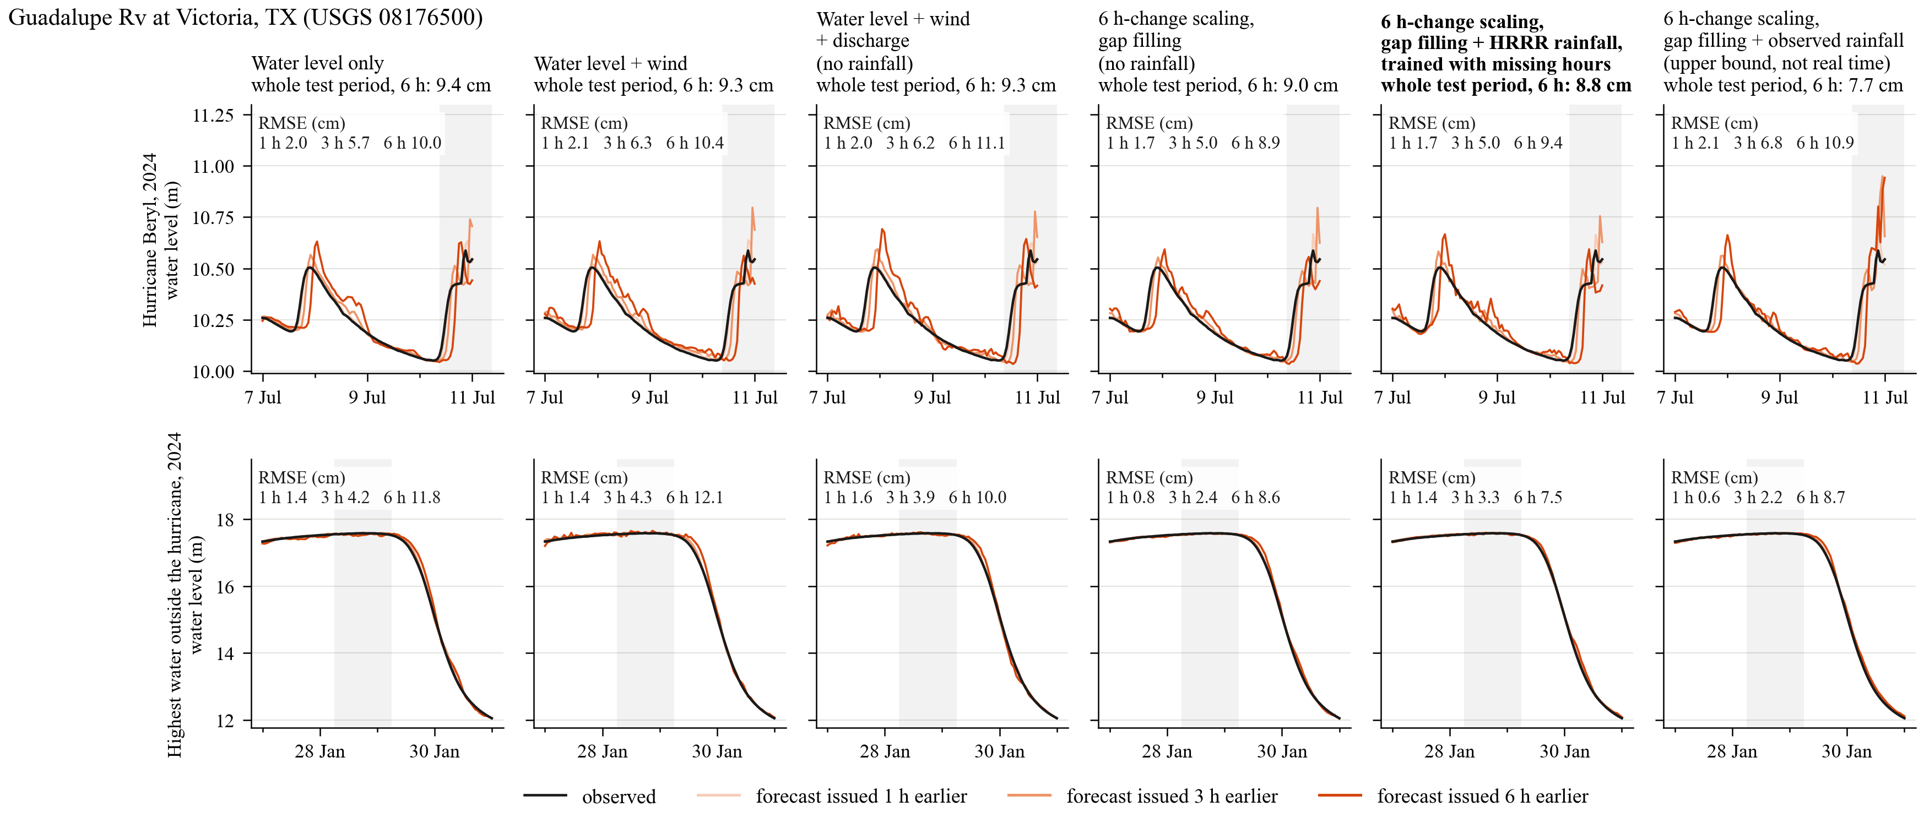
River — Guadalupe Rv at Victoria, TX (USGS 08176500), Texas100m
Whole test period, step by step: wind -0.1 cm; discharge and wind refinements +0.0 cm; 6 h-change scaling and gap filling -0.2 cm; HRRR rainfall and training with missing hours on top of that -0.2 cm (observed rainfall would give -1.3 cm).

Slide 24
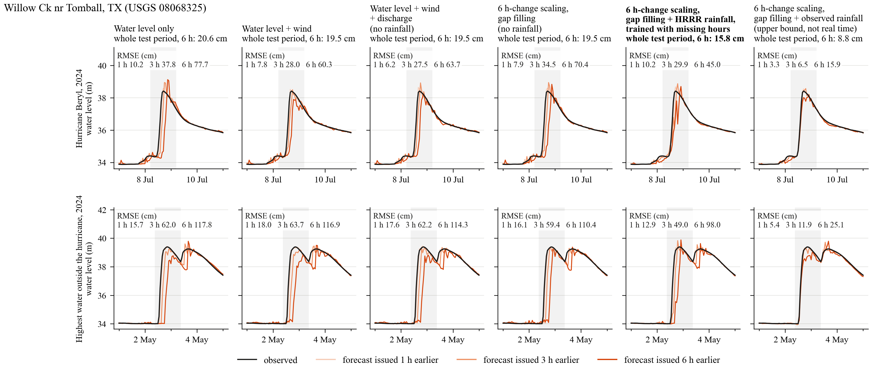
Urban creek — Willow Ck nr Tomball, TX (USGS 08068325), Galveston100m
Whole test period, step by step: wind -1.0 cm; discharge and wind refinements -0.1 cm; 6 h-change scaling and gap filling +0.0 cm; HRRR rainfall and training with missing hours on top of that -3.7 cm (observed rainfall would give -10.7 cm).

Slide 25
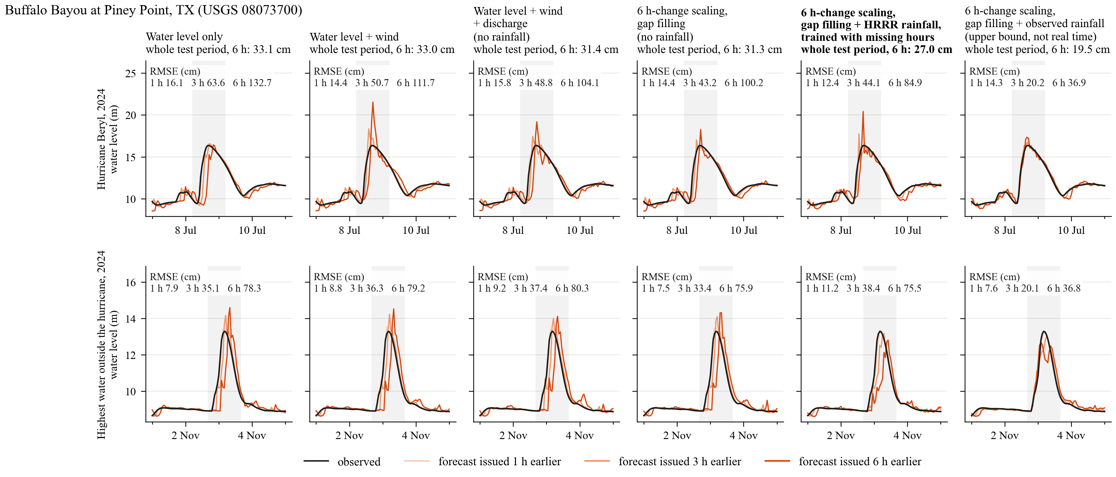
Urban creek — Buffalo Bayou at Piney Point, TX (USGS 08073700), Galveston100m
Whole test period, step by step: wind -0.1 cm; discharge and wind refinements -1.6 cm; 6 h-change scaling and gap filling -0.2 cm; HRRR rainfall and training with missing hours on top of that -4.3 cm (observed rainfall would give -11.8 cm).

Slide 26
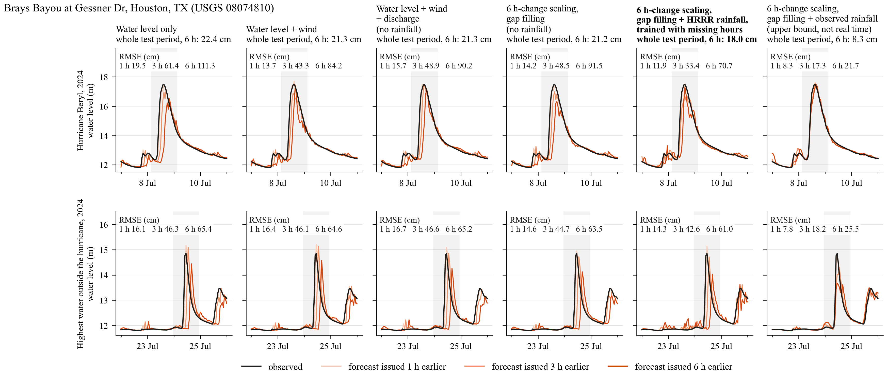
Urban creek — Brays Bayou at Gessner Dr, Houston, TX (USGS 08074810), Galveston100m
Whole test period, step by step: wind -1.1 cm; discharge and wind refinements -0.1 cm; 6 h-change scaling and gap filling -0.1 cm; HRRR rainfall and training with missing hours on top of that -3.2 cm (observed rainfall would give -12.9 cm).

Slide 27
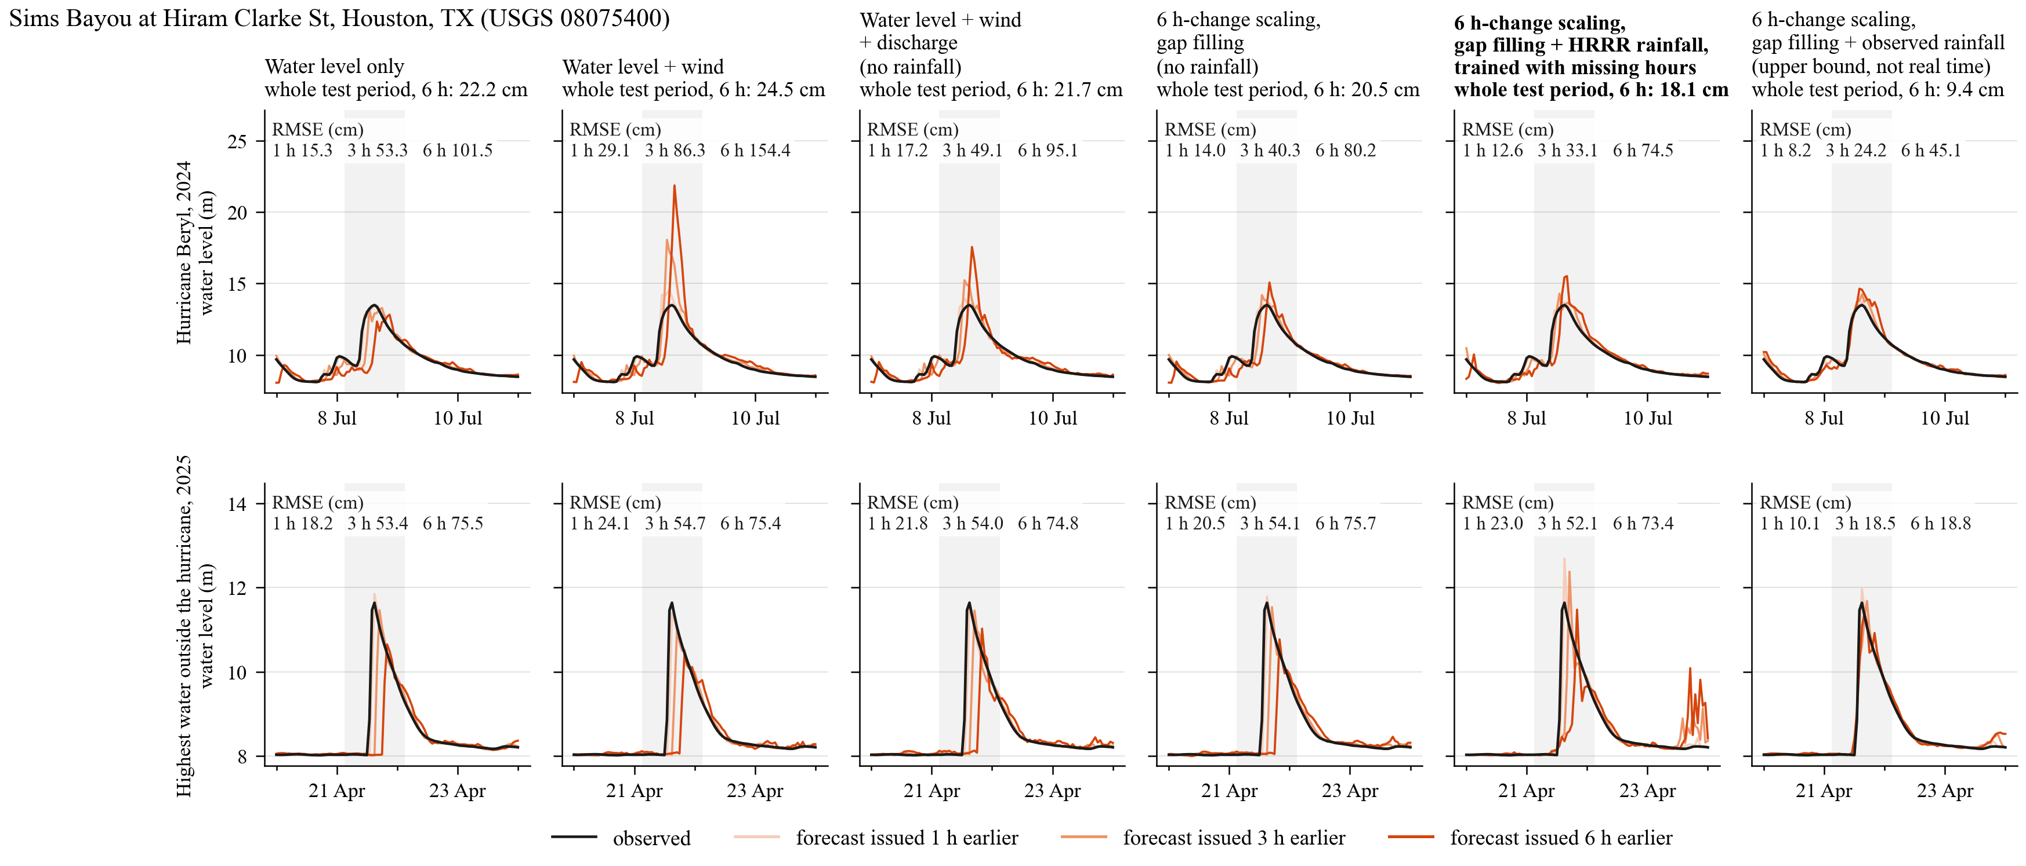
Urban creek — Sims Bayou at Hiram Clarke St, Houston, TX (USGS 08075400), Galveston100m
Whole test period, step by step: wind +2.3 cm; discharge and wind refinements -2.7 cm; 6 h-change scaling and gap filling -1.2 cm; HRRR rainfall and training with missing hours on top of that -2.4 cm (observed rainfall would give -11.1 cm).

Slide 28
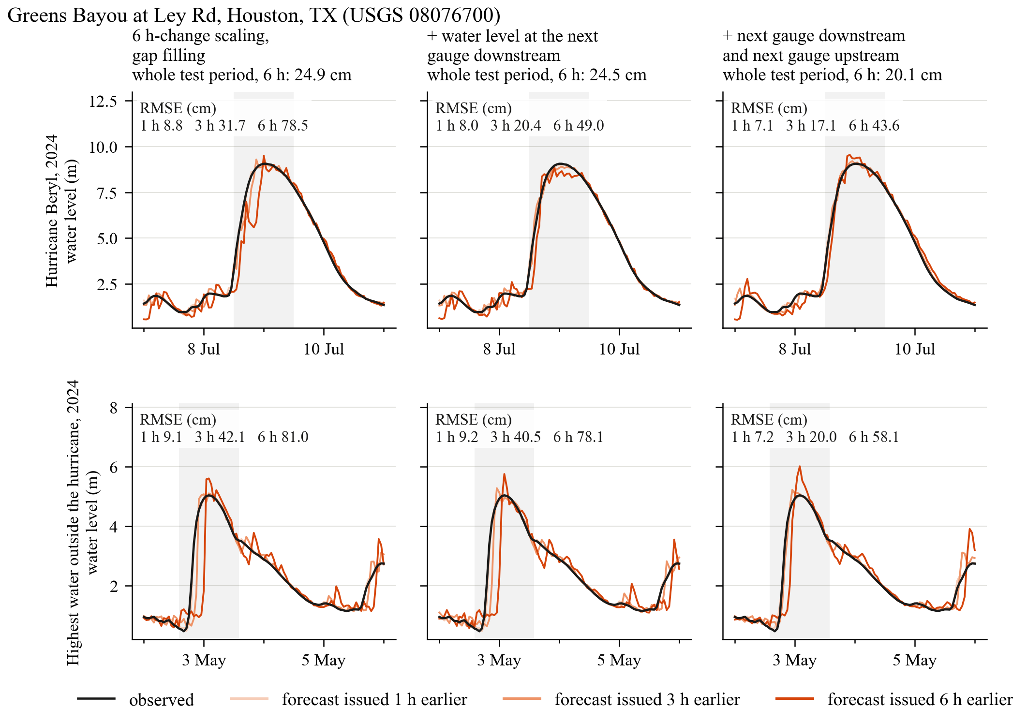
The 6 h forecast runs late: a gauge upstream helps at 127 stations, the lag stays on average
On the station slides the 6 h forecast often follows the observation a few hours late. Tested: give the model the water level at the next gauge downstream (sees tide and surge first) and at the next gauge upstream (sees a flood wave first) on the same river.
6 h RMSE, all stations: 9.50 cm without, 9.48 cm with the downstream gauge, 9.35 cm with both. With HRRR rainfall: 8.71 to 8.60 cm.
The gain is at the 127 stations that have a gauge upstream: 11.7 to 11.2 cm, 38 better and 2 worse by 0.5 cm or more (with HRRR rainfall 10.3 to 10.0 cm, 29 better, 2 worse). The downstream gauge alone changes nothing.
Lag of the 6 h forecast behind the observation, mean over 43 event periods at 22 stations: 2.5 h without, 2.5 h with the downstream gauge, 2.5 h with both. At the stations with an upstream gauge: 2.5 h and 2.5 h. Mississippi at Baton Rouge during Francine: 3 h in all three.
On average the upstream gauge improves the height of the forecast, not its timing. The lag comes from what has not happened yet at forecast time: with the observed rainfall of the next 6 h as input, the lag at the urban creeks drops from 4-5 h to nearly zero.
Lag: the shift, 0 to 8 h, at which the forecast fits the observation best.
The station with the largest gain: Greens Bayou at Ley Rd, with a gauge 11.5 km upstream on the same bayou. Here the 6 h forecast (red-orange) also rises earlier: its lag goes from 2 to 1 h during Beryl and from 4 to 2 h in May 2024. This station is the exception; over all stations with an upstream gauge the lag does not change.

Slide 29
Rainfall in real time: where the two rainfall inputs come from
6 h RMSE (cm)
Rainfall of the past 72 h taken from
Available in real time
All stations
Urban creeks
Stations worse
AORC reanalysis (used for training)
no
8.66
10.9
-
MRMS radar and gauge analysis, 1 km
yes, 16 min after the hour
8.70
10.8
2 of 443
HRRR short-range forecast, 1 to 6 h lead
yes
9.14
11.7
105 of 443
No rainfall of the past 72 h
-
9.70
11.9
261 of 443
The same trained model (scaling + gap filling + HRRR rainfall, trained with missing hours) in every row; only the source of the past rainfall is changed, without retraining. Stations worse: by 0.5 cm or more than with the training product.
Past 72 h. The model was trained with AORC, which is not produced in real time. MRMS replaces it at almost no cost: hourly correlation with AORC 0.93 over the two test years, 3 hours missing in two years. A short-range HRRR forecast does not: hourly correlation 0.33, and half of the gain from rainfall is lost. The forecast script therefore uses MRMS and falls back to HRRR only for hours MRMS does not have.
Next 6 h. HRRR precipitation forecast, the cycle issued 1 h before forecast time, total of the 45 km around the station - exactly as in training.
HRRR is still produced. NWS replaced NAM by RRFS on 3 November 2026 and intends RRFS to replace HRRR later; when that is announced, the next-6 h rainfall input has to be retrained with RRFS forecasts, and an archive of them has to be collected first.

Slide 30
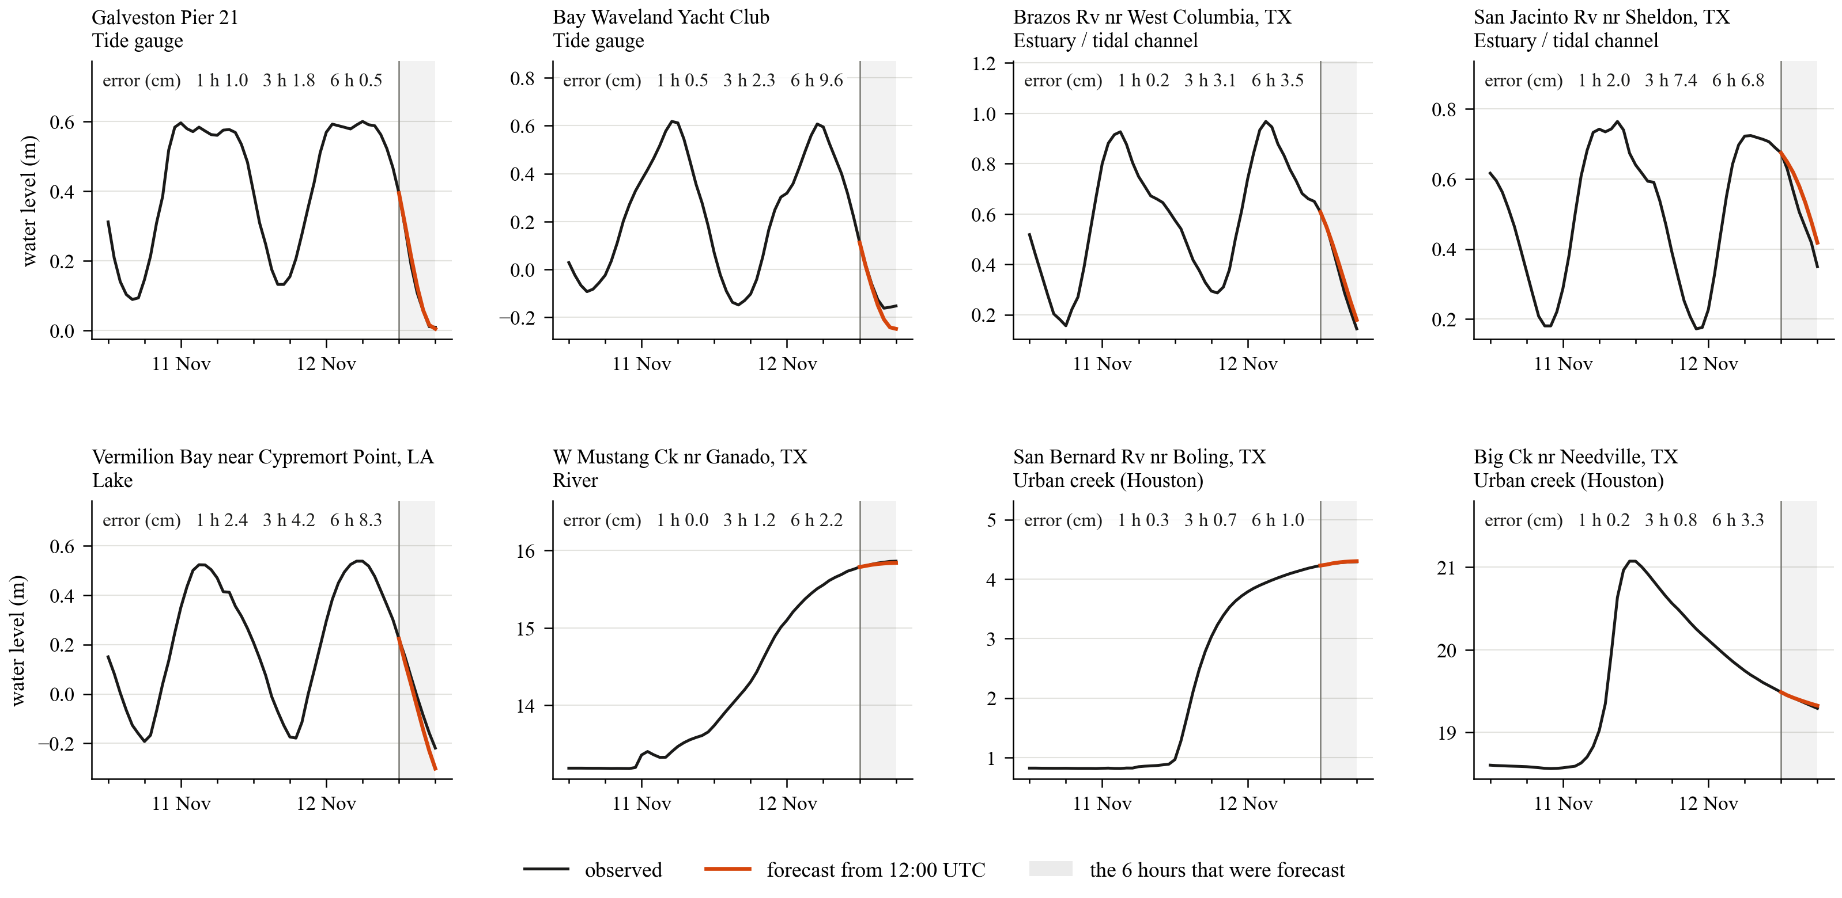
A forecast from the real-time data services for 12 November 2026, 12:00 UTC, checked afterwards
Black: observed, 48 h before the forecast time and the 6 h after it. Red-orange: the forecast of the model that is run (scaling + gap filling + HRRR rainfall, trained with missing hours). Numbers: error at 1, 3 and 6 h. The forecast script was run the same day at 20:14 UTC for the forecast time 12:00 UTC, with inputs dated no later than 12:00 UTC (gauges and MRMS up to 12:00, HRRR wind from the 12:00 cycle, HRRR rainfall from the 11:00 cycle), so that the 6 h could be checked at once. Eight stations with large changes in those 6 h, from all five types, all with a complete record: the tide going out, Texas rivers still rising or falling after the rain of 11 November. Largest miss here: Bay Waveland, 9.6 cm at 6 h, where the fall stopped earlier than forecast.

Slide 31
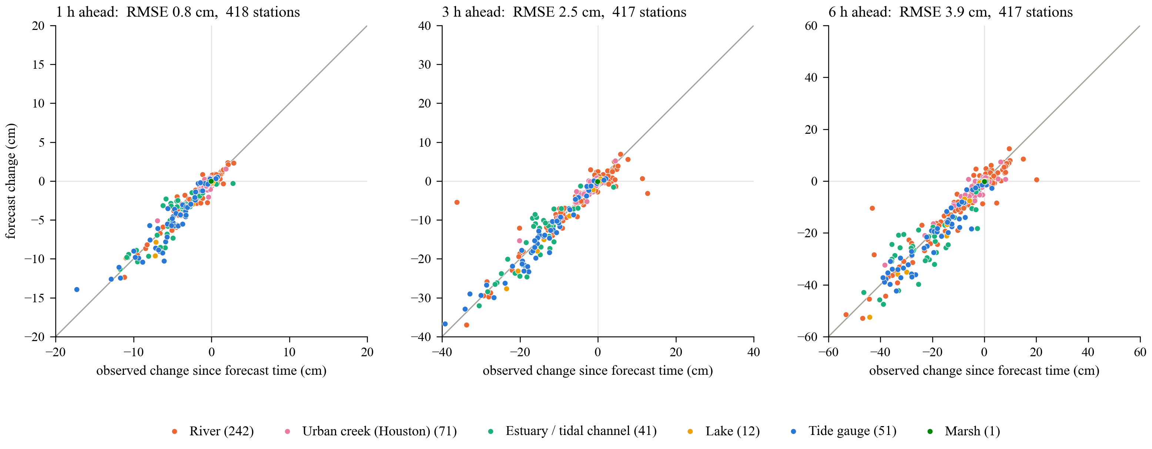
The same forecast at all 417 stations: 1, 3 and 6 hours ahead
Each dot is a station: how much the water level changed after the forecast time (horizontal) against how much the forecast said it would change (vertical). On the line = exact.
RMSE over all stations: 0.8 cm at 1 h, 1.5 at 2 h, 2.5 at 3 h, 3.1 at 4 h, 3.4 at 5 h, 3.9 at 6 h; half of the stations are within 0.3, 0.6 and 1.0 cm at 1, 3 and 6 h. At 6 h by type: tide gauges 4.4, estuaries 7.1, lakes 3.6, rivers 3.5, urban creeks 2.1 cm.
418 of the 457 stations got a forecast (the others returned no or too little data); the whole run took under a minute. Largest miss: Colorado River near Bay City, 33 cm at 6 h (the river fell 43 cm, the forecast 10 cm). One forecast time with no rain ahead: it shows that the chain works, it is not a statistic.

Slide 32
1, 3 and 6 h forecasts: the computing cost is the same, the timing is not
Computing
One model gives all six lead times in one pass, so offering 1 h, 3 h or 6 h costs the same. Training: once, about 40 min on one A100 GPU. One forecast for the 457 stations: about 50 s, of which USGS water level 6 s, NOAA water level 37 s (54 gauges one after another, the service refuses parallel requests), HRRR wind 4 s, discharge 2 s, rainfall and the network itself under 1 s each. The only input that grows with the lead time is the HRRR wind forecast: 1, 3 or 6 forecast hours, about 2 MB and under 1 s each.
Accuracy
RMSE (cm), stations with real-time data
newest hour in hand
newest 1 h not yet in
newest 2 h not yet in
1 h ahead
2.2
3.4
4.5
3 h ahead
5.4
6.1
6.9
6 h ahead
8.6
9.2
9.8
Scaling + gap filling + HRRR rainfall, trained with missing hours; all forecasts of 2024 and 2025. Lead time counted from the forecast hour.
Timing
What a short lead time needs is speed, not computing. Measured on 12 November 2026, 21:06 UTC: the newest reading was 7 min old at the NOAA tide gauges and 51 min old at the USGS gauges (median). Asked again every 5 min until 47 min after the hour: half of the USGS gauges had the 21:00 reading after 32 min, 77% after 47 min. Wind and rainfall do not hold the run back: the script takes the newest MRMS hour and HRRR cycle that are published.
If the forecast waits until the USGS readings of the forecast hour are in, it leaves about an hour after it: the 1 h forecast is then already in the past, the 3 h forecast has about 2 h left, the 6 h forecast about 5 h.
A 1 h forecast is therefore useful only if the run starts a few minutes after the hour, without the newest hour at the USGS gauges. The model is trained for that; the price is the middle column of the table. It also needs an hourly scheduled run; the forecast is started by hand so far.

Slide 33
When a gauge stops reporting: the model is now trained for it
6 h RMSE (cm)
Water level + wind + discharge
Scaling + gap filling + HRRR rainfall
Scaling + gap filling + HRRR rainfall,
trained with missing hours
All forecasts, 2024 to 2025
newest observation at forecast time
9.7
8.7
8.6
gauge silent for 1 h
16.8
12.3
9.2
gauge silent for 2 h
17.1
13.0
9.8
gauge silent for 3 h
17.4
14.2
10.4
Hurricanes Beryl and Francine
newest observation at forecast time
30.7
29.3
29.1
gauge silent for 1 h
41.1
35.2
30.6
gauge silent for 2 h
41.0
36.2
31.5
gauge silent for 3 h
43.9
39.2
32.1
A station is still forecast while its newest observation is at most 3 h old. The newest 1, 2 or 3 hours of water level were removed from every test forecast, the way the forecast script fills a gap; wind, rainfall and discharge were left as they are.
Without preparation one silent hour was enough to throw the model off: 8.7 to 12.3 cm with scaling, gap filling and HRRR rainfall (9.7 to 16.8 cm with water level + wind + discharge, which fills gaps with the station mean). The model had hardly seen such input in training.
Trained with the newest 1 to 3 hours removed in a quarter of the samples, the same model loses 0.6 cm per silent hour instead: 8.6, 9.2, 9.8, 10.4 cm. At 1 h lead: 2.2 cm with a fresh observation, 5.5 cm after 3 silent hours (10.5 cm before). With complete input nothing is lost (first row of each block). Everything else about the model is unchanged, so this is the model file that is run.

Slide 34
Where things stand
From water level only to water level + wind + discharge: 10.2 to 9.7 cm over all stations, nearly all of it from wind and at tide gauges, estuaries and lakes.
Three options were compared:
A. Water level + wind + discharge, without rainfall. All stations 9.7 cm, urban creeks 12.9 cm.
B. Same inputs, with 6 h-change scaling and gap filling. All stations 9.5 cm (-2%); large rivers much better (the 26 rivers whose level ranges over metres: median 7.3 to 5.6 cm); 79 stations better, 1 worse; urban creeks 12.7 cm. No new data.
C. B with rainfall (MRMS for the past 72 h, HRRR forecast for the next 6 h), trained to cope with missing hours. All stations 8.7 cm (-11%), urban creeks 10.9 cm (-15%); 203 stations better, 15 worse.
The version that is run: C. The forecast script builds all of its inputs in real time; one forecast from the real-time services, for 12 November 2026, was checked against the observations. It is run from a separate directory and is not connected to the group's forecast website.
With exact rainfall the same model reaches 6.9 cm over all stations and 7.4 cm at urban creeks. The distance between C and that number is rainfall-forecast error, not model error: a better short-range rainfall forecast (radar-based nowcast) can replace HRRR later without changing the model.
Open points:
1. Rainfall should be switched off at gate-controlled stations such as the Pearl River locks, where it misleads the model.
2. HRRR will be replaced by RRFS at a date not yet announced; the next-6 h rainfall input then has to be retrained with RRFS forecasts.
3. The forecast is started by hand; it is not scheduled and not connected to the group's website.

