Slide 1

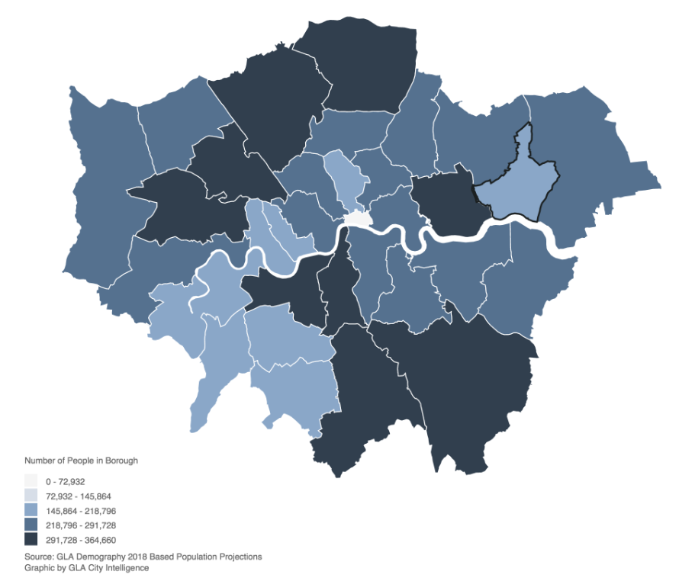
London Housing
Case study
By Laurence Forget Brisson
Presented to Ricardo D. Alanis-Tamez
From data.london.gov.uk

Slide 2
Question : Which boroughs of London have seen the greatest increase in housing prices, on average, over the last two decades?
Sourcing and loading
Cleaning, transforming, and visualizing
Modeling
Evaluating and concluding
Four stages of Data Science Pipeline

Slide 3
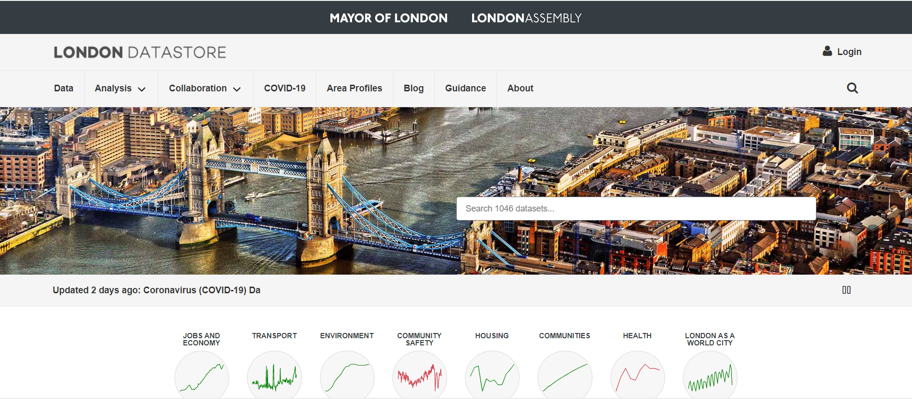
Sourcing and loading
Data Set obtained from data.london.gov.uk as Excel spreadsheets.
Contains the average prices of the houses by boroughts, monthly, over a 26 years period.

Slide 4
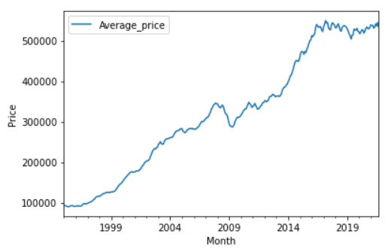
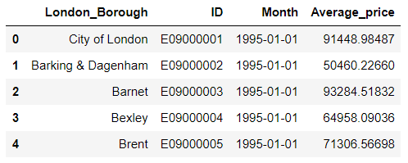
Cleaning, transforming, and visualizing
Previsualization of the data :
.head()
.shape
Transformation :
Transposition – Row: Observations, Columns: Variables and Indices: Unique ID
Melt()
Cleaning :
Reassignment of column indexes
Renaming columns
Removing null values
Visualization :
Line plot for a single borough monthly and yearly to have a look at the trend

Slide 5
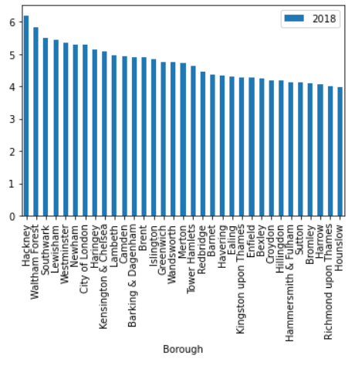
Modelling
Calcul of the difference in housing price between 1998 and 2018 to define a ratio for each borough.
Visualization of the ratios for each borough.
Ratios range from ~4 and above 6, which indicates a significant difference between boroughs.

Slide 6
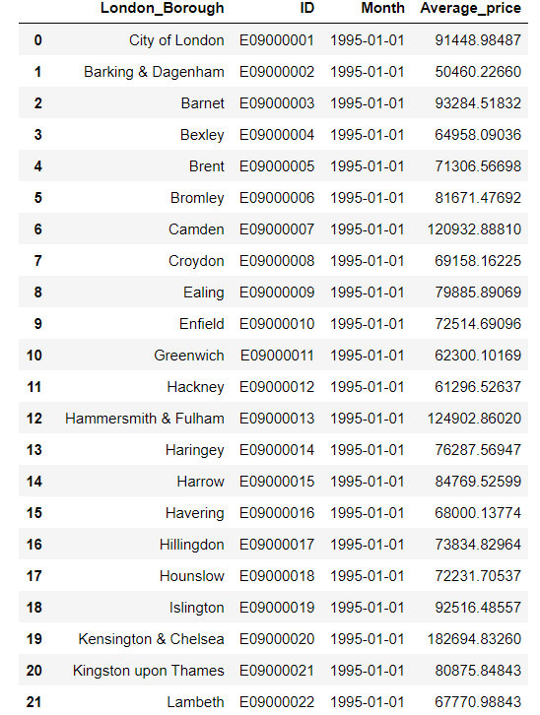
Conclusion
There is a marked difference in the increase in house pricing between London boroughs for the period between 1998 and 2018.
Causes that could explain the differential increase observed could be explored (e.g. criminality, transportation, accessibility, etc.).

