Slide 1
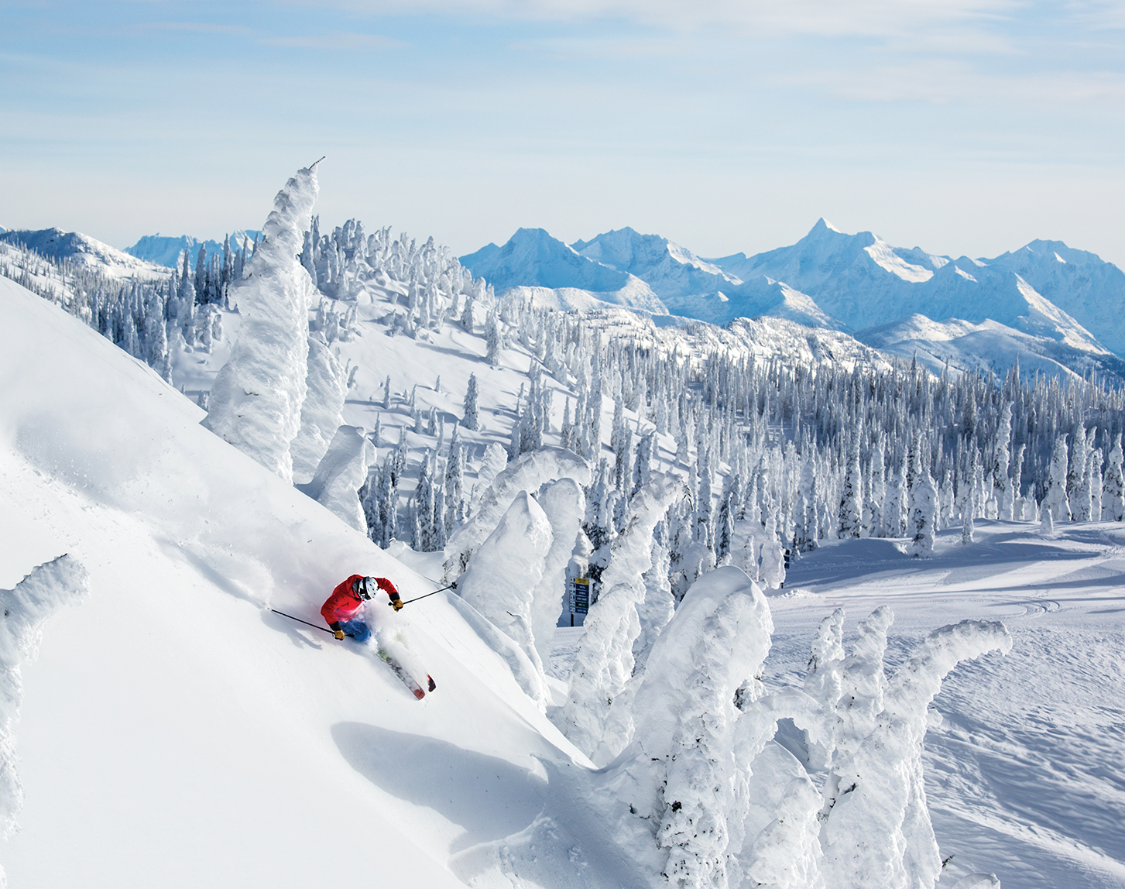
Guided Capstone Project Report – Big Mountain Resort
By Laurence Forget Brisson
Presented to Ricardo D. Alanis-Tamez
https://www.powder.com/resort-guide/2019-whitefish-montana/

Slide 2
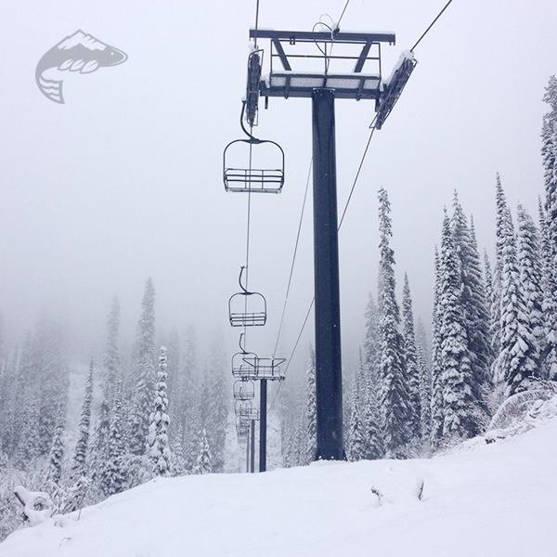
Big Mountain Resort, MT, USA
350,000 visitors per year;
11 lifts, 2 T-bars and 1 magic carpet;
New investment: New chair lift
Result in the increase of the operational costs by 1,540,000$ this season.
The pricing strategy of the company needs to be adjusted to select a better value for the ticket price, aiming to maximize the capitalization of the facilities, according to the market.
https://www.firsttracksonline.com/2014/11/06/whitefish-adds-new-lift-and-ski-terrain/

Slide 3
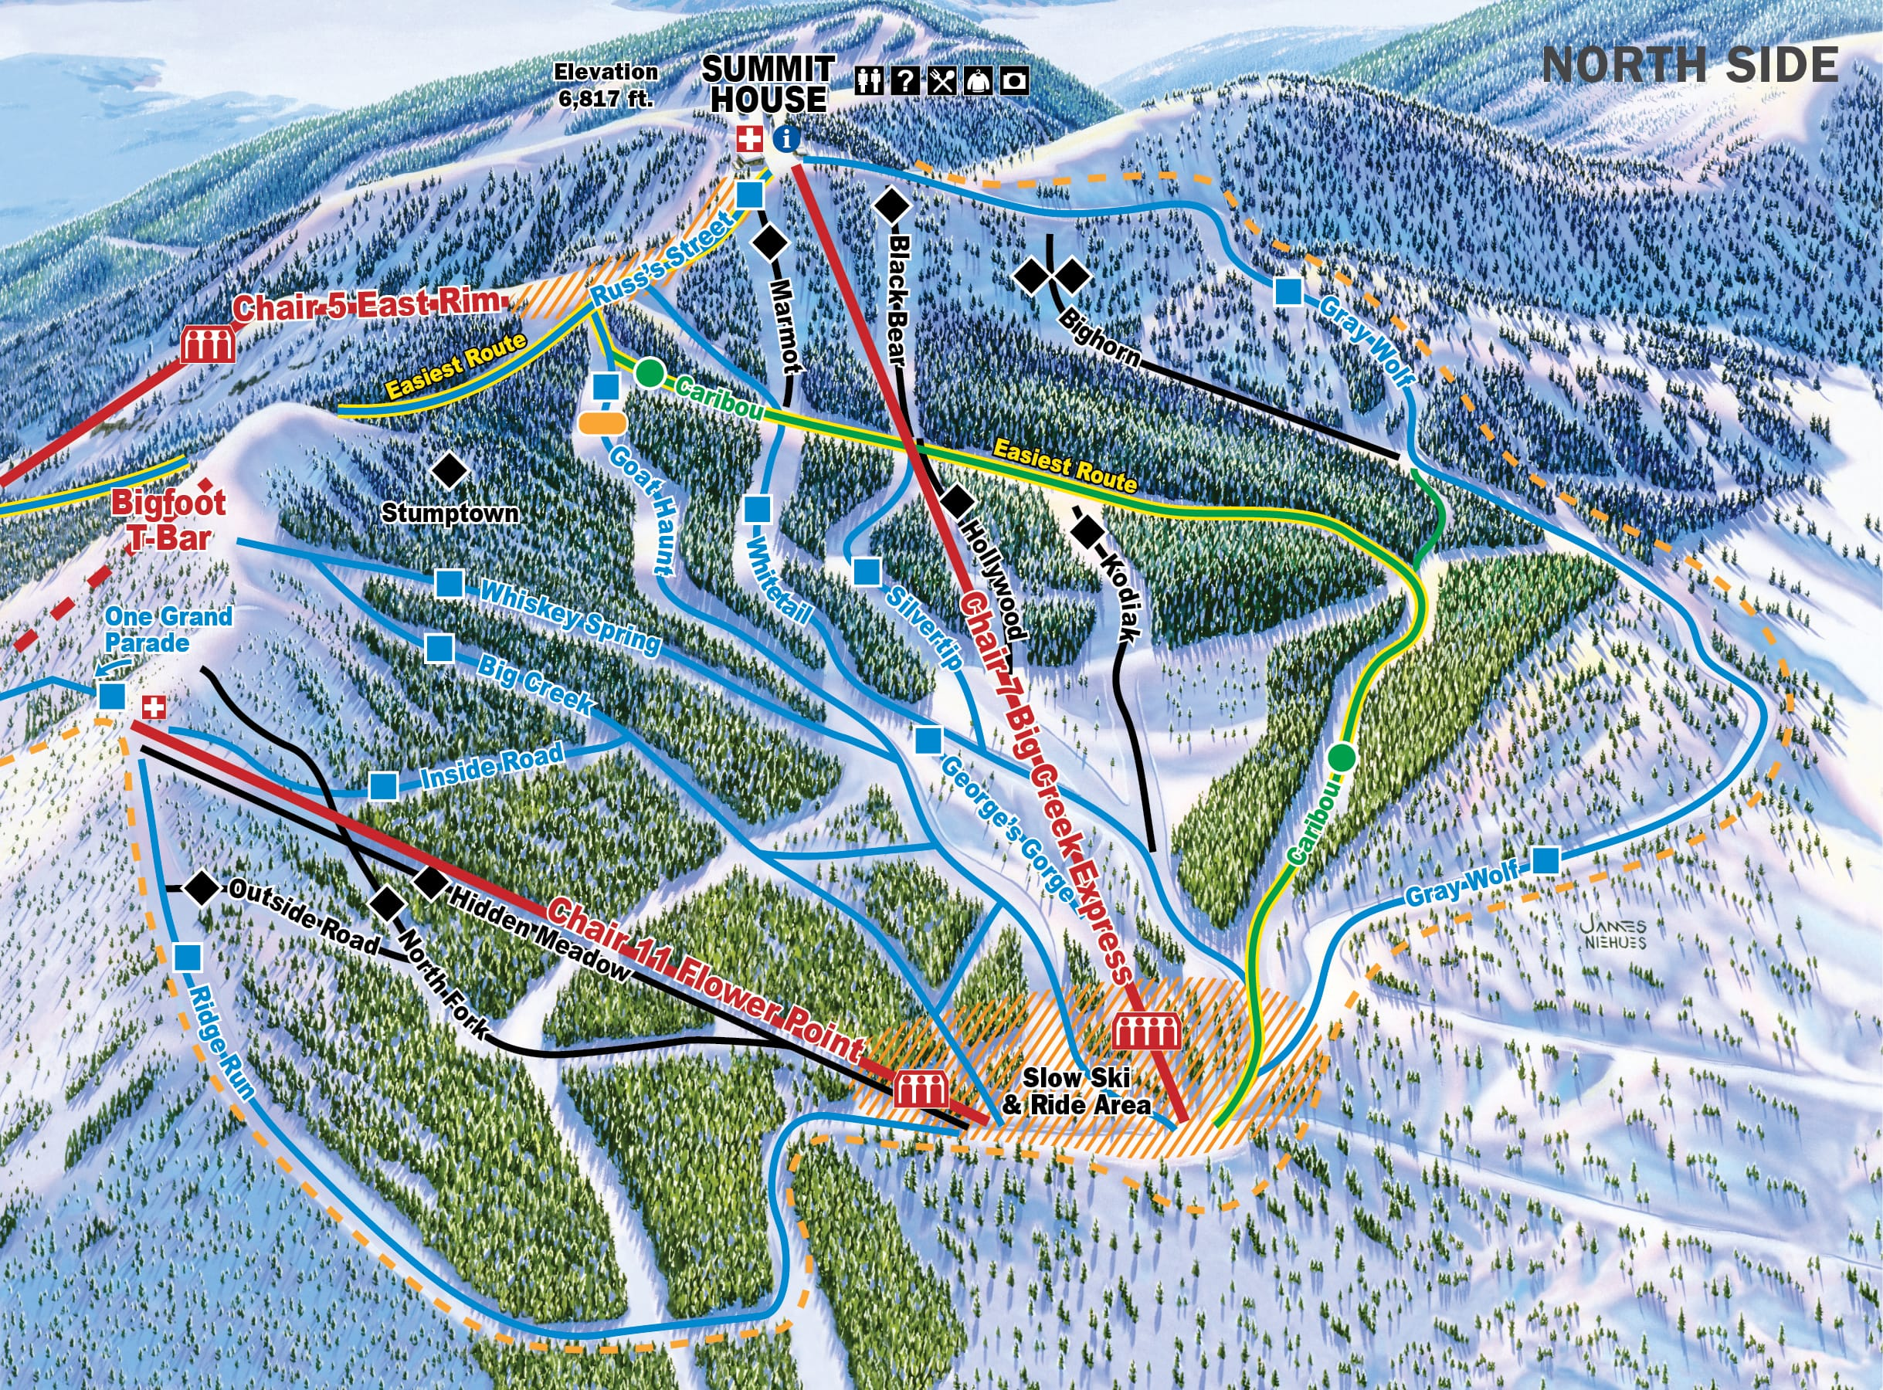
Problem identification
The specific problem to answer by this work:
“What are the options for Big Mountain Resort to adjust their pricing strategy in order to increase the capitalization rate and absorb the investment of a new chair lift (1,540,000$) this season?”
https://skimap.org/skiAreas/view/367

Slide 4
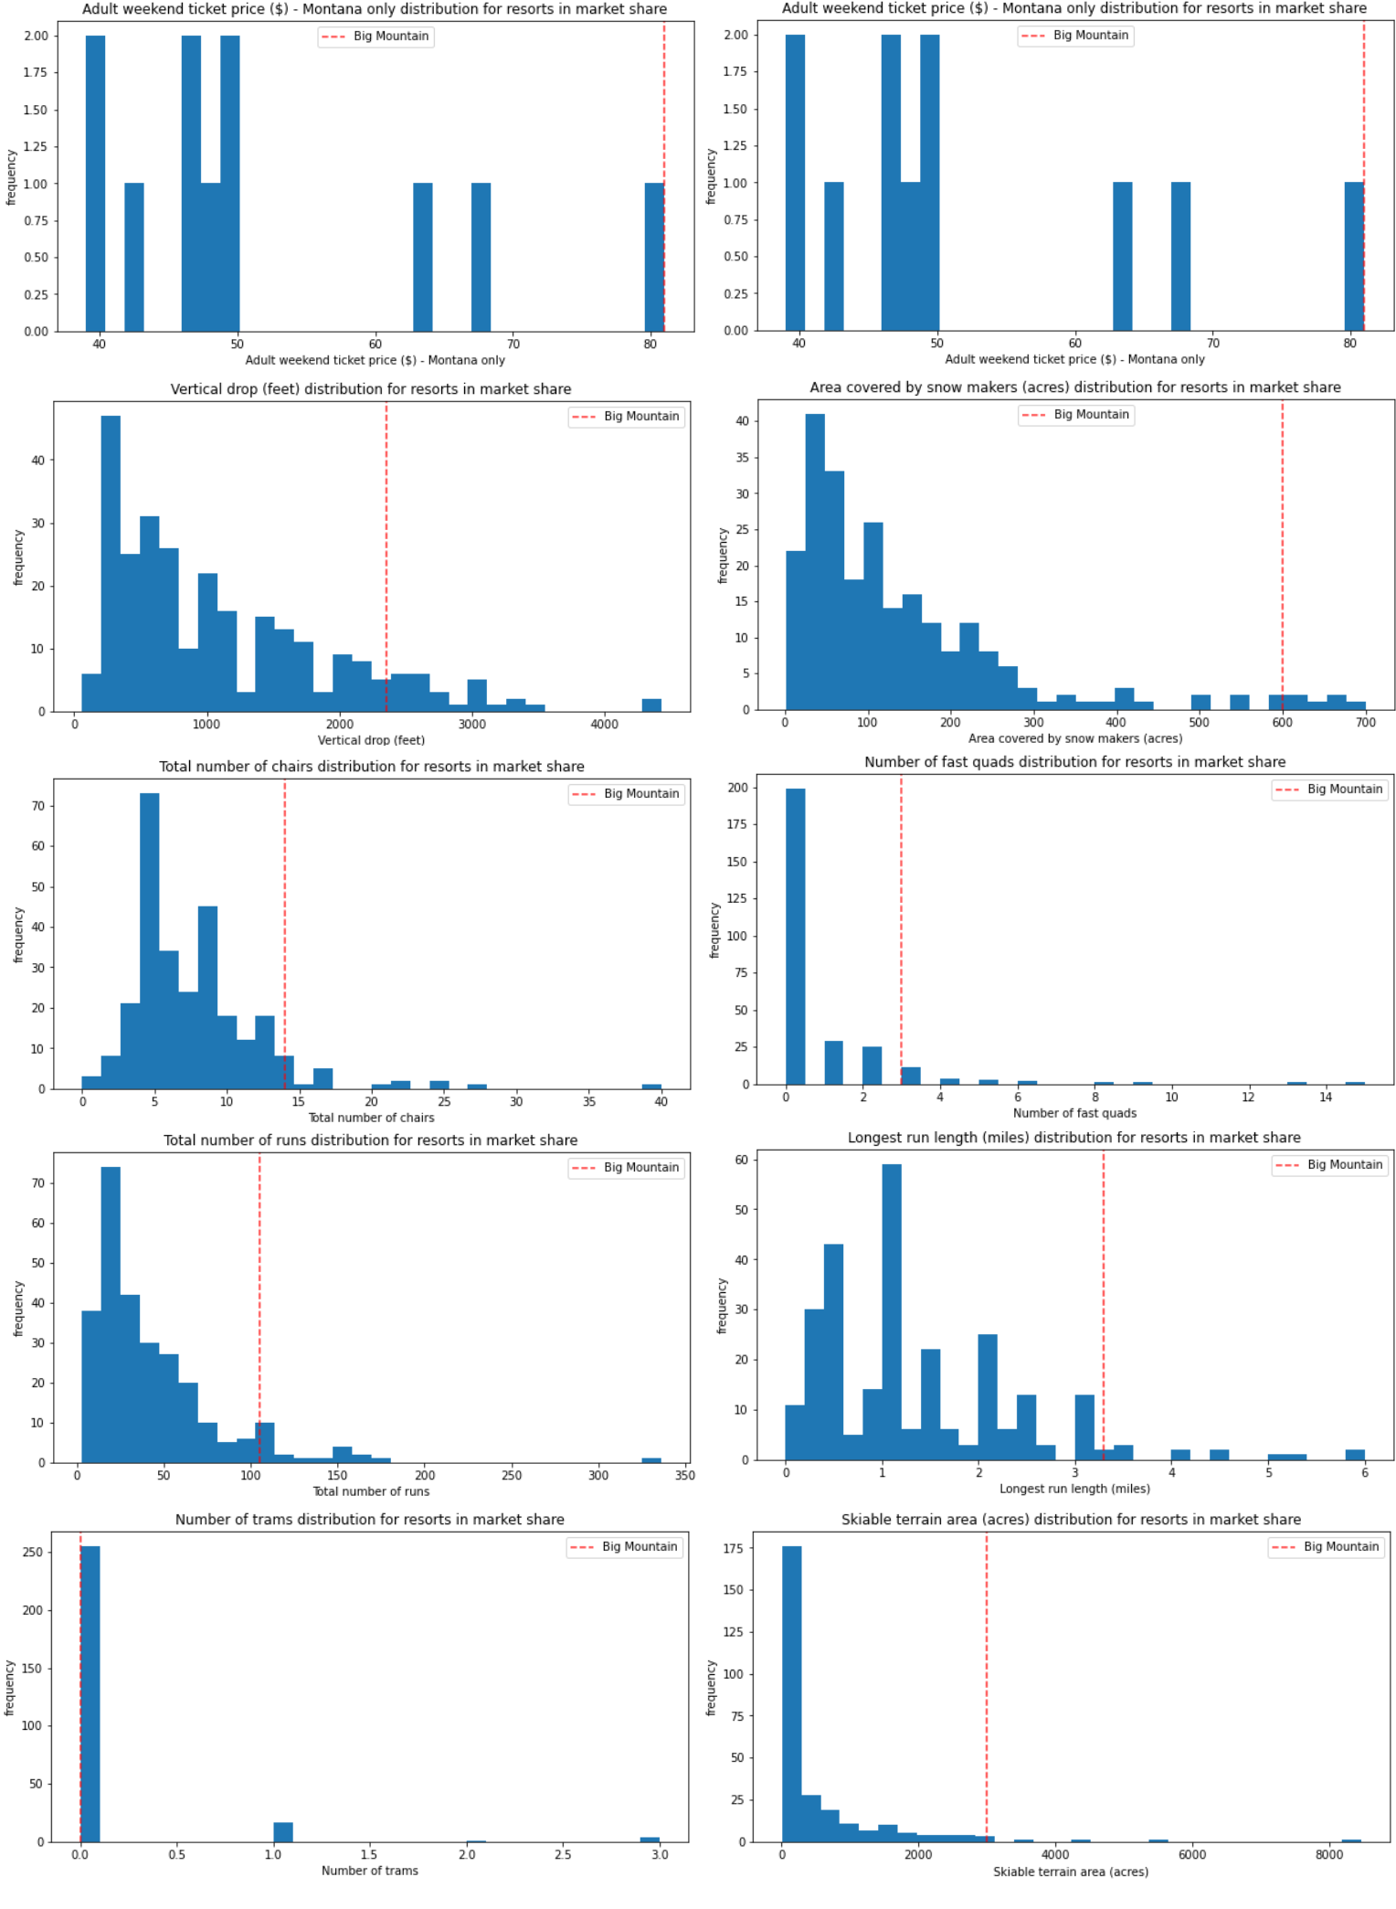
Recommendation and key findings
Assuming 350,000 visitors over the season and visitors skiing for 5 days.
Modeling of different scenarios - Some results:
Closing one run makes no difference but closing 2 and 3 runs successively reduces support for ticket price or revenue. Closing 4 and 5 runs have the same impact than closing 3 runs, but increasing the closures down to 6 or more leads to a large drop in revenue.
Increasing the vertical drop by adding a run to a point 150 feet lower down, this requiring the installation of an additional chair lift to bring skiers back up, without additional snow making coverage support an increase of 1.99$ for ticket price. Over a season, this could lead to a profit of 3,474,638$.
Doing the same modification as 2), but adding 2 acres of snow making cover don’t lead to an increase in profit.
Increasing the longest run by 0.2 mile to boast 3.5 miles length, requiring an additional snow making coverage of 4 acres, don’t leas to an increase in profit.
In order to upgrade instead of downgrading, scenario 2 would be support here. Considering that an increase of 14.87 ± 10.39$ is suggested by modeling, 1.99$ could be considered as a minimum increase to account for the investment of a new chairlift.
Please refer to the report for the figures details.

Slide 5
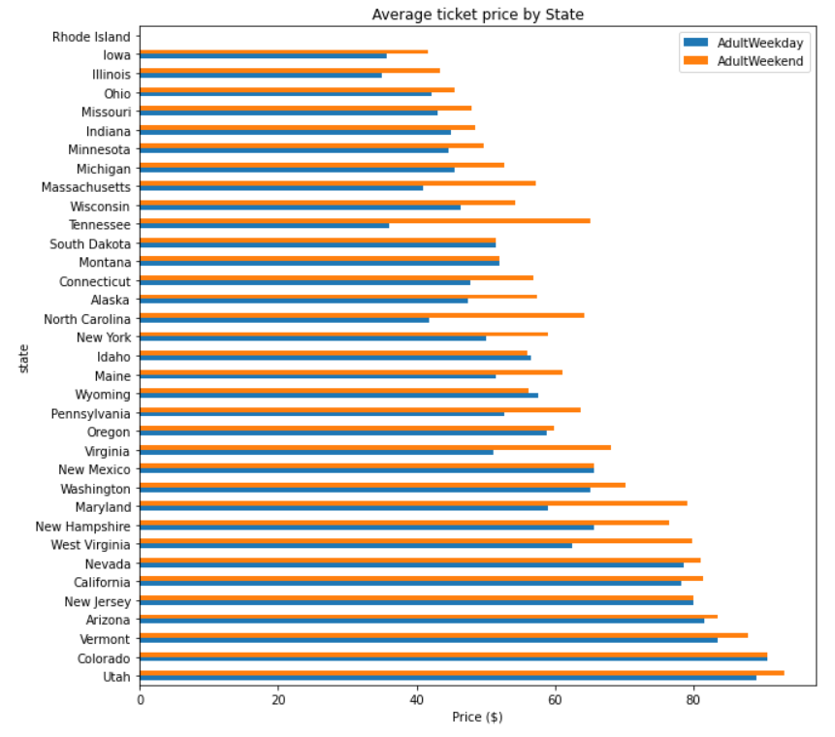
Modeling results and analysis
Target variable: Ticket price
Enclosed under “AdultWeekday” and “AdultWeekend” variables.
“AdultWeekend” less affected by missing value and favored for the analysis.
Exploration of trends in the variable.
Mean of ticket price by states.
PCA.
Correlation indicators.

Slide 6
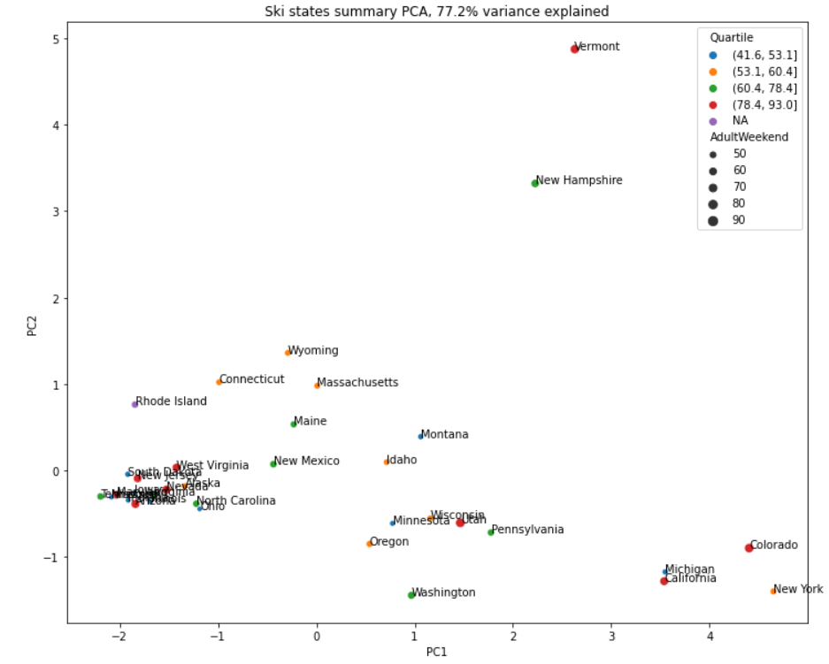
PCA
The 2 first components seem to account for over 75% of the variance and the first 4 components account for over 95%.
PCA results could be used to have more insights into the market.
Do Vermont, New Hamshire, New York, Colorado, Michigan and California should be included in the same market as Montana ?
This should be the subject of further work.

Slide 7
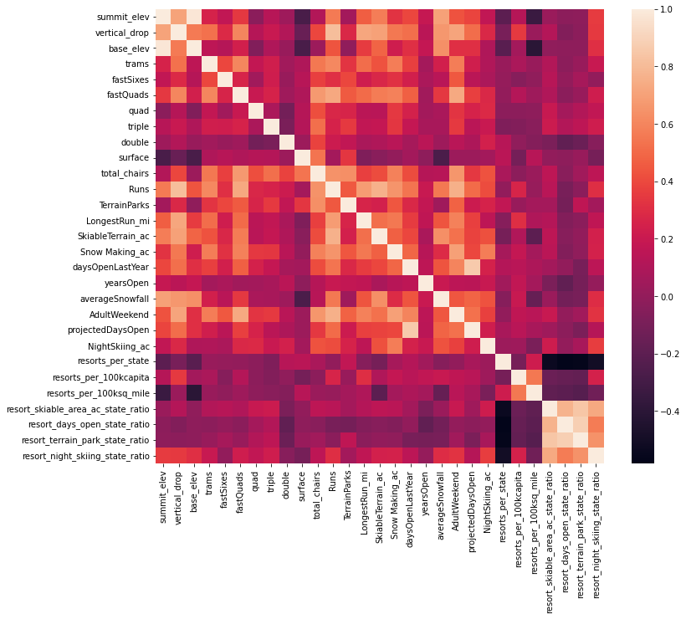
Heat map
“resorts_per_100kcapita” and “resorts_per_100ksq_mile” have a high correlation.
Ticket price is related to a lot of variables, including the number of chairs, the characteristics of the mountains, and the other facilities.

Slide 8
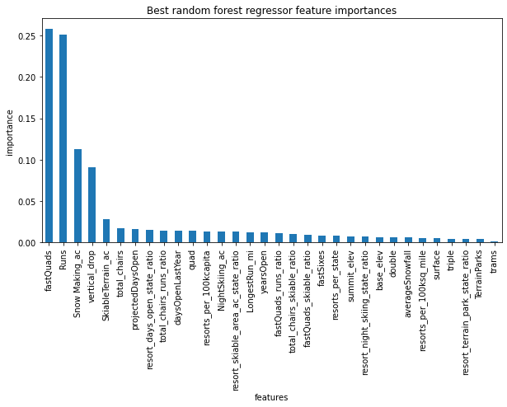
Random Forest and linear model
To check the mean and median strategies for imputing missing values, with and without scaling.
Imputing with the median helps, but scaling the features does not.
Linear model indicate that the top four dominant features related to ticket price are:
fastQuads
Runs
Snow Making_ac
vertical_drop

Slide 9
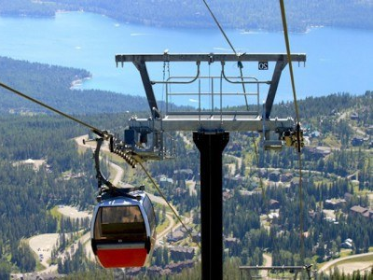
Summary and conclusion
The modelled price for Big Mountain is 95.87$, while the actual price is 81.00$.
Big Mountain resort seems to be charging much less that what is predicted.
1.99$ could be considered as a minimum increase.
For thought:
Possibility that ticket prices of other resorts may also be biased?
Possible variation of ticket price throughout the week?
Should we model the operational cost increase (or variation) as a function of visitor traffic, considering the investment of a new chairlift.
Should we modulate the modeled ticket price for Big Mountain according to a more defined market?
Should we test the ability to pay of the visitors?
https://www.allglacier.com/packages/view/whitefish-high-alpine-adventure

