Slide 1
Program Name goes here
Link to github Repository: GitHub
Links to trello board / project management tools: Trello Planning Board
You MUST provide evidence showing how the problem has been decomposed, how the components have been developed and trialled, and of how they have been assembled and tested to create a final, working outcome.

Slide 2
Relevant Implications
Explain the relevant implications here. Please watch this video to learn how to do this.
Notes:
Explain the relevant implications here. Then as you work, develop your code, discuss how the implications are being met.

Slide 3
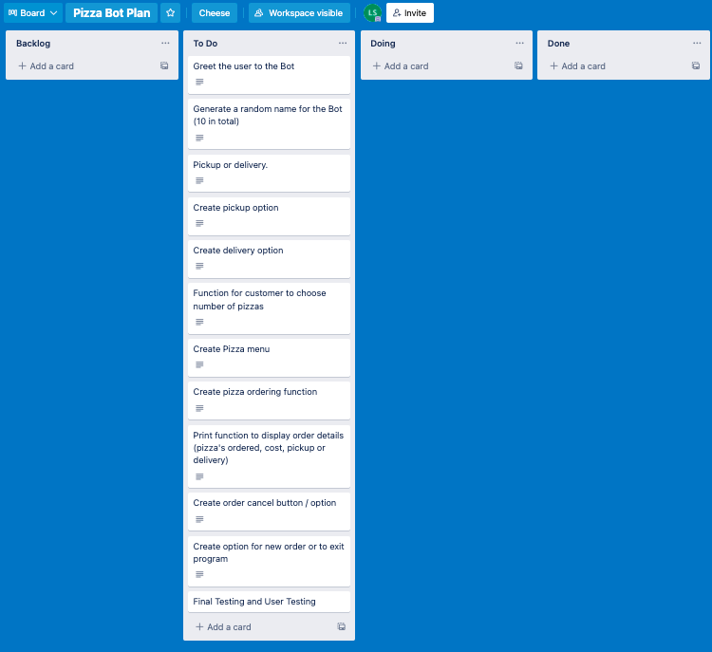
Decomposition
Notes:
Paste screenshots of your initial Trello board / task decomposition on this slide. If you have a long list, you might need to break it up into several columns. Delete this instruction when you are done.

Slide 4
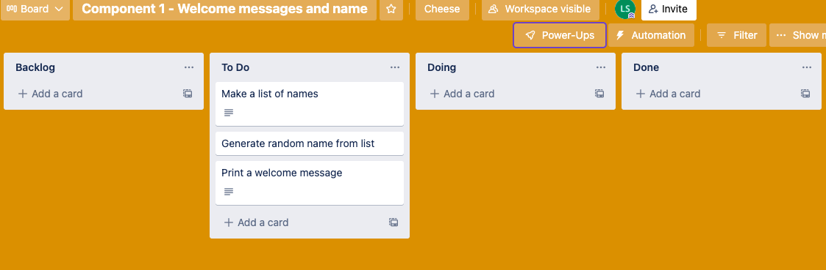
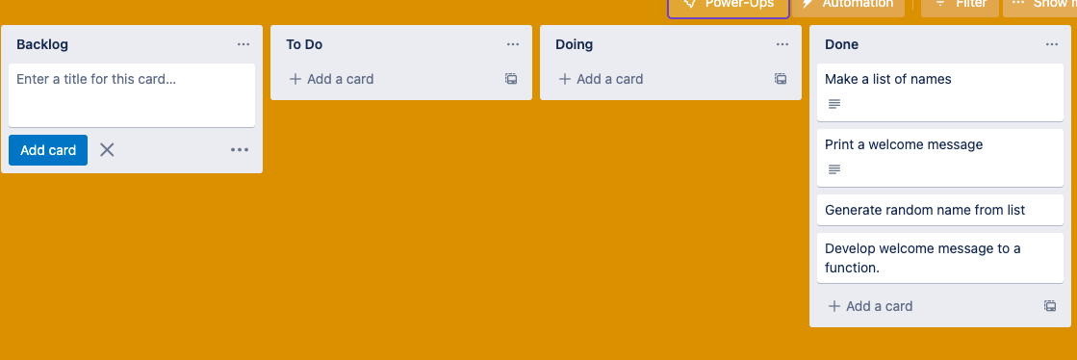
Component 1 (Trello screenshot)
Version 2
Version 1

Slide 5
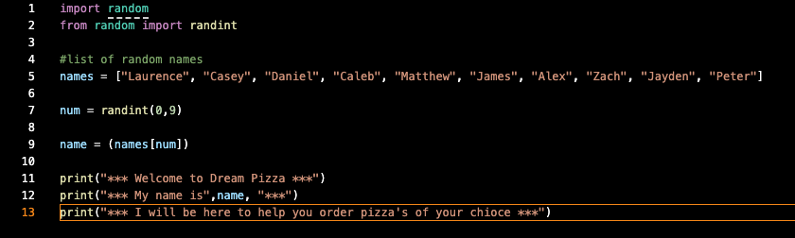

Component 1 - Test Plan (?and screenshot)
Test Case | Expected Values
Run program (without debugging) | Print Welcome messages with random name from the list of name – program runs correctly and as expected.

Slide 6
Component 1 version 2 - Test Plan (?and screenshot)
Test Case | Expected Values
Run program (without debugging) | Print Welcome messages with random name from the list of name – program runs correctly and as expected.

Slide 7
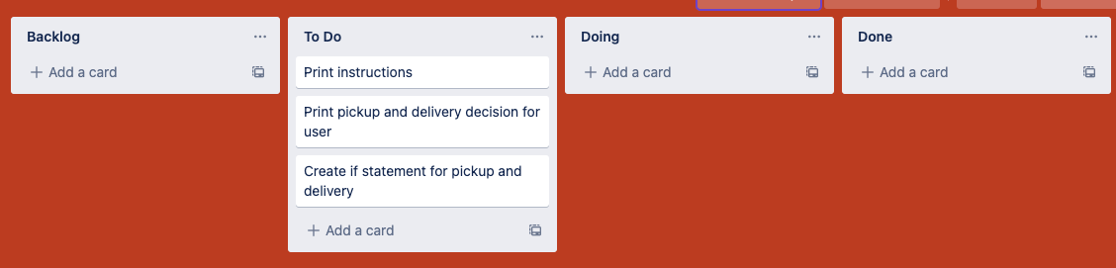
Component 2 (Trello screenshot)

Slide 8
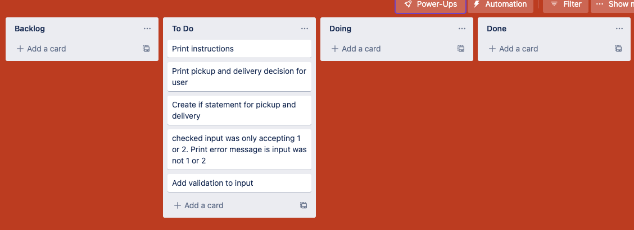
Component 2 Version 2 (Trello screenshot)

Slide 9
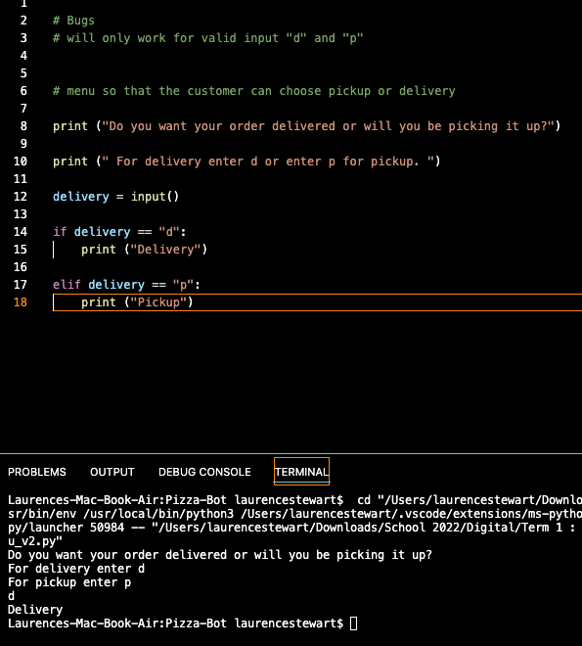
Component 2 version 1 - Test Plan (?and screenshot)
Test Case | Expected Values
Run program | Enter p: program prints pickup Enter d: program prints delivery Enter invalid: program stops

Slide 10
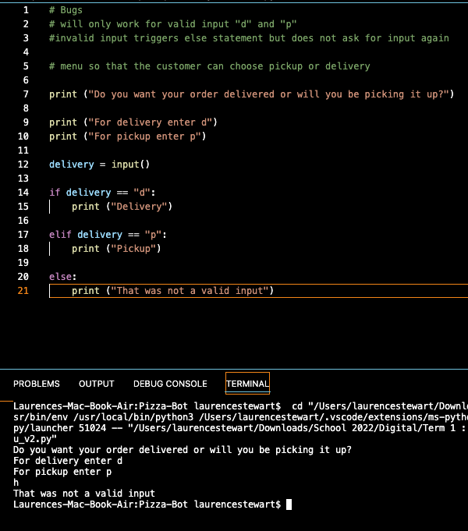
Component 2 version 2 - Test Plan (?and screenshot)
Test Case | Expected Values
Run program | Enter p: program prints pickup Enter d: program prints delivery Enter invalid: program prints error message

Slide 11
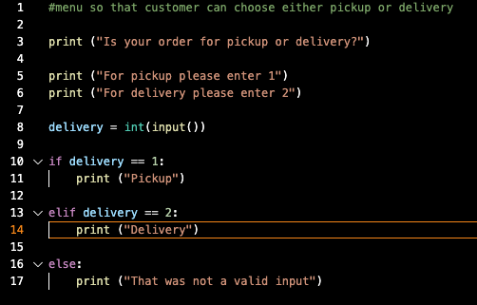
Component 2 version 3 - Test Plan (?and screenshot)
Test Case | Expected Values
Run program | Enter 1: program prints pickup Enter 2: program prints delivery Enter invalid: program displays value error

Slide 12
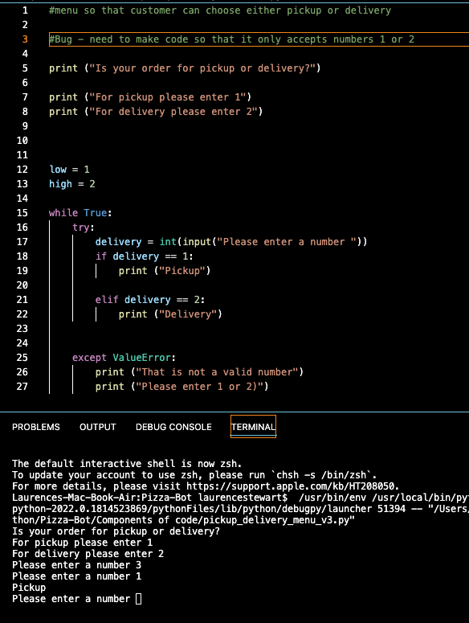
Component 2 version 4 - Test Plan (?and screenshot)
Test Case | Expected Values
Run program | Enter 1: program prints pickup Enter 2: program prints delivery Enter invalid: program displays value error Enter number other that 1 or 2: program does not work

Slide 13
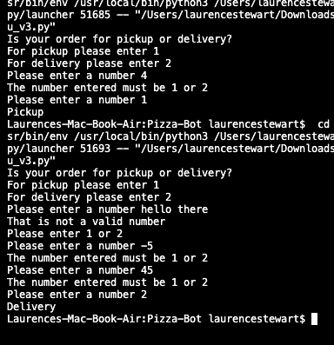
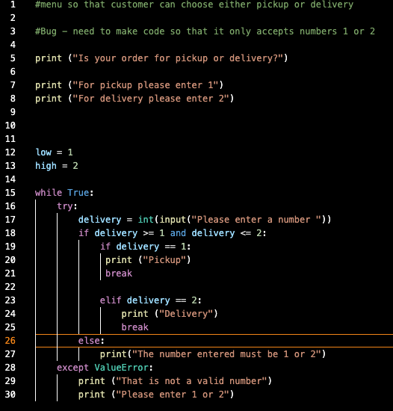
Component 2 version 5 - Test Plan (?and screenshot)
Test Case | Expected Values
Run program | Enter 1: program prints pickup Enter 2: program prints delivery Enter invalid entry: program asks for the input again until correct input is entered. Enter number other than 1 or 2: error message asks for correct entry again.

Slide 14
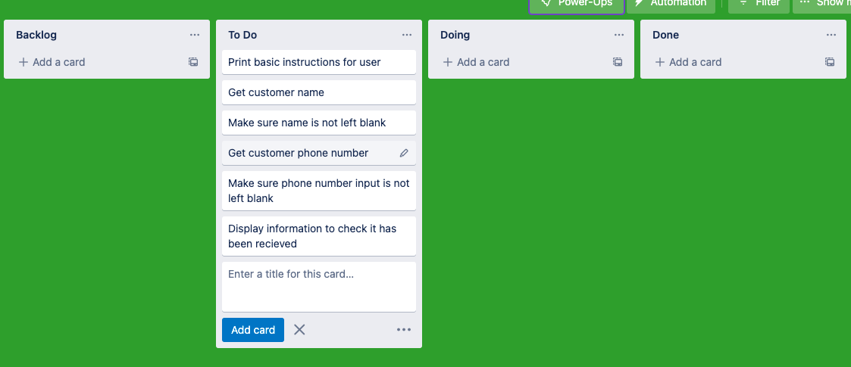
Component 3 Pickup info (Trello screenshot)

Slide 15
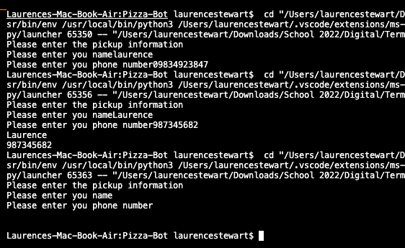
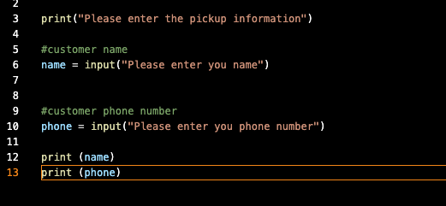
Component 3 v1 - Test Plan (and screenshot)
Test Case | Expected Values
Input name Input phone number Input blank, nothing entered | Program to print name Program to print phone number Accepted blank and printed nothing

Slide 16
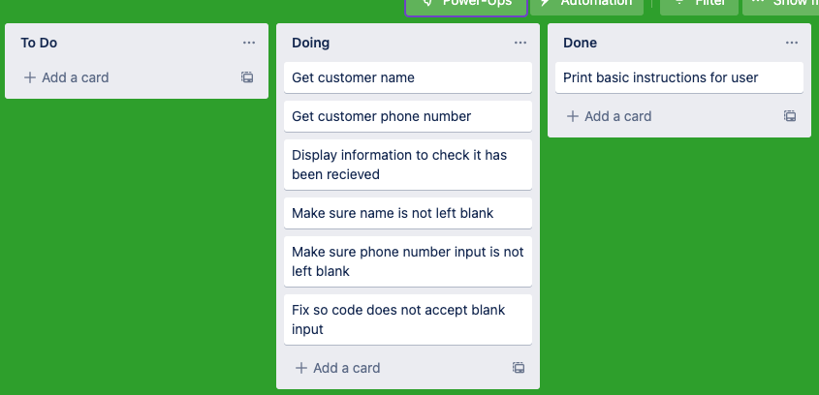
Component 3 v2 Pickup info (Trello screenshot)

Slide 17
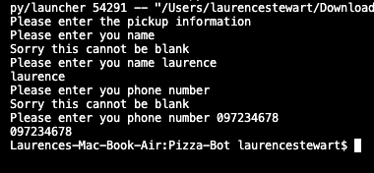
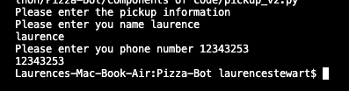
Component 3 v2 - Test Plan (and screenshot)
Test Case | Expected Values
Input name Input phone number Input blank, nothing entered | Program to print name Program to print phone number The code prints "Sorry this cannot be blank" and goes back to input statement.

Slide 18
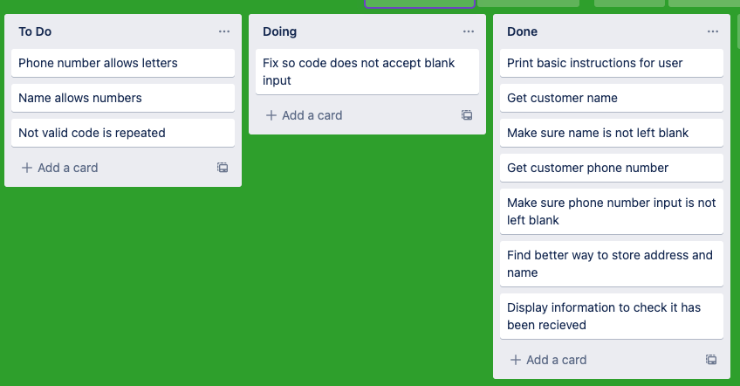
Component 3 v3 Pickup info (Trello screenshot)

Slide 19
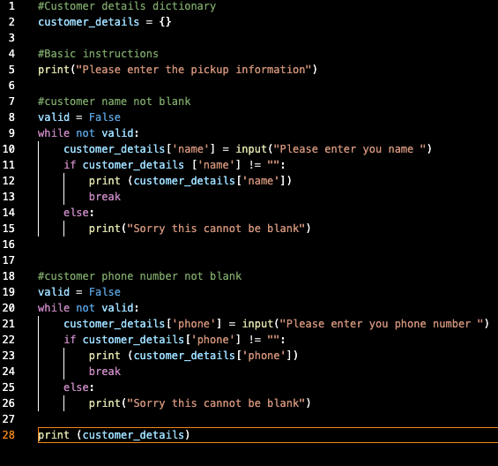
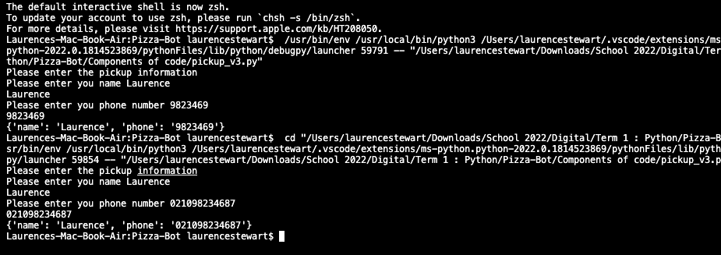
Component 3 v3 - Test Plan (and screenshot)
Test Case | Expected Values
Input name Input phone number Input blank, nothing entered | Program to print name Program to print phone number The code prints "Sorry this cannot be blank" and goes back to input statement.

Slide 20
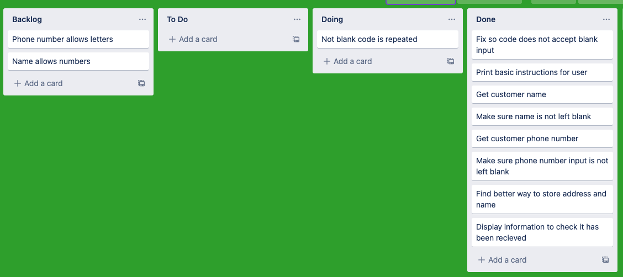
Component 3 v4 Pickup info (Trello screenshot)

Slide 21
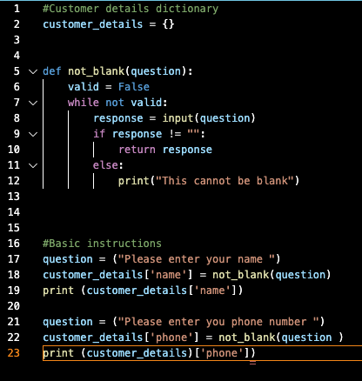

Component 3 v4 - Test Plan (and screenshot)
Test Case | Expected Values
Input name Input phone number Input blank, nothing entered | Program to print name Program to print phone number The code prints "Sorry this cannot be blank" and goes back to input statement.

Slide 22
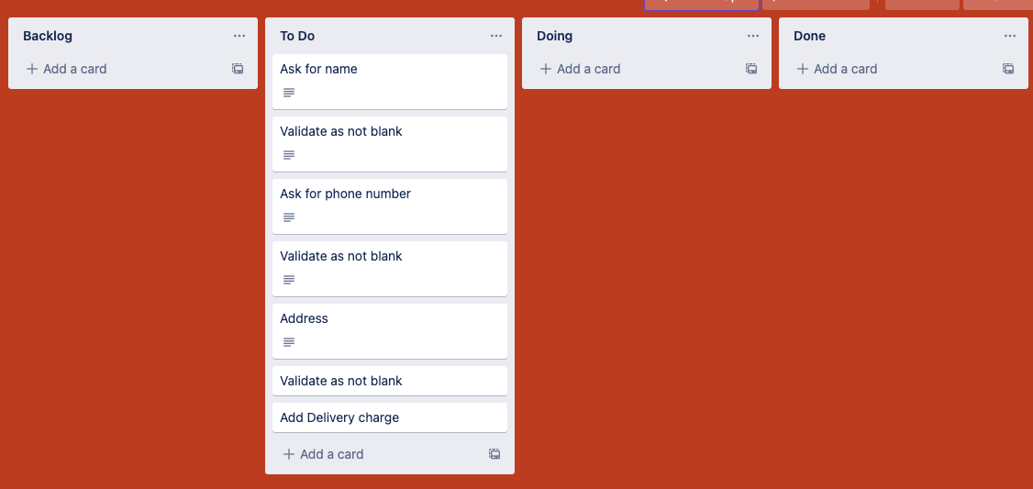
Component 4 Delivery information (Trello screenshot)

Slide 23
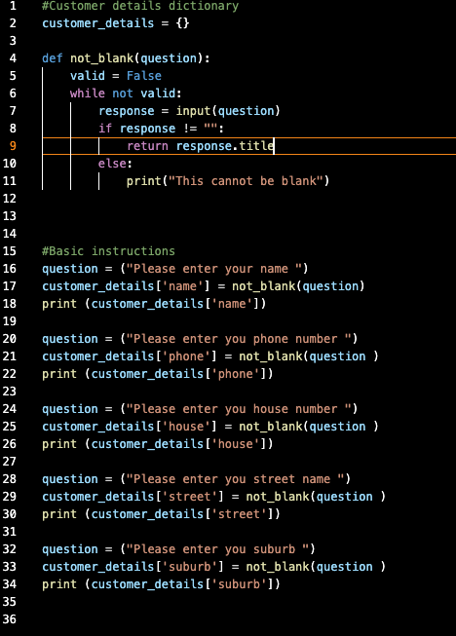
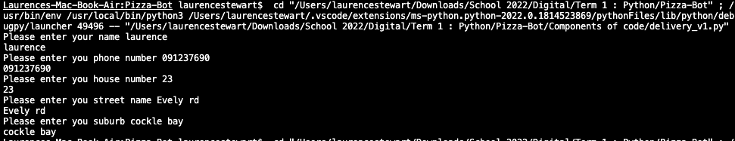
Component 4 v1 - Test Plan (and screenshot)
Test Case | Expected Values
Input name Input phone number Input house number Street name Suburb name Left blank | Printed name Printed phone number Accepted blank and printed blank input Printed street name Printed Suburb name Asked for input again

Slide 24
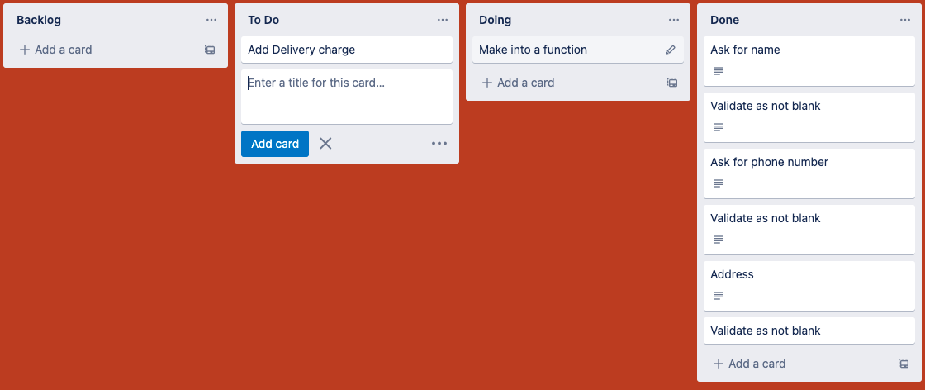
Component 4 v2 Delivery information (Trello screenshot)

Slide 25
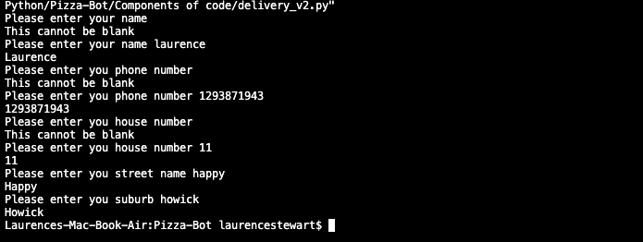
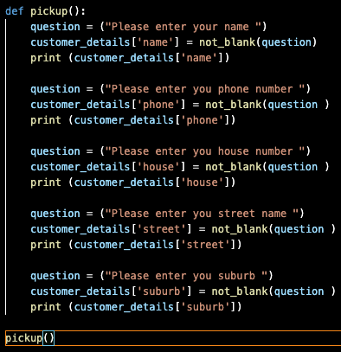
Component 4 v2 - Test Plan (and screenshot)
Test Case | Expected Values
Input name Input phone number Input house number Street name Suburb name Left blank | Printed name Printed phone number Printed house number Printed street name Printed Suburb name Asked for input again

Slide 26
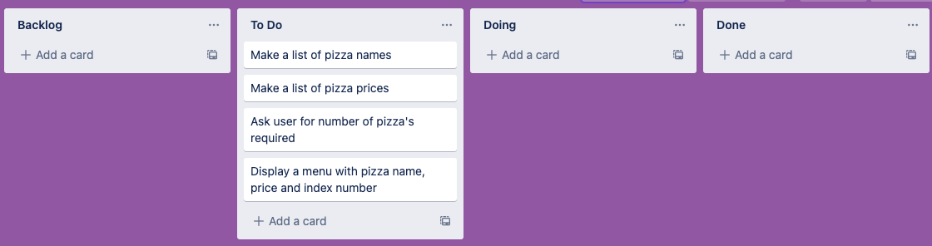
Component 5 Pizza Menu (Trello screenshot)

Slide 27
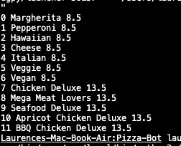
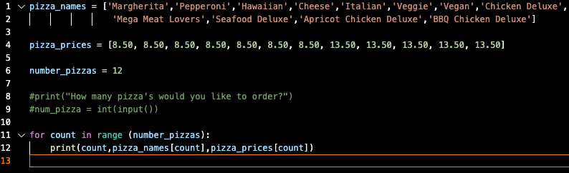
Component 5 v1 - Test Plan (and screenshot)
Test Case | Expected Values
Run file | Printed a list with index number, also printed list pizzas and their prices

Slide 28
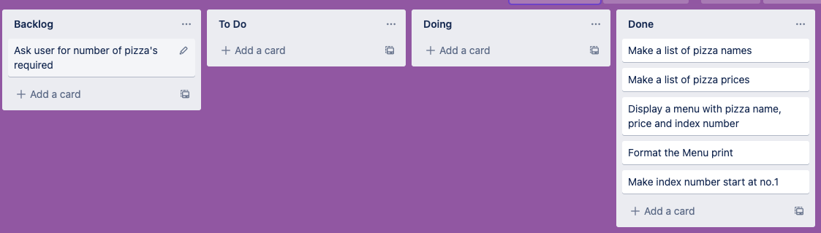
Component 5 v2 Pizza Menu (Trello screenshot)

Slide 29
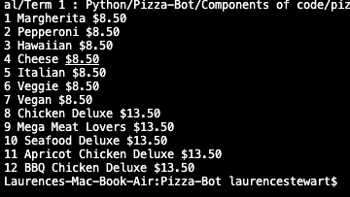
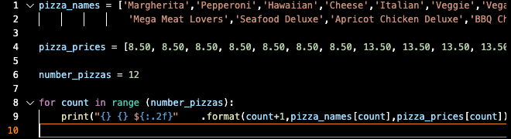
Component 5 v2 - Test Plan (and screenshot)
Test Case | Expected Values
Run file | Printed the list with index number, pizza names and pizza prices. Price is formatted to 2 decimal places with a dollar sign. The Pizza menu also starts at 1 not 0.

Slide 30
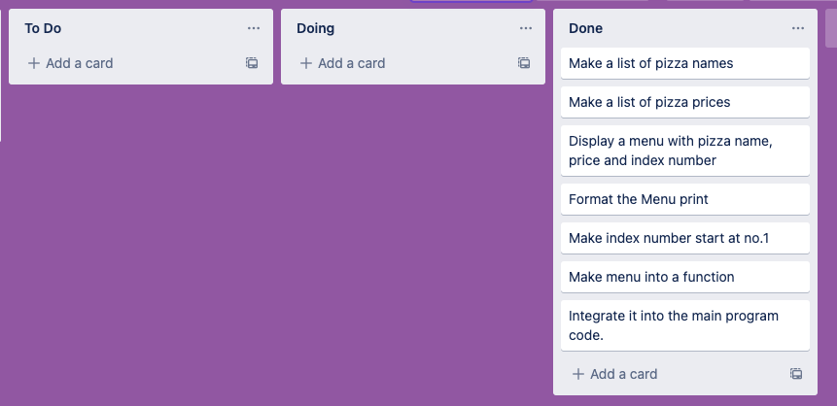
Component 5 v3 Pizza Menu (Trello screenshot)

Slide 31
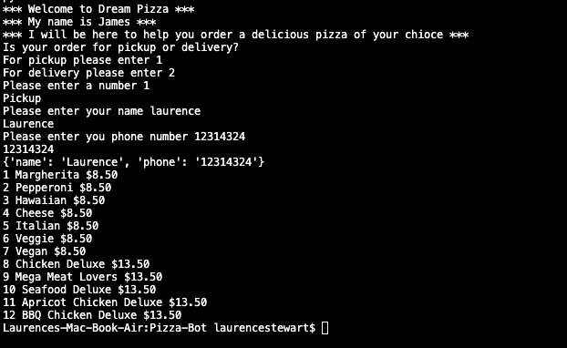
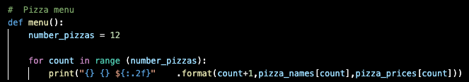
Component 5 v3 - Test Plan integrated into main program
Test Case | Expected Values
Run file | Printed the list with index number, pizza names and pizza prices. Price is formatted to 2 decimal places with a dollar sign. The Pizza menu also starts at 1 not 0.

Slide 32
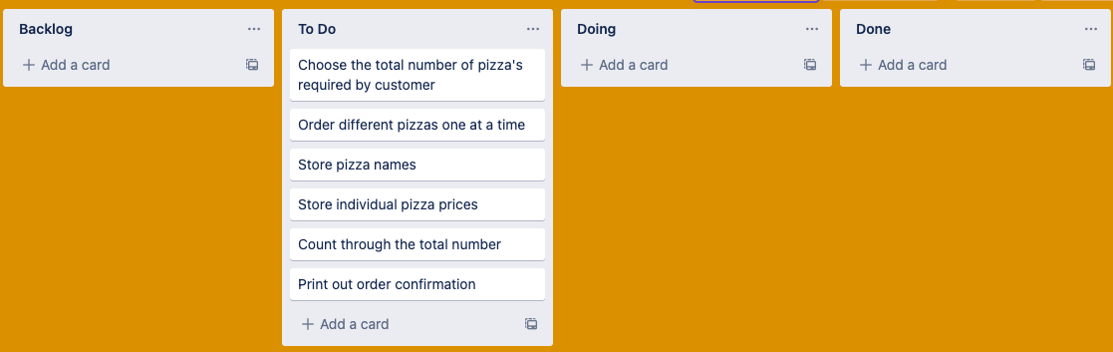
Component 6 v1 Pizza order (Trello screenshot)

Slide 33
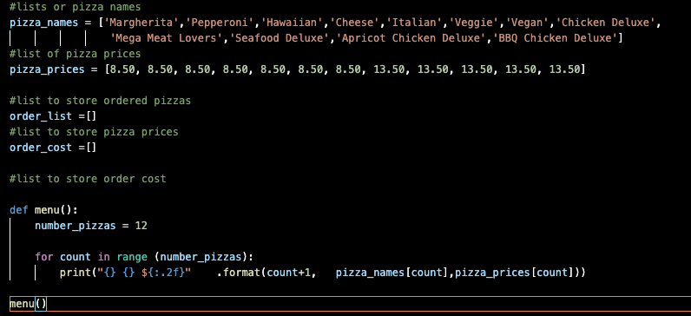
Component 6 v1 - Test Plan (and screenshot)
Test Case | Expected Values

Slide 34
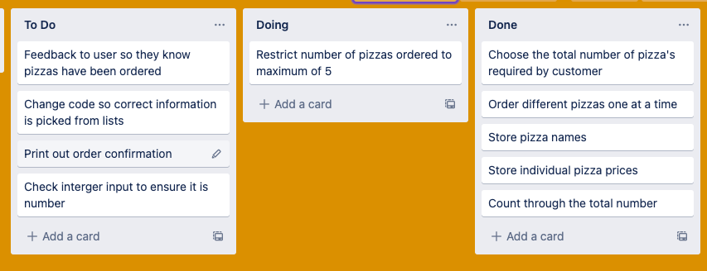
Component 6 v2 Pizza order (Trello screenshot)

Slide 35
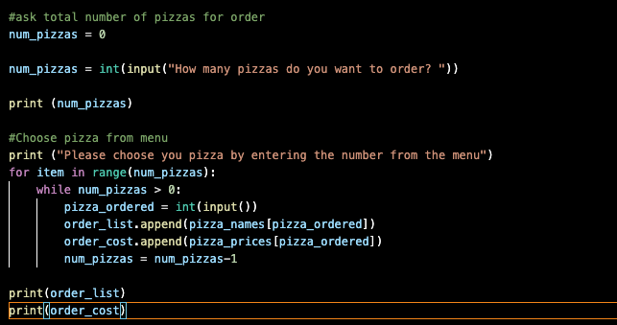
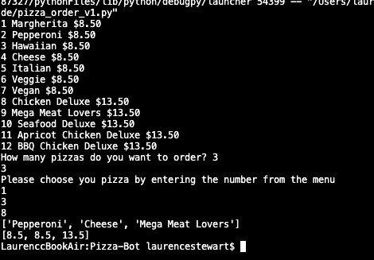
Component 6 v2 - Test Plan (and screenshot)
Test Case | Expected Values
Entered 3 pizzas Entered cat | Steeped through the menu and selected 3 pizzas Program broke

Slide 36
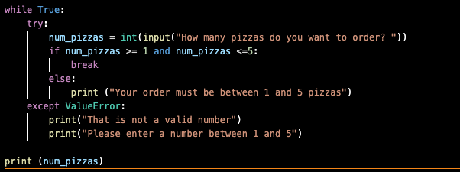
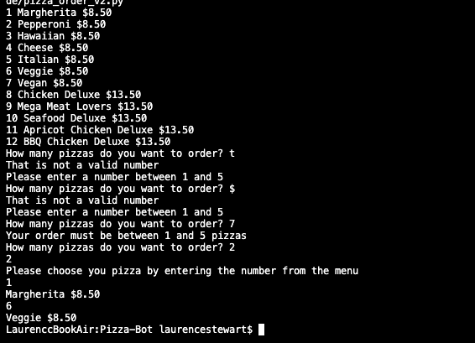
Component 6 v3 - Test Plan (and screenshot)
Test Case | Expected Values
Entered t Entered $ 7 2 | Not a valid number Not a valid number Must between 1 and 5 Accept input

Slide 37
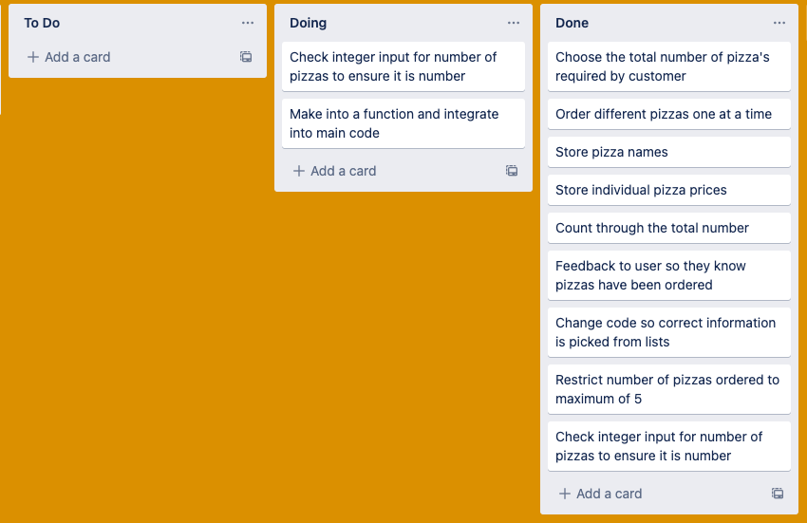
Component 6 v4 Pizza order (Trello screenshot)

Slide 38
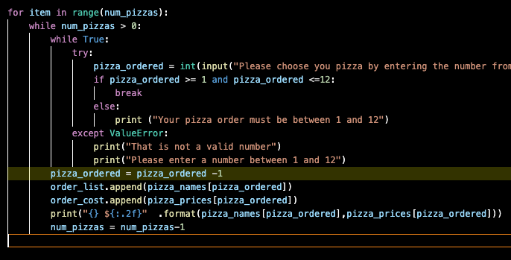
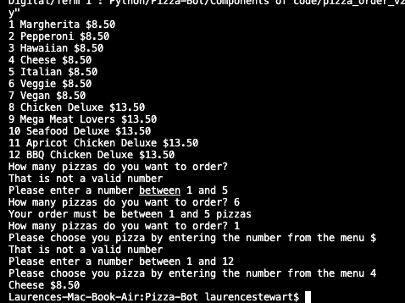
Component 6 v4 - Test Plan (and screenshot)
Test Case | Expected Values
Entered t Entered $ 7 2 | Not a valid number Not a valid number Must between 1 and 5 Accept input

Slide 39
Component 6 v5 Pizza order (Trello screenshot)

Slide 40
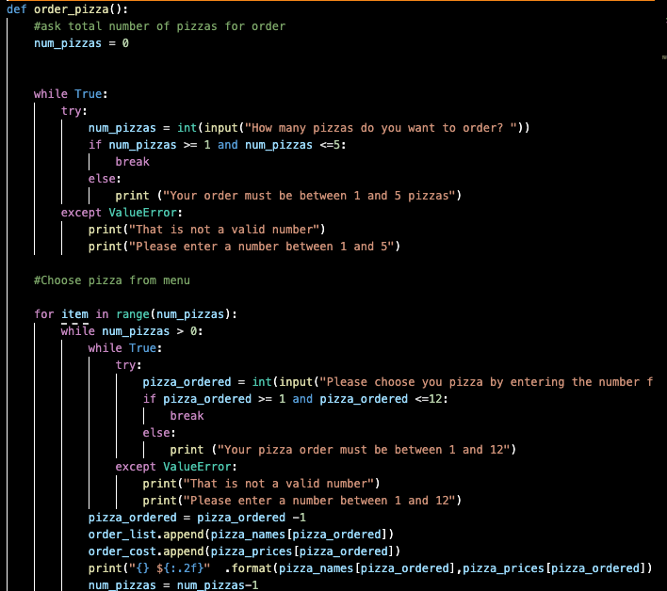
Component 6 v5 - Test Plan (and screenshot)
Test Case | Expected Values
Entered t Entered $ 7 2 | Not a valid number Not a valid number Must between 1 and 5 Accept input

Slide 41
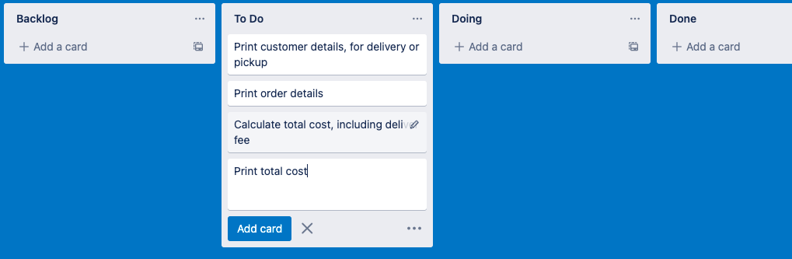
Component 7 v1 Order Print Function (Trello screenshot)

Slide 42


Component 7 v1 - Test Plan (and screenshot)
Test Case | Expected Values
Ran with random test data | Prints correctly, and print correct information

Slide 43

Component 7 v2 Order Print Function (Trello screenshot)

Slide 44


Component 7 v2 - Test Plan (and screenshot)
Test Case | Expected Values
Ran with random test data | Prints correctly, and print correct information

Slide 45
Version Control Evidence
Your version control evidence should go here. This could be in the form of annotated screenshots which show you you managed this process or you could make a brief screencast explaining how you implemented version control.
Notes:
Your version control evidence should go here. This could be in the form of annotated screenshots which show you you managed this process or you could make a brief screencast explaining how you implemented version control.

Slide 46
Discusses how the information from planning, testing and trialling of components assisted in the development of a high-quality outcome
Notes:
Discusses how the information from planning, testing and trialling of components assisted in the development of a high-quality outcome

