Slide 1



Superstore_sample
View in Power BI
Last data refresh:
4/30/2026 8:00:28 AM UTC
Downloaded at:
4/30/2026 8:12:59 AM UTC

Slide 2
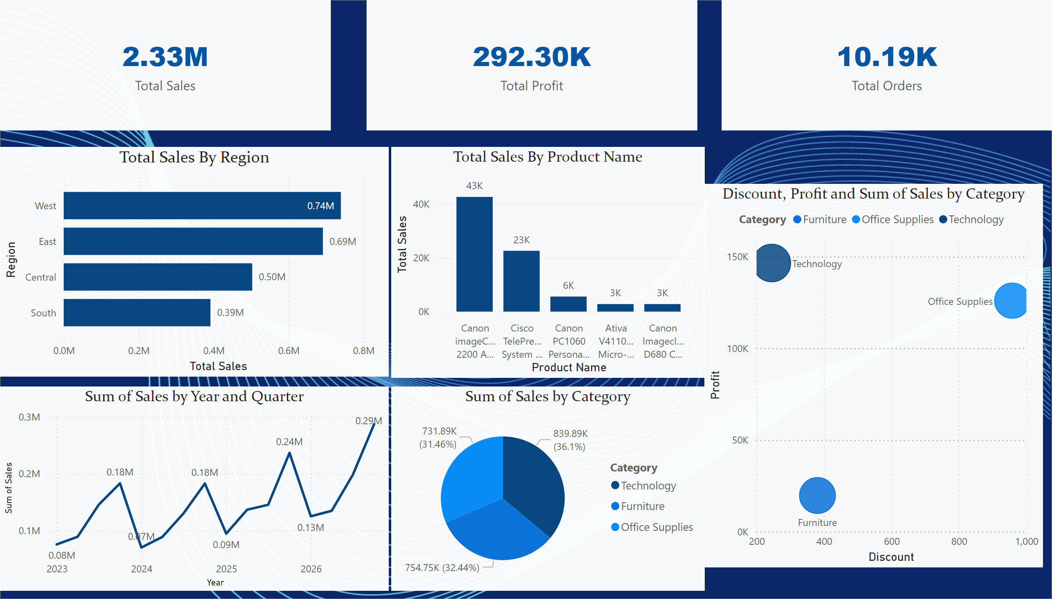
Sales analysis Dashboard
Notes:
card
No alt text provided
card
No alt text provided
card
No alt text provided
Total Sales By Region
No alt text provided
pieChart
No alt text provided
lineChart
No alt text provided
Total Sales By Product Name
No alt text provided
scatterChart
No alt text provided

