Slide 1
Constraint Programming in Perl 6
The Perl Conference
Riga, Aug. 7-9, 2019
Laurent Rosenfeld

Slide 2
Declarative Programming
Constraint propagation programming is a form of declarative programming :
  You don’t state what to do or how to do it, you don’t specify a control flow or specific algorithmic steps
  Non-imperative, non-procedural programming
  You state definitions, axioms, rules, predicates and use them to derive new facts, theorems or properties
  Other examples : DB query languages (SQL), regexes and grammars, logic programming (e.g. Prolog or Picat), functional programming, compilation (make), configuration management

Slide 3
Constraint Programming
Relations between variables are stated in the form of constraints
  that describe the properties of the solution to be found, and
  can be contraint satisfaction problems (A or B is true), or
  linear inequalities or equations, and others.
Here, I wanted to try to explore some form of symbolic computation
  where the program automatically solves a math equation
  This is very much experimentation, not a beautiful shiny module with bells and whistles

Slide 4
Celsius to Fahrenheit Conversion
Let’s consider a Fahrenheit to Celsius converter :
  C = 5 / 9 (F - 32)
This could be written in Perl 6 as :
  sub celsius ($f) { return 5/9 * ($f – 32); }
But if you want to do it the other way around :
  F = 9 / 5 C + 32
  sub fahrenheit ($c) { return 32 + 9/5 * $c; }
I would like to have to define only one formula, not 2 subs

Slide 5
The Ideal Gas Law
The Celsius/Fahrenheit conversion is simple enough
But consider the ideal gas law :
  p * v = n * k * t
  where p = pressure, v = volume, n = quantity, k = Boltzmann’s constant and t = temperature
This equation is not one-directional
Given any four of the quantities, we can compute the fifth
Do we want to write five subroutines? Well, not me.

Slide 6
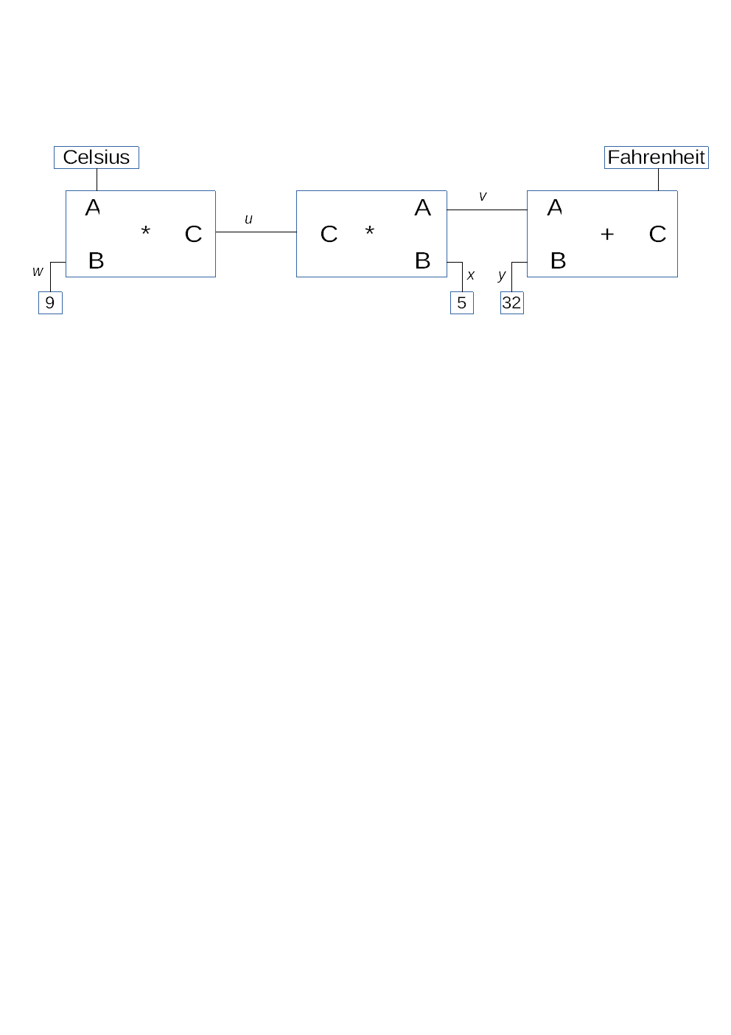
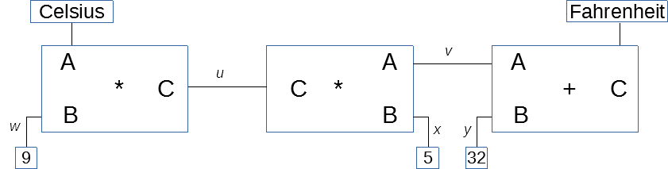
A Constraint Model for Conversion
Let’s try to make a model for Fahrenheit/Celsius
We have :
  Two multipliers (left) and one adder (right) with 3 terminals
  And some connectors between them

Slide 7
Anatomy of a Multiplier (or Adder)
A multiplier box polls its terminals
If two are set, then it can:
  multiply values (if A and B are set) to populate C, or
  Divide values (if C is set along with A or B) to find the missing value

Slide 8
Example Code for the Multiplier (1)
The subroutine takes three terminals as parameters and calls ternary-constraint with the terminals and the needed arithmetic operations
sub multiplier ($a, $b, $c) {
# The constraint that $a * $b = $c.
my $mult = { $^p * $^q };
my $div = { $^p / $^q };
return ternary-constraint($a, $b, $c,
$mult, $div, $div);
}

Slide 9
Example Code for the Multiplier (2)
In ternary-constraint(), we have :
sub ternary-constraint($a, $b, $c, $ab, $ca, $cb) {
# ...
if $av and $bv {
$c{'set_val'}(%c, $ab($a{'val'}, $b{'val'}));
} elsif $av and $cv {
$b{'set_val'}(%c, $ca($c{'val'}, $a{'val'}));
} elsif $bv and $cv {
$a{'set_val'}(%c, $cb($c{'val'}, $b{'val'}));
}
# ...

Slide 10
Instantiating the Converter
The user code to create the converter is not simple ...
  sub converter($c, $f) {
  # Connect $c to $f with constraints to convert from °C to °F
  my ($u, $v, $w, $x, $y) = map {make-connector($_)}, 1..5;
  multiplier($c, $w, $u);
  multiplier($v, $x, $u);
  adder($v, $y, $f);
  constant($w, 9);
  constant($x, 5);
  constant($y, 32);
  }

Slide 11
Automating the Instantiation
… But this is Perl 6
  We can use grammars to parse the math formula, and
  Automate the creation of the various objects needed
For now, the grammar is relatively simple and can parse math formulas like:
  9 * c = 5 * (f – 32), or
  p * v = n * k * t
I’m not sure how it could be made more general

Slide 12
Lessons Drawn
Finally, this implementation is too complex
  Note : I tried both functional and OO versions
I’m not convinced it can really be useful (the use cases are quite limited)
  I’m not sure at this point how to handle two math formulas
Looking back, I think it might be more interesting to try to implement a logic programming engine (perhaps something like Prolog or Picat)
  Perhaps converting Ovid’s Prolog module to Perl 6 may be interesting
  Or possibly something along the lines of Jeff Goff’s work on Picat

Slide 13

Conclusions
This work was inspired in part by the MIT book SICP (Abelson & Sussman) and its adaptation to Python (John Denero)
  https://wizardforcel.gitbooks.io/sicp-in-python/
Thank you for listening. Any questions?
These slides will be available on Github :
  https://github.com/LaurentRosenfeld/
  They can be used under the terms of the Creative Commons Attribution ShareAlike License (CC-BY-SA)

