Slide 1
Plasma Project
Engineering project audit
Laurent Thawpick
Academic tutor : C. Douat
Thawpick Laurent 4A GPSE October 6th of 2026

Slide 2
Summary
Introduction and Context
Study case and Objectives
State of the Art
Chip geometries
Functional Analysis
Risks Analysis
Temporal organisation (Gantt)
Experiment protocol and plan of the future
THAWPICK Laurent 4A GPSE October 6th of 2026

Slide 3
Introduction and Context
Plasma jet in canal or micro canal: Strong interest in biomedical applications (wound healing, cancer therapy) and surface modification.
Miniaturization Challenge: Problem with plasma jet in microcanals
Context
Big Project around about study plasma propagation and application
THAWPICK Laurent 4A GPSE October 6th of 2026

Slide 4
Study case and objective
Goal : Study, effect of plasma propagation through different tube diameters
(To be published at the end of the scholar year)
Principal Objective : Study of plasma propagation in different tube diameters
(Phase 1 → He, Phase 2 → Ar)
Study plasma propagation with different straight tubes separately (500um, 200um, 100um, 50um, 10um)
Study plasma propagation with different diameter tubes together (500 um, 200um, 100um, 50um, 10um)
THAWPICK Laurent 4A GPSE October 6th of 2026

Slide 5
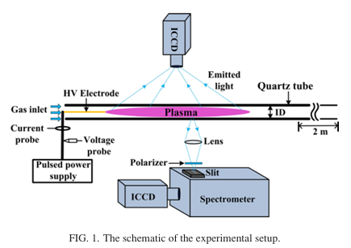
State of the art
- 5 quartz tubes with a series of inner diameters (70um, 60um, 1mm, 2mm, 4mm)
Results :
For id < 70um → breakdown of discrete plasma bullet into a continuous filamentary plasma column
Increasing of the streamer head field (E > 20kV/cm) with a no-linear velocity peak at 1mm
Picture 1 - Effects of the tube diameter on the propagation of helium plasma plume via electric field measurement- S. Wu, X. Lu, Y. Yue, X. Dong, and X. Pei
THAWPICK Laurent 4A GPSE October 6th of 2026

Slide 6

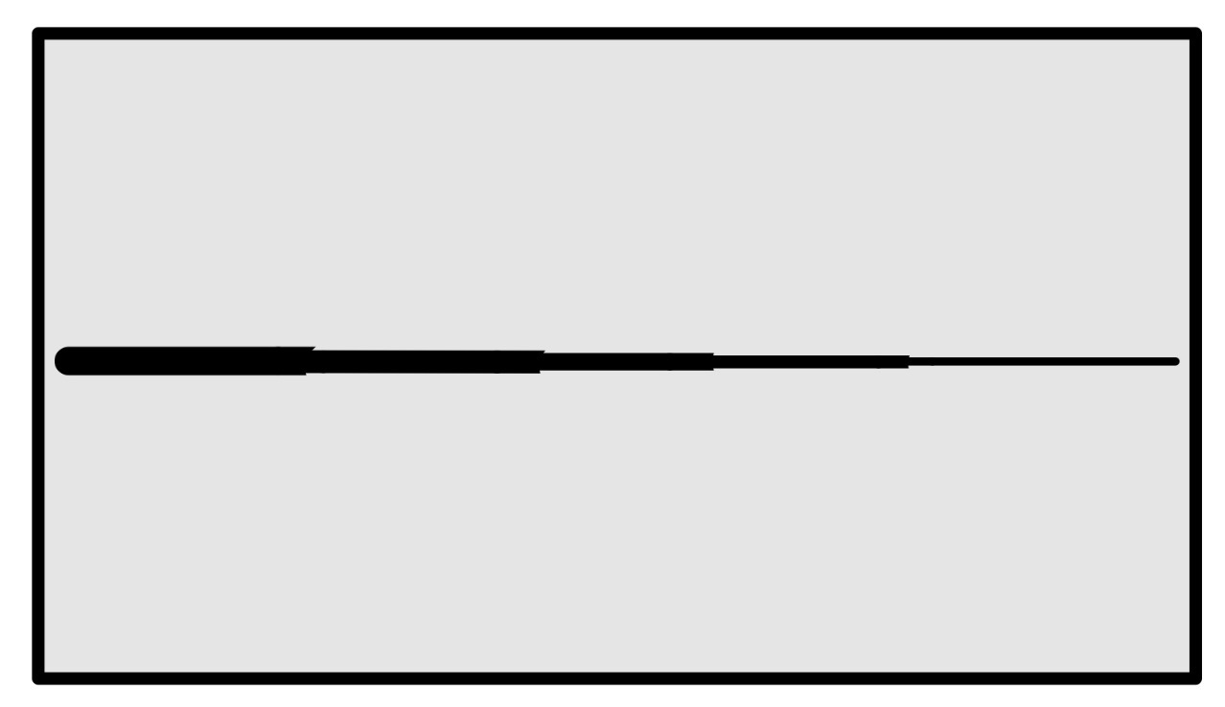
Chip geometries
500um
200um
500um
200um
100um
50um
10um
100um
50um
10um
Picture … - Different diameter tubes together Ipad
Picture …- Different straight tubes separately - Ipad
THAWPICK Laurent 4A GPSE October 6th of 2026

Slide 7
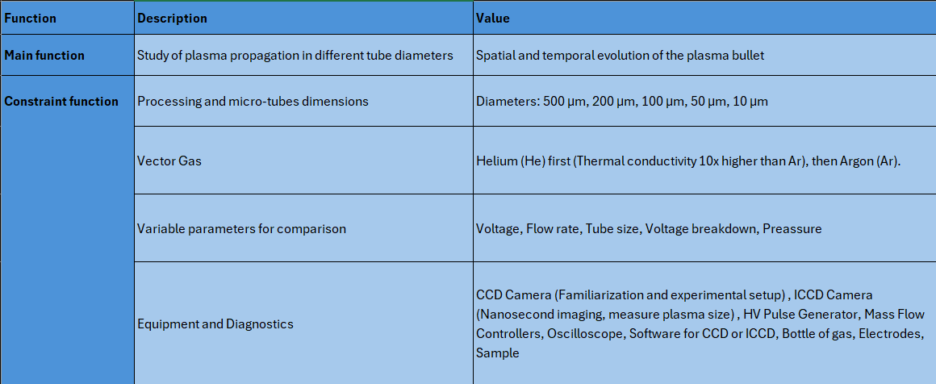
Functional Analysis
Table 2 - Functional Analysis for the project - Excel
THAWPICK Laurent 4A GPSE October 6th of 2026

Slide 8
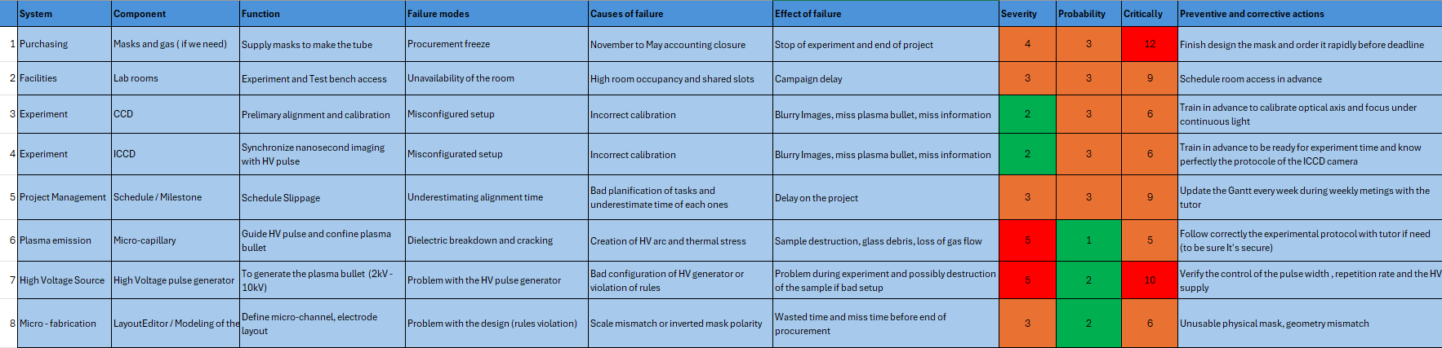
Risks Analysis
Table 1 - Risks Analysis for the project - Excel
THAWPICK Laurent 4A GPSE October 6th of 2026

Slide 9
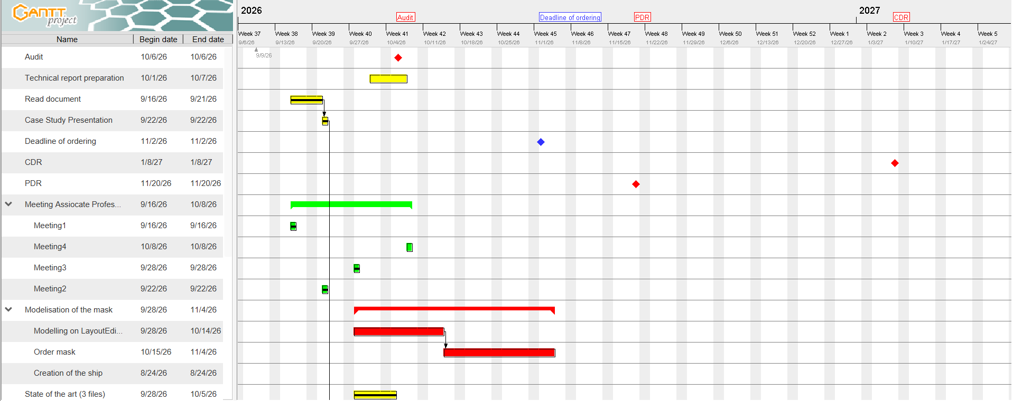
Organisation of the project (Gantt)
Table 3 - Organisation of the project - GanttProject
THAWPICK Laurent 4A GPSE October 6th of 2026

Slide 10
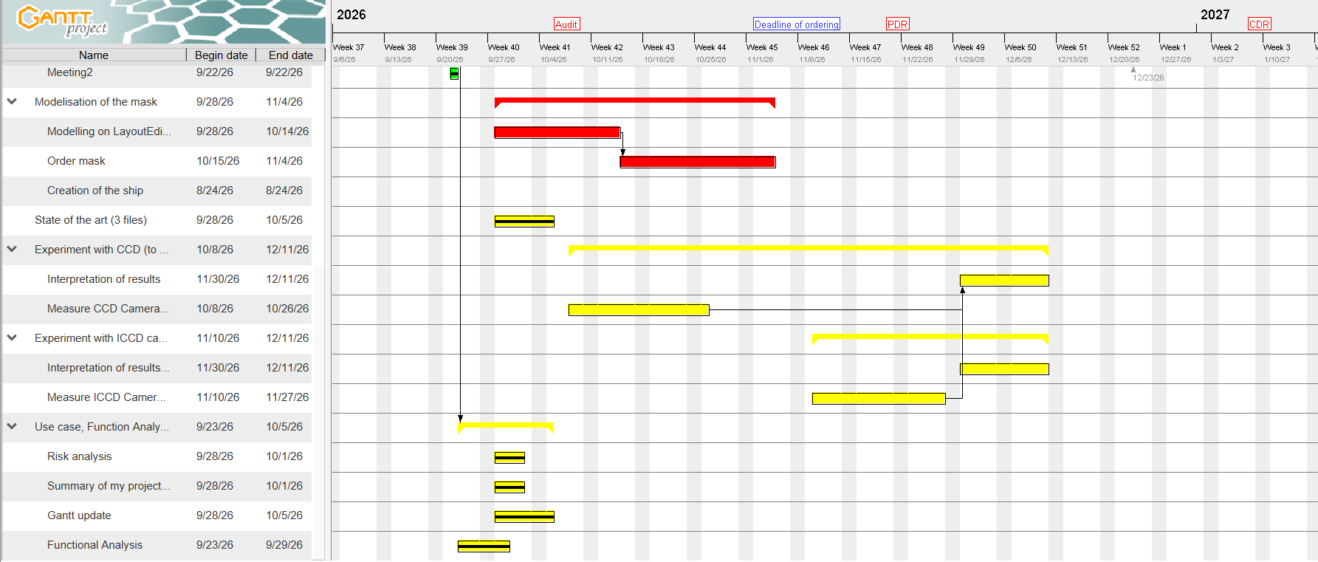
Organisation of the project (Gantt)
Table 4 - Organisation of the project - GanttProject
THAWPICK Laurent 4A GPSE October 6th of 2026

Slide 11
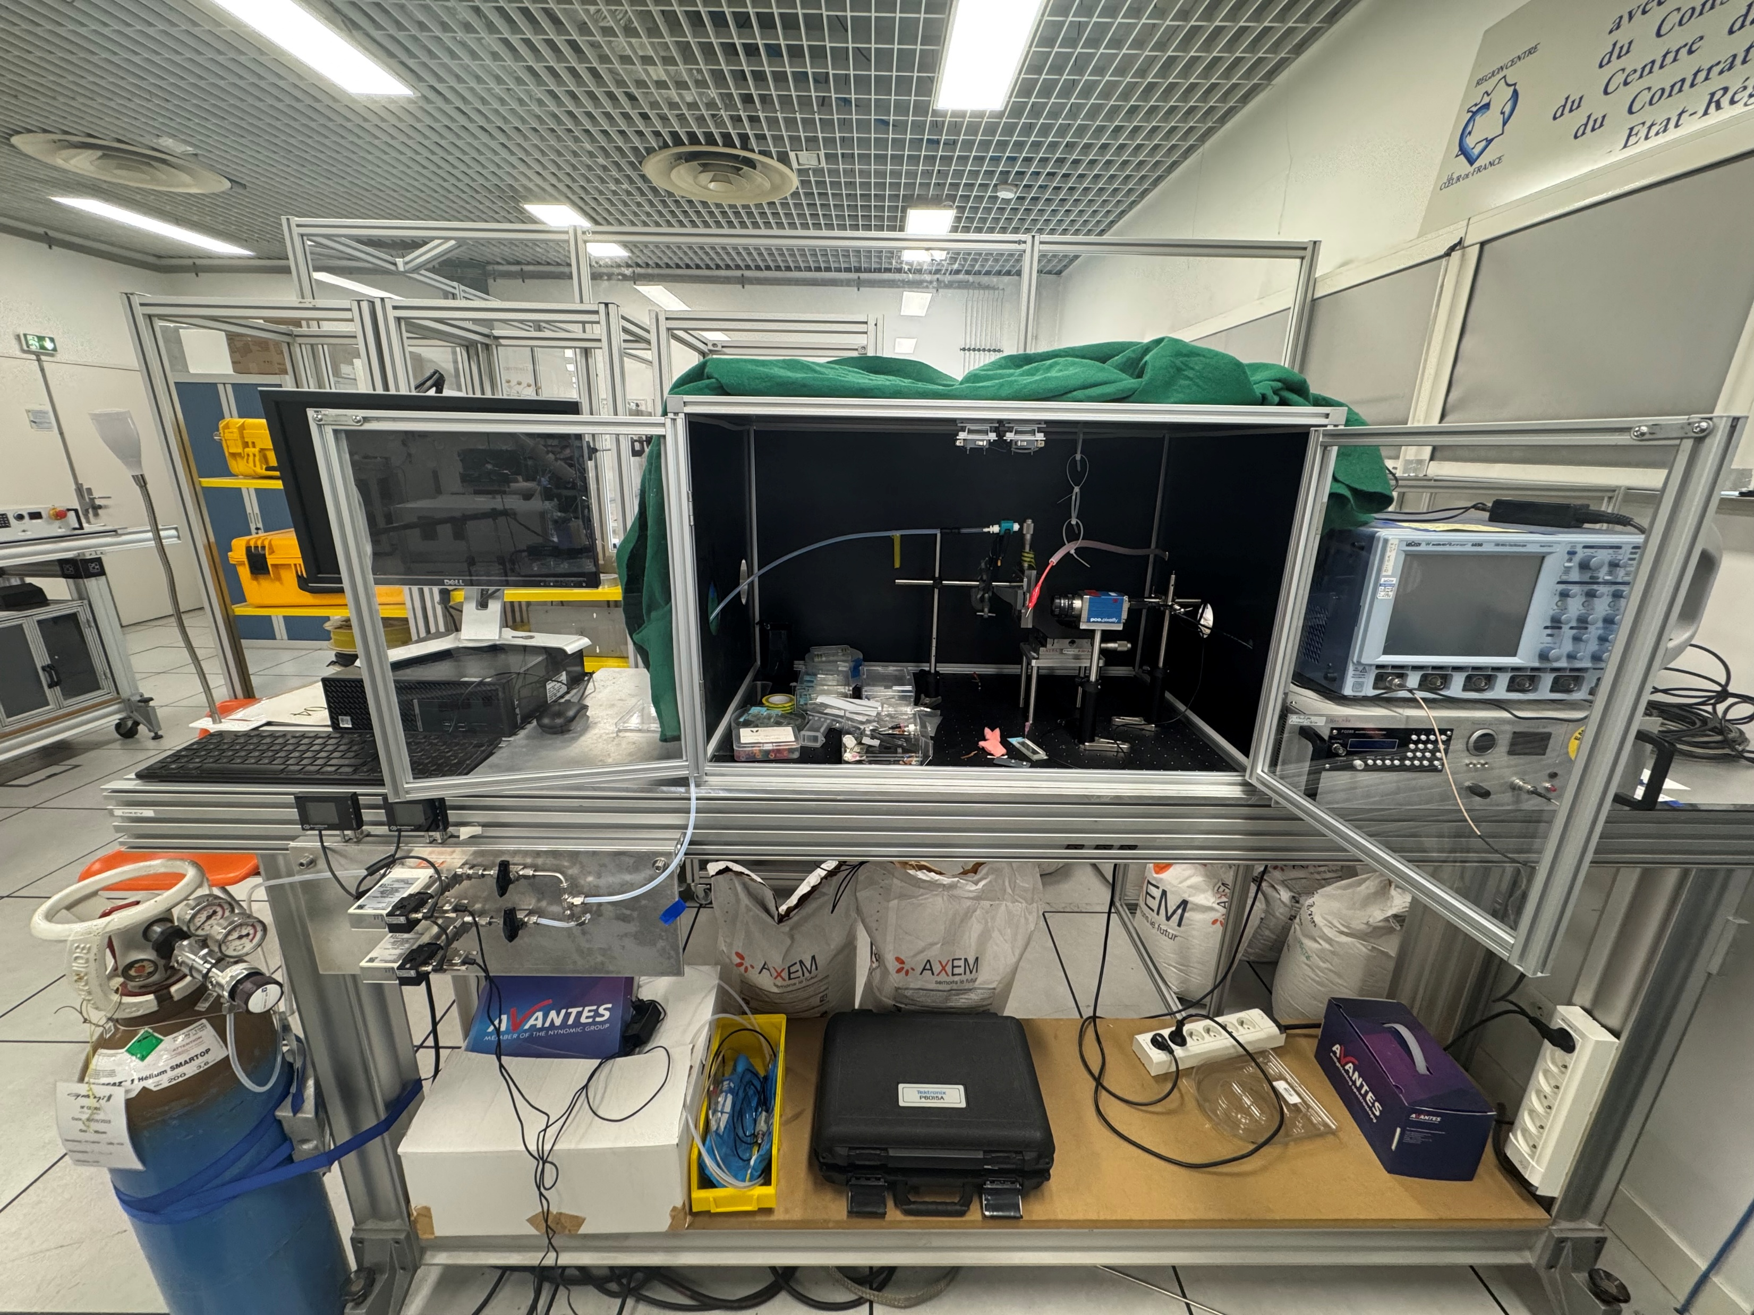
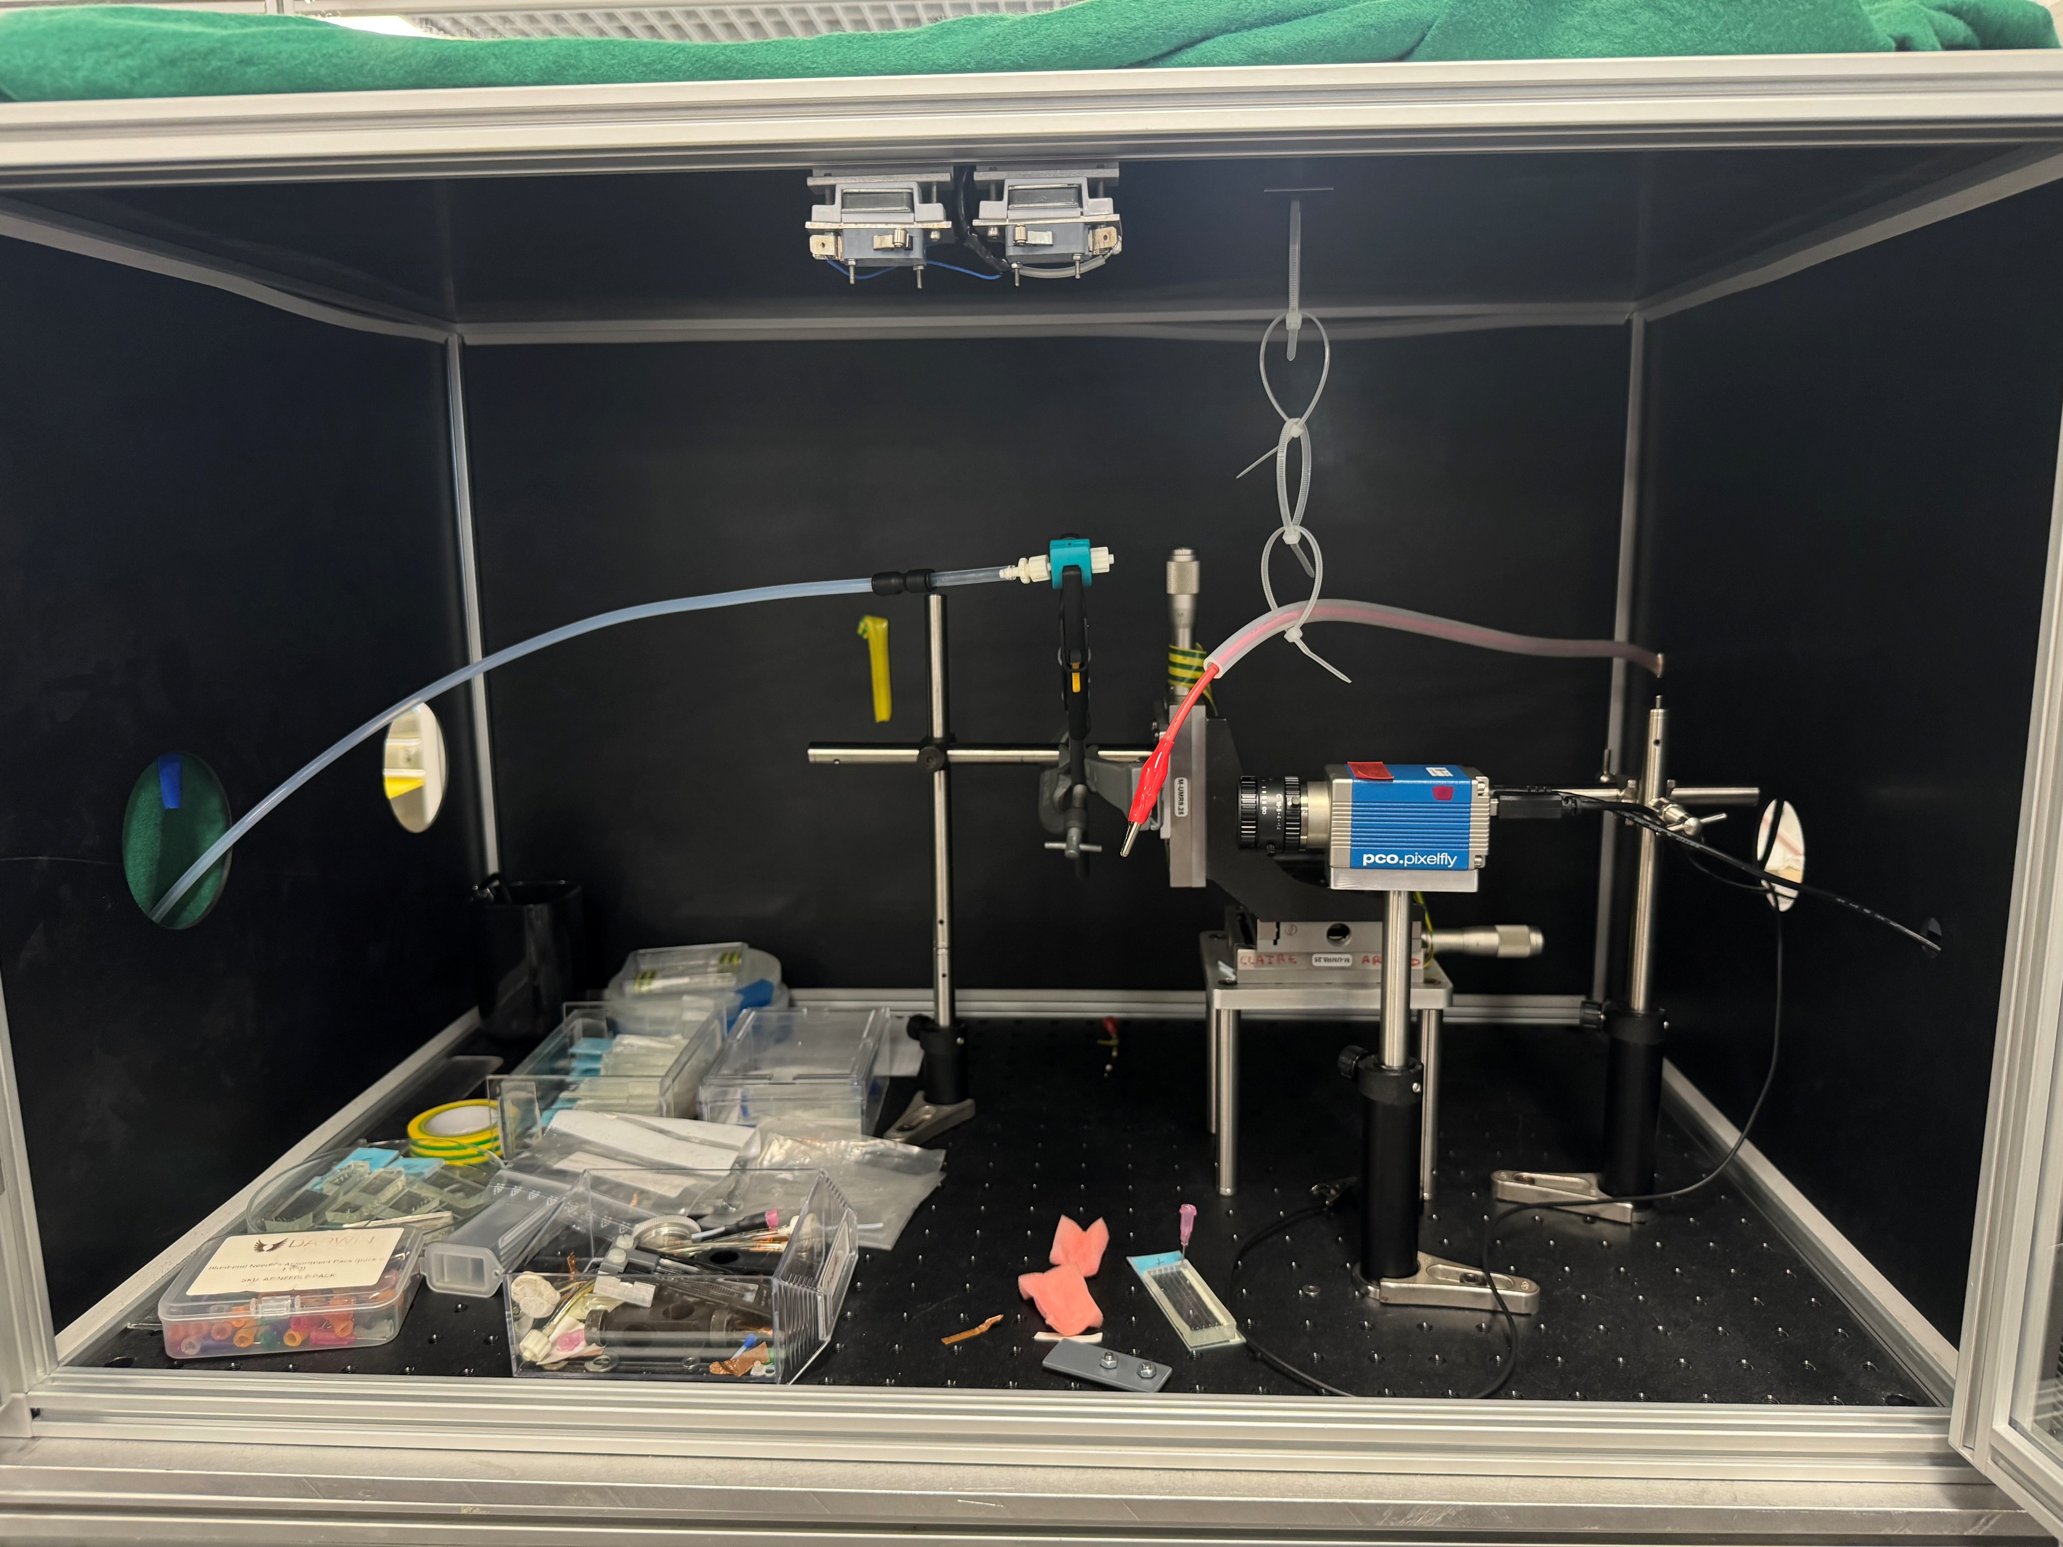
Experiment Protocole
(c)
(a)
→ Oscilloscope
→ HV generator (2kV – 10kV max)
→ Dark Room
(b)
Picture 1 - Experimental plan - Gremi
THAWPICK Laurent 4A GPSE October 6th of 2026

Slide 12
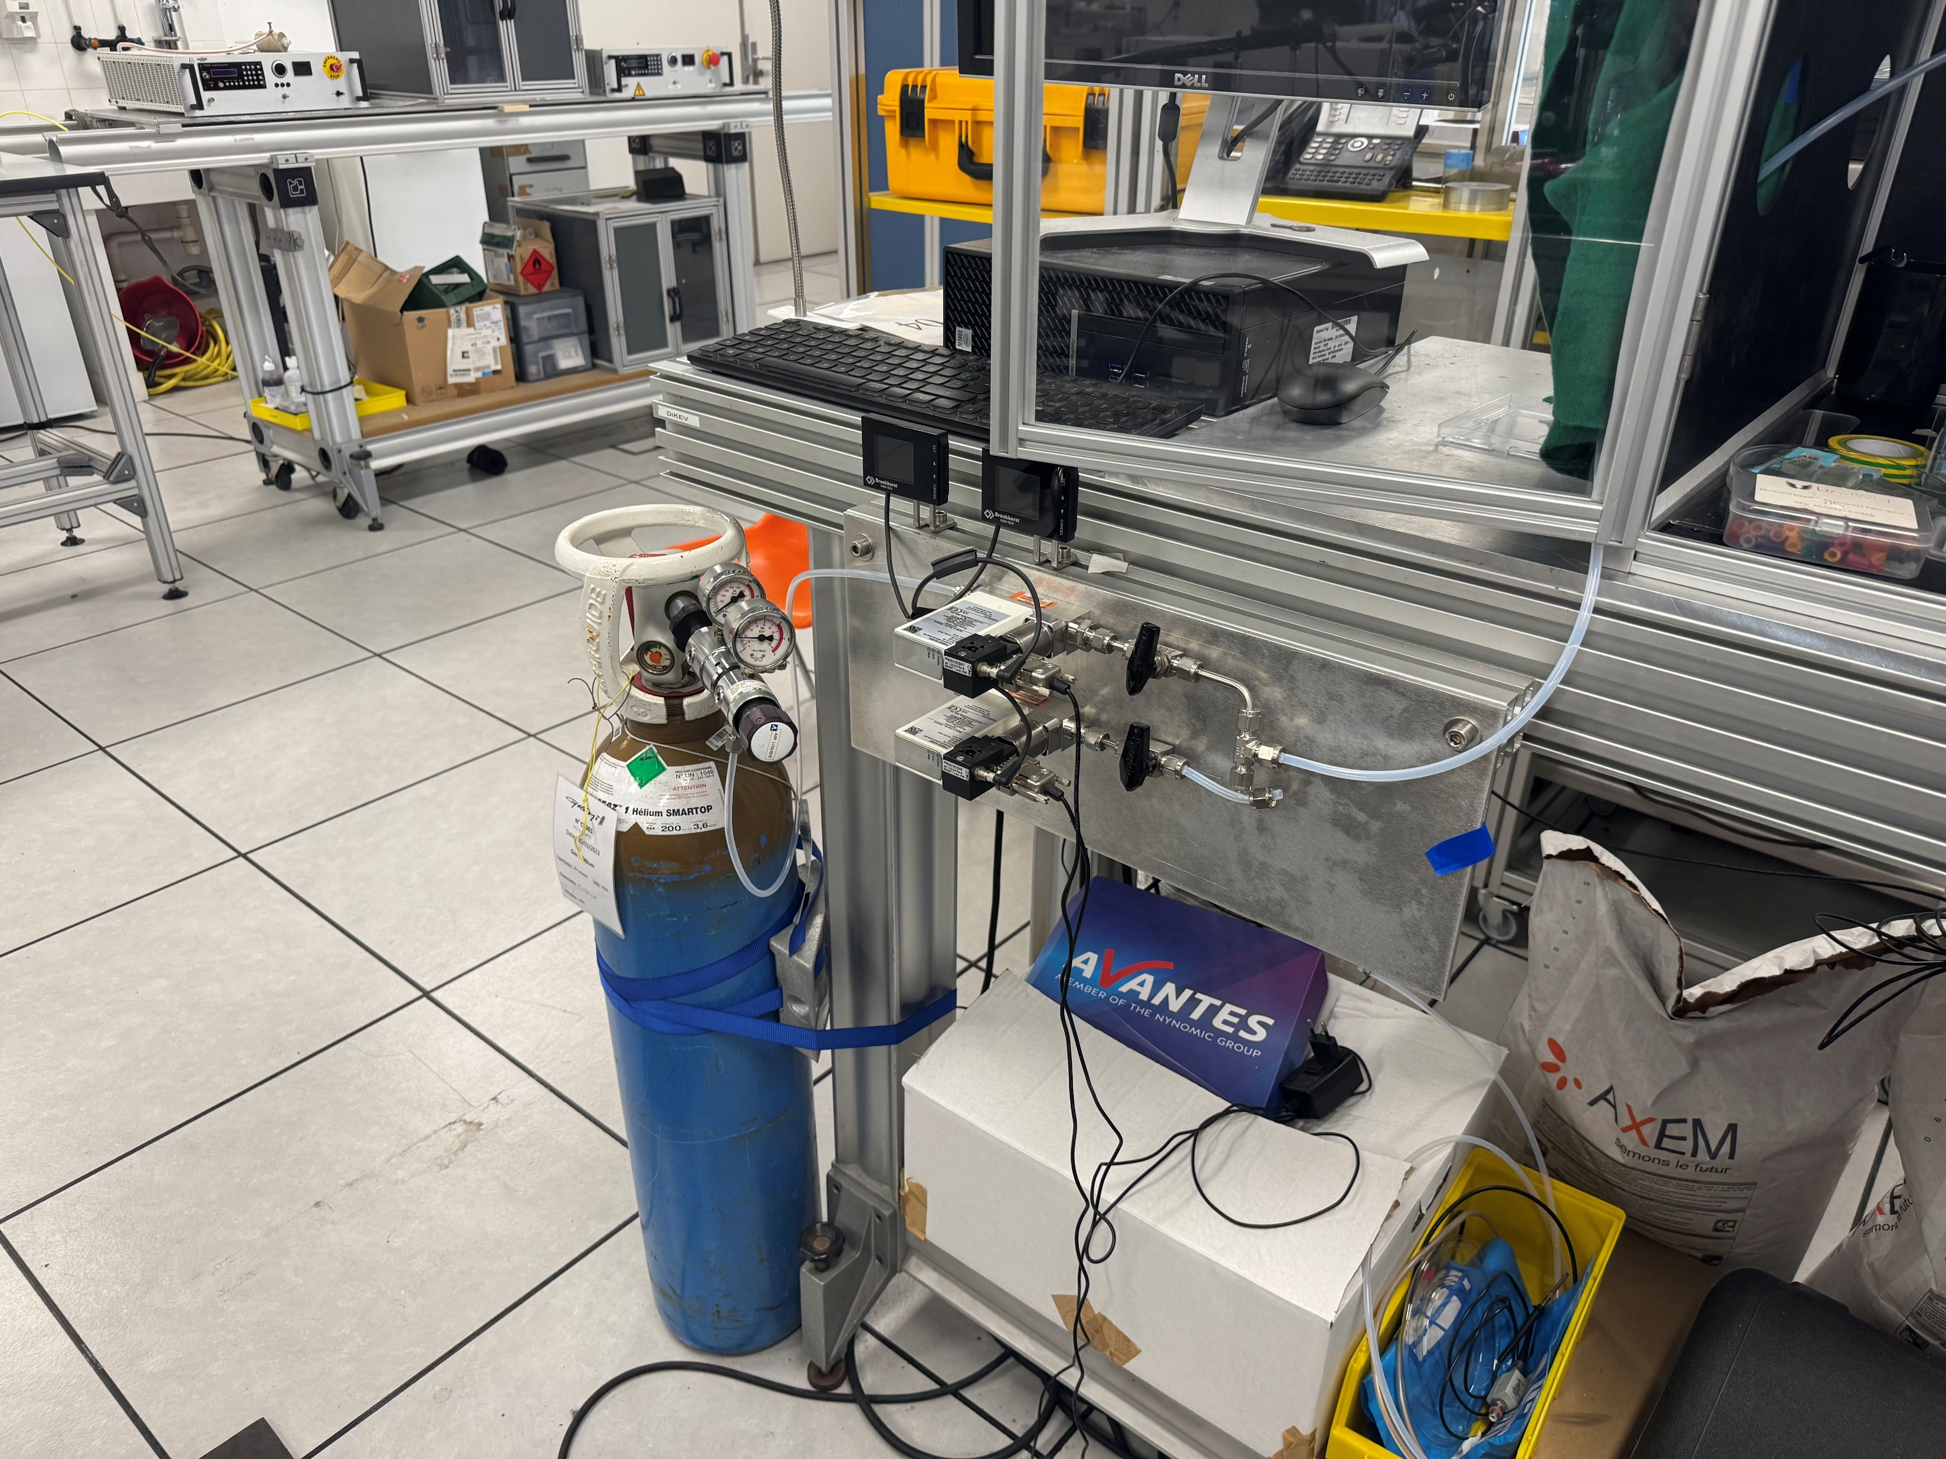
Experiment protocol
(a)
(c)
(f)
(e)
(b)
(d)
Picture 2 - Experimental plan - Gremi
Picture 3 - Experimental plan - Gremi
(c) → Gas pipe
(d) → Sample
(e) → Electrodes
(f) → CCD Camera (Charge-Coupled Device)
→ Debimeter for the gas
→ Gas bottle (He)
THAWPICK Laurent 4A GPSE October 6th of 2026

Slide 13
Plan for the future
Create the chip (Modeling mask, Order it, Process and creating of the ship
Experiment with CCD, then ICCD
THAWPICK Laurent 4A GPSE October 6th of 2026

Slide 14
Thank you for listening
Thawpick Laurent 4A GPSE October 6th of 2026

