Slide 1
Seita
PCF Generation Platform
Robust – Flexible – Agile

Slide 2
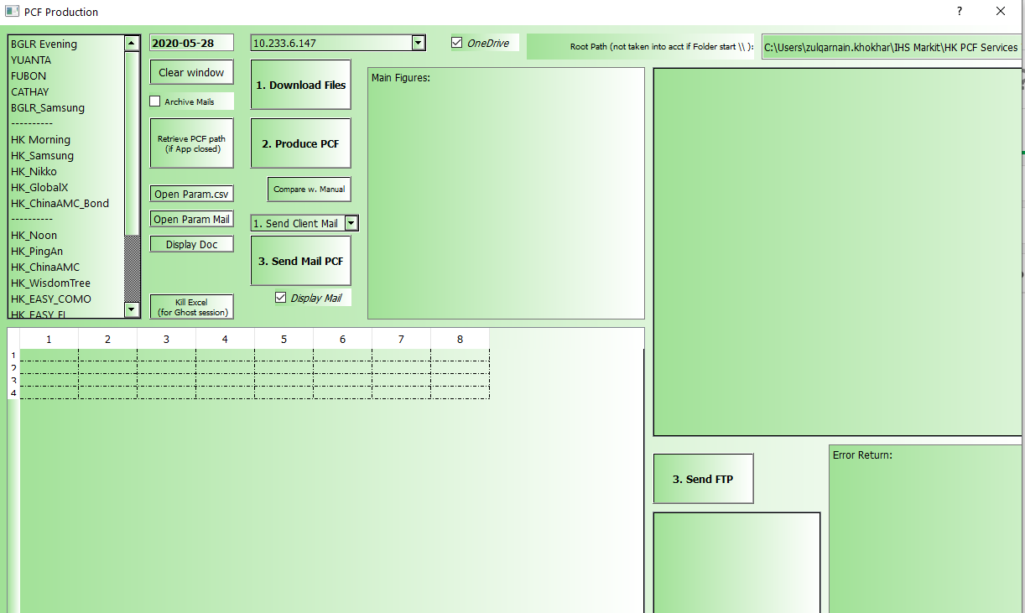
Seita
Platform created using advanced data processing libraries e.g: Pandas / Numpy…
Currently, analysts are using multiple excel sheets, manually copy pasting raw data, which is prone to lot of human errors.
It’s not a collection of python scripts running for each individual PCF
Structured in modules / Class / Functions
Keep working on making the tool smarter
Current process in different regions:
Excel sheets / VBA Macros
Python single scripts (not encapsulated into App)
Corona/ Inmon
Why not Corona?

Slide 3
Seita
Development Status

Slide 4

Development Divided in 3 Phases
Phase 1 (Completed)
Onboarded All HK PCFs
Rigorous Quality Testing
Optimized the Source Code
Capability to read data from website/FTP/Files/SQL etc
Capability to distribute PCFs by email and upload to FTP
Improved error alert messages to identify processing errors
Phase 2 (In-Progress)
Extensive Broad and PCF specific validations will be incorporated
Additional functionality will be available on UI along with capability for Holiday Treatment
Source Code will further be streamlined
Singapore and EMEA PCFs will be Onboarded (Migration)
Phase 3 (2021)
Onboard US PCFs
Reduce dependency from the core team to mitigate risk
Complete Documentation.
Use additional data science and MLP tools to train on PCF corporate action and holiday treatment.
Complete Automation!

Slide 5
Developer’s Organization for Delivery
Develop – Deliver – Test

Slide 6
Present Delivery System
Don’t forget:
Open Anaconda Prompt and write:
pip install paramiko
pip install selenium
You can find other details in the IT install guide:
\\uk-pdeqtfs01\E\SolaBI\Python_Installer\IT_guide_PyInstall.docx
Developer Environment
Local C:\ of Laurent Tupin
Common Environment
UK server
\\uk-pdeqtfs01\E\SolaBI\Python_Installer
Simple Python Process to deliver from LT Local environment
From UK Server to Local User environment
Re-Install
PyInstaller_Seita.exe
Just Update if files are more recent in UK Server
C:\Users\laurent.tupin\Desktop\Python_App\PyUpdate_Solution.py
Application ‘.EXE’ to install Solution or
Simple Python Process both clicked by user

Slide 7
Chart of New Delivery
Developer List:
Laurent Tupin
Khokhar Z.
Vincent Rosaldes
Benito Ting
Thanos A.
Xiao Shang
Reviewer:
Karan Agarwal
Anuj Garg
Advanced Users:
Laurent Tupin
Khokhar Z.
Vincent Rosaldes
Benito Ting
LiYing Chua
Thanos A.
Venkatesha Muniraju
Xiao Shang
Developer Local Environment
Developers can test the new features
Press Python process to push from Dev to Gitlab
Synchronized
GITLAB Folder synchronized
Carry on Test in here before delivery
GITLAB
Developer add new code
Simple Python Process to deliver from Gitlab to Test Environment
Test Env for Advanced User
Server Path to be defined
From Server to Local User environment
Same logic than before: Seita_Test.bat
Prod Environment
After sufficient time of testing, we can deliver Test in Prod BEFORE to deliver new featured to Test
From Server to Local

Slide 8
GITLAB - Getting Started
International Programing Collaboration

Slide 9
Introduction
Join D1-DevOps Group
Benito had the process detailed
To be Paste here
Learning to use GitLab
Nice Youtube Tuto, very simple:
https://www.youtube.com/watch?v=Jt4Z1vwtXT0&list=PLhW3qG5bs-L8YSnCiyQ-jD8XfHC2W1NL_
Install Git Bash (Git-2.26.2-64-bit.exe)
Open CMD and apply the command you will find on Gitlab (https://git.mdevlab.com/d1-devops/global/Seita)
git config --global user.name "Name"
git config --global user.email “email“
Only for LT: 1st to push Seita
Open CMD or Git Bash
cd C:\Users\laurent.tupin\Documents\GitLab\LT_App
git init
(git remote add origin https://git.mdevlab.com/laurent.tupin/LT_APP/Seita.git)
(git status)
git add .
git commit -m "Initial commit"
git push –u https://git.mdevlab.com/laurent.tupin/LT_APP.git master

Slide 10
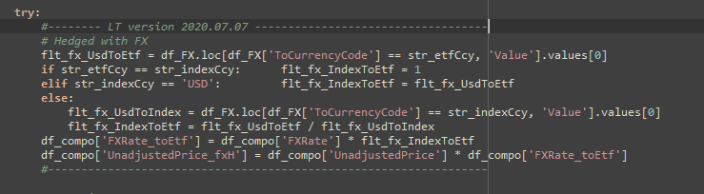
Additional Safety to avoid investigate through the branch merging

Slide 11
Seita App
What to do to add a new PCF ?

Slide 12
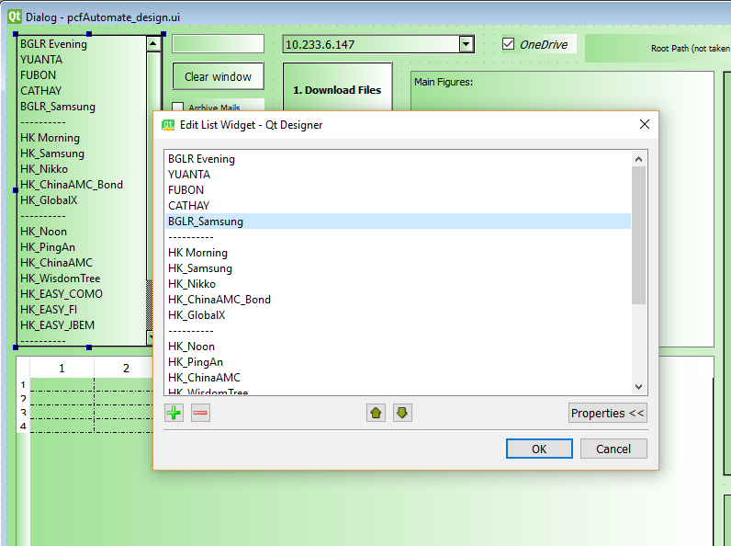
How to add a PCF
One path where I already document that aspect:
\\uk-pdeqtfs01\E\SolaBI\Python_Installer\Py_Package\Seita
Add New PCF to Seita.docx
Add your perimeter to the UI
Open the file: pcfAutomate_design.ui
Add the perimeter in the list
You need the application Designer.exe
Example: BGLR_SAMSUNG

Slide 13


How to add a PCF
2. Fill the CSV with the parameters of your perimeter
3. You need only to fill the PCF_Creater.py file
Seita.py is the definition of the behavior of the UI (Connection the button and the code), you only change it if you create / update a button
Creater is where the creation of PCF are defined
Download should not be touched
Generic Process is filled with Miscellaneous process

Slide 14
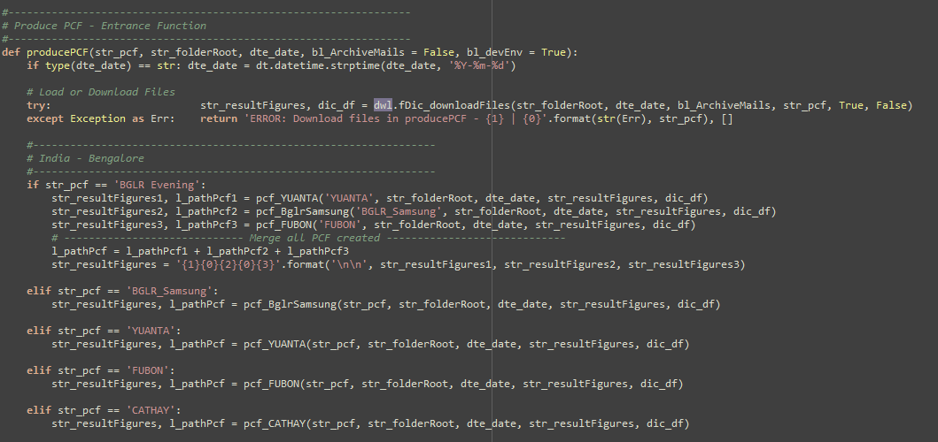
How to add a PCF
Copy-Paste code as to have your Perimeter Name (BGLR_SAMSUNG) in the ’IF’
Do the same thing in the function :
sendPCF
sendFTP
Only need to add some row in case you want your PCF to be within a group of PCF
Create the process BglrSamsung

Slide 15
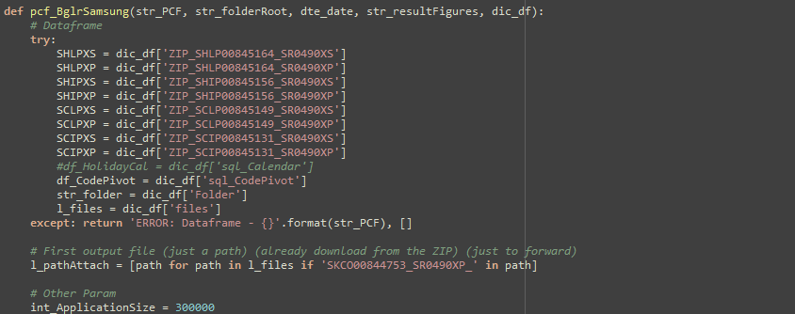
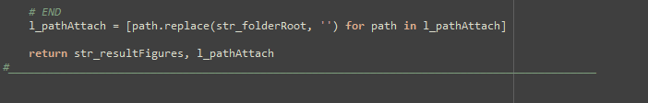
How to add a PCF
ID defined in the CSV: Seita_Param.csv
ZIP_SKCO00844753_SR0490XP
Thus, you have the document you downloaded in DataFrame and you can transform them into DataFrame to deliver
Return:
You need to return a message + a list of path of the file you have just created
* You need to remove the Root Path from every path to have the App sending those files later on.

