Slide 1
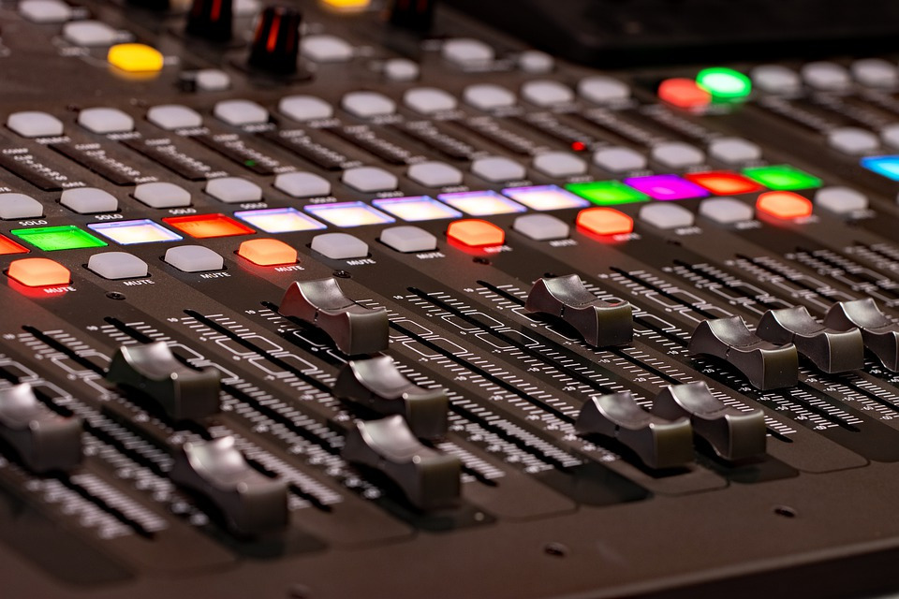
Laurenz Hundgeburth NeuraBeats
Onset Detection Challenge
2022

Slide 2
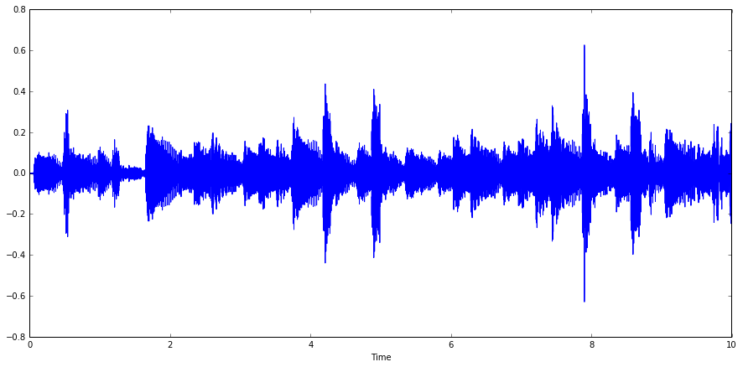
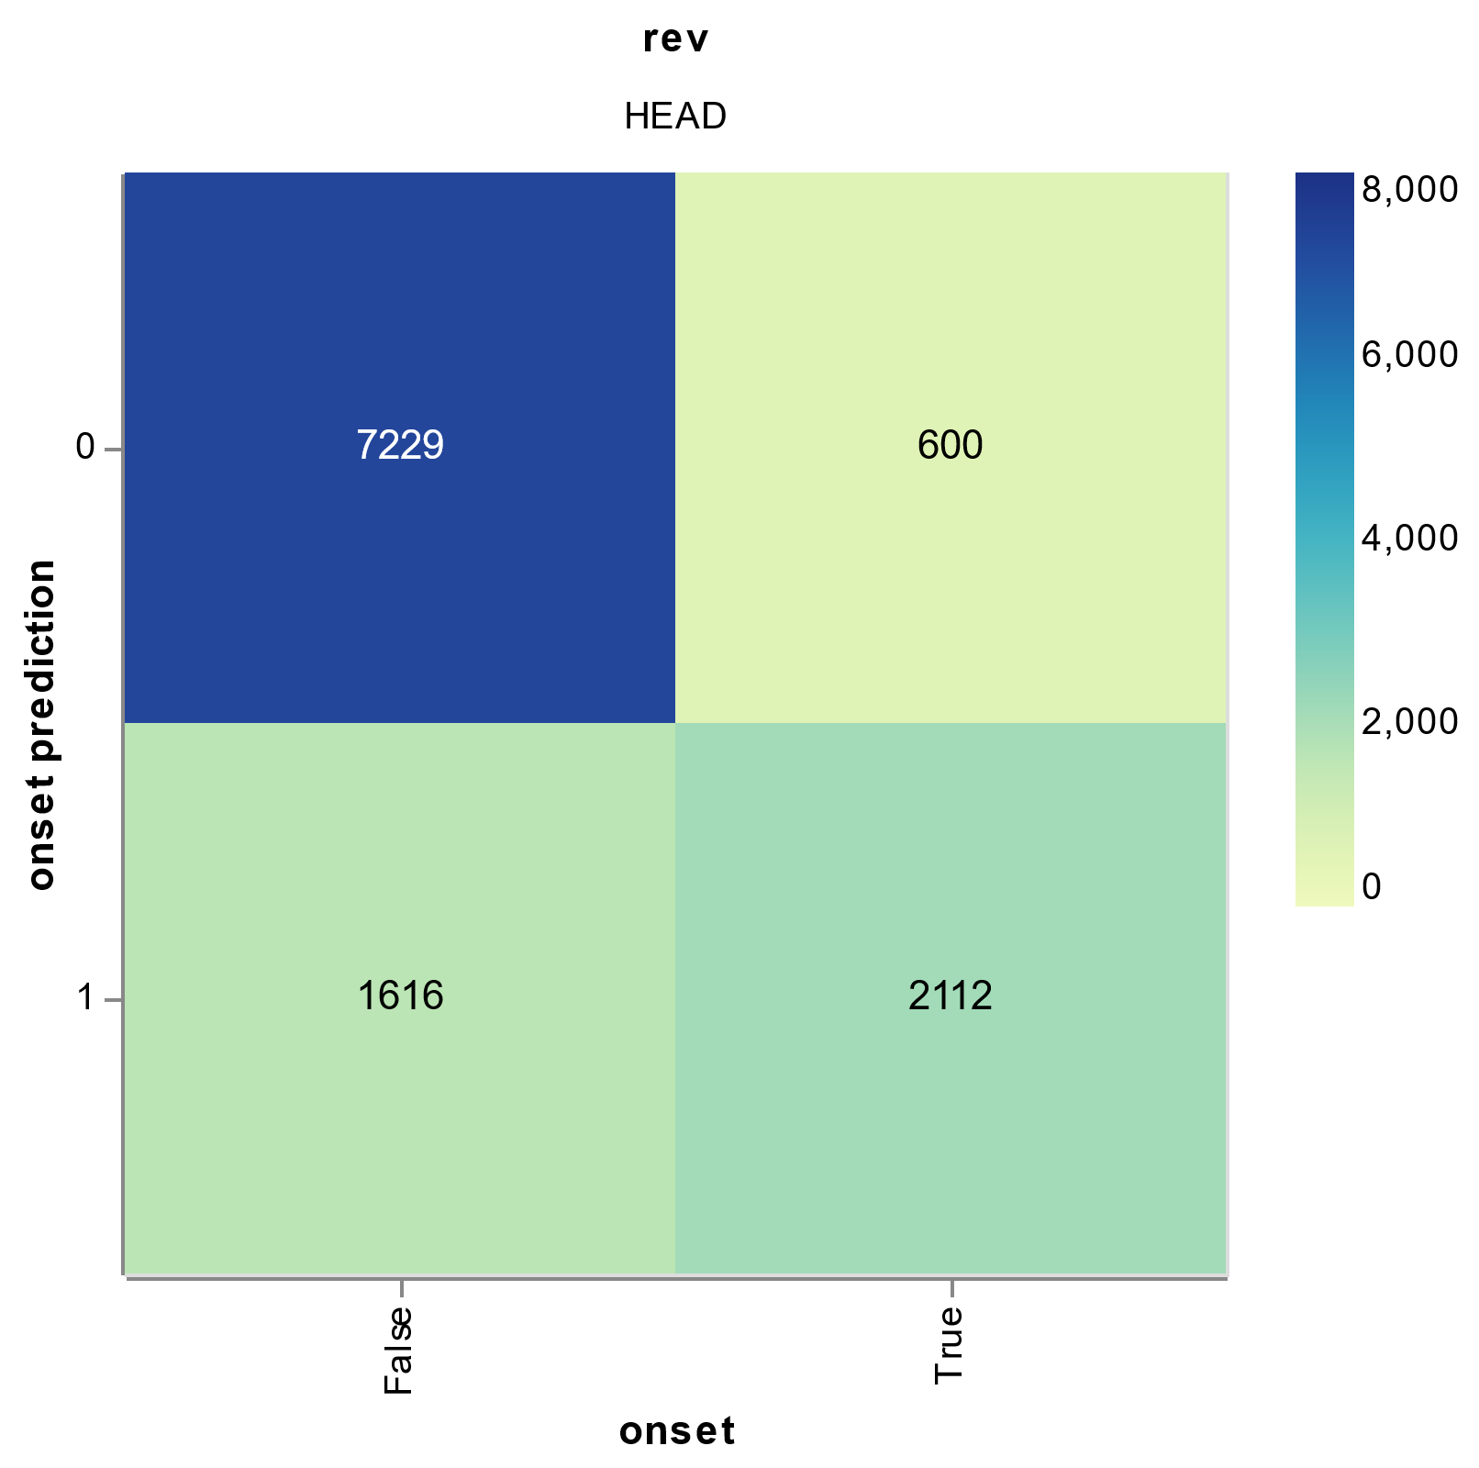
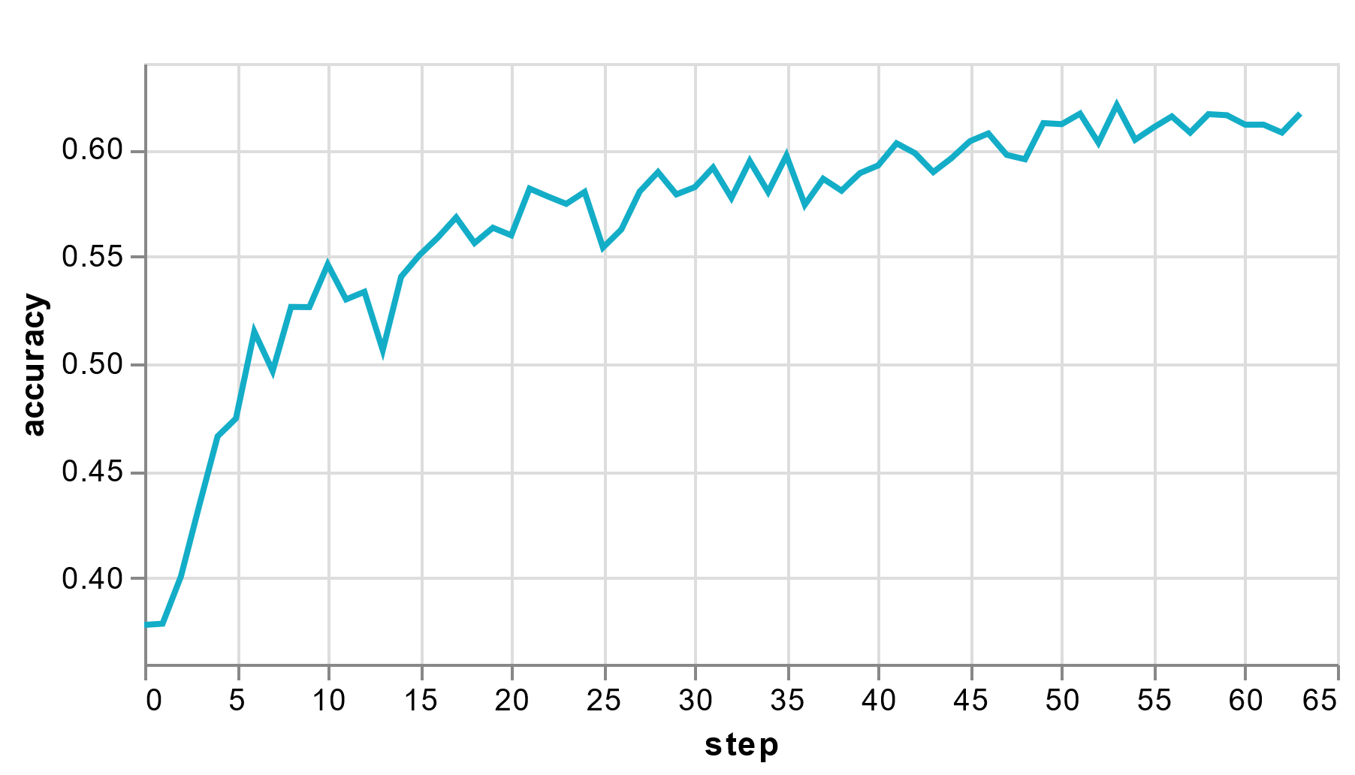
Results:
Test set onset F1 score
0.39
Onset labelling strategy:
Code repository:
https://github.com/LaurenzBeck/music-processing-challenge
Experiment UI (dvc studio):
https://studio.iterative.ai/user/LaurenzBeck/views/music-processing-challenge-iu33ikqwxa
onset
False
True
False
Timestamps in columns
Column entry is labelled as onset, if the gt timestamp is between the start of the frame and the start of the next frame.
Sliding window approach with overlapping frames of 6600 samples (~150ms) with 25 fps (hop size = 1800 samples or 40 ms)
Features:
Mean
Std
Signal Energy
Average power spectral density (welch method)
Kurtosis
Skew
Superflux
Modelling:
feature normalization, simple MLP ([256, 128, 128]), MC dropout, Lamb optimizer, class-weighted label smoothing CE loss, one-cyle learning rate policy
Ewma filter
Diff to prev frame
Ewma filter

Slide 3
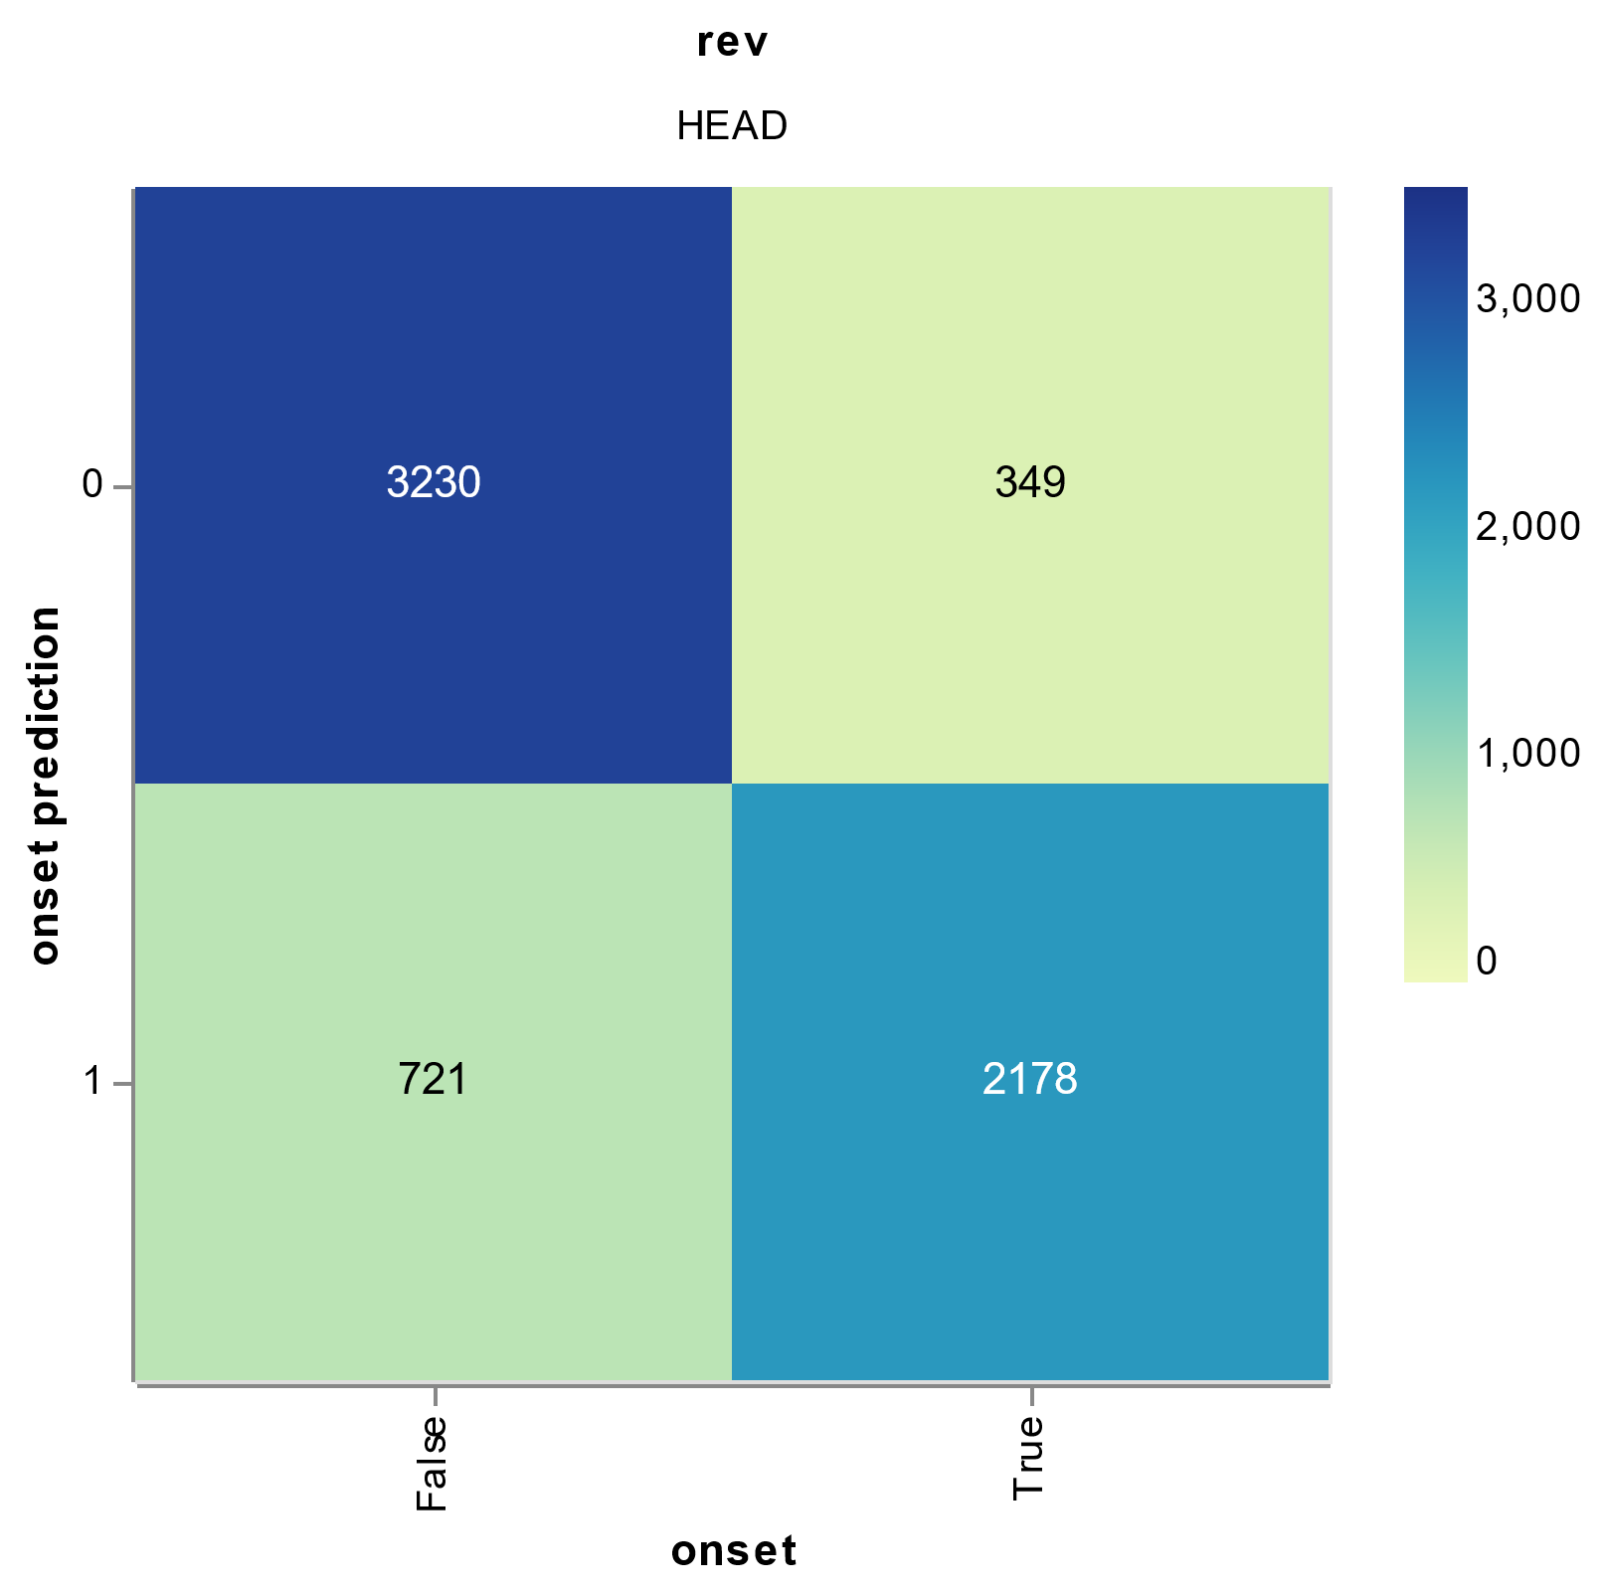
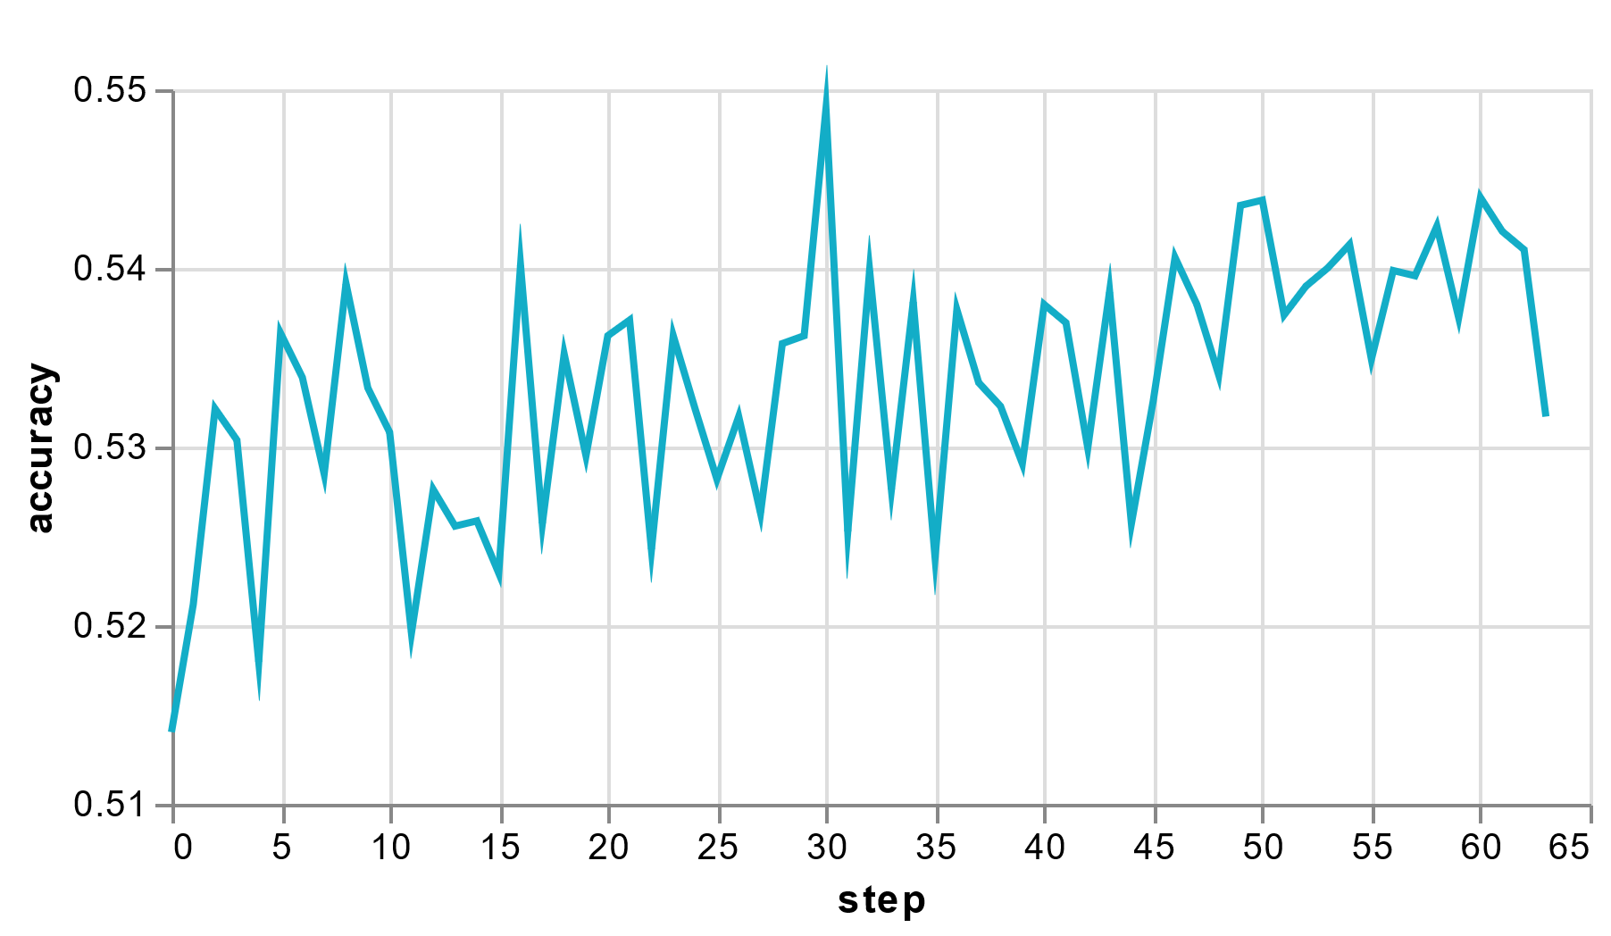
Results:
Test set onset F1 score
0.429
Onset labelling strategy:
Code repository:
https://github.com/LaurenzBeck/music-processing-challenge
Experiment UI (dvc studio):
https://studio.iterative.ai/user/LaurenzBeck/views/music-processing-challenge-iu33ikqwxa
onset
False
True
False
Timestamps in columns
Column entry is labelled as onset, if the gt timestamp is between the start of the frame and the start of the next frame.
Sliding window approach with overlapping frames of 3150 samples (~71ms) with 14 fps
Features:
Mean
Std
Signal Energy
Average power spectral density (welch method)
Kurtosis
Skew
Superflux
Modelling:
feature normalization, simple MLP ([256, 128, 128]), MC dropout, Lamb optimizer, class-weighted label smoothing CE loss, one-cyle learning rate policy
Ewma filter
Diff to prev frame
Ewma filter

