Slide 1


Extending the Usage of Adjectives in the Zulu AfWN
Laurette Marais, Laurette Pretorius
Global Wordnet Conference 2023
27 January 2023
Donostia, Spain
GF Seminar #5
7 February 2023

Slide 2
Outline
Introduction
Qualificatives in Zulu
Problem
Zulu Resource Grammar
Solution
Evaluation
Discussion
Conclusion

Slide 3
Introduction: Zulu
Zulu → Nguni → Southern Bantu → Bantu
One of 11 official languages of South Africa
Home language of 25% of South Africans (12M in 2011)
Agglutinative morphology
Nominal classification (nouns exhibit “class gender”)
Concordial agreement
umuntu omuhle (1) nice person
indaba enhle (9) nice story
izihlala ezinhle (8) nice trees

Slide 4
Introduction: AfWN
PWN for NLP inspired AfWN (ZWN) for NLP (Bosch et al, since 2008)
ZWN
n: 4907
v: 1523
a: 1590 (1338)
Why the expand model?
Under-resourced languages
Shared underlying structure
Developers of AfWN confronted with the problem of adjectives
Often complex constructions based on nouns and verbs

Slide 5
Qualification in Zulu
English adjectives seldom map to Zulu adjectives
Qualificatives
Adjectives (small closed class) (big, small, tall etc)
Descriptive possessive (of gold → golden)
Verbal relative (which does not see → blind)
Copulative relative (which is a lie → false, which has noise → noisy)
Mojapelo (2014): “[t]he challenge ... is that while they [qualificatives] are all meaning equivalents of the same English word category, they straddle a number of morphosyntactic categories in Northern Sotho, which nevertheless share a semantic function.”

Slide 6
Problem: Qualificatives in the ZWN
funny
hlekisayo
hlekis[VRoot]
+a[VTermSuf]
+yo[RelSuf]
“he always tells such funny jokes and makes us laugh”
“uhlala esitshela amahlaya ahlekisayo futhi uyasihlekisa”
“indaba ayihlekisanga”
the story was not funny
hlekisayo?
class gender → tense → polarity → attr/pred → long/short → 380+ forms

Slide 7
Problem: diverse morphosyntax
English sense | ZWN written form | Past negative predicative (class 9) | Essence?
nice | hle | ibingeyinhle | hle [ADJ]
funny | hlekisayo | ayihlekisanga | hlekis [V]
blind | ngaboni | ibonile / ibone | bon [V] + NEG
false | ngamanga | ibingengamanga | nga + amanga [COP]
believable | nokukholwa | ibingenakukholwa | na + (u)kukholwa [COP assoc]
All these forms are predicate based qualificatives → there is some verb phrase implicit in every written form!
A sophisticated computational solution is required to effectively deal with the complexity of the adjective-like qualificatives in the ZWN.

Slide 8
Problem: surface forms
 | Attributive | Pres | Pos | umuntu ongaboni | the person who is blind
 |  |  | Neg | umuntu obona(yo) | the person who is not blind
 |  | Past | Pos | umuntu ongabonanga | the person who was blind
 |  |  | Neg | umuntu obonile(yo) | the person who was not blind
 |  | Future | Pos | umuntu ongazukubona | the person who will be blind
 |  |  | Neg | umuntu ozobona | the person who will not be blind
 | Predicative | Present | Pos | umuntu akaboni | the person is blind
 |  |  | Neg | umuntu uyabona | the person is not blind
 |  |  | Pos | umuntu akabonanga | the person was blind
 |  |  | Neg | umuntu ubon(il)e | the person was not blind
 |  |  | Pos | umuntu akazukubona | the person will be blind
 |  |  | Neg | umuntu uzobona | the person will not be blind
 | Attributive | Pres | Pos | umuntu ongaboni | the person who is blind
 |  |  | Neg | umuntu obona(yo) | the person who is not blind
 |  | Past | Pos | umuntu ongabonanga | the person who was blind
 |  |  | Neg | umuntu obonile(yo) | the person who was not blind
 |  | Future | Pos | umuntu ongazukubona | the person who will be blind
 |  |  | Neg | umuntu ozobona | the person who will not be blind
 | Predicative | Present | Pos | umuntu akaboni | the person is blind
 |  |  | Neg | umuntu uyabona | the person is not blind
 |  |  | Pos | umuntu akabonanga | the person was blind
 |  |  | Neg | umuntu ubon(il)e | the person was not blind
 |  |  | Pos | umuntu akazukubona | the person will be blind
 |  |  | Neg | umuntu uzobona | the person will not be blind
 | Attributive | Pres | Pos | umuntu ongaboni | the person who is blind
 |  |  | Neg | umuntu obona(yo) | the person who is not blind
 |  | Past | Pos | umuntu ongabonanga | the person who was blind
 |  |  | Neg | umuntu obonile(yo) | the person who was not blind
 |  | Future | Pos | umuntu ongazukubona | the person who will be blind
 |  |  | Neg | umuntu ozobona | the person who will not be blind
 | Predicative | Present | Pos | umuntu akaboni | the person is blind
 |  |  | Neg | umuntu uyabona | the person is not blind
 |  |  | Pos | umuntu akabonanga | the person was blind
 |  |  | Neg | umuntu ubon(il)e | the person was not blind
 |  |  | Pos | umuntu akazukubona | the person will be blind
 |  |  | Neg | umuntu uzobona | the person will not be blind
Class 1 | Form | Tense | Pol | Zulu | English
 | Attributive | Pres | Pos | umuntu ongaboni | the person who is blind
 |  |  | Neg | umuntu obona(yo) | the person who is not blind
 |  | Past | Pos | umuntu ongabonanga | the person who was blind
 |  |  | Neg | umuntu obonile(yo) | the person who was not blind
 |  | Future | Pos | umuntu ongazukubona | the person who will be blind
 |  |  | Neg | umuntu ozobona | the person who will not be blind
 | Predicative | Present | Pos | umuntu akaboni | the person is blind
 |  |  | Neg | umuntu uyabona | the person is not blind
 |  |  | Pos | umuntu akabonanga | the person was blind
 |  |  | Neg | umuntu ubon(il)e | the person was not blind
 |  |  | Pos | umuntu akazukubona | the person will be blind
 |  |  | Neg | umuntu uzobona | the person will not be blind
Examples of Zulu qualificatives derived from the Zulu written form ngaboni (‘blind’)

Slide 9
Zulu GF Resource Grammar
Grammatical Framework resource grammar
Implements morphosyntax of Zulu
First available general purpose computational grammar for Zulu (indeed, any African language)
GF runtime enables parsing (text to tree) and linearising (tree to text)

Slide 10
Solution: overview
Recover implicit morphosyntactic constructions from the written forms by parsing them using the ZRG
Provide functionality to generate and analyse full forms of these constructions
Mostly automatic process which can be reused
for future versions of the ZWN
for the other languages in the AfWN once resource grammars for these languages are available

Slide 11
Solution: preparing to parse
e[RC][4]nga[NegPre]bon[VRoot]i[VTNeg]
e[RC][9]nga[NegPre]bon[VRoot]i[VTNeg]
…
ngaboni
engaboni
fun bon_V : V ;
lin bon_V = mkV “bon” ;
ZulMorph
837 / 1338
krwada+?
ekrwada+?
krwada
ekrwada

Slide 12
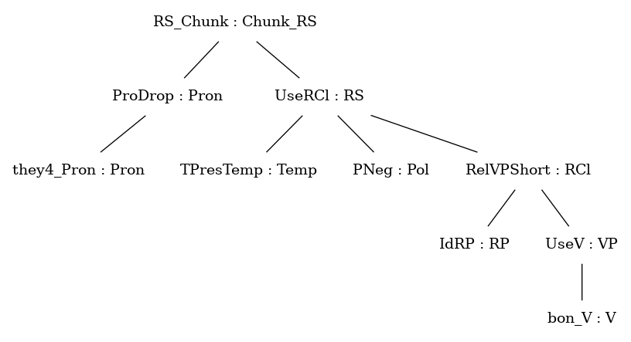
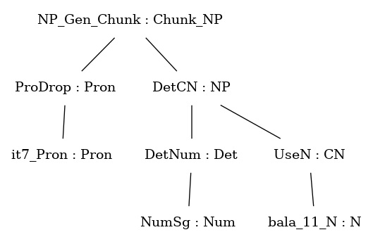
Solution: parsing written forms
ngaboni
engaboni
ZRG
sobala
Parses | Number | %
RS | 628 | 0.75
NP | 104 | 0.12
confident | (628 + 104) = 732 | 0.88
not confident | 105 | 0.12

Slide 13
Solution: mapping
English sense | ZWN written form | Function | VP | Polarity
nice | hle | nice_1_A | CopAP (PositA hle_A) | Pos
funny | hlekisayo | funny_1_A | UseV hlekis_V | Pos
blind | ngaboni | blind_1_A | UseV bon_V | Neg
false | ngamanga | false_1_A | CopNP (DetCN (DetNum NumPl) (UseN anga_6_N)) | Pos
believable | nokukholwa | believable_1_A | CopNPAssoc (Deverb15 PPos (UseV kholw_V)) | Pos

Slide 14
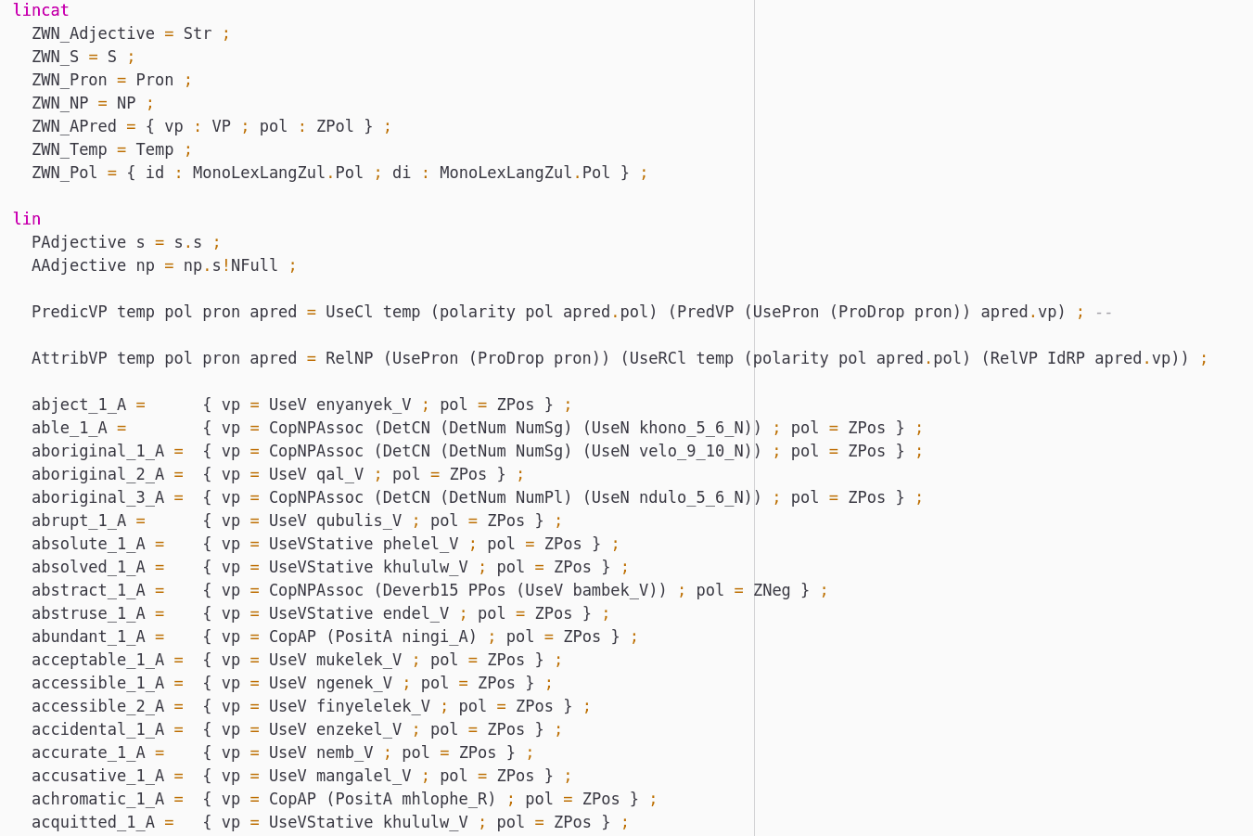
Solution: adjective grammar

Slide 15
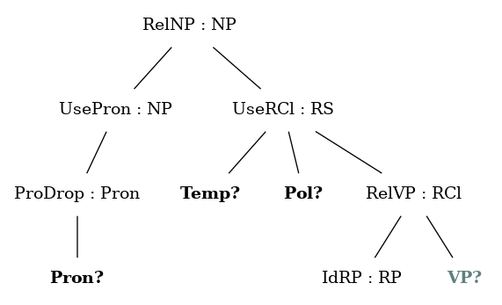
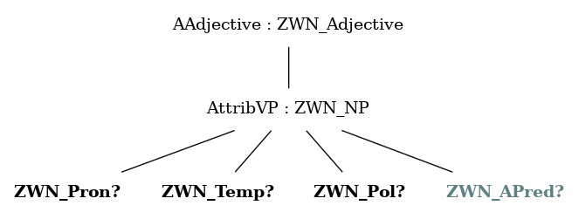
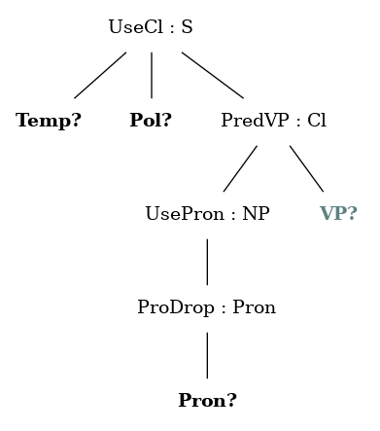
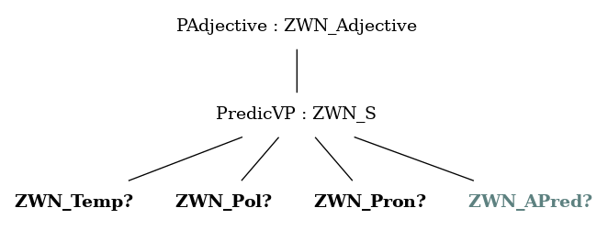
Solution: adjective grammar

Slide 16

Solution: wrapper tool

Slide 17
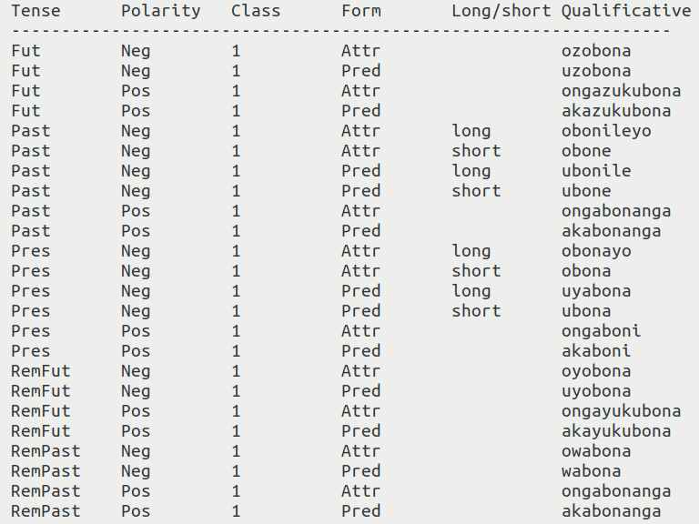
Solution: wrapper tool

Slide 18

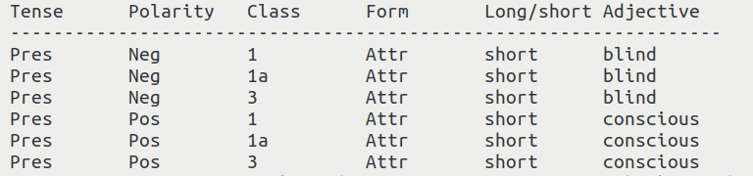
Solution: wrapper tool

Slide 19
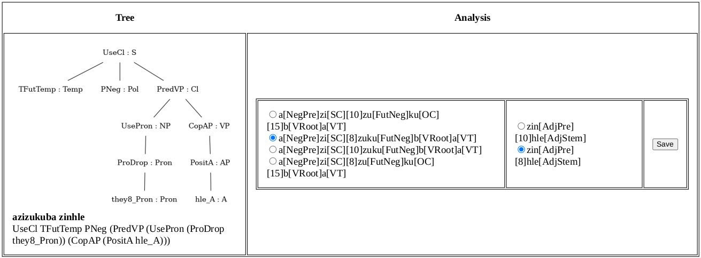
Evaluation
How to evaluate?
Use ZulMorph to facilitate evaluation
48 / 50 = 96%

Slide 20
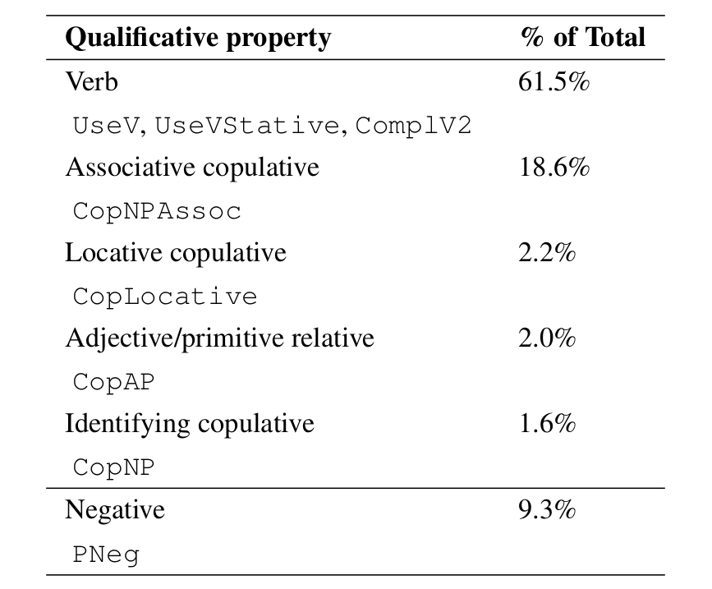
Discussion
Adjectives are a small percentage of “adjectives” in ZWN
“Adjectives” in the ZWN are most often verbs

Slide 21
Conclusion
Zulu resource grammar allows us to take full advantage of morphologically complex written forms in the ZWN
Repeatable process
Future versions
Other word categories
More languages
https://github.com/LauretteM/gf-afwn

Slide 22
GF issues
Major lexical “mismatch”
Syntactic translation vs semantic translation?
Towards a “phrase” dictionary for systematic differences

Slide 23
Siyabonga!

