Slide 1
Multilingual natural language generation for early literacy support
Laurette Marais
15 June 2022

Slide 2
Outline
Context
Problem
Solution requirements
Groundwork
Application
Notes:
Context (2 minutes)
Problem (3 minutes)
Solution requirements (5 minutes)
Groundwork (10 minutes)
Application (5 minutes)
Demo (5 minutes)

Slide 3
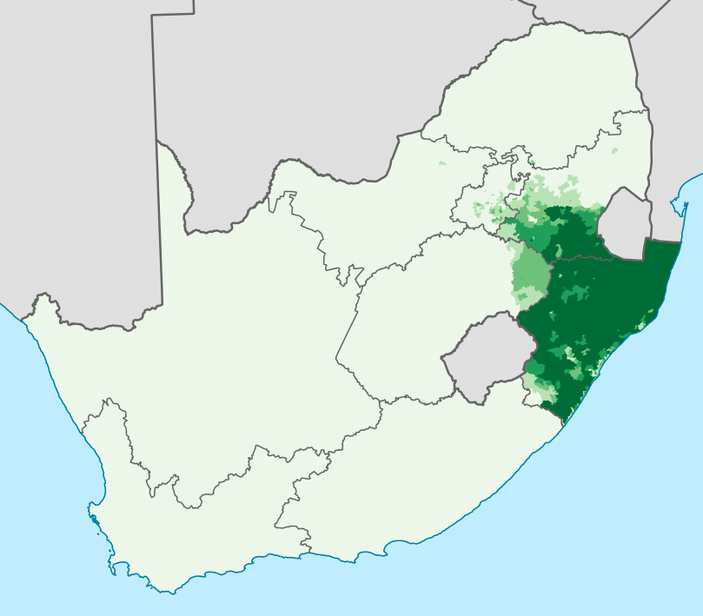
Context
isiZulu
~11.5M¹ (23%) home language speakers (2011)
Largest home language in South Africa
~260k Grade 1 learners with isiZulu HL
PIRLS²: 87% Grade 4’s cannot read for comprehension
About 230k?
HL education Grades 1 - 3
English/Afrikaans education Grades 4 - 12
https://en.wikipedia.org/wiki/Zulu_language,
image: https://commons.wikimedia.org/w/index.php?curid=28087429
Howie, Sarah J., et al. PIRLS literacy 2016: South African highlights report (Grade 4). Centre for Evaluation and Assessment (CEA), 2017.

Slide 4
Problem
Support foundation phase literacy development, using NLP
learning to read and write HL
learning the LOLT (English)
learning to read and write the LOLT
Challenges specific to NLP for isiZulu
Under-resourced (human and other…)
Agglutinating morphology
Data sparseness
Conjunctive orthography
Morpheme fusion

Slide 5
Solution requirements
Requirements of NLP in supporting foundation phase literacy and language learning?
Correctness
Morphology and syntax
Semantics (across languages)
Coverage
Linguistic structures
Vocabulary (curriculum)
Repetition vs novelty
Multimodal
Engaging with text and speech

Slide 6
Groundwork
Grammatical Framework (GF) is well positioned to provide for these requirements
GF “is a programming language for multilingual grammar applications”
interlingua architecture: abstract syntax vs concrete syntax
distinguishes between resource grammars and application grammars
Concrete 1
Concrete 2
Abstract
Concrete 3
Concrete 4

Slide 7
Groundwork: GF
EatS s f = s ++ “eet” ++ f
EatS : Someone -> Food -> S
Concrete 1
Concrete 2
Abstract
Concrete 3
Concrete 4
EatS s f = s ++ “?dla” ++ f
EatS s f = s ++ “? eating” ++ f
Notes:
You are eating bread
I am eating bread
mina ngidla isinkwa
wenu udla isinkwa

Slide 8
Groundwork: GF
PredVP : NP -> VP -> Cl
PredVP np vp = vp.v ++ np.s ++ vp.obj
PredVP np vp = np.s ++ vp.s
Concrete 1
Concrete 2
Abstract
Concrete 3
Concrete 4
PredVP np vp = np.s ++ vp.s ! np.agr
PredVP np vp = np.s ++ vp.s ! np.agr

Slide 9
Groundwork: GF
GF Resource Grammar Library
common (“universal”) abstract syntax
30+ languages
now includes isiZulu (WIP funded by SADiLaR)
computational lexicon
treebanks
Implementation includes
lexical paradigms for nouns
morphosyntactic rules for verb phrases
verbs
copulatives (identifying, descriptive, associative)
conjunctive orthography?
specific focus on syntax of NP

Slide 10
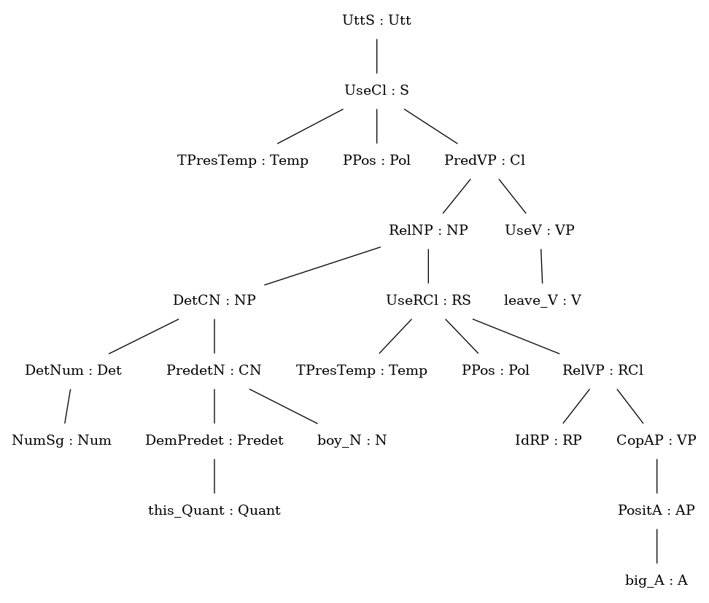
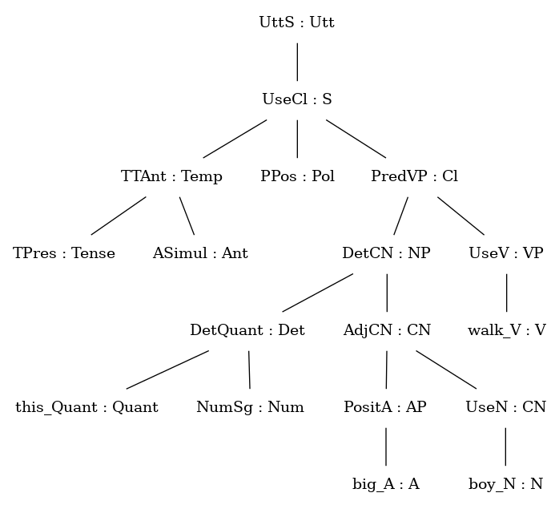
Groundwork: GF
lo mfana omkhulu uyahamba
this big boy walks
Notes:
Development of the isiZulu RG has entailed some choices over what to implement and what to leave out.
Two sentences that are very nearly literal translations of each other, have different abstract syntax trees.
Two main reasons for deviating from the “universal” common abstract syntax:
linguistic transparency
efficiency

Slide 11
Groundwork: GF
boy_N
s | Sg | Pl
Full | umfana | abafana
Reduced | mfana | bafana
Poss | mfana | bafana
Loc | kumfana | kubafana
c | C1_2
walk_V
s | R_a | R_ile | R_e | R_i | R_anga
 | hamba | hambile | hambe | hambi | hambanga
r | RC
syl | SylMult
voice | Active
big_A
s | AF1 | khulu
 | AF2 | nkulu
 | AF3 | khulu
t | AdjType
Notes:
This is a representation of how lexical items live in the grammar. Rules govern how they are combined.

Slide 12
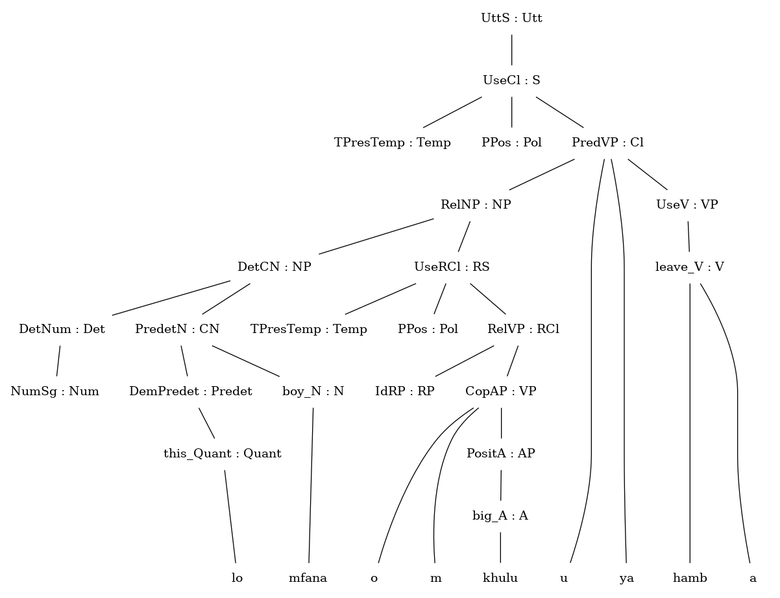
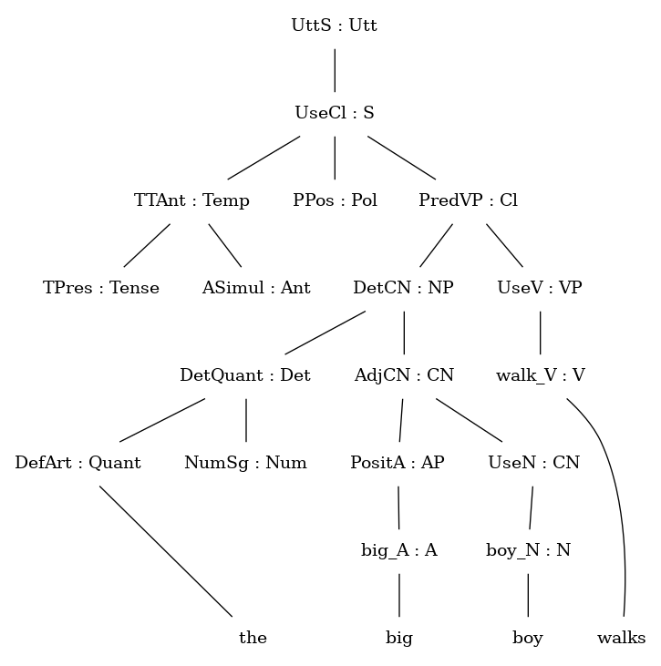
Groundwork: GF
lo mfana omkhulu uyahamba
this big boy walks
Notes:
Development of the isiZulu RG has entailed some choices over what to implement and what to leave out.

Slide 13
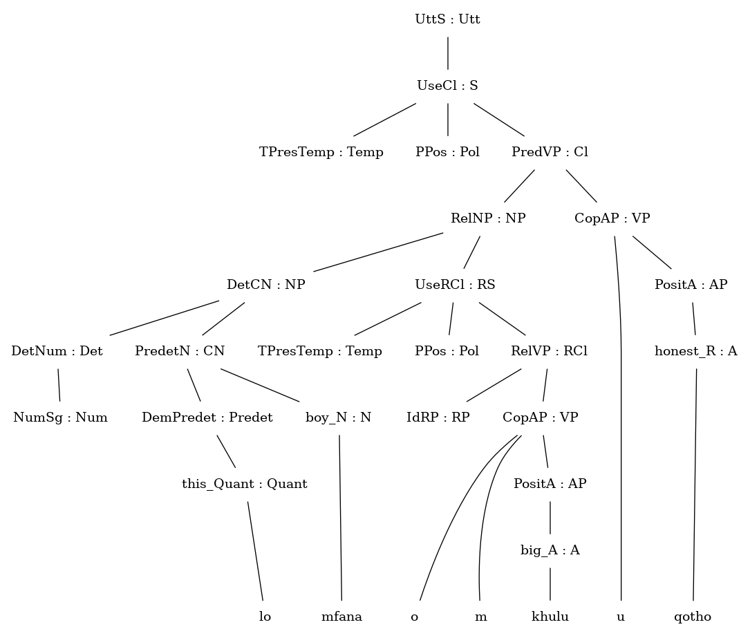
Groundwork: GF
lo mfana omkhulu uqotho

Slide 14
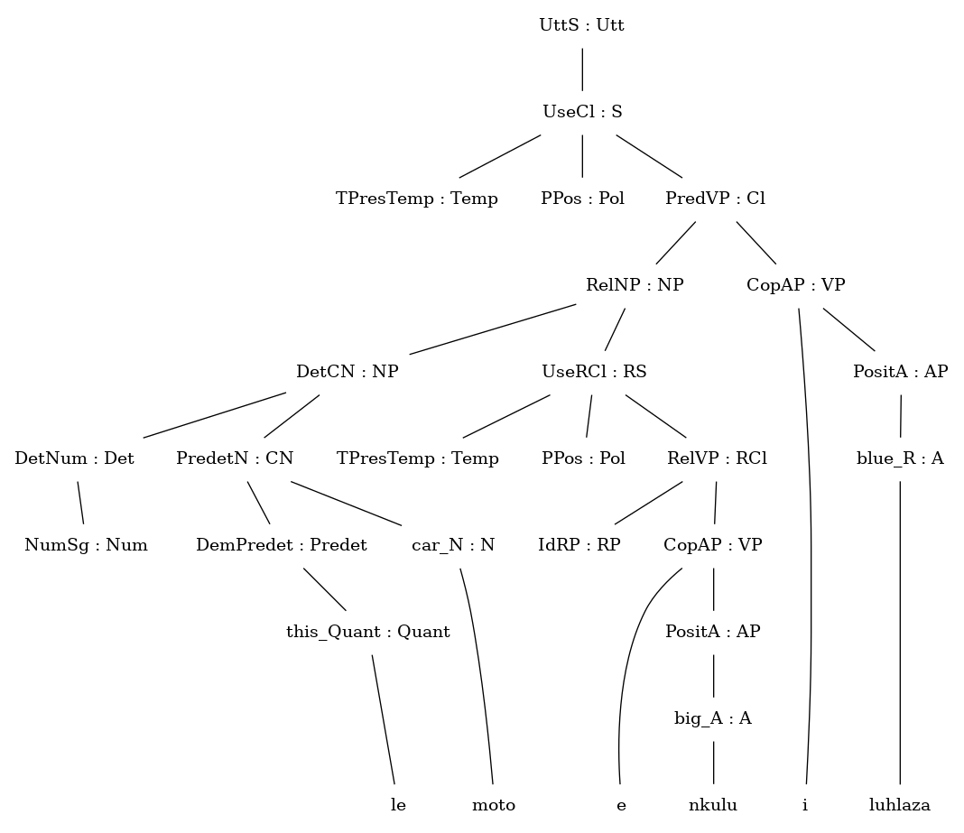
Groundwork: GF
le moto enkulu iluhlaza

Slide 15
Groundwork: GF
Demo of resource grammar
Notes:
While there may still be errors, the important point is that they can be fixed like any other software bug.
lo mfana omkhulu uyahamba
Edit tree
girl_N, beautiful_A
lo mfana unemoto enkulu
Edit text
that_Quant
blue_A
NumPl (2nd)

Slide 16
Application
Given a GF runtime, the GF runtime provides
parsing of text
linearising of trees
incremental NLG
controlled translation
parse in one language, linearise in another
How can we exploit this to support early literacy and language learning?

Slide 17
Application
Ngibona ugogo.
Ugogo
uyapheka
uyahamba
ubona

Slide 18
Application
Ngibona ugogo.
I see the grandmother.
Ugogo
uyapheka
uyahamba
ubona

Slide 19
Application
I see the grandmother.
Ngibona ugogo.
I
cook
walk
see

Slide 20
Application
Demo of incremental NLG with TTS speech prompt

Slide 21
Application
Support foundation phase literacy development, using NLP
learning to read and write HL
learning the LOLT (English)
learning to read and write the LOLT
Challenges specific to NLP for isiZulu
Under-resourced (human and other…)
Agglutinating morphology
Data sparseness
Conjunctive orthography
Morpheme fusion
resource grammar

Slide 22
Application
Requirements of NLP in supporting foundation phase literacy and language learning
Correctness
Morphology and syntax - resource grammar
Semantics (across languages) - application grammar
Coverage
Linguistic structures - resource grammar
Vocabulary (curriculum) - application grammar
Repetition vs novelty - application grammar
Multimodal
Engaging with text and speech - speech technology
Notes:
lo mfana omkhulu uyahamba
Edit tree
girl_N, beautiful_A
lo mfana unemoto enkulu
Edit text
that_Quant
blue_A
NumPl (2nd)

Slide 23
Thank you!

