Slide 1
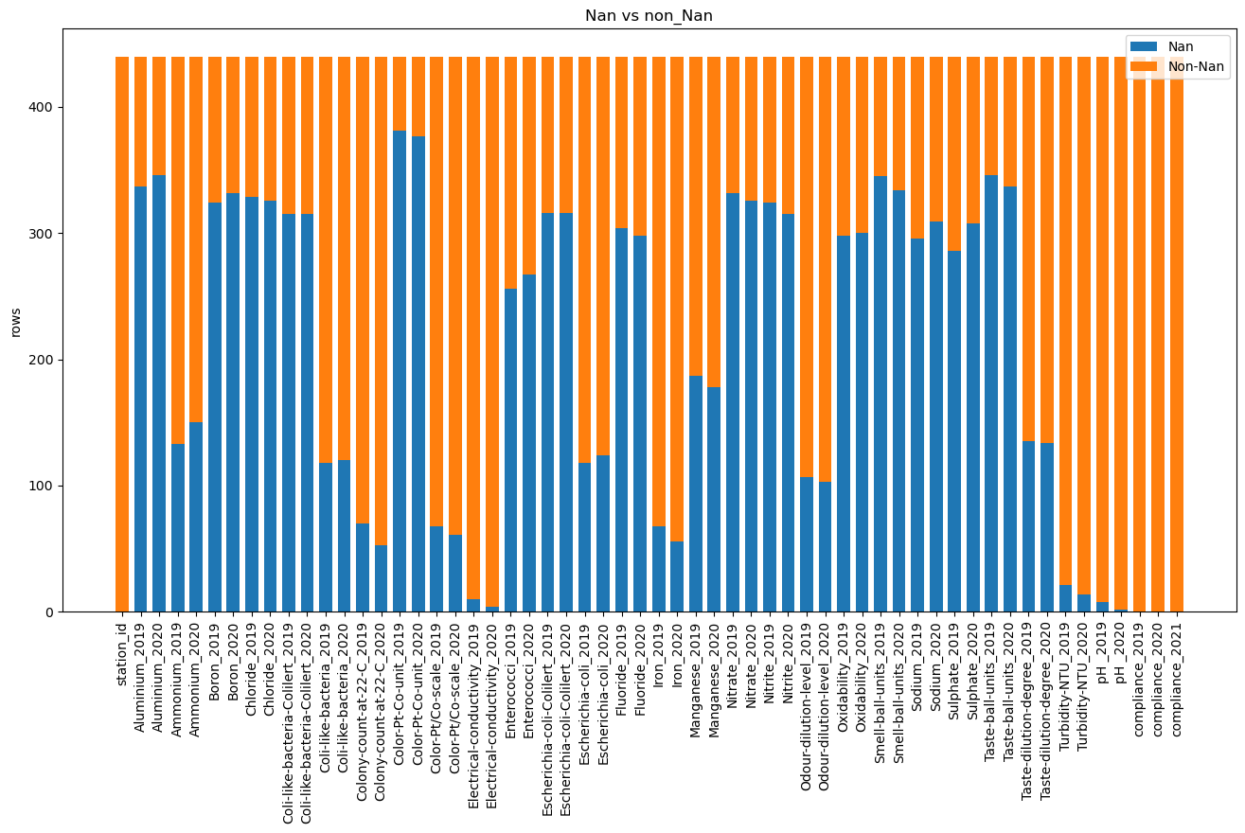
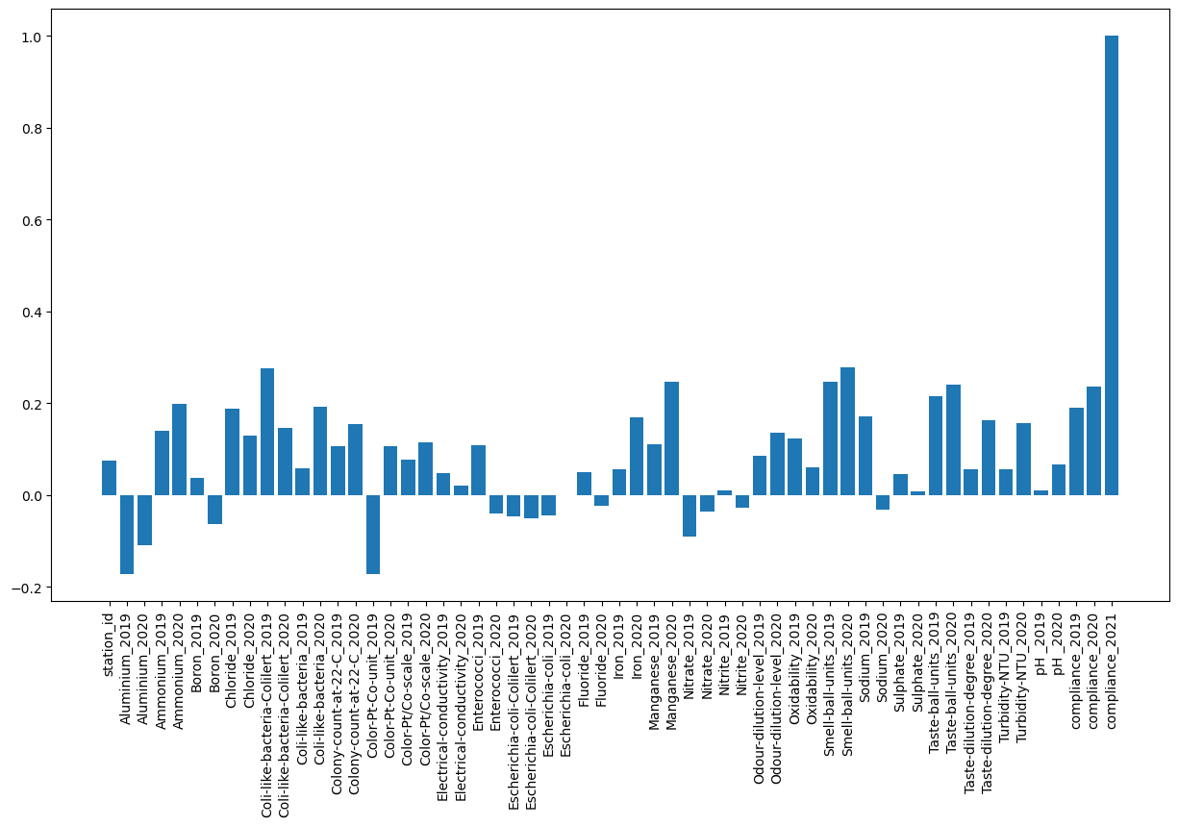
Predicting water quality of Estonian water stations
Holden Karl Hain, Rasmus Moorits Veski, Lauri Kuresoo
Tartu Ülikool Arvuti teaduse Instituut
Introduction (text)
Methodology (skeemid ja tekst)
Results (Graafid ja täpsused mudelid)
Conclusion
Despite the fact that most of our planet is covered with water, not more than 3 % of this amount is fresh. To make sure that the water is safe to drink, the Estonian Health Board has been measuring its quality in more than thousand water stations across the country thereby making sure that every citizen will get the freshest water right from their tap.
To bring water quality measurement to the next level and automate working process of Estonian water inspectors, Estonian government would like to invent predictive water quality model that would enable them to prioritize the tests or react proactively to the deterioration of the water conditions. Therefore, enhancing the role of scientific and data-driven approach on a governmental level.
Our goal in this competition is to create a model that predicts the water quality in Estonian water stations with 90% accuracy.
Add your information, graphs and images to this section.
Add your information, graphs and images to this section.
Add your information, graphs and images to this section.
Introduction (Visuals)
Train data nan values of each feature
Train data correlations with result variable
Sources
Poster form Posternerd.com

