Slide 1
Power Flow & Time Domain Simulator for Transmission Systems
6.7300 Final Project & Demo
Project ID : Grid Transmission
December 15, 2023
Khandoker N
Rafa Islam EECS
Laurentiu
Anton EECS
Jordi Laguarta
Soler EECS
Notes:
Good afternoon everyone. Thank you for joining us today. We are team grid transmission. I am Rafa, and together with my colleagues- Jordi and Laurie - we have developed a power flow and time domain simulator for our project.

Slide 2
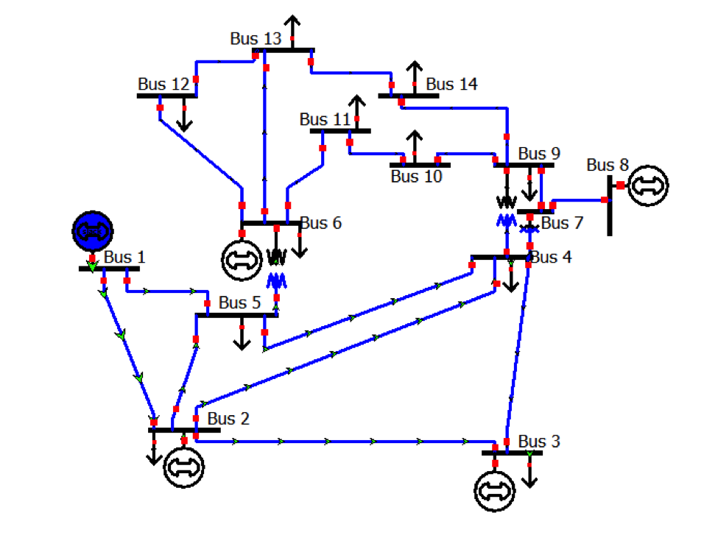
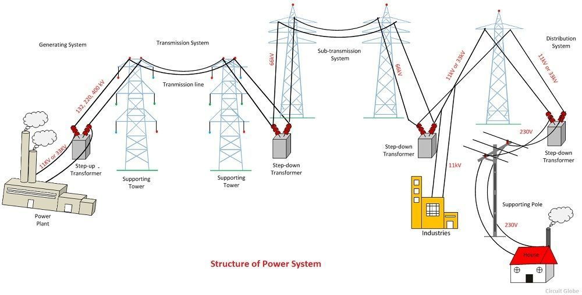
Background & Motivation
Increased complexity in power systems [1, 2]
Need for power flow and time domain simulators
N-1 secure ideal for reliability [3]
Integrated risks, ethics and reliability engagement [4,5]
Benchmarked on IEEE-14 bus test system [6]
[1] J. Smith et al. "Challenges in Modern Power System Modeling," Journal of Electrical Engineering, 2020.
[2] Siemens. "PSS/E 33.4 Program Operation Manual," Mar 2013.
[3] J. Duncan, W. D. Glover, M. S. Sarma. "Power Systems Analysis and Control," 5th ed. Cengage Learning, 2012.
[4] N. C. Kunz, J. J. Moran, A. J. Kellow. "Ethical decision making in the energy sector: Renewable energy, environmental protection, and climate change mitigation," WIREs Energy and Environment, vol. 6, no. 5, e247, 2017.
[5] D. Sovacool, L. Dworkin, M. Bazilian. "Energy decisions within an applied ethics framework: an analysis of five recent controversies," Energy, Sustainability and Society, vol. 10, no. 1, p. 17, 2020.
[6] “IEEE 14-Bus System,” Illinois Center for a Smarter Electric Grid. [Online]. Available: https://icseg.iti.illinois.edu/ieee-14-bus-system/.
Notes:
We are interested in power systems because they power our lives. As you can see in the bottom figure, transmission spans from generation to distribution where Each component is interconnected with each other. Our simulator models both the network which includes transmission lines, transformers and buses, and the generators which we call machines. We also have tested our simulator on the IEEE 14 bus system shown on the top figure.

Slide 3
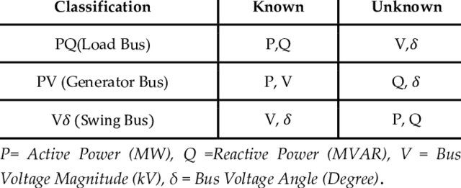
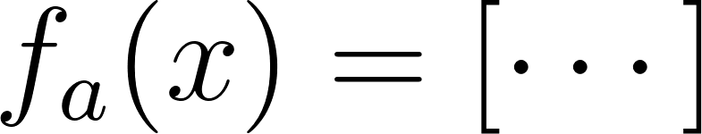
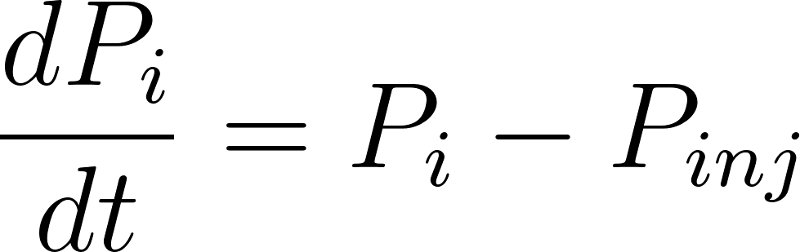
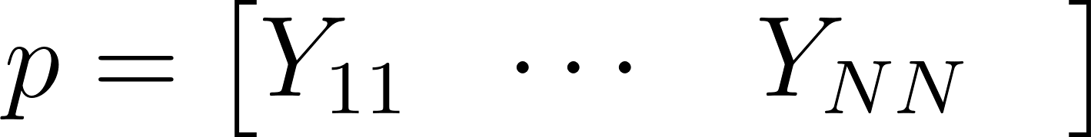
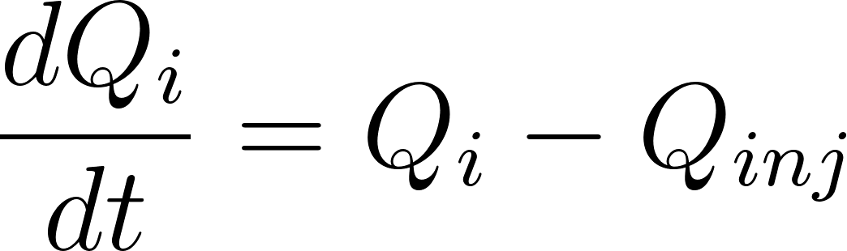
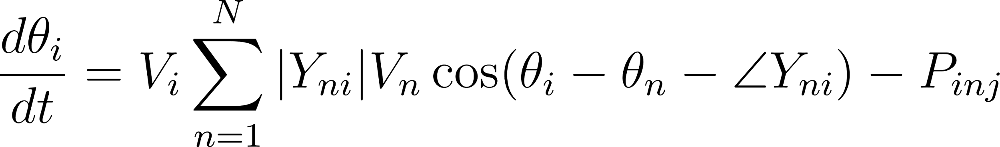
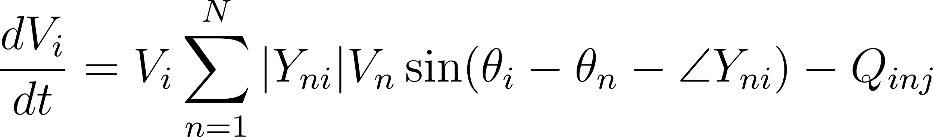
Network Formulation
2x14 States
2x14 Inputs
2x14 ODEs
14x14 Parameters
Classification | Knowns | Unknowns
Swing Bus | V, 𝛳 | P, Q
PV (Generator Bus) | P, V | Q, 𝛳
PQ (Load Bus) | P, Q | V, 𝛳
[3] J. Duncan, W. D. Glover, M. S. Sarma. "Power Systems Analysis and Control," 5th ed. Cengage Learning, 2012.
[17] L. Anton, K. N. R. Islam, J. Laguerta Soler. "Project Milestone 4," Nov 2023.
Notes:
Our network comprises three types of buses, each with four quantities. Two of these are known inputs, while the other two are states we need to determine. We've defined the network functions as the time derivatives of these states, and you can see detailed in our slides. Our network parameters come from the bus admittance matrix."

Slide 4
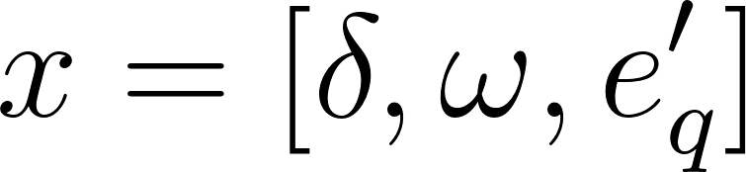
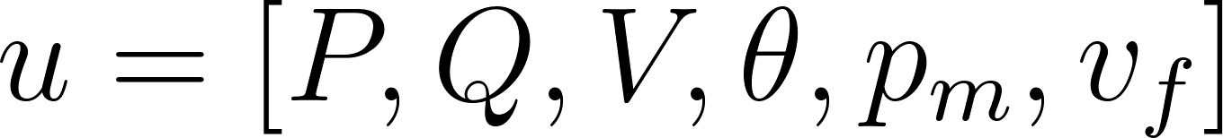
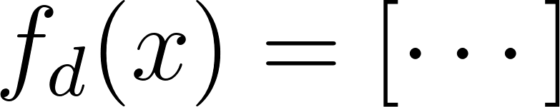
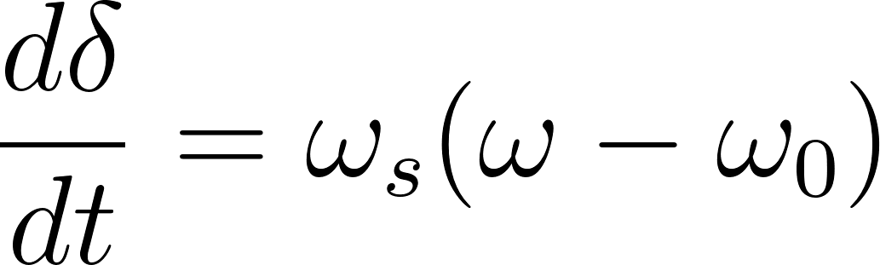
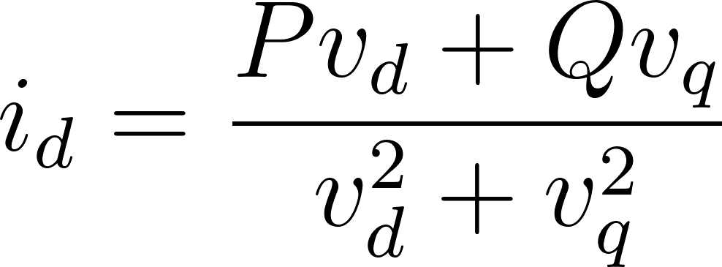
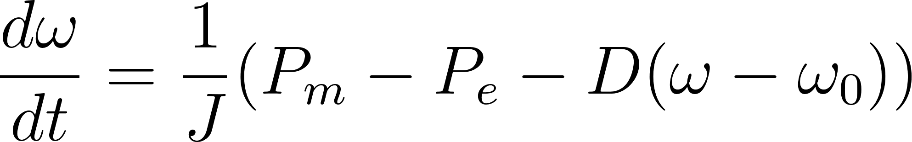
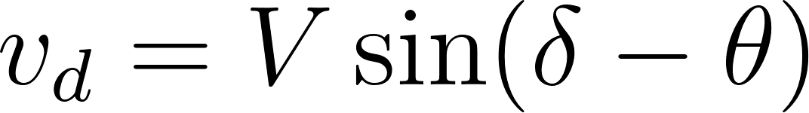
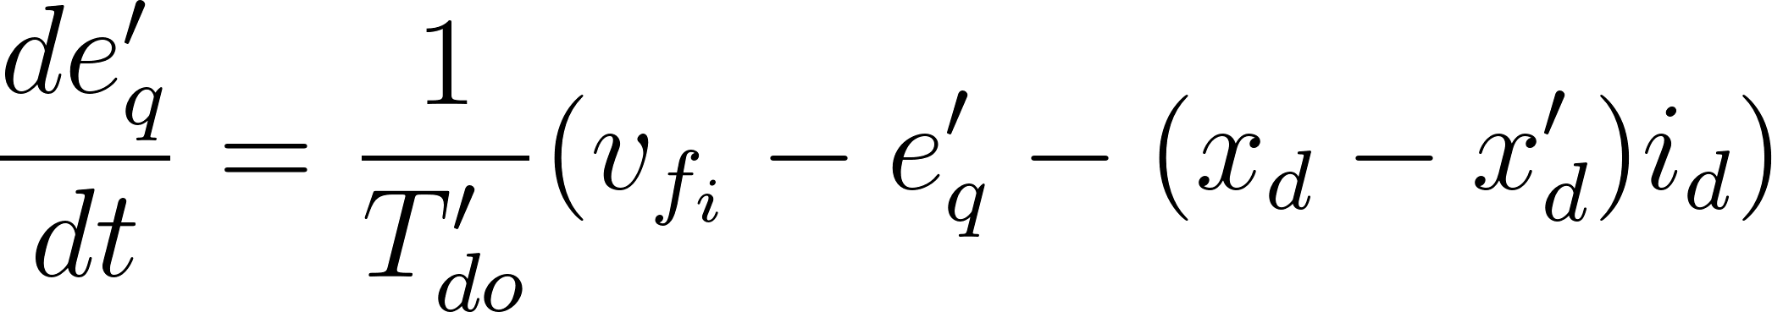
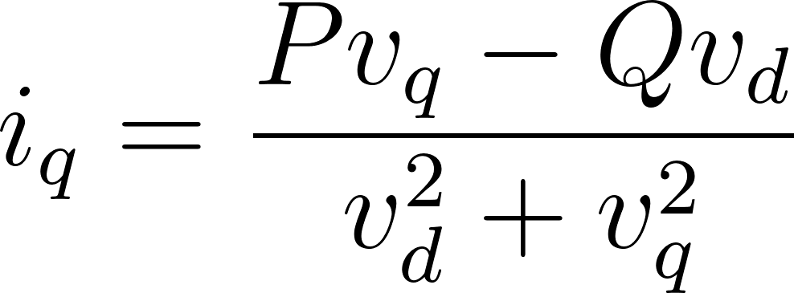
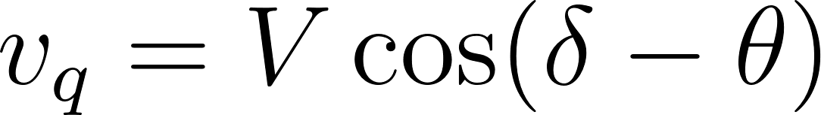
Synchronous Machine Type III₂ Formulation
3 States
Parameters
3 Inputs
3 ODEs
Where:
[17] L. Anton, K. N. R. Islam, J. Laguerta Soler. "Project Milestone 4," Nov 2023.
[3] J. Duncan, W. D. Glover, M. S. Sarma. "Power Systems Analysis and Control," 5th ed. Cengage Learning, 2012.
Notes:
Moving on to how we model our machines. We use a single-axis generator, or a Type III2 generator, for its ability to capture both mechanical and electrical dynamics. Each machine is defined by three states: the rotor angle, speed, and induced voltage. Our machine functions are the time derivatives of these states. Our inputs come from the network, mechanical power, and field excitation voltage. The network quantities determine our machine’s electrical power for the power balance eqn.

Slide 5


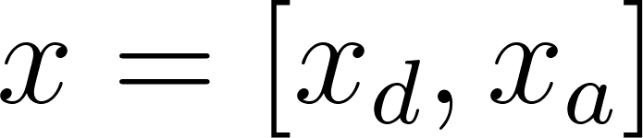
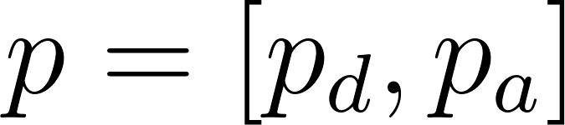

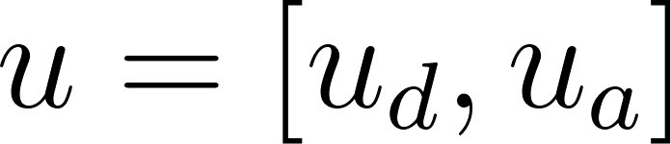
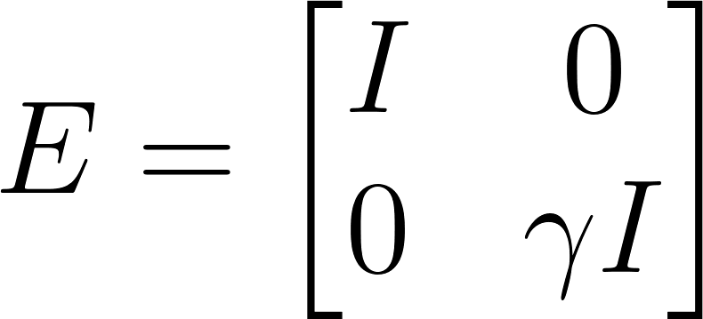
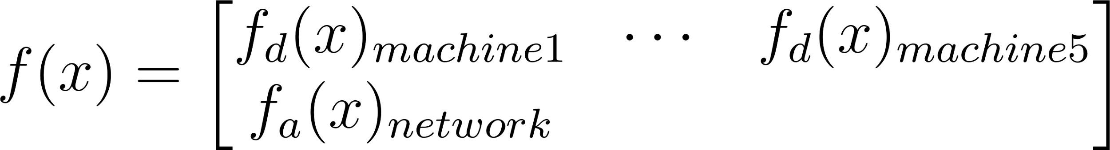
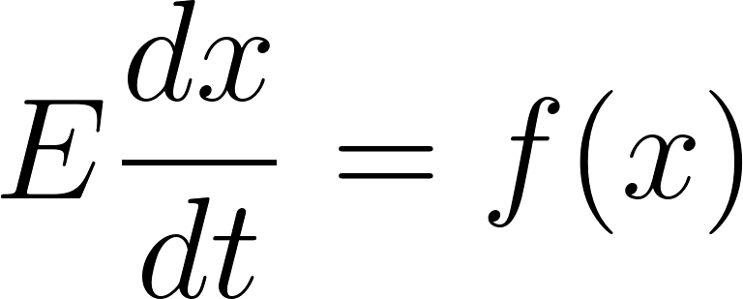
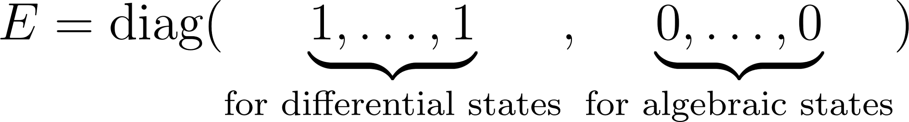
System Formulation
3x5 + 2x14 States^{[17]}
Parameters
Inputs
ODEs
[17] L. Anton, K. N. R. Islam, J. Laguerta Soler. "Project Milestone 3," Sep 2023
[3] J. Duncan, W. D. Glover, M. S. Sarma. "Power Systems Analysis and Control," 5th ed. Cengage Learning, 2012..
Notes:
We then combine the machines and network into one big system by taking the machine functions from fd and network fa and we do the same for our states inputs and parameters. We create an E matrix on the left hand side which is an Identity except that the quantities on the network have a gamma constant to ensure that power flow is instantaneously met. The reason that we don’t put zero is that Forward Euler cannot handle when E is singular so we just set gamma to be very small.

Slide 6
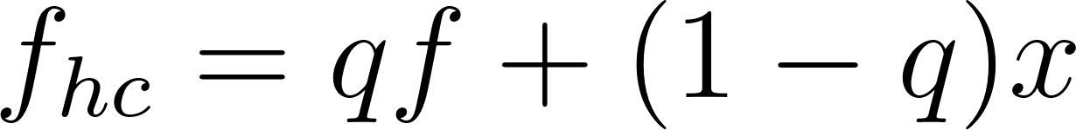
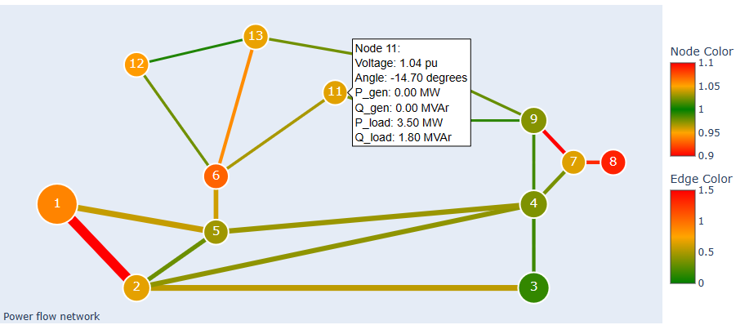
Numerical Methods - Powerflow
(Static) Powerflow
Solved using NewtonNd()
Homotopy continuation^{[19]} available:
Power Flow Network Visualization
[19] Alexander, J. C., and James A. Yorke. "The homotopy continuation method: numerically implementable topological procedures." Transactions of the American Mathematical Society 242 (1978): 271-284.
Notes:
To solve power flow we use an N-dimensional newton solver. It can take either a closed form jacobian if available or otherwise it will do finite difference to create it. The reason for this is that if we are solving power flow just for the network we have an analytical jacobian we can use but for the whole system we don’t so in that case we do finite differences. There have been instances where the newton solver struggled to converge so we implemented standard homotopy continuation as we learned in class with a small tweak where it only kicks in if the solver has issues converging. We show a screenshot of our results where the larger the lines or nodes are the more power is going through it. and that we will go more into detail during our demo. We’ve also placed voltage limits on the nodes and thermal limits on the lines and if they’re within limits they’re green yet if they go over they turn red.

Slide 7
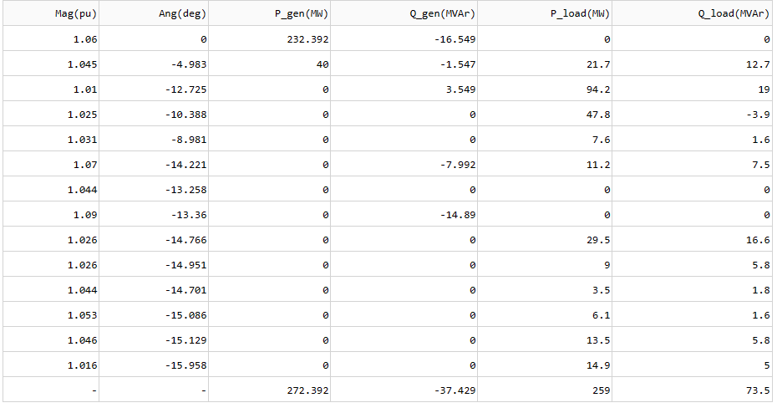
Numerical Methods - Powerflow (Cont.)
Power Flow Detailed Results per Bus
Notes:
We’ve also tabulated the results for the nodes which we can see here and the same for the branch flows here. We compared the results with matpower, a standard power flow package, and the results were correct.

Slide 8
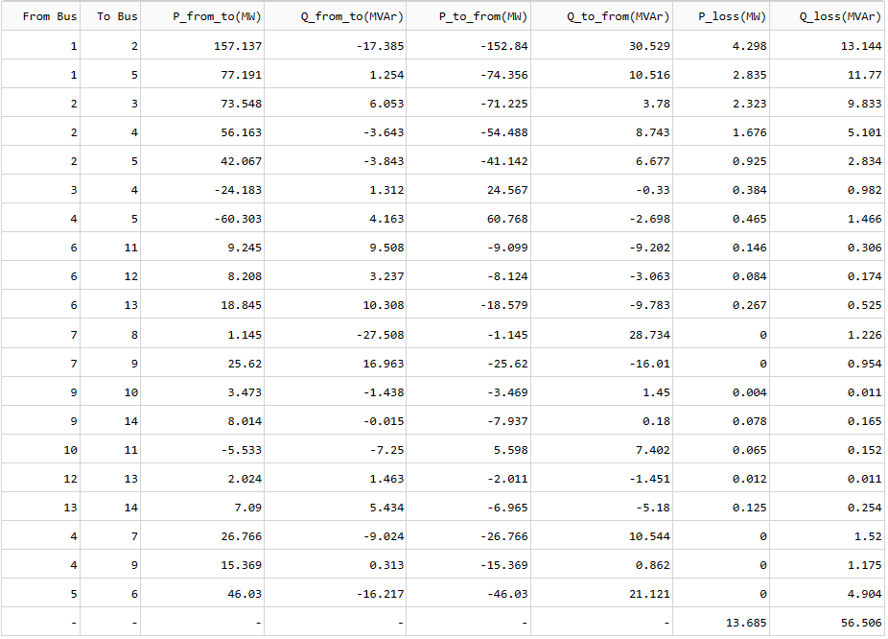
Numerical Methods - Powerflow (Cont.)
Power Flow Detailed Results per Branch
Notes:
WE also analyzed the dynamic response of the system with 3 methods. The method 1, 2, 3.
WE created a reference solution to compare the 3 methods. Trapezoidal produces much smaller error for the same time step but is much slower. Improving dynamic improves the time but still much slower than forward euler. We show here machine 1 but we did this for all machines.

Slide 9
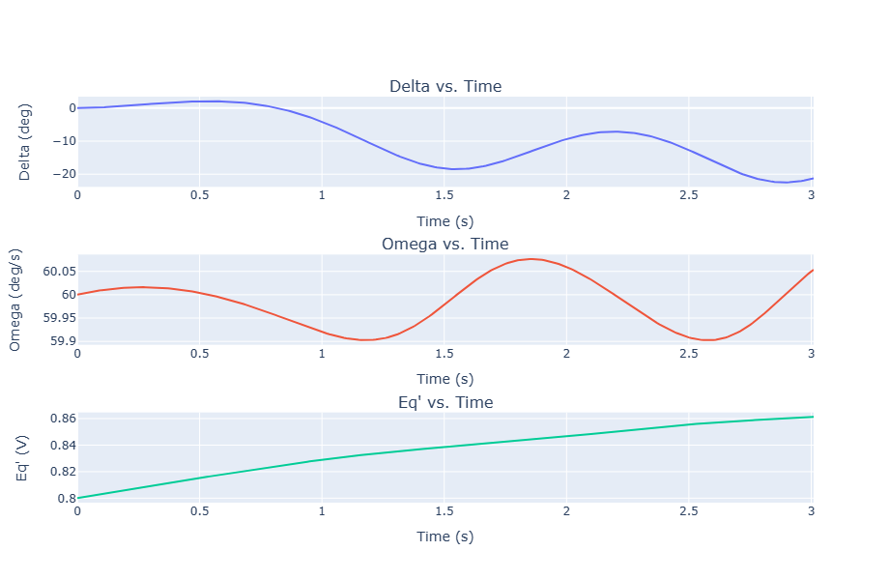
Numerical Methods - Time Integration
Demo Time!
Dynamic Solve
Machine 1 Results
Method | Stability | Error at 𝚫t = 0.01 | Runtime
Forward Euler | Stable for 𝚫t < 0.01s | ~1e-1 | ~0.12 s
Trapezoidal Method | Stable for 𝚫t < 0.1s | ~1e-2 | ~35 s
Trapezoidal (Dynamic Timestep)^{[20]} | Dynamically adjusts 𝚫t (min(𝚫t)=0.01) | ~1e-2 | ~30 s
Reference solution: Forward Euler with 𝚫t = 1e-5 seconds
[20] Alvarado, Fernando L. "Parallel solution of transient problems by trapezoidal integration." IEEE Transactions on Power Apparatus and Systems 3 (1979): 1080-1090.
Notes:
We also modeled the time domain response using three different methods and created a reference solution with ForwardEuler to compare against. We found that, as expected, trapezoidal was stable for an order of madnitude larger timestep and produced an order of magnitude smaller error when comparing at the same time resolution. ForwardEuler was much faster with an error that we can tolerate. We also tried dynamic timestepping but because our test simulation did not settle to a steady state, we only saw marginal benefits.
We therefore set ForwardEuler as the default option in our simulator, which we would now like to demo for you.

Slide 10
References
J. Smith et al. "Challenges in Modern Power System Modeling," Journal of Electrical Engineering, 2020.
Siemens. "PSS/E 33.4 Program Operation Manual," Mar 2013.
J. Duncan, W. D. Glover, M. S. Sarma. "Power Systems Analysis and Control," 5th ed. Cengage Learning, 2012.
N. C. Kunz, J. J. Moran, A. J. Kellow. "Ethical decision making in the energy sector: Renewable energy, environmental protection, and climate change mitigation," WIREs Energy and Environment, vol. 6, no. 5, e247, 2017.
D. Sovacool, L. Dworkin, M. Bazilian. "Energy decisions within an applied ethics framework: an analysis of five recent controversies," Energy, Sustainability and Society, vol. 10, no. 1, p. 17, 2020.
“IEEE 14-Bus System,” Illinois Center for a Smarter Electric Grid. [Online]. Available: https://icseg.iti.illinois.edu/ieee-14-bus-system/.
K. Lee. "Time Domain Analysis in Power Systems," IEEE Transactions on Power Systems, 2018.
H. Kim et al. "Time Domain Simulation for Electromechanical Systems," Journal of Mechanical Engineering, 2019.
S. Williams. "Frequency Domain Analysis of Power Systems," Energy Journal, 2021.
R. D. Zimmerman, C. E. Murillo-Sánchez, R. J. Thomas. "MATPOWER: Steady-State Operations, Planning, and Analysis Tools for Power Systems Research and Education," Version 5.1, 2011. Available: https://matpower.org.
B. Badrzadeh, Z. Emin. "The need for enhanced power system modelling techniques and simulation tools," ELECTRA, Feb 2020.
M. Shahidehpour, F. Wang. "Challenges of integrating renewable resources in the power system," IEEE Transactions on Power Systems, vol. 34, no. 5, pp. 3768-3778, 2019.
"Enhancing safety and reliability in power system simulators," Journal of Power Systems, vol. 32, no. 4, pp. 987-995, 2018.
M. Ilic et al. "State Space Modelling and Primary Control of Smart Grid Components," 1st ed. Cambridge University Press, Feb 2021.
L. Anton, K. N. R. Islam, J. Laguerta Soler. "Project Milestone 1," Sep 2023.
L. Anton, K. N. R. Islam, J. Laguerta Soler. "Project Milestone 4," Sep 2023.
L. Anton, K. N. R. Islam, J. Laguerta Soler. "Project Milestone 3," Sep 2023.
Federico Milano. "Documentation for PSAT Version 2.0.0," Feb 14, 2008.
Alexander, J. C., and James A. Yorke. "The homotopy continuation method: numerically implementable topological procedures." Transactions of the American Mathematical Society 242 (1978): 271-284.
Alvarado, Fernando L. "Parallel solution of transient problems by trapezoidal integration." IEEE Transactions on Power Apparatus and Systems 3 (1979): 1080-1090.

Slide 11
Thank you! :)
Questions?

Slide 12
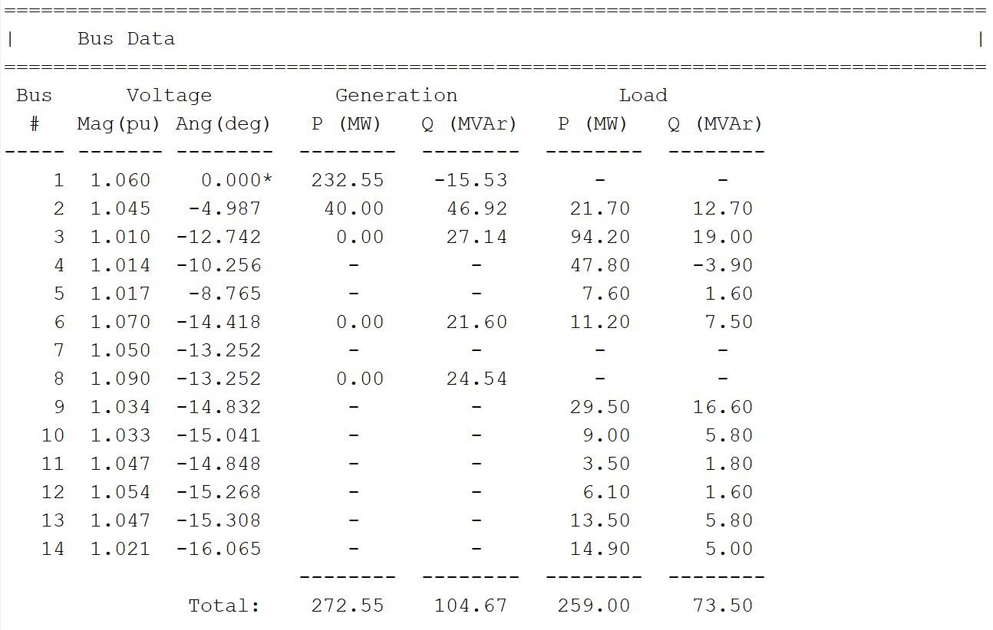
MATPOWER^{[10]} Benchmarking - Bus Results
[10] R. D. Zimmerman, C. E. Murillo-Sánchez, R. J. Thomas. "MATPOWER: Steady-State Operations, Planning, and Analysis Tools for Power Systems Research and Education," Version 5.1, 2011. Available: https://matpower.org.

Slide 13
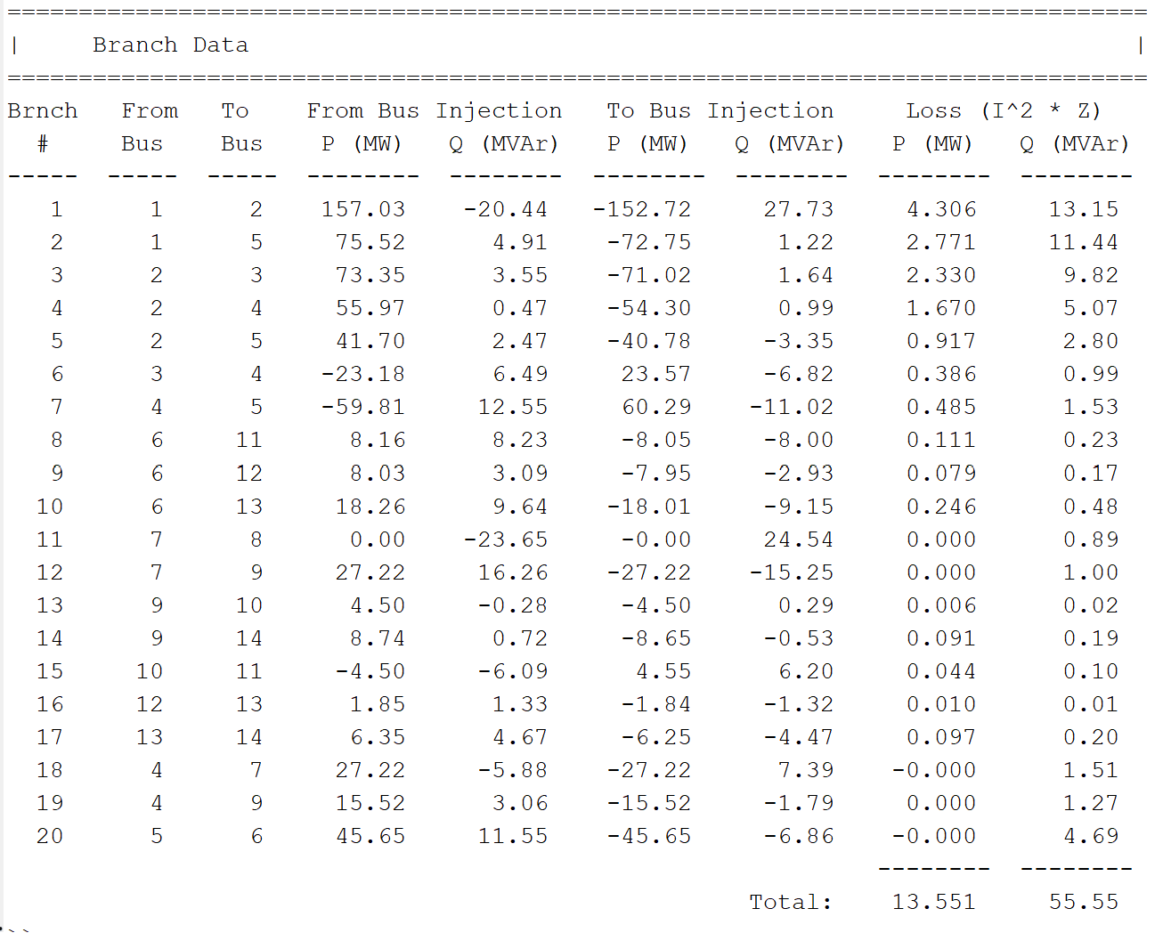
MATPOWER^{[10]} Benchmarking - Branch Results
[10] R. D. Zimmerman, C. E. Murillo-Sánchez, R. J. Thomas. "MATPOWER: Steady-State Operations, Planning, and Analysis Tools for Power Systems Research and Education," Version 5.1, 2011. Available: https://matpower.org.

