Slide 1
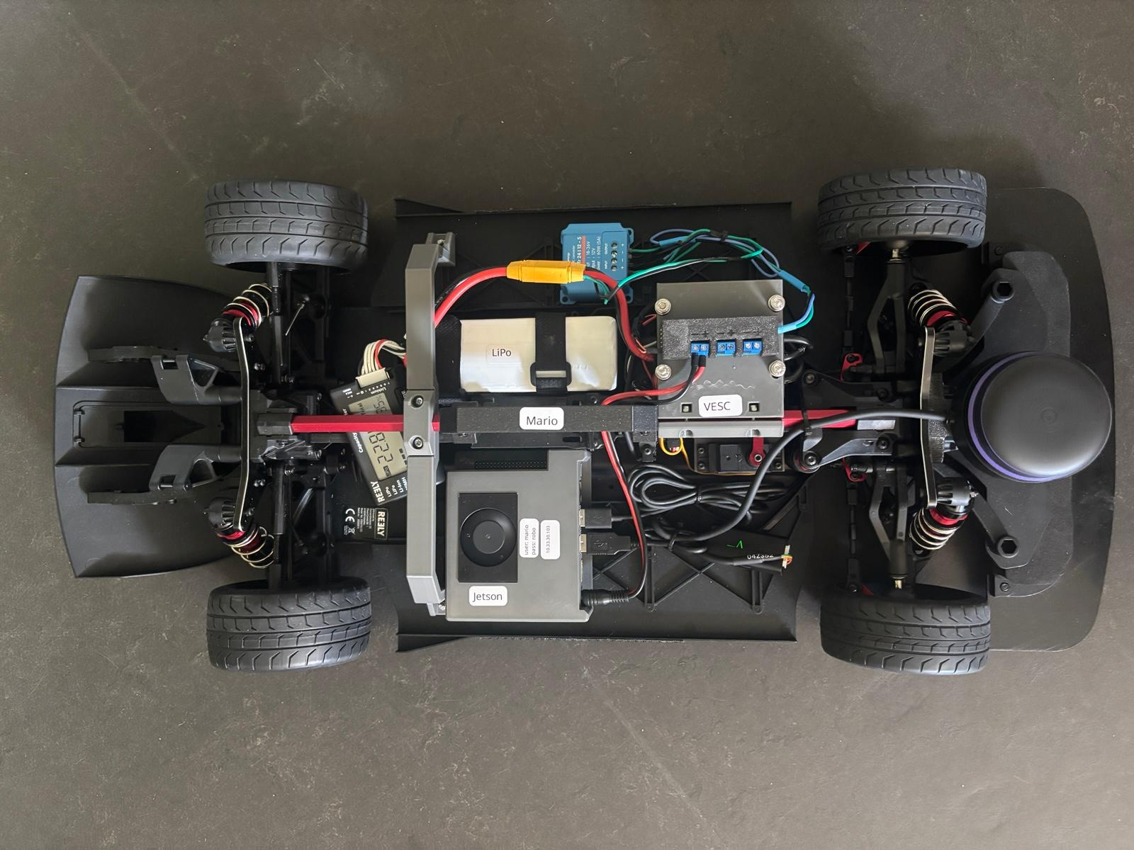
powerDistributionCover
(Lochrasterplatte, Terminals, 90 Grad Header Pins)
Handle + 2x HandleClamp
(4x M3, 4x M3 self locking Nut)
VescMount +
VescMountClamp
(4x M5, 4x M3,
4x M3 self locking Nut)
Enforcer Bracket +
EnforderBracketClamp
(4x M3, 4x M3 self locking Nut)
RPLidarMount
(2x M5, 4x M3)
JetsonCase +
JetsonCaseBottom
(4x M3)
ServoMount
(2x M4, 4x M3)

