Slide 1
TASKJUVO · PRODUCT WALKTHROUGH
From a business need
to a shared outcome.
A visual guide to the clickable prototype and its main navigation path.
01
02
03
04
05
06
Brief
Define
Compare
Confirm
Work
Reflect
Start with the task
Make the outcome clear
Review evidence
Agree the plan
Review progress
Improve the experience
Red outlines and arrows show the recommended navigation sequence.
6-step tour

Slide 2
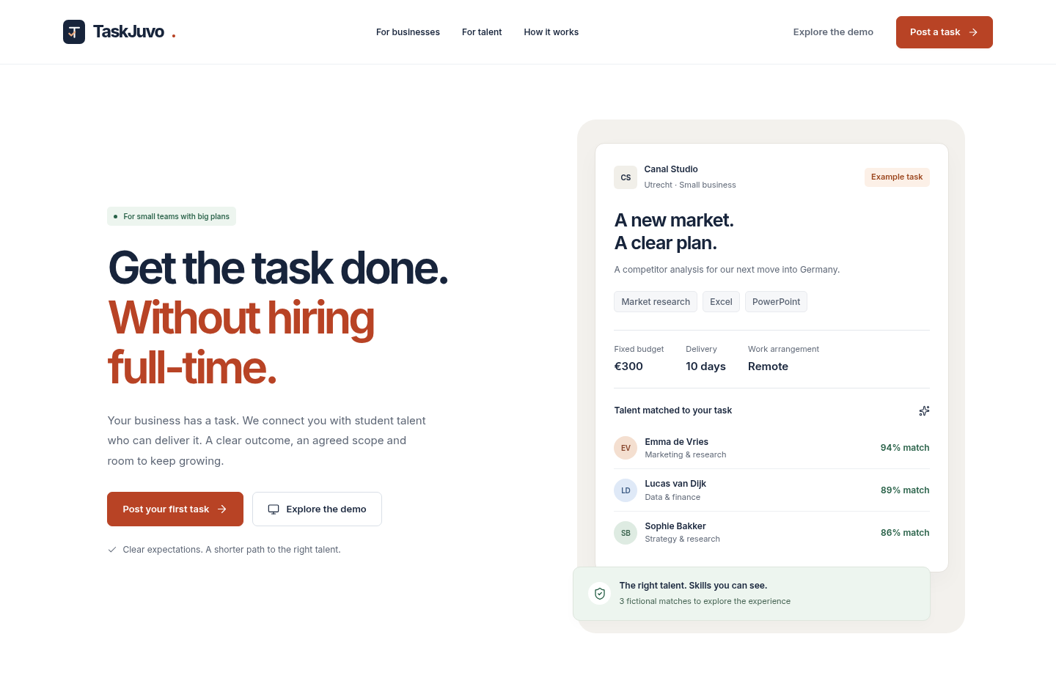
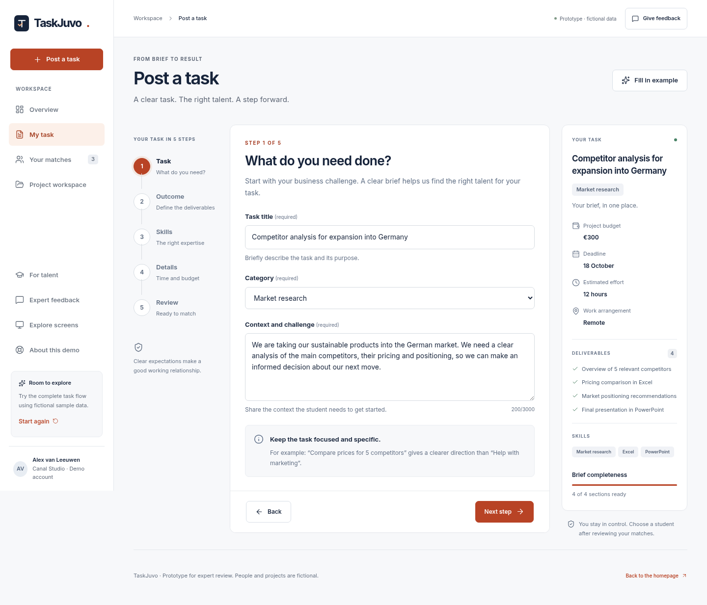
TASKJUVO · WALKTHROUGH 01
Start with a clear task
The homepage gives the business owner two obvious ways into the flow.
NEXT
1
Click the primary CTA
2
Use the sample or brief
NAVIGATION
1 Brief
2 Define
3 Compare
4 Confirm
5 Work
6 Reflect
TaskJuvo

Slide 3
TASKJUVO · WALKTHROUGH 02
Define the brief before matching
The wizard turns a vague request into a focused, reviewable task.
Recommended path
Complete the five steps, then review the summary before moving to matches.
1
Task
Name the challenge
2
Outcome
List deliverables
3
Skills
Set the expertise
4
Details
Agree time + budget
5
Review
Check the brief
3
Next step keeps momentum
NAVIGATION
1 Brief
2 Define
3 Compare
4 Confirm
5 Work
6 Reflect
TaskJuvo

Slide 4
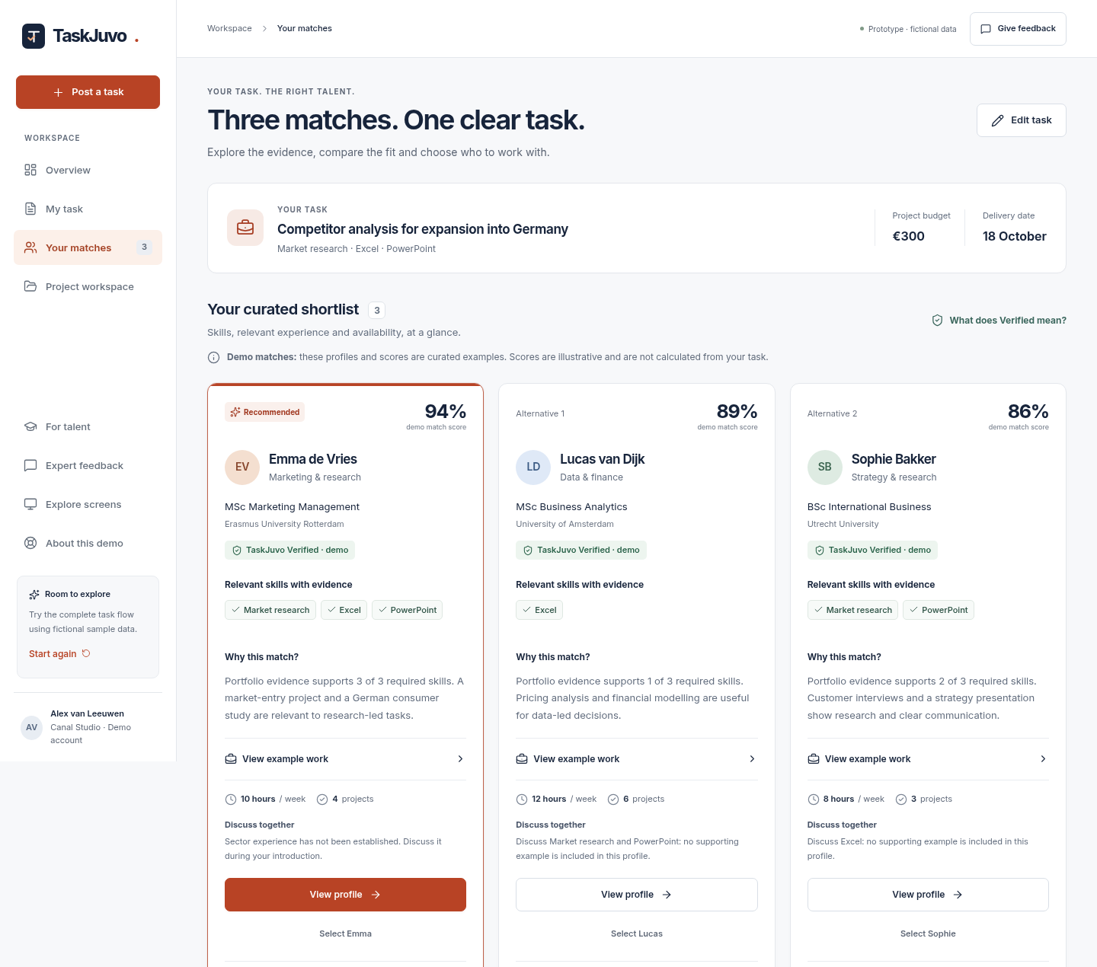
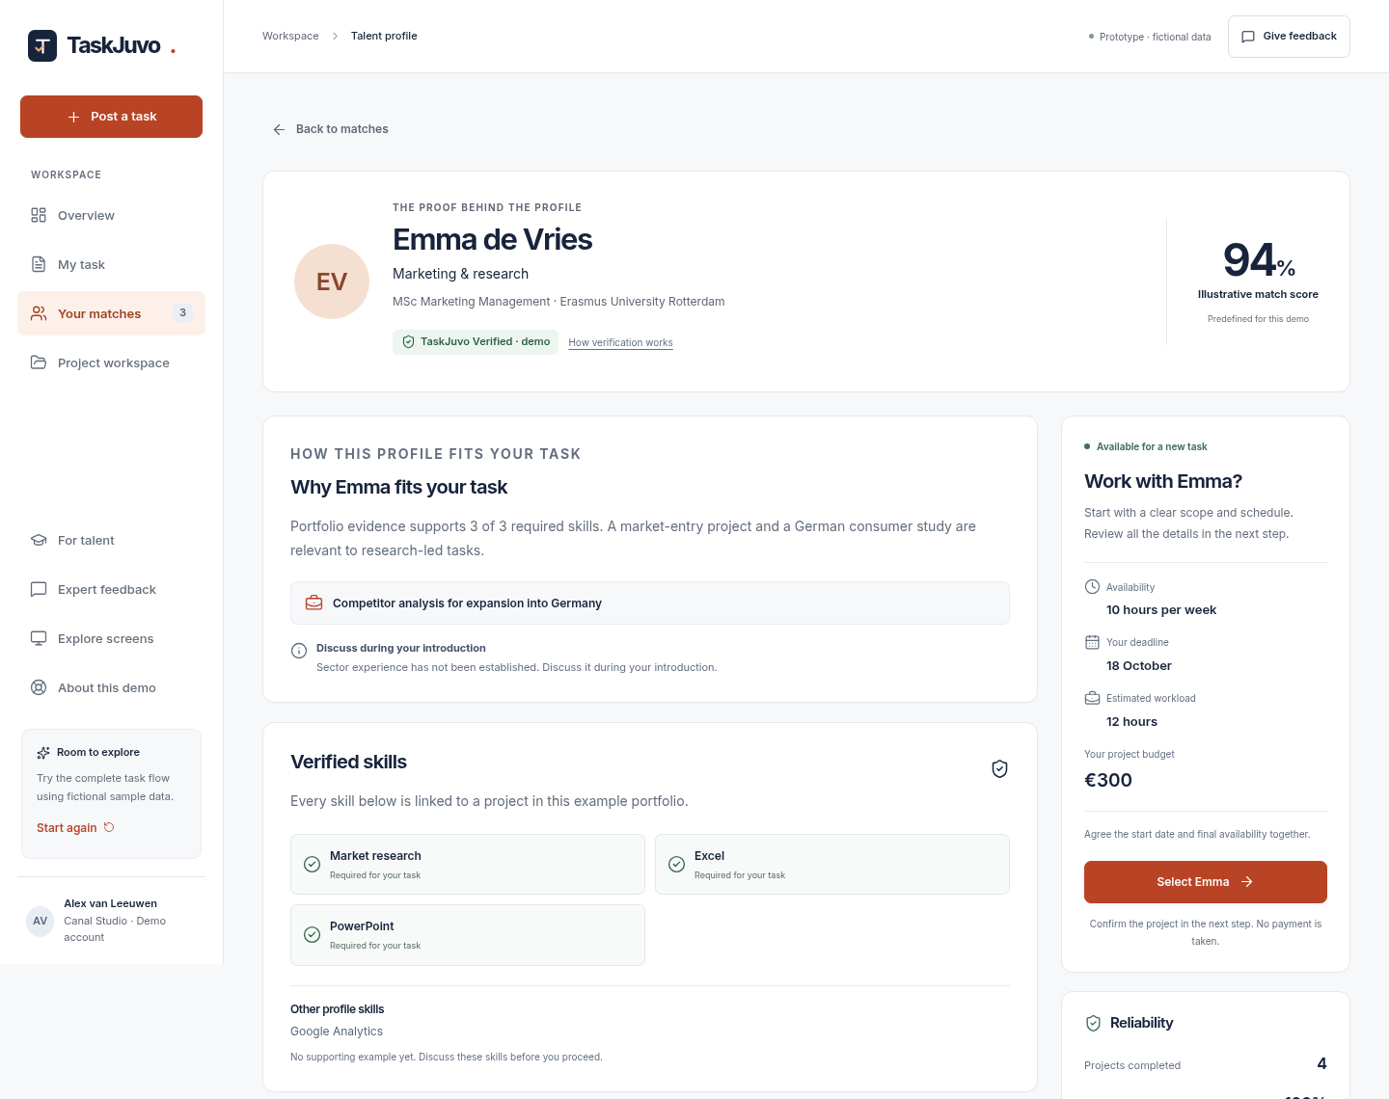
TASKJUVO · WALKTHROUGH 03
Compare evidence, then open a profile
Matches are presented side by side so the choice is explainable.
1
Open the strongest match
2
Review fit + evidence
NAVIGATION
1 Brief
2 Define
3 Compare
4 Confirm
5 Work
6 Reflect
TaskJuvo

Slide 5
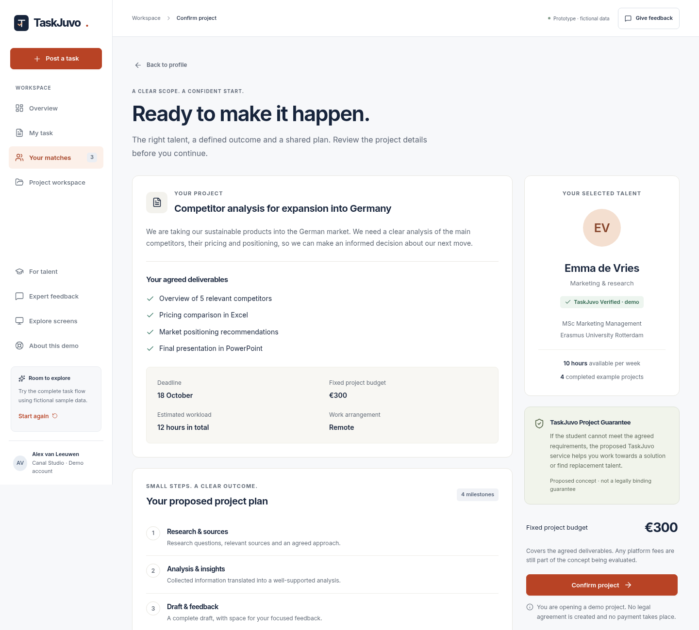
TASKJUVO · WALKTHROUGH 04
Confirm a shared project plan
The confirmation screen makes scope, budget, timing and milestones visible before commitment.
What to check
1
Deliverables match the brief
2
Milestones set expectations
3
Budget and deadline are clear
4
The guarantee is labelled as a concept
5
Confirm to open workspace
NAVIGATION
1 Brief
2 Define
3 Compare
4 Confirm
5 Work
6 Reflect
TaskJuvo

Slide 6
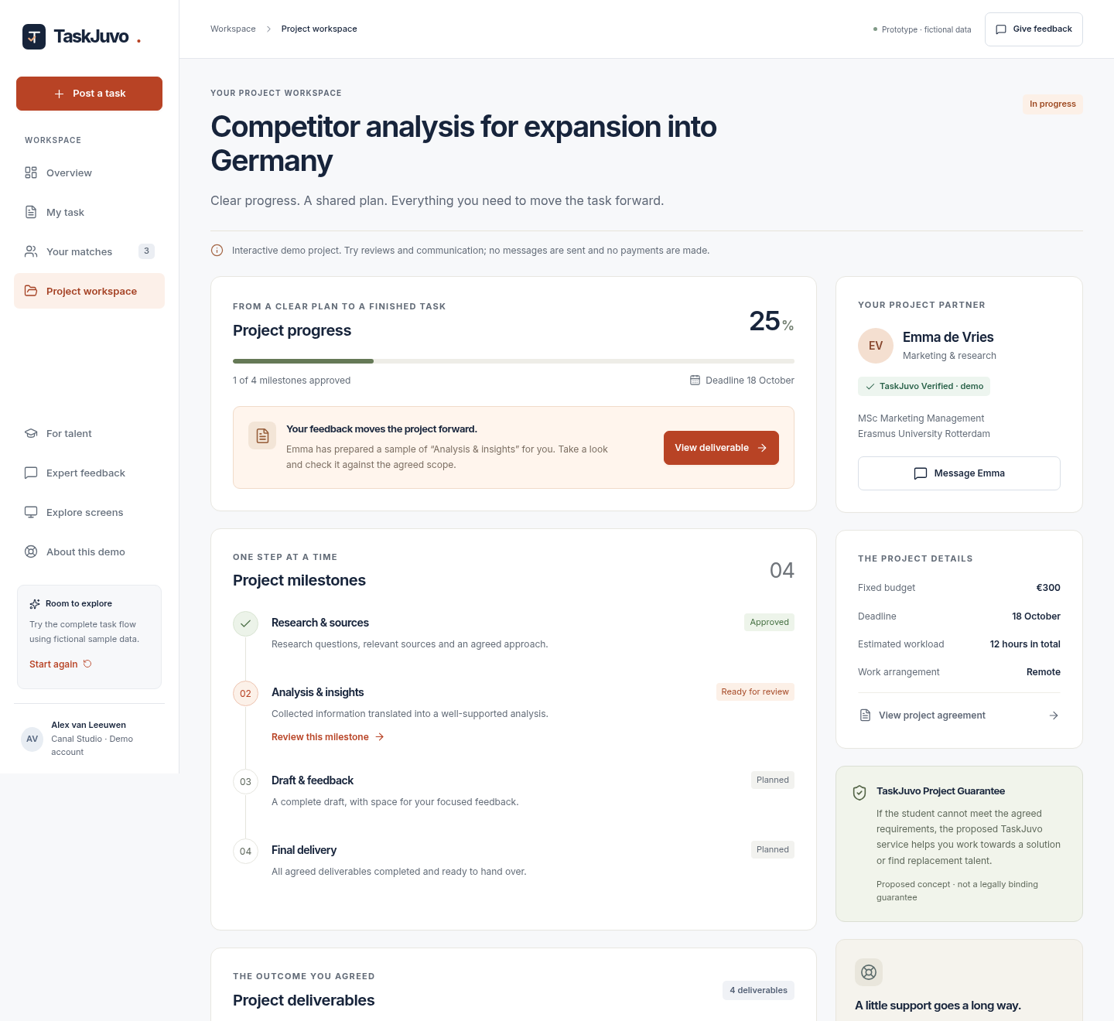
TASKJUVO · WALKTHROUGH 05
Work in one shared workspace
Progress, reviews, deliverables and communication stay together after the match.
Use the workspace to…
01
Review
Check the current milestone
02
Approve
Move progress forward
03
Message
Clarify scope together
04
Deliver
Open sample outputs
6
Every action has context
NAVIGATION
1 Brief
2 Define
3 Compare
4 Confirm
5 Work
6 Reflect
TaskJuvo

Slide 7
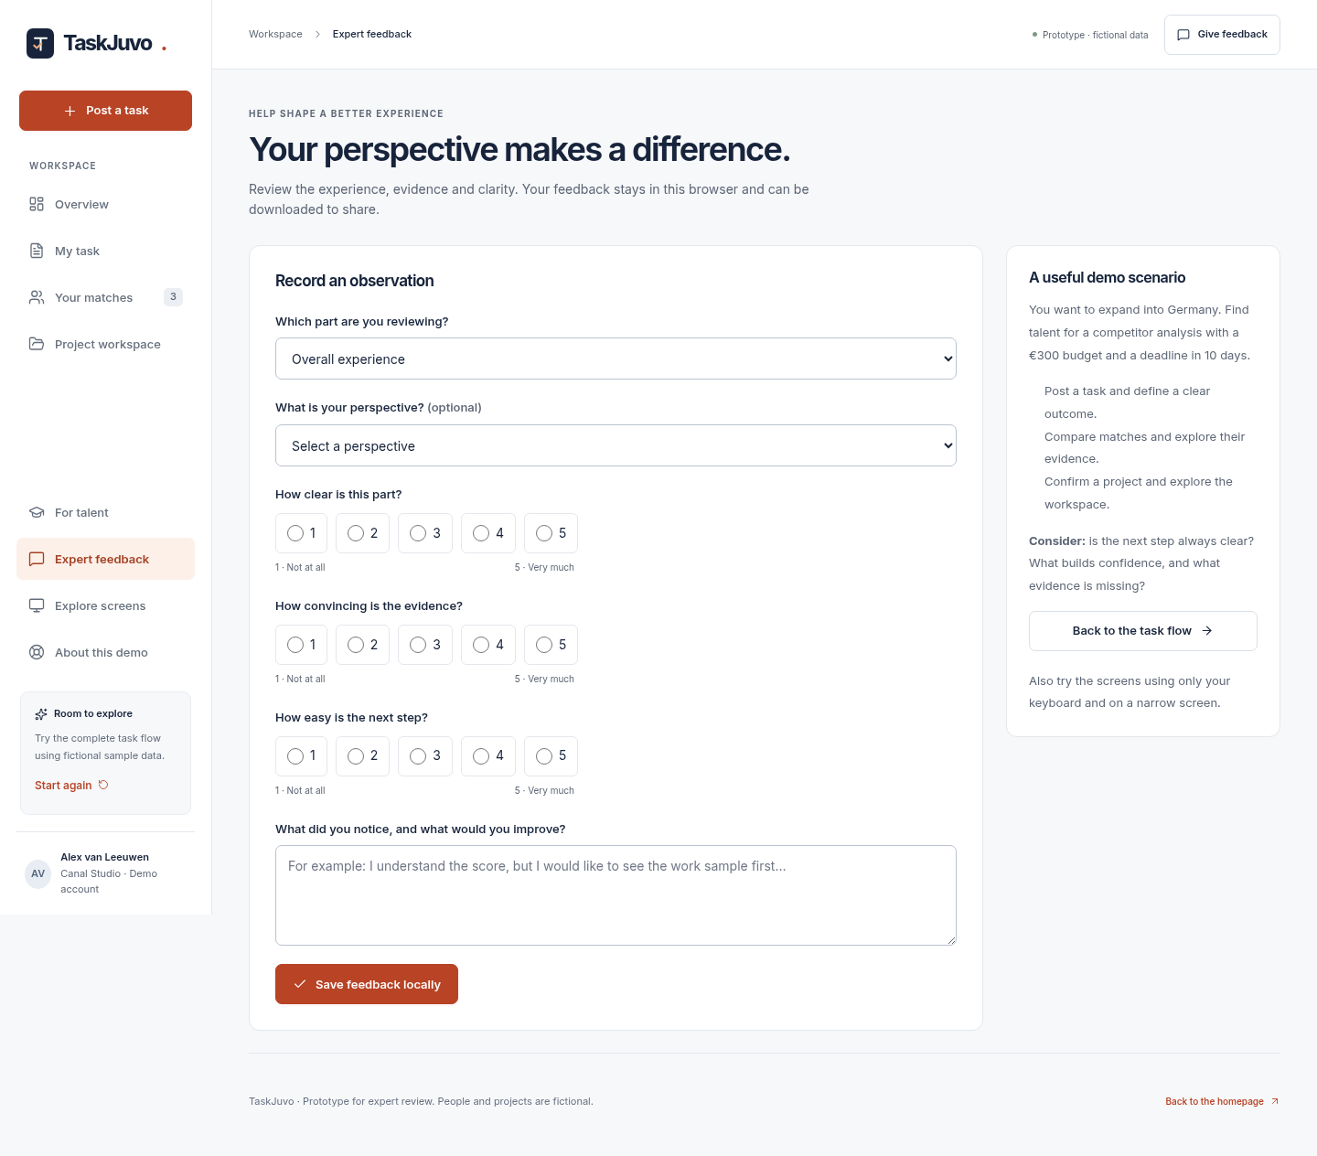
TASKJUVO · WALKTHROUGH 06
Reflect and improve the next iteration
Expert feedback closes the loop and keeps observations attached to the prototype experience.
A simple review loop
1
Observe
Rate clarity, evidence and next steps
2
Capture
Write one concrete improvement
3
Download
Share a readable Markdown note
7
Save feedback locally
NAVIGATION
1 Brief
2 Define
3 Compare
4 Confirm
5 Work
6 Reflect
TaskJuvo

