Slide 1
ELITEA Pricing FAQs
Is ELITEA an IP (Intellectual Property) of EPAM ?
YES. We have Epam License agreement that need to be signed by client in advance.
3. Why is the infra cost same, for Hosted and Enterprise set-ups ? In my understanding of a hosted set-up, the infra cost is borne by customer. So why is it charged same as the Enterprise set-up (1700$ per month for 200 active users) ?
For both options, clients will pay the same amount.
in case of EPAM hosted - to EPAM,
in case of Enterprise to Cloud provided directly.
Cost of Support will be different, because when we control hosting, we are able to support it without additional communication with their DevOps team, etc.
Is there a perpetual licensing model for ELITEA, other than the monthly/Annual subscription cost ?
EPAMERS can use it for personal purpose with no additional cost. Epam shared SaaS instance.
Client should buy professional services with Elitea with monthly fix / consumption-based fee
In this case: EPAM SaaS Min 80 SPs ~ $6k, on premise installation Min 160 SPs ~ $12k monthly

Slide 3
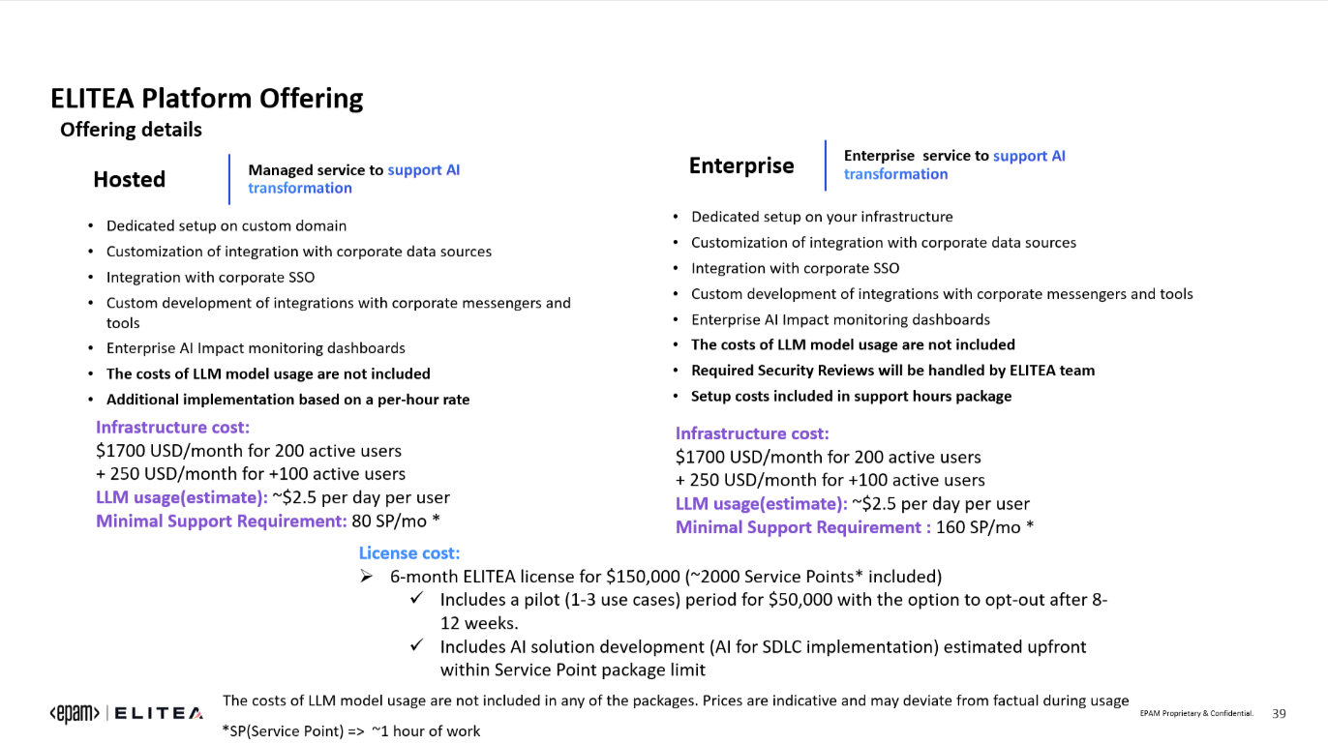

Slide 4
ELITEA Pricing FAQs (contd.)
I see that we charge 250 USD per month for every +100 active users. In situations where we have an incremental list of 5s or 10s or 50s of user additions, should I still pay a fixed price of 250 USD extra ? Or is there a 'per user' cost model ?
First of all, we take into account "Active users" (who regularly use Elitea and LLMs for their routine). So, the client will be able to add any number of users to Elitea. This is not user-based license.
We provide a dedicated environment with fixed power of resources. This infrastructure supports up to 200 Active users, so when we see more and more wider adoption where client has more than 200 users, we propose to add additional node that will allow to support up to 100 more. we can't up and down nodes based on 1, 10 ppl

Slide 5
For 200 active users, the total LLM usage cost comes to 120K (2.5*20*12*200) per year. Is that in addition to the licensing cost & infra cost ? Kindly confirm. Example: For a project with 200 active users, ELITEA cost per year would be 440.4K (split given below) –
Licensing cost - 300K (150K licensing cost of 6 months * 2) This is not just License. This is Support and professional services including PoCs, Agents development, Education and Coaching
Infra cost - 20.4K (1700 per month *12 )
LLM cost - 120K (2.5*20 working days per month * 12)
ELITEA Pricing FAQs (contd.)
The reality is that we don't have enough statistic for 200+ users. In general, teams reuse Agents, Data sources, do conversation with Elitea in a groups. It means that cost of LLM is less at scale.
Secondly, if they Use LLM with Elitea, it means that they use Agents, Assistants, Prompts and improve they productivity gain at list from 20%. Taking in to account average cost of employee ~ $350 / day (350-20%=>70*20*12*200= $3.360M) considering: infra-20.4k + Prof Services 300k + LLM even 120k they save $2.916Millions yearly
 | Cost (USD) | Applicable for 200 active users
Licensing cost | 3,00,000.00 | (150K licensing cost of 6 months * 2) This is not just License. This is Support and professional services including PoCs, Agents development, Education and Coaching
Infra cost | 20,400.00 | (1700 per month *12 )
LLM cost | 1,20,000.00 | (2.5*20 working days per month * 12)
Total Cost per year | 4,40,400.00
Avg. employee cost / day | 350.00 | USD
Total employee cost / year | 84,000.00 | USD
Total cost for 200 active users | 1,68,00,000.00
Productivity gain with Elitea | 20%
Savings incurred to Client, on resource cost | 33,60,000.00 | $ 3.36 Mn
Savings incurred to Client, negating the License cost (ROI) | 29,19,600.00 | $ 2.92 Mn

Slide 6
Could you explain us the cost of using ELITEA for a small-scale project that has only 50 Active users. This might be a simpler & practical scenario, for better understanding of the cost models, overall.
ELITEA Pricing FAQs (contd.)
For small projects we could suggest a compromise, with EPAM Hosted Elitea:
Infrastructure Cost $800 will be able to handle ~100 active users daily ( with limited monitoring features)
LLM "Pay as you go" ~$2.5 per day per user with soft limit f.e. $200 monthly
Minimal Support Requirement: 80 SP/mo * - $3600
(Optional) Professional Services : 0-360 SPs
AI for PoCs
AI Agent Development
AI Usage in Education and Coaching
Tailored AI Consulting / Engineering
Monthly $0-16200 (no location restriction*)
Monthly $23400 (with location restriction).
*location restriction - It is about resources who will support platform or provide additional services like agents development, trainings, coaching, etc..
For Example. if they need named accounts & support from Europe or US only, it means that rate will be higher.

Slide 7
AI Goal, @Mckesson
– Team to complete Elitea Basics Self study - EliteA Basics [self-study] | Learn
- Create Elitea POCs, in relevance to Project objectives
POC 1:
Effectively use the Elitea Prompts, Datasource & Tool assistants, to create and publish the test strategy doc to Confluence.
Create an agent that makes use of ‘TestStrategy’ prompts, ‘FileParser’ & ‘ConfluenceAssistant’ tools to create the project artifacts and which essentially gets uploaded to Confluence.
POC 2:
Create ELITEA Test Automation Agents for Report Tool integration.
POC 3:
Use ELITEA to log a defect in JIRA / ADO automatically, given a test script failure from Test Automation runs.

