Slide 1
Translation App
Description
This is a Language Translator App which is fully written in Kotlin Language that utilizes ML Kit for real-time language detection and translation. The app features text capture via camera and provides instant translations, making it an essential tool for travellers, language learners, and everyday use.
By – Lav Kasi

Slide 2


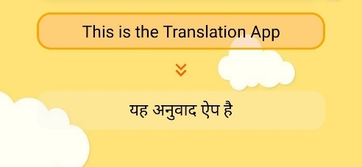
Key Features and Outcomes
Efficient Multilingual Communication: The app will enable users to seamlessly translate text between multiple languages, improving communication and understanding across diverse language barriers.
Real-Time Translation: By incorporating camera-based text recognition and speech-to-text features, the app will offer real-time translation, enhancing the user experience by providing instant results.
Translation Screenshot

Slide 3

Key Features and Outcomes
Translation History Management: Users will be able to track and manage their previous translations with the help of a history feature, making it easier to revisit frequently translated phrases or texts.
Offline Functionality: The app will provide offline translation capabilities by allowing users to download language packs, ensuring translations are accessible even without internet connectivity.
History Screenshot

Slide 4
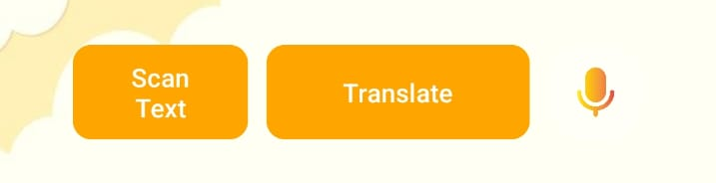
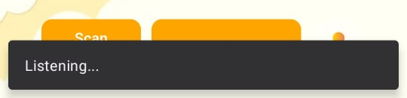
Key Features and Outcomes
Voice-Based Translation (Microphone Integration): The app will integrate microphone functionality, allowing users to speak directly into the app for voice-to-text translation, facilitating a more natural and hands-free interaction.Data
Security and Privacy: The app will prioritize user privacy and data security by not collecting personal data or storing translation histories without the user's explicit consent, ensuring secure and private usage.
Working of
Microphone

Slide 5
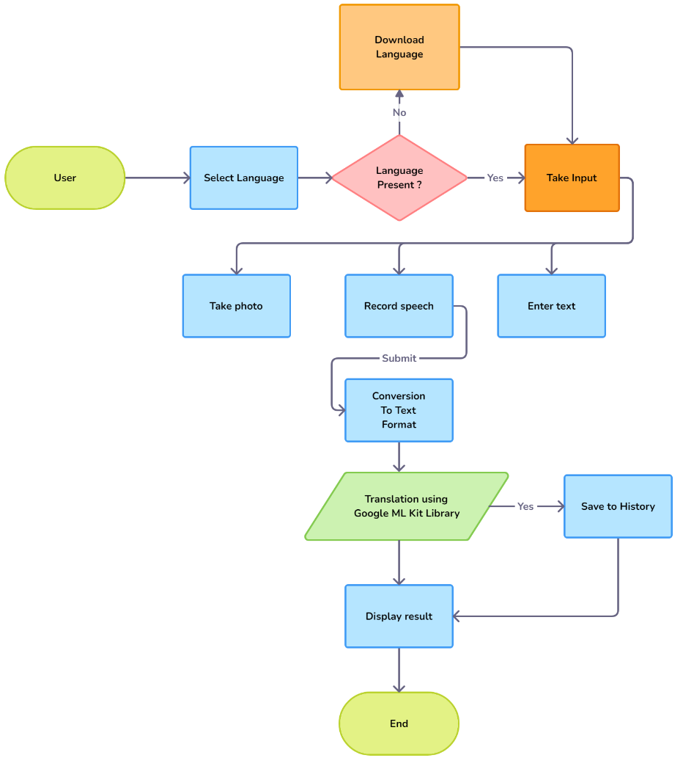
Working of the Application
Language Selection: Users choose the source and target languages for translation.
Input: Users can enter text or use the microphone or camera for translation process.
Translation: The app processes the input and displays the translated text in real time.
Language Download: The app will check the availability of the language pack and download accordingly.
History & Offline Access: Translations are saved in the history, and the app works offline by downloading language packs.

Slide 6
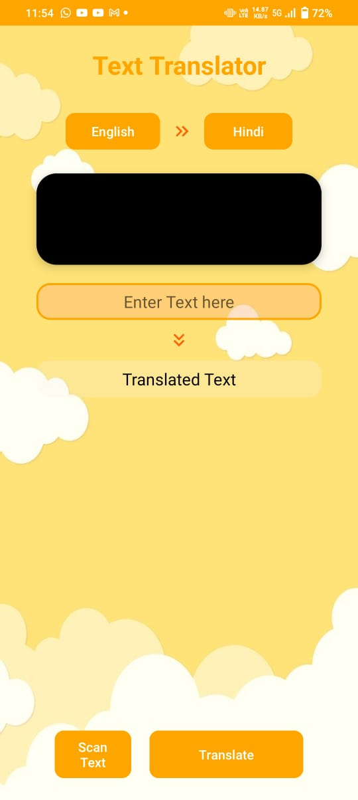
Innovative Elements of App
Selective Language Downloads: App will download only the specific languages the user need, saving storage space and optimizing performance.
Real-Time Voice Translation: The app allows users to speak directly into their device, translating spoken words instantly in real-time for smooth conversations.
Image-Based Text Translation: Users can take pictures of text (like road signs, menus, or documents), and the app will translate the text within the image.
Privacy-First Design: The app ensures no data is sent to external servers, protecting user privacy and maintaining offline data processing.
Screenshot

Slide 7
Testing and Evaluation
Device Testing: Evaluate the app's performance across various smartphones and tablets, ensuring compatibility and smooth operation.
Translation Accuracy: Test translation accuracy for different languages using both online and offline modes with real-world text, speech, and images.
User Interface Usability: Conduct usability testing with diverse users to assess the ease of navigation and user experience.
Performance Metrics: Measured the app's response time and data consumption during different translation tasks.

Slide 8
Future Goals for Application
Text to Speech: Implement seamless text-to-speech functionality, allowing users to hear translations spoken aloud.
Language Pack Management: Develop advanced language pack management to let users download, update, and remove language packs as needed.
Publishing and Monetization: Plan for app publishing on platforms like Play Store and App Store and implement monetization strategies like donation to sustain app development while keeping user accessibility in mind.
User Feedback and Analytics Integration: Integrate a user feedback system and analytics to gather insights on app usage patterns and areas for improvement, ensuring continuous app optimization based on user needs.

Slide 9
Conclusion
This Translation App is a powerful tool designed to break down language barriers with real-time text and speech translation. Its offline functionality allows users to access translations even without internet connectivity. With language packs available for download only when needed, the app optimizes performance and storage. Additionally, user privacy is a top priority, as no data is sent to external servers, ensuring confidentiality.
This app offers an intuitive and efficient user experience, making it ideal for travelers, students, and professionals alike. By combining advanced technology with a user-focused design, the app provides an accessible and reliable solution for seamless communication across languages.

Slide 10
Thank You Checkout My App lavkalsi.github.io/LanguageTranslatorApp

