Slide 1
CloudVisor: Retrofitting Protection of Virtual Machines in Multi-tenant Cloud with Nested Virtualization
Fengzhe Zhang, Jin Chen, Haibo Chen, Binyu Zang
System Research Group
Parallel Processing Institute
Fudan University
http://ppi.fudan.edu.cn/system_research_group
2011-10-24
Notes:
I’m gonna introduce a system called cloudvisor, that protects VMs in multi-tenant cloud.

Slide 2
Multi-tenant Cloud
Widely available public cloud
Amazon EC2, RackSpace, GoGrid
Infrastructure as a Service
Computation resources are rented as Virtual Machines
To save cost, VMs from different users may run side-by-side on the same platform
Notes:
Multi-ten cloud, also known as public cloud, is already widely available now, such as ...
They provides computation infrastructure as a service. That means ...
To save the cost, .... That’s why it’s called multi-tenant.

Slide 3



Multi-tenant Cloud Software Stack
Pay-as-you-go
Flexible
Scalable
Control
VM
VM
VM
Hypervisor
Notes:
Here is a typical software stack in a multi-tenant cloud.
It is usually composed of a hypervisor and a control VM.
Users can rent more or less computation resources by renting different number of VMs.

Slide 4
Can we simply trust public cloud?
Probably Not !
Notes:
Multi-tenant cloud has lots of merits, but the question is ...
It is suggested that the answer is probably not!

Slide 5
Problem #1: Curious/malicious Administrator
Jack’s bank account password = xyz
xyz
Control
VM
VM
Hypervisor
most concerned issue:
“invisibly access unencrypted data in its facility”- Gartner, 2008
Notes:
There are two reasons that we cannot simply trust multi-tenant cloud.
The first problem comes from the curious/malicious operators.
As the hypervisor is the most privileged software on the platform, it can access all the resources including the user VM.

Slide 6
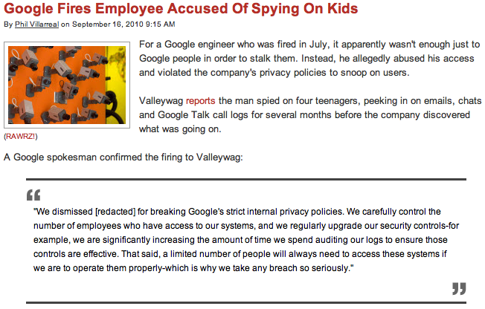
Problem #1: Curious/malicious Administrator
peeking in on emails, chats and Google Talk call logs for several months before the company discovered...
Notes:
Threat is very real. a recent case is that “google just fires...”

Slide 7
Problem #2: Large TCB for Cloud
~9M LOC
[Colp 2011]
Control
VM
Trusted Computing Base
Hypervisor
monolithic virtualization stack
one point of penetration leads to full compromise
Notes:
The second reason is that large trusted computing base.
The trusted computing base, including both the control vm and hypervisor.
TCB size is steadily growing, the tcb for xen has increased from 5m to 9m.
The the problem of fragile TCB is clearly stated in previous talk.

Slide 8
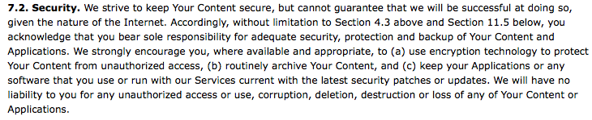
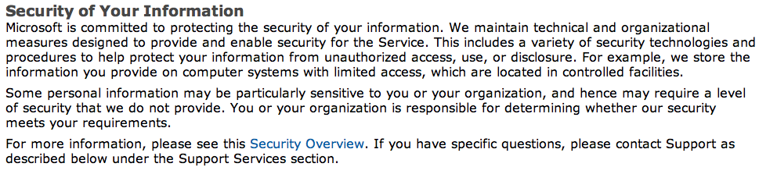
Result: Limited Security Guarantees in Public Cloud
Amazon AWS User Agreement, 2010
Microsoft Windows® Azure™ Platform Privacy Statement, Mar 2011
Notes:
Consequently, there are limited security guarantees in public cloud.
For example, amazone’s user agreement states that “We strive to keep your data secure, but ...”
Windows Azure also recommends that users should protect their sensitive data using cryptography.

Slide 9
Data Encryption is not Enough
Encryption is only good for static data storage
Data never decrypted in the cloud
Cloud is just used as online storage space
As for computation cloud
Data are involved in computation, such as web services
Data should be decrypted during computation
Encryption is not enough in this case
Note, computation cloud is more widely desired
Notes:
However, simply using data encryption is not enough to protect senstive data.
These are usually needed to compute in many computation services. .

Slide 10
Goal of CloudVisor
Defend again curious or malicious cloud operators
To ensure privacy and integrity of a user VM
Be transparent to existing cloud infrastructure
No or little modifications to virtualization stack (OS, Hypervisor)
Minimized TCB
Easy to verify correctness (e.g., formal verification)
Non-goals
DOS
Side-channel attacks
Semantic attacks to VM services from network
Notes:
Awaring of these problems, the goal of cloudvisor is to ...

Slide 11
Observation and Idea
Key observation
Live with a compromised virtualization stack
Idea: separate security protection from VM hosting
CloudVisor: another layer of indirection
In charge of security protection of VMs
Interposes between VMs and hypervisor
Hypervisor (unmodified)
VM multiplexing and management
This separation results in
Minimized TCB
Hypervisor and CloudVisor separately designed and evolved
Notes:
Privacy and integrity protection of VMs are mostly independent from other core functionalities of virtualization

Slide 12
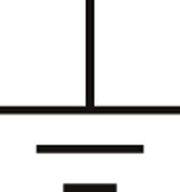
CloudVisor Overview
evidence of intact CloudVisor
Control
VM
VM
VM
Encrypted VM Image
Hypervisor
CloudVisor
HW Security Chip
Notes:
Here is an overview of how users could leaverage cloudvisor system.
...
After the platform is booted, remote user can challenge the Security chip to get an evidence of intact version of cloudvisor is running.

Slide 13
VM Protection Approach
Bootstrap | Uses Trusted Computing technology
Memory Pages | Interpose address translation from guest physical address to host physical address, disallow illegal mapping to VM memory
I/O data | Whole VM image encryption Transparent decrypt I/O data in CloudVisor Network I/O not encrypted
CPU states | Interpose control switches between hypervisor and VM (i.e., VMexit), hides CPU register states from the hypervisor
(in paper)
Notes:
Here are an overview of the protecting approaches of cloudvisor.
CV uses EPT to isolate VMs’ memory from each other.
IOMMU is controlled by CV to restrain DMA access range with the driver VM
IO data is only decrypted after read into memory
Disk IO reqs are recognized in CV by IO port

Slide 14
Bootstrapping Trust
2 basic Trusted Computing techniques
Authenticated boot
Remote attestation
CloudVisor
remote attestation
authenticated boot
GRUB
User
TPM Chip
BIOS
hash
sign(hash)
User can ensure a correct version of CloudVisor is running
Notes:
The first step to boostrap trust.
Before BIOS loads Grub, it first measure the binary of Grub by hashing. The hash is stored in hw security chip.
Grub will in turn measure the binary of cloudvisor.

Slide 15
Interposition with Nested Virtualization
CloudVisor is based on standard hardware support for virtualization like VT-x, VT-d
It can host only 1 hypervisor
Hypervisor runs in un-privileged mode
CloudVisor runs in most privileged mode
Notes:
After boostraping the trust, cloudvisor interposes all architectrual events by nested virtualization.

Slide 16
1-on-1 Nested Virtualization (Turtles, 2010)
VM
VM
VM
Hypervisor
Cloudvisor
Notes:
Cloudvisor is based on 1-on-1 nested virt.
Logic view of 1-on-1 nested virt.

Slide 17
Virtualization Preliminary: VT-x
VM
Ring 3
Ring 0
guest mode
VM entry
VM exit
host mode
Hypervisor
Notes:
Besides traditional privilege rings on the processor, VT-x introduced a new host mode.
Hypervisor is designed to run in host mode. All privileged operations in guest mode would cause trap into host mode, ie, Vmexit.

Slide 18
Interposition with CloudVisor
VM
Ring 3
Hypervisor
Ring 0
guest mode
VM entry
VM exit
VM entry
VM exit
host mode
Cloudvisor
Notes:
Cloudvisor interposes hypervisor and vms...
In this way, some sensitive states (general purposed registers) could be saved during VMExit.

Slide 19
VM Memory Isolation
Goal: forbid hypervisor access to VM memory
Rules:
When a page is assigned to a VM, CloudVisor changes the ownership of the page
A memory page is only accessible to its owner
Notes:
By leveraging this privileged position, cloudvisor conducts memory isolation by hardware assistance.
The goal of memory isolation is to forbid ...
Cloudvisor also provide strong memory isolation among the hypervisor and guest vms.

Slide 20
Memory Translation with EPT
Page Table Base
Extended Page Table Base
Page
Table
Extended
Page
Table
Guest Virtual
Address
Guest Physical
Address
Host Physical
Address
Memory access initiated from
CPU: address translated by MMU (Page Table and EPT)
Devices: address translated by IOMMU
Notes:
For CPU initialated memory access, a virtual memory address should be first translated to physical addresses.
We mainly use ept to achieve the isolation.
Here, I will first show how ept works in typical virtualization.
If EPT is enabled.

Slide 21
Memory Isolation with EPT
VM
Ring 3
Hypervisor
Ring 0
guest mode
EPT
EPT
maintained by Cloudvisor
invisible to hypervisor
maintained by hypervisor
read-only to hypervisor
updates validated by Cloudvisor
host mode
Cloudvisor
Notes:
Here is how cloudvisor supports memory isolation with ept
For each VM,

Slide 22
Memory Isolation with EPT
In EPT maintained by CloudVisor
There’s no mapping to VM memory
This guarantees a page is either mapped by hypervisor or a VM, not both
CloudVisor tracks the ownership of every page
Encrypt unauthorized pages and store its hash
Notes:
Once a page is assigned to a VM, the mapping to the page is removed from the EPT of the hypervisor.

Slide 23
Implementing I/O Protection
CloudVisor intercepts and parses disk I/O request
Programmed I/O, DMA
Encrypt/decrypt data transparent to VM and hypervisor
Calculate hash to verify the integrity of the data (in paper)
Network I/O are not encrypted
User VM should protect the transferred data by itself
Notes:
Another major resource to protect is disk data. VM disk image is already encrypted on storage. the question is how to give vm decrypted data transparently.
(AES-128 bits)
For DMA requests, the address of an in-memory Physical Region Descriptor Table, which contains a number of descriptors describing scattered requesting I/O buffers, will be written to the DMA configuration port by a requesting VM. CloudVi- sor scans the table and creates one record in the white-list for each table entry.

Slide 24
Disk Read: Transparent Decryption
1. encrypted data loaded from disk to hypervisor memory
2. hypervisor tries to copy data to I/O buffer in VM memory, fails because EPT fault
3. traps into CloudVisor, CloudVisor decrypts the data and copies it to corresponding I/O buffer in VM memory
Notes:
Reverse procedure is done when disk write request is issued.

Slide 25
Impact on VM Operations
CloudVisor works with Save/Restore/Migration
VM save: transparently encrypted and hashed
VM restore: transparently decrypted and verified
Require key exchanges between two machines during migration (Mao et al. 2006)
Transparent memory sharing (not supported)
Problem: each VM has different keys
Sol#1: use a common key for page sharing
Sol#2: provide only integrity protection for shared pages

Slide 26
Implementation
Xen hypervisor
Run unmodified Windows, Linux Virtual Machine
~200 LOC patch to Xen to reduce VMexit (Intel platform only, Optional)
Run on SMP and support SMP VMs
5.5K LOCs
Intel TXT is used to further decrease code size

Slide 27
Performance Evaluation
How much overhead does CloudVisor incur?
What’s the source of overhead?
Is CloudVisor scalable on multicore?

Slide 28
Test Environment
Hardware: Dell R810
1.8 GHz 8-core Intel processor with VT-x, VT-d, IOMMU, EPT, AES-NI and SR-IOV support
32 Gbyte memory
Software:
Xen-4.0.0 and XenLinux-2.6.31.13 as Domain0 kernel
Debian-Linux with kernel 2.6.31 and Windows XP with SP2, both are 64-bit version
Notes:
Who controls the pf?

Slide 29
Uniprocessor Performance
Average slowdown 2.7%

Slide 30
I/O Intensive Workload

Slide 31
Source of Overhead
Additional VMexits due to CloudVisor
Although CloudVisor only intercepts a small set of architectural events, VMexits caused by I/O buffer copying is inevitable
Cryptographic operations
Encryption and hash
Notes:
Although we try to intercept the minimum set of arch events, two major kinds of events happens often:

Slide 32
Multi-core scalability: KBuild
1/2 core means two processes on a core
Notes:
Scalability is OK up to 8 cores.

Slide 33
Performance of Multiple VMs

Slide 34
Related Work
Nested Virtualization (Turtles, 2010)
Support two layers of virtualization, no security protection
Result in an even larger TCB
Virtualization-based rootkits
Bluepill, Subvirt
VMM-based process protection
CHAOS, Overshadow
Efforts in improving or reducing virtualization layer
NoHype: removal of virtualization layer
NOVA: microkernel based VMM
Virtualization-based attacks and defenses

Slide 35
Conclusion and Future Work
Hypervisor can host VMs without knowing what’s inside
That means: hypervisor can provide services without being trusted
Hiding VM resources from the hypervisor can be done with a small code base (~5.5 KLOC)
Future: HW support of CloudVisor
Reduce overhead and complexity

Slide 36
Thanks

Slide 37
Backup

Slide 38
Interposition with CloudVisor
VM
stack
Hypervisor
guest mode
VM entry
VM exit
VM entry
VM exit
host mode
Cloudvisor
stack
Notes:
In this way, some sensitive states (general purposed registers) could be saved during VMExit.

Slide 39
Prevent Unauthorized Access
encrypthash
VM1
missing
hypervisor’s Page Table
VMEXIT
hypervisor’s EPT
CloudVisor
Physical Memory
It is supposed that hypervisor will not use VM memory this way
just in rare cases
Notes:
If the hypervisor tries to map a VM memory page, it is interposed by CV.
Use of the mapping will cause EPT violation.
There is a reference count it page ownership table, which decides if

Slide 40
Para-virtualization Support
No visible architectural events, no interposition, not supported
PV drivers
Memory sharing and event channel
Not supported now, maybe doable

Slide 41
Optimization
Network benchmarks are beneficial from directly assigned network card
Apache, memcached
I/O data encryption/decryption uses hardware crypto instructions
Intel AES-NI

