Slide 1
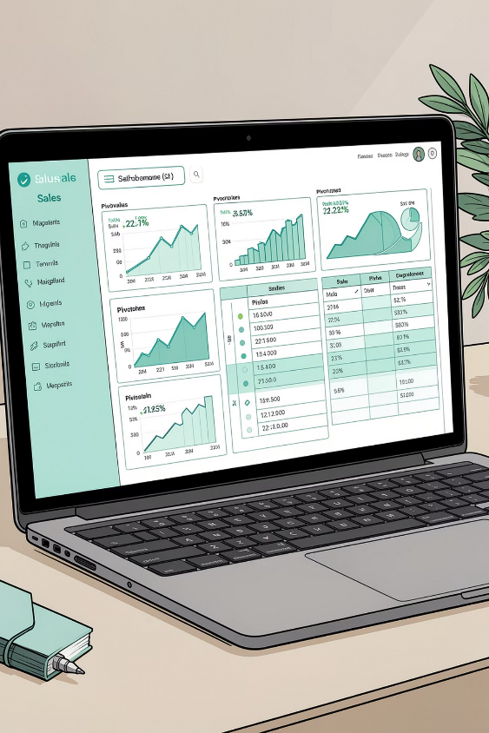
Vrinda Store — Annual Report 2022
Interactive dashboard created in Excel to analyze 2022 sales, customers, and channels. Objective: understand customers and increase sales in 2023–2024.

Slide 2
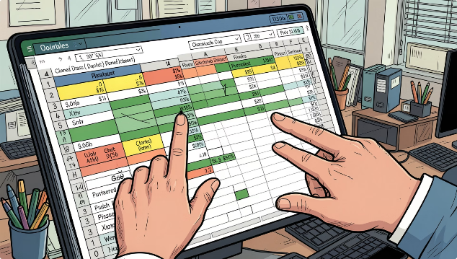
Dataset & Scope
Source: Vrinda Store Data Analysis (Excel). Analysis covers orders, sales, customer demographics, channels, states, categories, and order status for 2022. Cleansed and validated for missing values and anomalies.

Slide 3
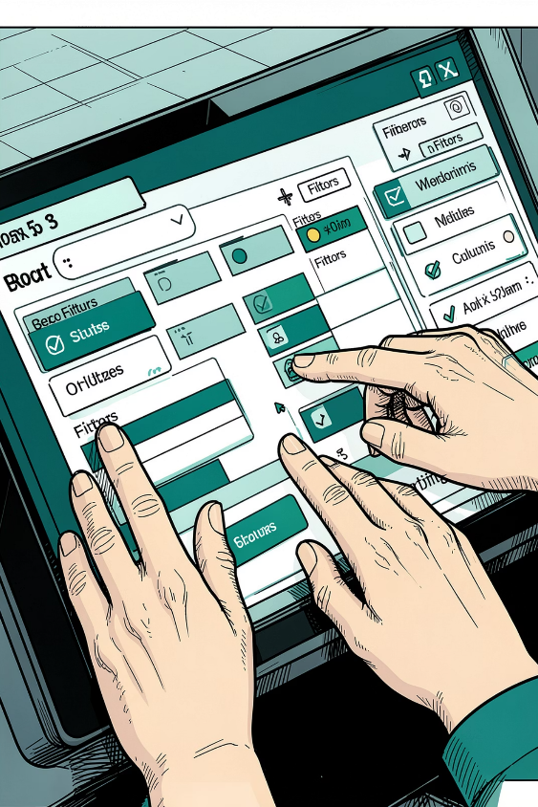
Process Overview
01
02
1. Data Cleaning
2. Pivot Tables
Verified missing values, standardized formats, and removed anomalies.
Built pivot tables for each KPI question to summarize metrics.
03
3. Dashboard
Merged pivots into one interactive dashboard and added slicers for dynamic filtering.

Slide 4
Key Questions (KPIs)
Sales vs Orders
Top Month
Single-chart comparison of sales amount and order counts by month.
Identify month with highest sales and orders.
Gender Split
Top States
Who purchased more — men or women?
Top 10 states contributing to sales.
Age vs Orders
Channels & Categories
Relation between age groups and number of orders by gender.
Which channel contributes most to sales and which category sells highest.

Slide 5
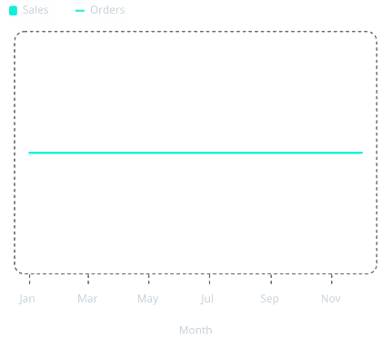
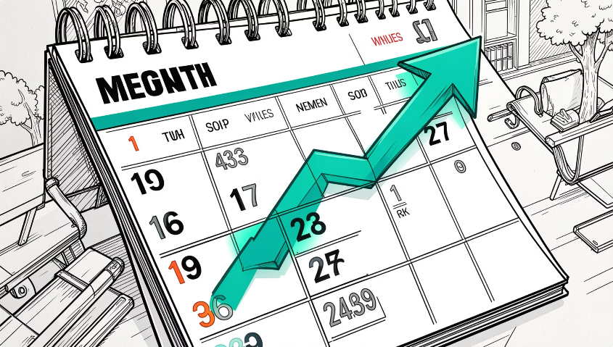
Sales & Orders — Monthly Comparison
Use the combined chart to compare sales amount (bars) vs orders (line) and identify peak month. Dashboard includes slicers to filter by state, channel, category, gender, and age group.

Slide 6


Gender & Age Insights
Gender Split
Women ~65% of buyers — majority of purchases.
Top Age Group
Adults 30–49 yrs contribute ~50% of orders.
Age x Gender
Relationship chart available on dashboard showing orders by age band and gender.

Slide 7
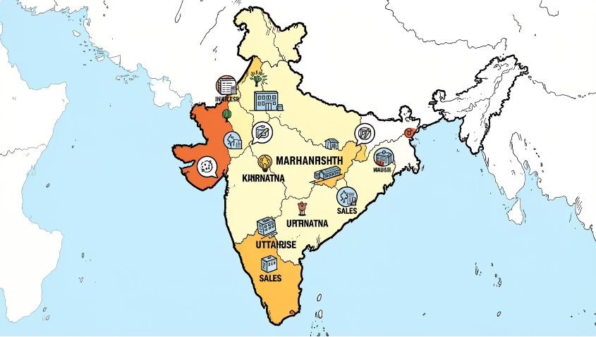
Geography — Top States
Top 3 states: Maharashtra, Karnataka, Uttar Pradesh. Dashboard lists top 10 contributing states to prioritize regional campaigns and inventory.

Slide 8
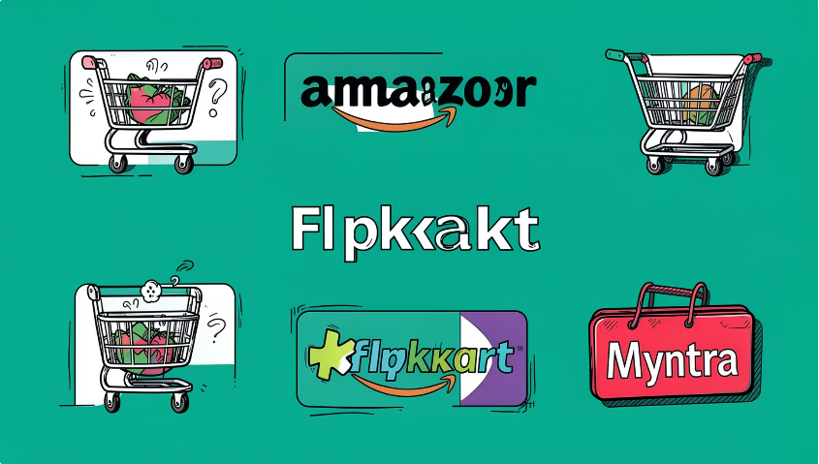
Channels & Categories
Top Channels
Amazon, Flipkart, Myntra drive the most sales.
Best Category
Highest-selling product category identified on dashboard (category name available in dataset).
Order Status
More than 90% of products were delivered in 2022.

Slide 9
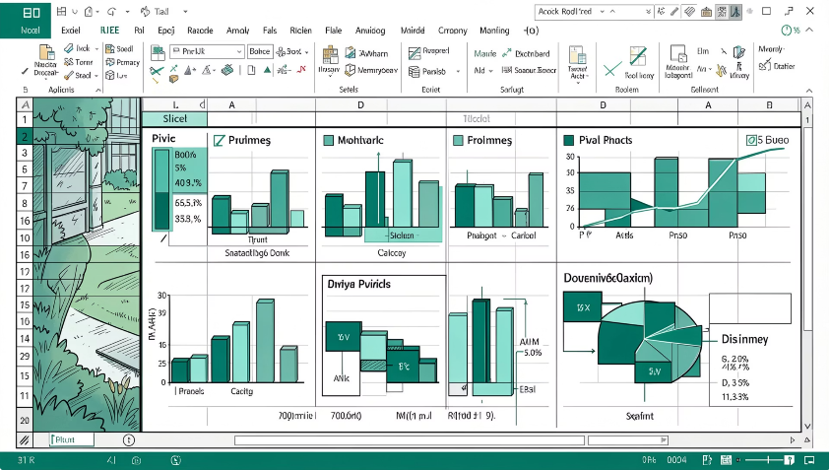
Dashboard Interaction & Deliverables
Interactive Excel dashboard combining pivot tables and slicers. Features:
Single-chart sales vs orders
Filters for month/state/channel/category/gender/age
Pivot-based top-10 lists and demographic breakdowns
View screenshot and files in the provided GitHub links.

Slide 10

Conclusions & Recommendation
Target Audience
Channel Priority
Next Steps
Focus on women aged 30–49 in Maharashtra, Karnataka, and Uttar Pradesh.
Promote offers and coupons on Amazon, Flipkart, and Myntra to maximize reach.
Use dashboard slicers to refine campaigns, monitor top states and categories, and track month-over-month performance into 2023–2024.
Author
Lavakumar Marisarla — Aspiring Data Analyst
LinkedIn: www.linkedin.com/in/lavakumarmarisarla
GitHub: github.com/Lavakumarmarisarla

