Slide 1

AI-Powered Water Usage Awareness and Conservation Assistant
Discover how artificial intelligence can transform water conservation efforts in residential and campus facilities.
1M1B – IBM SkillsBuild AI + Sustainability Internship Project
Aligned with SDG 6: Clean Water and Sanitation
Introducing a Conceptual AI Prototype for a Sustainable Future

Slide 2
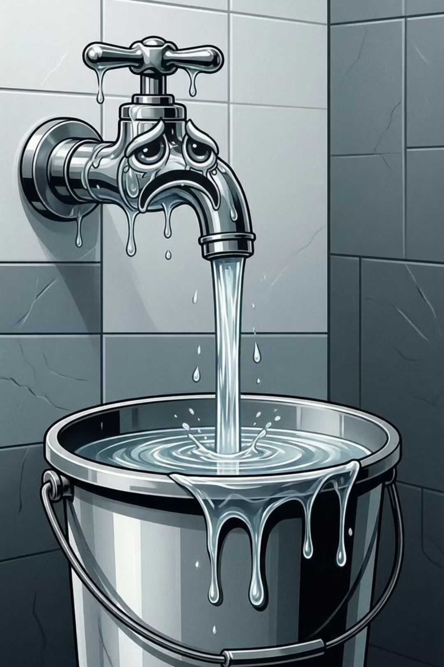
Addressing the Critical Challenge of Water Wastage
Significant Water Wastage
Water wastage is a pervasive sustainability issue, particularly in high-density residential areas and hostels.
Lack of Awareness
A critical barrier to conservation is the lack of awareness regarding personal water consumption habits and their environmental impact.
Absence of Actionable Tools
There's a noticeable gap in simple, accessible tools that provide practical, actionable insights for reducing water usage.
Threat to Sustainability
Inefficient water usage directly impacts long-term water sustainability, threatening future resources and ecosystem health.

Slide 3
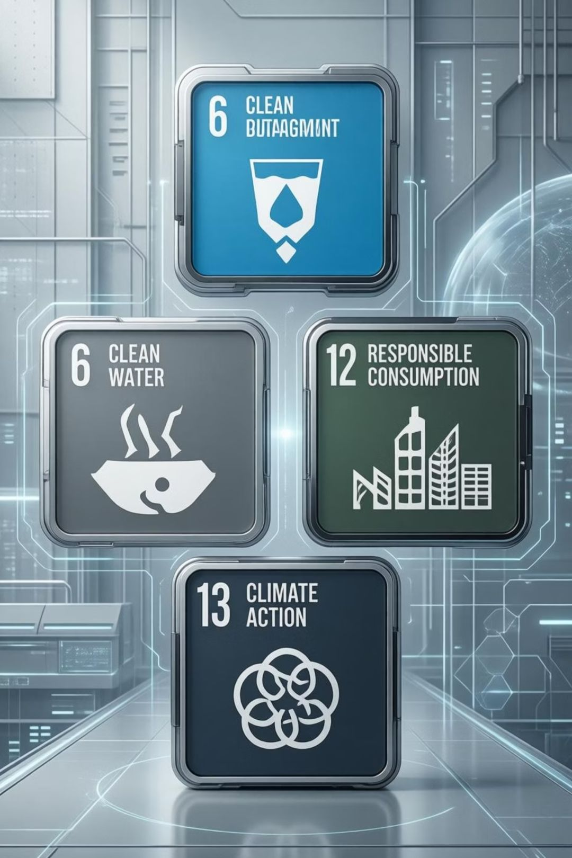

Global Goals: Our Commitment to Water Sustainability
Our project directly contributes to the United Nations Sustainable Development Goals, fostering a more sustainable planet.
Primary SDG Alignment
Secondary SDG Alignment
SDG 6: Clean Water and Sanitation
SDG 12: Responsible Consumption and Production
Promoting efficient use of resources and reducing waste generation.
Ensuring availability and sustainable management of water and sanitation for all.
SDG 13: Climate Action
Taking urgent action to combat climate change and its impacts through resource conservation.

Slide 4
Introducing Our AI-Based Water Conservation Assistant
Our innovative solution leverages artificial intelligence to empower users with personalized water usage insights and recommendations.
01
02
03
Conversational AI Interface
User Data Input
AI-Powered Analysis
An intuitive, interactive AI assistant designed for easy user engagement.
Users provide simple, basic details about their daily water consumption activities.
The AI analyzes input through advanced prompt-based workflows, understanding usage patterns.
04
05
Personalized Insights
Water-Saving Recommendations
Delivers tailored insights into water consumption, highlighting areas for improvement.
Provides practical and effective suggestions to reduce water usage and promote conservation.

Slide 5


The AI Workflow: From Input to Impact
Our prototype outlines a clear, iterative process for guiding users towards more sustainable water practices.
User Input
AI Prompt Processing
Insights & Decisions
Sustainability Comparison
User Input: Simple questions about daily habits.
AI Prompt Processing: Advanced algorithms interpret the data.
Sustainability Benchmark Comparison: Compares user data against eco-friendly standards.
Insights & Recommendations: Delivers actionable advice.
Informed User Decisions: Empowers users to make sustainable choices.

Slide 6

Under the Hood: AI Technologies & Responsible Implementation
Core AI Technologies
Responsible AI Principles
Prompt Engineering
Crafting precise queries to guide AI analysis and generate relevant insights.
No Personal Data
Conversational AI
Ensuring user privacy by avoiding the collection of sensitive personal information.
Enabling natural and intuitive interaction with the water assistant.
Transparent Outputs
Information Summarization
Providing clear explanations for all recommendations and insights.
Distilling complex data into clear, concise, and actionable recommendations.
Conceptual IBM Granite Models
Ethical & Unbiased
Leveraging foundational AI models for robust data processing and understanding.
Developing the AI with a commitment to fairness and preventing algorithmic bias.

Slide 7

Anticipated Impact & Future Vision
Our AI assistant promises significant environmental benefits and has immense potential for future enhancements.
Expected Impact
Future Scope
Reduced Water Wastage
1
Smart Meter Integration
Directly contributes to a measurable decrease in unnecessary water consumption.
Connecting with IoT devices for real-time, automated water usage data.
Increased Awareness
Educates users on their water footprint, fostering a deeper understanding of conservation.
Mobile/Web Interface
2
Developing accessible platforms for broader user reach and convenience.
Sustainable Behavior Change
Promotes long-term shifts towards eco-conscious habits in daily life.
Community-Level Insights
3
Aggregating anonymous data to provide conservation strategies for entire facilities or campuses.

