Slide 1
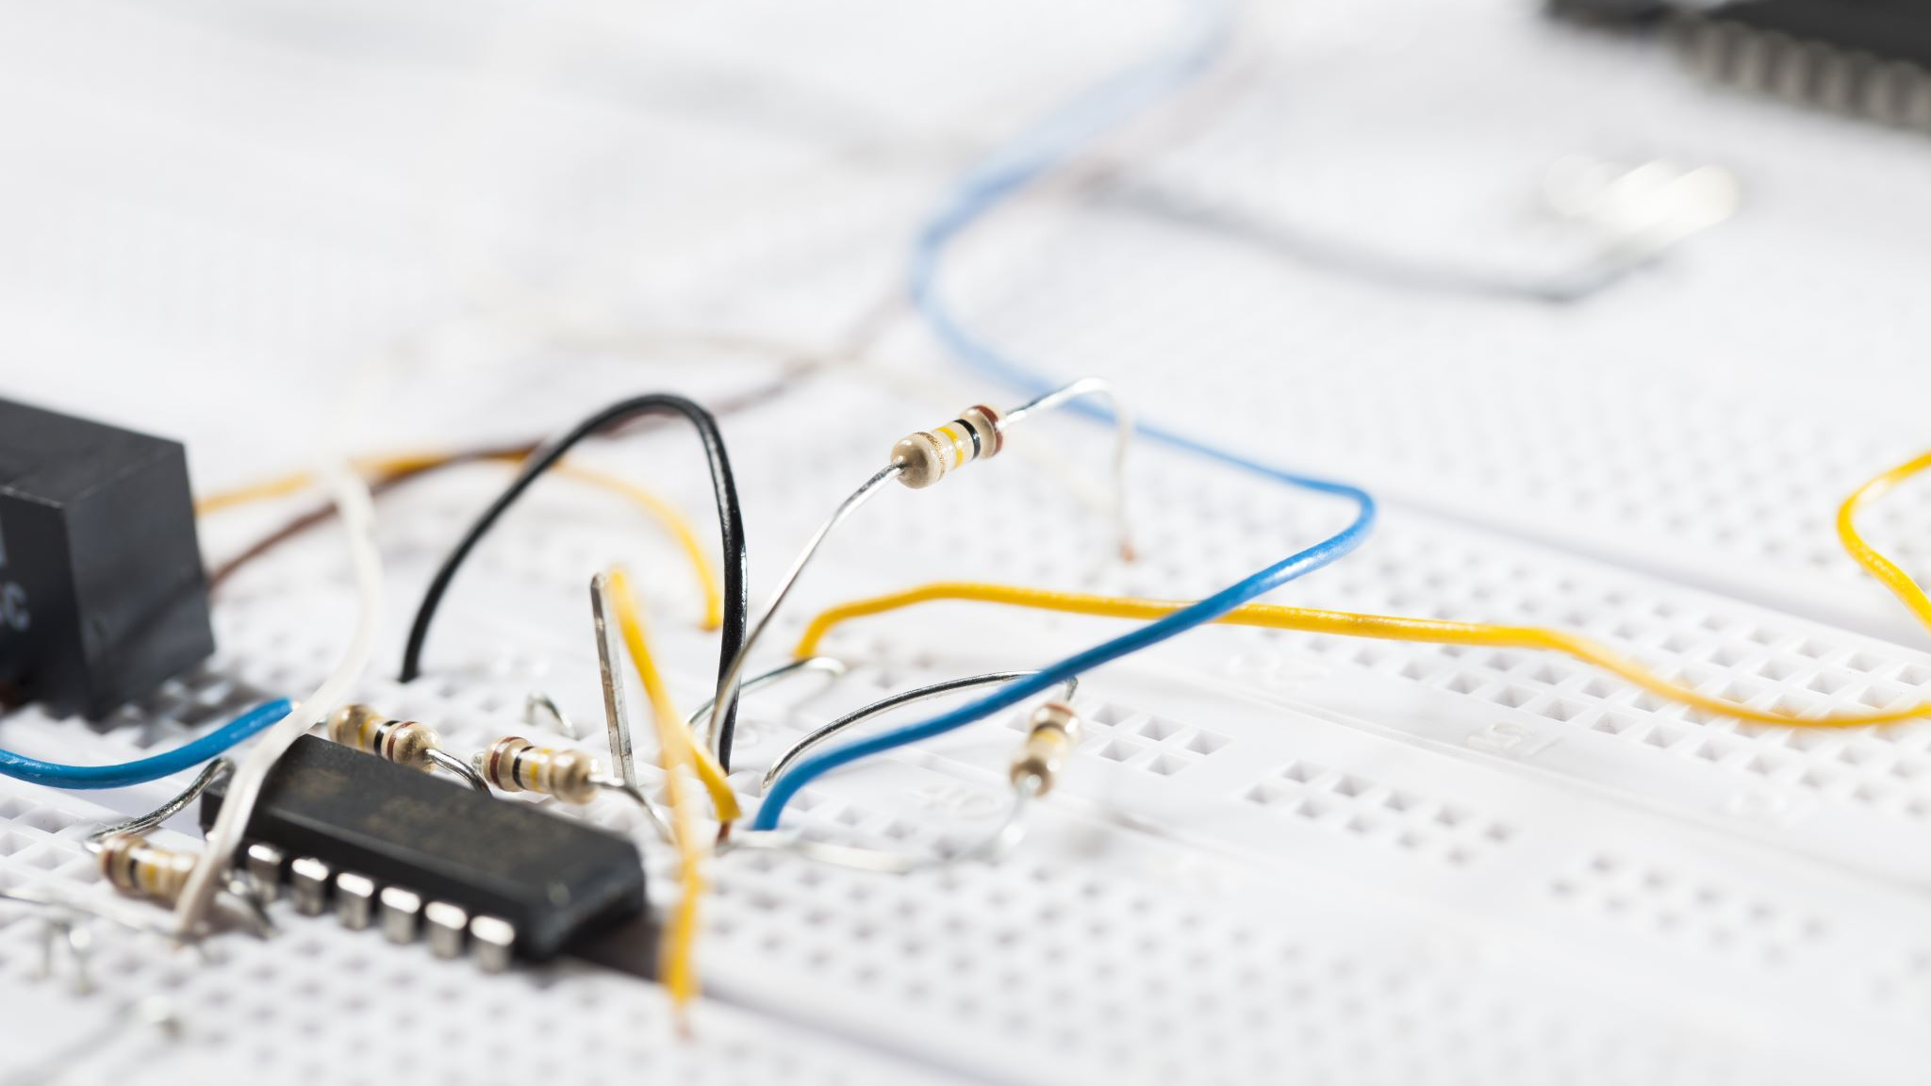
TRAFFIC PROTECTION AND ROOT CONTROL
Traffic control using data science

Slide 2

Traffic
Traffic congestion occurs when the number of vehicles is larger than the capacity of a road or intersection.
If one person stops, the people behind try to overtake, blocking vehicles coming from the opposite direction. Just because one person decides is impatient, the entire stretch of road gets blocked.

Slide 3

DATA SCIENCE IN TRAFFIC CONTROL
Optimizes traffic signal timings, route suggestions, and lane management to reduce congestion and travel times.
Data science can detect, classify, and track people and vehicles, and alert drivers to vulnerable road users.
Data science can suggest routes to avoid traffic jams.
Data science can ensure the safety of pedestrians while crossing roads.

Slide 4

PROBLEM STATEMENT
Traffic congestion can cause a number of problems, including:Increased fuel consumptionAir pollutionCarbon dioxide emissionsNoise pollutionIncreased stressDelayed emergency vehiclesUnsafe drivingRoad accidentsInjuries

Slide 5
IMPLEMENTATION OF DATA SCIENCE IN TRAFFIC CONTROL
Analyze
AI-powered navigation apps can analyze real-time traffic data to provide drivers with the most efficient routes, avoiding congestion and delays.
Adjust
Adjust traffic signals.
Enable
AI algorithms can enable dynamic lane management.
Detect
Detect speeding.
Monitor
Monitor traffic.
Guide
Guide ambulances.
Ensure
Ensure pedestrian safety.

Slide 6

FUTURE DATA SCIENCE IN TRAFFIC CONTROL
Improving traffic flow can lead to huge improvements in road safety. AI is paving the way for smooth transportation with the help of computer vision and machine learning algorithms. We analyse traffic flow by collecting data through cameras and drones deployed in various congested areas within the city.

Slide 7
CONCLUSION
In future AI going to play important role in every sector
AI in traffic control can minimize the accident and traffic
People can easy identify the traffic and can move freely without traffic

Slide 8

THANK YOU

