Slide 1
Most Popular Components
LAVAN R P

Slide 2
Types of components
DataGrid
Chats
List View
Scheduler
Diagram
PDF Viewer
Excel Library

Slide 3
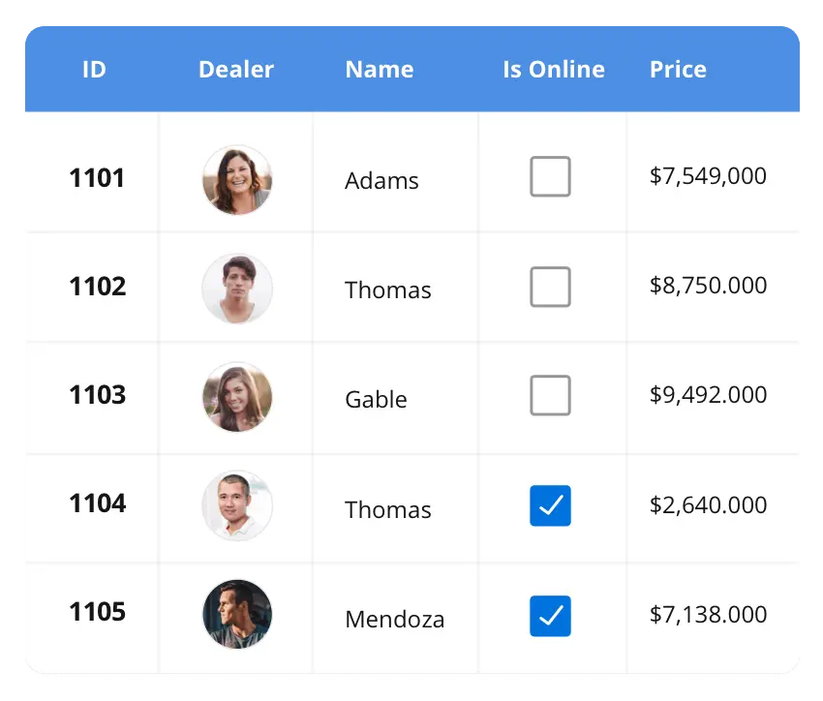



DataGrid
The DataGrid control is a high-performance grid component that helps display and manipulate large amounts of data in a tabular format. Its rich feature set includes functionalities like data binding, sorting, grouping, editing, filtering, swiping, dragging, resizing, loading more items, pull-to-refresh, and exporting to Excel and PDF file formats.
SUPPORTED PLATFORMS
angular
Blazor
JavaScript
React
Vue
ASP.NET core
ASP.NET MVC
WAF
WinForms
Flutter
Xamarin
UWP
.NET MAUI
Xamarin
Flutter
UWP
JavaScript
.NET MAUI
This Photo by Unknown Author is licensed under CC BY

Slide 4
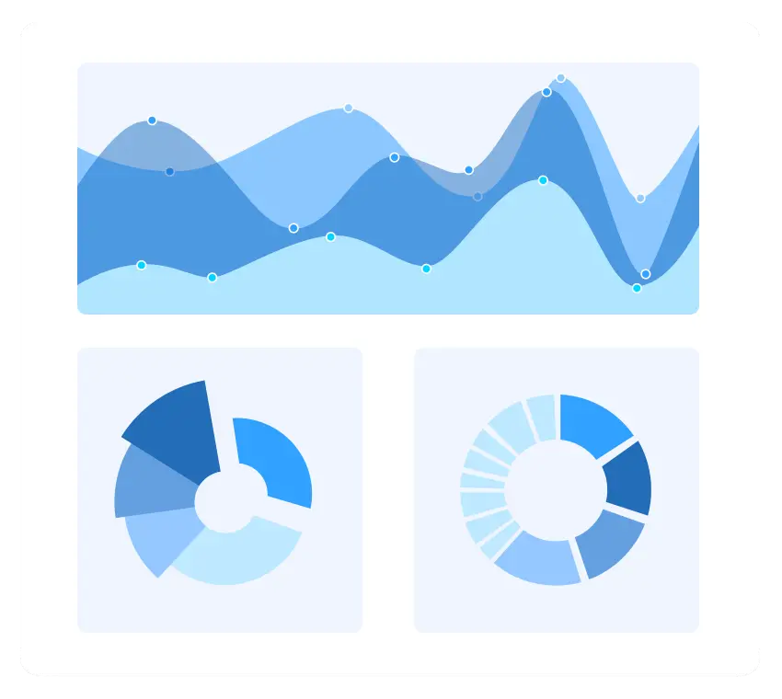
Chats
The Charts control can plot a wide range of chart types, ranging from line charts to specialized financial charts. Its rich feature set includes functionalities like data binding, multiple axes, legends, animation, data labels, annotations, trackballs, tooltips, and zooming.
SUPPORTED PLATFORMS
angular
Blazor
JavaScript
React
Vue
ASP.NET core
ASP.NET MVC
WAF
WinForms
Flutter
Xamarin
UWP
.NET MAUI
Xamarin
Flutter
UWP
JavaScript
.NET MAUI

Slide 5
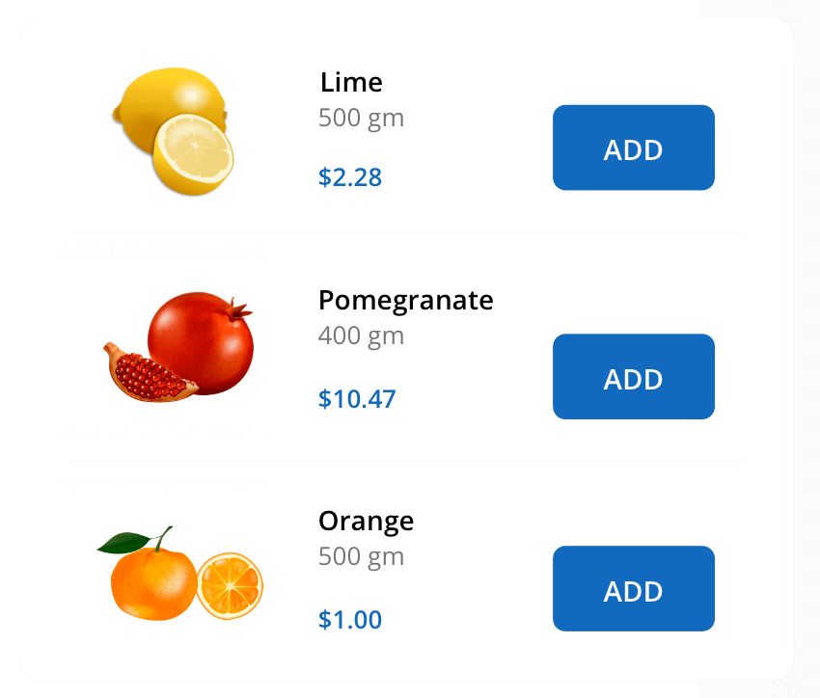
List View
The List View renders a set of data items with UI views or custom templates. It has many features like grouping, sorting, filtering, paging, swiping, multiple selection, drag and drop, and different layout types. The List View control has been optimized to work with large amounts of data.
SUPPORTED PLATFORMS
angular
Blazor
JavaScript
React
Vue
ASP.NET core
ASP.NET MVC
WinForms
.NET MAUI
Xamarin
.NET MAUI
Xamarin
JavaScript

