Slide 1
Pomodoro Project
Devon Williams
CS 3080

Slide 2
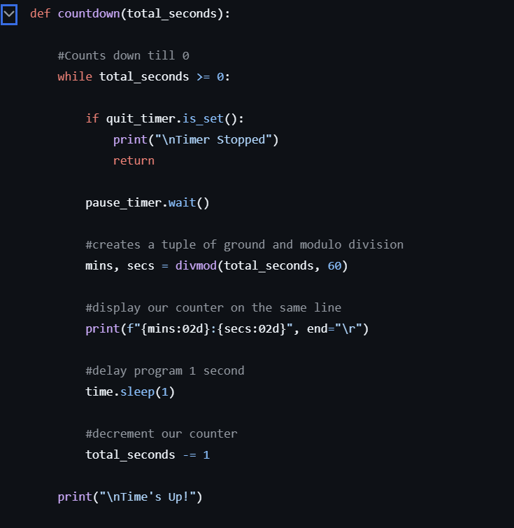
Time Module
Creating timer countdown
Count Down
Repeating
Working Session / Break Session
Issue with pause/resume/quitting

Slide 3
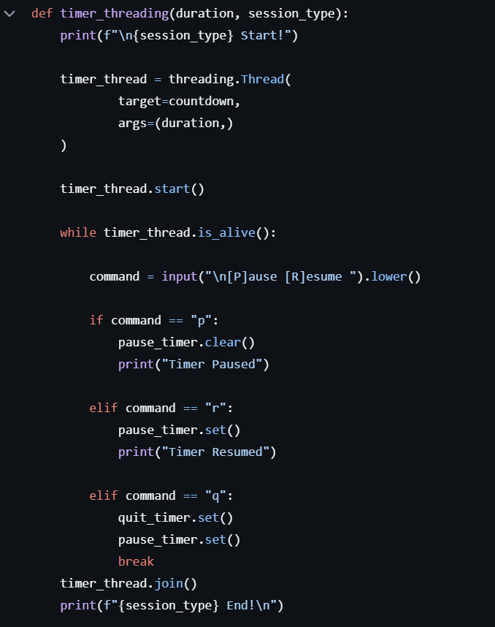
Threading Module
Allowed for user input while timer running
User could pause/resume/quit

Slide 4
Tkinter Module
Eliminated both time and threading
Had to learn many of the methods to get working

