Slide 1
NETWORK TRAFFIC ANALYSIS
CYBER SECURITY
Presented By:
G.Lavanya
Salem College of Engineering and Technology-
Computer Science and Engineering

Slide 2
OUTLINE
Problem Statement
Security the flow
Unveiling the Invisible
Network security is Essential for Cyber Security
Network traffic analysis in action
Tools for enhanced Security
Result
Conclusion
Future Scope
References

Slide 3
Problem Statement
"In today's interconnected world, the volume and complexity of network traffic continue to increase exponentially, presenting significant challenges in terms of security, performance optimization, and resource management. Efficiently analyzing and understanding this vast amount of data is crucial for identifying and mitigating security threats, optimizing network performance, and ensuring the smooth operation of critical services.
However, existing network traffic analysis tools often struggle to keep pace with the evolving nature of network threats and the sheer scale of modern networks. Thus, there is a pressing need for advanced network traffic analysis solutions that can effectively handle large volumes of data, provide real-time insights, and adapt to emerging threats to safeguard network integrity and performance.

Slide 4

Security the flow
NTA empowers us to safeguard our networks by examining the data flowing through them.
By identifying suspicious activity and potential threats, NTA becomes a crucial shield in the cybersecurity arsenal.

Slide 5

Unvieling the INVISIBLE
Network traffic analysis (NTA) is the meticulous examination of data traversing a computer network.
It dissects network traffic into measurable components for in-depth analysis, identification, and classification.
Common components analyzed include packets (data units), flows (sequences of packets), conversations (interactions between devices), and applications.

Slide 6
Nta essential for Cyber security
Proactive Threat Detection: Identify malicious activity, malware, and potential threats before they can wreak havoc.
Intrusion & Breach Identification: Uncover unauthorized access attempts and data breaches to take swift action.
Anomaly Detection: Spot deviations from normal traffic patterns that might indicate a cyberattack.
User Activity Monitoring: Gain insights into user behavior and identify potential insider threats.

Slide 7
Network traffic analysis in Action
Malware Detection: Identify network traffic patterns associated with known malware signatures.
Command and Control (C&C) Traffic Detection: Uncover communication between infected devices and malicious servers.
Data Exfiltration Detection: Spot unusual data transfer patterns that might indicate sensitive data theft.
Lateral Movement Detection: Detect attempts by attackers to move within the network and compromise additional devices.

Slide 8
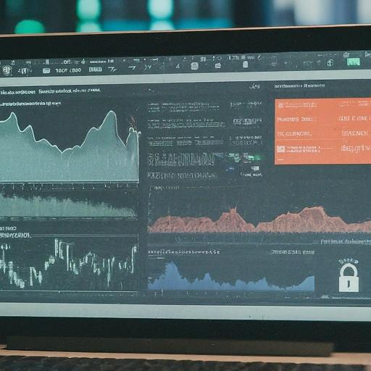
Tools for enhanced security
Packet Sniffers:
Network Traffic Analyzers (NTAs)
Security Information and Event Management (SIEM) Systems

Slide 9
Result
Network traffic security, achieved through network traffic analysis (NTA), is a vital aspect of overall cybersecurity.
It involves monitoring and analyzing the data flowing through your network to identify malicious activity, potential threats, and anomalies. Here's a breakdown of how network traffic analysis contributes to cybersecurity

Slide 10
Conclusion
network traffic analysis (NTA) serves as a powerful guardian in the realm of cybersecurity. By meticulously examining the data flowing through your network, NTA empowers you to proactively identify and combat potential threats.
It grants you improved threat visibility, facilitates faster incident response, and strengthens your overall security posture.

Slide 11
Future scope
The future of network traffic security in cybersecurity is brimming with exciting possibilities fueled by advancements in technology. The trends are,
Machine Learning (ML) and Artificial Intelligence (AI)
Automated Threat Hunting and Response
Integration with Security Fabric
Focus on User and Entity Behavior Analytics (UEBA)
Cloud-based Network Traffic Analysis (NTA)
Privacy-Preserving Network Traffic Analysis

Slide 12
References
"Applied Network Security Monitoring: Collection, Detection, and Analysis" by Chris Sanders, Jason Smith, and Mandiant
"The Practice of Network Security Monitoring: Understanding Incident Detection and Response" by Richard Bejtlich

Slide 13
THANK YOU

