Slide 1
Electronic Medical Record (EMR) Database System- Project 2
SR NO | STUDENT NAME | STUDENT ID
1 | Lavannya Patil | 801471484
2 | Yamini Buyya | 801482615
3 | Sriya Popuri | 801472588

Slide 2
EMR Enhancement Overview
Project 2 utilizes the Phase 1 EMR database and performs advanced features.
The main features of the project are security, access control, audit logging, and performance.
UML and ER diagrams have been updated to show the new tables and relationships.
It improves database reliability, maintainability, and real-world usability.

Slide 3
Schema Updates and New Additions
New tables introduced:
Roles, Permissions → define system-level access
User_Role, Role_Permission → link users to roles and permissions
Audit_Log → tracks system changes and user actions
Login_History → records login attempts and timestamps
Enhancements:
Added new foreign keys, constraints, and security relationships.
Improved normalization and consistency across entities.

Slide 4
Revised UML Model with Security Extensions
UML Model now includes user access components: Roles, Permissions, User_Role.
Logging components added: Audit_Log and Login_History.
Reflects separation between user management, security, and clinical data.
Clear mapping of entities used for authentication, authorization, and auditing.

Slide 5
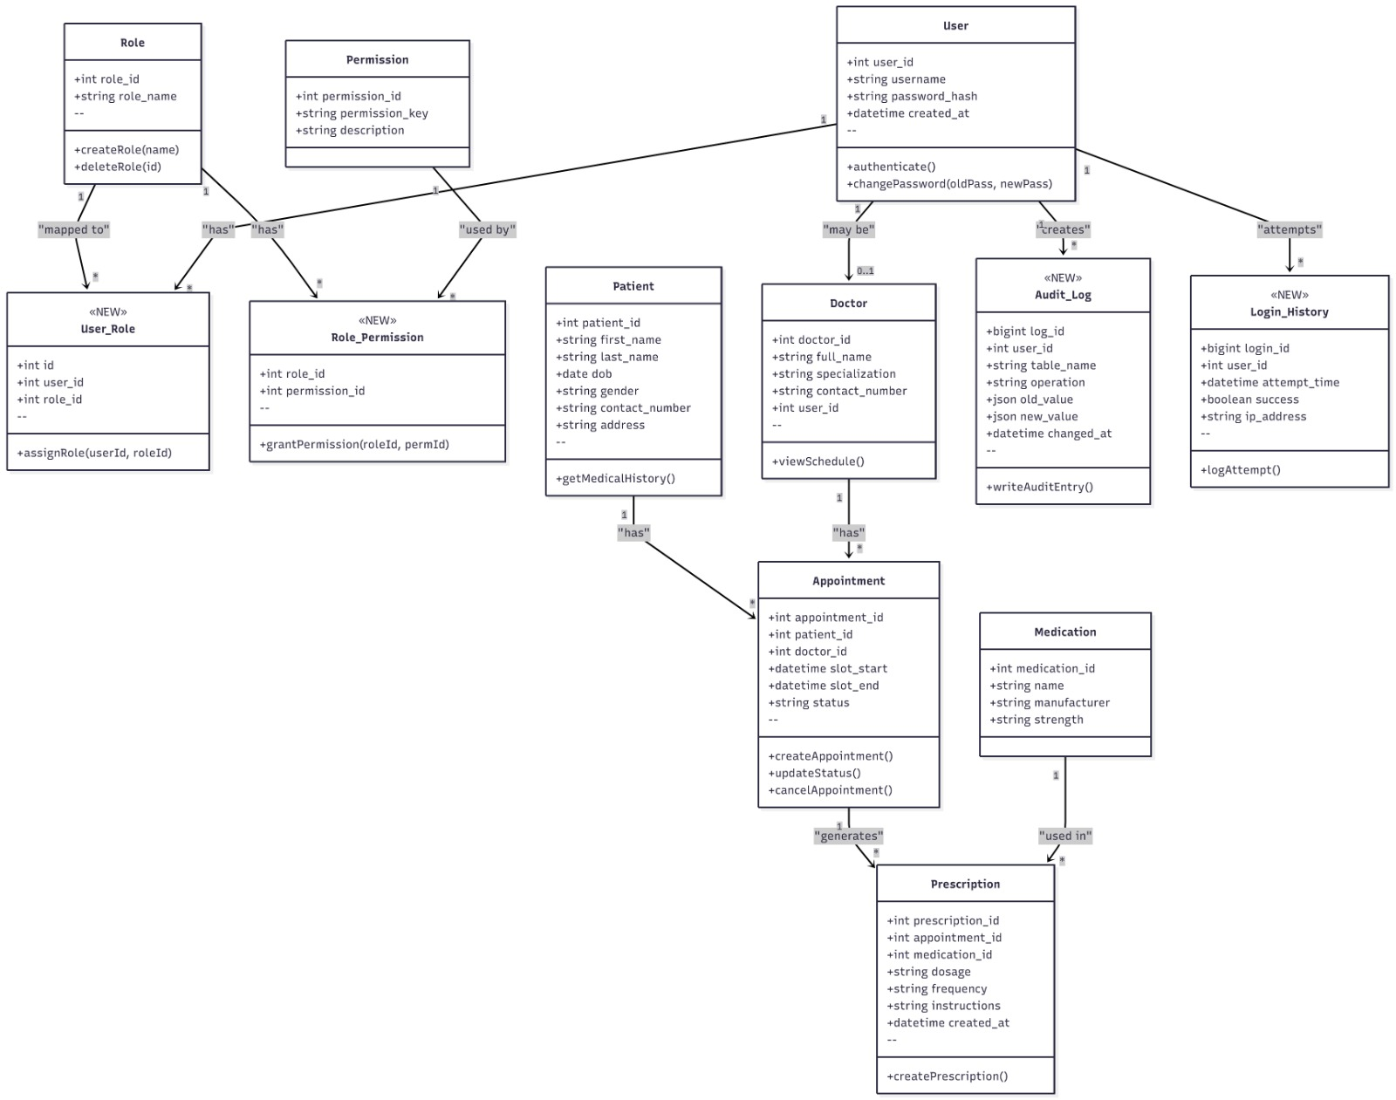

Slide 6
Enhanced ER Diagram with RBAC and Logging
New relationships added:
Users ↔ User_Role ↔ Roles
Roles ↔ Role_Permission ↔ Permissions
Users → Audit_Log (tracks user actions)
Users → Login_History (tracks login events)
Core entities remain connected: Patients, Doctors, Appointments, Prescriptions
Result: A more secure, fully traceable EMR database structure.

Slide 7
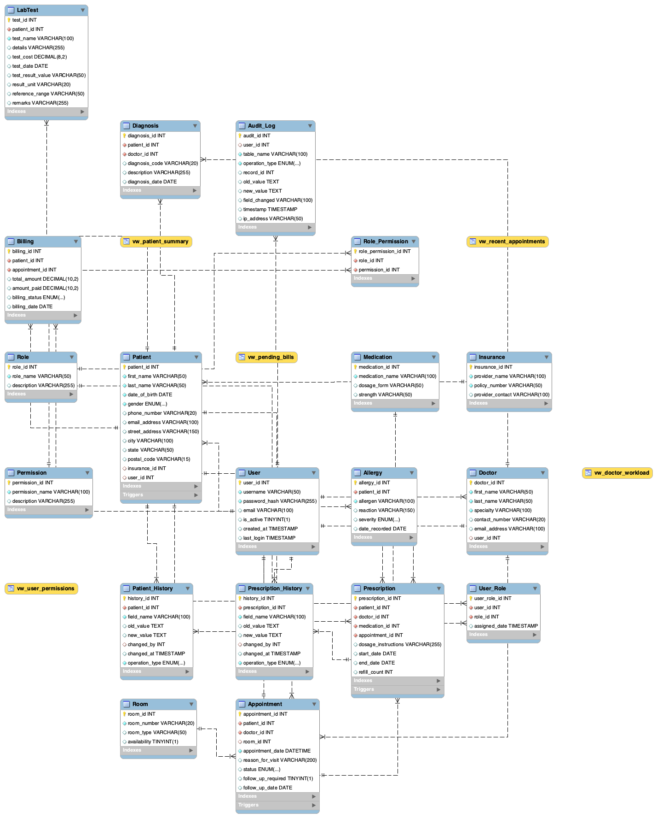

Slide 8
Stored Procedures Implemented in Project 2
Stored procedures created for:
Creating appointments
Authenticating users
Recording audit logs
Updating prescriptions
Managing user role assignments
Benefits:
More secure than inline SQL
Faster execution
Ensures consistent logic across the system

Slide 9
Secure User Authentication Framework
Implemented secure login using hashed passwords.
Login_History records successful and failed attempts.
API validates user identity before allowing access.
Supports system monitoring and detecting unusual activity.

Slide 10
RBAC Implementation and Access Governance
Users receive roles which indicate their system rights.
Roles decide the actions that can be performed (CRUD + system operations).
Some roles are: Admin, Doctor, Receptionist, Auditor.
It guarantees that only certain people can access the confidential medical information and that they have the right to do so.

Slide 11
Database Views for Secure and Simplified Access
Views added to simplify access:
vw_user_permissions — returns assigned roles + permissions per user
vw_doctorAppointments — summarized appointment lists
vw_patientSummary — safe patient details without sensitive info
Benefits:
Improves query readability
Supports security by limiting column exposure

Slide 12
Index Optimization for Performance Improvement
Indexes were created on:
Username (faster authentication lookups)
Appointment date (quicker scheduling queries)
Audit log user actions (faster log search)
Permission mappings (faster RBAC checks)
Impact:
Shorter query time
Better scalability
Improved system responsiveness

Slide 13
Audit Logging and Trigger Mechanisms
Triggers configured to track:
INSERT, UPDATE, DELETE operations
Automatically write audit entries
Capture user ID, timestamp, operation type, and table name
Purpose:
Provides accountability for all database activity
Meets healthcare compliance and security requirements

Slide 14
DEMO
healthcare-emr-system.vercel.app

Slide 15
Conclusion
The EMR system now has a strong, fully normalized database structure built in Project 1.
Core healthcare features such as patient records, appointments, prescriptions, lab tests, and billing were successfully implemented.
Project 2 enhanced the system with RBAC, secure authentication, audit logs, triggers, views, and indexes.
Together, both phases produced a secure, scalable, and fully auditable EMR database.
The final system is reliable, maintainable, and suitable for real-world healthcare use.

Slide 16

Thank you

