Slide 1


Slide 2
Group – 4 Members
Chinthapatla Lavanya
Vinneth M Raju
Indupalli Sasi Kiran
Ambika.B.A
Abhishek R Gowda

Slide 3
Project Overview :
Branch dashboard to discuss New and renewal business number with each branch. This dashboard will be discussed between Corporate team and Individual branch heads.
Discuss performance metrics in the branch.
Overall performance summary
Detailed branch performance
Key insights and action items
Summary of new, cross sell and renewal business numbers for the branch

Slide 4
Agenda
Project Overview
Data Description
KPI Analysis
Data Schema
Dashboard Designs
Key Metrics and key Insights
Challenges Faced
Recommendations
Conclusion

Slide 5
Data Description:
Brokerage : Contains Information about client policies,account exceutuive,income class,amount,renewal status
Fees : Contains data on client related income transcations,including revenue detail,transcation types
Budget : Details the budget allocations for branches and employees,including new roles,cross-sell initiatives and renewals
Invoice : Holds information about invoices generated,including transaction details and associated clients
Meetings :Tracks meetings managed by account executives,including branch associations and attendee detail
Oppurtunity : Documents details of oppurtunities managed by account executives,including revenue,stages,and risk information

Slide 6






Kpi Analysis
1- No of invoices By Acc. Exec
Cross Sell
New
2- Target ,Achieve & New
Renewal
3- Yearly meeting count
KPI
4 –Stage Funnel By Revenue
5- No of meetings by Acct Exec
6- Top Open Opportunity

Slide 7
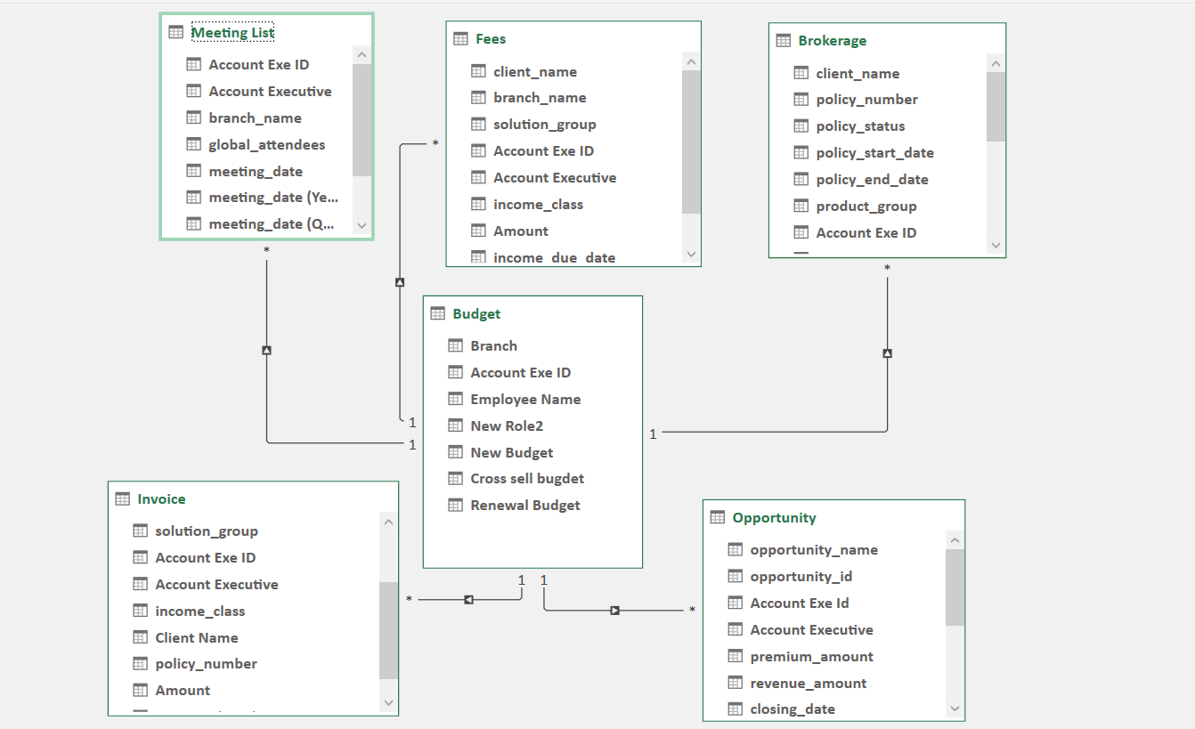
Data Schema :

Slide 8
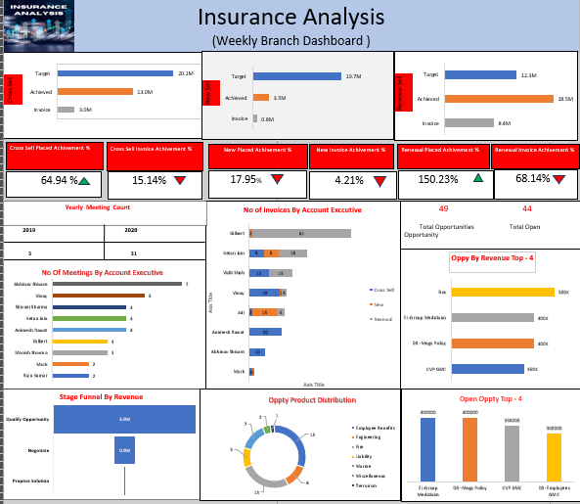
Excel DashBoard :

Slide 9
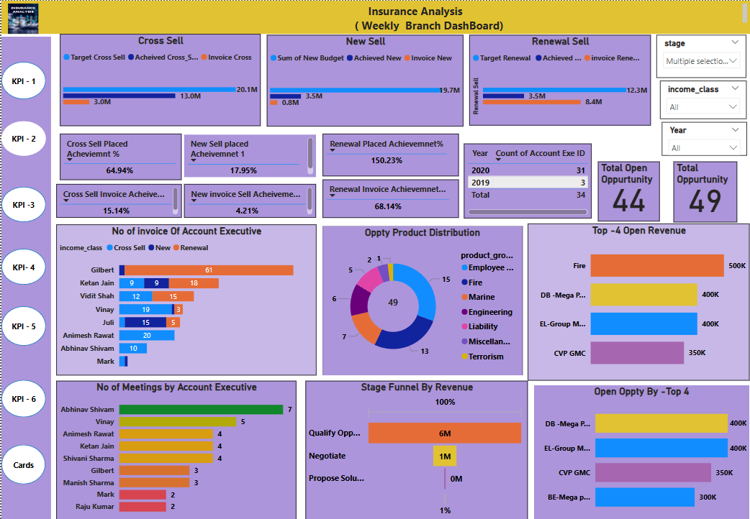
Power Bi

Slide 10
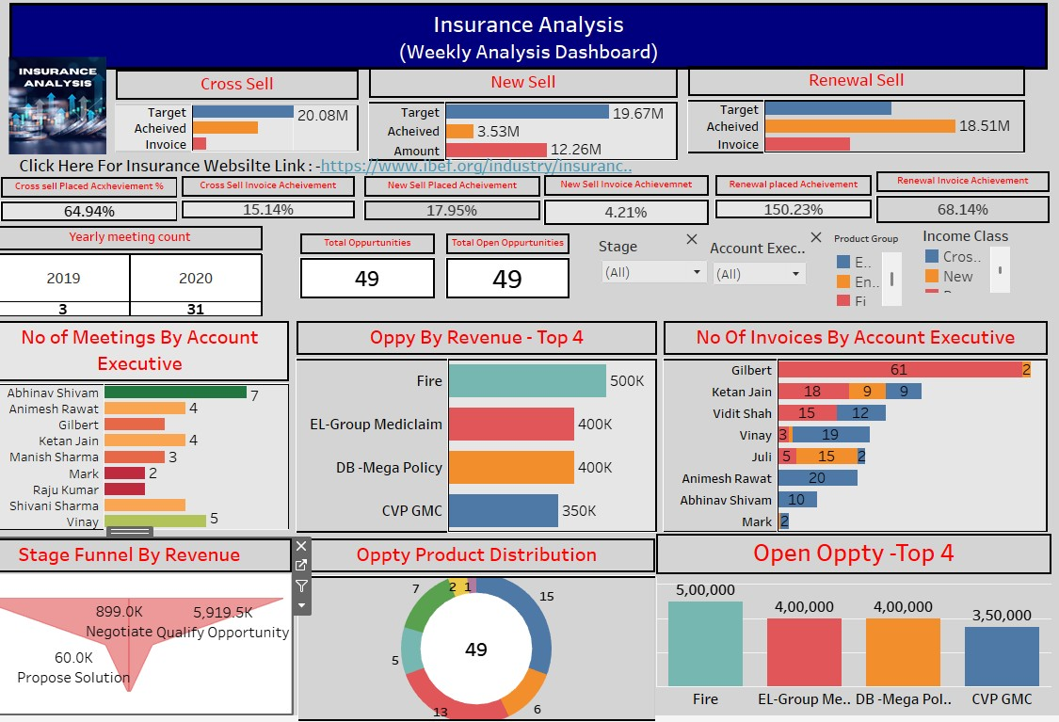
Tableau

Slide 11
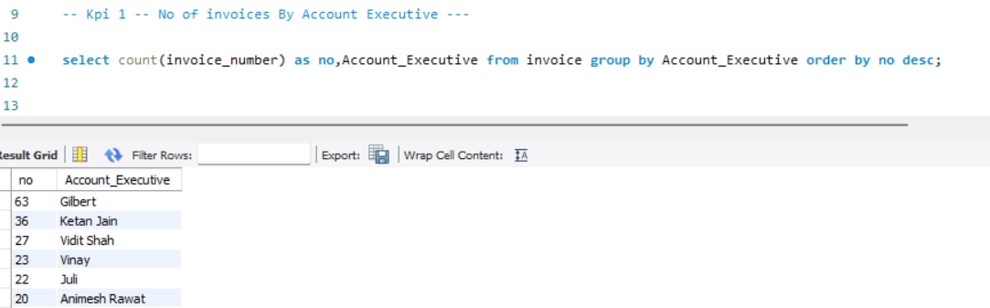
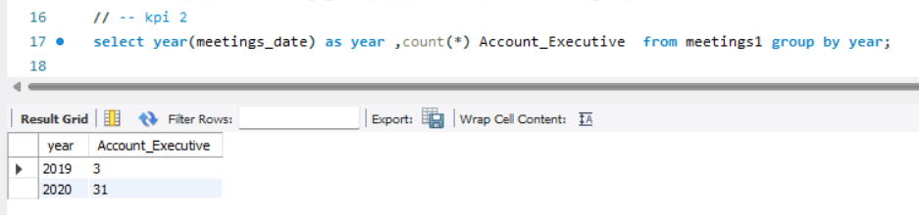
Sql Queries
Kpi 1 -No of Invoices By Account Executive
Kpi 2 – Yearly Meeting Count

Slide 12
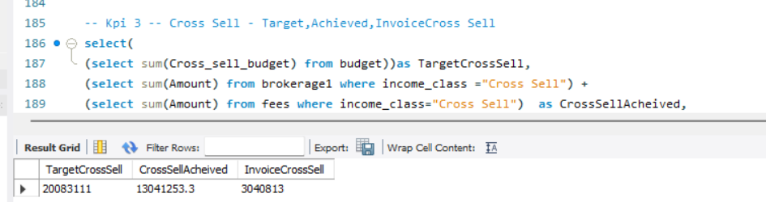
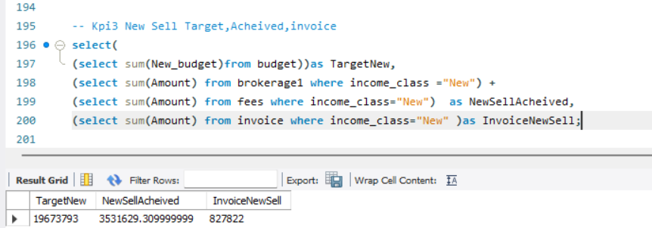
Kpi –3 – Cross Sell –Target,Achieved,Invoice Cross Sell
Kpi -3 _NewSell – Target ,Achieved,Invoice New Sell

Slide 13
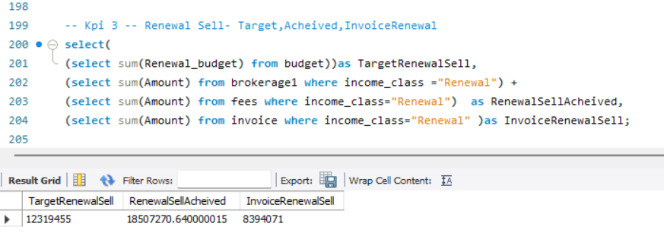
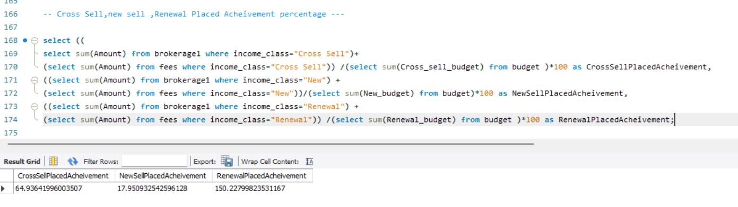
Kpi 3 – Renewal Sell –Target,Achieved,Invoice New
Kpi 3 – Cross Sell ,new Sell ,Renewal Placed Achievement percentage

Slide 14
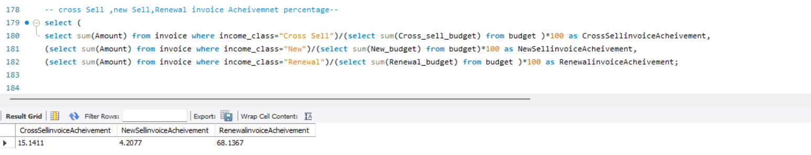
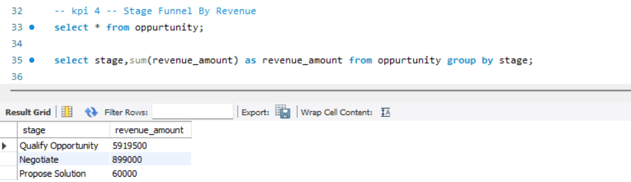
Kpi 3 – Cross Sell,New Sell ,Renewal Invoice Acheivement Percentage
Kpi 4 _ Stage Funnel By Revenue

Slide 15
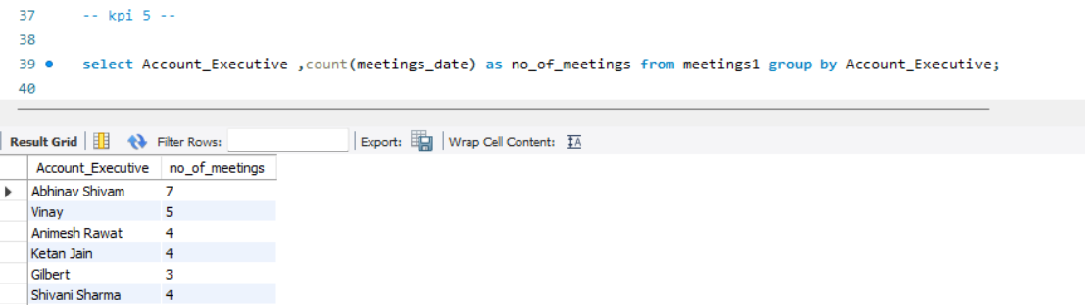
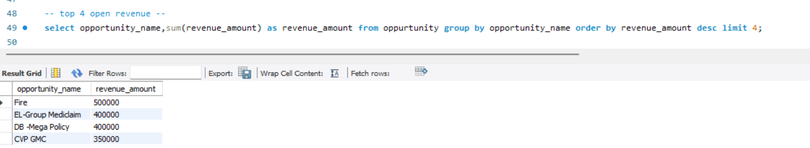
Kpi -5 No Of Meetings By Account Executive
Kpi – 6 Top Open Oppty By Revenue

Slide 16
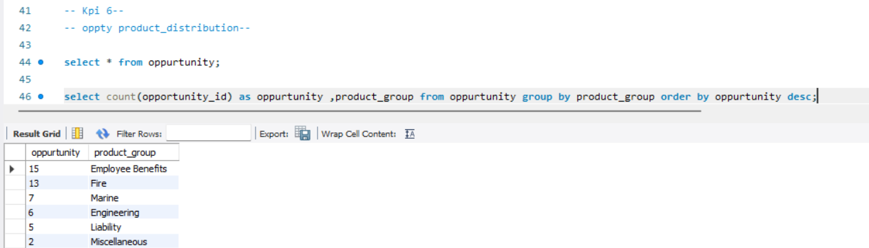
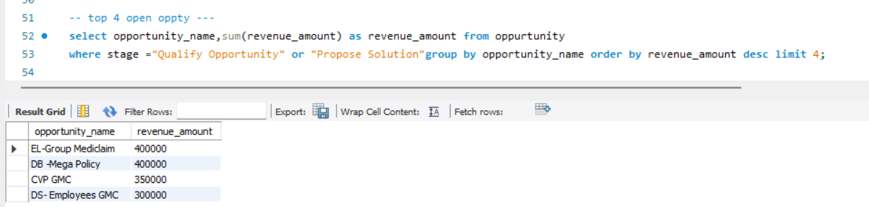
K[Kpi – 6 – Oppty by Product Distribution
Kpi 6 – Open Oppty Top 4

Slide 17
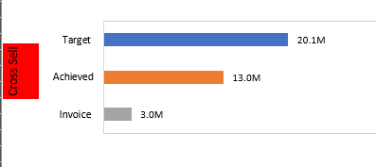
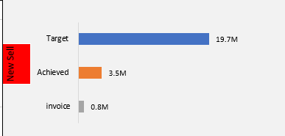
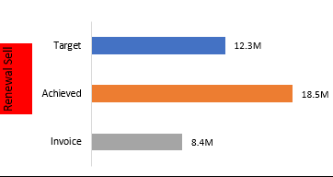
Key Metrics Visualized:
Cross-Sell Performance: Target 20.08M → Achieved 13.04M
New Business: Target 19.67M → Achieved 3.53M
Renewal Success: Target 12.32M → Achieved 18.51M (150.23% of target!)
Key Insights:
Renewal policies exceeded expectations, but cross-sell & new business need improvement.
Actionable Step: Strengthen new business & cross-sell strategy.

Slide 18
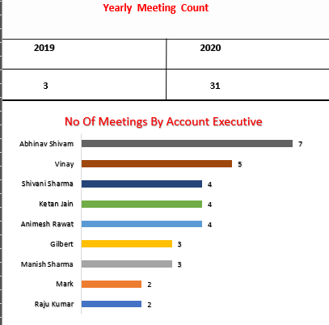
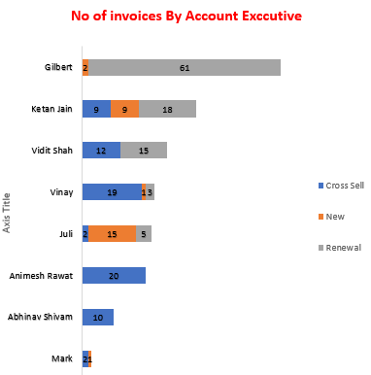
Key Metrics:
Meeting Count Growth: 2019 (3 meetings) → 2020 (31 meetings).
Top Performer (Meetings): Abhinav Shivam (7 meetings).
Top Performer (Invoices Processed): Gilbert (61 invoices).
Key Insights:
Employee engagement increased, leading to more opportunities.
Training underperformers based on top performers' strategies can boost results

Slide 19
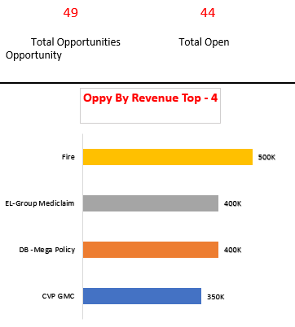
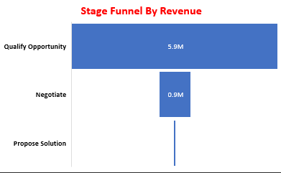
Revenue Breakdown:
Top Revenue Source: Fire Insurance ($500K)
Other High Revenue Policies: EL-Group Mediclaim ($400K), DB-Mega ($400K)
Opportunity Funnel:
Total Open Opportunities: 44
Stage-wise Funnel: 5.92M in initial stage, only 60K in proposed solutions
Key Takeaway:
High revenue potential exists but needs better deal closures.
Actionable Step: Focus on closing high-value policies in later funnel stages.

Slide 20
Challenges Faced :
Writing Complex DAX Functions in Power BI for calculations and aggregations.
Dealing with Null Values in Data Relationships, causing incorrect visualizations.
How We Overcame These Challenges:
For DAX Issues:
Broke down complex formulas into smaller steps for debugging.
Used CALCULATE, SUM,DIVIDE functions effectively.
For Null Value Problems:
Checked and cleaned data before importing

Slide 21
Recommendation:
Enhance Customer Service :
Implement Ai Driven chatbots for 24/7 customer support
Train staff on customer engagement and conflict resolution
Expand Product Offerings :
Introduce new insurance products tailored to emerging markets
Bundle products for better value to customers
Increase Sales and Retention:
Launch Personalized marketing campaings based on customer data
Introduce loyalty program to reward long term customers .
Market Analysis and adaption:
Conduct market research to identify customer needs and preferences
Adjust strategies based on competitive analysis and market trend
Employee Engagement :
Foster a positive work environment to boost employee morale.
Introduce employee recognition program to retain top talent
Enhance operational Efficiency:
Conduct regular training sessions for employees on new technologies
Team collaboration activities

Slide 22
Conclusion
This dashboard provides a clear and data-driven sales performance analysis for better decision-making.
The biggest challenge was optimizing data transforming into KPIs and creating them into dashboard.
Final Impact: Improved readability, real-time filtering, and better sales tracking.

Slide 23
Thank You

