Slide 1

AEGIS
Adaptive Engine for Guarding, Intelligence & Security
From suspicious events to actionable threats.

Slide 2
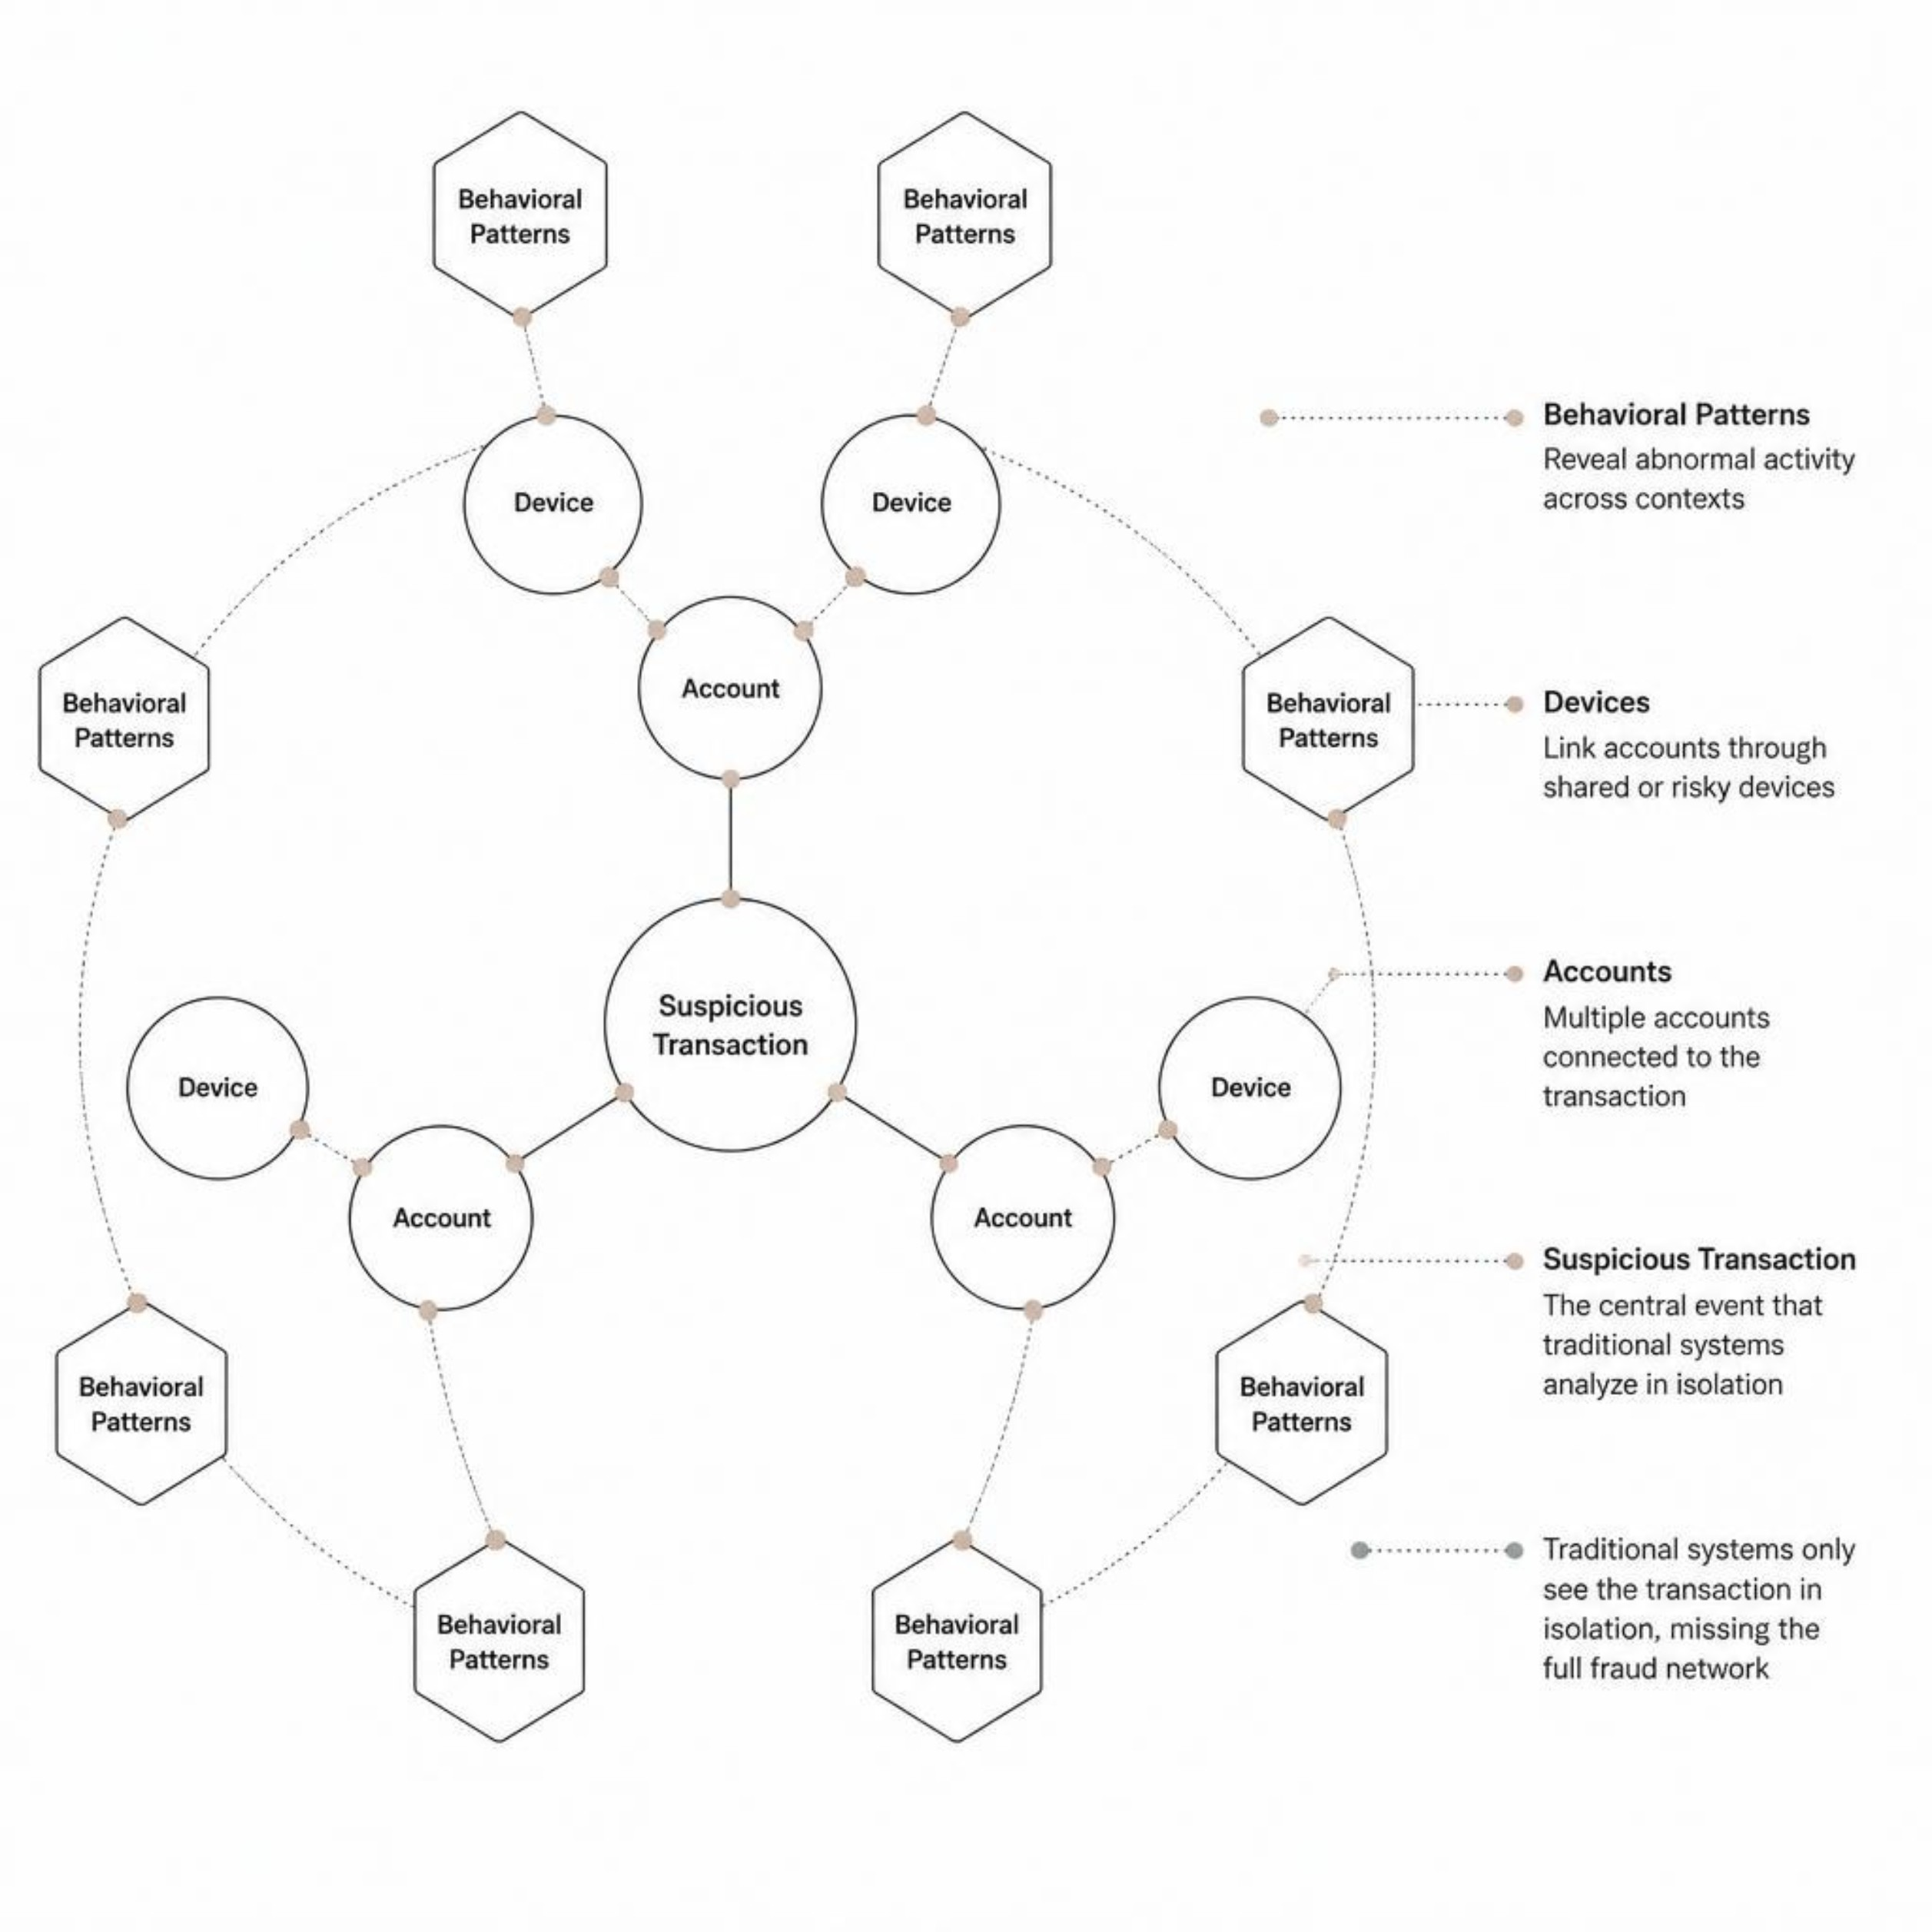
THE PROBLEM
Isolated Detection Misses Connected Threats
What's Missing
Transactions evaluated in silo
No cross-account correlation
Device & behavior signals ignored
Coordinated fraud goes undetected

Slide 3

THE SOLUTION
The AEGIS Pipeline
Data Layer
Risk Fusion
ML & ShadowNet
End-to-end threat intelligence — from raw transaction data to automated action in milliseconds.

Slide 4


Slide 5
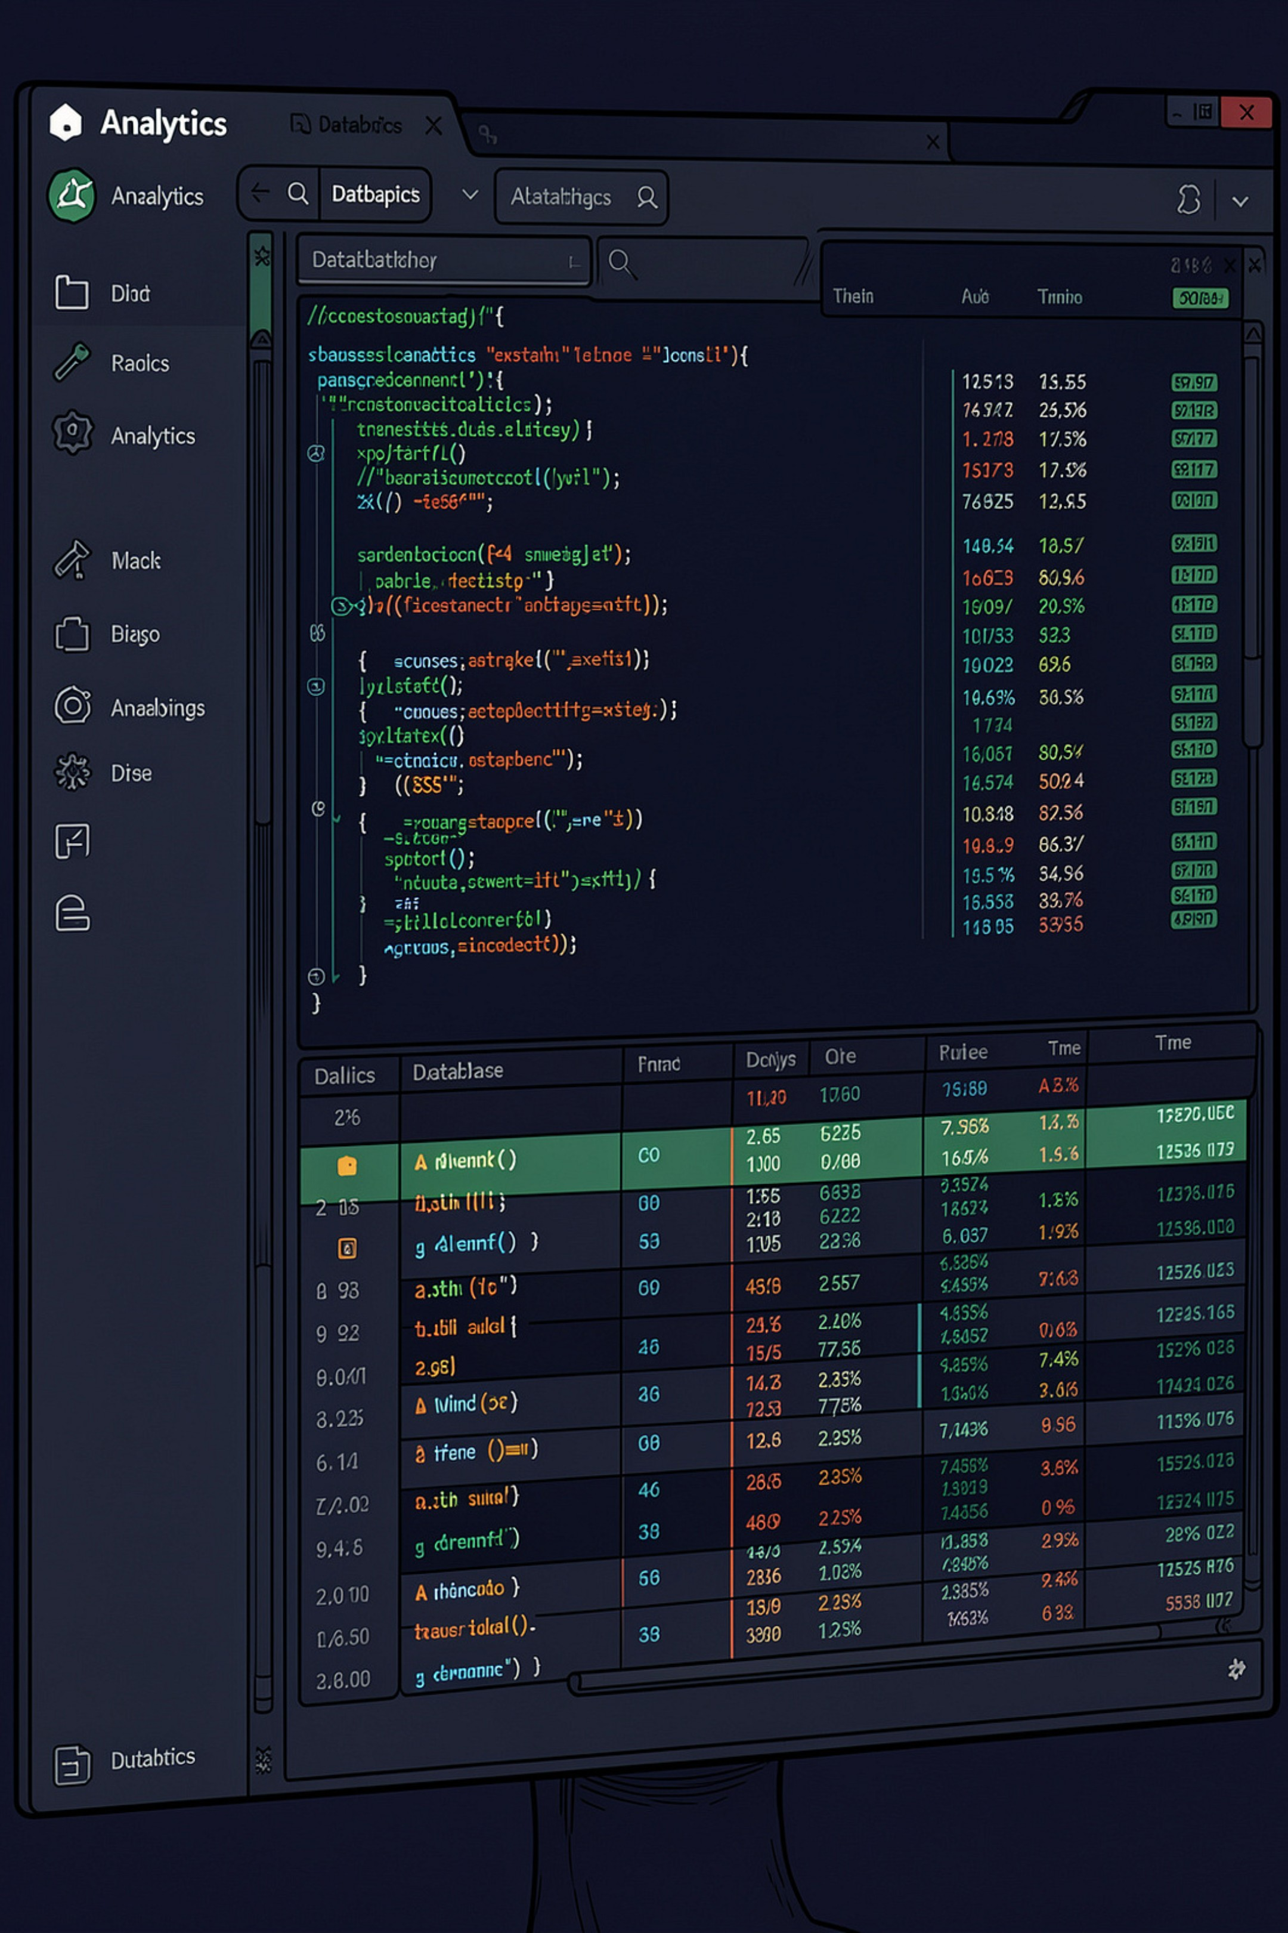
ANALYTICS LAYER
How Exasol Powers AEGIS
ACTIVITIES
THREAT_PATTERNS
Real-time transaction logs & user events
Historical fraud signatures & anomaly baselines
SANDBOX_LOGS
Behavioral telemetry from isolated environments
Exasol's in-memory MPP engine enables sub-second analytical queries across billions of events.

Slide 6
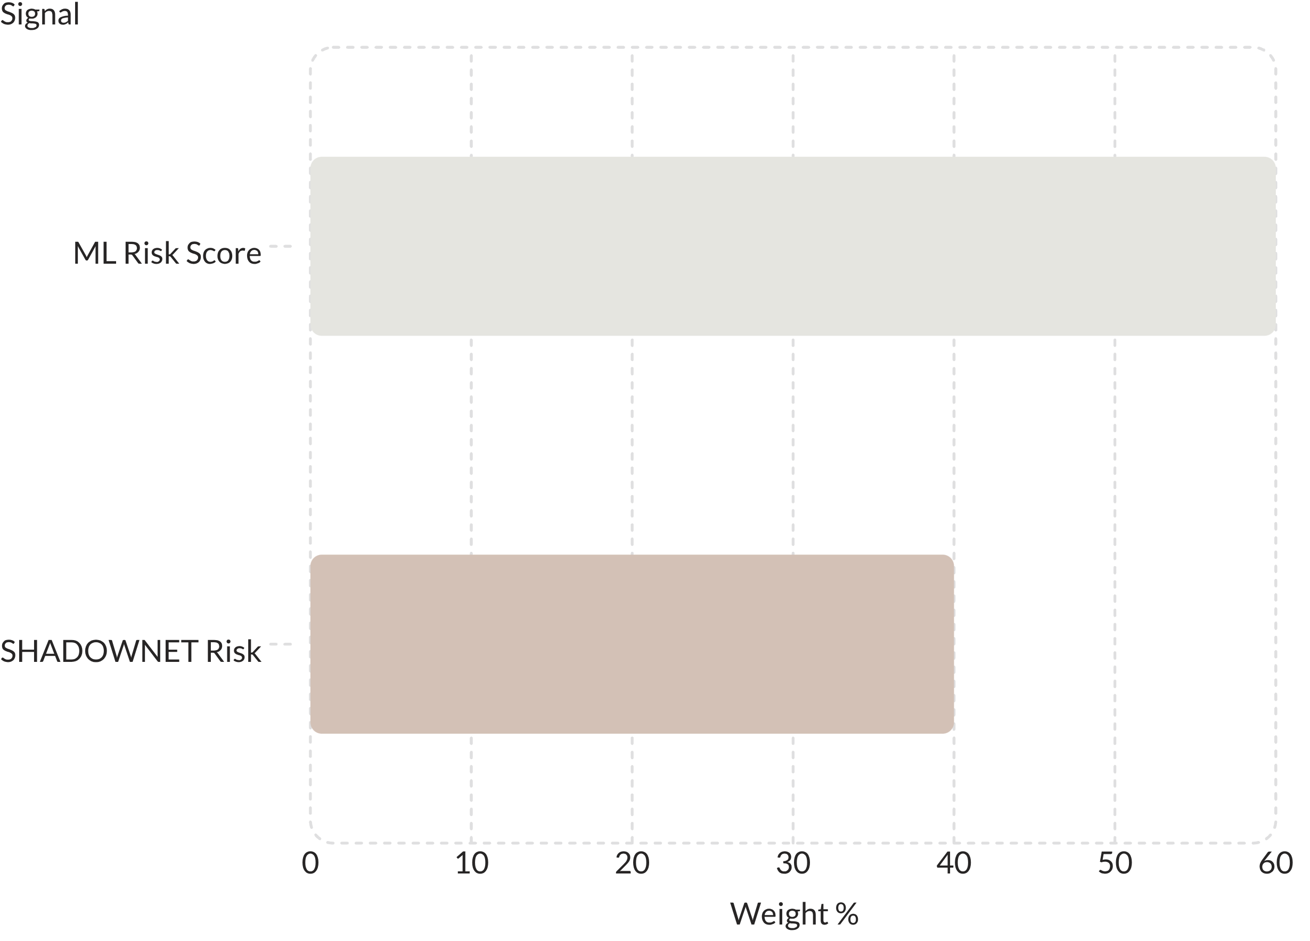
RISK INTELLIGENCE
AEGIS Risk Fusion Engine
Fusion → Action
✅ Allow
🔍 Monitor
Score < 20
Score 20–40
⚠️ Review
🚫 Block
Score 40–70
Score > 70

Slide 7
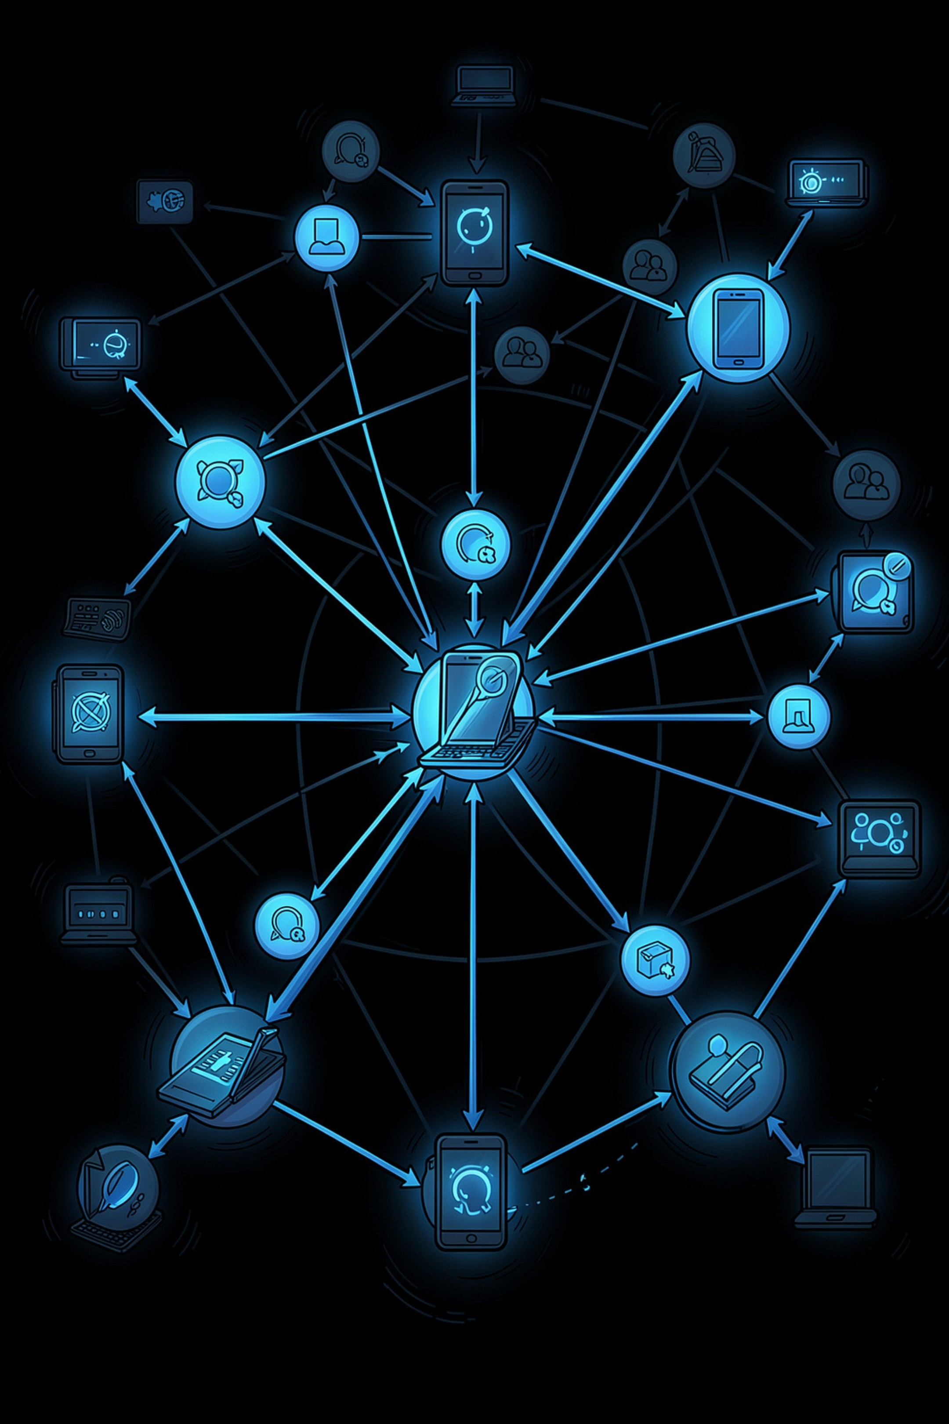
SHADOWNET
Network Graph Investigation
🔗 Account Clusters
🖥️ Device Fingerprinting
Linked accounts sharing devices, IPs, or behaviors
Cross-account device reuse = fraud signal
💸 Transaction Chains
Money flow patterns across the network

Slide 8
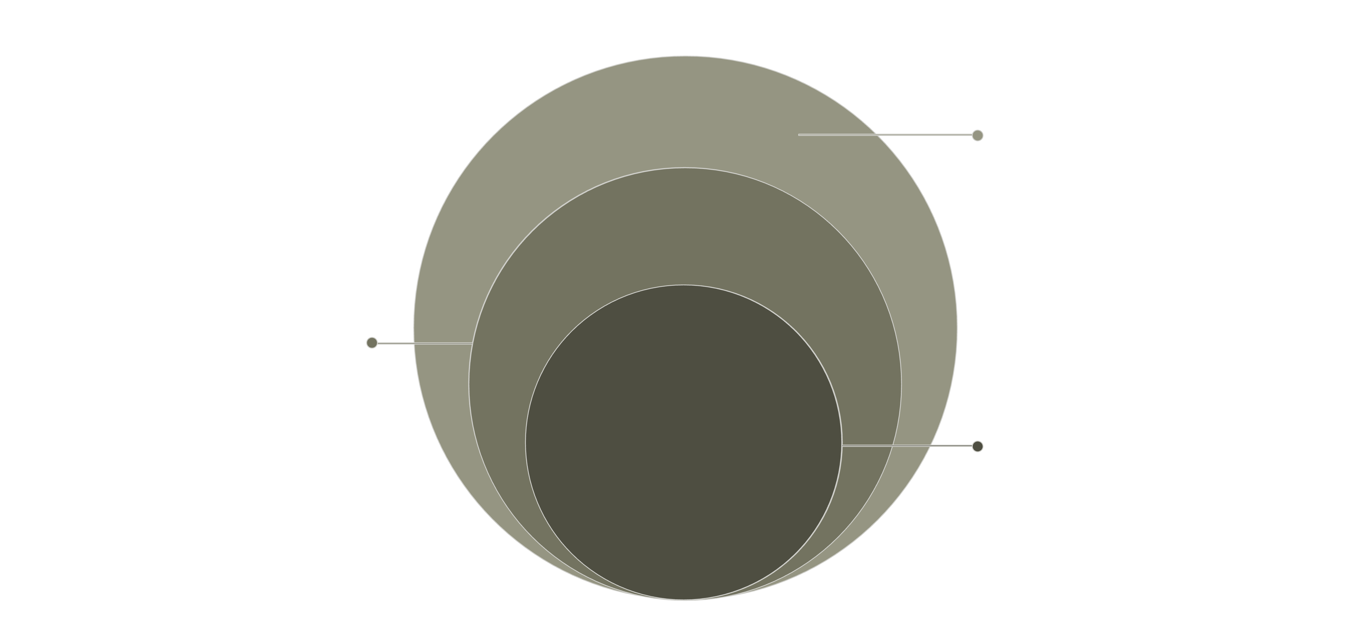
ARCHITECTURE
Full Stack Architecture
API & UI
Flask orchestration and React dashboard
ML & Analytics
Risk scoring and analytics (ML + Exasol)
Final Decision
Allow / Review / Block outcomes
Lightweight API layer connects real-time UI to heavy ML and analytics backends with minimal latency.

Slide 9




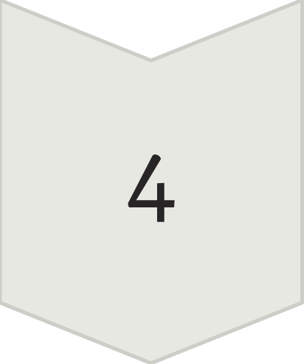
IMPACT
From Event to Action
EVENT
Raw transaction ingested
CONTEXT
Network & behavior enriched
PREDICTION
ML + SHADOWNET fused
ACTION
Automated response triggered
GitHub: https://github.com/Lavanya-Vaidya/Exasol
Demo: https://drive.google.com/file/d/1WpnuUuCr9cKryRO1KakOo7IsnMcWY2WG/view

