Slide 1
Football Analytics: Uncovering Patterns in Players, Teams, and Referees
Name: Lavanya E
Enrollment Number: EN12025087237
Batch code: 5029
Mentor : Munna Pandey

Slide 2
Introduction
Data Overview
Football is a game of skill, strategy, and performance. This project analyzes players, teams, team comparison, profile and market value and referees using historical match data to uncover patterns and insights that influence match outcomes. The goal is to provide data-driven understanding for better performance and decision-making.
Total Players:4654
Season of the game: 2012 to 2020
No.of Stadium:3268
No.of Player’s Agents:107
No.of Games:1582
Data sources:
game_events.xlsx, game_lineups.xlsx, games.xlsx, players.xlsx, appearances.xlsx.
Data Preprocessing
All source files were combined using Inner and Left Joins to create a unified dataset. Missing values were identified and treated appropriately, while outliers in numerical features were detected and handled. After preprocessing, the final dataset consisted of 3,809 rows and 36 columns ready for analysis.

Slide 3
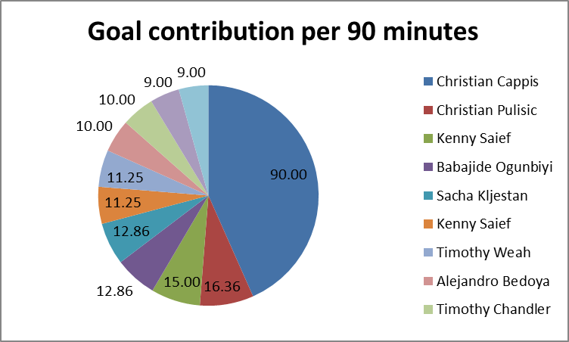
Performance Analysis
Business Objective question
Tool: EXCEL
Which players have the highest goal contribution per 90 minutes?
How do yellow/red cards correlate with performance?
What is the probability distribution of goals per match?
Christian Cappis, Christian Pulisic, and Kenny Saief are the most effective players in goal contribution per 90 minutes. Yellow/red cards have almost no impact on performance. Most matches have 2–3 goals, while very low- or high-scoring matches are rare. These insights help understand player efficiency, discipline impact, and overall match scoring trends.
Click here
Notes:
For go to excel sheet -> use click here

Slide 4
Business Objective question
Player Profile
Do minutes played and competition type influence the number of goals/assists?
Which players perform better in home vs away matches?
Who are the top scorers and assist providers across competitions?
Tool: SQL
Players generally become more productive as the match progresses, with most goals and assists occurring in the later stages (61–90 and 91–120 minutes).
Domestic competitions generate the highest contributions, while international and other competitions are less consistent. This indicates that players adapt their performance depending on competition type.
.
Player performance is consistent in home and away matches, showing reliability regardless of match location.·
Top performers, such as Aron Johannsson (highest scorer) and Christian Pulisic (balanced goal and assist contribution), drive team success and can be relied upon for strategic offensive plays.
Click here
Click here
Click here

Slide 5
Query 1 result
Query 3 result
minutes_bucket | competition_type | avg_goal_assists
0-30 | domestic_cup | 0.1951
0-30 | domestic_league | 0.0739
0-30 | international_cup | 0.1579
0-30 | other | 0
31-60 | domestic_cup | 0.2813
31-60 | domestic_league | 0.1875
31-60 | international_cup | 0.0476
61-90 | domestic_cup | 0.4277
61-90 | domestic_league | 0.245
61-90 | international_cup | 0.2174
61-90 | other | 0.75
91-120 | domestic_cup | 0.6667
91-120 | international_cup | 1
player_id_x | player_name_x | away_contribution_per_90
119169 | Aron Johannsson | 1.1594
39378 | Jozy Altidore | 1.0678
537467 | Joseph Efford | 1.0651
315762 | Luca de la Torre | 1.0588
504215 | Giovanni Reyna | 1.0506
483047 | Seyi Adekoya | 0.8571
370846 | Timothy Weah | 0.7991
542776 | Jonathan Amon | 0.7054
27577 | Clint Dempsey | 0.6988
355369 | Jordan | 0.6931
Query 2 result
player_id_x | player_name_x | home_contribution_per_90 | away_contribution_per_90
119169 | Aron Johannsson | 1.1594 | 1.1594
39378 | Jozy Altidore | 1.0678 | 1.0678
537467 | Joseph Efford | 1.0651 | 1.0651
315762 | Luca de la Torre | 1.0588 | 1.0588
504215 | Giovanni Reyna | 1.0506 | 1.0506
483047 | Seyi Adekoya | 0.8571 | 0.8571
370846 | Timothy Weah | 0.7991 | 0.7991
542776 | Jonathan Amon | 0.7054 | 0.7054
27577 | Clint Dempsey | 0.6988 | 0.6988
355369 | Jordan | 0.6931 | 0.6931

Slide 6
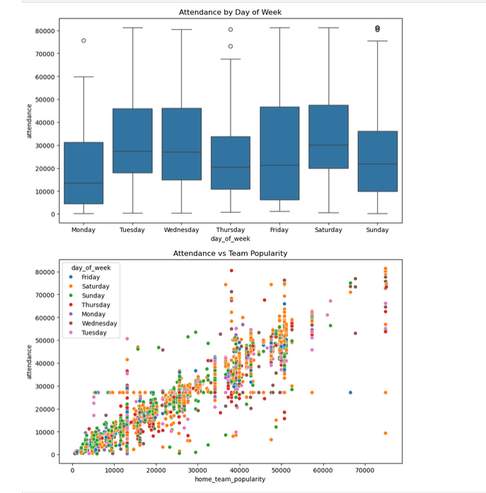
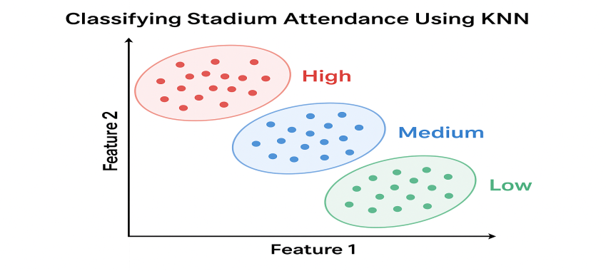
Attendance & Stadium Analysis
What factors influence stadium attendance (team popularity, day of week)?
Can we classify stadiums into high/medium/low attendance using KNN?
Which stadiums host the highest scoring games?
Business Objective question
Tool: Python
Attendance increases with the home team’s popularity, regardless of the day of the week. However, weekend matches (especially Saturday) tend to have higher or more variable attendance than weekday matches, indicating that both team popularity and scheduling affect crowd size.
Top 10 stadiums by average goals per game show that Hermann-Neuberger-Stadion, MDCC-Arena, Hacker Wiehenstadion, Erzgebirgsstadion, Jahnstadion Regensburg, and Vodafone Park lead with 8.5 goals per game..
We applied KNN to classify stadiums into High, Medium, and Low attendance based on match features.
The model achieved 88% overall accuracy, performing best on High and Low attendance stadiums.
Medium attendance stadiums are sometimes misclassified, likely due to overlapping features.
This analysis helps identify stadiums likely to attract large or small crowds, useful for planning, ticketing, and staffing

Slide 7
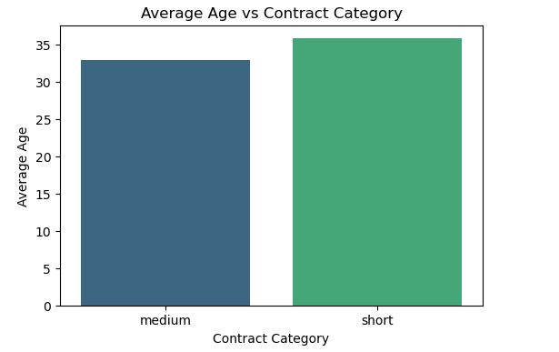
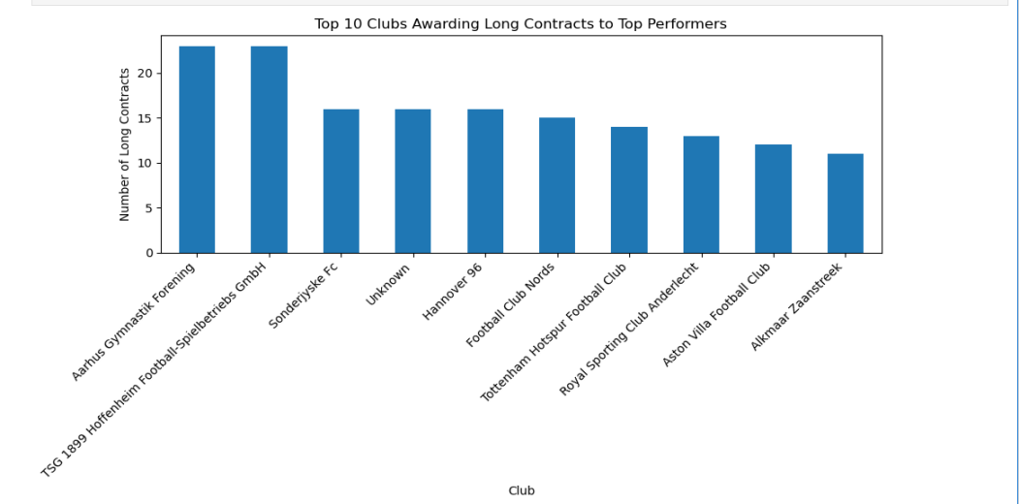
Contract Management
Business objective questions
TOOL: Python
What is the average contract length for top-performing players?
Which clubs tend to give the longest contracts for top-performing players?
Do players with more yellow/red cards receive shorter contracts?
We trained a model to predict contract length from age and other factors.
The model achieved 100% accuracy, indicating a very clear pattern.
Younger players are much more likely to receive medium/long contracts, while older players get short-term deals.
Clubs like Aarhus Gymnastik Forening and TSG 1899 Hoffenheim top the list for awarding the most long contracts to high-performing players.
Overall, a handful of clubs dominate long-term deals, showing a stronger commitment to retaining top talent compared to others
Yellow cards: Players in different contract categories show a significant difference in yellow cards (p < 0.001), suggesting disciplinary record affects contract length.
Red cards: No significant difference across contract categories (p > 0.05), so red cards don’t seem to influence contract length.

Slide 8
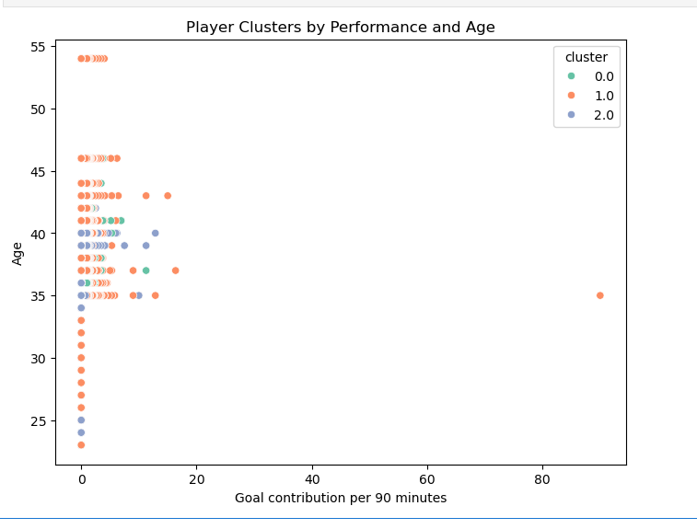
Player Attributes & Demographics
Business Objectiv Questions
Tool: Python
Can we cluster players by performance and demographic attributes using K-Means?
Do younger players outperform older players in certain metrics?
We successfully segmented the players into three distinct groups based on age and goal contribution per 90 minutes.
The analysis reveals a large cluster of low-performing players across many ages, a smaller cluster of moderate performers, and a tiny cluster of very high performers (outliers).
This clustering can be used to target different contract, training or scouting strategies for each group instead of treating all players alike.
This suggests that, in this sample, older players are making more concentrated contributions per match, while younger players are contributing more in raw counts but less per 90 minutes.
Age group | Goal contrib./90 | Goals | Assists
Young | 0 | 0.17 | 0.14
Mid | 0 | 0.16 | 0.09
Older | 0.47 | 0.15 | 0.07

Slide 9
Substitution Patterns
Business objective questions
At what time are most substitutions made?
Which players are substituted most frequently?
Are some teams more aggressive in substitutions than others?
Tool: Excel
Most substitutions occur between the 64th and 79th minute, with the next highest in the 80th–95th minute, and very few in the first 30 minutes or after the 96th minute.
Fabian Johnson and Christian Pulisic are substituted most frequently, around 59 times each.
Substitution patterns indicate strategic timing in later stages of matches, highlighting key players who are rotated regularly.
In type_x column filter only substitution. then using pivot . Separately doing pivot for home and away club teams. comparing both team,finally away club teams are more aggressive

Slide 10
Referee Analysis
Business Objective questions
Which referees issue the most yellow/red cards?
Do referees favor home or away teams in fouls or cards?
Is there a significant difference between referees’ decisions across leagues?
Tool: SQL
Row Labels | Count of referee | Sum of total_yellow_cards | Sum of total_red_cards
domestic_cup | 118 | 37 | 1
domestic_league | 264 | 433 | 11
international_cup | 115 | 47 | 0
other | 8 | 1 | 0
Top card issuers: Felix Zwayer (16Y /1R), Guido Winkmann (13Y /0R), Felix Brych (12Y /0R)
Red cards are rare, mostly 0–1 per referee.
We analyzed fouls and cards given by referees to home and away teams.
The data shows nearly identical counts for both sides, indicating no systematic favoritism.
Any differences are minor and within normal match variation.
Domestic leagues → most referees, highest card counts → high intensity.
International cups → fewer cards → possibly less aggressive or stricter enforcement

Slide 11
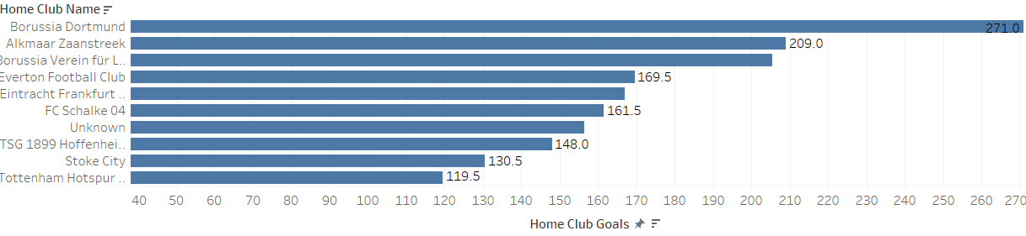
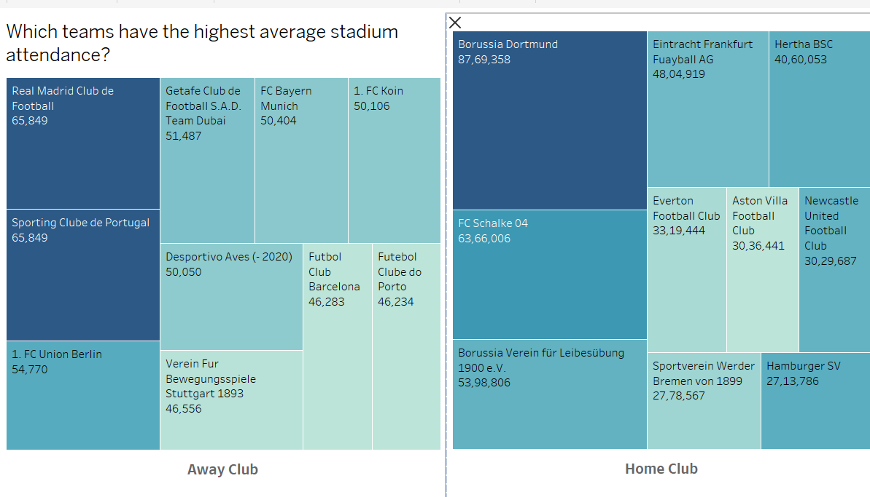
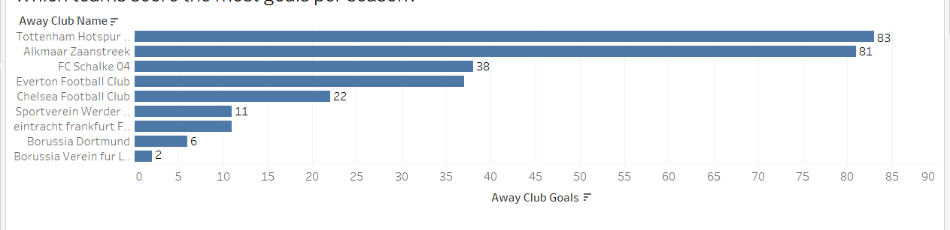
Team Comparison
Tool:Tableu
Business objective questions
Home club teams have a
Higher attendance compared to Away club teams.
As well as home club teams are score more goals.
Which teams have the highest average stadium attendance?
Which teams score the most goals per season?

Slide 12
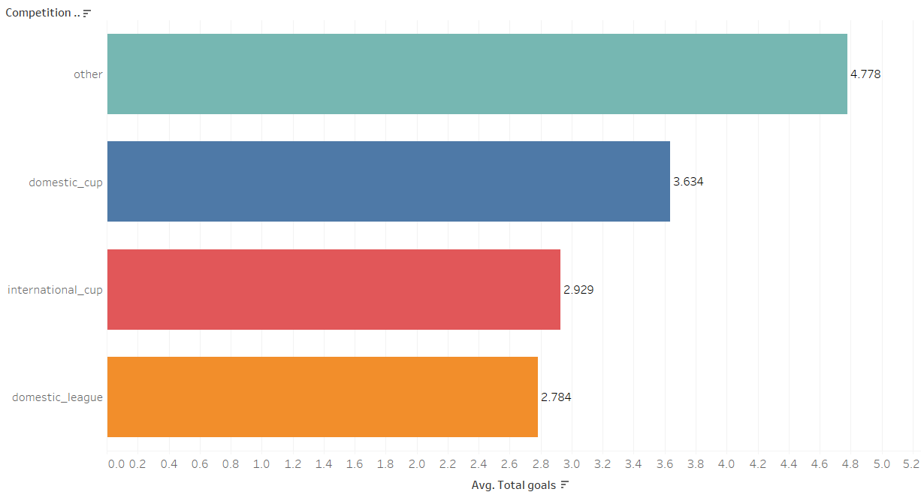
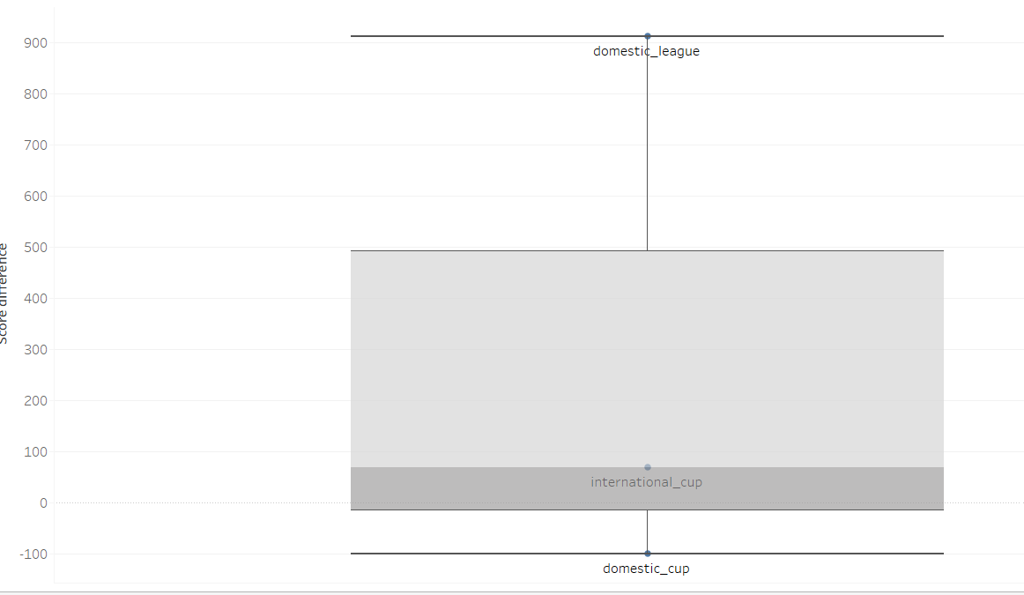
Competition Analysis
Business Objective questions
Tool: Tableau
Which competitions have the highest average goals per match?
Are international competitions more competitive (closer scorelines) than domestic leagues?
Do competitions have seasonal trends (more goals or fouls in
first/second half of the season)?
Other category competitions have the highest avg goals per match.
Then International cup competitions are more competitive than domestic league.
Yes, every two years all competitiors have the highest goals.

Slide 13
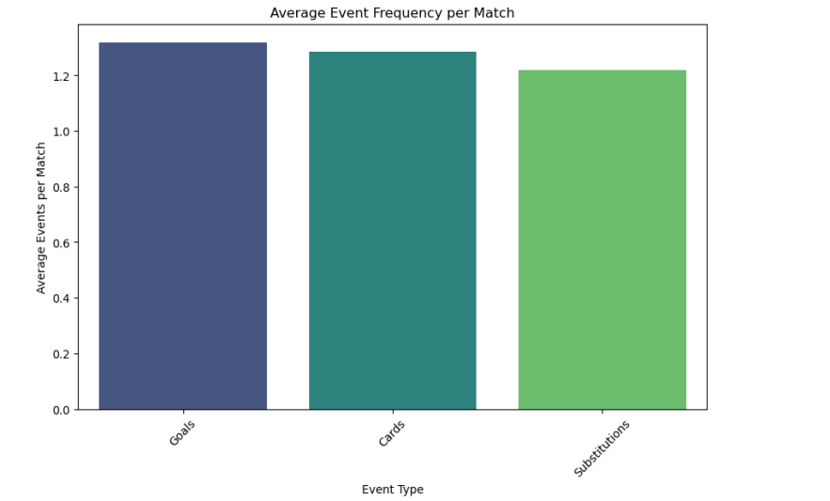
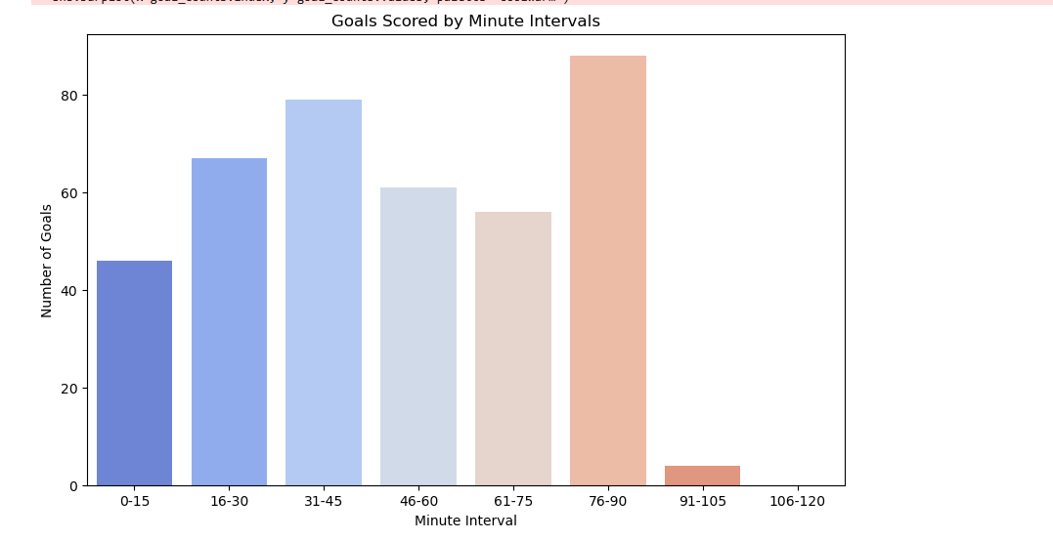
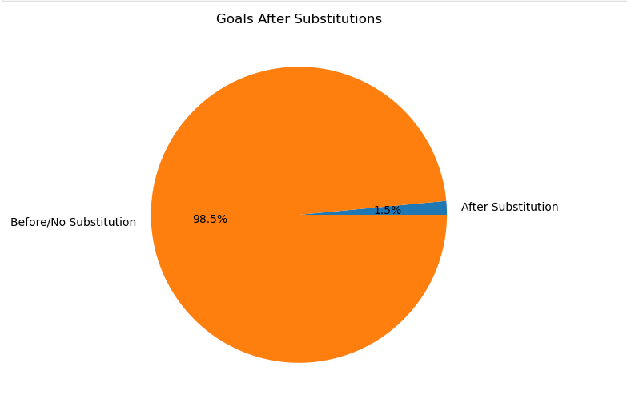
Event analysis
Bussiness objective questions
Tool: Python
Which event types occur most frequently per match?
Are more goals scored after substitutions?
Which minutes of the match have the most goals?
Goals event types occur most frequently .
76-90 minutes have the highest goals.
Before substitutions players scored more goals

Slide 14
Thank you

