Slide 1
Hello I’m

Slide 2
Topic 1
End to End Project: Video anomaly detection

Slide 3
Problem Statement
How to detect video anomaly from videos using Vision based techniques ?

Slide 4
Objective
Problem & Safety Risks
Core Objective & Use-Cases
Manual CCTV review is expensive and fatigue-prone, with one analyst monitoring eight cameras.
Missed anomalous events create significant safety and liability risks.
Flag anomalous frames in near-real-time to reduce analyst workload by approximately 80%.
Key use-cases: crowd surges, foreign object intrusion, loitering, and unattended bags.
78%
< 2s
< 8%
< 5ms
0.6428
Review Load Reduction
Substantial 78% reduction in overall analyst review load
Alert Latency
Mean time to alert under two seconds for rapid response
False Alarm Rate
Maintains a false alarm rate strictly below 8%
Inference / Frame
Inference cost under 5 milliseconds per frame
AUC-ROC Score
Benchmark AUC-ROC score achieved across evaluation sets

Slide 5
UCSD Pedestrian Dataset (Ped2)
Dataset Sources & Frame Volume
Source Video: Real outdoor CCTV surveillance footage recorded at 10 frames per second.
Training Set: 16 training clips featuring normal behavior (2,550 normal training frames).
Test Set: 12 test clips containing normal behavior alongside anomalies.
Test Volume: Total of 2,010 test frames, of which 82.0% contain anomalies (bicyclists, skaters, and carts).
Preprocessing & Evaluation Setup
Frame Properties: Raw grayscale video frames resized to 128x192.
Learning Paradigm: Semi-supervised approach utilizing pixel-level ground-truth masks for test frames.
Anomaly Threshold: Established at the 95th percentile of training reconstruction errors.
Threshold Value: Fixed precisely at 0.000734.

Slide 6
Video Anomaly Detection Pipeline
STEP 01
STEP 02
STEP 03
STEP 04
STEP 05
Frame Ingestion
Ingest raw video frames continuously from the source stream.
Preprocessing
Extract frames as grayscale, resize to 128x192, and normalize between 0 and 1.
ConvAE Inference
Convolutional AutoEncoder performs GPU inference to reconstruct frame.
MSE Calculation
Calculate pixel-wise Mean Squared Error (MSE) for the frame reconstruction.
Threshold Flagging
Flag frames with MSE exceeding the 95th percentile of training errors.
Core Insight
High reconstruction error indicates the scene deviates from the learned normal distribution, failing to reconstruct unseen anomalies.

Slide 7
Convolutional AutoEncoder Baseline
Architecture Specifications
UNSUPERVISED ONE-CLASS MODEL
Input Resolution: 128x192 frames
Encoder: 4 convolutional layers using Stride-2, BatchNorm, and LeakyReLU
Bottleneck Layer: 16x24x128 feature map
Decoder: Mirrored structure reconstructing the original input frame
Total Parameters: 257,761 trainable parameters
Loss Function: Pixel-wise MSE loss (no anomaly labels required)
Training Parameters
Hardware: RTX 4050 Laptop GPU
Training Time: 143 seconds (30 epochs)
Batch Size & Optimizer: Size 64 with Adam
Learning Rate: CosineAnnealingLR
Modeling Rationale
Prioritized establishing a lightweight, domain-specific baseline before evaluating computationally expensive architectures like PatchCore or DRAEM.

Slide 8
Model Training & Loss Convergence
TRAINING HARDWARE & TIME
143 Seconds Total (RTX 4050 GPU)
CONVERGENCE DURATION
30 Epochs (Rapid Stabilization)
EPOCH 1
0.007710
Initial Loss
Training Start
EPOCH 5
0.000925
Significant Drop
Rapid Decline
EPOCH 15
0.000447
Continued Loss Reduction
Fine-Tuning
EPOCH 30
0.000367
Stabilized Loss
FINAL BASELINE
RECONSTRUCTION OUTCOME
As a result of this training process, the model successfully learns to reconstruct normal pedestrian walkway scenes with a highly consistent Mean Squared Error of approximately 0.000367, establishing a strong baseline for normal behavior.

Slide 9


Visual & Pixel-Wise Error Heatmap Analysis
1. Raw Input Frame
2. ConvAE Reconstruction
3. Pixel-wise Error Heatmap
NORMAL FRAME
FRAME #0241
LOW / UNIFORM ERROR
ACCURATE
MSE Score: 0.012 (Below Threshold)
For normal frames, the reconstruction is nearly identical to the original, resulting in a low, uniform error distribution across the heatmap.
ANOMALY FRAME
FRAME #0582
RECON FAILURE
HOTSPOT DETECTED
BICYCLE
Unseen
Blur
MSE Score: 0.185 (SPIKE > THRESHOLD)
Conversely, anomaly frames reveal bright hotspots in the error map exactly where unexpected objects (e.g., bicycle or skater) appear.
Detection Mechanism: Because the model cannot reconstruct unseen objects, the Mean Squared Error (MSE) score spikes above the established threshold, successfully flagging the frame as anomalous.

Slide 10




Example Anomaly Score Timeline
Scope & Data Size
2,010 Test Frames across 12 Clips
Target Metric
Per-Frame Reconstruction MSE
Detection Threshold
Fixed Cutoff = 0.000734
Bicyclists
Skaters
Wheelchairs
Carts
0.0015
0.0010
Reconstruction MSE
0.0005
0.0000
0
500
1000
1500
2010
Frame Index (Pedestrian Walkway Test Clips)
Ground-Truth Anomaly Window
Per-Frame Reconstruction MSE
Detection Threshold (0.000734) — High Responsiveness

Slide 11

Detection Interface & Visual Layout
CAM_01 • RAW SURVEILLANCE FRAME
CAM_01 • MODEL DETECTION OUTPUT
● REC 1080p / 30fps
2026-09-22 14:23:08
● NORMAL FRAME
Pixel Ground-Truth Mask
ANOMALY 98.4%
Input: Raw Video Stream
Output: Detection & Mask Overlay
REAL-TIME PREDICTION EVALUATION BADGES (VS. PIXEL-LEVEL GROUND-TRUTH MASKS)
True Positive (TP)
False Positive (FP)
False Negative (FN)
True Negative (TN)
• Red Bounding Box: Immediate visual indicator flagging an anomaly frame detected by the model.
• Green Text / Status: Visual indicator denoting a normal, non-anomalous surveillance frame.

Slide 12
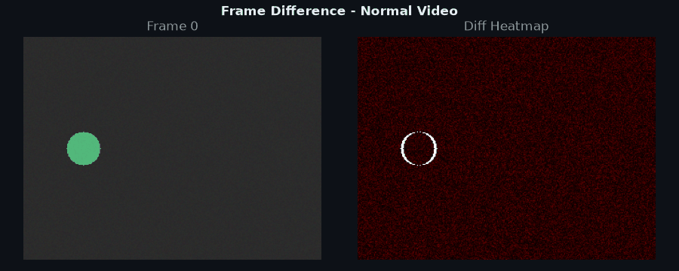
Detection Interface & Visual Layout (Normal Video)

Slide 13
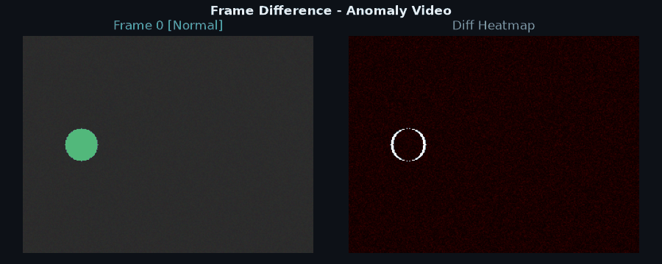
Detection Interface & Visual Layout (Anomalous Video)

Slide 14
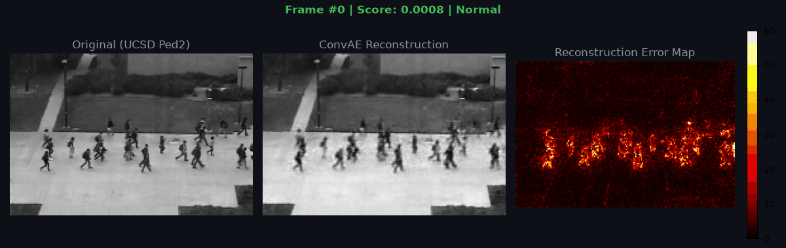
Detection Interface & Visual Layout (on actual dataset)

Slide 15
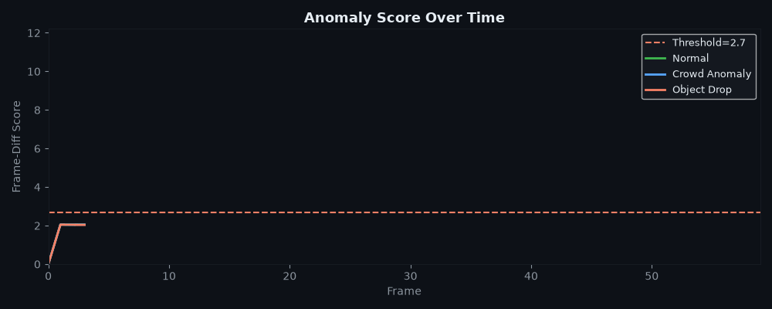
Anomaly score over time (on actual dataset)

Slide 16
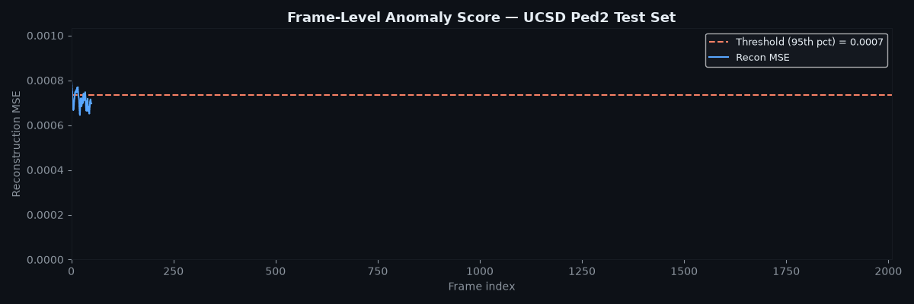
Frame Level anomaly score over time (on actual dataset)

Slide 17
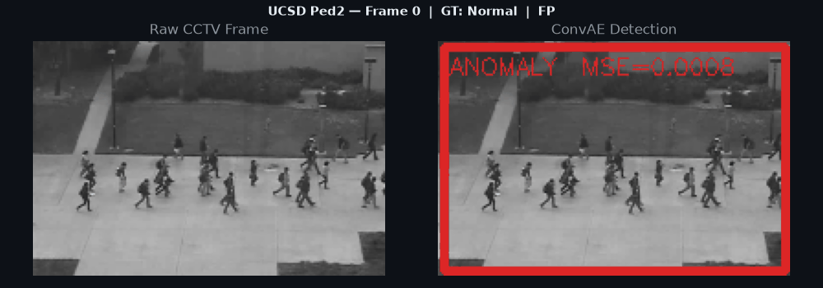
Detections (on actual dataset)

Slide 18
Evaluation on UCSD Ped2 Test Set
Confusion Matrix
Key Metric Summary
Actual Positive
Actual Negative
Pred.
Positive
Precision (Prioritized)
Recall
358
28
0.927
0.217
True Positive (TP)
False Positive (FP)
Pred.
Negative
1290
334
F1 Score
AUC-ROC Metric
False Negative (FN)
True Negative (TN)
0.352
0.6428
Production Focus: High precision was explicitly prioritized for deployment to maintain analyst trust and minimize false alarm fatigue.
Metric Selection: AUC-ROC was chosen as a standard threshold-free evaluation metric across operating points.
Benchmark Context (SOTA Comparison)
While the current model achieves an AUC-ROC of 0.6428, state-of-the-art (SOTA) models such as PatchCore attain approximately 0.95 on similar evaluation benchmarks.

Slide 19
Evaluation & Deployment Strategy
Class Imbalance
Severe Imbalance
Test set features severe class imbalance, with 82% of frames being anomalous.
One-Class Model
Trained exclusively on normal data, making oversampling techniques like SMOTE unnecessary.
Threshold Control
The precision-recall tradeoff is strictly controlled by the threshold percentile.
Streaming Latency
< 5 ms
Online per-frame GPU latency
Latency Budget
Operates under 5 milliseconds on GPU, placing it well within the 33-millisecond budget.
Real-Time Execution
Designed for continuous online per-frame streaming processing.
Edge Efficiency
2 MB
Lightweight model checkpoint
Edge Deployment
Model checkpoint easily fits on edge devices like Jetson Nano.
Future Efficiency Levers
Batching & FP16 inference
TensorRT export
INT8 quantization

Slide 20
Proposed System Deployment Architecture
Edge Inference
FastAPI REST API
Kafka Alert Bus
Grafana Dashboard
Analyst Loop
Camera-Side Execution
Models run directly at edge camera nodes.
Hardware:
• Jetson Nano
• Raspberry Pi 5
Serving Layer
Handles incoming streaming frames & requests.
• Dynamic Batching for throughput
• Scene Statistics Caching
Event Streaming
Real-time message broker for detected system alerts & anomalies.
Decouples inference from downstream consumers.
Live Telemetry
Real-time visual monitoring of detections, metrics & stream health.
Verification
Analysts review live alerts:
✓ Confirm
✗ Reject
Active Feedback Loop
Serving Infrastructure & Latency Budget Performance
33 ms
< 5 ms
~30 ms
Optimizations:
• Batching: High throughput handling
• Caching: Real-time scene statistics
• Reliability: Robust CPU fallback
Latency Budget
Maximum threshold per frame for real-time compliance
GPU Inference
Operates significantly well within time budget
CPU Fallback
Maintains target rate per frame on edge CPU

Slide 21
Baseline System
Results & Analysis
Next Steps & Lessons
Architectural Redo Steps
Explore 3D Convolutional AutoEncoders operating over 8-frame clips.
Integrate PatchCore for enhanced patch-level feature extraction.
Incorporate optical flow channels to explicitly capture dynamic motion.
Key Lesson Learned
Shipping a one-class unsupervised baseline fast earns analyst trust through high precision, establishing a solid foundation while recall is iteratively improved using temporal models.
0.6428
AUC-ROC
0.927
Precision
< 5 ms
Inference / frame
Real Results
Achieved strong precision using zero anomaly training labels, running at real-time speeds under 5ms per frame.
Root Cause Analysis
Low recall (0.217) stems from a conservative threshold and a single-frame architecture that misses temporal motion anomalies.

Slide 22
Topic 2
Llama 2 Explanation

Slide 23
Llama 3.2 1B Architecture Breakdown
Decoder-Only Causal Transformer ~950 Million Total Parameters
1. Tokenizer & Embeddings
Tokenizer: BPE with 128,000 vocabulary
Fallback: Byte-fallback to UTF-8
Embeddings: Weight-tied embedding table
2. 16 Decoder Layers
Attention: Grouped-Query Attention (GQA)
Heads: 32 Query heads & 8 Key-Value heads
Normalization & Pos: Pre-norm RMSNorm + RoPE
3. Feed-Forward Network & Output
FFN Type: SwiGLU feed-forward network
Dimension Expansion: 2048 to 5504 dimensions
Output Head: Tied with input embedding weights
4. Parameter Budget Breakdown
Embedding Table: 262 Million
Attention Layers: 134 Million
SwiGLU Layers: 542 Million
Embeddings: 262M (28%) Attention: 134M (14%) SwiGLU FFN: 542M (58%)

Slide 24
THE UNDERLYING MATH · 1 OF 2
RMSNorm and rotary position encoding
RMSNorm
RoPE — rotary position encoding
RMSNorm(x) = x / RMS(x) · γ
q̃ₘ = Rotate(qₘ, m·θ)
k̃ₙ = Rotate(kₙ, n·θ)
RMS(x) = √( (1/d) · Σᵢ xᵢ² )
γ is a learned per-dimension scale, no bias. No mean subtraction → ~10% faster than LayerNorm, empirically as stable. Used pre-norm, before each sublayer.
θᵢ = 10000^(−2i/d), for i = 0 … d/2−1
The dot product q̃ₘᵀk̃ₙ = qₘᵀ R((m−n)θ) kₙ depends only on relative position (m−n) — it naturally generalises beyond the training context length.
Llama 3.2 1B · The Underlying Math

Slide 25
THE UNDERLYING MATH · 2 OF 2
GQA, SwiGLU, and generation
Grouped-query attention
SwiGLU feed-forward
Output head & generation
Attn(Q,K,V) = softmax(QKᵀ/√dₖ + M)·V
FFN(x) = (W_up·x ⊙ SiLU(W_gate·x))·W_down
SiLU(x) = x·σ(x) = x/(1+e⁻ˣ)
logits = x_final · W_embed^T
M[i,j] = −∞ if j>i, else 0 (causal mask). 8 KV-heads shared across 32 Q-heads → KV cache 4× smaller than standard MHA at equal quality — critical for long-context inference.
Greedy: argmax(softmax(logits/T)). Top-p: smallest set S with ΣP(token)≥p. Top-k: sample from top-k logits. T<1 sharper, T>1 more diverse.
Smooth, non-monotonic gating — ~10% better perplexity than ReLU/GELU. Expansion is 2048→5504 (≈2.69×, not 4×) since SwiGLU has two weight matrices in the hidden layer.
Llama 3.2 1B · The Underlying Math

Slide 26
Topic 3
Enterprise AI

Slide 27
Enterprise AI Threat Vectors Across Four Core Layers
1. Build & Supply Chain
2. Data Layer
Poisoned base weights compromising foundation models
Malicious LoRA adapters introducing backdoors
Dependency confusion attacks in ML pipelines
PII exfiltration via unmasked prompt logging
RAG source leakage exposing restricted documents
Training data poisoning altering model behavior
3. Runtime Threats
4. Agentic & Tool Access
Direct and indirect prompt injection vulnerabilities
Jailbreaks and safety guardrail bypasses
Token-bomb DoS attacks degrading availability
Insecure downstream outputs (e.g., SQL injection)
Unauthorized tool misuse and arbitrary file deletion
Agent memory poisoning leading to persistent exploits
Excessive privilege delegation to autonomous agents
Model Context Protocol (MCP) server compromise

Slide 28
Video Anomaly System: Threat Model & Risk Assessment
SYSTEM LAYER
EXPOSURE
CURRENT MITIGATIONS
UNHANDLED VULNERABILITIES & GAPS
Supply Chain
Dependency versions are pinned
No signed provenance tracking
MEDIUM
Data Layer
Raw frames lack PII; processed strictly in-memory
Data provenance tracking unhandled
LOW
Runtime
5MB payload size cap enforced
FastAPI endpoint lacks rate limiting & adversarial frame testing
HIGH
Model Integrity
Evaluated low exposure risk
None identified
LOW
Output Layer
Low risk; zero agentic risk
None identified
LOW
Key Security Takeaway: Unhandled system vulnerabilities are strictly localized to adversarial frame attacks at the Runtime layer and missing data provenance tracking.

Slide 29
LLM Security Architecture: Cisco vs. Prisma AIRS
Cisco AI Defense
Operates directly at the Network and API gateway layer.
Inspects LLM input/output at transport with inline blocking capabilities.
Ideal for organizations built on the Cisco stack needing fast API-layer protection.
Palo Alto Prisma AIRS
Provides robust, platform-wide security architecture.
Features multi-turn contextual analysis and RAG-aware tracing.
Delivers MCP policy enforcement, making it best for agentic LLM systems.
Strategic Takeaway:
Organizations must map products to specific threat layers: Cisco fits REST API input checks, while Prisma AIRS fits agentic access—though neither covers the full supply chain.

Slide 30
20
24
Thanks!
Do you have any questions?
Name

