Slide 1
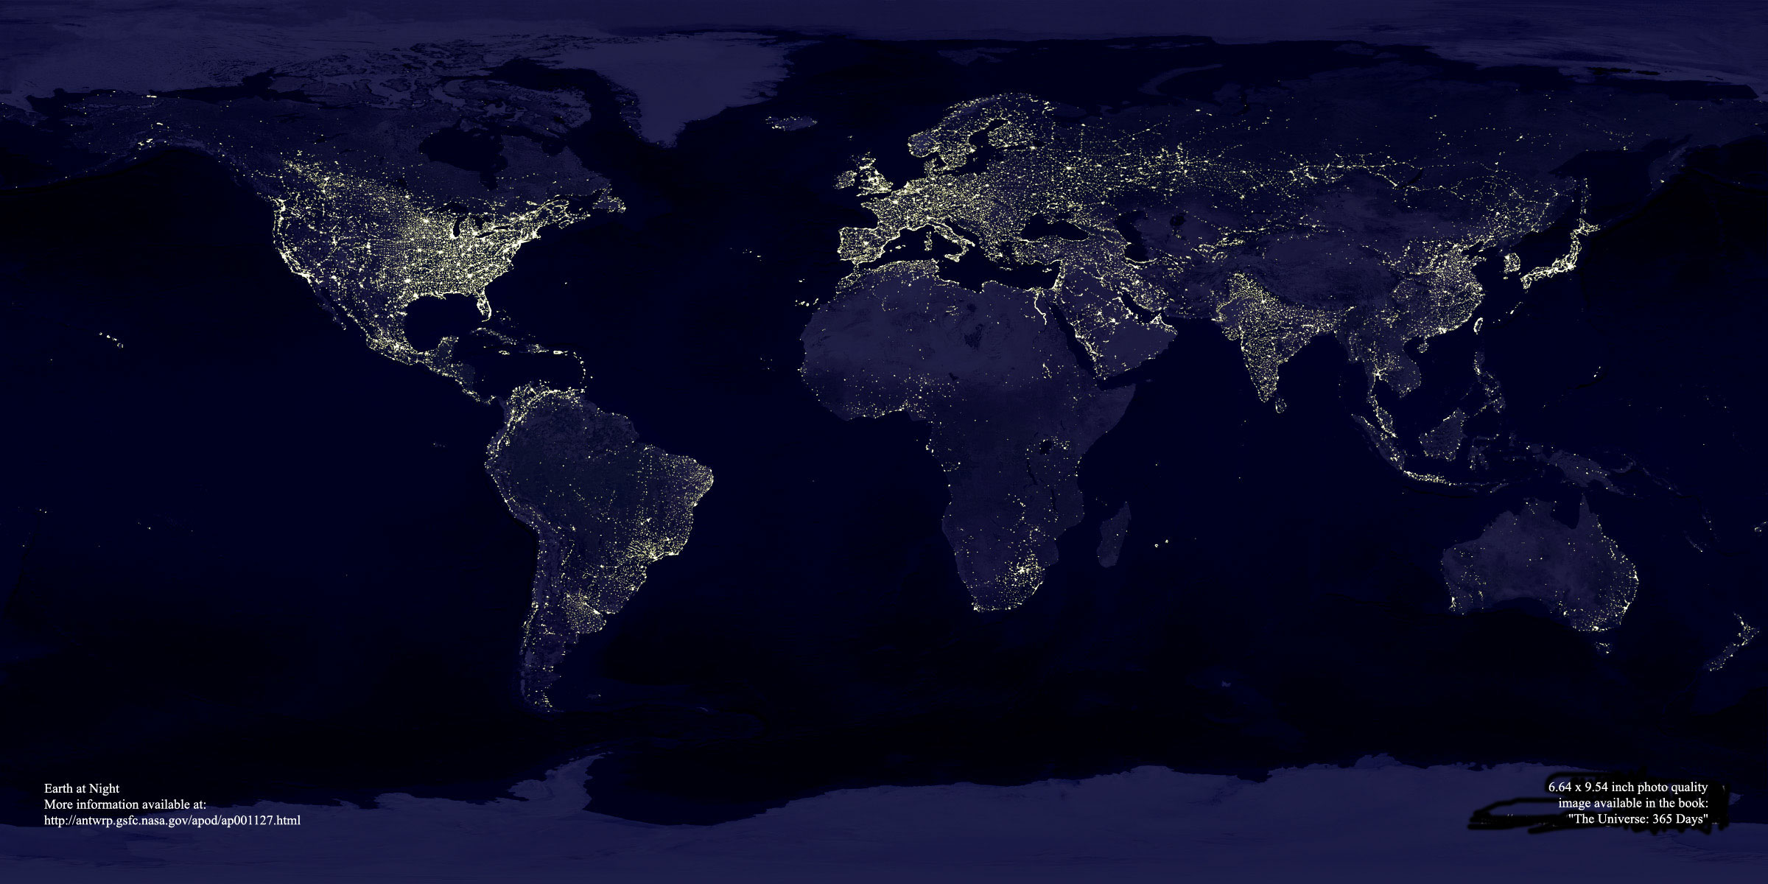

Slide 2
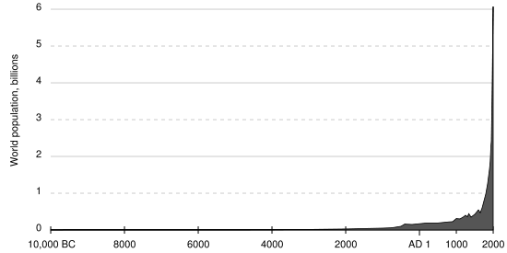
The rate of growth, r, remains the same from year to year, then the change in population size in any given time interval is:
  dN/dT = rN.
However, r is not a constant for human populations .
During early parts of our population growth, r was low. More recently, as agriculture flourished and particularly when the industrial revolution took off in the 1800s, r has grown dramatically. Thus the final part of the curve is much steeper than a simple exponential.

Slide 3
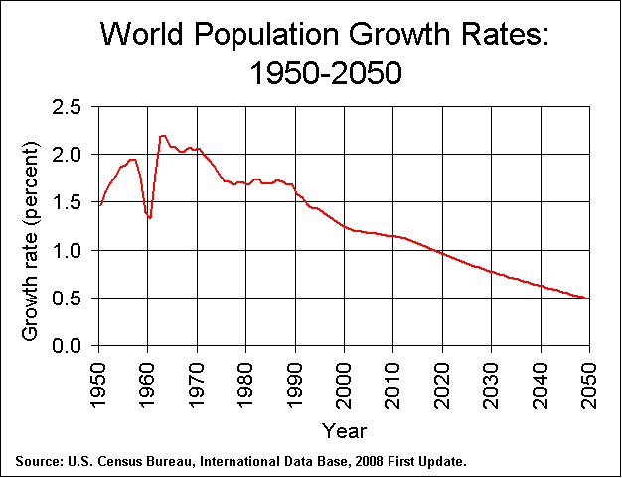
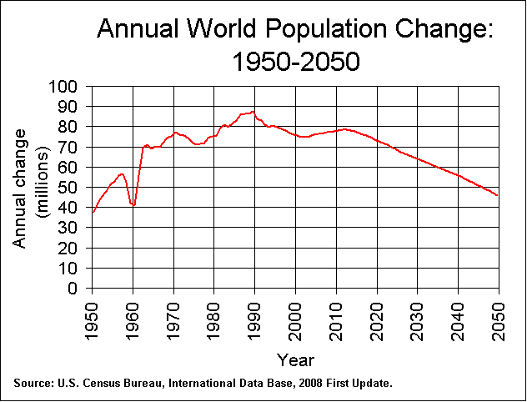
The growth rate peaked in 1963 and has been declining since.
Despite the declines in rate, the number of people added to the population each year continued to increase until 1990.
Population pyramids help to explain this difference.

Slide 4
A typical example of a high birth rate and high death rate pyramid. Life expectancy is low.

Slide 5
2000
This kind of analysis can be used to project changes in population in the coming years.
2.7 million
2025
4.7 million
Although both birth and death rates are currently high, the birth rate is higher and the death rate is expected to decrease. Therefore, projections show that the pyramid and the population will expand rapidly.
2050
7.1 million

Slide 6
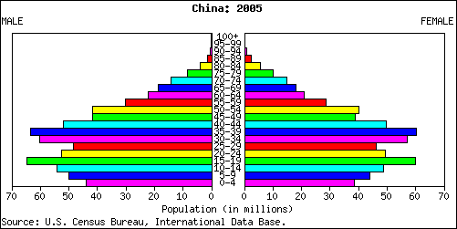
China’s pyramid shows the results of the single child policy.

Slide 7
1.268 billion
China’s population is projected to stabilize by 2050
1.453 billion
1.424 billion

Slide 8
The Russia pyramid shows frequent changes in birth or death rates, with a rapid, recent reduction in births.
2000
147 million
2025
128 million
Projections suggest this lower birthrate will continue and the population will actually shrink.
2050
109 million

Slide 9
The Japan pyramid also shows frequent changes in birth or death rates, with a rapid, recent reduction in births.
127 million
The Japanese population is currently shrinking and will continue to do so.
118 million
94 million

Slide 10
The US pyramid shows the results of the baby boom (1946-66) and maybe the “baby bounce” 25-30 years later
2000
282 million
2025
349 million
The birth rate is picking up again and the population is predicted to rise further. The 2050 population will be about 50% larger than in 2000.
2050
420 million
The 85+ category is the most rapidly growing.

Slide 11
Obviously populations cannot continue to grow at this rate, or even at a reduced but still exponential rate. At some point the resources of the globe will be exhausted.

Slide 12
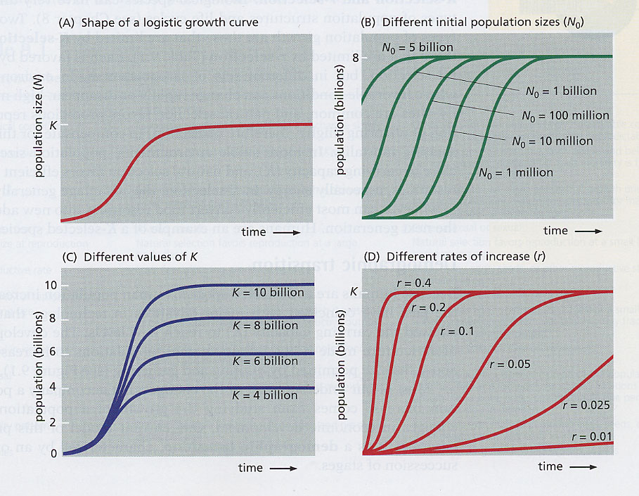
In experimental situations, populations reach a maximum as resources (food supply, energy input, etc.) are exhausted and waste products accumulate. The equation describing this kind of growth is called the logistic equation. The new parameter introduced here is the carrying capacity, K, or plateau value.
dN/dT = rN(K - N)/K

Slide 13
The value of K determines the size of a population, or if you are looking at the world as a whole, K determines the total number of people the earth can support. Unfortunately estimates of the global carrying capacity vary widely and have frequently been surpassed as new technologies progressed.

Slide 14
Although the carrying capacity or upper limit on population has been difficult to establish for global populations, it is a useful concept for analyzing changes in local or national populations.
Japan, 2000
Russia, 2000
As we’ve seen, several of the industrialized nations seem to have reached or are close to stabilized (or even declining) populations. How did they get there?

Slide 15
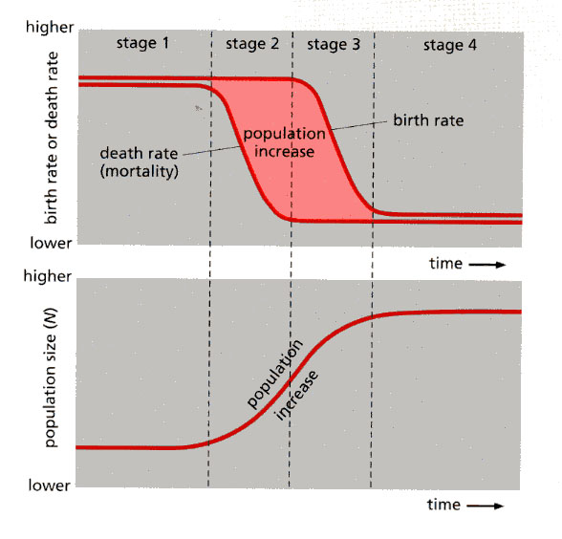
As populations or countries develop, they frequently go through demographic transitions that include reductions in first the death rate and later in the birth rates. During such a transition population size increases.
Finally, a new plateau level or new carrying capacity is established.

Slide 16
The industrial revolution allowed demographic transitions like this.
For example, England began a transition in the early 1700s that took 250-300 years to complete.
Other industrialized countries - US, Canada, Japan, Germany, France, others - went through a transition in about 200 years.
Several recently developing countries, as exemplified by Brazil, India, and China, began transitions during the twentieth century and did so much more suddenly, often going from high traditional mortality rates to low modern rates in a single generation.
With improving sanitation and medical care many other countries are expected to join this accelerated transition, but some may continue to lag because of poor nutrition, famine, persistent warfare, and epidemic diseases.

Slide 17
Increases to total population
  One of the most important – agriculture
      This allowed stable settlements
      Promoted government, collective defense
      Growth of trades, textiles, pottery, metallurgy
      Much better nutrition, both plants (grain, etc) and domestic animals
  Public health measures that reduce spread of diseases – clean water, reduction of vector niches (eg mosquitos), quarantines, sanitation, monitoring of food supplies
    Antibiotics
    Vaccinations
  Industrial revolution and its sequelae
  Green revolution -

Slide 18
Limits on human population
    Prosperity
    Disease
    Food supply/famine
    Water
    Pollution
- decreased birth rate
- increased death rate

Slide 19
Limits on human population
    Prosperity
      with increased health and economic prosperity, human populations reduce their birth rate, often through some form of birth control
      -the use of birth control is directly correlated with the rate and extent of education of girls and young women.
    Disease
    Food supply/famine
    Water
    Pollution

Slide 20
Limits on human population
    Disease -
      The three largest killers are:
        HIV/AIDS - has killed >25 million, 2.4-3.3 million in 2005
    - estimated about 40 million infected in 2005
    - about 1/3 in subsaharan Africa
        Tuberculosis - in 2004 14.6 million chronic cases, 8.9 million new, 1.6 million deaths;
        - resurgent partly due to the rise in HIV and neglect of TB control;
        Malaria (Anopheles mosquito) - 515 million cases/yr, 1-3 million deaths
    Large epidemics
        Influenza - seasonal epidemics, sporadic pandemics
        - 1918 “Spanish flu”, perhaps the “greatest medical holocaust in history” - 50-100 million deaths in two years
        - extremely virulent, 2.5% lethal compared with normal flu 0.1%
        - one fifth of the world infected, no way to escape it
        Bubonic plague (fleas) -
        Small pox

Slide 21
Limits on human population
    Prosperity
    Disease
    Food supply/famine
        -often caused by droughts, crop failures
        - currently famines are problems of food distribution, politics
    Water
    Pollution

Slide 22
Limits on human population
    Prosperity
    Disease
    Food supply/famine
    Water
        water shortages are likely to be one of the most critical problems this century
        we will return to it in later lectures, because global warming will have major effects on water supply
    Pollution

Slide 23
Limits on human population
    Disease
    Food supply/famine
    Water
    Prosperity -> reduced fertility
    Pollution – air, water
      Environmental exposure causes almost a quarter of all diseases. More than two million people worldwide are estimated to die prematurely every year from indoor and outdoor air pollution.
      In developing countries some 3 million people die annually from water-borne diseases, most of them under-five-year-olds. An estimated 2.6 billion people lack improved sanitation services. By 2025, water withdrawals are predicted to have risen by 50 per cent in developing countries and by 18 per cent in the developed world.
    Now, global warming - it may overwhelm all the other limits.

