Slide 1
PSCS_46_ Application for Assessment of Quality of Textbook/Reference Books/E-Book
CSE7101- Capstone Project
Review-4
Batch Number: CSE_169
Under the Supervision of,
Dr. Md ZiaUr Rahman
Project Guide
School of Computer Science and Engineering
Presidency University
Roll Number | Student Name
20221CSE0392 | LAVANYA M
20221CSE0266 | SUPRAJA POSINA
20221CSE0385 | CHETHANA T
Name of the Program: Computer Science and Engineering
Name of the HoD: Dr.Blessed Prince
Name of the Program Project Coordinator: Dr.Muthuraju V
Name of the School Project Coordinators: Dr. Sampath A K , Dr. Geetha A

Slide 2
Content
problem Statement
Literature Survey
Objectives
Front End
Back End
Existing Methods and Drawbacks
Proposed Method & Feasibility Study
Architecture Diagram
Modules
Hardware and Software Details
Timeline (Gantt Chart)
References

Slide 3
Problem Statement
Problem Statement Number: PSCS_46
Organization:Ministry of AYUSH
Category: Software
Problem Description:In academic institutions, the evaluation of textbooks, reference books, and e-books is often carried out manually by faculty members or subject experts. This process is time-consuming, lacks standardization, and is prone to inconsistencies and human bias. Feedback is usually stored in scattered formats, making it difficult to track, compare, or maintain historical records. Without a centralized and automated system, ensuring the quality, relevance, and up-to-date nature of learning resources becomes challenging. There is a need for a software-based solution that streamlines the evaluation process, standardizes scoring criteria, and generates transparent, data-driven reports for better decision-making in selecting academic materials.

Slide 4
Literature Survey
One of the first large reviews of introductory textbooks was done by Cobb. He inspectively examined sixteen samples. The findings of his revealed significantdifferences in their construction, clarity and teaching method. This is due to such large deviations, and unless teachers have an organized mode, it becomes difficult to choose the best one. Works such as his actually demonstrated why good evaluation techniques were so important [1].
Subsequently, scholars began to examine the manner in which reviewers interact with the books.Gurung and Martin came to the Textbook Assessment and Usage Scale, which was shortened to TAUS. The tool was used to test the manner in which students and teachers process and understand textbook material. They discovered that individual variables, including interest in the subject or prior knowledge are significant contributors to the ratings. A good textbook may not receive the same grades even when reviewed by different individuals based on his or her perception [2].
After that Fey and Matthes presented a rather simple checklist of high quality textbooks. What became apparent in their review is that those that are the best possess proper facts, reasonable layout, absence of cultural or bias concerns and are suited to the learning objectives. Their ideas hold real value. They offer schools and assessors a platform upon which decisions are made [3].

Slide 5
Literature Survey
Mohammadi and Abdi examined real assessments in upper classes and classrooms. Their case considered the number of tests that are overloaded with subjective feelings. The result of that is uneven results throughout the board. They have mentioned that applying formal techniques, including online techniques, reduces errors and allows maintaining consistency [4].
Mahmood realistically assessed outdated evaluation arrangements. He described the fact that there are very many places which claim to go through textbooks but do not live up to standards. He termed it as a deception of assessment. The system appears to be well arranged on the surface, yet, it does not measure books efficiently on the quality aspect. All this shows that there is a need to have consistent rules and training of individuals conducting the reviews [5].
A major step in the construction of those systems was made by Ivic, Antic, and Pesikan. They compiled a comprehensive instruction on textbook requirements. It goes in dispensation such as page setup, pictures, clearcut writing, fit to learn and its approachability. Their entire strategy is lauded by creating more consistent and reliable reviews [6].

Slide 6
Objectives
To develop a web-based platform for evaluating the quality of textbooks, reference books, and e-books.
To provide a standardized assessment framework with predefined quality parameters and weightages.
To enable secure reviewer authentication and role-based access control.
To automate the scoring and report generation process for quick decision-making.
To create a centralized database for storing book details, reviews, and historical records.
To ensure transparency, consistency, and efficiency in the evaluation process.

Slide 7
Front End
Overview & goals
Frontend purpose:
Provide secure reviewer/admin interfaces for submitting books, filling evaluations, viewing dashboards, and approving requests.
Be fast, accessible, mobile-responsive, and easy to use (low learning curve for faculty).
Surface analytics (charts/tables) and permit exports (PDF/CSV).
Primary priorities:
Usability & clarity for non-technical users.
Strong form validation and helpful error messages.
Visual summaries (scores, trends, per-criterion breakdown).
Role-based UI (Reviewer vs Admin vs Viewer).
Charts: Recharts or Chart.js (Recharts integrates well with React).
Auth & realtime: integrate with Supabase Auth or Auth0; use Supabase Realtime or Socket.IO for live updates.

Slide 8
Back End
Node.js (JavaScript/TypeScript) with Express.js or Next.js API Routes
Non-blocking I/O makes it ideal for a system with many form submissions.
Lightweight and fast for REST APIs.
Integrates well with Supabase/PostgreSQL and frontend frameworks like React.
The backend handles all core functions of the system:
Authentication & Authorization:
Reviewer login
Admin login
Role-based access control (RBAC)
Token-based session handling (JWT)
Secure password storage with hashing
Book Management API:
Add new textbook/reference book
Validate duplicate submissions
Upload files (PDF/e-book)
Update book metadata
Retrieve book list / details

Slide 9
Existing Methods and Drawbacks
Expert committee reviews – Accurate but time-consuming, costly, and sometimes subjective.
Student/teacher surveys – Easy to collect but prone to bias and low response rates.
Online ratings (Amazon, portals) – Accessible but vulnerable to fake or non-expert reviews.
Publisher endorsements – Quick but often biased or commercially influenced.
Automated content checks (NLP, plagiarism, readability) – Scalable but miss conceptual depth and pedagogy.
Drawback summary: Existing methods are either slow and resource-intensive or fast but unreliable, lacking a balanced, transparent system for consistent textbook quality evaluation.

Slide 10
Proposed Method & Feasibility Study
Proposed Method:
Frontend: Developed using React, TypeScript, and TailwindCSS to provide a responsive and user-friendly interface.
Role-based Access: Students/reviewers submit ratings and comments, while admins/committees approve books and view analytics.
Data Storage: Implemented initially with localStorage for demonstration, but designed for extension to Express + MongoDB .
Analytics: Interactive dashboards using Recharts summarize subject-wise averages and overall textbook performance.
Feasibility:
Technical: Built with proven, lightweight, open-source tools.
Economic: Low cost; runs on standard hardware.
Scalable: Can extend to real databases and cloud deployment

Slide 11
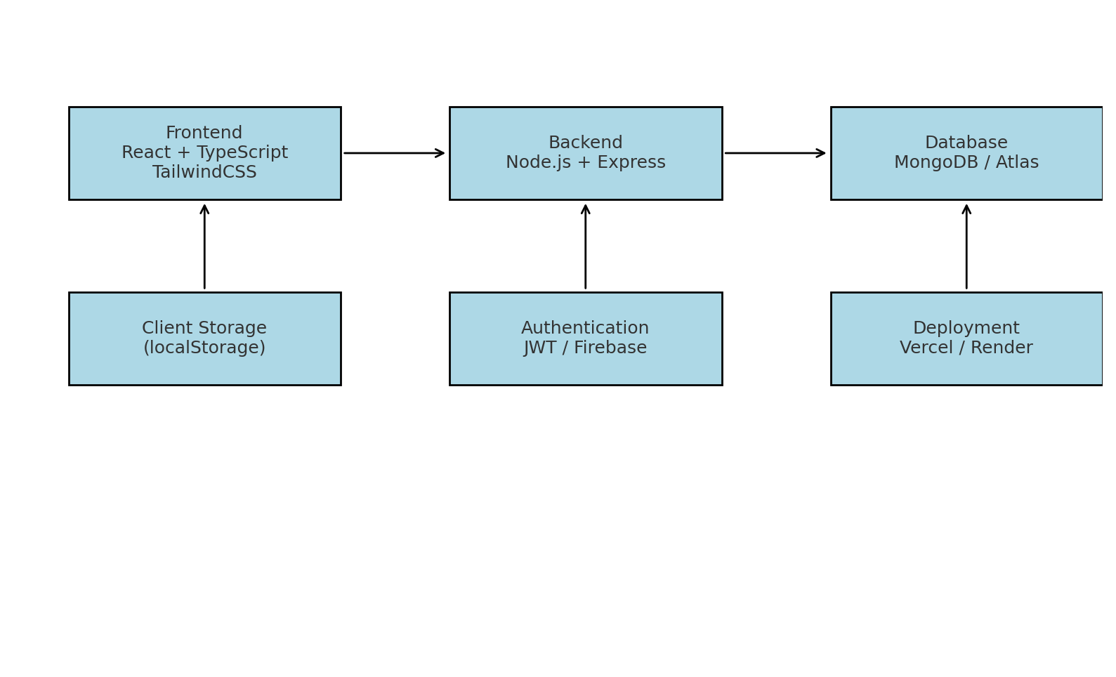
Architecture Diagram
Chatbot messenger

Slide 12
Modules
Authentication & Role Management:
Handles login and session storage.
Provides role-based access for Student, Reviewer, and Admin/Committee.
Book Management Module:
Displays textbooks with details (title, author, subject, rating).
Allows searching, filtering, and browsing books.
Review & Rating Module:
Students/Reviewers submit reviews with ratings and comments.
Stores and updates aggregated book scores.
Admin/Committee Module:
Approves or rejects books.
Monitors performance and ensures quality standards.
Analytics & Reporting Module:
Uses Recharts for visual dashboards.
Provides subject-wise averages and comparison charts.
Storage Module:
Uses localStorage (demo).
Can be extended to MongoDB for persistence.

Slide 13
Hardware and Software Details
Hardware:
Laptop/Server,
Internet.
Software:
Node.js & npm: Node 18.x LTS (or Node 20.x); npm bundled.
Check with: node -v and npm -v
Code editor: Visual Studio Code (recommended) or Notepad / Notepad++.
Git: for version control (git CLI).
Browser: Chrome, Firefox, Edge (latest stable) for testing.
Frame work: React(v18+) with TypeScript
Charts: Recharts

Slide 14
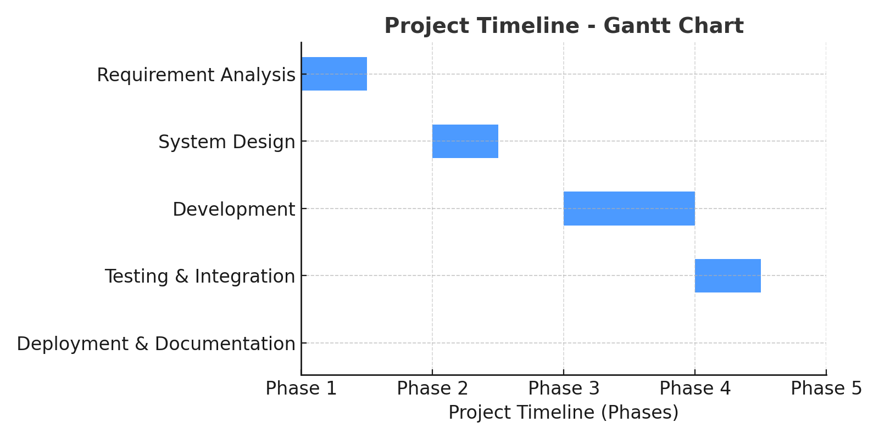
Timeline (Gantt Chart)

Slide 15
References(IEEE paper format)
[1] M. S. Al-Ajlan and M. A. Al-Khalifa, "Towards the development of an automated evaluation tool for digital educational resources," International Journal of Advanced Computer Science and Applications (IJACSA), vol. 7, no. 7, pp. 204–210, 2016.
[2] N. G. T. Izquierdo, L. A. G. Villalobos, and J. D. M. Ramírez, "A framework for the evaluation of e-learning materials," in Proc. IEEE Global Engineering Education Conf. (EDUCON), Abu Dhabi, UAE, 2016, pp. 1129–1134.
[3] R. K. Singh and A. Sharma, "Design and development of web-based evaluation system for academic resources," International Journal of Computer Applications, vol. 183, no. 8, pp. 25–30, June 2021.
[4] T. M. Connolly and E. A. Stansfield, "Evaluating the quality of learning resources: A web-based approach," in Proc. IEEE International Conf. on Advanced Learning Technologies (ICALT), Athens, Greece, 2014, pp. 37–41.
[5] M. A. Al-Emran, "Towards an intelligent framework for textbook evaluation in higher education," Education and Information Technologies, vol. 24, no. 2, pp. 1453–1468, Mar. 2019.
[6] S. R. K. Somasekhar, P. V. Kumar, and R. J. Reddy, "Automated assessment of educational content using multi-criteria analysis," in Proc. IEEE International Conf. on Technology for Education (T4E), Mumbai, India, 2020, pp. 215–220.

Slide 16
References(IEEE paper format)
7] I. Ivić, S. Antić, and A. Pešikan, eds., Textbook Quality: A Guide to Textbook Standards, vol. 2, Göttingen: V&R unipress GmbH, 2013.
[8] O. Yasar, “A comparative analysis of assessment and evaluation exercises included in geography textbooks written according to the 2005 secondary education geography curriculum and textbooks of the former curriculum in Turkey,” International Journal of Progressive Education, vol. 5, no. 1, pp. 45–68, 2009.
[9] P. Race, The Lecturer’s Toolkit: A Practical Guide to Assessment, Learning and Teaching, London: Routledge, 2019.
[10] J. N. Giger and L. Haddad, Transcultural Nursing: Assessment and Intervention, ElsevierHealth Sciences, 2020.

Slide 17
github link
https://github.com/Lavanya7004/Quality-Assesment-Capstone Project

Slide 18


