Slide 1



Based on a presentation by Gofur Halmruatov Elena Myazina

Slide 2
Introduction XML and JSON
Comparing JSON vs. XML
Conclusion and references

Slide 3
XML
XML stands for EXtensible Markup Language
XML is a markup language much like HTML
XML was designed to carry data, not to display data
XML tags are not predefined. You must define your own tags
XML is designed to be self-descriptive

Slide 4
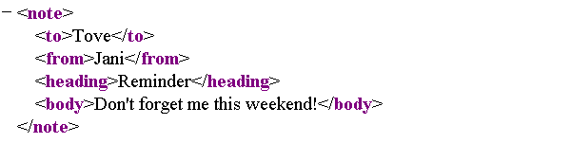
XML: Example

Slide 5
XML: Well-formed
XML documents must have a root element
XML elements must have a closing tag
XML tags are case sensitive
XML elements must be properly nested
XML attribute values must always be quoted

Slide 6
XML: Validity
Valid XML is An XML document that has an associated document type declaration and complies with the constraints expressed in it.
Document Type Definition (DTD)
XML Schema

Slide 7
XML: Processing files
Programming languages and SAX API
Programming Languages and DOM API
And Others

Slide 8
XML: Transformation engines and filters
XSL-FO is a declarative, XML-based page layout language.
An XSL-FO processor can be used to convert an XSL-FO document into another non-XML format, such as PDF.
XSLT is a declarative, XML-based document transformation language. An XSLT processor can use an XSLT stylesheet as a guide for the conversion of the data tree represented by one XML document into another tree that can then be serialized as XML, HTML, plain text, or any other format supported by the processor.

Slide 9
XML: Advantages

XML provides a basic syntax that can be used to share information between different kinds of computers, different applications, and different organizations.
With XML, your data can be available to all kinds of "reading machines" (Handheld computers, voice machines, news feeds, etc)
XML provides a gateway for communication between applications, even applications on wildly different systems. As long as applications can share data (through HTTP, file sharing, or another mechanism)
It supports Unicode, allowing almost any information in any written human language to be communicated.
It can represent common computer science data structures: records, lists and trees.
Its self-documenting format describes structure and field names as well as specific values.
It is based on international standards.







Slide 10
XML: DisAdvantages


It is difficult for the end-user to understand its capabilities.
XML syntax is redundant or large relative to binary representations of similar data, especially with tabular data.
The redundancy may affect application efficiency through higher storage, transmission and processing costs.
XML syntax is verbose, especially for human readers, relative to other alternative 'text-based' data transmission formats.
The hierarchical model for representation is limited in comparison to an object oriented graph.
Expressing overlapping (non-hierarchical) node relationships requires extra effort.
XML namespaces are problematic to use and namespace support can be difficult to correctly implement in an XML parser.






Slide 11
JSON
JSON (JavaScript Object Notation) is a lightweight data-interchange format
JSON code is valid JavaScript
JSON is a text format that is completely language independent
JSON is built on two structures:
A collection of name/value pairs
An ordered list of values
JSON file extension: *.json

Slide 12
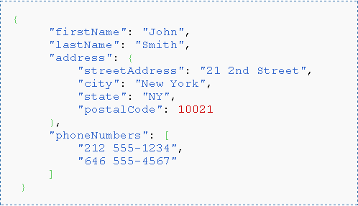
JSON: Example

Slide 13
JSON: in JavaScript

JSON is a subset of the object literal notation of JavaScript
var myJSONObject = {"bindings": [
{"ircEvent": "PRIVMSG", "method": "newURI", "regex": "^http://.*"},
{"ircEvent": "PRIVMSG", "method": "deleteURI", "regex": "^delete.*"},
{"ircEvent": "PRIVMSG", "method": "randomURI", "regex": "^random.*"}
] };
Members can be retrieved using dot or subscript operators.
myJSONObject.bindings[0].method
To convert a JSON text into an object, you can use the eval() function. eval()
invokes the JavaScript compiler
var myObject = eval('(' + myJSONtext + ')');
In browsers that provide native JSON support, JSON parsers are also much faster than eval
var myObject = JSON.parse(myJSONtext, reviver);




Slide 14
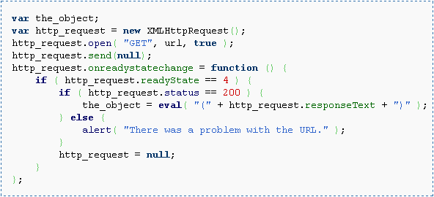
JSON: in AJAX

Slide 15


Comparing Criteria: Human readability
XML
JSON
Both formats Human readability are almost in same degree

Slide 16


Comparing Criteria: Data Creation
 XML: JAXB or XmlBeans
 JSON: Json-lib (http://json-lib.sourceforge.net)

Slide 17

Comparing Criteria: Extensibility
 XML
 JSON

Slide 18
Comparing Criteria: Speed
Each format has its advantages and disadvantages
JSON is smaller than XML
JSON is part of JavaScript code, It needs less time to parse data thank the time for XML
JSON is faster than XML in AJAX

Slide 19
Comparing Criteria: Fetching data from Server
XML uses XMLHttpRequest to fetch data from Server
JSON can fetch data from Server with and without XMLHttpRequest in AJAX, it also uses JSONRequest
Speed fetching data is almost same, but speed parsing fetched data is different

Slide 20

Comparing Criteria: Security
 JavaScript eval() function does not check json code before running it, this is place for code injection attack
 Solution

Slide 21
Comparing Criteria: Others
JSON is thinner than Xml
JSON is native to the client(most browsers support IE8,Firefox and others)
JSON can do cross domain calls that XMLHttpRequest can not
It is easier to encode / escape in JSON than XML

Slide 22
Conclusion
What to use depends on the applications and your requirements. For data- oriented applications, I prefer JSON to XML due to its simplicity and
ease of processing on the client side. XML may be great on the server side, but JSON is definitely easier to deal with on the client side.

Slide 23
References
http://www.json.org/
http://www.w3schools.com/XML/
http://www.w3.org/XML/
http://wikipedia.org/JSON
http://wikipedia.org/XML
http://www.subbu.org/blog/2006/08/json-vs-xml

