Slide 1
Comparative Analysis of Lossless Data Compression Algorithms On Genetic Code for Biological Species.
Reg.No | Name of the Student
BL.EN.U4CSE19076 | Lavanya Ratna Sirisha Munduri
BL.EN.U4CSE19145 | Vinamratha Pattar
BL.EN.U4CSE19133 | Trisha Chander

Slide 2
Problem Definition
Comparative Analysis of Lossless Data Compression Algorithms On Genetic Code for Biological Species.

Slide 3
Motivation / Need for the project
Motivation and Need:
In every mRNA sequence, there’s approximately 3 million nucleotides (A, U, G, C)
To store these as strings of lengths greater than 3 million is tedious and would take up a lot of storage.
Compression of genomic sequences can decrease the storage requirements, and increase the transmission speed which can be useful for synthesis of medicines and genetic engineering. Various lossless data compression algorithms may be used to achieve this.
Our project serves the purpose of compressing the given strings using Huffman Encoding, Run Length Encoding and LZW compression, while simultaneously acting as a tool to compare the compression algorithms and calculate the save percentage.

Slide 4
Algorithmic Strategy used
RLE, LZW and Huffman Coding are all lossless data compression algorithms that can be used to encode as well as decode our input of the rna sequence. Reasons for choosing these algorithms:
RLE:
Counts the consecutive repetition amount of a symbol and uses that value to represent the run.
Efficient with files that contain lots of repetitive data and does not require much CPU horsepower.
LZW:
Creates a key value pair for every new sequence of input
The key value dictionary does not need to be passed on to the decompression part
Huffman Coding:
Huffman takes advantage of the disparity between frequencies and uses less storage for the frequently occurring characters
This is at the expense of using more storage for rare characters, however as are inputs would be only 4 characters, this drawback does not apply here

Slide 5
Literature Survey/Existing System (if applicable)
S.NO | Author names | Full title of the paper with Year | Inference from the paper(based on methodology, technology) | Open Problem (for your proposed work)
1 | Ayman E. El-Sharkawey, Marwa Esmail Ali | Comparison between (RLE & Huffman and DWT) Algorithms for Data Compression. (2019) | All the compression techniques work differently for different types of files. Trade-off must be made between speed and space, and RAM usage. | -
2 | S. Naranan V. K. Balasubrahmanyan | Information Theory and Algorithmic Complexity: Applications to Linguistic Discourses and DNA Sequences as Complex Systems Part I: Efficiency of the Genetic Code of DNA (2000) | The average binary code length of the genetic code exceeds the optimal average length of the Huffman code only by 2 to 5%, showing that the genetic code is close to optimal. However, in the end, applying huffman coding is preferred for storing data to save space. | -
3 | Worasait Suwannik | LZW Encoding in Genetic Algorithm | To reduce the search space, one approach is to use a compressed encoding chromosome. An LZWGA chromosome must be decompressed using an LZW decompression algorithm. By using compressed encoding, the search space is reduced dramatically. | -

Slide 6
Software/Tools Requirements
Software Requirements
Tkinter
Python 3
Jupyter Notebook
OS - Windows/Linux/macOS
Hardware Requirements
RAM - 2 GB+
Processor Speed - 2.0 GHz+
Hard Disk - 250 GB+

Slide 7
Modules in the Project
Tkinter module for GUI (buttons, window,etc)
RLE Compression
RLE Decompression
LZW Compression
LZW Decompression
Huffman Encoding
Huffman Decoding
Flow Diagram
Application Root
Accept String
Encode the string
Decode the string
Calculate compression ratio and save percentage

Slide 8
Results and Discussion
For every compression algorithm, the size of the data is calculated before and after compression, and then the save percentage is calculated
In most cases, it appears that Huffman Coding has the highest save percentage
For large strings, LZW requires a bigger dictionary size and in general, for larger file sizes, LZW needs better computing resources or an overflow problem is observed
Generally, the only drawback of Huffman is that based on the rarity of certain characters the depth of the tree is increased and the binary code word will be large in length. However, this does not apply to our input as they are a combination of only four letters
RLE is not optimal as in some cases, the encoded data is larger in size than the original. This occurs when the letters have a low continuous frequency. However, if our input has many continuous characters, in some cases, RLE is better than Huffman.

Slide 9
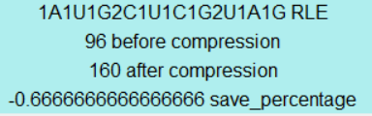
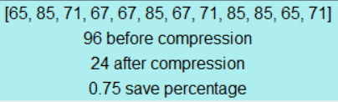
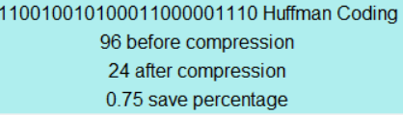

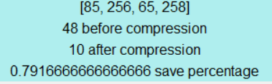
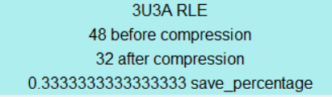
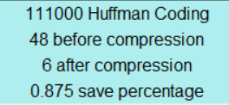
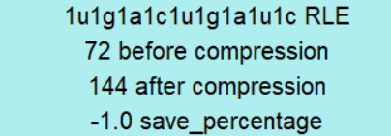
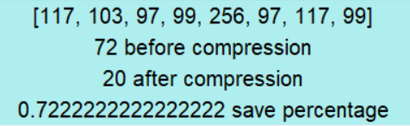
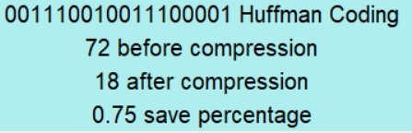
Results/Snapshots/Demo
RLE | LZW | HUFFMAN ENCODING
AUGCCUCGUUAG - Methionine, Proline, Arginine, Stop
 | UUUAAA - Phenylalnine,Lysine
 | UGACUGAU

Slide 10
THANK YOU

