Slide 1
Walk the Plank
Prototype Prepared for DDOSH
Les Vainqueurs, 4 May 2017
Version 1.0

Slide 2
Introduction
The premise of Walk the plank

Slide 3
Premise
Walk the Plank is a strategic board game played between 3 and 5 people
The goal of the game is to "survive" while other pirates (your opponents) attempt to push you off of a boat
Originally a board game; DDOSH is seeking to bring the game online
Our task: prepare an online version of Walk the Plank

Slide 4
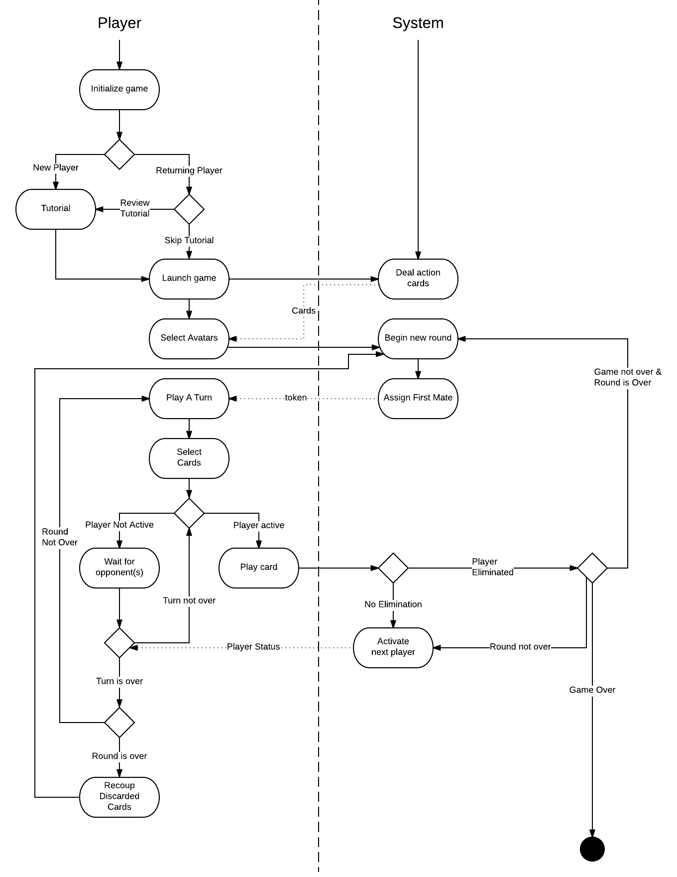
https://www.lucidchart.com/documents/view/d8a5a3b8-ecae-44fd-8b28-fae072327c27

Slide 5
Walk the Plank Online - prototype

Slide 6
About this prototype
This prototype is intended to show what an eventual online version of Walk the Plank will look
We only show a handful of features that map to a subset of the gathered requirements
The purpose is to show that Les Vainqueurs understands both Walk the Plank and the desires of DDOSH in bringing Walk the Plank online

Slide 7
Walk the Plank Online - Prototype
Game pieces - Avatars and Planks

Slide 8
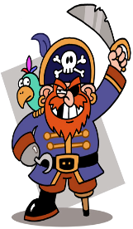
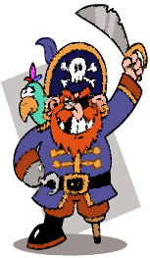

Avatars

Slide 9
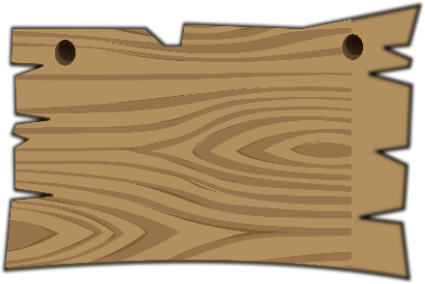
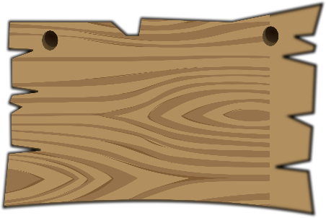
Plank Pieces

Slide 10
Walk the Plank Online - prototype
Action cards and tokens

Slide 11
About action cards
Action Cards are Walk the Plank's main source of game action and are its strongest strategic asset
Players play a card each round, each in an attempt to move enemy pieces towards the sea or rescue their own pieces
Several (usually more powerful) cards have restrictions on them that prevent them from being used often

Slide 12
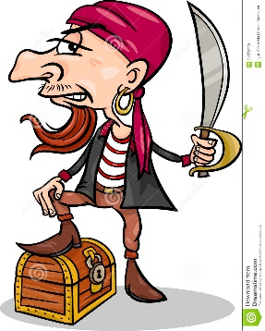
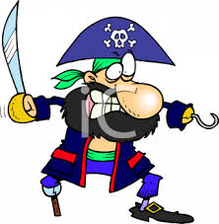

Action cards
Shove Left
Shove Right
Shove anyone
Shove Left
Shove Right
Shove anyone

Slide 13

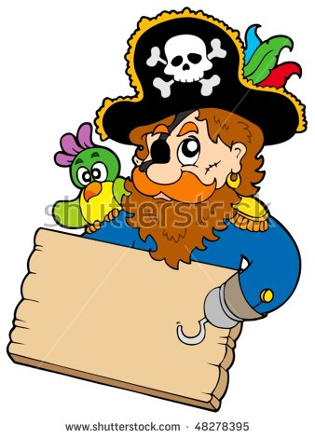

Action Cards continued
Run around
Extend
Retract

Slide 14
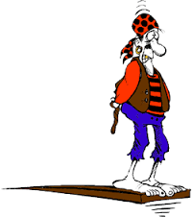
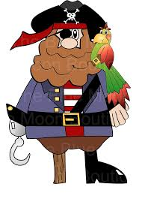


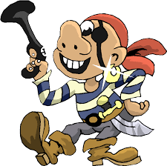
Action Cards (continued)
Pull
Charge
I don’t wanna die
Drag
S H I P
S E A
Not played in first cycle of a round

Slide 15

Back of the cards

Slide 16

First mate Token
Given to the player determined to go first
Rotates counter clockwise.
First Mate

Slide 17
Gameplay demo
Prototype
Walk the plank online

Slide 18


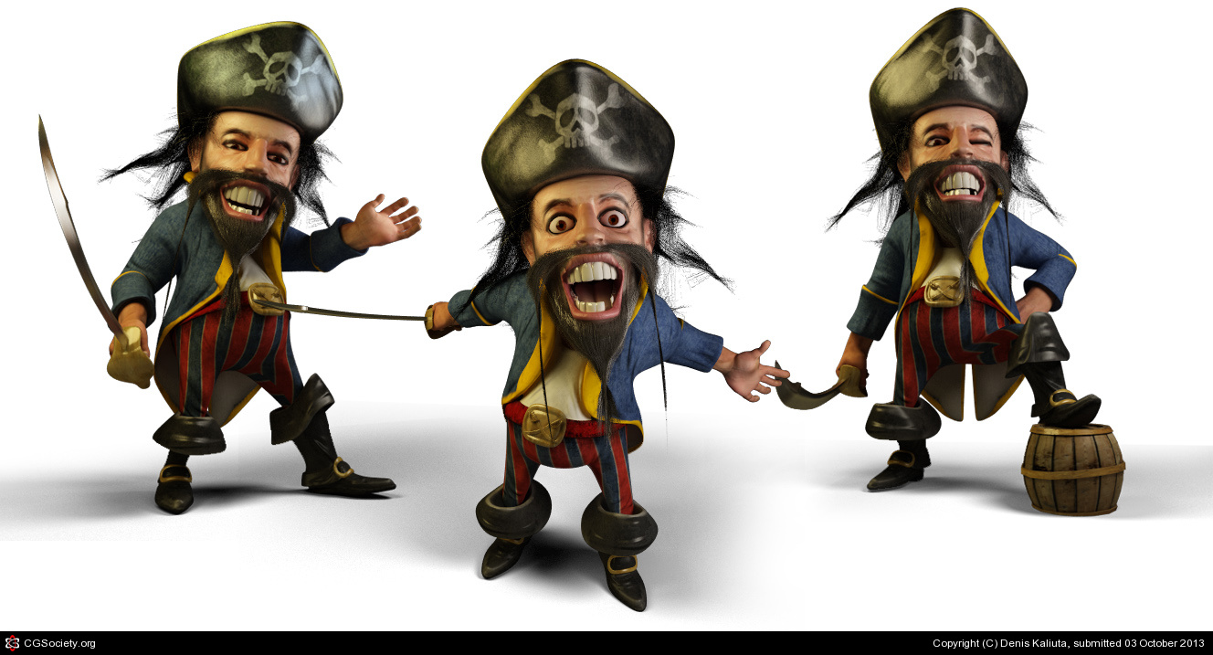

About Us
Walk the Plank
Contact Us
Settings
Returning Player
New Player
@DDOSH 2017
@2017 DDOSH
Notes:
Welcome Screen

Slide 19
DDOSH is a partnership of entrepreneurs, Divya Krishna Chitla, Daniel Cordero, Ohan Oumoudian, Sri Tulasi Yadlapalli and Henri Hila, with deep interest in shaping the world and moving life experiences to the internet as a means of preservation for future generations.
Home

Slide 20
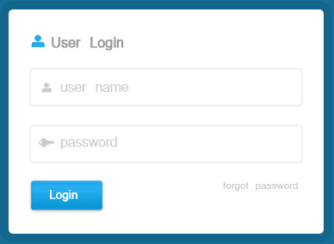
User Login prompt

Slide 21
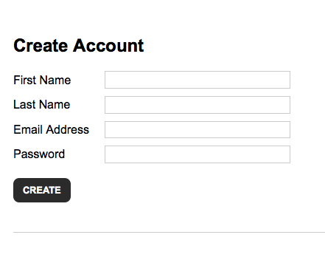
Account Creation
Account Created Successfully!
OK

Slide 22
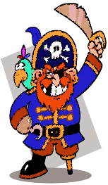
Pop up screen – player options
Play Online
Choose game mode
Single Player
Choose your pirate

Slide 23


Single player option
Enter your name
Pick up to 4 opponents
Players may choose to play against up to four computers
Chooses own player color, then chooses which colors will be the player’s opponents
N e X t

Slide 24
Enter your name
Online mode
Players may elect to play the game online with up to four other anonymous players
Players choose a username and wait to join a “room” which has other players waiting to play
N e x t

Slide 25
Opponents found
Players Online
Divya
Thulasi
Henry
Return

Slide 26


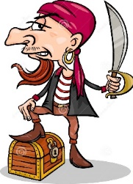





Pick 3 cards for round 1, in the order to be played
Retract
Extend
Shove Left
Shove Right
Shove anyone
Run around
Pull
Charge
I don’t wanna die
Drag
S H I P
S E A
Not played in first cycle of a round
Next

Slide 27
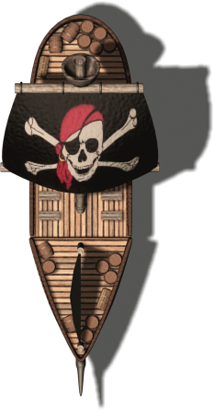








Rules
Pause/play
Dannator
Next
Sam
Ohanator

Slide 28
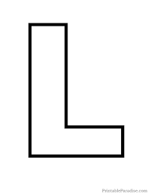



Rules
Pause/play
Dannator
Next
Sam
Shove Left
Ohanator

Slide 29

Rules
Pause/play
Shove Right
Dannator
Sam
Next
Shove Left
Ohanator

Slide 30


Rules
Pause/play
Shove Right
Dannator
Shove Left
Sam
Shove Left
Next
Ohanator

Slide 31

Rules
Pause/play
Shove Right
Dannator
Next
Shove Left
Sam
Shove Left
Drag
S E A
Ohanator

Slide 32


Rules
Pause/play
Shove Right
Charge
Dannator
Shove Left
Sam
Next
Shove Left
Drag
S E A
Ohanator

Slide 33

Rules
Pause/play
Shove Right
Charge
Dannator
Shove Left
Retract
Sam
Shove Left
Drag
S E A
Next
Ohanator

Slide 34
Rules
Pause/play
Shove Right
Charge
Dannator
Next
Shove Left
Retract
Sam
Shove Left
Drag
I don’t
wanna die
S E A
Ohanator

Slide 35
Rules
Pause/play
Drag
Shove Right
Charge
S E A
Dannator
Shove Left
Retract
Sam
Next
Shove Left
Drag
I don’t
wanna die
S E A
Ohanator

Slide 36

Rules
Pause/play
Drag
Shove Right
Charge
S E A
Dannator
Shove Left
Retract
Run around
Sam
Next
Shove Left
Drag
I don’t
wanna die
S E A
Ohanator

Slide 37
Rules
Pause/play
Drag
Shove Right
Charge
S E A
Dannator
End of Round 1
Pick Cards for Round 2.
Shove Left
Retract
Run around
Sam
Next
Shove Left
Drag
I don’t
wanna die
S E A
Ohanator

Slide 38
Pick 3 cards for round 2, in the order to be played
Retract
Extend
Shove Left
Shove Right
Shove anyone
Run around
Pull
Charge
I don’t wanna die
Drag
S H I P
S E A
Not played in first cycle of a round
Next

Slide 39
Rules
Pause/play
Dannator
Sam
Ohanator
Next

Slide 40
Rules
Pause/play
Dannator
End of game Scenario 2
End of game Scenario 1
Sam
End of game Scenario 3
Ohanator
Next

Slide 41
Rules
Divya
Next
Sam
Online version Sample Screen
Henry

Slide 42
Game rules
Shove Left
Allows the player to move the player on his or her left 1 plank towards the sea. May only be used if the player being shoved is on the same plank as the active player
Shove Right
Allows the player to move the player on his or her right 1 plank towards the sea. May only be used if the player being shoved is on the same plank as the active player
Shove Anyone
Allows the player to move the player on his or her right or left 1 plank towards the sea. May only be used if the player being shoved is on the same plank as the active player
Extend
Adds one plank back to the board. Cannot be used if three planks are already on the board
Retract
Removes one plank from the board . Cannot be used if there are less than two planks on the board. Any avatars on a plank that is removed will fall into the water and be eaten by the kraken
Pull
Allows the player to move one plank towards the ship and 'pull' one other pirate avatar along . The avatar being pulled may belong to the active player or an opposing player. Both avatars being moved must be on the same plank
Drag
Allows the player to move one plank towards the sea and 'drag' one other pirate avatar along. The avatar being dragged may belong to the active player or an opposing player. Both avatars being moved must be on the same plank
Charge
Allows player to move one plank towards the sea and push an avatar on that plank one space further towards the sea. It cannot be played in the first cycle of a round
I Don't Wanna Die
Allows player to move two planks back towards the ship
Runaround
Allows player to move one plank forward or backward
The Shove Anyone, Retract, Extend, and I Don't Wanna Die Action may not be played on subsequent rounds
Back

Slide 43
Experiences:
Understanding user experiences and context
Exploring and evaluating design ideas
Communicating ideas to the customers
Eliciting requirements
Analyzing requirements
Prioritize requirements and create conceptual prototypes and mock-up.
Implement advanced strategies for gathering, reviewing and analyzing data requirements.
Apply best practices for effective communication and problem-solving

Slide 44
Limitations:
In the prototype, we’ve restricted to guest logins, no any login accounts for the users are shown.
No computer-generated outputs.
Assuming that the players are consistent through out the game

