Slide 1

Project Presentation of Industry Oriented Hands on Experience (22CS422)
On
Arrivio
Intelligent Household Food Waste Prevention Platform
Lavanya Kapoor
2210991850
Supervised By
Dr. Preeti Saini
Department of Computer Science and Engineering,
Chitkara University, Punjab

Slide 2
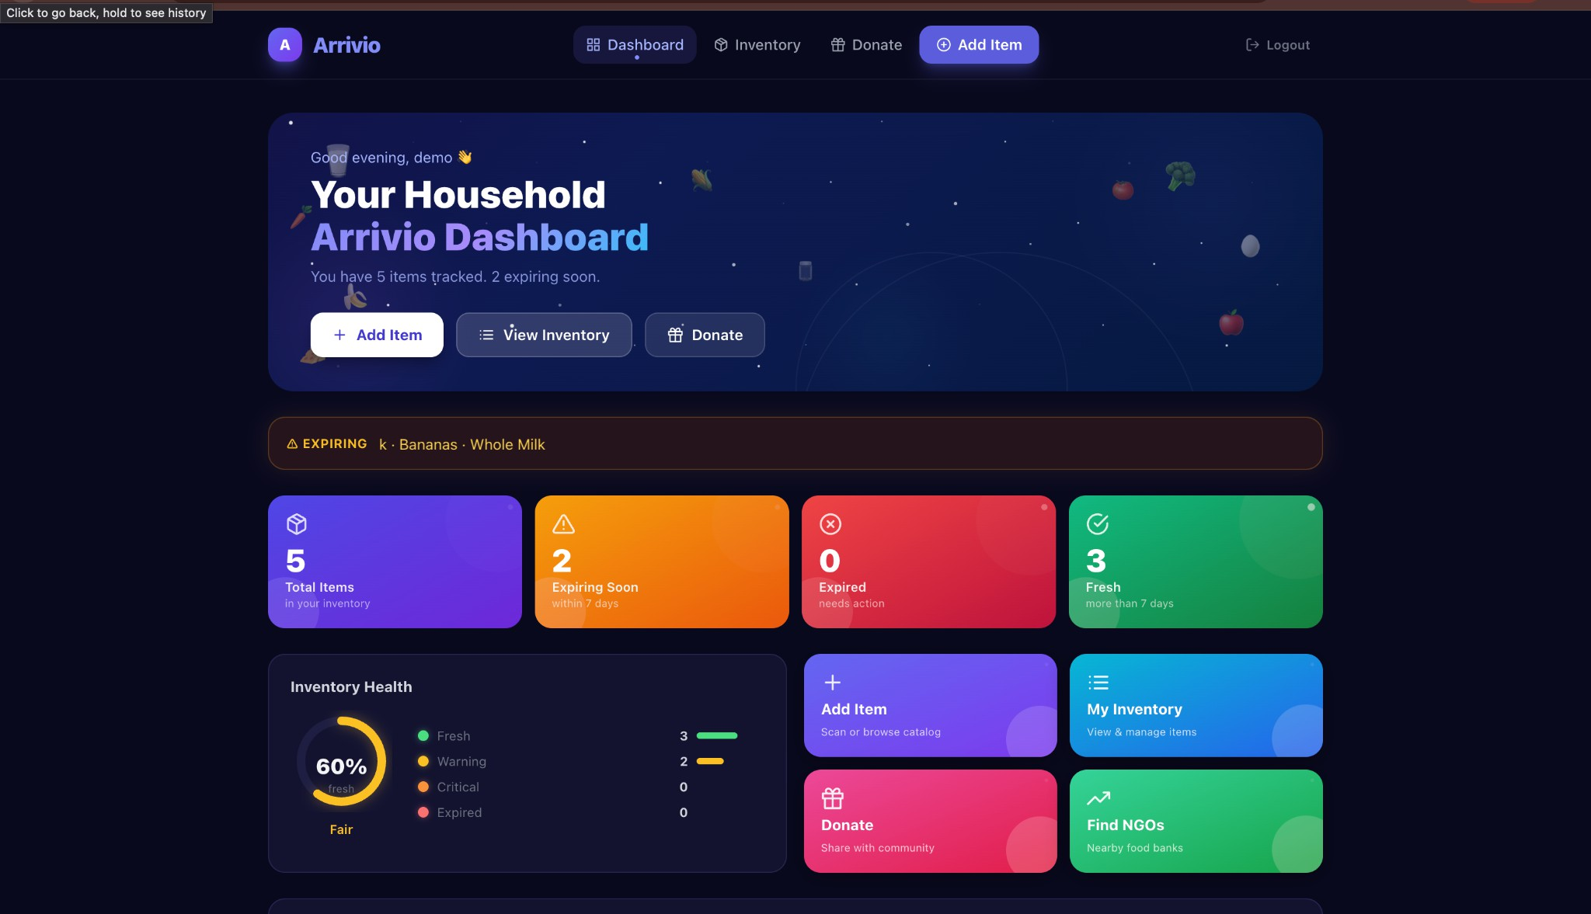
Introduction
What is Arrivio?
📸 INSERT SCREENSHOT HERE
Arrivio Dashboard
(dark theme overview)
A full-stack intelligent web application to help households reduce food waste
Tracks item expiry dates in real-time with colour-coded urgency alerts
Community donation board to share near-expiry food with local members & NGOs
Built on React.js, Node.js, Express & MongoDB
🌍 1.3 Billion tonnes of food wasted globally every year
🏠 30% of household food is discarded without being consumed
🇮🇳 Food worth ₹50,000 crore wasted annually in India

Slide 3
Problem Statement
Why Does Household Food Waste Happen?
😕 Forgetting purchases
People don't remember what they bought or when it expires
📦 No centralised tracker
No single system to manage multiple household items
🗑️ Wasted donations
Near-expiry food that could be donated is simply thrown away
🏢 No NGO connectivity
No easy way to find and connect with local food banks

Slide 4
Key Features
🔴 Expiry Tracking
🤝 Community Donation
📍 NGO Finder
Real-time colour-coded alerts:
Fresh → Warning → Critical → Expired
Peer-to-peer board to list and claim near-expiry food items
Geolocation-based finder for 30+ verified food banks in 8 cities
🌿 Carbon Footprint Tracker
📊 Analytics Dashboard
📋 Inventory Health
Quantifies personal CO₂ savings from donations (EPA methodology)
8-week trend charts, donut & bar charts, waste rate meter
Live household freshness ring with health percentage score

Slide 5
System Architecture
LAYER 1 — FRONTEND
React.js + Tailwind CSS + Redux
Dashboard | Inventory | Donate | Analytics | NGO Finder
⬇ HTTP / REST API (Axios + Cookies)
LAYER 2 — BACKEND
Node.js + Express.js REST API
Auth Routes | Inventory Routes | Donation Routes | JWT (httpOnly Cookie)
⬇ HTTP / REST API (Axios + Cookies)
LAYER 3 — DATABASE
MongoDB (Local / Atlas)
Collections: users | items | donations

Slide 6
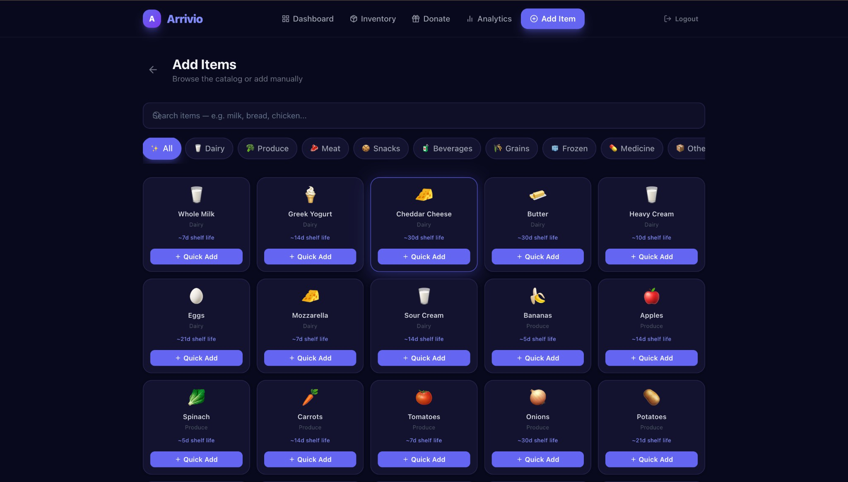
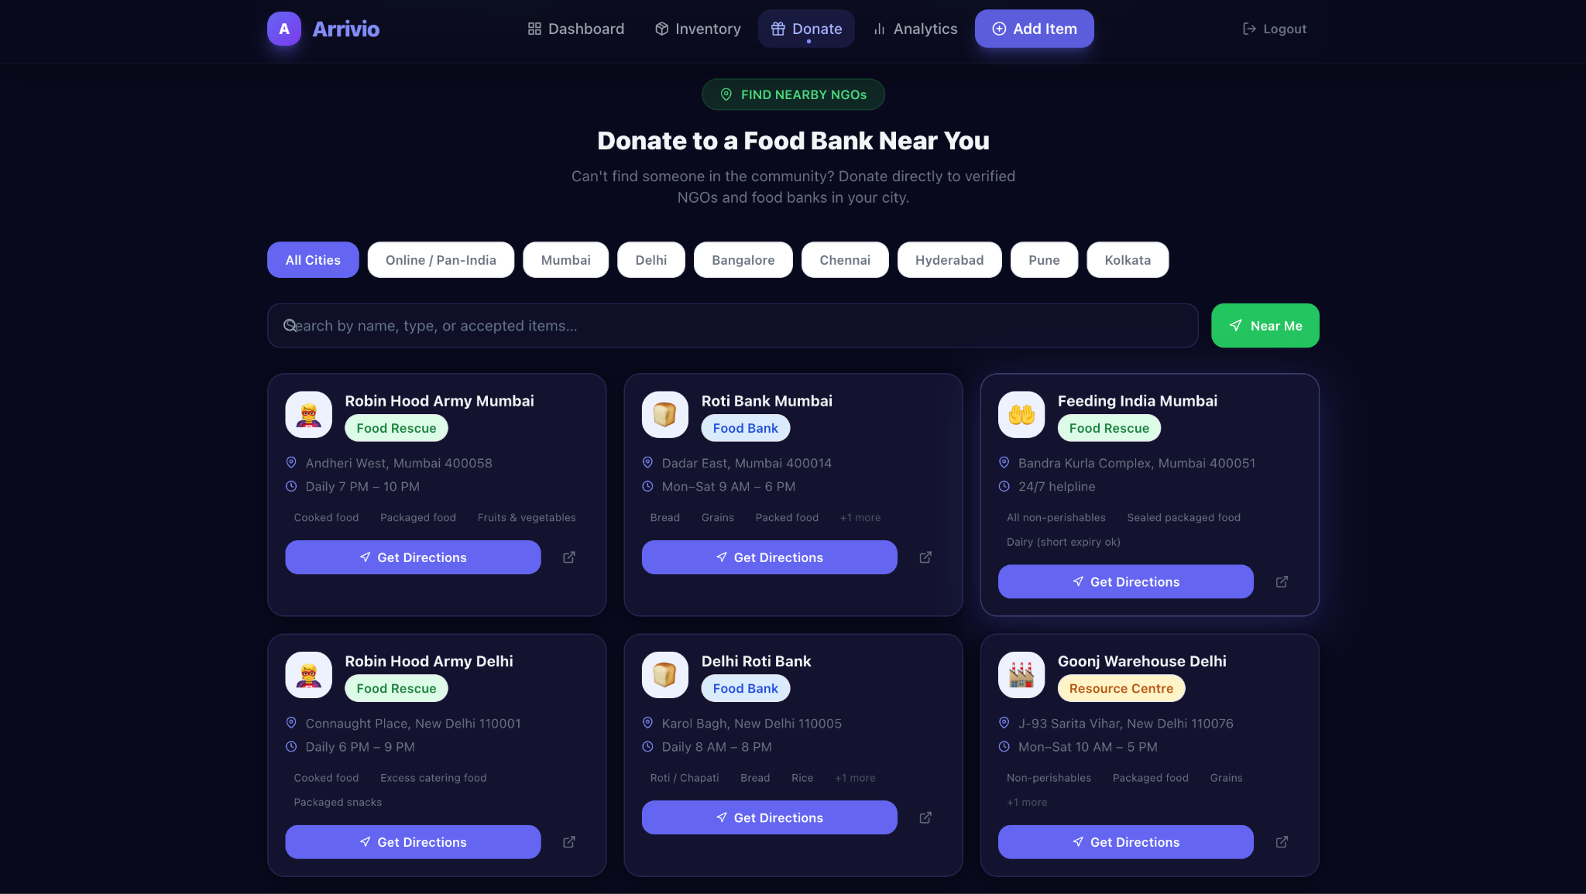
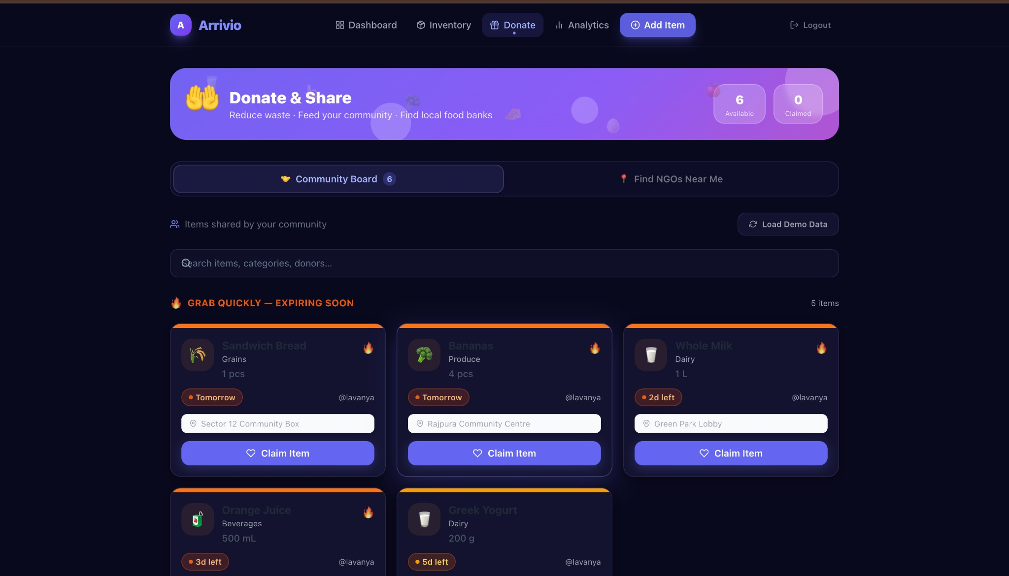
Application Screenshots
📸 Dashboard
(Insert dashboard screenshot showing stat cards & health ring)
📸 Inventory View
(Insert inventory list with colour-coded urgency badges)
📸 Donation Board
(Insert community board with 'Grab Quickly — Expiring Soon' items)
📸 NGO Finder
(Insert NGO finder page with city filters & Get Directions)

Slide 7
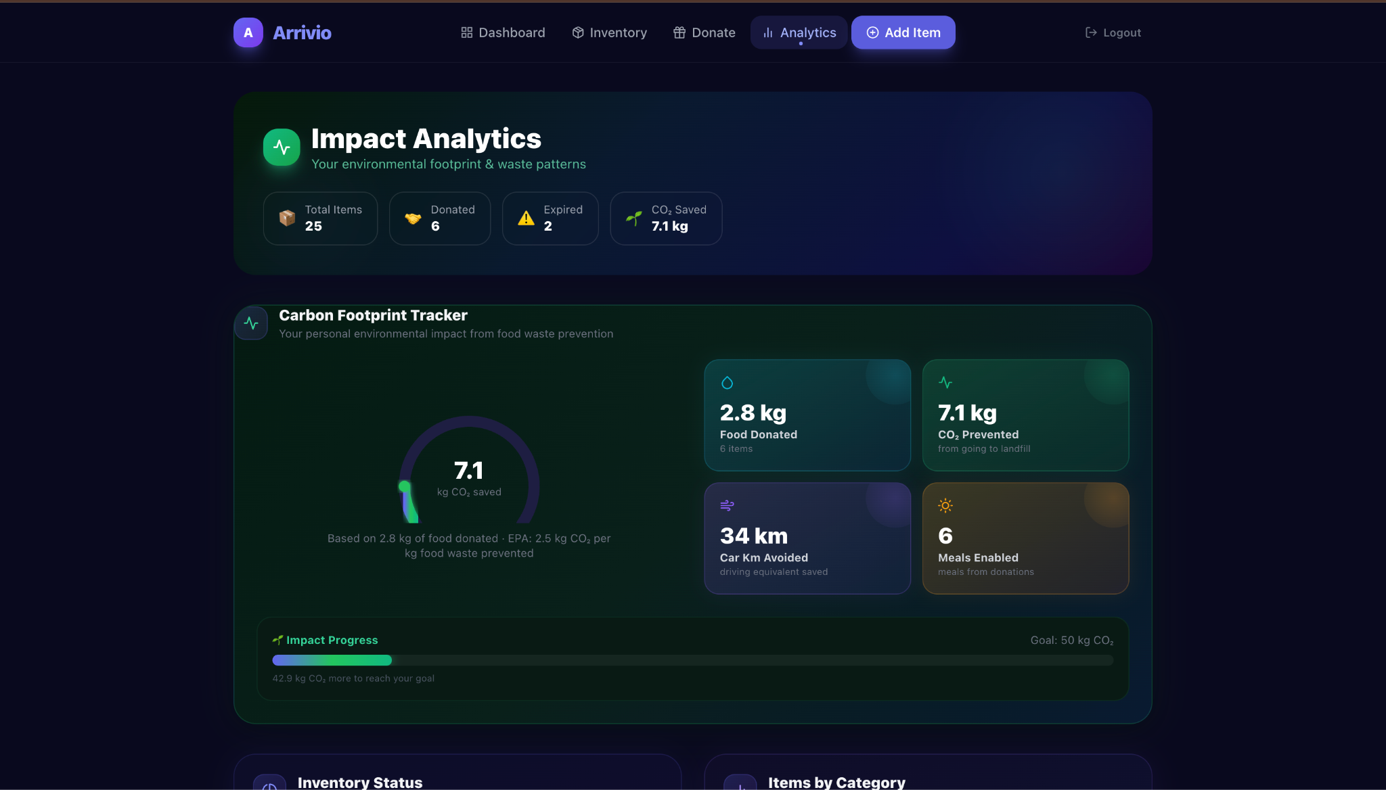
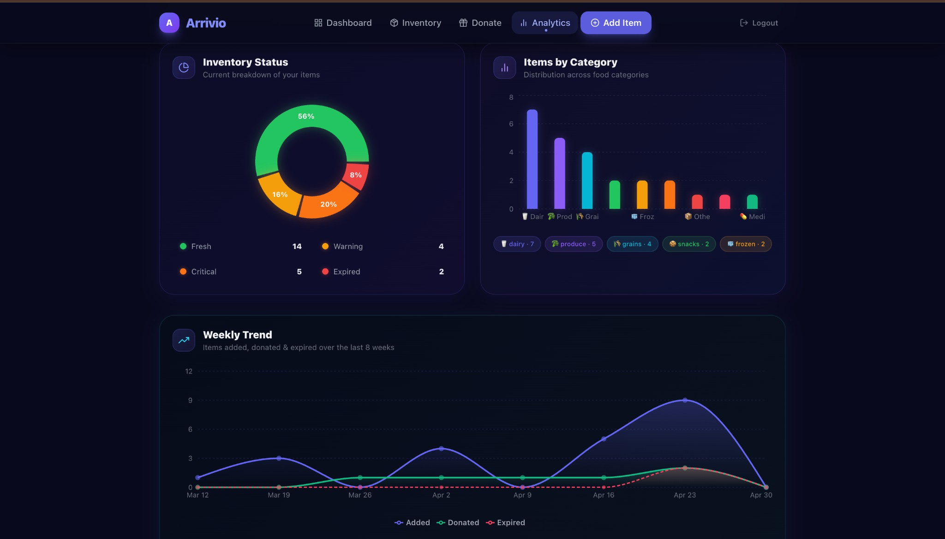
Impact Analytics & Carbon Footprint Tracker
📸 INSERT SCREENSHOT HERE
Carbon Footprint Tracker
• CO₂ saved = kg donated × 2.5 kg CO₂/kg
• Car km avoided = CO₂ saved ÷ 0.21 kg CO₂/km
• Meals enabled = kg donated ÷ 0.5 kg per meal
Analytics Dashboard Charts
• Inventory Status Donut — Fresh/Warning/Critical/Expired
• Category Bar Chart — Items across 9 food categories
• 8-Week Trend Area Chart — Added / Donated / Expired
• Waste Rate Circular Meter — Green / Amber / Red rating

Slide 8
Results & Social Impact
Household
(1,000 families)
Community
20% waste reduction
~20,000 kg food saved annually
67% claim rate
Food redistribution addressing food insecurity
Environmental
Individual
~2.5 kg CO₂ eliminated
per kg of food waste prevented
CO₂ tracker creates personal
accountability & behaviour feedback loop

Slide 9
Conclusion
What Makes Arrivio Unique?
First platform to unify expiry tracking, peer-to-peer donation, NGO integration & carbon analytics in one free app
Real-time colour-coded urgency intelligence: Fresh / Warning / Critical / Expired
Geolocation-based NGO finder with 30+ verified food banks across 8 Indian cities
Carbon Footprint Tracker backed by EPA-cited methodology
Interactive Impact Analytics Dashboard with 4 chart types & dedicated API endpoint
Validated via user testing — measurable improvement in waste reduction intent

Slide 10
Thank You
Lavanya Kapoor | 2210991850
Supervised by: Dr. Preeti Saini
Department of Computer Science and Engineering, Chitkara University, Punjab

