Slide 1

A Seminar Presentation on
“PARSELTONGUE - VOICE CODING”
Presented By
KANIKA DHYANI (1MJ16CS722)
SAURAV MISHRA (1MJ16CS745)
ABHIRAM BVS (1MJ16CS004)
LAVANYA S (1MJ16CS068)
Seminar Guide - Mr. Karthick Myilvahanan
Associate Professor, Dept of CSE,
MVJCE, Bangalore
Approved by AICTE |Affiliated to VTU | Recognized by UGC with 2(f) & 12(B) status |Accredited by NBA and NAAC

Slide 2
Problem Statement
Some software developers may have physical limitations to use their full mental potential. For these developers, the usage of keyboard and mouse may not be very feasible. Weather it may be developers who have been coding for years and suddenly couldn’t do it anymore or beginners who want to learn and discover the universe of software development.
When the world is moving towards neutral networks and AI, it's necessary that the communication with any machine becomes more natural and surpasses these physical limitations. The simple concept if coding by using voice command may sound very acceptable but indeed is a myth.
Voice coding can not only enable the genius coders who have lost their ability to code but not the immense creative minds, but also enable us to communicate with machines in a more natural way. It will help in bridging the gap between humans and machines and the complex human emotion of yes, maybe, not sure etc. So now that we have a vision in our mind, let’s explore they way we can make this a reality.
Approved by AICTE |Affiliated to VTU | Recognized by UGC with 2(f) & 12(B) status |Accredited by NBA and NAAC

Slide 3

PARSELTONGUE
Approved by AICTE |Affiliated to VTU | Recognized by UGC with 2(f) & 12(B) status |Accredited by NBA and NAAC

Slide 4
Abstract
Dragonfly is a speech recognition framework. It is a Python package which offers a high-level object model and allows its users to easily write scripts, macros, and programs which use speech recognition.
Dragonfly was written to make it very easy for Python macros, scripts, and applications to interface with speech recognition engines. Its design allows speech commands and grammar objects to be treated as first-class Python objects. This allows easy and intuitive definition of complex command grammars and greatly simplifies processing recognition results.
Dragon NaturallySpeaking (DNS) is a speech recognition software we will be using to give speech input. Dragonfly uses Natlink to communicate with DNS. The code that will be entered by the users will be entered using the continuous speech mode supported by the Dragon NaturallySpeaking.
Approved by AICTE |Affiliated to VTU | Recognized by UGC with 2(f) & 12(B) status |Accredited by NBA and NAAC

Slide 5
Existing System
In existing system a generator for voice recognition syntax-directed programming environments is used. It takes as input a context free grammar (CFG) for a programming language, such as Basic, C, C++, Java, or an XML DTD or XML Schema, together with a voice vocabulary for that language. The voice vocabulary includes the literals from the programming language; the names of classes and functions from the class and function libraries available and associate them with a list of pronounceable words and phrases that the programmer would use to enter and edit a program in the language.
Vocal Generator generates as output a programming environment in which the programmer can write programs by voice input alone. This programming environment includes a voice recognition syntax-directed program editor. This voice recognition syntax-directed program editor aids the programmer by providing automatic completion of program text and appropriate navigation relative to the specific programming language. A voice recognition syntax-directed program editor can also be used to edit programs that have already been developed. It analyzes a given program and generate the vocabulary used in the specific program.
Approved by AICTE |Affiliated to VTU | Recognized by UGC with 2(f) & 12(B) status |Accredited by NBA and NAAC

Slide 6
Existing System
Once Vocal Generator has been built it can be used several times to generate programming environments that support voice recognition syntax-directed programming in specific programming languages. Relatively little effort is required to prepare the input grammar and voice vocabulary for each additional programming language.
Disadvantage
Computer languages are not spoken, they exist only in written form. A significant effort will be necessary to determine how to vocalize these languages. This is an issue that has not been explored yet.
Approved by AICTE |Affiliated to VTU | Recognized by UGC with 2(f) & 12(B) status |Accredited by NBA and NAAC

Slide 7
Literature Survey 1
Title | Programming by voice, Vocal Programming
Year | 2000
Methodology | Syntax based programming
Technology | Dragon Naturally Speaking Microsoft Visual C++
Benefits | Generates programming environment for different languages Syntax based text editor provides navigation and selection
Issues | A significant effort will be necessary to determine how to vocalize these languages. This is an issue that has not been explored yet
Future Work | To make pronunciation of keywords in programming language more user friendly
Approved by AICTE |Affiliated to VTU | Recognized by UGC with 2(f) & 12(B) status |Accredited by NBA and NAAC

Slide 8
Literature Survey 2
Title | Voice Recognition Applications for Programming Environments
Year | 1989
Methodology | Finite State Machine
Technology | Syntax based Speech Recognition
Benefits | Structured Vocabulary
Issues | The system should be trained many times overheating of some of the hardware components
Future Work | To make the system platform-independent
Approved by AICTE |Affiliated to VTU | Recognized by UGC with 2(f) & 12(B) status |Accredited by NBA and NAAC

Slide 9
Literature Survey 3
Title | Web Based Programming Tool with Speech Recognition for Visually Impaired Users
Year | 2017
Methodology | Waterfall Model
Technology | Automatic Speech Recognition Braille converter
Benefits | Accuracy is more than 85% Failed to give accurate results in very high noise areas
Issues | The application contain limited number of datasets with the sounds and words.
Future Work | Extra datasets can be added
Approved by AICTE |Affiliated to VTU | Recognized by UGC with 2(f) & 12(B) status |Accredited by NBA and NAAC

Slide 10
Hardware Requirements
Minimum Hardware Requirements
RAM: 4 GB
CPU: Intel® dual core or equivalent AMD processor (Faster processors yield faster performance)
HDD: 8 GB for DNS and 150 MB for Parseltongue
OS: Microsoft Windows 7 or newer
Sound card: Sound card that supports 16-bit recording
Microphone: Built-in or External microphone

Slide 11
Software Requirements
Dragon NaturallySpeaking 15 (or above) - Speech Recognition Engine
Python 2.7 (or above) - Required to execute the Parseltongue’s commands and functions
Python 3.6 (or above) - Required to execute python programs written using Parseltongue
Python Modules:
Dragonfly 2 - It is a speech recognition framework for Python that makes it convenient to create custom commands to use with speech recognition software.
WxPython - It is a cross-platform GUI toolkit for the Python.
PyWin - It provides access to much of the Win32 API, the ability to create and use COM objects
Natlink - It is an extension for Dragon which allows a user to create custom voice commands using Python rather than Advanced Scripting.
Unimacro - It provide a rich set of command grammars, that can be configured by the users without programming knowledge. It is the extension of Natlink.
Vocola - It aims for easily making user defined commands. It is the extension of Natlink.

Slide 12
Block Diagram
Dragonfly
(Python Framework)
Text Editor
Vocola
Dragon
Naturally Speaking
Natlink
Unimacro
Parseltongue Module
Approved by AICTE |Affiliated to VTU | Recognized by UGC with 2(f) & 12(B) status |Accredited by NBA and NAAC

Slide 13
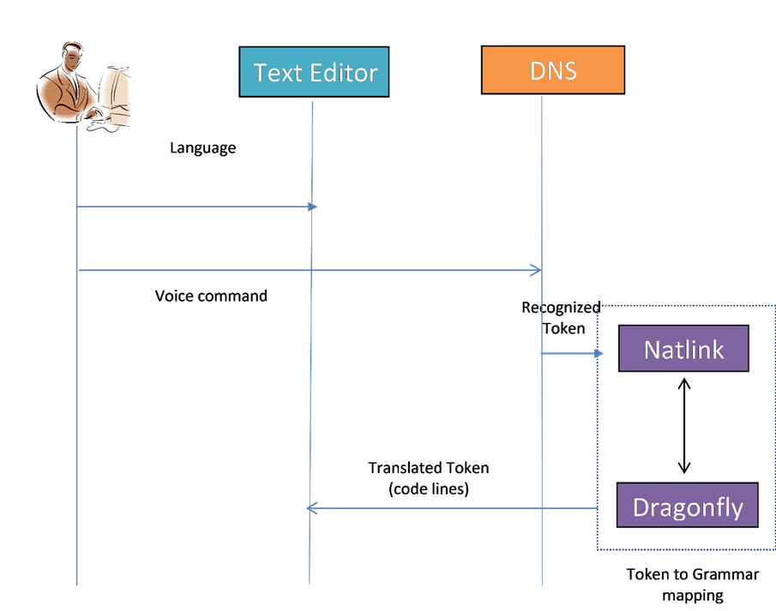
Sequence Diagram
Approved by AICTE |Affiliated to VTU | Recognized by UGC with 2(f) & 12(B) status |Accredited by NBA and NAAC

Slide 14
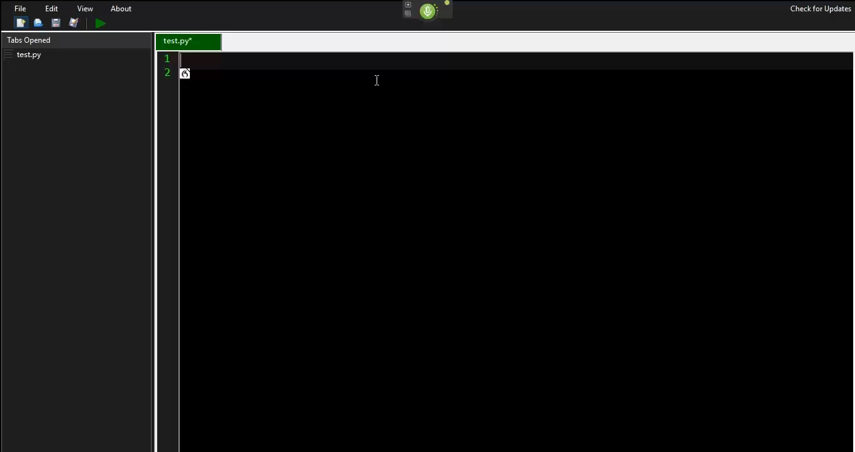
Results
Program to Add two numbers using Dragonfly and Parseltongue Grammar
Approved by AICTE |Affiliated to VTU | Recognized by UGC with 2(f) & 12(B) status |Accredited by NBA and NAAC

Slide 15
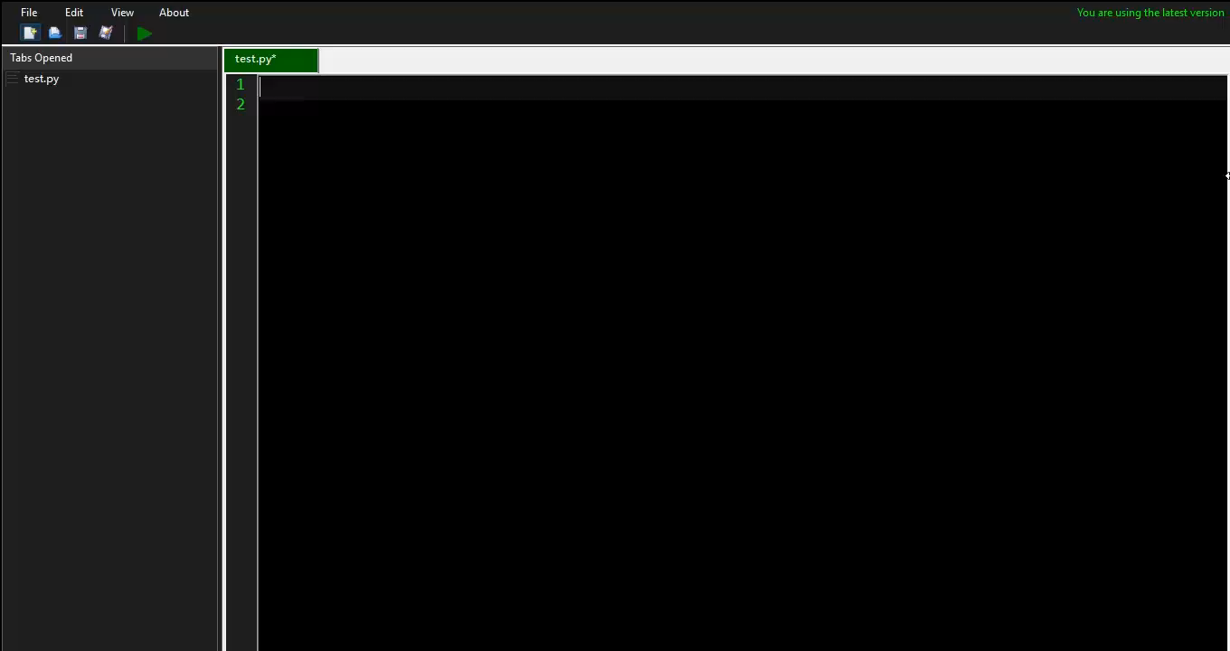
Performance: Speed
Test Case 1 (Typing): Program to check Leap Year
Video Duration: 120 seconds Typing Duration: 107 seconds
Approved by AICTE |Affiliated to VTU | Recognized by UGC with 2(f) & 12(B) status |Accredited by NBA and NAAC

Slide 16
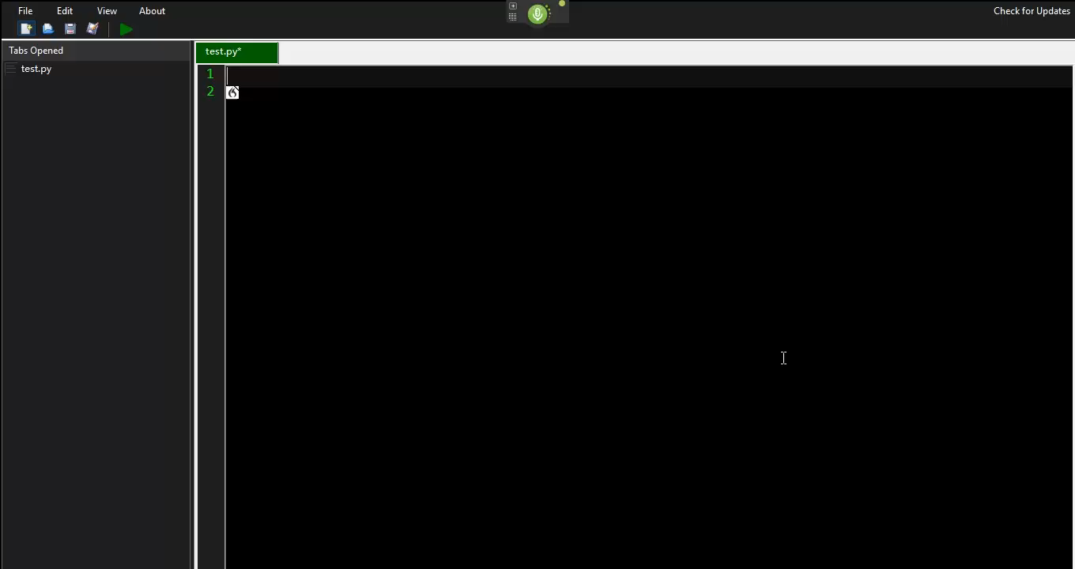
Performance: Speed
Test Case 1 (Parseltongue): Program to check Leap Year
Video Duration: 76 seconds Dictating Duration: 51 seconds
Approved by AICTE |Affiliated to VTU | Recognized by UGC with 2(f) & 12(B) status |Accredited by NBA and NAAC

Slide 17

Performance: Speed
Test Case 2 (Typing): Program to add two numbers
Video Duration: 58 seconds Typing Duration: 50 seconds
Approved by AICTE |Affiliated to VTU | Recognized by UGC with 2(f) & 12(B) status |Accredited by NBA and NAAC

Slide 18
Performance: Speed
Test Case 2 (Parseltongue): Program to add two numbers
Video Duration: 35 seconds Dictating Duration: 24 seconds
Approved by AICTE |Affiliated to VTU | Recognized by UGC with 2(f) & 12(B) status |Accredited by NBA and NAAC

Slide 19
Performance: Speed
Case\Scenarios | Typing | Dictating | No. of Characters | CPS (Characters per second) |  | Performance Increase
 |  |  |  | Typing | Dictating
Test Case 1 (Print “Hello, World!”) | 11 seconds | 6.25 seconds | 22 | 2.00 | 3.52 | 76%
Test Case 2 (Sum of two numbers) | 37.75 seconds | 23.25 seconds | 85 | 2.25 | 3.66 | 62%
Test Case 3 (Check odd or even) | 58.25 seconds | 34 seconds | 124 | 2.13 | 3.65 | 71%
Test Case 4 (Check Leap Year) | 101.5 seconds | 60.5 seconds | 214 | 2.11 | 3.54 | 68%
Test Case 5 (Check prime number) | 131 seconds | 74.75 seconds | 292 | 2.23 | 3.93 | 75%
Avg. typing speed: 2.14 CPS
Avg. dictating speed: 3.66 CPS
Avg. Performance Increase: 71%
Typing Speed vs Dictation Speed
Approved by AICTE |Affiliated to VTU | Recognized by UGC with 2(f) & 12(B) status |Accredited by NBA and NAAC

Slide 20
Performance: Accuracy
Train data | Number of test | Tests detected successfully
print | 200 | 197
while | 200 | 178
define | 200 | 192
read | 200 | 190
for | 200 | 162
variable | 200 | 181
Train data | Number of test | Tests spoken successfully
print | 200 | 200
while | 200 | 192
define | 200 | 180
read | 200 | 188
for | 200 | 197
variable | 200 | 183
Computer’s accuracy test (dictation)
Accuracy: 91.67%
Human’s accuracy test (dictation)
Accuracy: 95%
Average Typing Accuracy for Human: 92%
Average Parseltongue Accuracy: 93.33%
Typing Accuracy vs Dictation Accuracy
Approved by AICTE |Affiliated to VTU | Recognized by UGC with 2(f) & 12(B) status |Accredited by NBA and NAAC

Slide 21
Performance: Graphical Representation
Approved by AICTE |Affiliated to VTU | Recognized by UGC with 2(f) & 12(B) status |Accredited by NBA and NAAC

Slide 22
Performance: Graphical Representation
Approved by AICTE |Affiliated to VTU | Recognized by UGC with 2(f) & 12(B) status |Accredited by NBA and NAAC

Slide 23
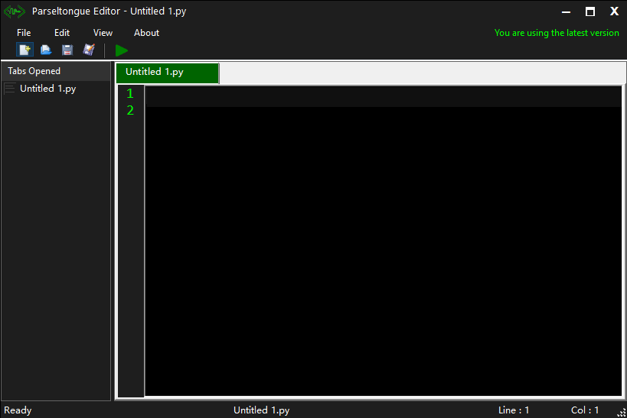
Additional Work
Parseltongue Editor
Approved by AICTE |Affiliated to VTU | Recognized by UGC with 2(f) & 12(B) status |Accredited by NBA and NAAC

Slide 24
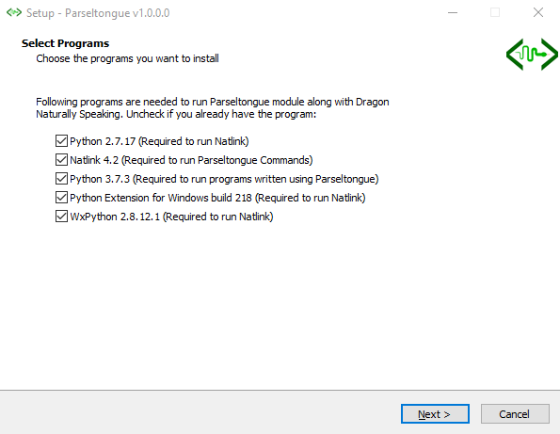
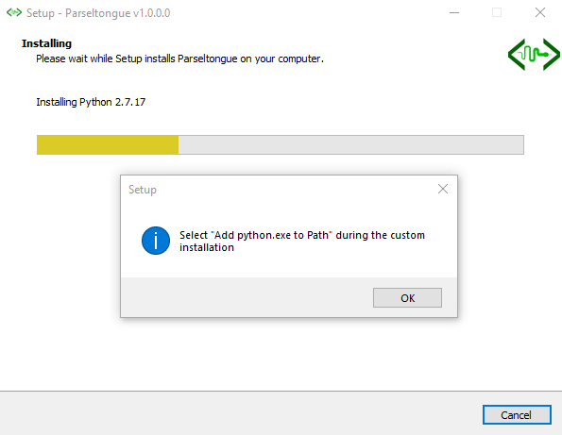
Additional Work
Parseltongue Bundle & Documentation
Github: https://github.com/DhyaniKanika/parseltongue
Approved by AICTE |Affiliated to VTU | Recognized by UGC with 2(f) & 12(B) status |Accredited by NBA and NAAC

Slide 25
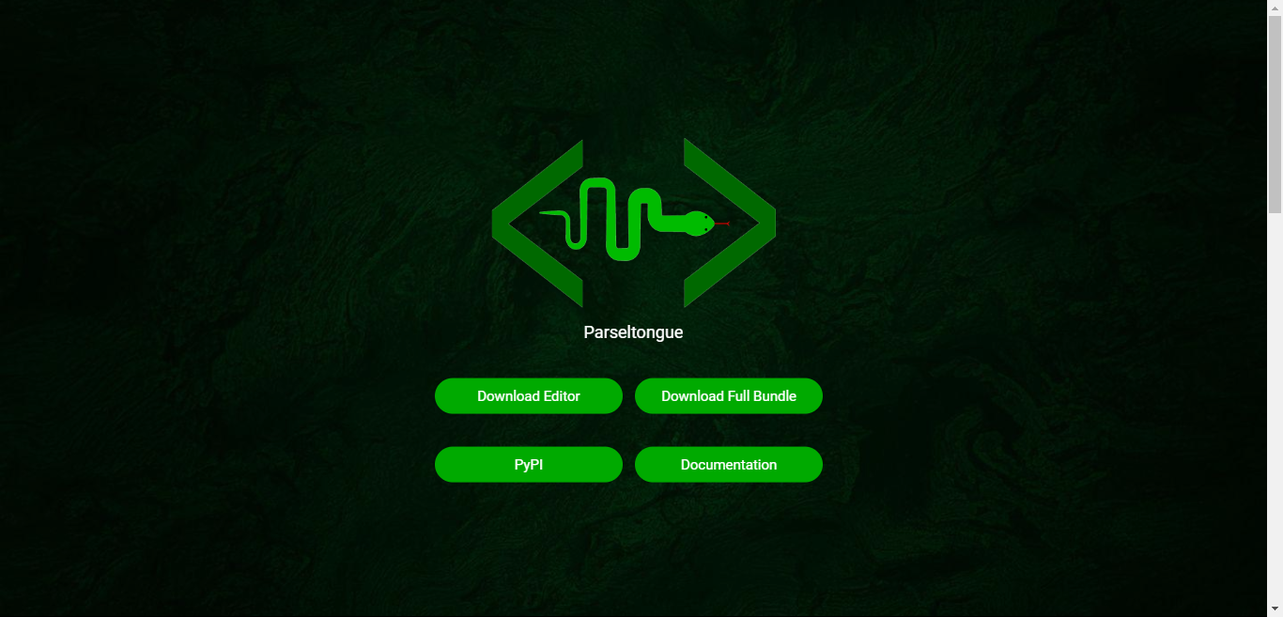
Additional Work
Website (www.Parseltongue.ml)
Approved by AICTE |Affiliated to VTU | Recognized by UGC with 2(f) & 12(B) status |Accredited by NBA and NAAC

Slide 26
Advantages and Disadvantages
Advantages
More accurate and faster than typing.
Errors committed by the user is lower when compared to typing.
Can be used by people not familiar with the syntax of the programming language.
Can be used by anyone facing physical limitations such as RSI or vision loss.
Disadvantages
Performance is highly dependent on the user’s system. Better systems will give more accurate and fast results.
For accuracy to increase, the user need to train the speech recognition engine to get accustomed to his/her natural way of speaking.
The setups very tedious and requires some prerequisites on system handling and directories.
Approved by AICTE |Affiliated to VTU | Recognized by UGC with 2(f) & 12(B) status |Accredited by NBA and NAAC

Slide 27
Scope and Future Work
Parseltongue is flexible enough to be used in different environments
It can be used:
By beginners to learn Python or new programming language
To teach students more on understanding the code rather than remembering the syntax
By developers to code faster
In testing by providing commands to make the process faster
These following implementations are milestones we aim to achieve
Increase the number of commands so that the user can access vast amount of python functions and libraries
Modify Parseltongue to support multiple programming languages
We hope to unable functionalities for blind users such as documentation in Braille and speech output
To simplify the installation process, therefore making it more accessible
Approved by AICTE |Affiliated to VTU | Recognized by UGC with 2(f) & 12(B) status |Accredited by NBA and NAAC

Slide 28
Conclusion
Voice coding has a huge potential yet to be unleashed. We made a small attempt of doing our part in popularizing voice coding by the means of this project. The Parseltongue project although inspired by the laziness to type, has taken us through a long journey Of discovering many ways it will be helpful. We were able design an environment that enables basic code writing with python and navigation through the text editor by using only voice commands. We tested our environment against traditional coding technique; typing and were able to successfully show that our environment is faster and more accurate.
Approved by AICTE |Affiliated to VTU | Recognized by UGC with 2(f) & 12(B) status |Accredited by NBA and NAAC

Slide 29
References
Code By Voice - https://github.com/simianhacker/code-by-voice
Dragonfly - https://code.google.com/archive/p/dragonfly
Dragonfly 2 - https://github.com/dictation-toolbox/dragonfly
Dragonfly Actions sub-package - https://dragonfly2.readthedocs.io/en/latest/actions.html
Hands Free Coding - https://handsfreecoding.org/
Programming by voice, voice coding paper by Stephen C.Arnold and Leo MarkDragon Systems, Dragon NaturallySpeaking SDK, C++ and SAPI Guide and Reference, Newton, Mass. 1999.
Web Based Programming Tool with Speech Recognition for Visually Impaired Users Kaveendra Lunuwilage1 Faculty of Computing, Sri Lanka Institute of Information Technology
Voice Recognition Applications For Programming Environments Adel S. Elmaghraby Engineering Mathematics & Computer Science University of Louisville 1 le, Kentucky
Approved by AICTE |Affiliated to VTU | Recognized by UGC with 2(f) & 12(B) status |Accredited by NBA and NAAC

Slide 30
Thank You

