Slide 1



WHAT MAKES A JOKE FUNNY?
SEBASTIAN LAVERDE ALFONSO & BATHALA SIVA
M.Sc. Computer Science for Digital Media
Big Data Architectures For Machine Learning and Data Mining
Notes:
classifiers

Slide 2
HUMOR DETECTION
What is humor?
Caleb Warren and Peter McGraw: “humor is a psychological response characterized by the positive emotion of amusement, the appraisal that something is funny, and the tendency to laugh.”
What is humor detection ?
Latent Structures behind Humor
Ambiguity
Incongruity
Interpersonal Effect
Phonetic Style
Notes:
Definitios: https://www.cs.cmu.edu/~alavie/papers/D15-1284.pdf
Ambiguity : Ambiguity occours when sentence has a multiple meanings
It’s a crucial component for many humorous jokes
Incongurity: Incongurity suggests that huomor arises when things that do not normally go together and it replaces a logic and familiarity
Eg: outcome is different
Interpersonal effects: Besides humorous theories , One important theory behind the humpr is its social factors , especially regarding inter personal effects on recievers.
i.E humor is essentially associated with the sentiment

Slide 3
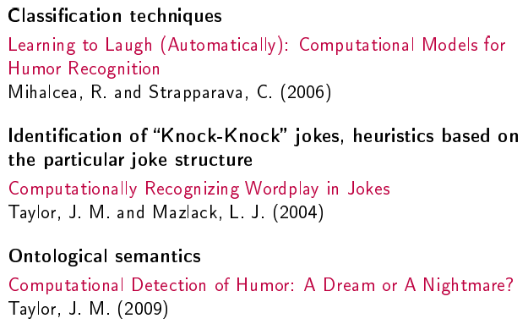
COMPUTATIONAL HUMOR
Computational humor is a branch of computational linguistics and artificial intelligence which uses computers in humor research.
Joke recognition Approaches:

Slide 4

How humor detection works?
1. We experiment with automatic classification techniques using:
(a) Heuristics based on humor-specific stylistic features (alliteration, antonymy, slang);
(b) Content-based features, within a learning framework formulated as a typical text classification task
(c) combined stylistic and content-based features, integrated in a stacked machine learning framework.
2. Use Labeled data to train a regression:

Slide 5
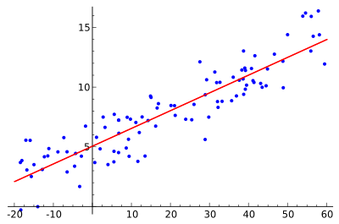
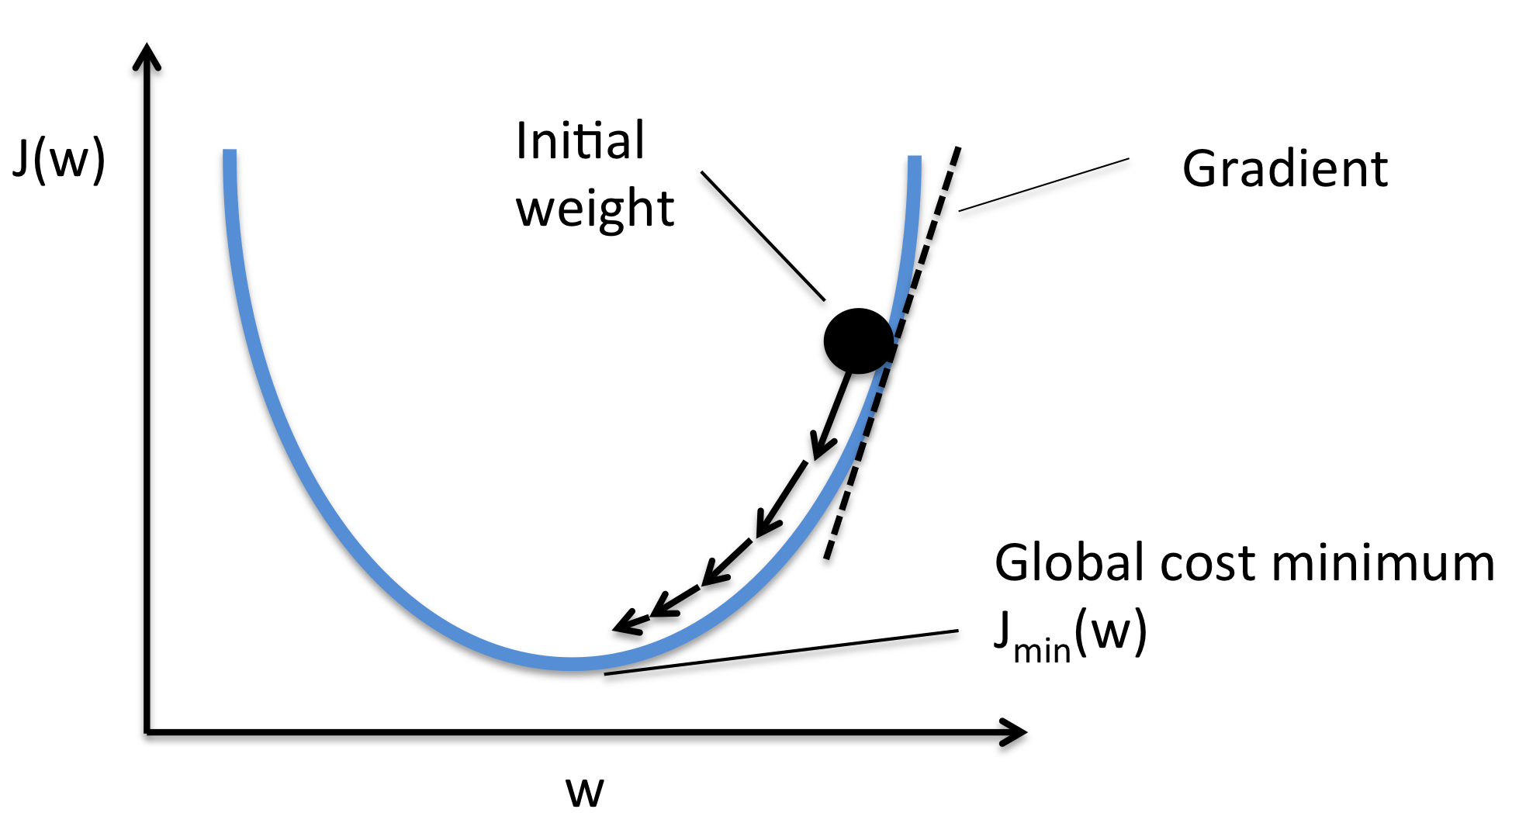
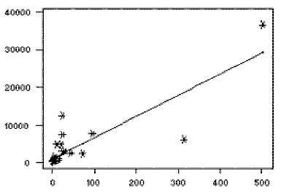
Linear Regression
What is Linear Regression ?
Linear regression attempts to model the relationship between two variables by fitting a linear equation to observed data. One variable is considered to be an explanatory variable, and the other is considered to be a dependent variable.
Linear Regression with SGD ?
Gradient Descent is the process of minimizing a function by following the gradients of the cost function. In machine learning, we can use a technique that evaluates and updates the coefficients every iteration called stochastic gradient descent to minimize the error of a model on our training data.
Least-Squares Regression
The most common method for fitting a regression line is the method of least-squares. This method calculates the best-fitting line for the observed data by minimizing the sum of the squares of the vertical deviations from each data point to the line.

Slide 6
Apache Parquet
The most Apache Parquet is a columnar storage format available to any component in the Hadoop ecosystem, regardless of the data processing framework, data model, or programming language. The Parquet file format incorporates several features that support data warehouse-style operations:
Columnar storage layout
Flexible compression options
Innovative encoding schemes
Large file size
Notes:
Columnar storage layout - A query can examine and perform calculations on all values for a column while reading only a small fraction of the data from a data file or table.
Flexible compression options - Data can be compressed with any of several codecs. Different data files can be compressed differently.
Innovative encoding schemes - Sequences of identical, similar, or related data values can be represented in ways that save disk space and memory. The encoding schemes provide an extra level of space savings beyond overall compression for each data file.
Large file size - The layout of Parquet data files is optimized for queries that process large volumes of data, with individual files in the multimegabyte or even gigabyte range.

Slide 7

Corpus Data Overview
CORPUS DATA
Jokes | 581.250
Others | 398’840.288
Total | 399’421.538
Subreddit
Anime
Travel
Jokes
Jokes
JOKES DATA STATISTICS (score)
mean | 84.25789075268817
stddev | 987.2982631018587
min | 0
max | 95.020
Jokes = 0,15% of total corpus

Slide 8
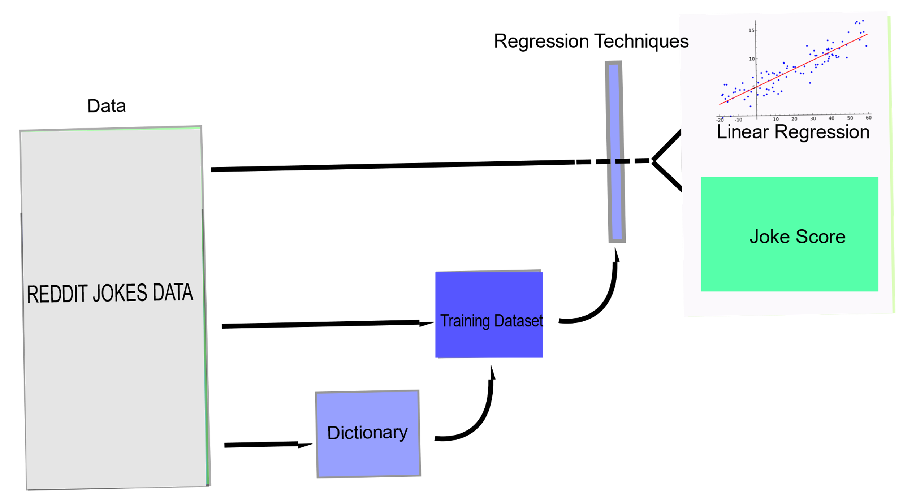
Basic Architecture

Slide 9
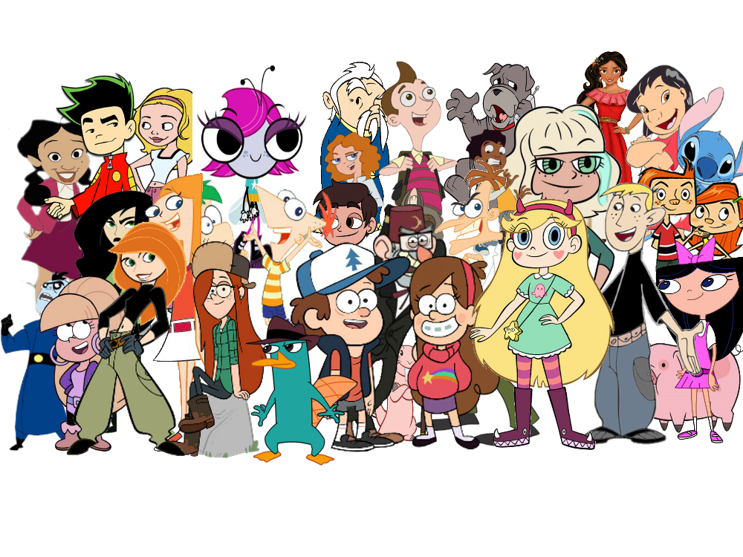

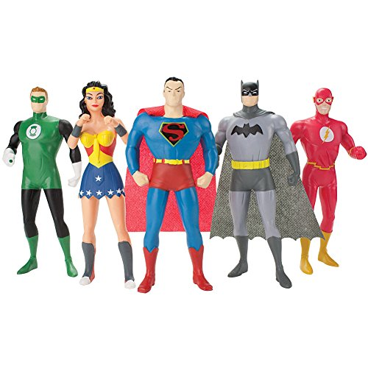
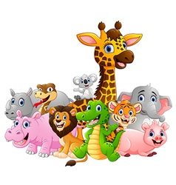
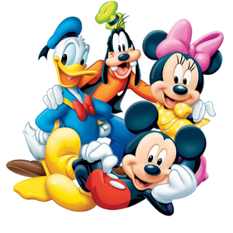
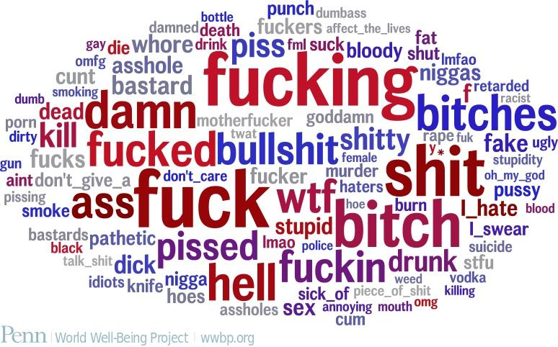
Overview of our Dictionary
Content based feature (dic_score)
Swear Words
Adult Slang
Nationalities
Animals
Superheroes/villains
Disney characters
High score joke words
Cartoons
Movie characters

Slide 10
Added Numeric Features: dicTscore & dicSTscore
dicTscore = How many words in the title are part of our dictionary
dicSTscore = How many words in the selftext are part of our dictionary
Create dictionary and the new features
Remove features that are not numeric (title, selftext)
Run regression algorithm
Predict score using inputs dicTscore and dicSTscore
dicTscore, dicSTscore
LinearRegressionSGD
Predicted Score

Slide 11
Overview of the Project
Reddit Corpus
Data Frame
DataFrame
Select and Filter the Data
Creating the Data frame
Jokes Score
Creating the Model(RDD)
Splitting the Data
Creating the New features
Creating the Dictionaries
Training the Model
Running the prediction

Slide 12
5%
Total number of Jokes = 581.250

Slide 13
51%
Total number of Jokes = 581.250
Titles
Selftext
26%
2, 152.104

Slide 14
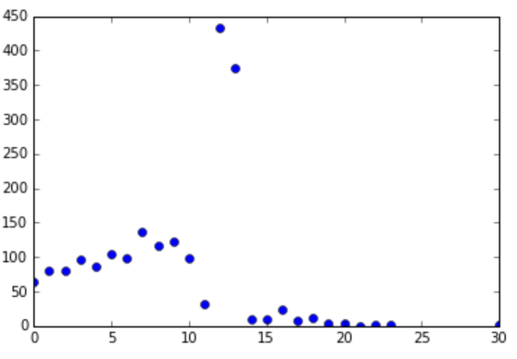
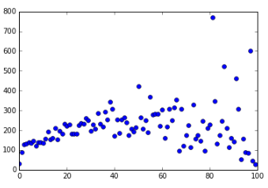
Avg. Score by dicTscore
I don’t distinguish between dicSTscores
Outliers
84
Avg. Score by dicSTscore
dicTscore
Outliers
Each point is contructed by the average score of different number of jokes
Average of the score 84
dicSTscore

Slide 15

Average score graph
Outliers

Slide 16
Average score graph
Linear tendency

Slide 17
Predicted score graph
Linear regression with SGD

Slide 18
Average Score, Predicted Score

Slide 19
Error graph

Slide 20
Average Error per dicTscore
Average Total Error = -65

Slide 21
Improvement
Make a better and clean dictionary
Filter the database from outliers based on score, dicTscore and dicSTscore
Add more semantic features
Run other regression with another distribution (not linear but exponential, gaussian, etc)
Run other algorithm like decision trees and SVM
Combine them all and test a lot
Try measuring other types of error (not compared with the Average but the more typical value perhaps)
Analyse deeply the high_score Jokes
Notes:
Alliteration: This is about the repetition of phonemes in a text. It is a generalization of the rhyme. As stated in [12], structural and phonetic properties of jokes are at least as important as their content.
Ambiguity: It may be explained by the Incongruity Resolution Theory that ambiguity plays an important role, as it gives more than one interpretation to texts. Sjöbergh and Araki [22], Basili and Zanzotto [2], and Reyes, Buscaldi, and Rosso [18] mention different ways to measure it, such as counting the number of meanings of the words that appear or counting the number of possible syntax trees

Slide 22
CONCLUSION
In this project, we showed that regression techniques can be successfully applied for the question : what makes a joke funny?. Experimental results obtained on very large data sets showed that learning approaches can be efficiently used to score humorous texts.
Moreover, we have also showed that it is possible to bootstrap a very large and relatively clean corpus that falls under a certain genre (e.g. humor), starting with a handful of manually selected dataset and using filters based on document structural information and simple thematic clues.
WHAT MAKES A JOKE FUNNY?
By analysis of the linguistic features that emerged like our dictionary and identifying structures behind humor like Ambiguity, Incongruity, Interpersonal Effect, Phonetic Style

Slide 23

score=5162,
title='Two priests are out driving one day..’,
selftext='when they get pulled over by a police officer.\n\nThe cop approaches the priests vehicle and says to the driver\n"Sorry to pull you over father, but we\’re looking for a couple of child molesters"\n\nThe two priests look at each other for a few moments and have a few quiet words to each other. The driver turns back to the cop and says;\n\n"Alright officer, we\'ll do it"'

Slide 24
REFERENCES
https://www.wolframcloud.com/objects/agriffin/HumorDetector
http://www.coli.uni-saarland.de/courses/cacl10/slides/Humor_Kaeshammer.
http://web.eecs.umich.edu/~mihalcea/papers/mihalcea.emnlp05b.pdf
https://www.cs.ox.ac.uk/files/244/mihalcea.cicling07.pdf
https://github.com/pln-fing-udelar/pghumorhttps://pdfs.semanticscholar.org/9b13/5cab89155147f56559ddcc10b404c44f5db9.pd
https://web.stanford.edu/~jurafsky/slp3/6.
https://github.com/wsilva/humor-classifier-with-naive-bayes/blob/master/python/NaiveBayesWordClassifier.py

