Slide 1



KaggleX- Showcase 2023
Notes:
Recommending picking out he most interesting and important parts from your documentation.

Slide 2
Customer Churn in Telecommunication
Lavinia Lau

Slide 3
Background
Professional / academic background
Business Analytics Manager at Gateway Casinos, Canada
MSc in Data Science and Business Statistics, and degree in Marketing
Current line of work
Datamine customer and marketing data to tackle business challenges, and deliver actionable insights for informed decision-making
Translate abstract data science concepts into practical solutions for non-technical internal clients
Aspirations
Continuously learn and stay updated on various data science techniques to effectively address business challenges with the most suitable solutions

Slide 4
Project Definition
Project summary: Analyze customers’ churn based on their demographics, subscribed services and account information, so as to adjust marketing offers / services to prevent the potential churn (i.e. leaving a company).
Topics covered:
Preparation & Exploration
Project setup for reproducible results
Data cleansing
Exploratory data analysis (EDA) and feature engineering
Data visualization to study relationship
Mutual information
Machine Learning
Handle imbalance classification data using SMOTE
Data preprocessing for categorical data (label encoding) and numerical data (scaling)
3 ML models: Random forest, XGBoost and Neural Network
Model evaluation for classification (accuracy score and classification report)
Permutation importance for feature selection
Model Explainability & Applications
1D partial dependence plots for discovering tipping points
2D partial dependence plots for further insights into marketing applications
SHAP summary plot

Slide 5
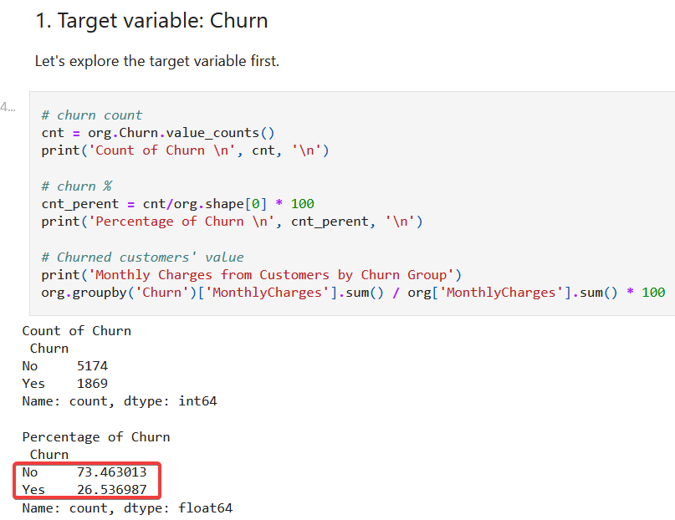
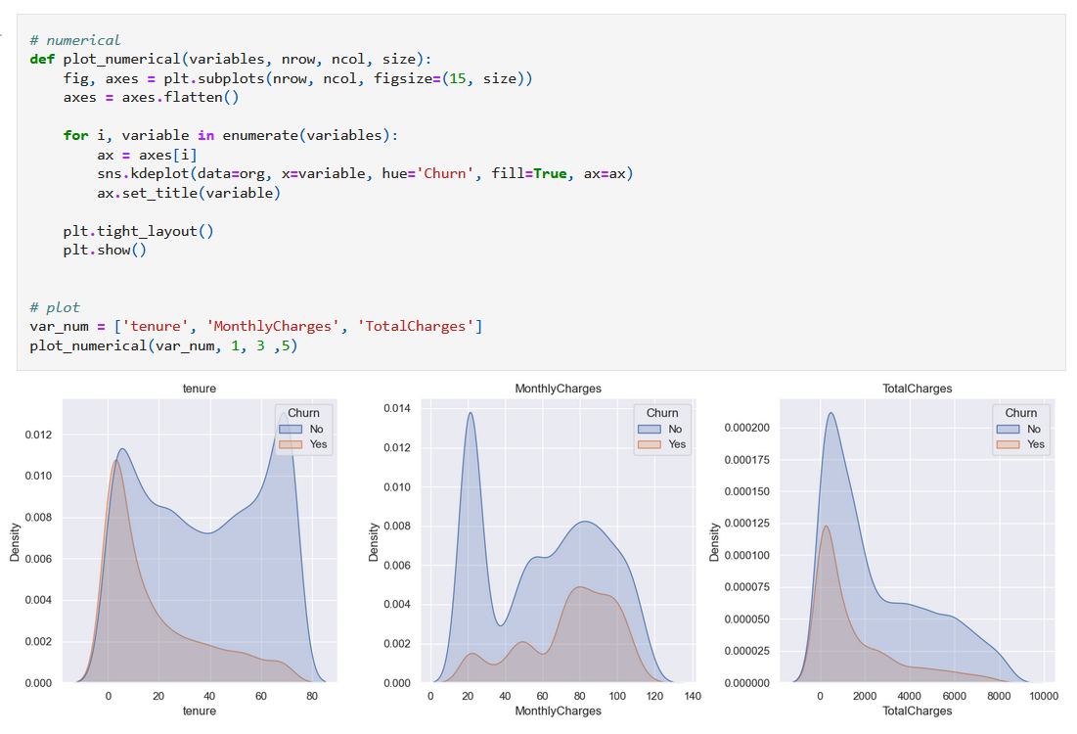
Preparation and Exploration
This is a classification problem with an imbalanced target variable, which I will address the imbalance using SMOTE later.
I have also studied the churn rate with all independent variables. Below is an example of plotting multiple density plots at once for EDA. Monthly charges and contract length are the two key factors influencing churn.
Notes:
Test

Slide 6
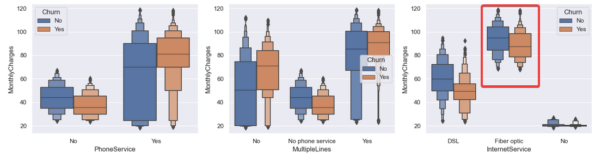
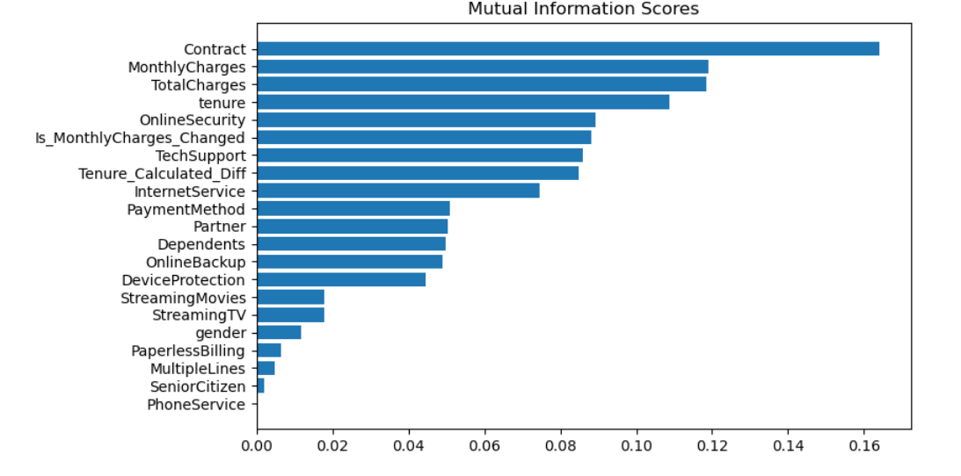
Preparation and Exploration
After locating price is a key factor in churn, I have plotted it against other categorical variables. Some services (e.g. fiber optics) are more expensive than others.
Before modelling, I have used mutual information to rank the variables by their scores.

Slide 7
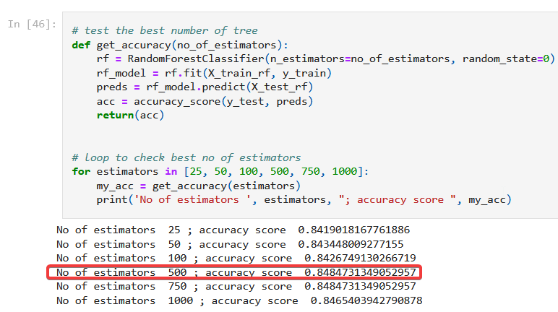
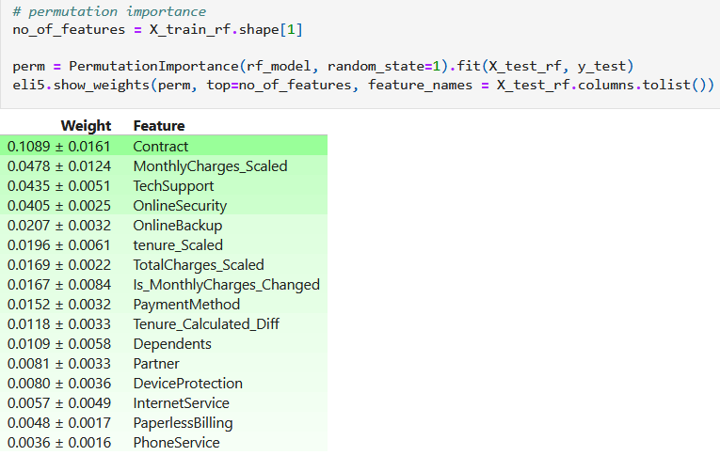
Machine Learning (Model Parameters and Feature Selection)
After preprocessing the numerical data by scaling and categorical by label encoding, I proceed to predict churn by applying random forest, XGBoost and Neural Network.
We also need to finetune the models’ number of estimators to see when accuracy score peaks.
In addition to adjusting parameters, I employed permutation importance for feature selection. If a feature has a low impact, I remove it and rerun the model to assess if performance improves.

Slide 8
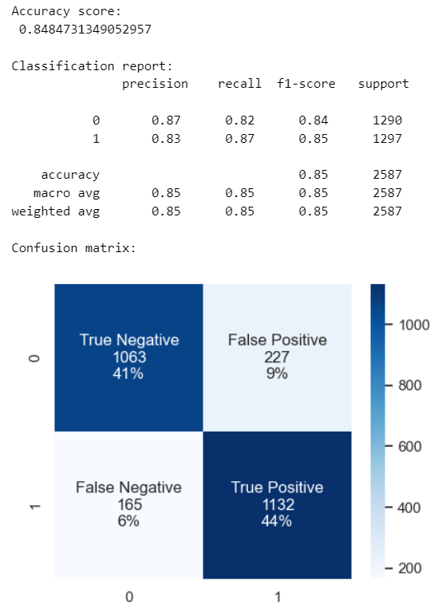
Machine Learning (Model Evaluation and Comparison)
The picture on the left shows the accuracy score, classification report and confusion matrix of the random forest model. We will mainly focus on churned group as we will want to retain the potential churned customers.
Below is the comparison of different models:
Models | Random Forest | XGBoost | Neural Network
Accuracy score (overall) | 84.8% | 84.7% | 82.6%
Precision of churned customers | 83% | 83% | 82%
Recall of churned customers | 87% | 87% | 83%
Precision for churned customers measures how accurately we identify customers who will churn. Recall for churned customers gauges our ability to catch all customers who genuinely churn.
Random Forest got the best result.

Slide 9
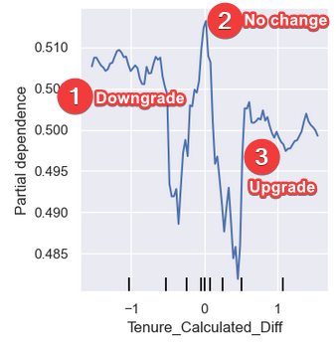
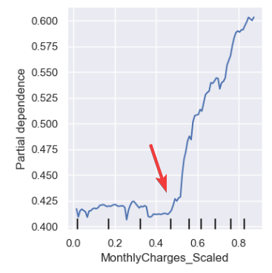
Explainability & Applications - What Are the Tipping Points?
Tipping point means the threshold where customers' churn rate changes significantly. We can create 1D partial dependence plots for individual variables to understand how they affect customer churn. Below are some examples of applications.
During feature engineering, I have created a new variable to see if customers have downgrade / upgrade their contract.
Observations:
- No change: Highest churn
- Downgrade: Some degree of churn
- Upgrade: Lowest churn
Implications:
Allow customers to change their contract if they reach out to terminate it.
Churn rate increases significantly when monthly charges hit $68.5 (i.e. Monthly charges scaled > 0.5).

Slide 10
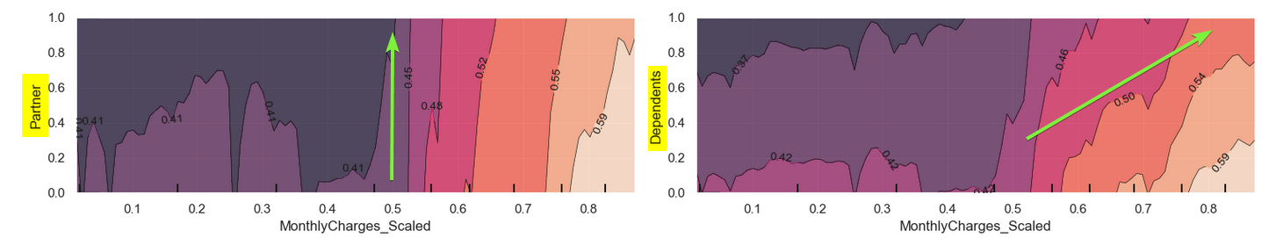
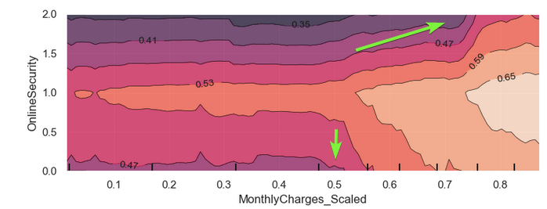
Explainability & Applications - What Other Factors Can We Manipulate?
We want to determine if customers are more willing to accept higher charges under specific circumstances so we can adapt our strategy accordingly. Below are some examples of 2D partial dependence plots for this purpose.
Observations:
The top two graphs show customers will leave if charges go higher than $68.5, with or without a partner. But Customers with dependents are more accepting of higher charges.
The bottom graph shows customers with online security service leave when charges reach $88.6, $20 dollar more than the baseline tipping point $68.5.

Slide 11
Project Links
Project details with python code and commentary: https://github.com/Lavinialau/Telecom-churn/blob/master/01_code/0_summary.ipynb

