Slide 1
Relevel Assignment - Data Analytics Internship
Create ‘Model for Product Recommendation’
Presented By: Lavish P.Isasare

Slide 2
A bit about myself...

Slide 3
Lavish Isasare, Wardha, Maharashtra, India.
Education : Bachelors of Engineering in Mechanical
Data Scientist
Forte : Auto ML and A.I.
Looking for an opportunity to showcase my skills.
Please visit my LinkedIn Profile .
For Projects, Please visit my GitHub Profile.

Slide 4
Product Recommendations
Mounting Drive and load the dataset
Exploratory Data Analysis (EDA)
Pre-processing and Feature Engineering
Train-test split
Model Creation,Fitting and Accuracy
Recommendation (Prediction)
Conclusion

Slide 5
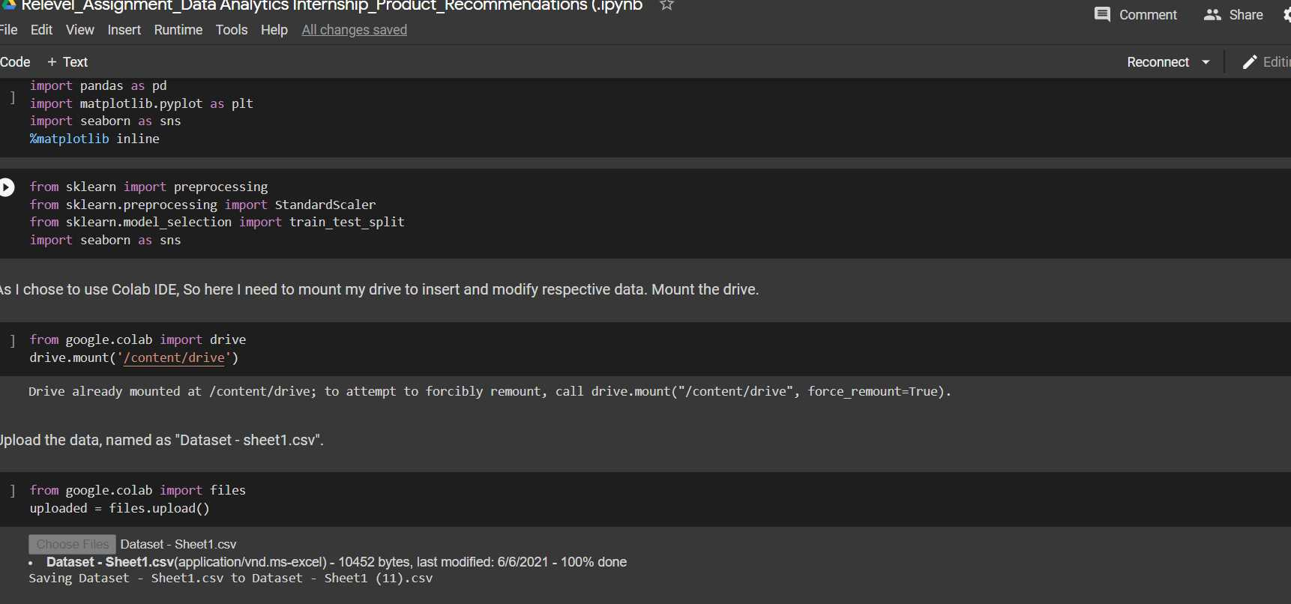
Mounting Drive and load the dataset
Mounting the drive
Import all the required modules and mount the drive. Which will help to load the dataset.

Slide 6
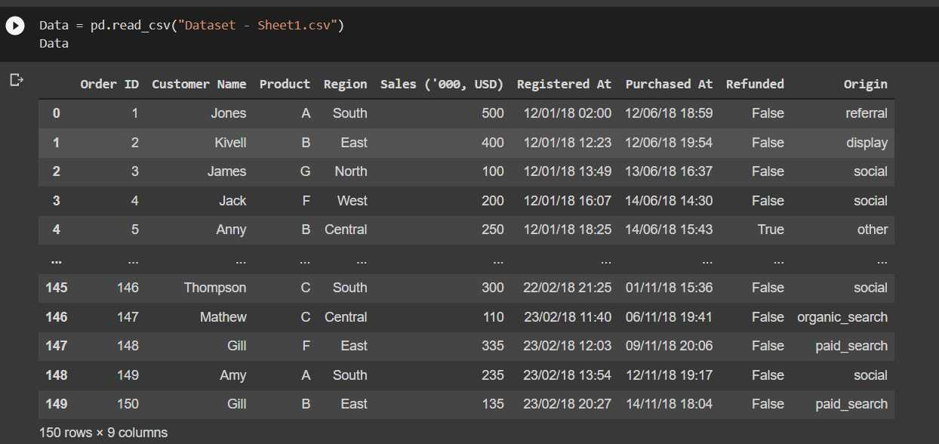
Exploratory Data Analysis (EDA)
Data will look like this. Let’s do the EDA or Exploratory Data analysis.

Slide 7
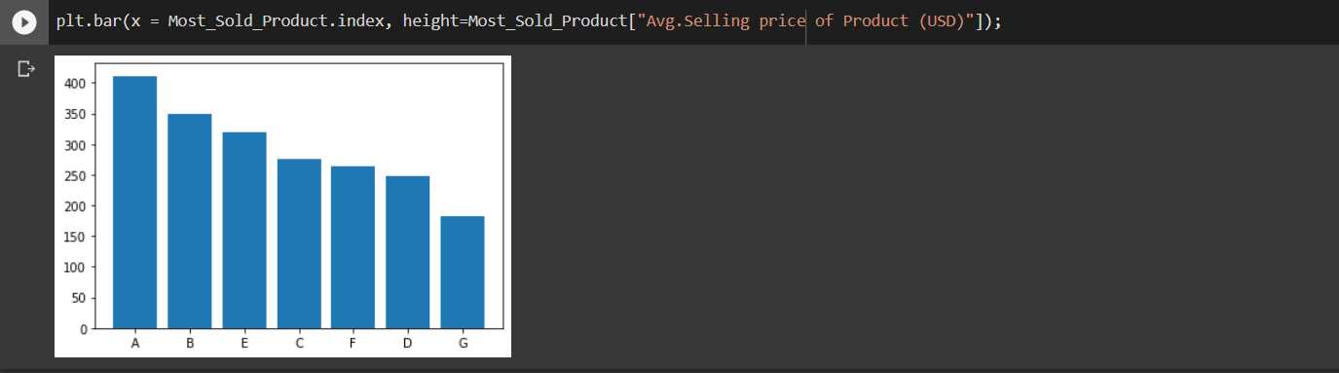
Check the data, their datatypes null values.
Use .info() , It will show the values without null values, their respective datatype.
Knock Knock! Null value, are you there?
What are the average prices of the products?
Product ‘A’ and ‘B’ prices are leading where as ‘G’ has lowest.

Slide 8
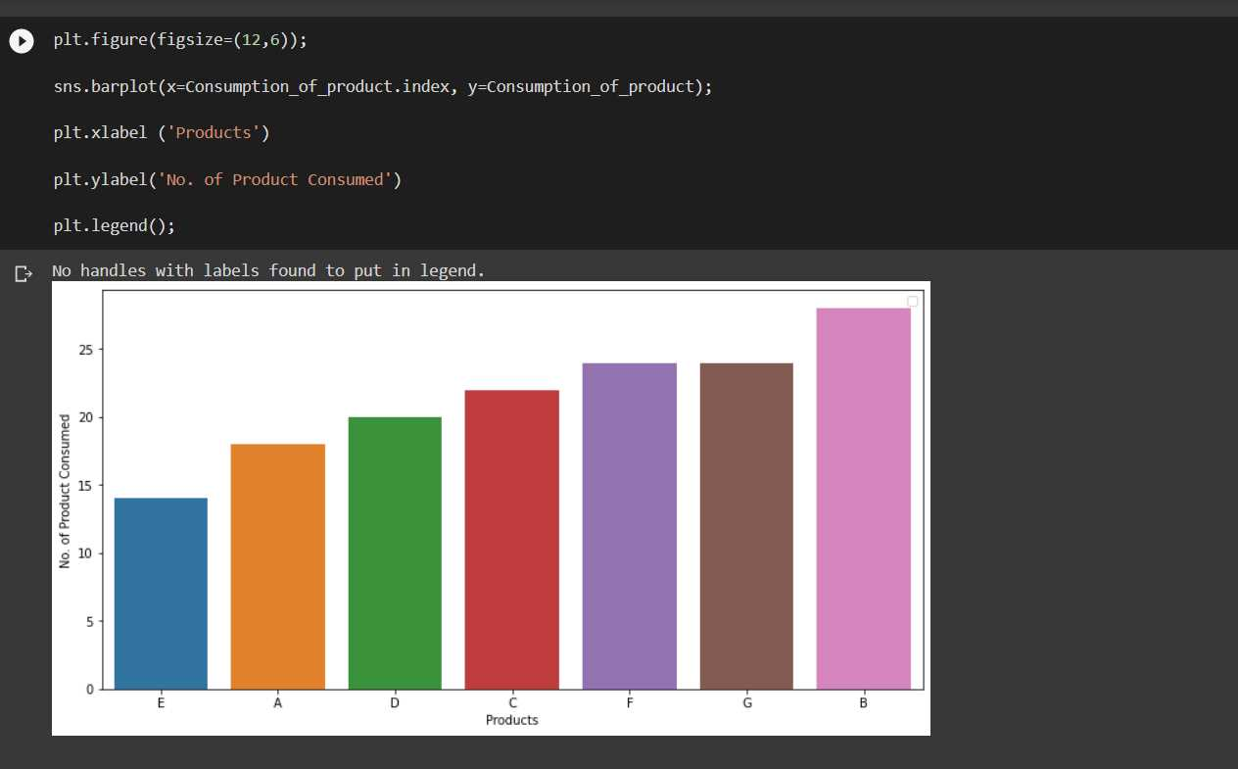
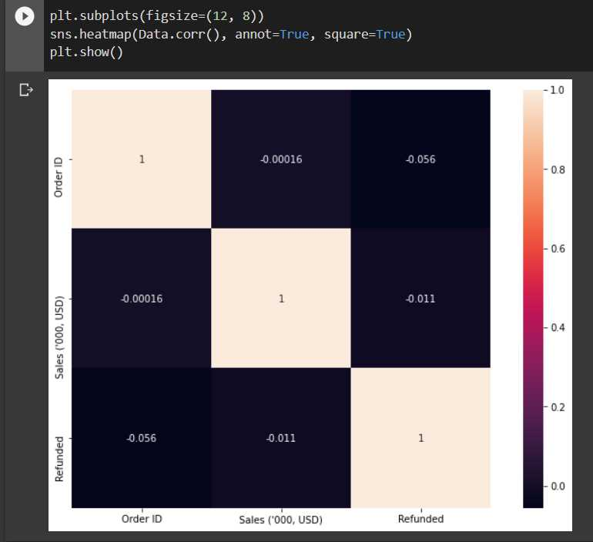
Which product is most consumable?
Whether is there any correlation or dependencies?

Slide 9
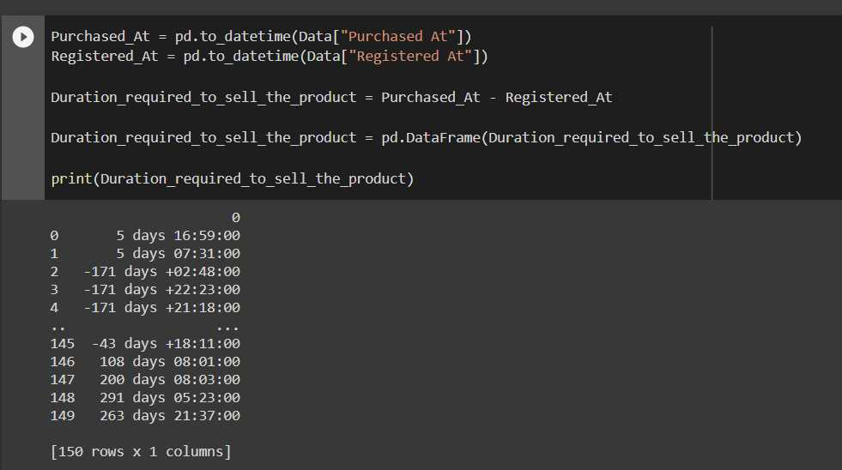
How much time required to sell the product? (Purchased At - Registred At)
But this analysis, will not help us to predict the target values. Let's drop this Idea. It's really nice to examine that How much time required to sell the product?

Slide 10
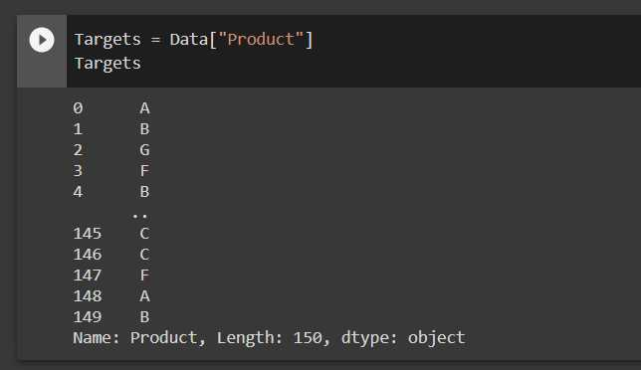
Pre-processing and Feature Engineering
Here, Need to create the Targets and Features.
Dataset is already balance here, So no need to apply 'SMOTE' algorithm.
As we know this is multiclass data, so we need to clear that by imputation technique. We are using here "One hot encoding" (.get_dummies) technique for Imputation.
As I got only one feature which can use for training. But before that, we need to impute it. So, import MinMax Scaler, because this feature having quantitative values so need to covert into array or sparse array.

Slide 11
Test – Train split
Let's do it.
X_train and y_train is having 70% of features and target values for trained the model. Whereas, X_test and y_test having 30% data on which trained model will be applied and predict the values or in this case recommend the values.
and check whether they applicable or not?

Slide 12
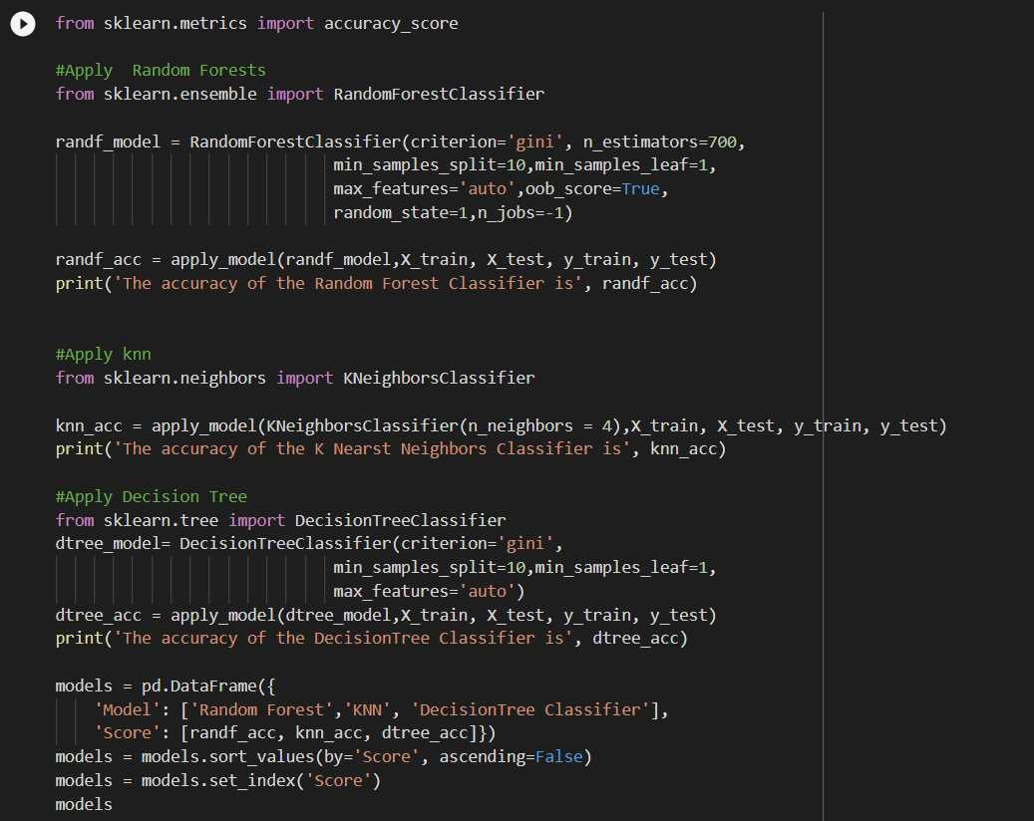
Model Creation, Fitting and Accuracy

Slide 13
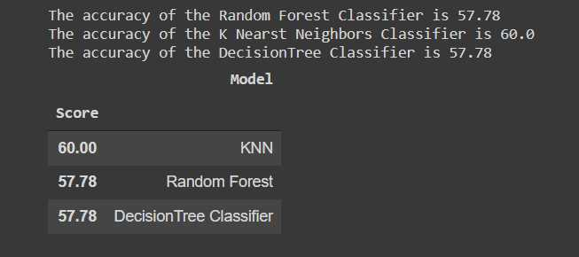
The less accuracy is given by Decision Tree Classifier, Where as Random Forest and KNN are given the same.
Features are not enough to predict the correct values which is also called 'Generalization'. We need to understand that complexity of algorithm will hamper the accuracy this given is not 'Big data'
Where as for simple data or for Normal data Linear or KNN classifier enough to predict.
I also believe that nested loop will also give the best recommendation.

Slide 14
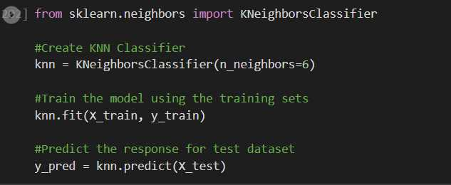
Recommendations
Here, 0 means 'not recommendable’ product and 1 means 'recommendable' product with respective to selling price of the product.
For example: In 0th (zeroth) row, 'G' product recommendable. In 1st 'B' product recommendable.

Slide 15
Conclusion:
If we observe data, we can see that data points are not sufficient to predict the values. Their involvement in training, fitting, application of model is negligible. we have already seen it in correlation and dependencies section. Some categorical columns (Features) are there but their values are not able affect the 'Targets’.
Still, predict the values upto the accuracy of 60.00%. The accuracy will change because of random training
feature selection.
I would like to suggest that for this type of Datasets, which are simple and less complicated in nature. We can get the recommendation (Prediction) with simple algorithm like (KNN) or by just complicated nested loop.
Presented By: Lavish P. Isasare

