Slide 1



Recommandation System :
Crop and Fertilizer Recommender

Slide 2

Learning Objectives
The primary objective is to Developed an AI-powered crop and fertilizer recommendation system using machine learning to improve predictive accuracy, aiming to enhance agricultural productivity and sustainability by leveraging data-driven insights.
Deployed a Flask-based web application featuring interactive data visualization, real-time recommendation delivery, and secure user access, enhancing user experience and system accessibility for agricultural stakeholders.
GOAL
Source :
www.freepik.com/

Slide 3
Tools and Technology used
Programming Language
1. Python
Libraries and Frameworks (Python)
Data Manipulation and Analysis
1. Numpy 2. Pandas
Data Visualization
1. Matplotlib 2. Seaborn
Machine Learning
1. Scikit-learn 2. TensorFlow/Keras
3. PyTorch 4. XGBoost/LightGBM/CatBoost
Web Frameworks
1. Flask

Slide 4
Problem Statement:
Farmers often struggle with inefficient crop and fertilizer management due to a lack of accessible, personalized information. This results in suboptimal yields, economic losses, and negative environmental impacts from improper fertilizer use. This project provides data-driven solution is needed to analyze soil properties, climate data, and crop requirements, providing farmers with tailored recommendations to maximize productivity, profitability, and sustainability. This project aims to develop such a system.

Slide 5
Methodology
Dataset Acquisition and Preprocessing
Exploratory Data Analysis (EDA)
Feature Engineering
Baseline Model Implementation
Advanced Model implementation
Model selection
Evaluation and Validation
Practical application and Deployment

Slide 6
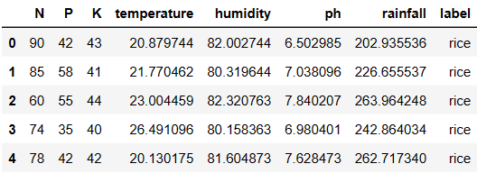
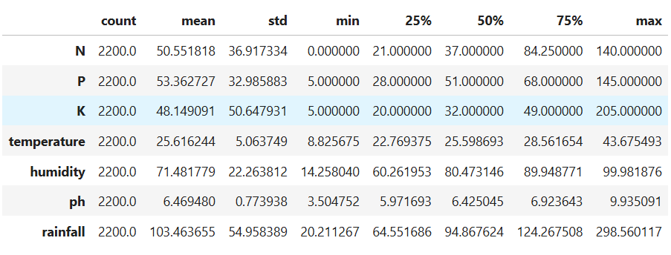
DATASET
Nitrogen (N): Ranges from 0 to 140 with a mean of around 50.55.
Phosphorus (P): Ranges from 5 to 145 with a mean of approximately 53.36.
Potassium (K): Has a wide range from 5 to 205, average near 48.15.
Temperature: Varies from 8.83°C to 43.68°C, average around 25.62°C.
Humidity: Ranges widely from 14.26% to nearly 100%, with an average of 71.48%.
pH: Varies from 3.50 to 9.94, with a mean value close to 6.47, which is slightly acidic.
Rainfall: Ranges from 20.21 mm to 298.56 mm, with an average of 103.46 mm.

Slide 7
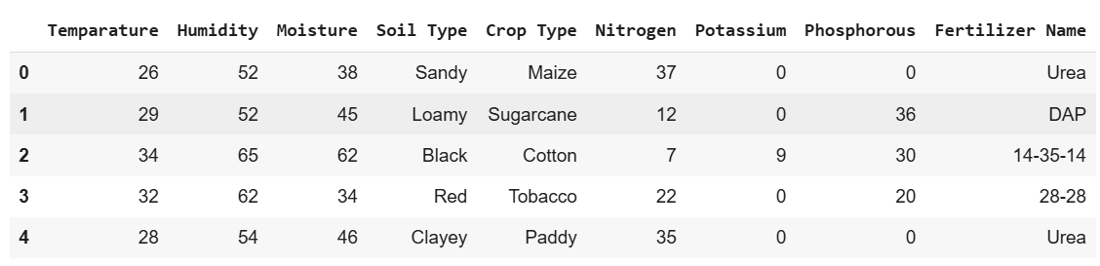
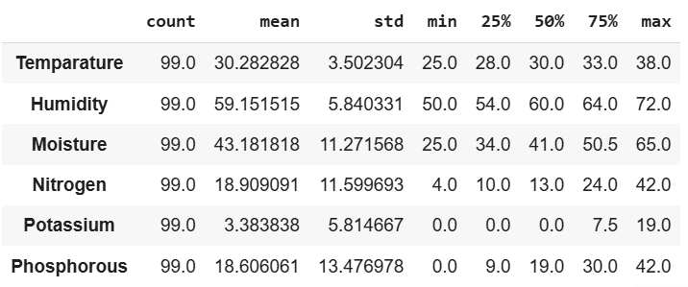
DATASET
Temperature (Tem): Ranges from 20.88 to 43.68 with a mean of 25.62
Humidity (Hum): Ranges from 14.26 to 99.98 with a mean of 71.48,
Moisture (Moi): Ranges from 1 to 100 with a mean of 68.0
Rainfall (rain): Ranges from 20.21 to 298.56 with a mean of 103.46
Nitrogen (N): Ranges from 0 to 140 with a mean of around 50.55
Phosphorus (P): Ranges from 5 to 145 with a mean of approximately 53.36
Potassium (K): Has a wide range from 5 to 205, average near 48.15

Slide 8
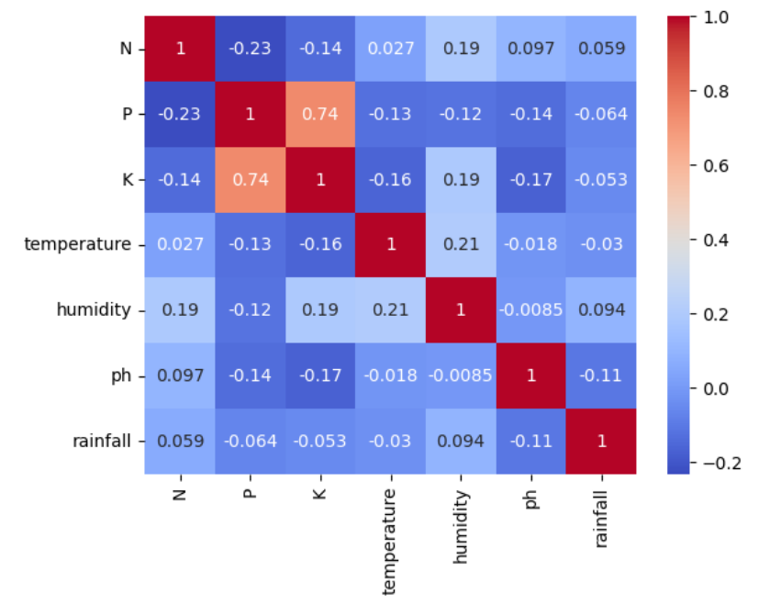
Exploratory data Analysis(EDA)
Correlation matrix for crop Data

Slide 9
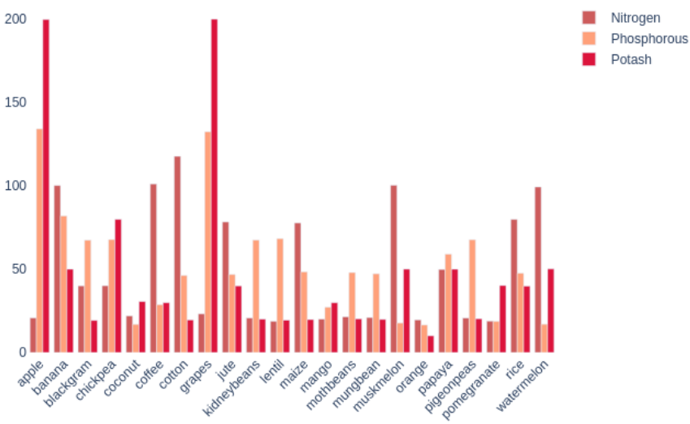
Exploratory data
Analysis(EDA)
This figure shows
Comparison b/w N,P,K
For different crops

Slide 10
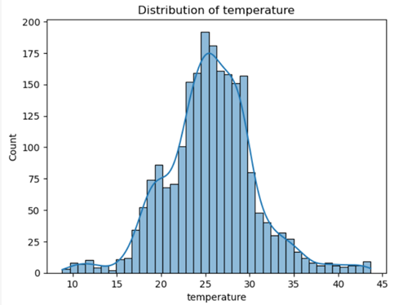
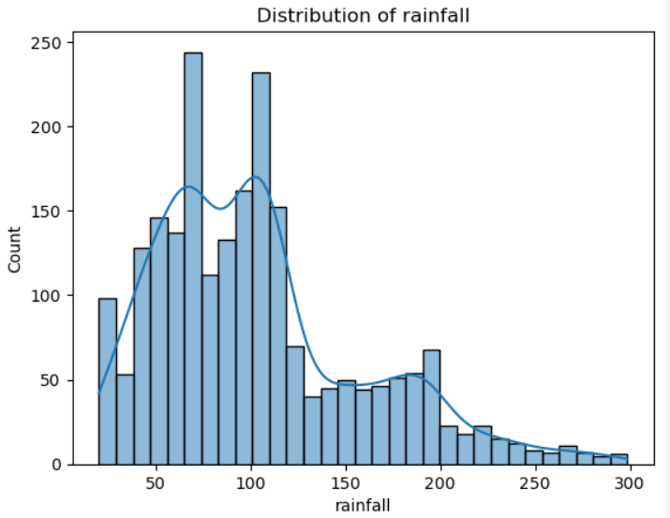
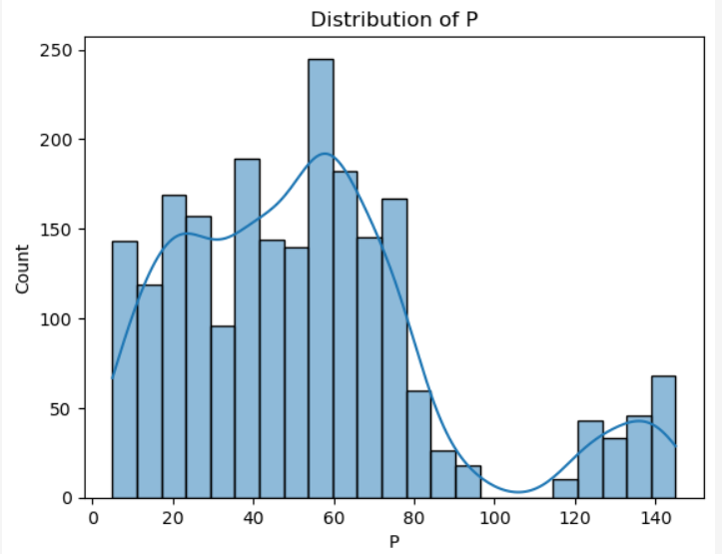
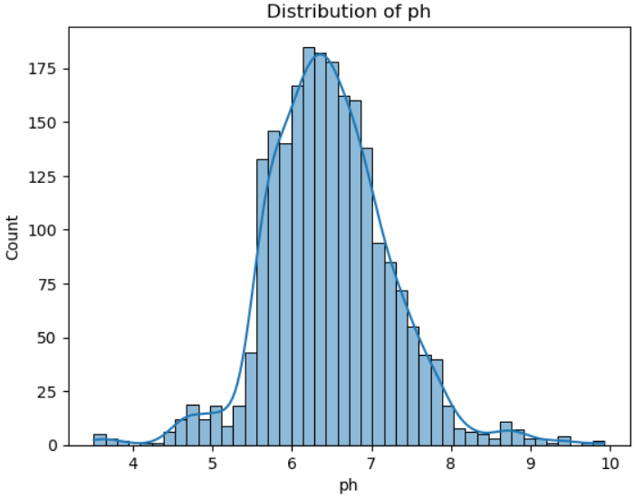
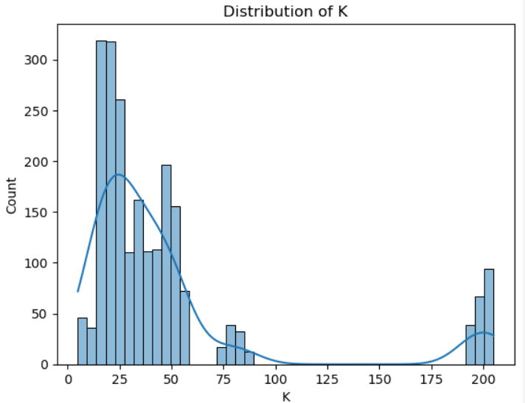
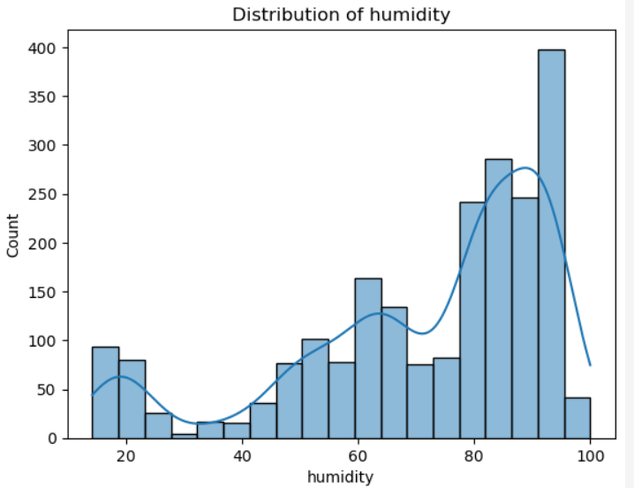
Exploratory data
Analysis(EDA)
Distribution of Different features of crop Dataset

Slide 11
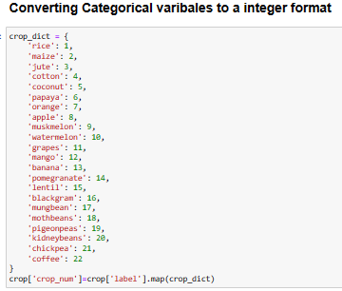
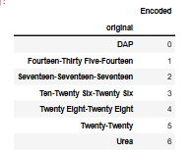
Feature Engineering
Why Feature scaling?
preventing Feature Domination
Improving Model Convergence
Enhancing Model Performance
Algorithm compatibility
Handling Normally Distributed Features
Algorithms Sensitive to Feature Scale
Regularization
Handling outliers

Slide 12
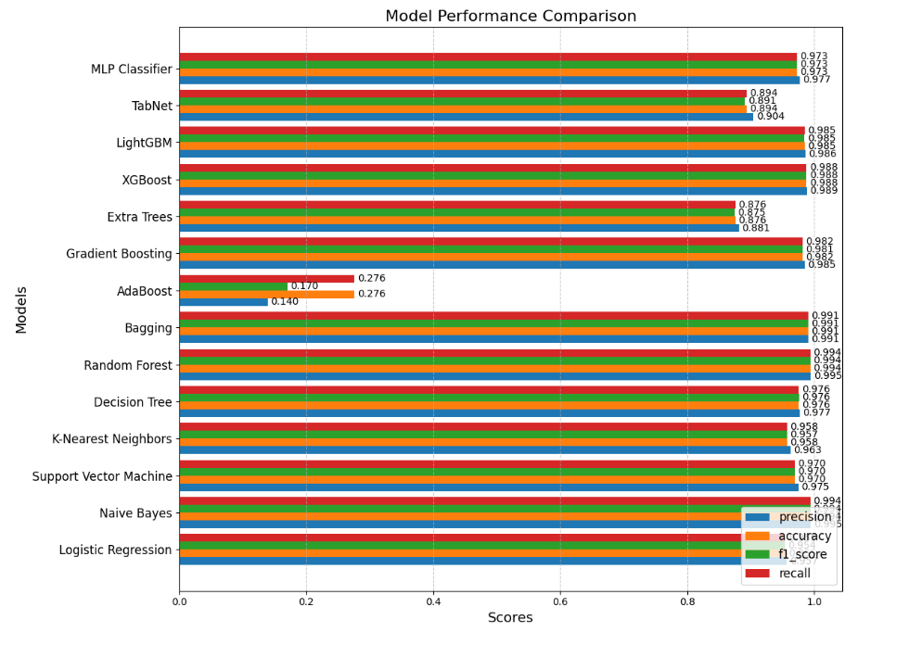
Model
Training and Evaluation

Slide 13
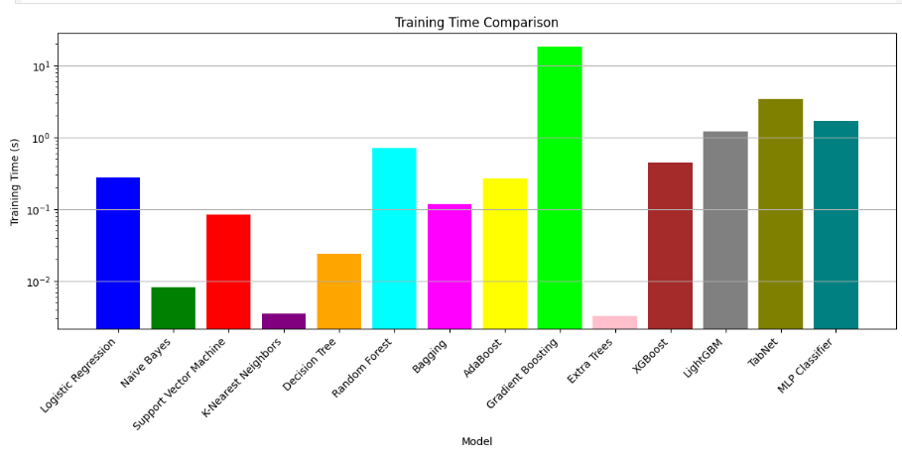
Model Training and selection

Slide 14
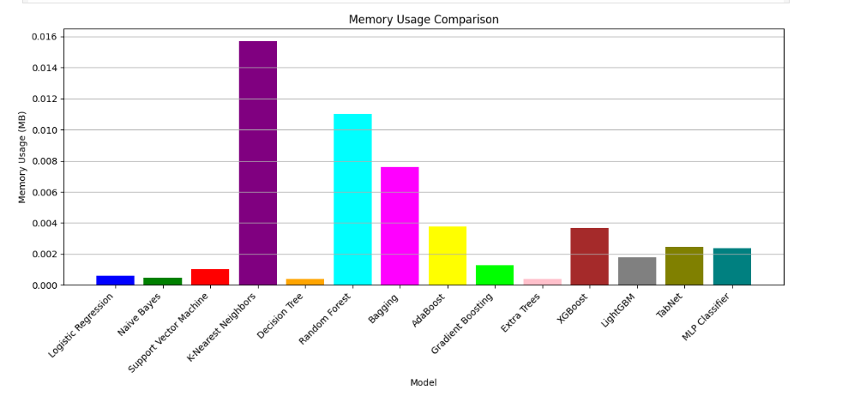
Model Training and selection

Slide 15
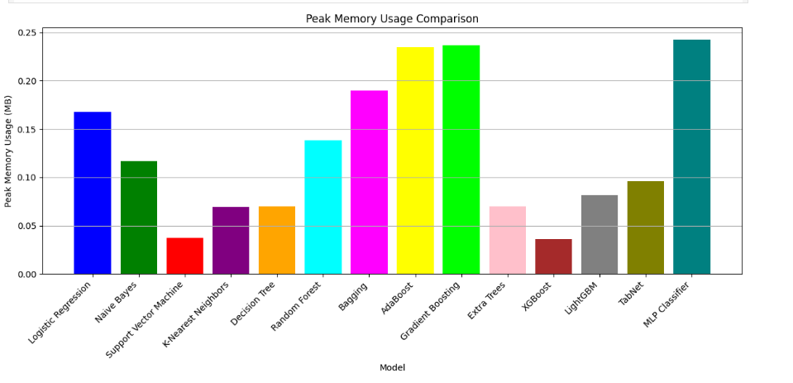
Model Training and selection

Slide 16
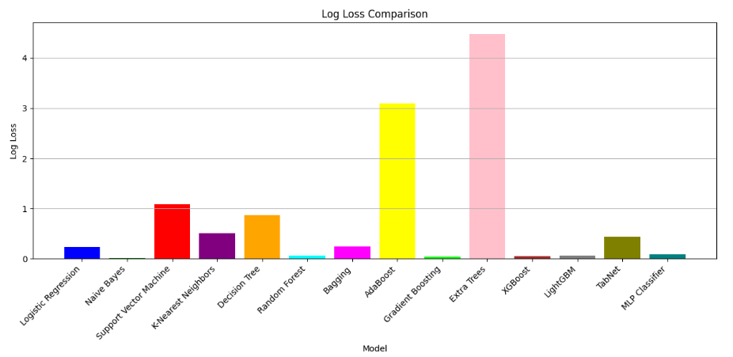
Model Training and selection

Slide 17
Solution:
For model selection and training, I evaluated a diverse set of machine learning algorithms, including Logistic Regression, Naive Bayes, Support Vector Machines, K-Nearest Neighbors, Decision Trees, and ensemble methods like Random Forest, Bagging, AdaBoost, Gradient Boosting, Extra Trees. I also explored advanced gradient boosting techniques with XGBoost and LightGBM, as well as the deep learning-inspired TabNet and a Multi-Layer Perceptron classifier. Performance was assessed using metrics such as accuracy, F1-score, Log-loss . Ultimately, Naïve Bayes and Random forest was selected for its ability to accurately predict optimal crop types and fertilizer needs based on least training time, memory uses, peak memory uses and Log-loss.

Slide 18
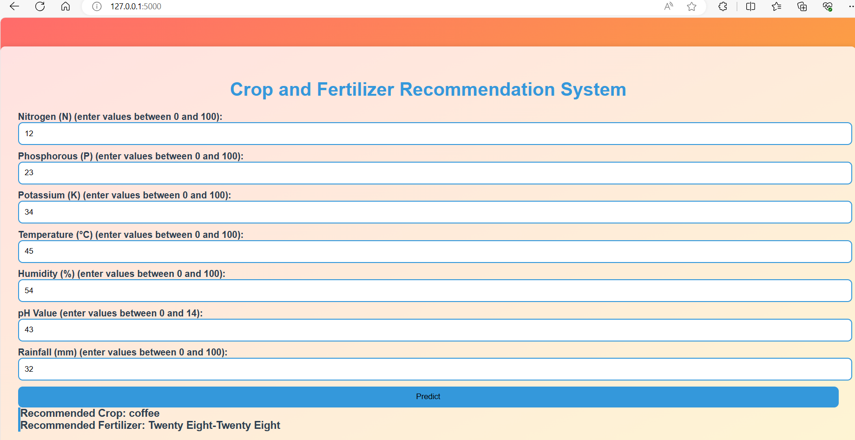
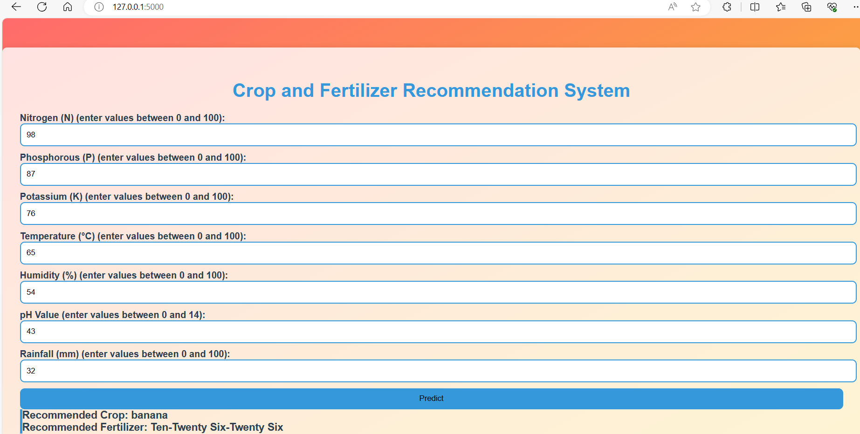
Screenshot of Output:

Slide 19
Conclusion:
This project successfully developed a data-driven Crop and Fertilizer Recommendation System, leveraging machine learning to provide personalized guidance to farmers. Through rigorous data analysis, feature engineering, and model selection, the system empowers users to make informed decisions, optimizing crop selection and fertilizer application for improved productivity, enhanced farm profitability, and sustainable practices. Ultimately, this project aims to support sustainable agriculture and enhance food security through the application of advanced analytics.

Slide 20
About Me
Name : Lavkesh Kumar
Internship Student Registration ID : STU63aac3112b64c1672135441
Internship ID : INTERNSHIP_1733138870674d99b64cb4b
Contact No. : +91 7542805076
Email Id: kumarlavkesh055@gmail.com

