Slide 1

Graphical User Interface Design I
Assignment
Nelson Mandela University
Change the world
SGU1000

Slide 2
Individual Assignment Description
Individual
Conduct a Heuristic Evaluation on at least one User Interface.
Find a team within the SGU1000 class or 3rd Year Project.
You only need to conduct one Heuristic Evaluation.
You may conduct more than one evaluation, but you must only submit one assignment.
This is an individual assignment submission.
You may only evaluate a developed website, desktop, mobile app or the team’s High fidelity prototype.
Use the exact template provided in this PowerPoint slide and do not remove any slides.
You need to find and describe an issue for each one of Nielsen’s 10 heuristics.
When you are done, conduct a debriefing session with the team and email the team the evaluation.
Submit your evaluation on the learnsite by the due date and time.
DUE: 17 September 2018, 08:55.
NB: Evaluator sections are marked with a red E.

Slide 3
Individual Mark Criteria
Heuristic Evaluation 50 marks
Identify the problem 5
Description 10
Screenshot 5
Severity 5
Frequency 5
Impact 5
Persistence 5
Evaluator Design Advice 5
Overall impression 5
Heuristics 50 marks
Quality of the individual’s identification and description
of usability problems for each of Nielsen’s 10 heuristics.
An evaluator cannot simply say that they do not like
something; they should explain why they do not like it
with reference to the heuristics or to other usability results.
TOTAL 100 marks

Slide 4
Team Assignment Description
Team
Find an evaluator within the SGU1000 class or 3rd Year Project to evaluate your systems interface.
You may only have your developed website, desktop, mobile app or your team’s High fidelity prototype evaluated.
Your system must be evaluated by a minimum of three and a maximum of five evaluators.
Design and implement solutions for all issues picked up by the evaluators.
Take screenshots of the implemented solutions and add them to the assignment PowerPoint slides the team received from the evaluators.
Submit all the PowerPoint slides from all evaluators the solutions added.
Prepare a team presentation.
You must present all of the issues found by the evaluator and the solutions you implemented.
Presentations will take place on 8 October 2018 and 15 October 2018.
Only one person must submit the assignment.
Make sure all team member details are on the assignment.
Marks will only be awarded to individuals who’s details are on the submitted assignment.
Use the exact same template provided in this PowerPoint slide and do not remove any slides.
Submit your assignment on the learnsite by the due date and time.
DUE: 8 October 2018, 07:45.
NB: Team sections are marked with a green T.

Slide 5
Team Mark Criteria
Presentation 25 marks
Introduction 5
Prepared 5
Time 5
Presentation quality 5
Overall impression 5
Heuristics 50 marks
Quality of the team’s solution for each of Nielsen’s 10
heuristics.
Evaluator Marks 25 marks
Evaluator Mark 1 5
Evaluator Mark 2 5
Evaluator Mark 3 5
Evaluator Mark 4 5
Evaluator Mark 5 5
TOTAL 100 marks

Slide 6
Heuristics Form for the Evaluator
Heuristic Guidelines |  | Mark Out of 10
1 | Match the system with the real world | 5
 | The system should speak the users' language, with words, phrases and concepts familiar to the user, rather than system-oriented terms. Follow real-world conventions, making information appear in a natural and logical order.
2 | Consistency and standards | 7
 | Users should not have to wonder whether different words, situations, or actions mean the same thing. Follow platform conventions. e.g. Use the same theme and elements across the system.
3 | Help and documentation | 5
 | Even though it is better if the system can be used without documentation, it may be necessary to provide help and documentation. Any such information should be easy to search, focused on the user's task, list concrete steps to be carried out, and not be too large. e.g. Contextual Help, Videos, Tooltips
4 | User control and freedom (Navigation) | 5
 | Users often choose system functions by mistake and will need a clearly marked "emergency exit" to leave the unwanted state without having to go through an extended dialogue. Support undo and redo and a clear way to navigate.
5 | Visibility of system status | 6
 | The system should always keep users informed about what is going on, through appropriate feedback within reasonable time. e.g. Progress bars, progress messages, feedback after every action.
6 | Flexibility and efficiency of use | 5
 | Accelerators - unseen by the novice user - may often speed up the interaction for the expert user such that the system can cater to both inexperienced and experienced users. Allow users to tailor frequent actions.
7 | Error prevention | 5
 | Even better than good error messages are a careful design which prevents a problem from occurring in the first place. Either eliminate error-prone conditions or check for them and present users with a confirmation option before they commit to the action. e.g. Disable submit buttons when form is empty, Highlight Primary Actions, Autocomplete, Autofocus.
8 | Recognition rather than recall (Memory) | 6
 | Minimize the user's memory load by making objects, actions, and options visible. The user should not have to remember information from one part of the dialogue to another. Instructions for use of the system should be visible or easily retrievable whenever appropriate. e.g. IntelliSense, Preview fonts.
9 | Error reporting, diagnosis, and recovery | 6
 | Error messages should be expressed in plain language (no codes), precisely indicate the problem, and constructively suggest a solution.
10 | Aesthetic & minimalist design | 5
 | Dialogues should not contain information which is irrelevant or rarely needed. Every extra unit of information in a dialogue competes with the relevant units of information and diminishes their relative visibility. Visual layout should respect the principles of contrast, repetition, alignment, and proximity.
Total (Out of 100) |  | 55

Slide 7
Individual Details
Name and Surname:
Student number:
Date:
My Team:
Name of team being evaluated:
Name of system being evaluated:
Sinovuyo Ngolomi
215329422
14/09/2018
Pro-Code
KLUE inc
InfoTechTutorials

Slide 8
Team Details
Team Name:
Student Number | Surname | Name(s)

Slide 9
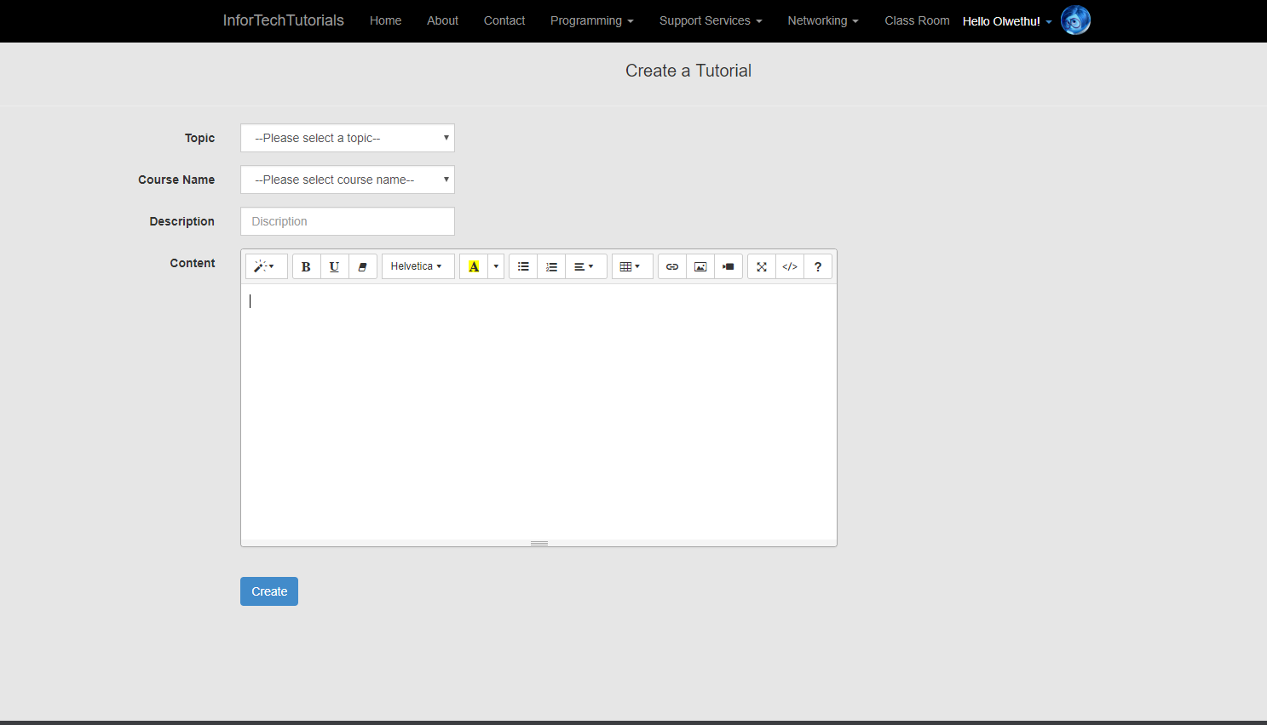
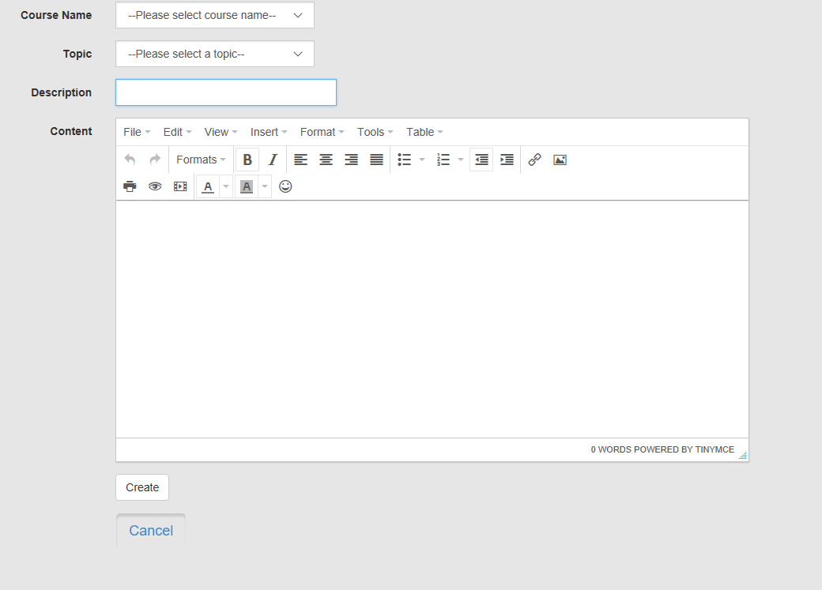
Heuristic Evaluation Form
Identify and Describe Issue
# 1E | Identify page and element: e.g. Home Page Create Tutorial - dropdown
H# E | Match the system with the real world Description: Rec The course name dropdown is below the topic dropdown, the logic in which these elements are arranged is not easy to follow .
Screenshot E
Solution
E | Evaluator Design Advice: The course name should be above the topic dropdown. The tutor should be asked to select the course name first and then select the topic they want to teach within the selected course.
T | Team Solution: We have switched the positions of topic and course
Screenshot T
Severity E | Frequency E | Impact E | Persistence E
3 | common | Difficult to overcome | Persistent, until fixed
0 = I don't agree that this is a usability problem at all.
1 = Cosmetic problem only: need not be fixed unless extra time is available on project. 2 = Minor usability problem: fixing this should be given low priority.
3 = Major usability problem: important to fix, so should be given high priority.
4 = Usability catastrophe: imperative to fix this before product can be released.
Severity

Slide 10
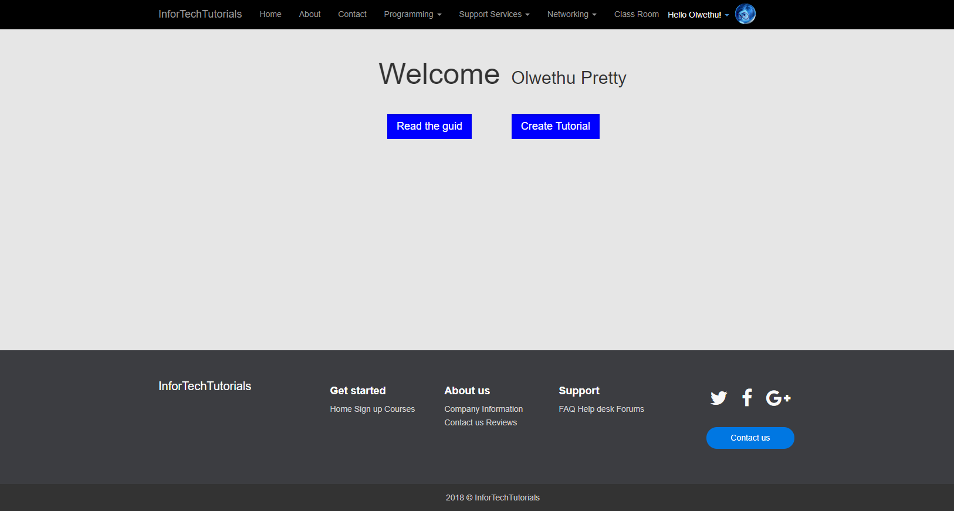

Heuristic Evaluation Form
Identify and Describe Issue
# 2E | Identify page and element: e.g. Home Page Classroom page - button
H# E | Consistency and standards Description: The color of the buttons of this page is not the same as the color that is used as the primary color of the website.
Screenshot E
Solution
E | Evaluator Design Advice: The primary color of the website should be used on all important or major buttons to indicate their significance and to show consistency.
T | Team Solution: We have changed the color to be more balanced with the primary color
Screenshot T
Severity E | Frequency E | Impact E | Persistence E
2 | common | Low impact | Persistent, until fixed
0 = I don't agree that this is a usability problem at all.
1 = Cosmetic problem only: need not be fixed unless extra time is available on project. 2 = Minor usability problem: fixing this should be given low priority.
3 = Major usability problem: important to fix, so should be given high priority.
4 = Usability catastrophe: imperative to fix this before product can be released.
Severity

Slide 11
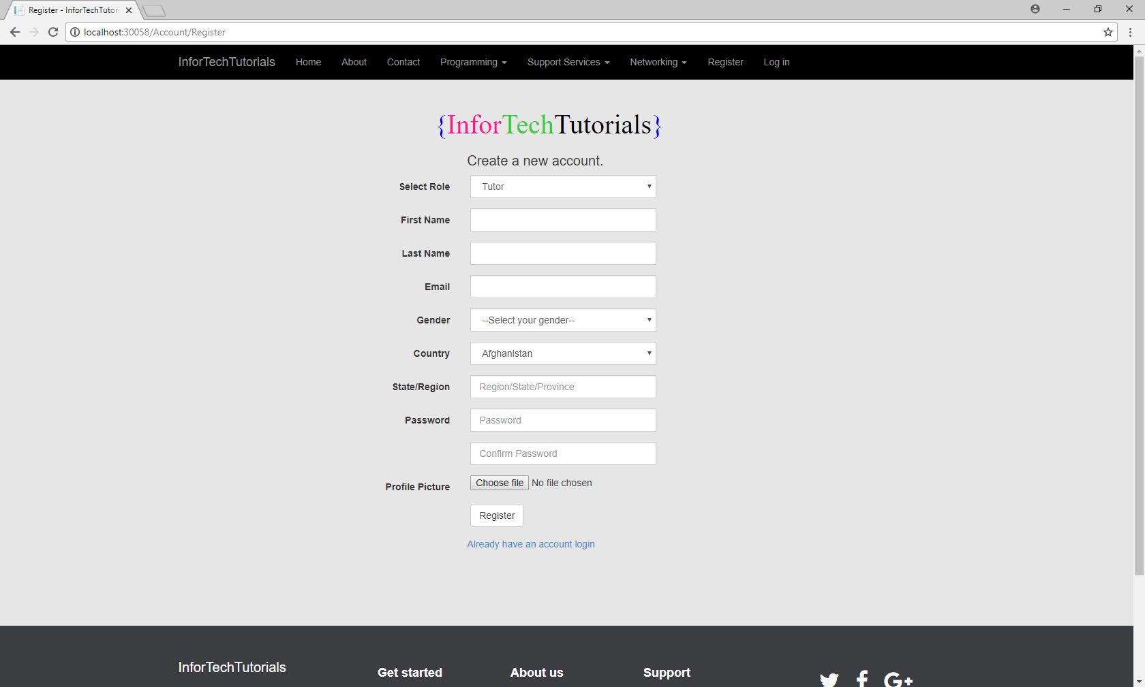
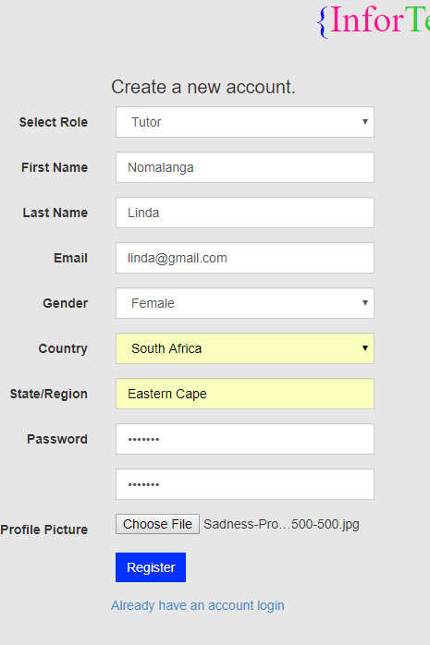
Heuristic Evaluation Form
Identify and Describe Issue
# 3E | Identify page and element: e.g. Home Page Registration page - button
H# E | Help and documentation Description: The register button has the same color as the input fields, it won’t be easy for a user to notice that it’s a button
Screenshot E
Solution
E | Evaluator Design Advice: Just change the background color of the button to the primary color of the website
T | Team Solution: We have changed the register button’s color to be recognizable
Screenshot T
Severity E | Frequency E | Impact E | Persistence E
2 | common | Low impact | Easy to overcome
0 = I don't agree that this is a usability problem at all.
1 = Cosmetic problem only: need not be fixed unless extra time is available on project. 2 = Minor usability problem: fixing this should be given low priority.
3 = Major usability problem: important to fix, so should be given high priority.
4 = Usability catastrophe: imperative to fix this before product can be released.
Severity

Slide 12
Heuristic Evaluation Form
Identify and Describe Issue
# 4E | Identify page and element: e.g. Home Page Create Tutorial - button
H# E | User control and freedom (Navigation) Description: There is no return or back button, the only option the user has is to create a tutorial
Screenshot E
Solution
E | Evaluator Design Advice: The team should add a back or cancel button to this page
T | Team Solution: We have added cancel button so users can cancel their process easly
Screenshot T
Severity E | Frequency E | Impact E | Persistence E
2 | common | Low impact | Persistent, until fixed
0 = I don't agree that this is a usability problem at all.
1 = Cosmetic problem only: need not be fixed unless extra time is available on project. 2 = Minor usability problem: fixing this should be given low priority.
3 = Major usability problem: important to fix, so should be given high priority.
4 = Usability catastrophe: imperative to fix this before product can be released.
Severity

Slide 13
Heuristic Evaluation Form
Identify and Describe Issue
# 5E | Identify page and element: e.g. Home Page Registration page
H# E | Visibility of system status Description: No feedback provided when the user clicks the register button, nothing that informs the user about what is happening as the system tries to save the registration details
Screenshot E
Solution
E | Evaluator Design Advice: Add a loader that will show up when the system is processing the registration data
T | Team Solution: The feedback has been here all the time , after the user click register the user will be redirected to a success notification if the operation was successful
Screenshot T
Severity E | Frequency E | Impact E | Persistence E
2 | common | low | persistent
0 = I don't agree that this is a usability problem at all.
1 = Cosmetic problem only: need not be fixed unless extra time is available on project. 2 = Minor usability problem: fixing this should be given low priority.
3 = Major usability problem: important to fix, so should be given high priority.
4 = Usability catastrophe: imperative to fix this before product can be released.
Severity

Slide 14
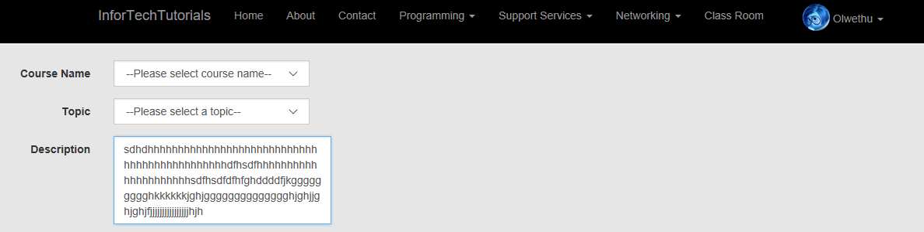
Heuristic Evaluation Form
Identify and Describe Issue
# 6E | Identify page and element: e.g. Home Page Create Tutorial – input field
H# E | Flexibility and efficiency of use Description: The description input field id too small for the content that should go there. It’s limiting the to one sentence description because if they write more than line they won’t see all the content
Screenshot E
Solution
E | Evaluator Design Advice: Use a text area for the description
T | Team Solution: We expanded the textbox to allow multilineText
Screenshot T
Severity E | Frequency E | Impact E | Persistence E
3 | common | high | Persistent, until fixed
0 = I don't agree that this is a usability problem at all.
1 = Cosmetic problem only: need not be fixed unless extra time is available on project. 2 = Minor usability problem: fixing this should be given low priority.
3 = Major usability problem: important to fix, so should be given high priority.
4 = Usability catastrophe: imperative to fix this before product can be released.
Severity

Slide 15
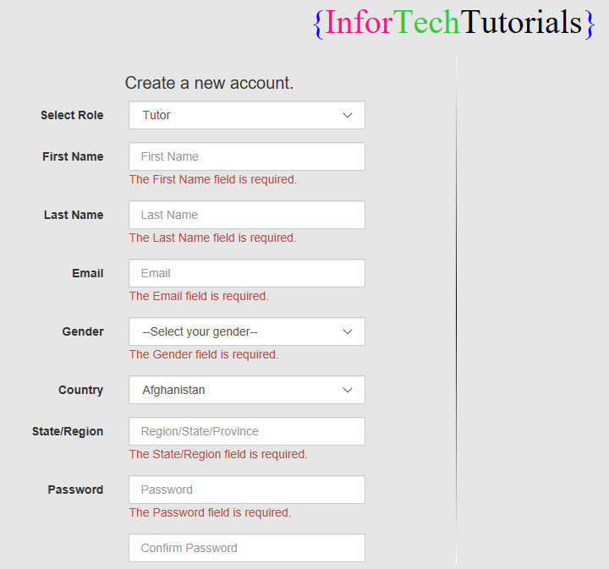
Heuristic Evaluation Form
Identify and Describe Issue
# 7E | Identify page and element: e.g. Home Page Registration Page- input fields
H# E | Error prevention Description: No indication of the required fields
Screenshot E
Solution
E | Evaluator Design Advice: Maybe just use asterisks to indication which fields are the required fileds
T | Team Solution: If there were optional fields we would indicate the required ones but all fields are required
Screenshot T
Severity E | Frequency E | Impact E | Persistence E
2 | rare | low | Easy to overcome
0 = I don't agree that this is a usability problem at all.
1 = Cosmetic problem only: need not be fixed unless extra time is available on project. 2 = Minor usability problem: fixing this should be given low priority.
3 = Major usability problem: important to fix, so should be given high priority.
4 = Usability catastrophe: imperative to fix this before product can be released.
Severity

Slide 16
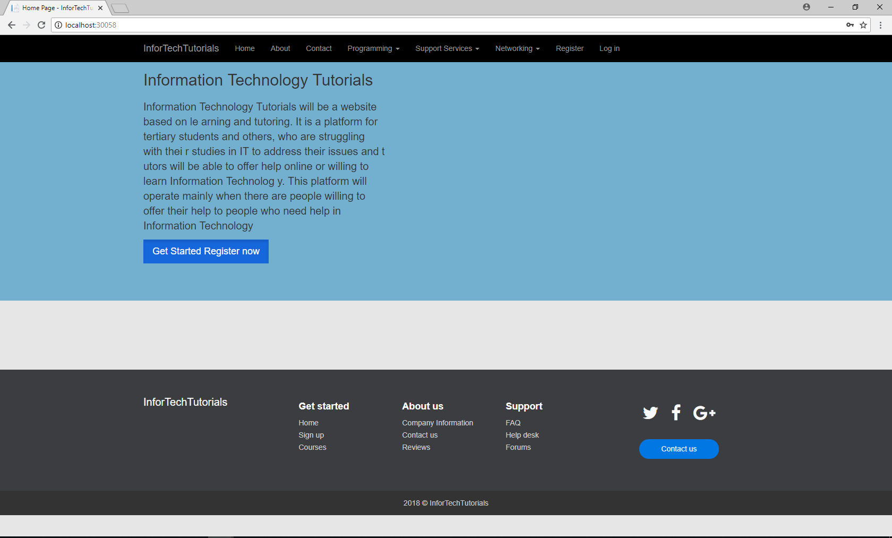
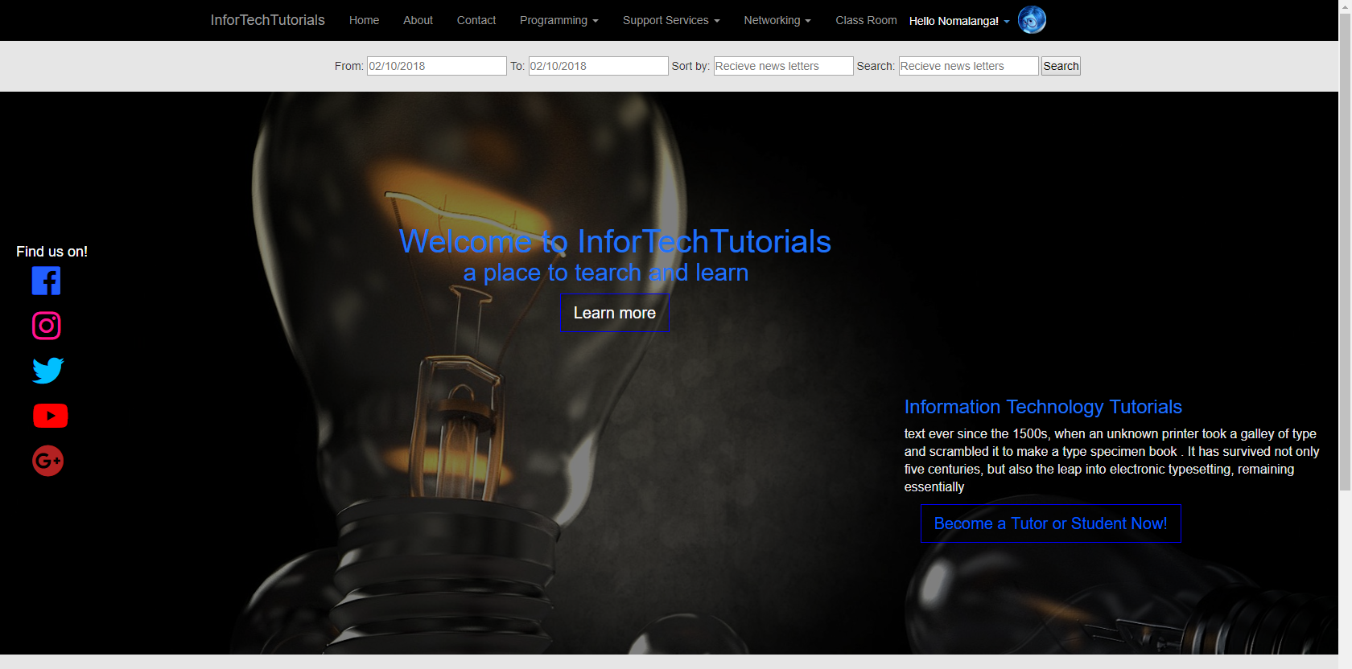
Heuristic Evaluation Form
Identify and Describe Issue
# 8E | Identify page and element: e.g. Home Page The home page - body
H# E | Description: Recognition rather than recall (Memory) The background color of the home page is different from the background color of the other pages
Screenshot E
Solution
E | Evaluator Design Advice: There should be only be one background color for all pages
T | Team Solution: We have changed the jumbotron/blue backgroung to something sootable and meaningful however it si still in development
Screenshot T
Severity E | Frequency E | Impact E | Persistence E
1 | rare | low | Easy to overcome
0 = I don't agree that this is a usability problem at all.
1 = Cosmetic problem only: need not be fixed unless extra time is available on project. 2 = Minor usability problem: fixing this should be given low priority.
3 = Major usability problem: important to fix, so should be given high priority.
4 = Usability catastrophe: imperative to fix this before product can be released.
Severity

Slide 17
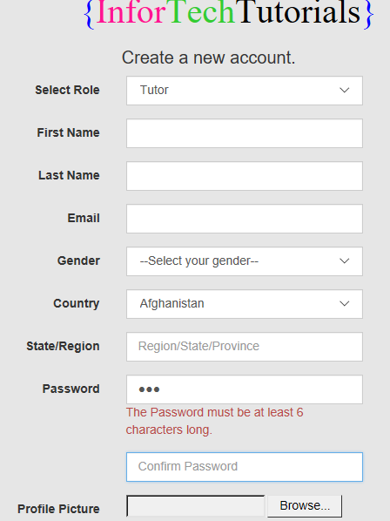
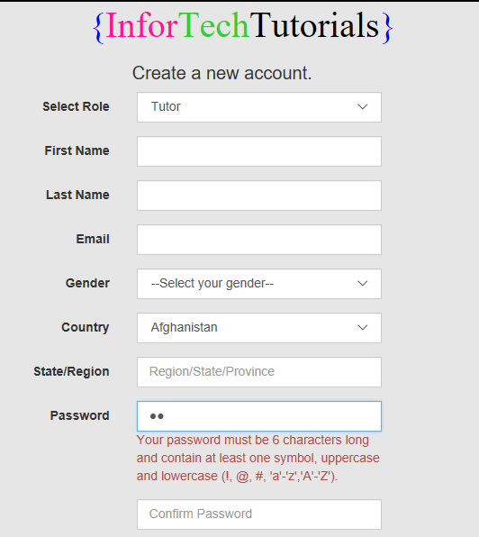
Heuristic Evaluation Form
Identify and Describe Issue
# 9E | Identify page and element: e.g. Home Page Registration page – password input field
H# E | Error reporting, diagnosis, and recovery Description: There is nothing that shows the user the requirements of a valid password, the user won’t how to create a valid password for this system
Screenshot E
Solution
E | Evaluator Design Advice: Maybe add span tag showing the user how does a valid password look like and the as they type the password, show the password strength.
T | Team Solution: There is a requirement for a user to create a secure account and it has been here, but we cannot put users in a tight spot to create passwords that they wont remember however we can specify the length of the password required and in that length we can request that they use some symbols, uppercases and lowercases
Screenshot T
Severity E | Frequency E | Impact E | Persistence E
3 | common | high | Persistent, until fixed
0 = I don't agree that this is a usability problem at all.
1 = Cosmetic problem only: need not be fixed unless extra time is available on project. 2 = Minor usability problem: fixing this should be given low priority.
3 = Major usability problem: important to fix, so should be given high priority.
4 = Usability catastrophe: imperative to fix this before product can be released.
Severity

Slide 18
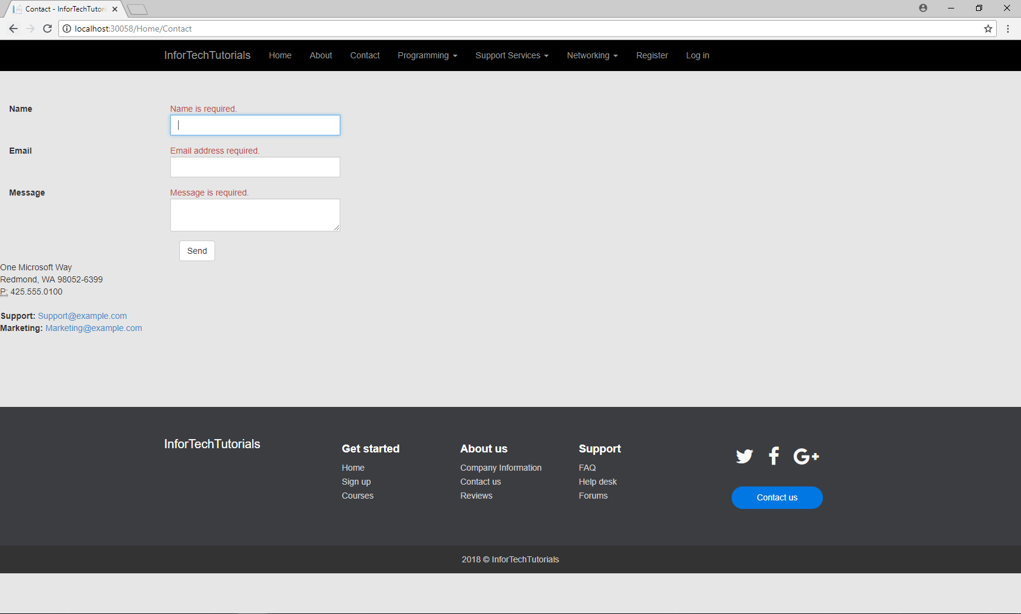
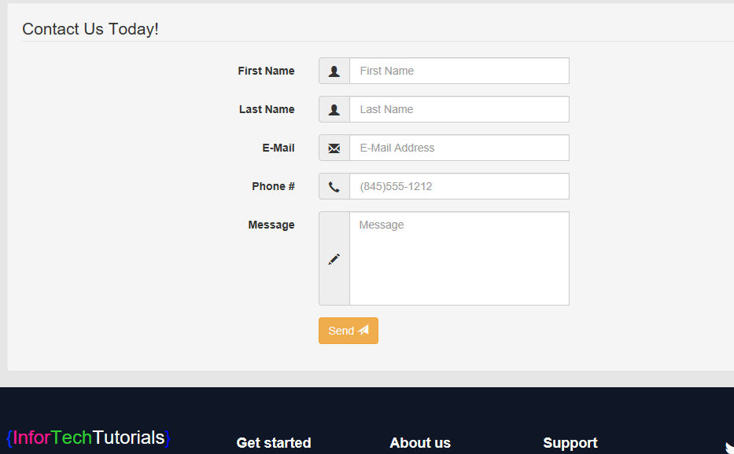
Heuristic Evaluation Form
Identify and Describe Issue
# 10E | Identify page and element: e.g. Home Page Contact page – labels and input fields
H# E | Aesthetic & minimalist design Description: The labels and their respective input fields are not aligned . The labels are too distant from their respective input fields. The user might not see the labels
Screenshot E
Solution
E | Evaluator Design Advice: Try to bring the labels closer to the input fields and align them properly
T | Team Solution: We have changed the contact form entirely, the new one have more fields and is better designed
Screenshot T
Severity E | Frequency E | Impact E | Persistence E
2 | rare | low | Easy to overcome
0 = I don't agree that this is a usability problem at all.
1 = Cosmetic problem only: need not be fixed unless extra time is available on project. 2 = Minor usability problem: fixing this should be given low priority.
3 = Major usability problem: important to fix, so should be given high priority.
4 = Usability catastrophe: imperative to fix this before product can be released.
Severity

