Slide 1

GTALK

Slide 2
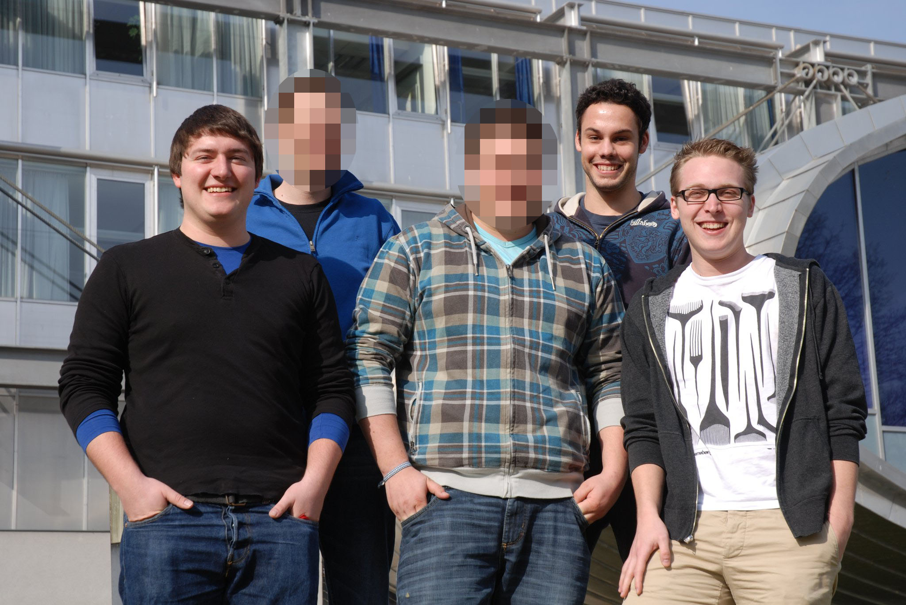
Projektteam
Kieslich
Lindorfer
Schöllhammer

Slide 3
Ziele
Symmetrische Ver/Entschlüsselung
von Nachrichten
mit AES-256
Schlüsselmanagement
Secure SQLite DB
Schlüsselimport
QR-Code

Slide 4
Bibliotheken
aSmack
Apache License, Version 2.0
XMPP kommunikation
Senden/Empfangen von Nachrichten
sqlcipher for android
Apache License, Version 2.0
AES-256
Verschlüsselung der Datenbank

Slide 5
Arbeitspakete
Design/Views
Datenbank
QR-Import
Passwordgenerierung

Slide 6
Password generierung
public static byte[] generateSeed() {
int recorderBufferSize = AudioRecord.getMinBufferSize(8000,
AudioFormat.CHANNEL_CONFIGURATION_MONO,
AudioFormat.ENCODING_PCM_16BIT) * 2;
AudioRecord recorder = new AudioRecord(AudioSource.DEFAULT, 8000,
AudioFormat.CHANNEL_IN_MONO, AudioFormat.ENCODING_PCM_16BIT,
recorderBufferSize);
byte[] recordedAudioBuffer = new byte[recorderBufferSize];
recorder.startRecording();
int bufferRead = recorder.read(recordedAudioBuffer, 0, recorderBufferSize);
try {
Thread.sleep(200);
} catch (InterruptedException e) {
e.printStackTrace();
}
recorder.stop();
recorder.release();
return recordedAudioBuffer;
}

Slide 7
LIVE DEMO

