Slide 1
Child Wellness Data Analysis
Portfolio Presentation
Lavonia Munedzimwe — Junior Data Analyst

Slide 2
Project Overview
Objective:
Analyze child wellbeing patterns using health, attendance, and demographic data.
Approach:
Cleaned dataset in Excel
Created calculated fields
Produced visualizations
Deliverables:
Charts, insights, recommendations, next steps

Slide 3
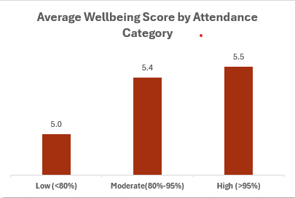
Attendance & Wellbeing
Children with higher attendance show stronger wellbeing scores.

Slide 4
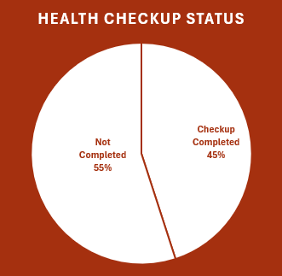
Health Checkup Status
Over 55% of children did not complete checkups, indicating access and follow‑up gaps.

Slide 5
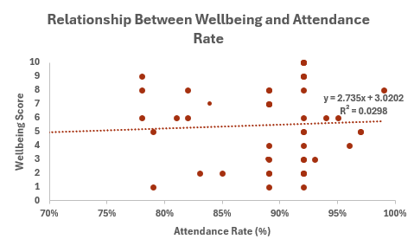
Wellbeing vs Attendance Rate
A slight positive correlation exists: higher attendance aligns with higher wellbeing.

Slide 6
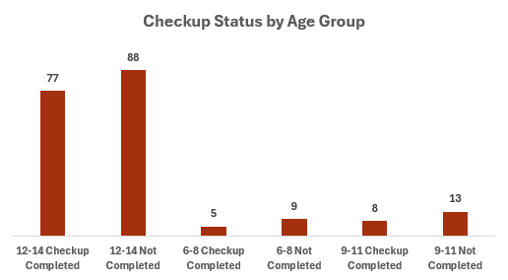
Wellbeing by Age Group
Older children (12–14) show lower engagement and checkup completion.

Slide 7
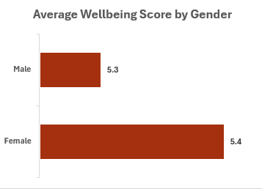
Wellbeing by Gender
Females show slightly higher wellbeing scores; differences are small but notable.

Slide 8
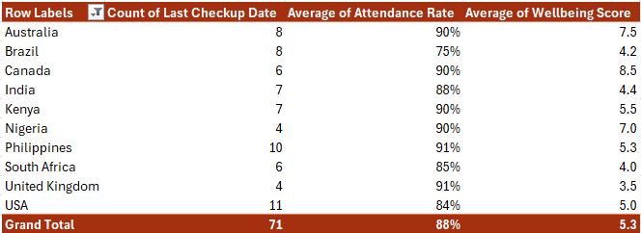
Country Pivot Summary
Countries with stronger attendance also show higher wellbeing and checkup consistency.

Slide 9
Recommendations
Strengthen healthcare follow-up systems.
Improve attendance via community engagement.
Create age‑specific wellness programs.
Explore subtle gender wellbeing differences.
Build monitoring dashboards.

Slide 10
Conclusion & Next Steps
Analysis highlights relationships between attendance, healthcare access, and wellbeing.
Next Steps:
Expand dataset
Add predictive models
Build dashboards
Partner with NGOs for intervention testing

