Slide 1
IBM University Engagement Project Submission
“Exploring the Power of Agentic AI with IBM Granite and LangFlow”

Slide 2

Project Title – Course Content Simplification Agent
Domain of Project – Education
Student Name | Recent Passport Photo | Email ID | Mobile number [WhatsApp]
Lavraj Ashok Pardhi |  | lavrajpardhi26@gmail.com | 8689826878
College: Tilak Maharashtra Vidyapeeth, Pune (Kharghar)
Qualification: BCA Graduate, 2026

Slide 3
Problem Statement -
Problem Statement : Course Content Simplification Agent
The Challenge
Educational materials vary in complexity and are not always easy for learners with different levels of prior knowledge. Students struggle to grasp key concepts because faculty notes and textbooks are often jargon-heavy or too advanced.
The Objective
Build an AI-powered agent that analyzes academic content and reframes the explanation in simple words, so learning becomes more inclusive and personalized at scale. The solution uses IBM Cloud Lite, IBM watsonx.ai and an IBM Granite model.
Target User and Pain Points
Target user: beginner students (for example BCA or first-year) who study Cloud Computing from faculty notes and textbooks.
Pain point 1: hard technical words (jargon) make the notes difficult to follow.
Pain point 2: one fixed explanation does not suit every learner's level.
Pain point 3: no quick way to check understanding while studying alone.

Slide 4
Proposed Solution -
Proposed Solution: SimpleStudy – Course Content Simplification Agent
SimpleStudy is a simple AI agent built in Langflow with IBM watsonx.ai and the IBM Granite model (ibm/granite-4-h-small). The student pastes a course topic or a hard paragraph, and the agent explains it in very simple English.
How it works
Step 1 – Chat Input receives the topic or paragraph.
Step 2 – The watsonx.ai component sends it, with the SimpleStudy System Message, to the Granite model.
Step 3 – Chat Output shows a short reply (under 120 words): Summary, Key terms with an everyday example, Remember (3 points) and a Quick check question.
Responsible AI by design
The agent never adds facts it is not sure about. If the input is unclear, it only asks for a clear course topic. The Quick check question helps the learner confirm understanding.
Current scope
This version simplifies Cloud Computing topics for beginner learners. Selecting a level (intermediate or expert) is planned in Future Scope.

Slide 5
Technology Used
Langflow platform – For designing and running the AI workflow visually (Chat Input → watsonx.ai → Chat Output)
IBM Granite model – ibm/granite-4-h-small, for understanding the learner's text and writing simple explanations
IBM Cloud (Lite) – Free-tier cloud to build and run the project securely
IBM watsonx.ai – Hosts the Granite model (project: My-course-simplifier, Dallas region) and shows token usage
Prompt engineering (System Message) – The SimpleStudy instructions that control the format, language and safety of every answer

Slide 6
Langflow component Used -
1) Chat Input – Interface where the student types a course topic or a hard paragraph.
2) IBM watsonx.ai – Text-generation component. It sends the input and the SimpleStudy System Message to the Granite model and returns the simple answer.
3) Name of IBM Granite model - ibm/granite-4-h-small → Small, fast and low-cost, good for short explanations.
4) Chat Output – Displays the answer: Summary, Key terms, Remember and Quick check.
5) System Message (inside the watsonx.ai component) – Holds the SimpleStudy rules: very simple English, fixed format, under 120 words, no facts it is not sure about.

Slide 7
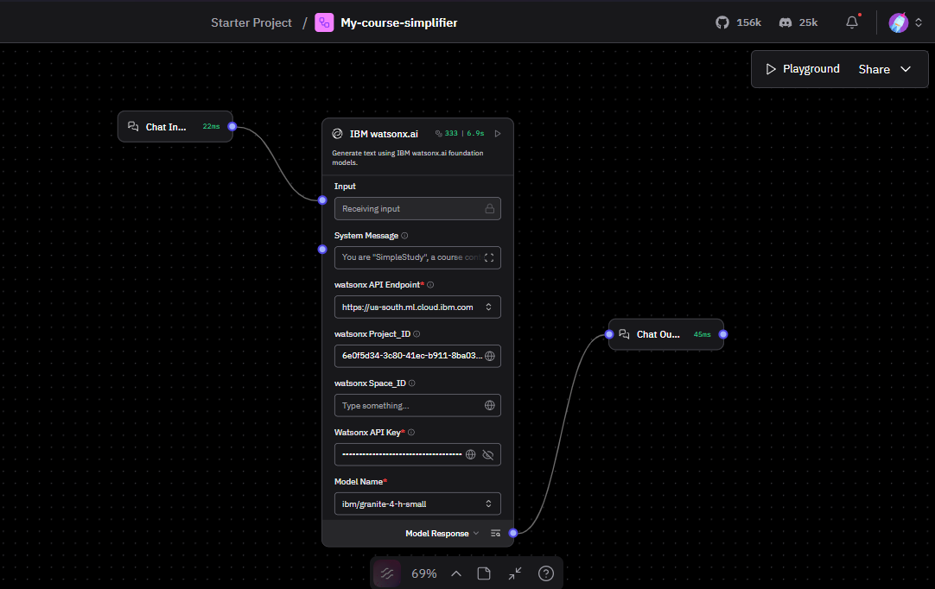
Langflow workflow -

Slide 8
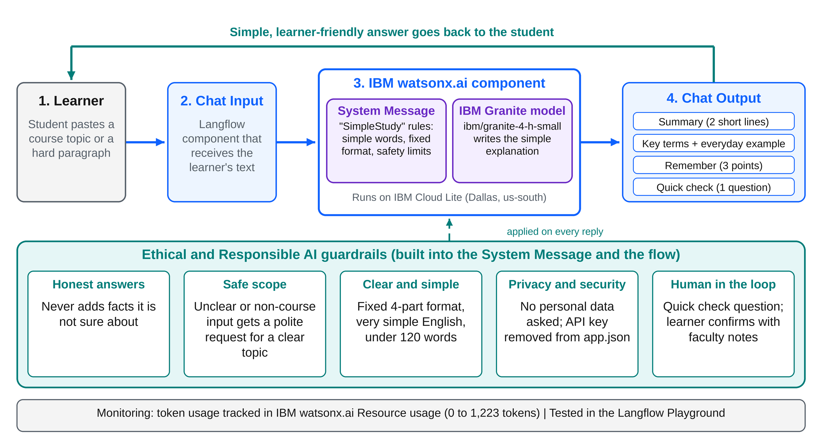
Architecture blueprint (with Ethical AI)

Slide 9
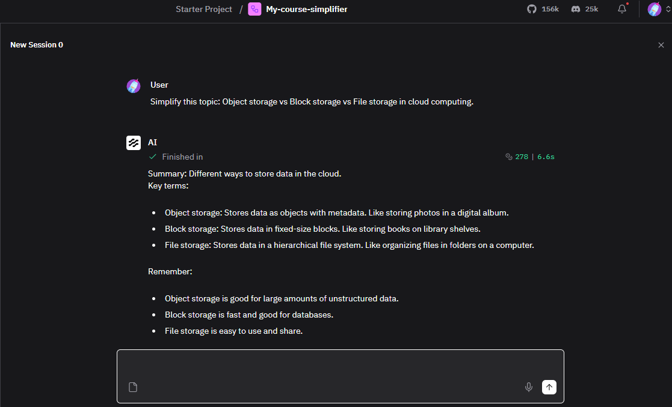
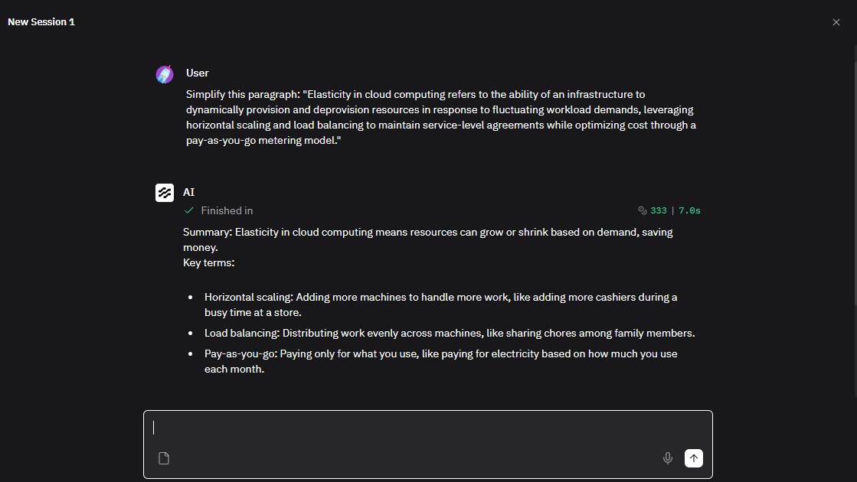
Demo – Langflow Playground
Prompt 1 – topic: Object vs Block vs File storage. Reply: 278 tokens, 6.6 s.
Prompt 2 – jargon paragraph: Elasticity in cloud computing. Reply: 333 tokens, 7.0 s.
What the demo shows: hard cloud terms become a short Summary, Key terms with everyday examples (photo album, library shelves, cashiers, family chores, electricity bill) and Remember points, in about 7 seconds.

Slide 10

Role of Agentic AI in the solution
Role of Agentic AI in SimpleStudy
Agentic AI lets SimpleStudy act as a goal-driven assistant, not a plain search tool. Its goal is simple: make hard course content easy to understand.
Using IBM watsonx.ai and the IBM Granite model, the agent reads the learner's input and decides by itself: is this a clear course topic? If yes, simplify it. If not, ask for a clearer topic.
It then plans the reply in a fixed structure (Summary, Key terms, Remember, Quick check) and follows its safety rules: no unsure facts and under 120 words.
The Quick check question keeps the learner active. Next, more agents (level detector, quiz checker) can make it a full multi-agent tutor.

Slide 11
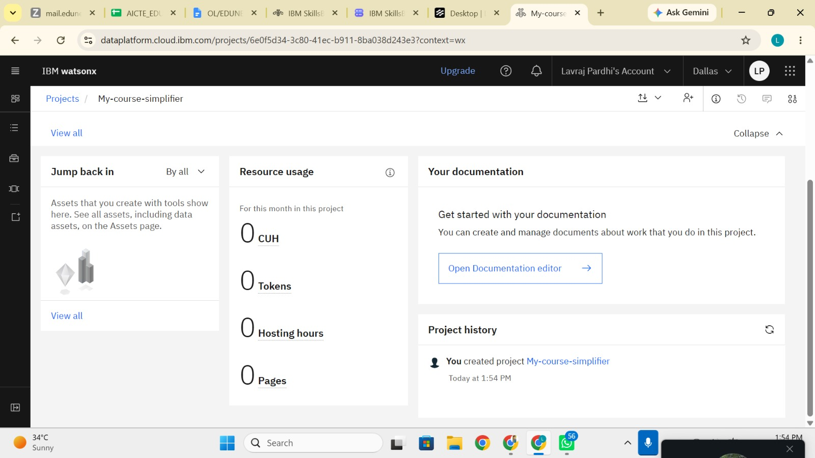
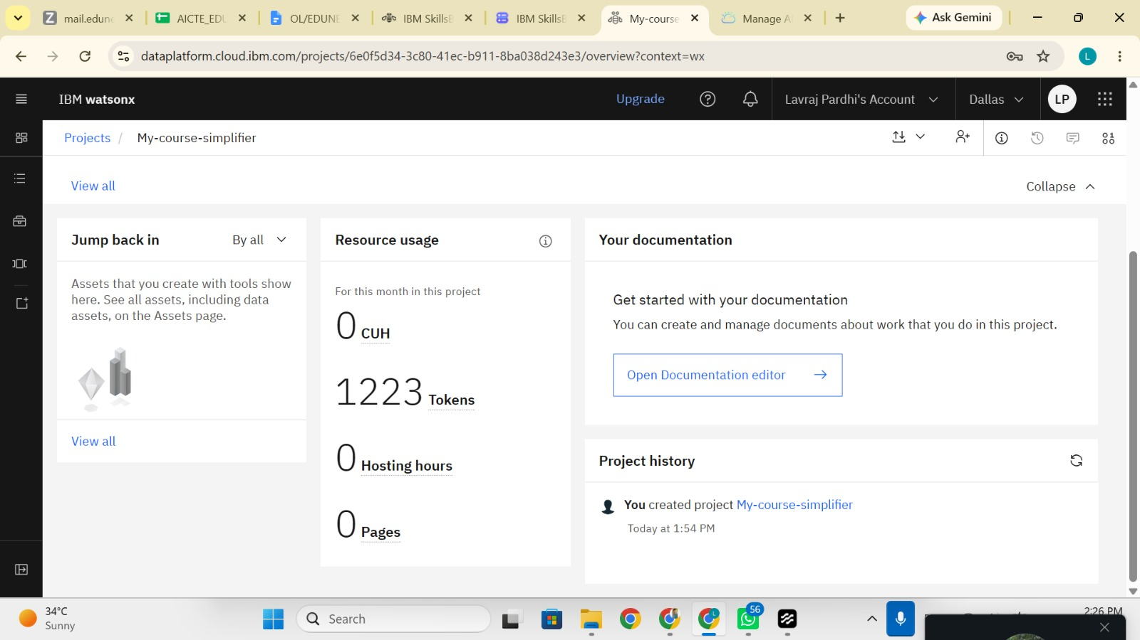
Token Usage
1,223 tokens used in total: 0 before the prompts, 1,223 after testing the flow
Before Prompt
After the Prompt
Source: IBM watsonx.ai → project My-course-simplifier → Resource usage (this month, this project).

Slide 12
Novelty and Uniqueness
SimpleStudy stands out because it is simple, safe and focused on the learner, not a general chatbot.
Learner-first format – Every answer has Summary, Key terms, Remember and a Quick check question.
Everyday examples – Each hard term comes with a real-life example, such as cashiers for horizontal scaling.
Made for Indian students – Very simple English for Cloud Computing learners.
Responsible AI by design – No unsure facts, polite refusal for unclear input, short replies under 120 words.
Light and efficient – Only 3 components, a small Granite model, about 7 seconds per reply and 1,223 tokens in total testing.
Easy to reuse – Change the System Message to adapt it to any subject; share the flow as app.json.
This makes SimpleStudy a simple, safe and low-cost study helper for every beginner.

Slide 13
Git Hub Link
GitHub Repository:
https://github.com/Lavrajpardhi/My-course-simplifier
Files uploaded in the repository:
1) README.md (project guide)
2) app.json (Langflow flow, API key removed)
3) My-Problem-Statement.pdf
4) Project presentation (PPT)
5) Screenshots (workflow, demo, token usage)

Slide 14
Future Scope
1. Learner level selection (Beginner / Intermediate / Expert) –
The student picks a level and the agent reframes the same topic for it. This completes the full vision of the problem statement.
2. Notes and PDF upload with RAG –
Read faculty notes or textbooks from a file and simplify them, using the real material for better accuracy.
3. Hindi and Marathi support –
Explain topics in regional languages for more inclusive learning.
4. Quiz and progress tracking –
A quiz agent can check the Quick check answers and track the learner's progress.

Slide 15
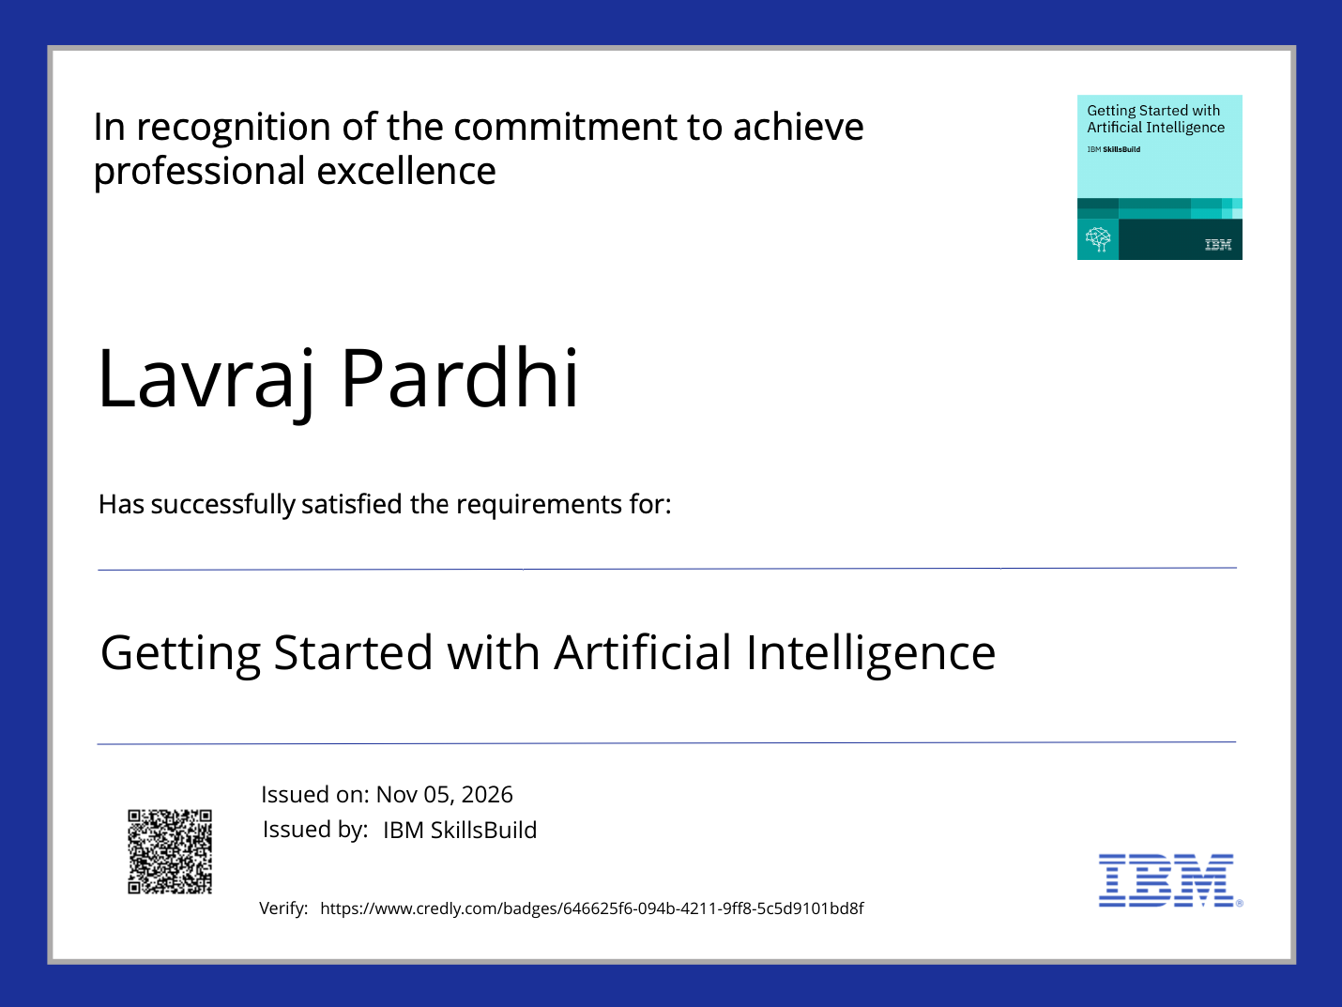
Certificates Earned:
Credly – Getting Started with Artificial Intelligence (IBM SkillsBuild)

Slide 16
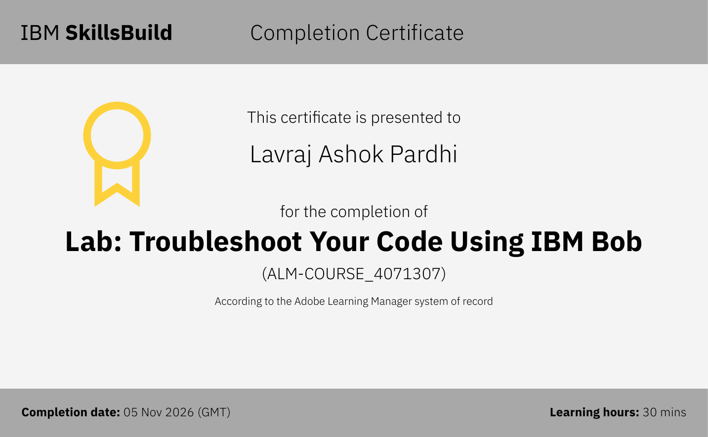
Certificates Earned:​
IBM Bob – Lab: Troubleshoot Your Code Using IBM Bob

Slide 17


