Slide 1
IRS.gov
Evaluation by:
Hong Qiao, Kristin Day, Jordan Reifsteck, Elsie Smith, and Vaishali Sainaath

Slide 2
Goals
Primary
Can a user complete their US taxes using the IRS.gov website
Secondary
Can they find all of the information they need?
Can they find all of the forms they need?
Can they find these things efficiently?
Do they trust that they have everything they need and that the information is the correct information?
How frustrating was the experience?

Slide 3
Motivation
Tax preparation is stressful and complicated.
The Internal Revenue Service (IRS) of the United States has provided a website of resources for taxpayers to assist with tax planning and preparation.
Although this resource is full of information, forms, instructions and other resources, this information is not always easy to find.
Every person who earns income within the geological borders of the US is required to file a tax return¹ reporting that income and paying any necessary taxes associated with it.
If there are errors on the tax return and more tax is owed, the taxpayer will be charged penalties and fees despite the honest mistake. In some cases, there may even be criminal charges.
Because of the inherent stress of tax preparation, the website providing resources and information for taxpayers should be simple to use.

Slide 4
Nielson’s Heuristic (5 of 10)
Visibility of system status The system should always keep users informed about what is going on, through appropriate feedback within reasonable time.
Match between system and the real world The system should speak the users' language, with words, phrases and concepts familiar to the user, rather than system-oriented terms. Follow real-world conventions, making information appear in a natural and logical order.
Consistency and standards Users should not have to wonder whether different words, situations, or actions mean the same thing. Follow platform conventions.
Recognition rather than recall Minimize the user's memory load by making objects, actions, and options visible. The user should not have to remember information from one part of the dialogue to another. Instructions for use of the system should be visible or easily retrievable whenever appropriate.
Aesthetic and minimalist design Dialogues should not contain information which is irrelevant or rarely needed. Every extra unit of information in a dialogue competes with the relevant units of information and diminishes their relative visibility.

Slide 5
Our Heuristics
1. Is the information clearly marked as current or relevant?
2. How long does it take to download necessary documents or forms?
3. Is the navigation easily understood? Is returning to the homepage straight forward from any page?
4. Is the “information” easy to find and search? How difficult is it to find the instructions for preparation relevant to you? How easy are the steps to follow?
5. Do you trust the information obtained from the website, and are you comfortable that you were able to find the correct information?

Slide 6
Evaluations
3 experts and 3 users
Two expert evaluators were law students who are experienced tax preparers and utilize the information from IRS.gov regularly. Both volunteer for tax programs sponsored by the IRS (Low Income Taxpayer Clinic and Volunteer Income Tax Assistance).
The third expert is an employee of the IRS who regularly handles inquiries from taxpayers related to the IRS.gov website.
There are three different types of users for the usability testing:
A user with no tax experience whatsoever who wants to try to prepare taxes for the first time.
A user with some tax experience, but who has never used IRS.gov
A user who is not a native English speaker who is new to preparing taxes in the United States

Slide 7
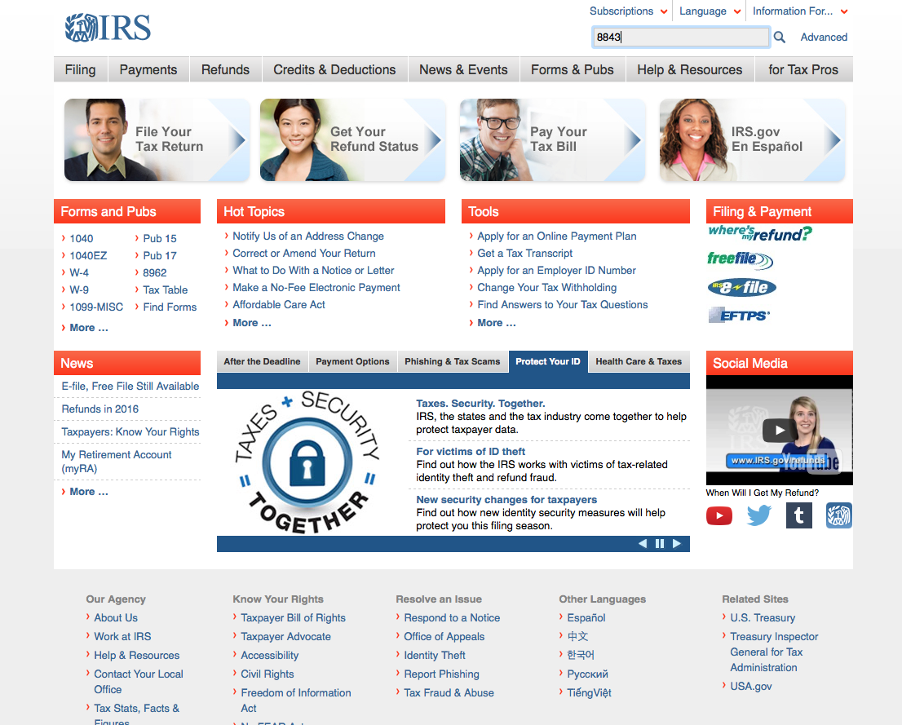
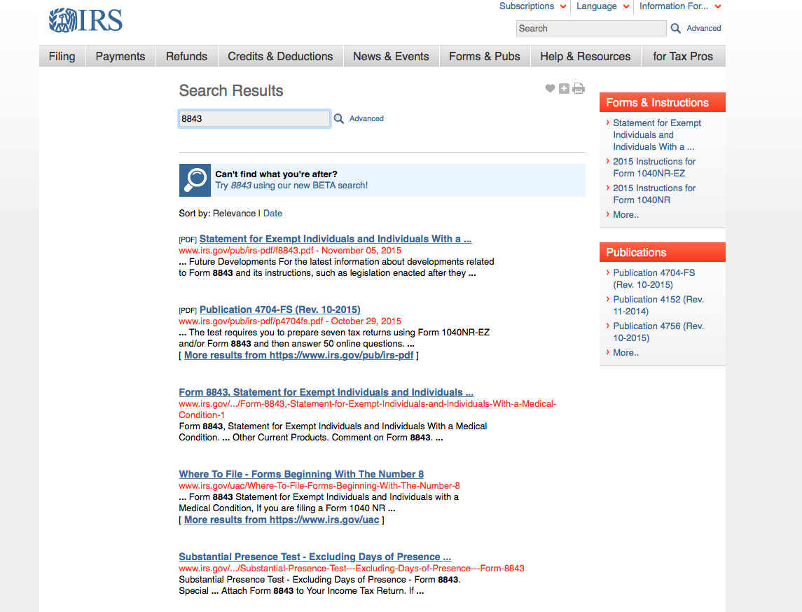
IRS.gov - initial findings (inconsistency)

Slide 8
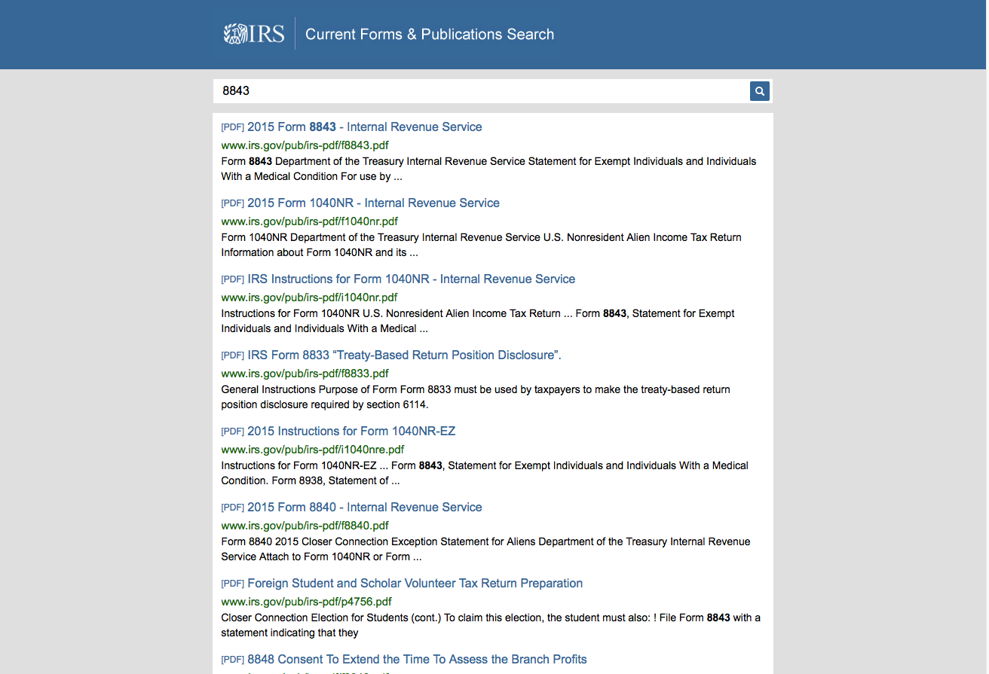
Inconsistency – continued Navigation disappears after search

Slide 9
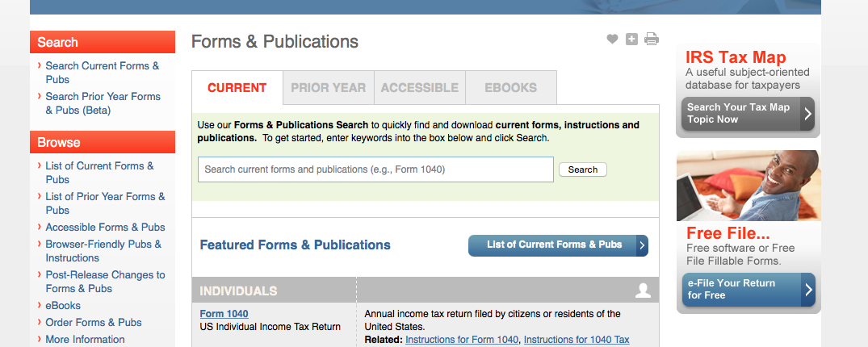
Current v. Past Year Information

Slide 10
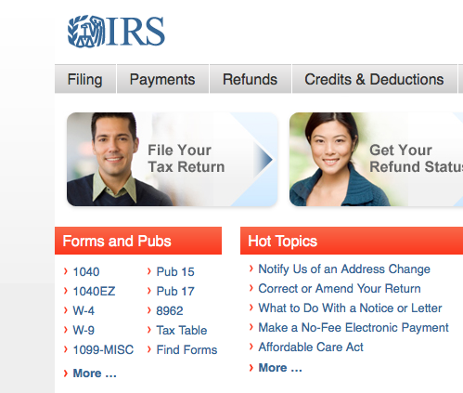
Current v. Past – cont’d

Slide 11
Conclusion
It is stressful enough to prepare taxes. The resource website should provide clear guidance and it should be easy to navigate. There are many improvements that could make the website easier to navigate and that would allow better access to relevant information to the user.

