Slide 1
Automatic classification of legal texts
Authors:
Hao Peng
Kristin Day
Sanjana Pukalay

Slide 2
Motivation
Develop inexpensive platforms for legal text search that are available to the public.
Why does it matter:
We are all held responsible for the law but we do not have access to it.

Slide 3
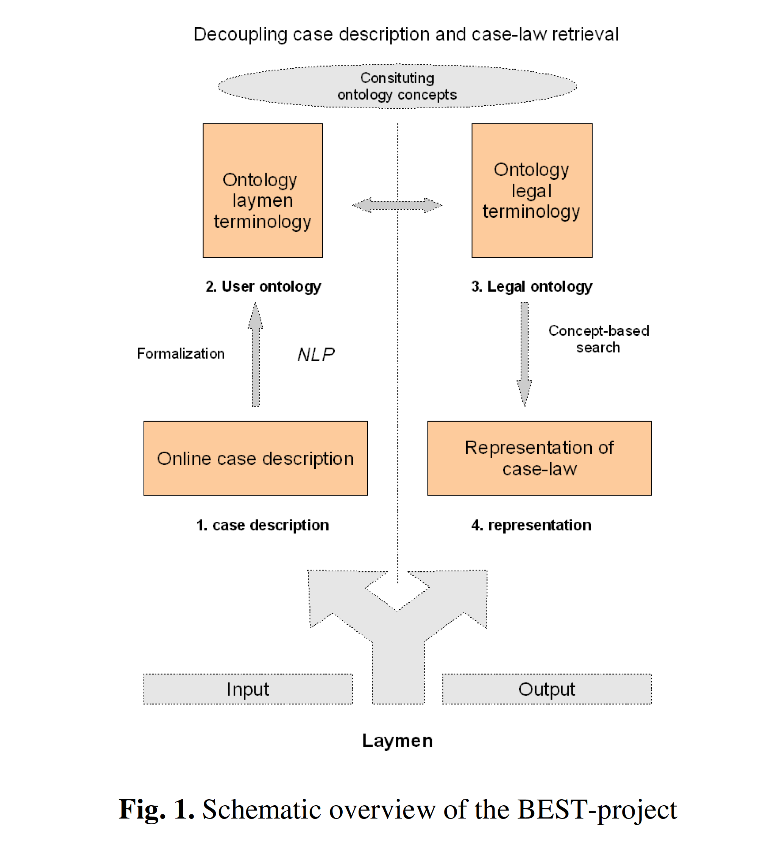
goals

Slide 4
Existing methods
Currently all legal search databases controlled by private corporations who only contract for services business-to-business.
These corporations charge excessive fees based on labor intensive manual mark-up of each judicial opinion.

Slide 5
Prior research
[DISCUSS LIT REVIEW HERE]

Slide 6
data
“Judicial opinions” from Indiana and California
250 hand labels in Excel spreadsheet
207 | Government | Substantive | Contract | EX | dispute related to a definitional issue in a government contract
208 | Family | Substantive | ChildSupport | DR | dispute of costs and income used to calculate child support
209 | Criminal | Substantive | ResistingLawEnforcement | CR | conduct sufficient to support conviction of resisting law enforcement
210 | Government | Procedure | SovereignImmunity | CT | disputes grant of summary judgment based on immunity in child abuse report mishandling civil case
211 | Estates | Substantive | RevocableTrust | TR | who does the trustee of a revocable trust serve
212 | Criminal | Evidence | Statements, SuppressEvidence | CR | dispute of evidence resulting from search and inculpatory statements made to police
213 | Civil | Procedure | Service-Notice | CT | whether or not service was made

Slide 7
Methods
Semi-Supervised Learning
As we only labeled 250 out of (1087+1655) case files
Compared accuracy of the following model using Label Propagation semi-supervised learning algorithm in SK-learn:
Bag of Words
Bag of Means on pre-trained Word2Vec model

Slide 8
Evaluation

Slide 9
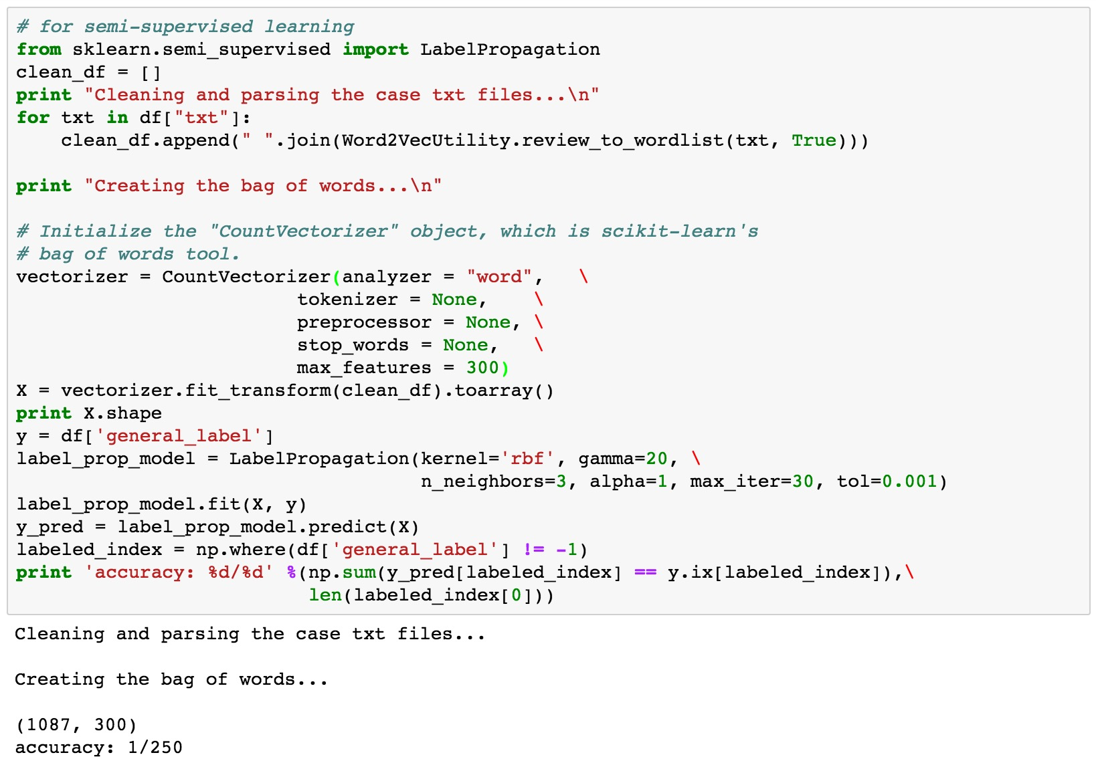
Accuracy of Bag of Word with Semi-supervised learning
* We set our vocabulary size to 300, thus each txt file is represented as a 300D vector, the same dimension as been used in the Word2Vec model.
*Out of all 250 case files that had been manually labeled by us, it only predicted one case file correctly !

Slide 10
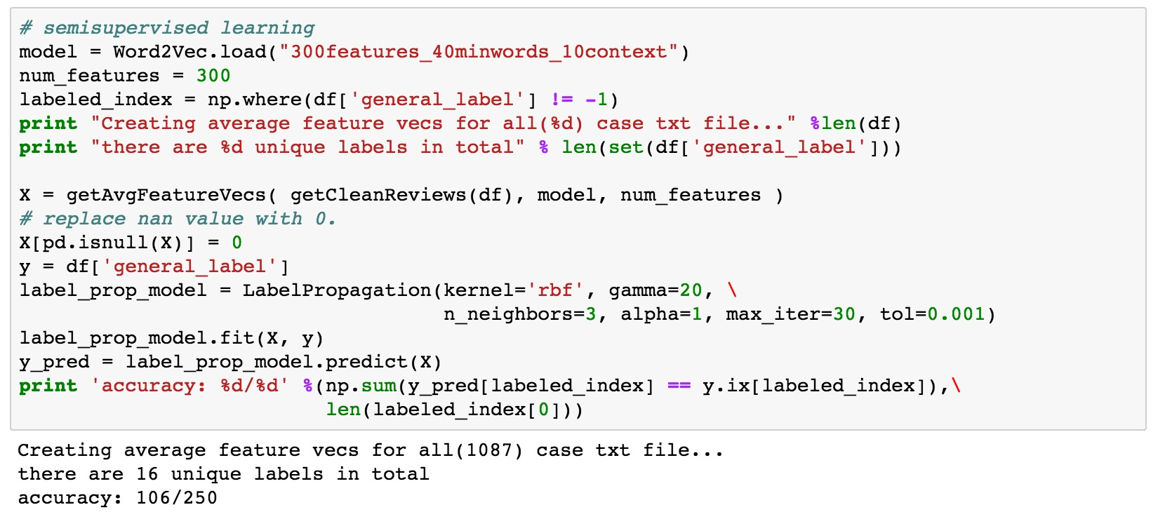
Accuracy of Bag of Means on Word2Vec with Semi-supervised learning
*It correctly classified 106/250 case files! Significantly better than Bag of Word model.

