Slide 1
Translation of layperson legal inquiries using word similarity measures
Authors:
Nithipat Tanmanatragul
Kristin Day
Jordan Reifsteck
Olga Scrivner

Slide 2
Motivation
Ultimate goal: Develop inexpensive platforms for legal text search that are available to the public.
Why does it matter:
We are all held responsible for the law but we do not have access to it.
one statute = one law
“the law” = all statutes + judicial opinions (also called “case law”)
Judicial opinions clarify the scope and meaning of statutes. They also fill in gaps (called “common law”).
Notes:
Westlaw uses 40 broad categorizations. They are hand crafted (called ”mark-up”) and the mark-up is regularly revised by hand as new opinions come in everyday from across the nation. One estimate stated that around 1000 new opinions are generated per state per day. Also, the average length of a judicial opinion is around 10 pages. (Thompson, 2001, p.70).

Slide 3
Existing methods
Currently all legal search databases controlled by private corporations who only contract for services business-to-business.
These corporations charge excessive fees based on labor intensive manual mark-up of each judicial opinion.
These searches require years of training to product accurate results.

Slide 4
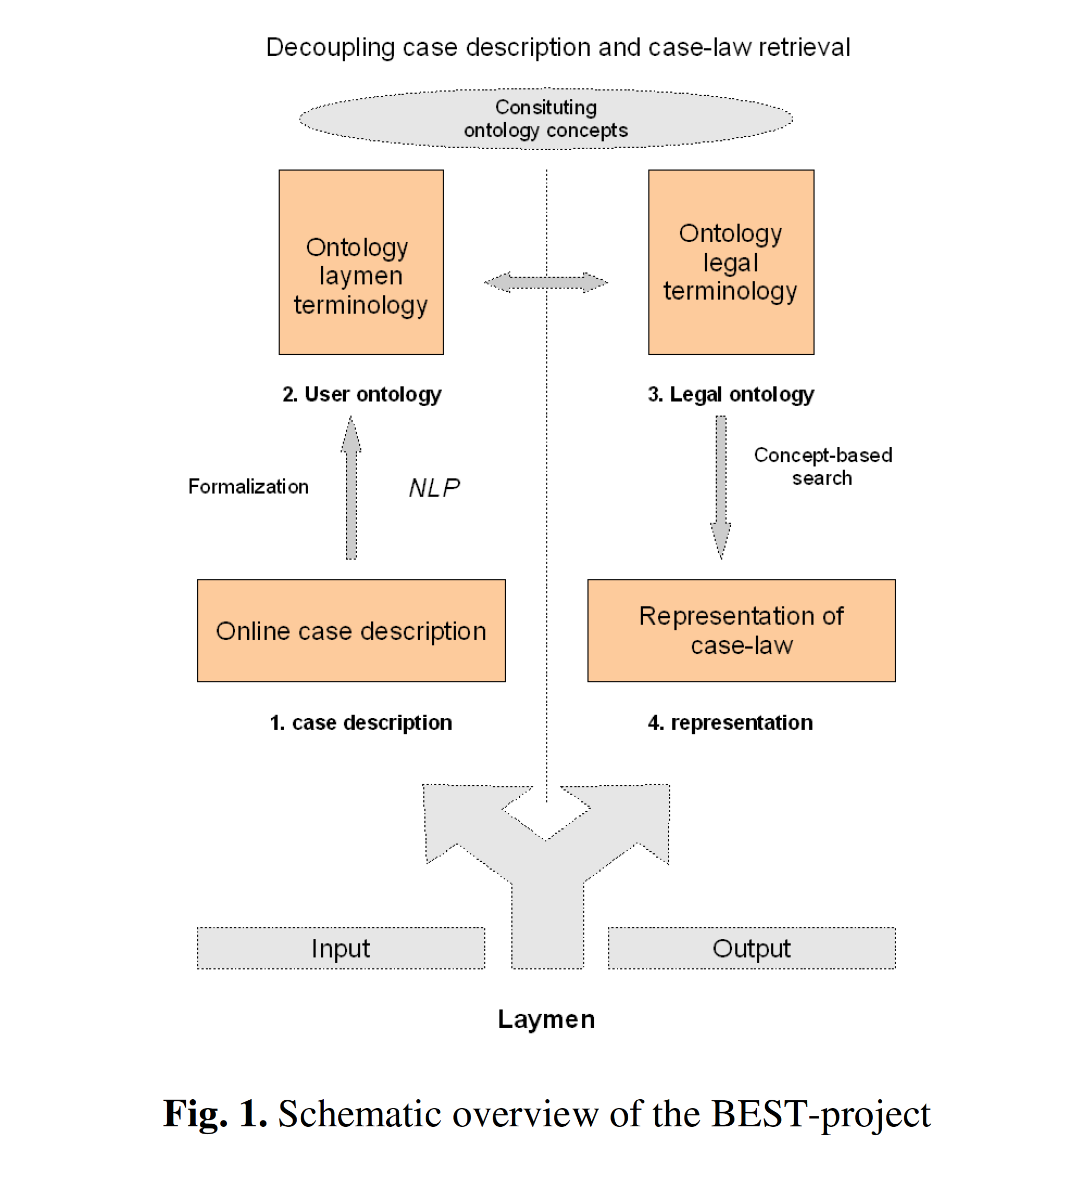
goals
Notes:
(Uijttenbroek, E.M., et al., 2016, p.292). The research in this article was used to attempt to give laypersons a better understanding of their liability based on the facts of their situation. This is often called “subrogation” and is a highly in-demand data analysis skill right now.

Slide 5
Prior research
Yi-Hung Liu, et al.
Predicting Associated Statutes for Legal Problems
Rudi & Vitanyi
Google Similarity Distance
Yong Jiang, et al.
A Semantic Similarity Measure Based on Information Distance…

Slide 6
data
“Judicial opinions” from Indiana and California
Indiana 1087 opinions (320,112 unique words) and California 1663 opinions (:
Downloaded from respective appellate court websites in pdf format
Converted to txt format using terminal commands (pdftotext)
Cleaned text using regular expressions in Python
The entire Indiana Code (all of the current laws of the State of Indiana)
36,000 pages of statutes
Over 6.8M words with 25,806 unique words
Unadulterated layperson legal questions from Justia.com’s attorney question forum for Indiana:
924 questions (as of 4/23/2016)
Contains 22,726 words with 3,447 unique words

Slide 7
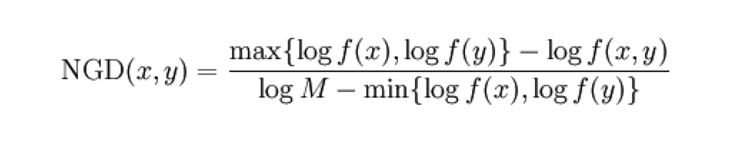
Methods
Find similarity distance of words using Normalized Google Distance (NGD)
In R (Work in Progress)
In Python (Work in Progress)

Slide 8
Conclusion
Future Work:
May try to clean the libraries from the various sources with POS tagging.
Although some code for the NGD method can be found online, the code available does not compile as written.
The code found online is not annotated clearly and it is difficult to follow.
If we cannot get any NGD code to work in R or Python, we will train Word2Vec models on the corpus of the legal documents/layperson questions to try to find word similarities.

Slide 9
Citations
Thompson, P. "Automatic Categorization Of Case Law." Proceedings Of The International Conference On Artificial Intelligence And Law Proceedings of the 8th International Conference on Artificial Intelligence and Law, ICAIL '01 (2001): 70-77. Scopus®. Web. 23 Apr. 2016.
Uijttenbroek, E.M., et al. Retrieval Of Case Law To Provide Layman With Information About Liability: Preliminary Results Of The BEST-Project. n.p.: 2007. Scopus®. Web. 23 Apr. 2016.
West Publishing Company. West's Analysis of American Law. West Publishing Company, St. Paul MN, 1994.
West Publishing Company. West's Law Finder: A Legal Resources Guide. West Publishing Company, St. Paul, MN, 1995.

