Slide 1
Progress Guard：Team project management platform
MileStone3：Prototype Walkthrough
Given By Yang Keyun, Zhang Xinbei, Chen Yilai, Sun Yufei

Slide 2
01
System Implementation
02
CONTENTS
System Contribution
03
Implementation of AI
04
Challenge and Solution
05
System video demo

Slide 3
System Implementation
/01

Slide 4
System Contribution
/02

Slide 5
Scalability and Elasticity
/03

Slide 6


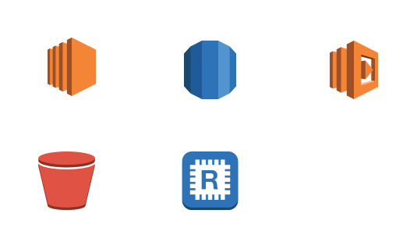
AWS Components
Elastic Load Balancer
Auto Scaling Group（EC2）
AWS SQS
AWS Lambda Function
Distribute incoming traffic across multiple resources, to ensure high availability and optimal performance.
...
Automatically expand and shrink EC2 instances depend on the workloads.
...
Automatically scales
Asynchronous
Decouple & Modularity
...
Auto scale based on incoming request volume and handle increased workloads.
Serverless Architecture
Event driven
...

Slide 7
AWS Components
AWS RDS
AWS Elastic Cache
for Redis Cluster
AWS S3 Bucket
RDS allows to scale database instances, including instance categories and storage capacity.
...
Use pub/sub mode of Redis, a memory-based cache database to make real-time chat faster.
Automatic adjust the nodes.
Data Replication.
...
Storage capacity can be automatically increased or decreased according to demand.
...

Slide 8
Project Contribution
/04

Slide 9
Project Contribution
Chen Yilai
Zhang Xinbei
Front-end of the project.
Front-end integretion with backend.
AWS Cognito deployment.
Backend for login/registration part.
Yang Keyun
Sun Yufei
Front-end integretion with backend.
Backend for task management.
Backend for team chat room.
Part of backend for task manage.
AI assistant.

Slide 10
System video demo
/05

Slide 11
Thanks

