Slide 1



Slug Hub July 2, 2019
Slug Hub
PO: Lawrence Tam
Team member names
Lawrence Tam
Naum Markenzon
Mason Nguyen
Xuhua Feng
Zhelin Li

Slide 2
Slug Hub
PROBLEM
From the tools available to them, students find information and resources available to them to be either obscure or annoying to navigate around
Build a mobile app that acts as a hub for student affairs and raises awareness of resources that UC Santa Cruz provides. From giving instant access to myUCSC and Canvas, to providing forms to sign up for LSS, to providing info on which labs are looking for research assistants, this app will make UCSC resources much more accessible to students
SOLUTION

Slide 3
Sprint 1
[ Sprint 1
As a student, I want easier access to academic information
So that I can graduate smoothly
Classes offered each quarter
Info on Curriculum chart/ classes needed to graduate
Advising info
Instant access to myUCSC and Canvas
Spikes
Learn React and web scraping techniques
store login information in database (privacy issue)
making the app scalable for future additions
Infrastructure tasks
Set up Github repository
Set up React native environment, everyone download Expo
]

Slide 4
Sprint 2
[ Sprint 2
As a student, I want to be engaged with my education
so I can make the most of my time here
Create Study groups (*)
LSS/MSI/small group tutoring
Booking rooms in library (Mchenry & SNE)
networking, social life, and entertainment
Academic calendar w/ deadlines (notifications)
Spikes
Setting up study group form (reuse GrepThink )
Infrastructure tasks
Build a new path for the application
Integrating logic for website navigation from app to browser and vice versa
UI/UX for all these features
]

Slide 5
Sprint 3
[ Sprint 3
As a student, I want a job
So I can get money and experience
Job fairs
Workshops
Handshake
Research opportunities
Spikes
Researching how to know when workshops/job fairs are available (inside info)
Figure out a way to access information on research opportunities
Infrastructure tasks
open Handshake website
]

Slide 6
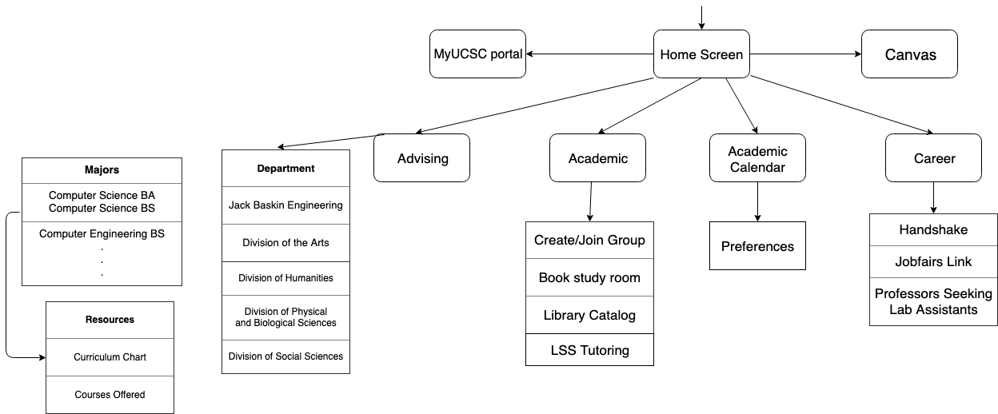
Architecture

Slide 7
Challenges/Risks
[Challenge 1] Getting familiar with coding in react native
[Challenge 2] Creating the overall structure of our hub
[Challenge 3] Pulling data from existing websites
[Challenge 4] Getting information from job fairs and handshakes

Slide 8
Technologies
[Technology 1] React Native
[Technology 2] Javascript
[Technology 3] Webscraping
[Technology 4] Google Calendar API
[Technology 5] Grepthink

Slide 9
Minimum Viable Product
[
Functional home page
Links to portal and Canvas
Links to Career, Advising and Academic sections
Advising Section
Links to departments, majors, and resources
Academic Section
Links to study rooms, library catalog, LSS tutoring, and Grepthink
Career Section
Links to Handshake, Jobfairs, and Research Opportunities with Professors
]

